Slide 1
FEWS NET Enhanced Flood Monitoring and Forecast
FEWS NET Science Team
March 23, 2026
Notes:
Default title slide

Slide 2

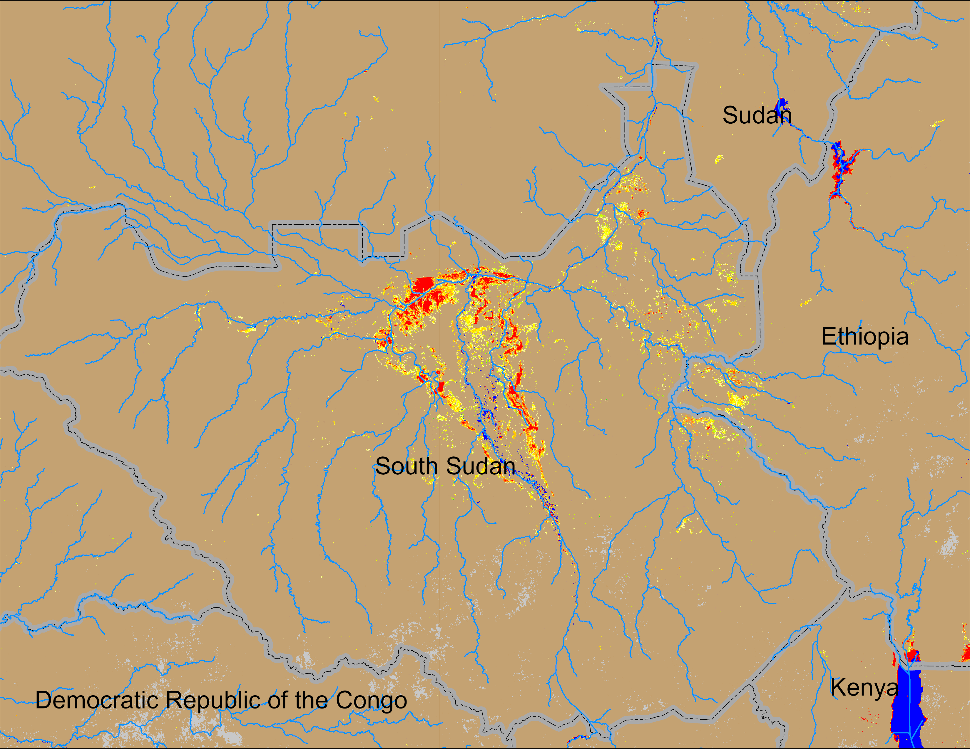
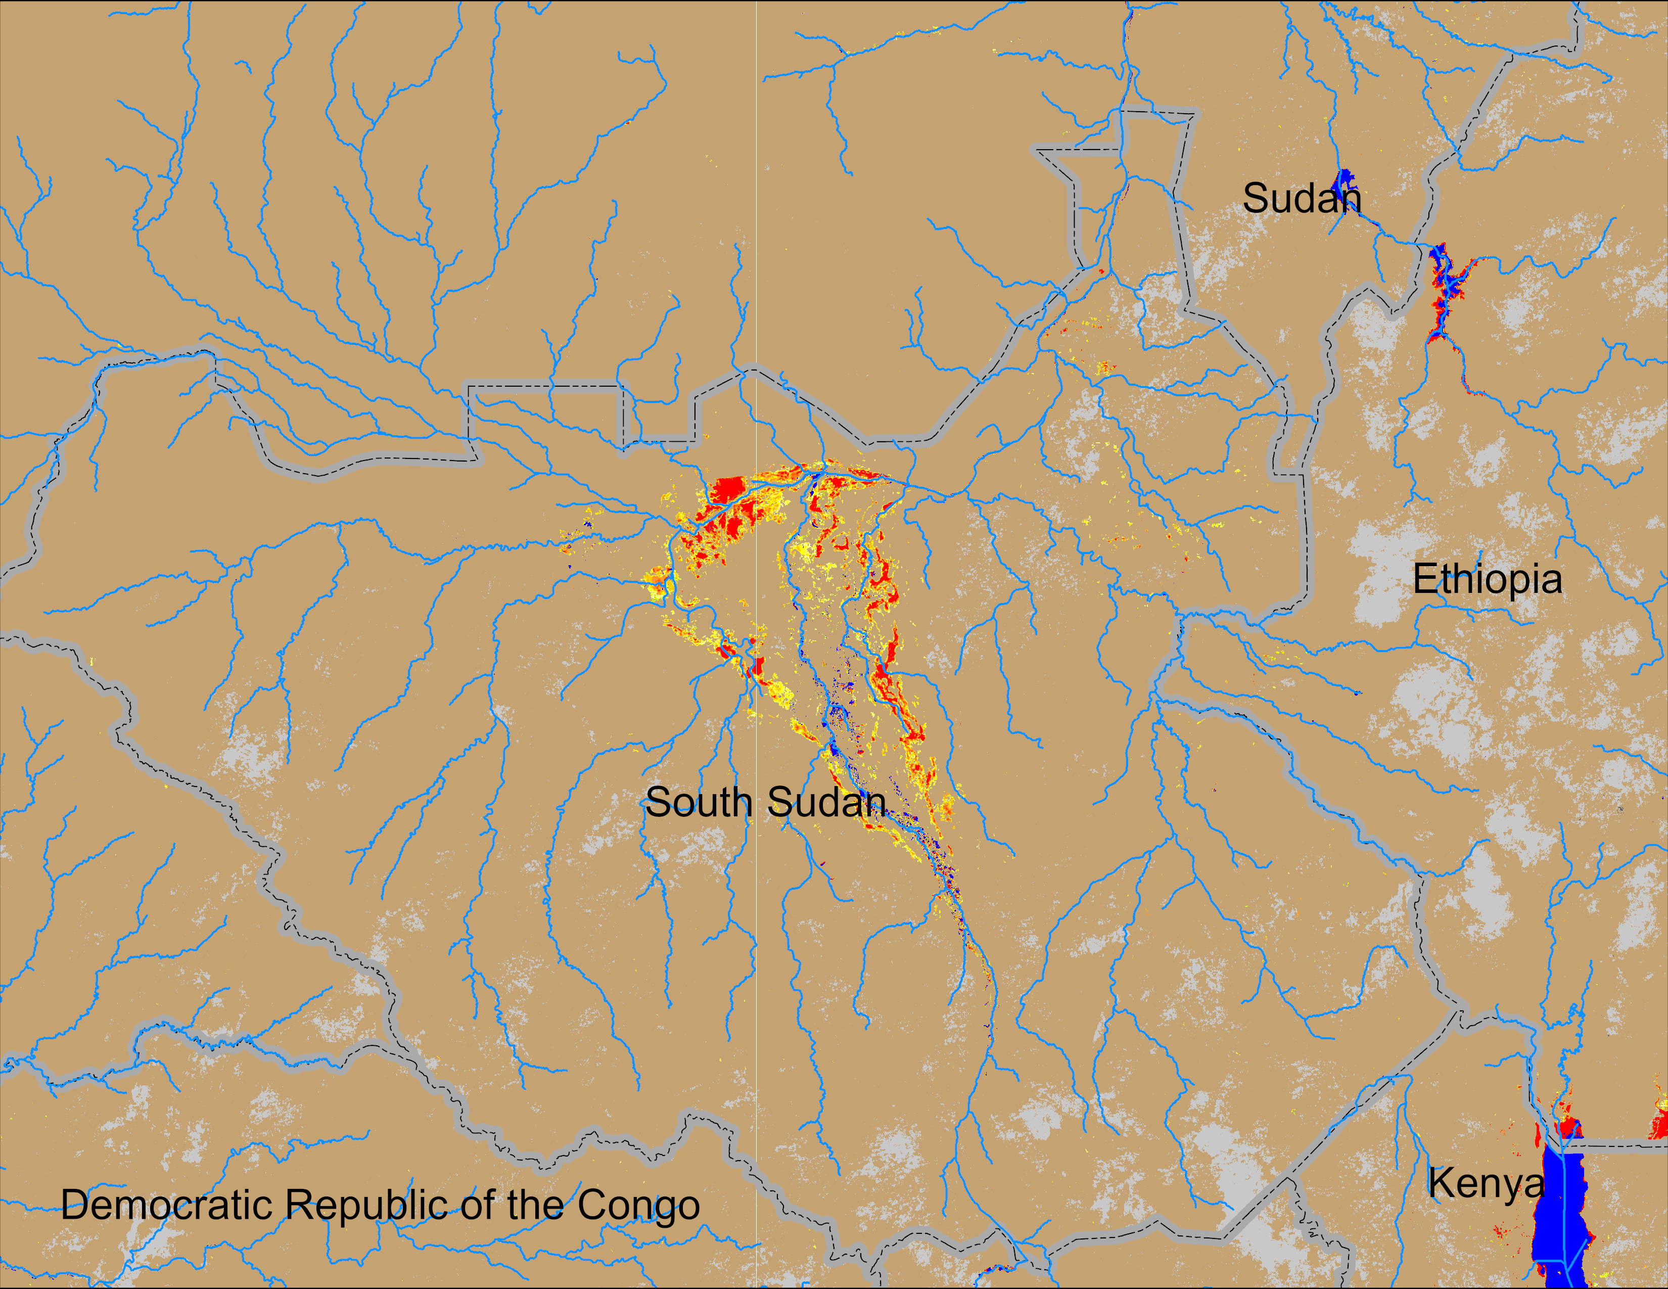
Flooding Conditions in South Sudan
NOAA VIIRS derived map: 12 – 16 Mar 2026
NOAA VIIRS 5-day comp.: 18 – 22 Mar 2026
More areas in the Sudd wetlands, as well as inundation in the eastern South Sudan have been dried out during the last week.

Slide 3
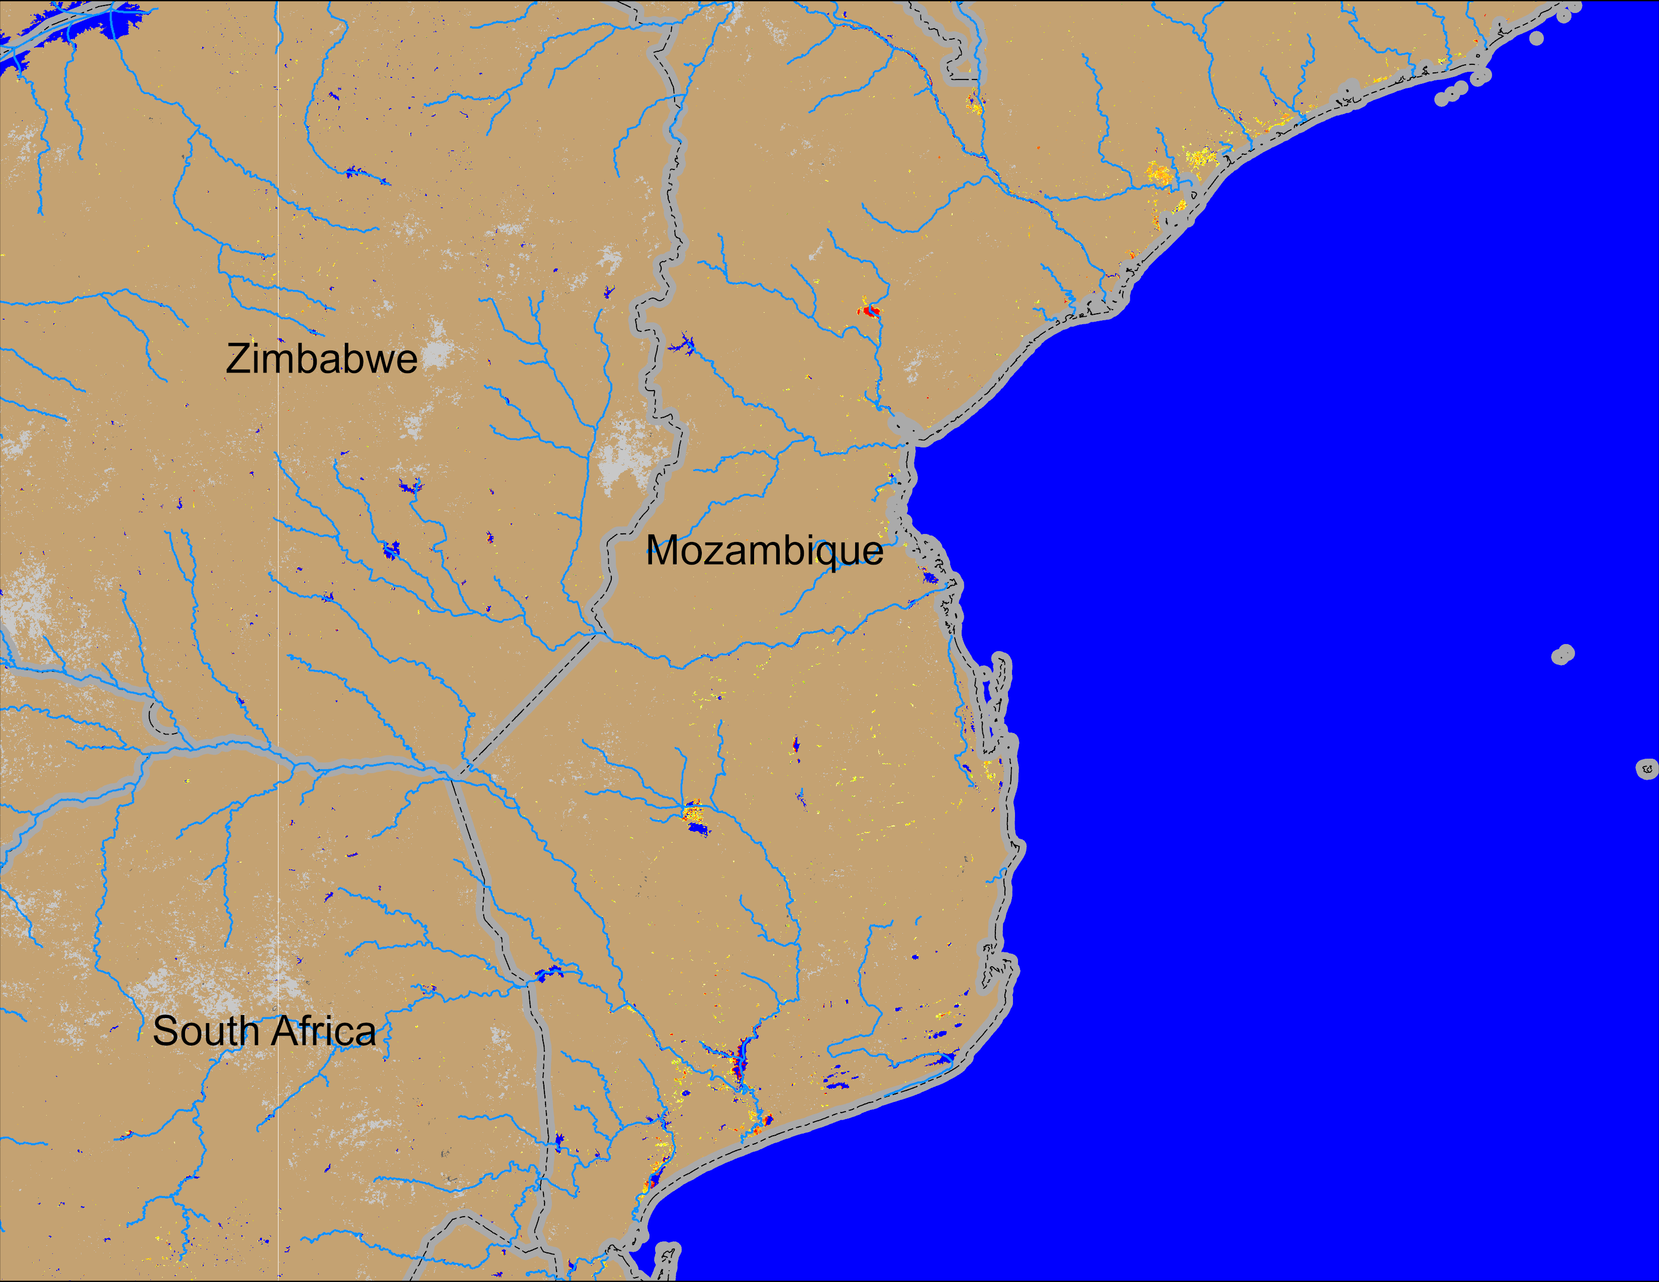
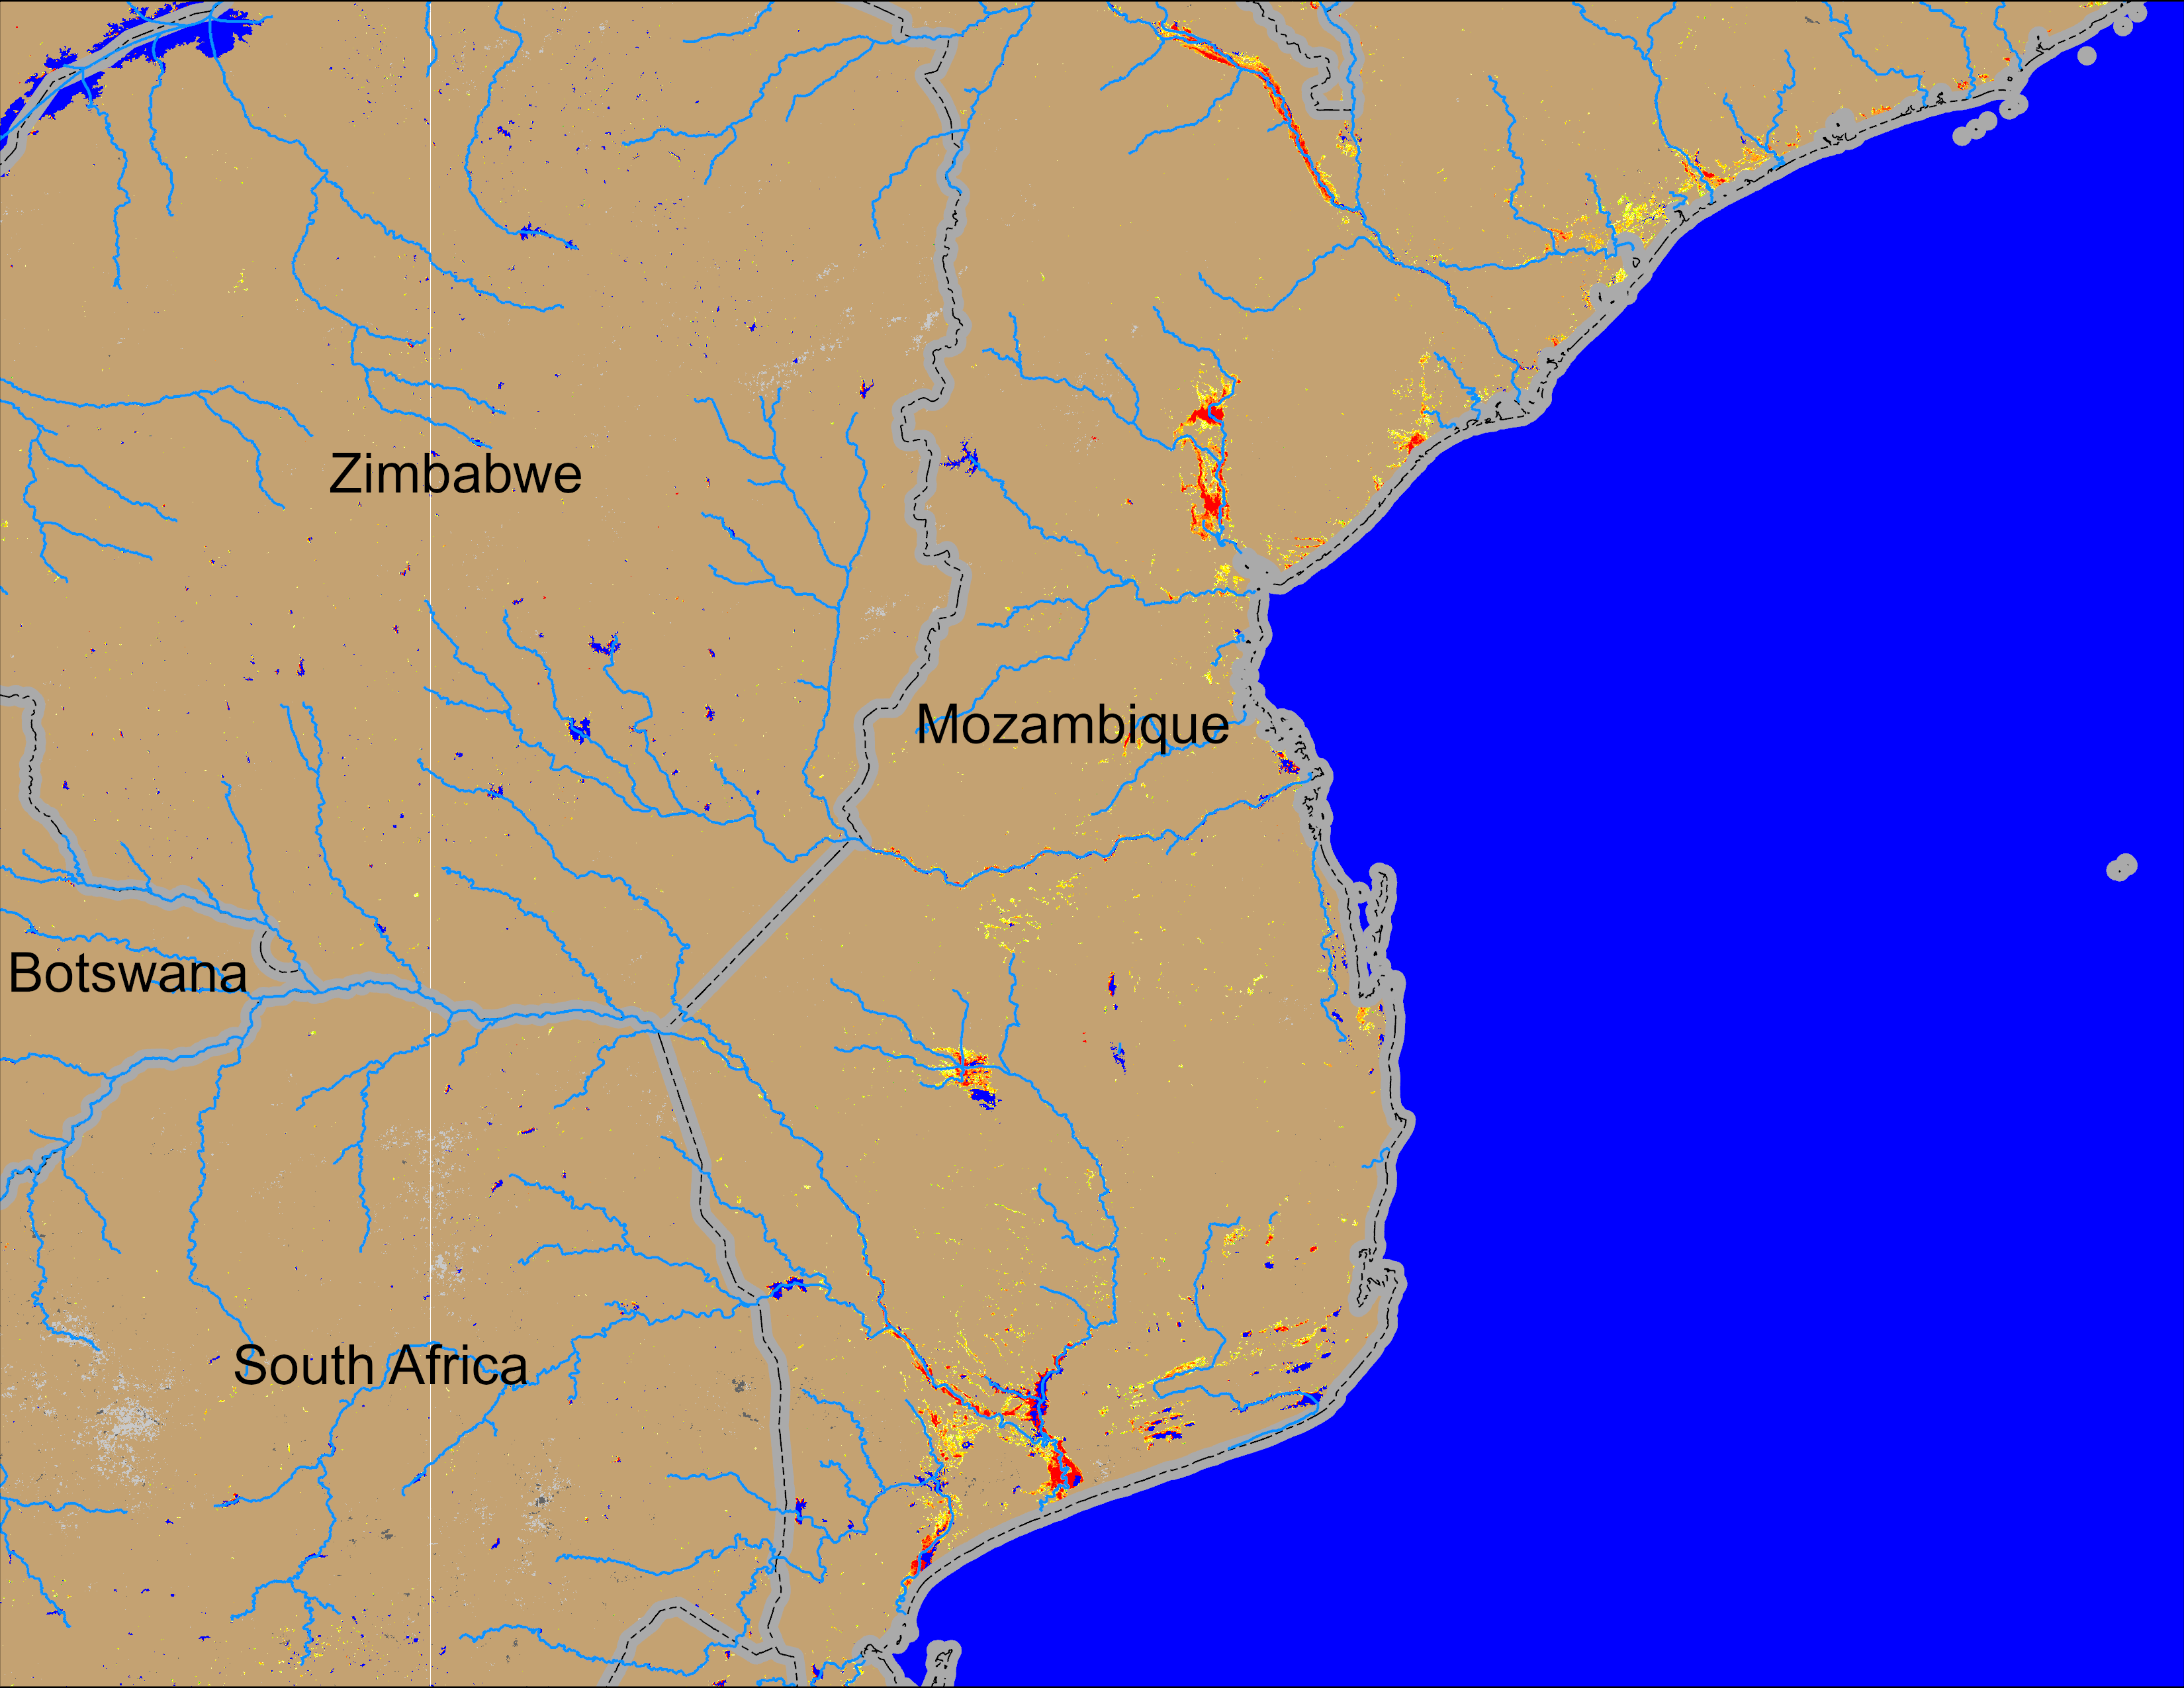
Flooding Conditions in Mozambique
NOAA VIIRS derived map: 04 – 08 Mar 2026
NOAA VIIRS 5-day comp.: 18 – 22 Mar 2026
New flooding occurred in the previously flooded regions of central and southern Mozambique.

Slide 4
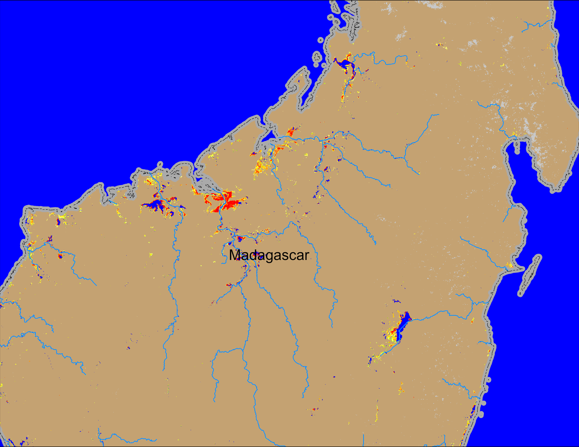

Flooding Conditions in Madagascar
NOAA VIIRS derived map: 12 – 16 Mar 2026
NOAA VIIRS 5-day comp.: 18 – 22 Mar 2026
Flooding conditions remained unchnaged in northern Madagascar.

Slide 5
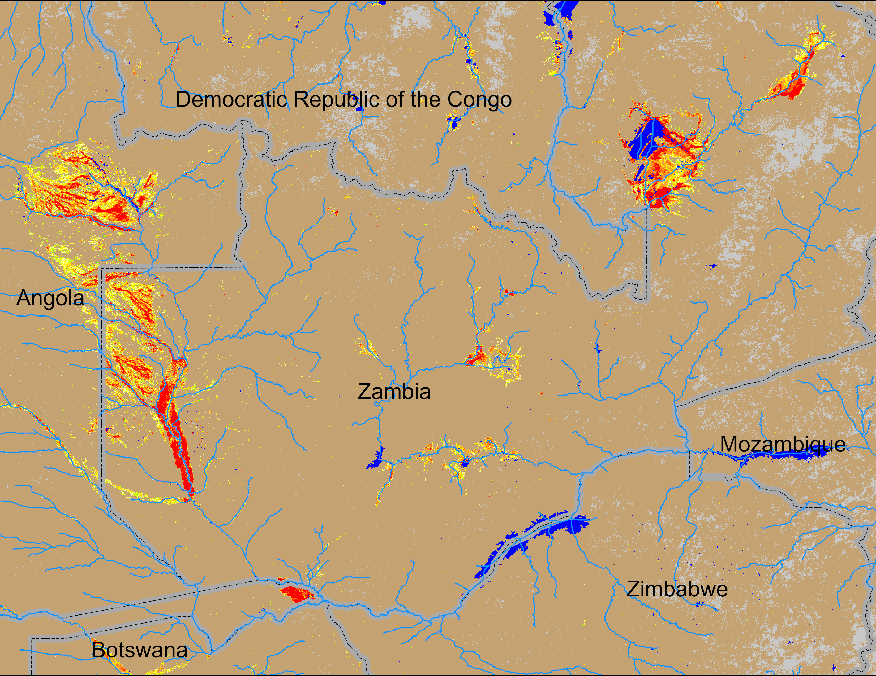
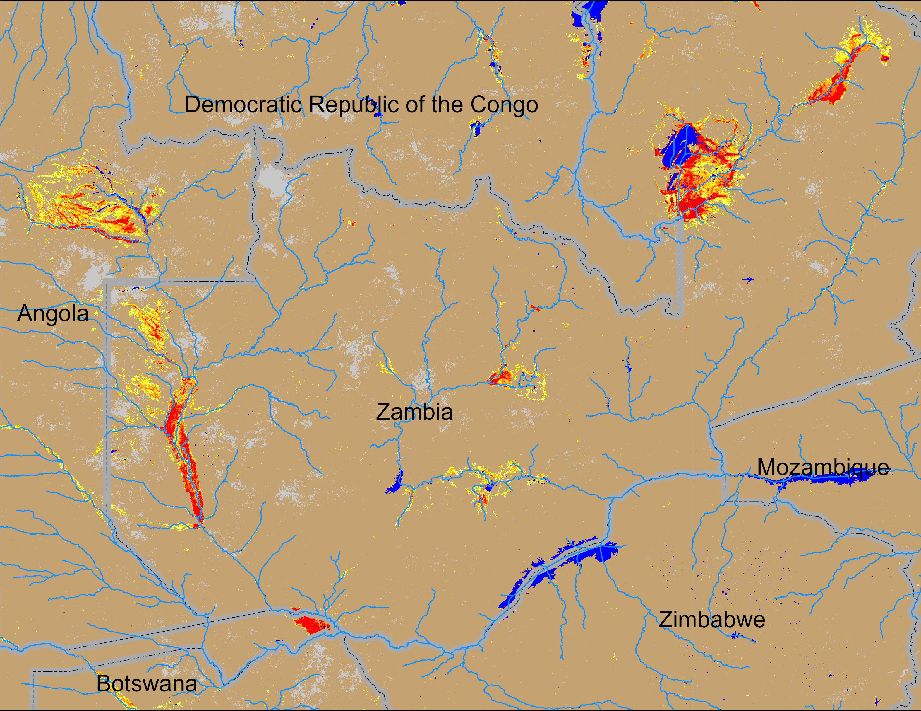
Flooding Conditions in Zambia
NOAA VIIRS derived map: 12 – 16 Mar 2026
NOAA VIIRS 5-day comp.: 18 – 22 Mar 2026
Intensifyed flooding remained unchanged across Zambia.

Slide 6
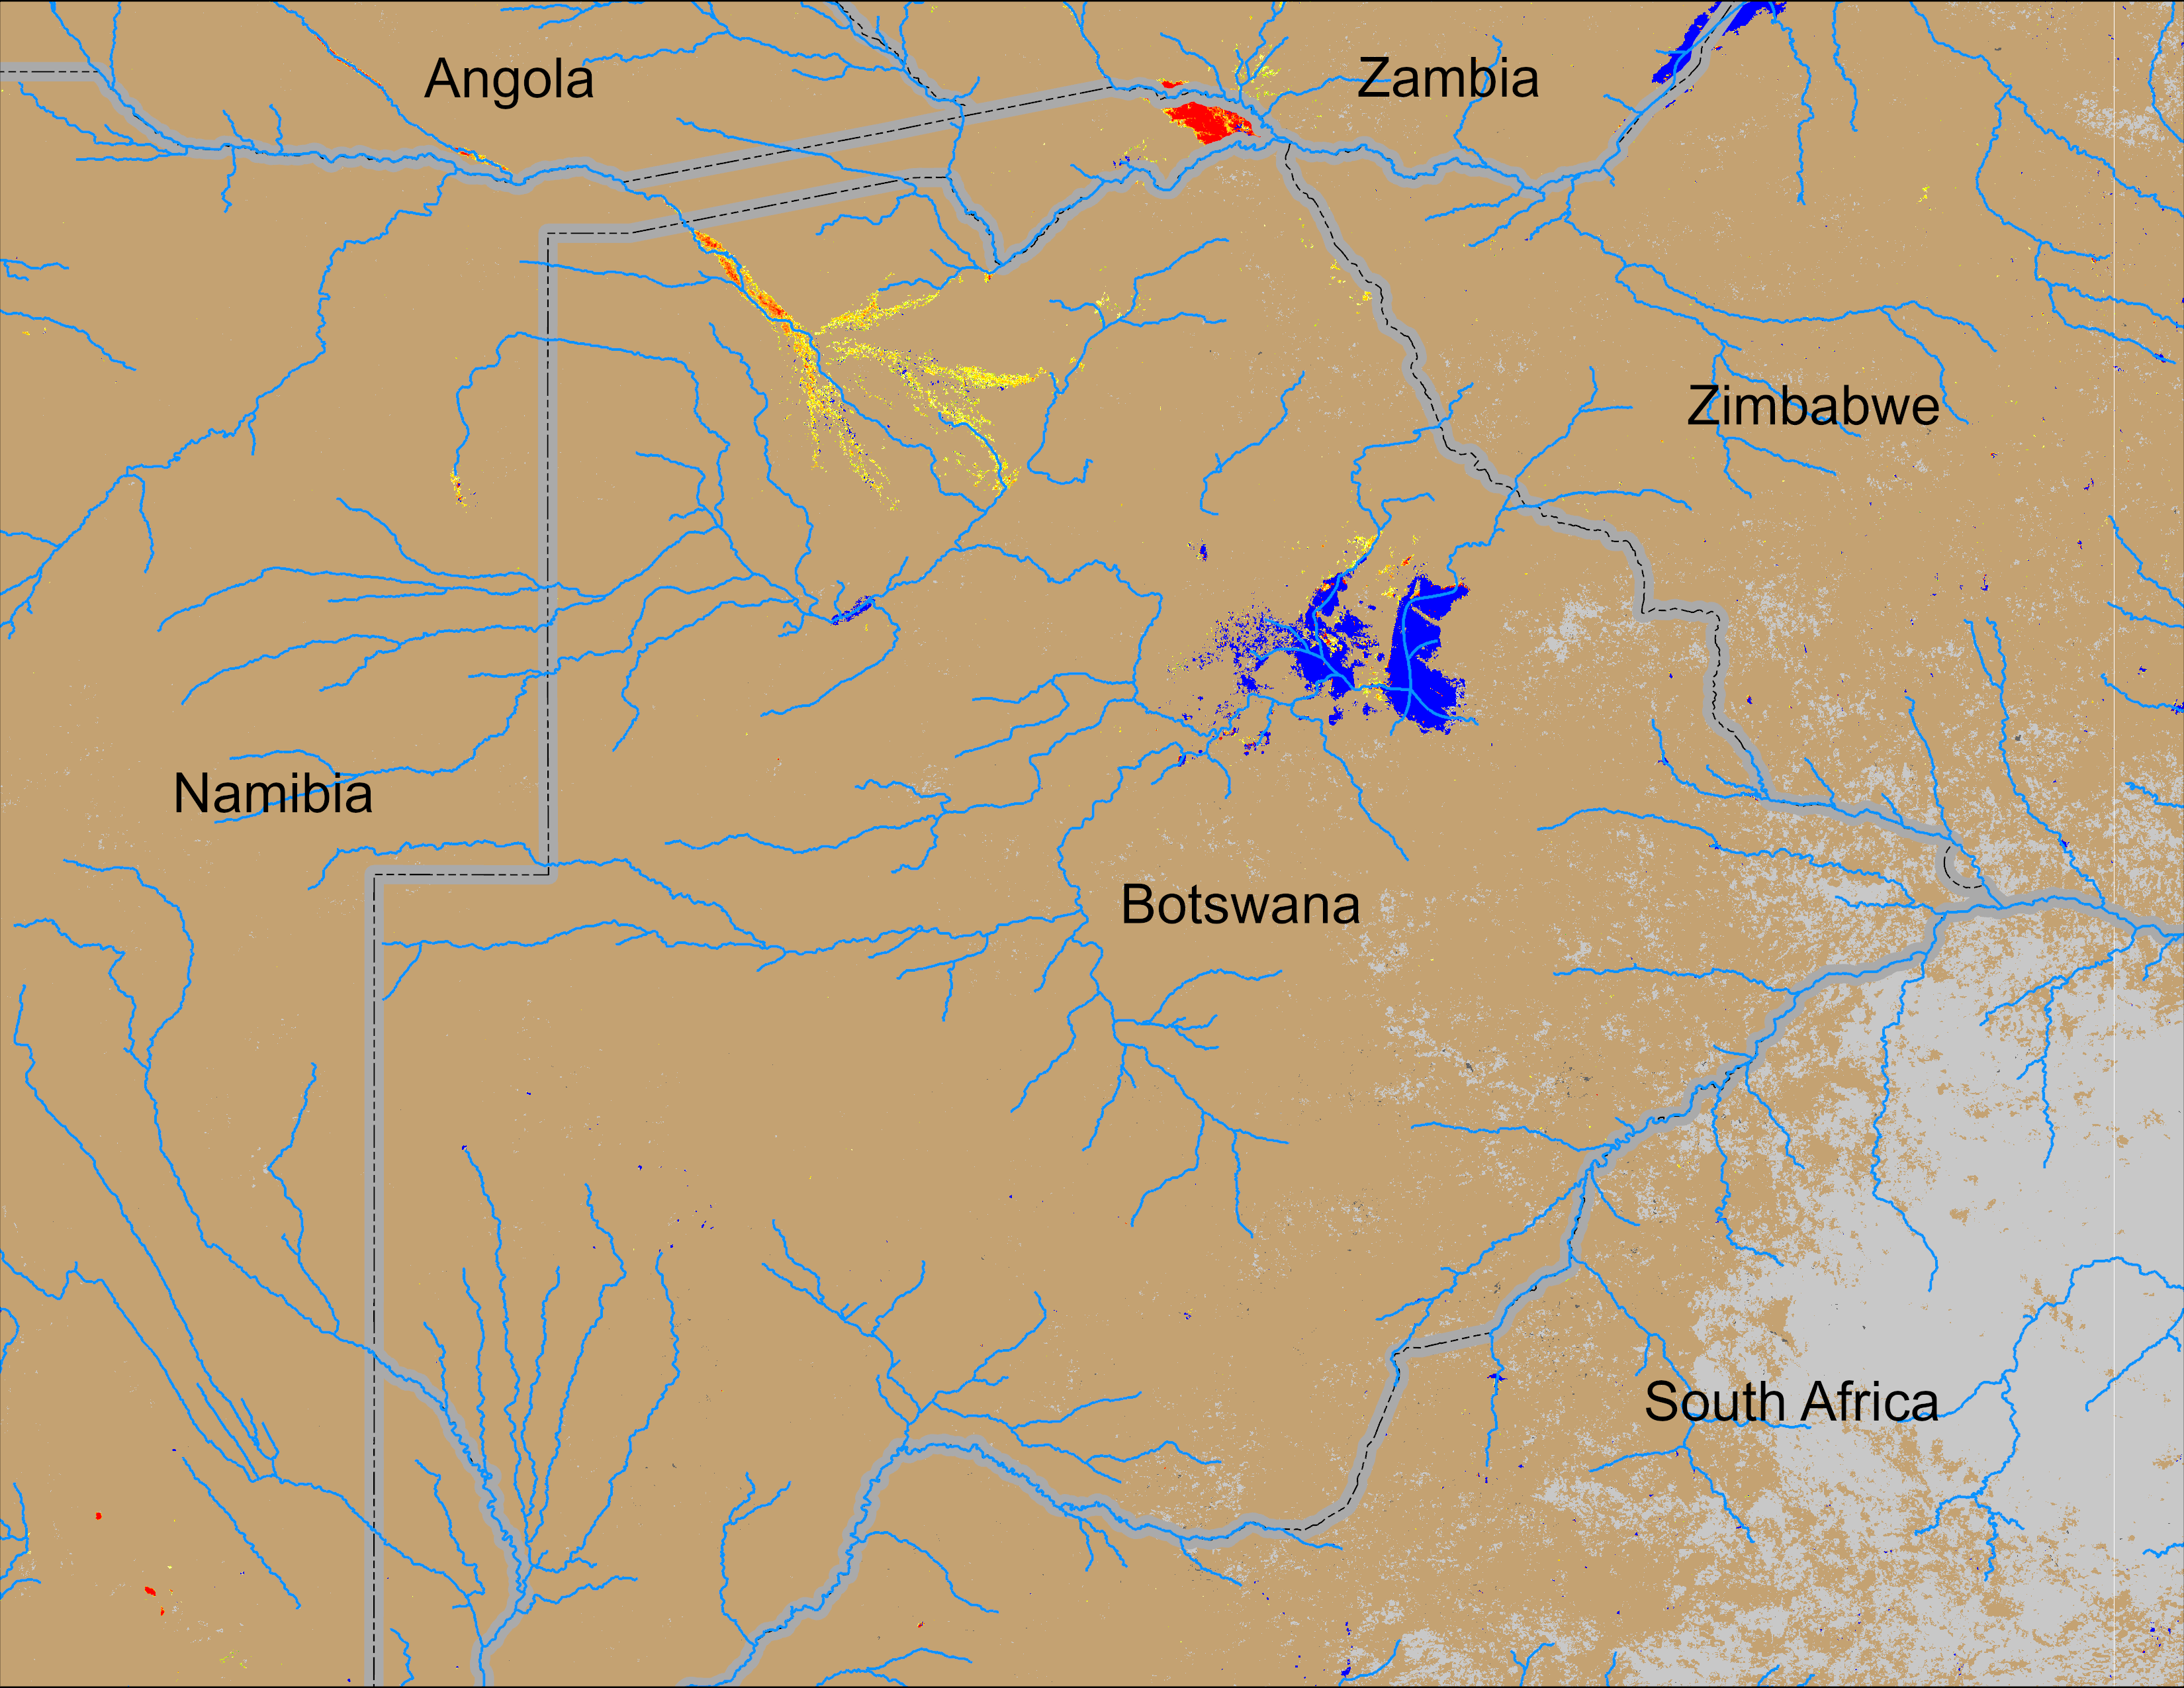
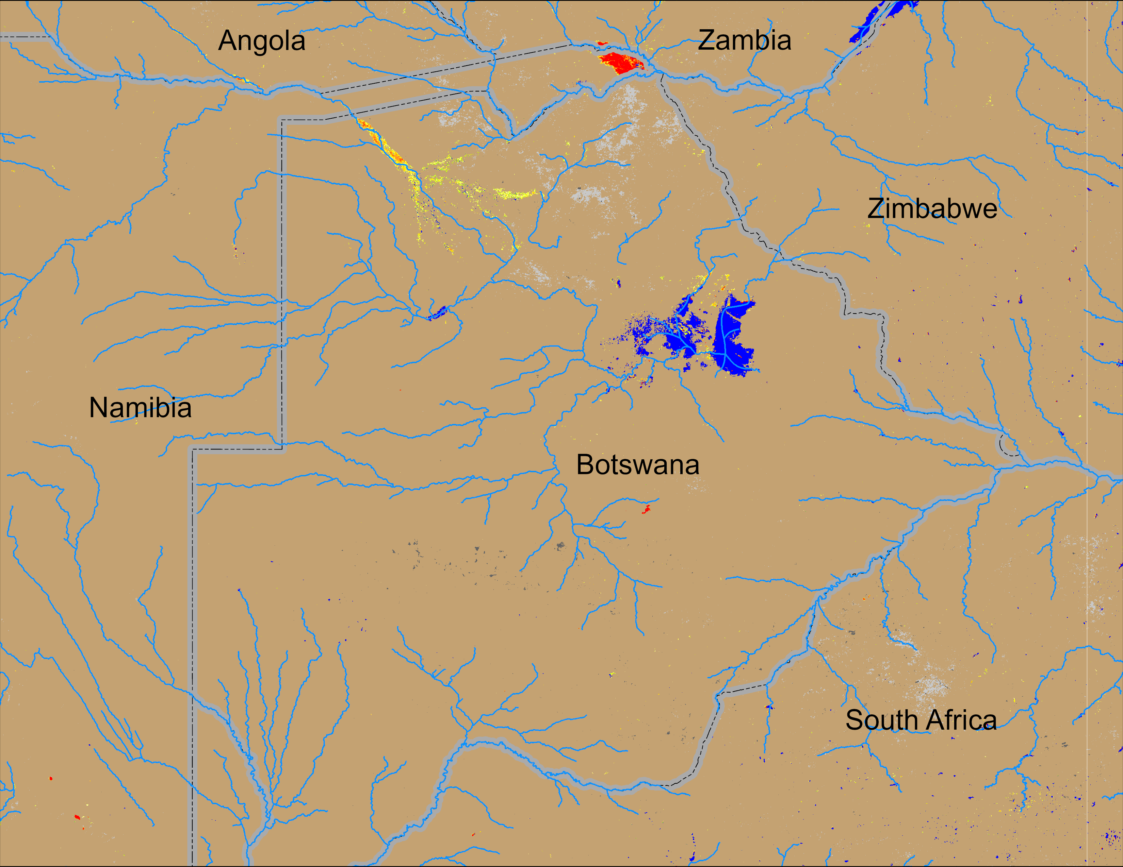
Flooding Conditions in Botswana
NOAA VIIRS derived map: 12 – 16 Mar 2026
NOAA VIIRS 5-day comp.: 18 – 22 Mar 2026
Flooding conditions remained unchanged in northern Botswana.

