Slide 1
FEWS NET Enhanced Flood Monitoring and Forecast
FEWS NET Science Team
March 09, 2026
Notes:
Default title slide

Slide 2

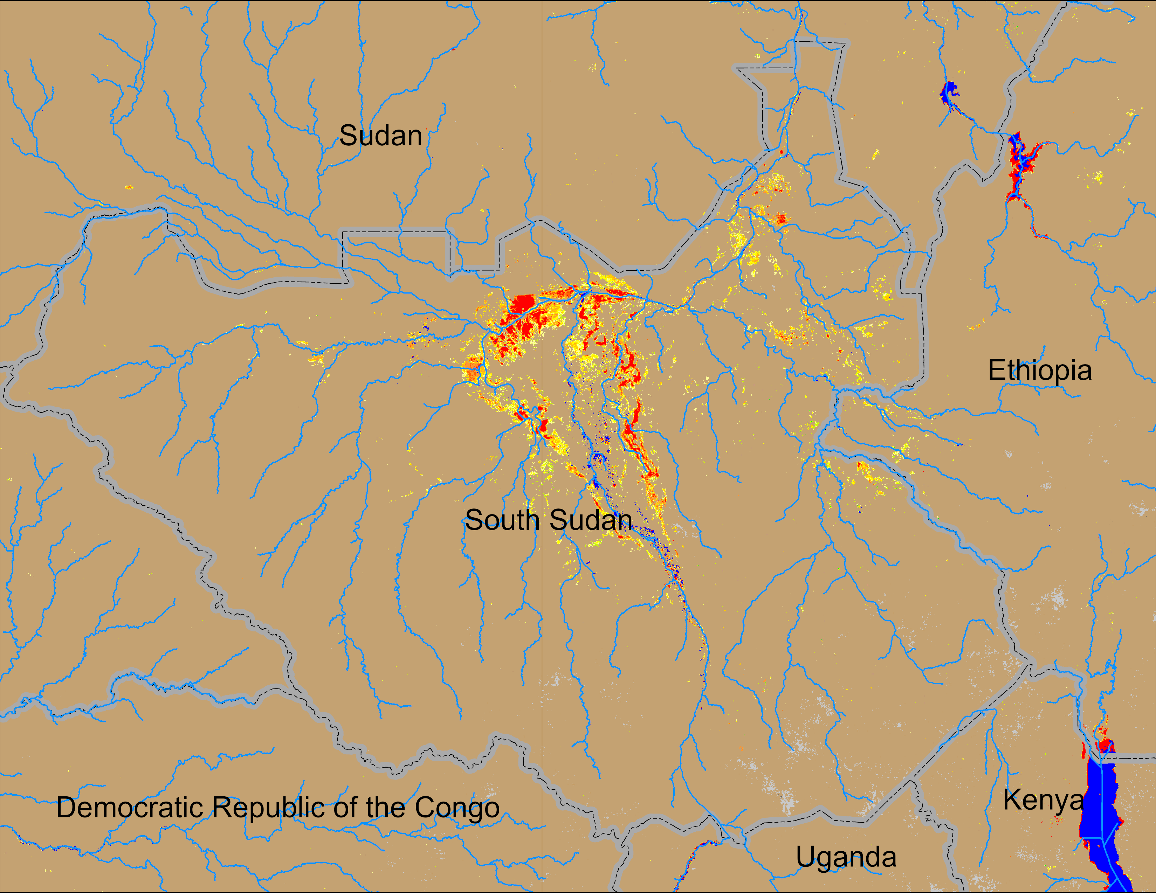
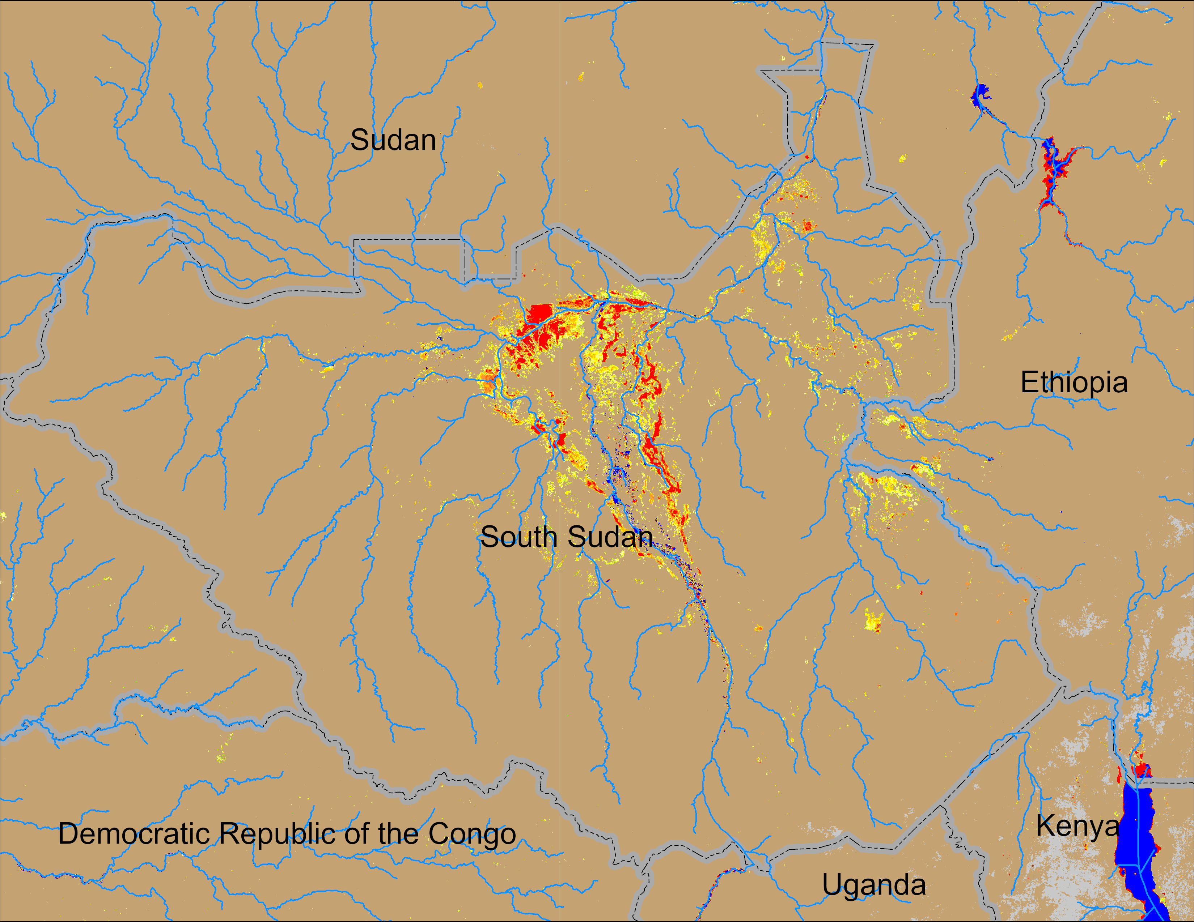
Flooding Conditions in South Sudan
NOAA VIIRS derived map: 19 – 23 Feb 2026
NOAA VIIRS 5-day comp.: 04 – 08 Mar 2026
While the Sudd wetlands remained unchanged, new areas of inundation can be seen in the eastern South Sudan bordering with Ethiopia. However, we need to double check if they are truly flooding or burn scars.

Slide 3
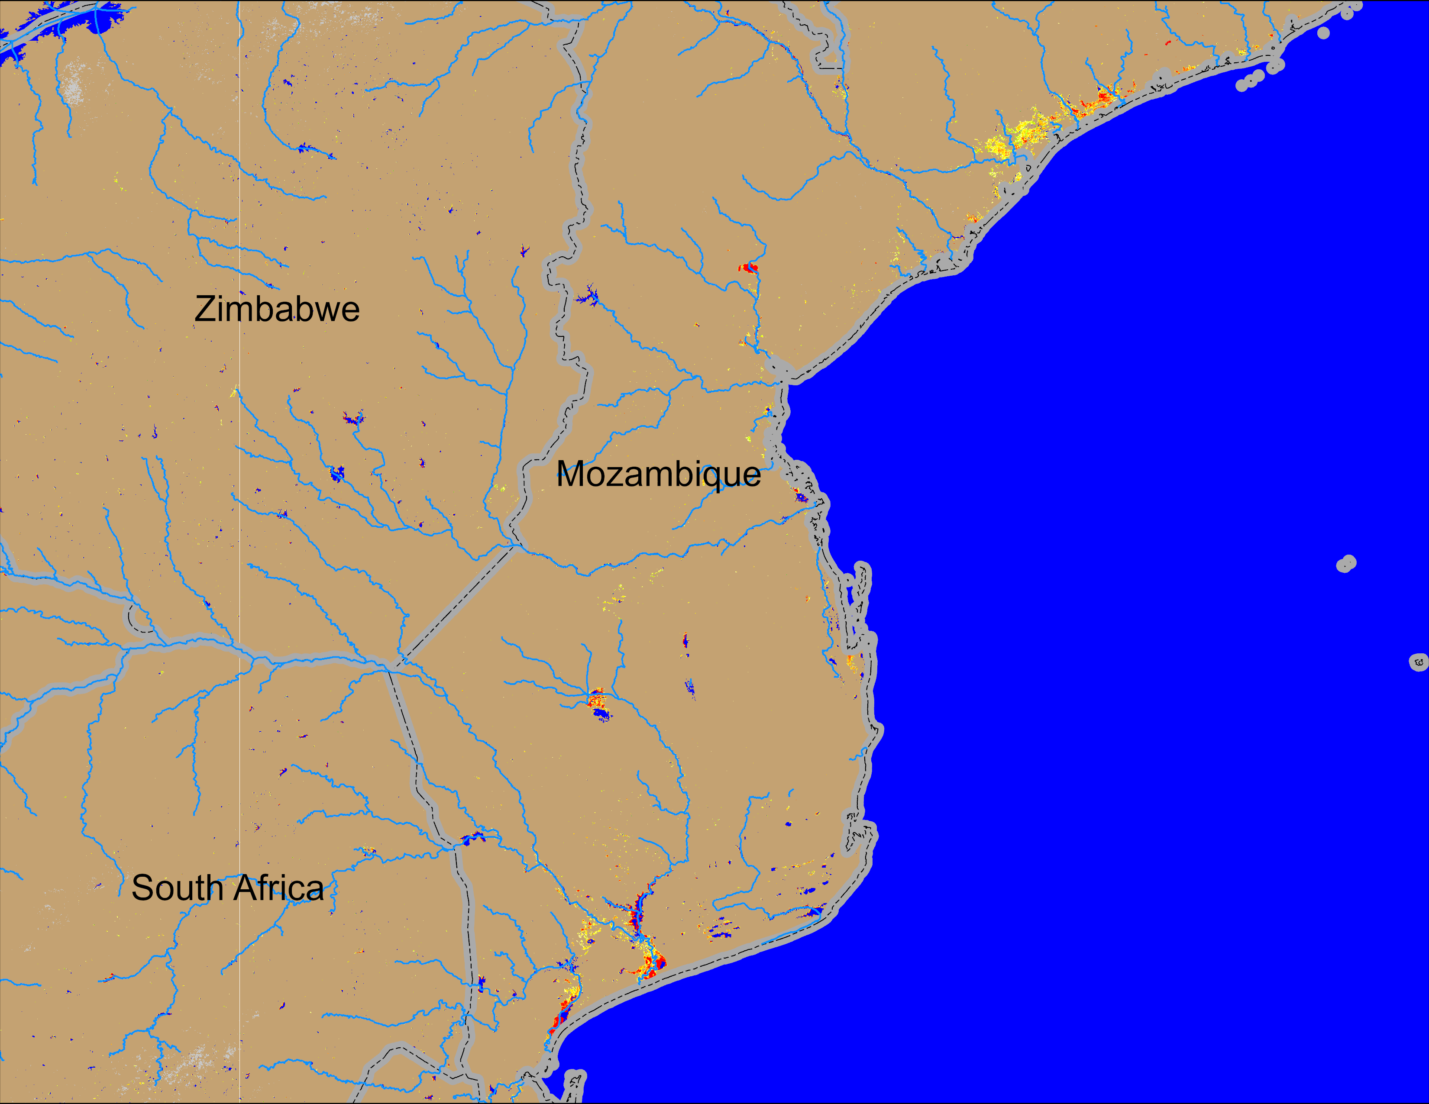

Flooding Conditions in Mozambique
NOAA VIIRS derived map: 19 – 23 Feb 2026
NOAA VIIRS 5-day comp.: 04 – 08 Mar 2026
Flooding conditions improved significantly across Mozambique.

Slide 4
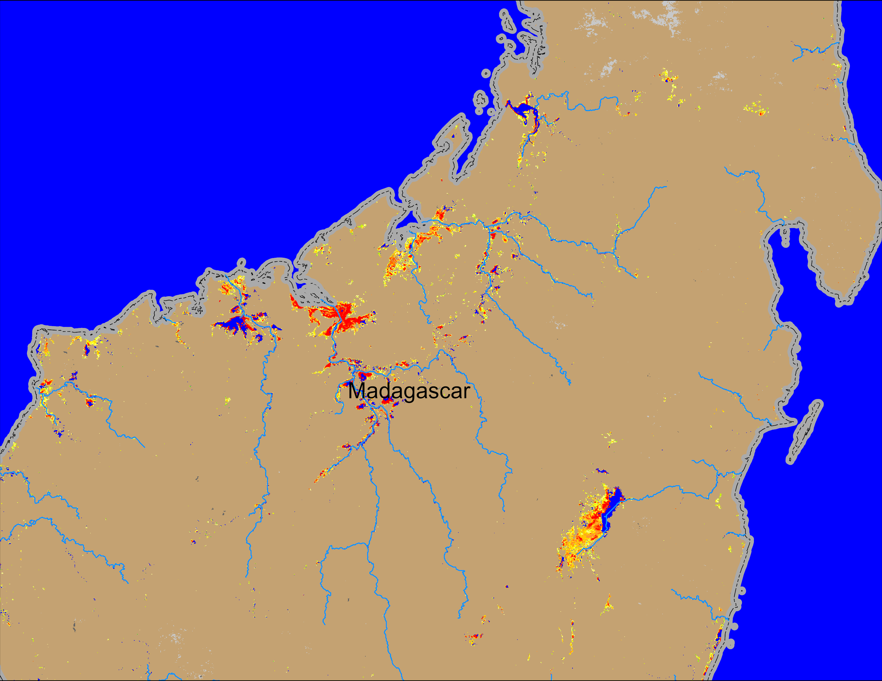
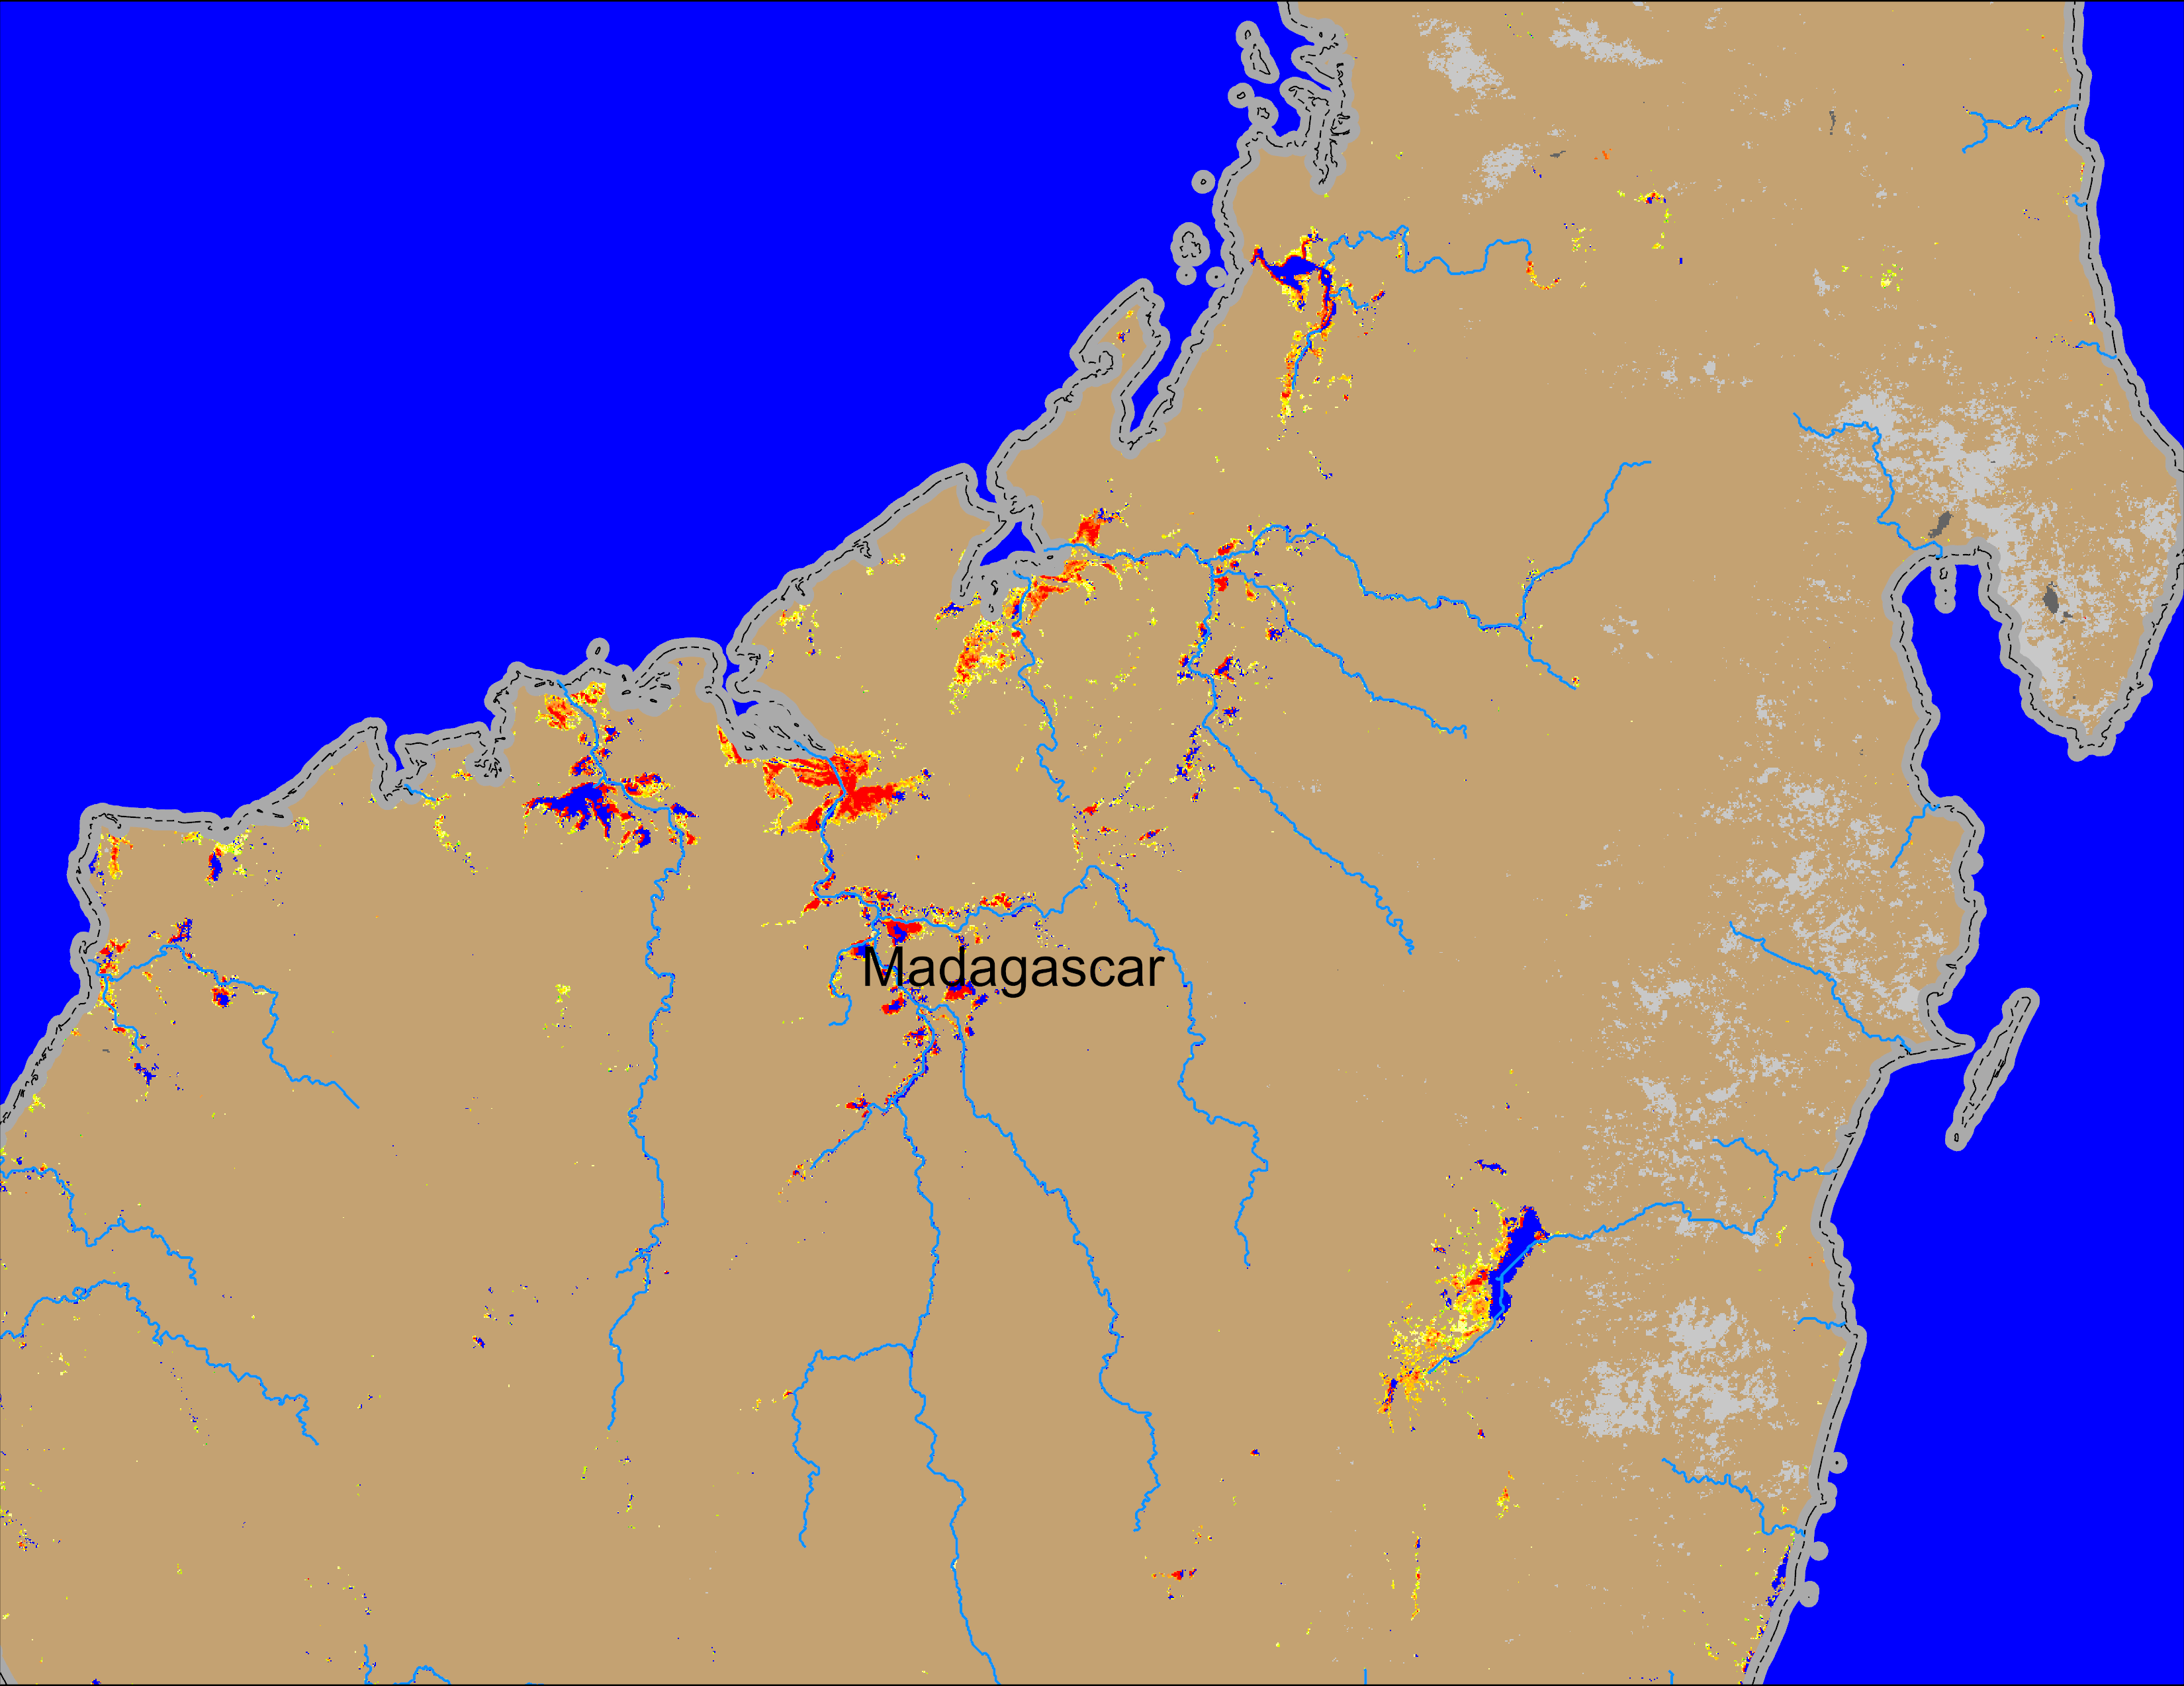
Flooding Conditions in Madagascar
NOAA VIIRS derived map: 19 – 23 Feb 2026
NOAA VIIRS 5-day comp.: 04 – 08 Mar 2026
Flooding conditions improved in northern Madagascar.

Slide 5
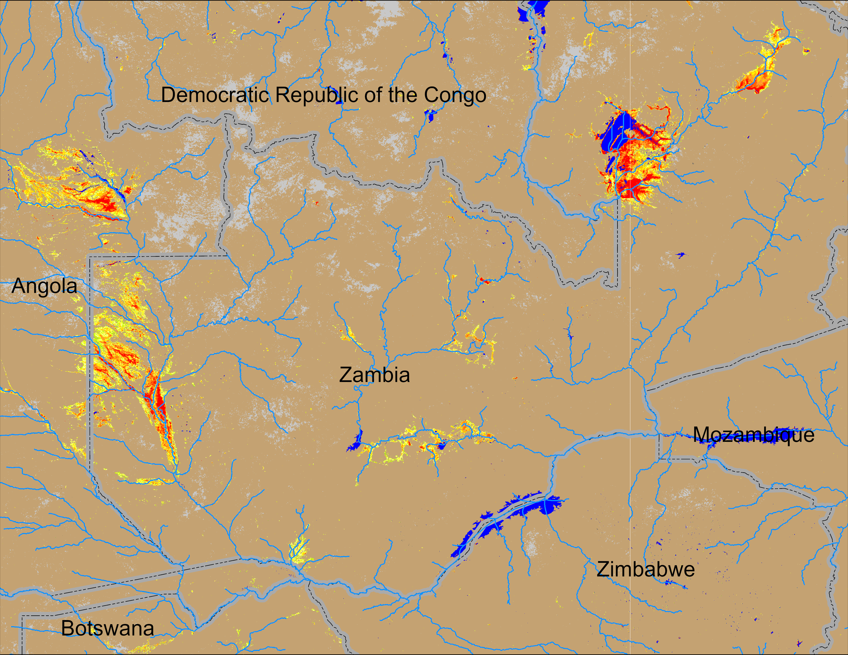
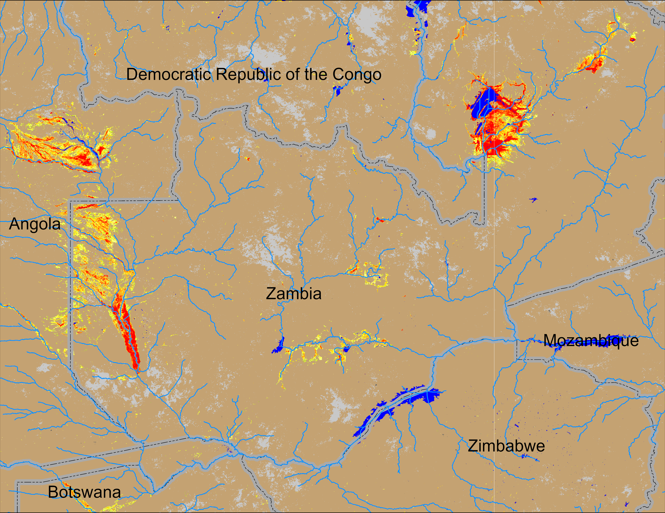
Flooding Conditions in Zambia
NOAA VIIRS derived map: 19 – 23 Feb 2026
NOAA VIIRS 5-day comp.: 04 – 08 Mar 2026
Flooding conditions intensifying across Zambia.

Slide 6
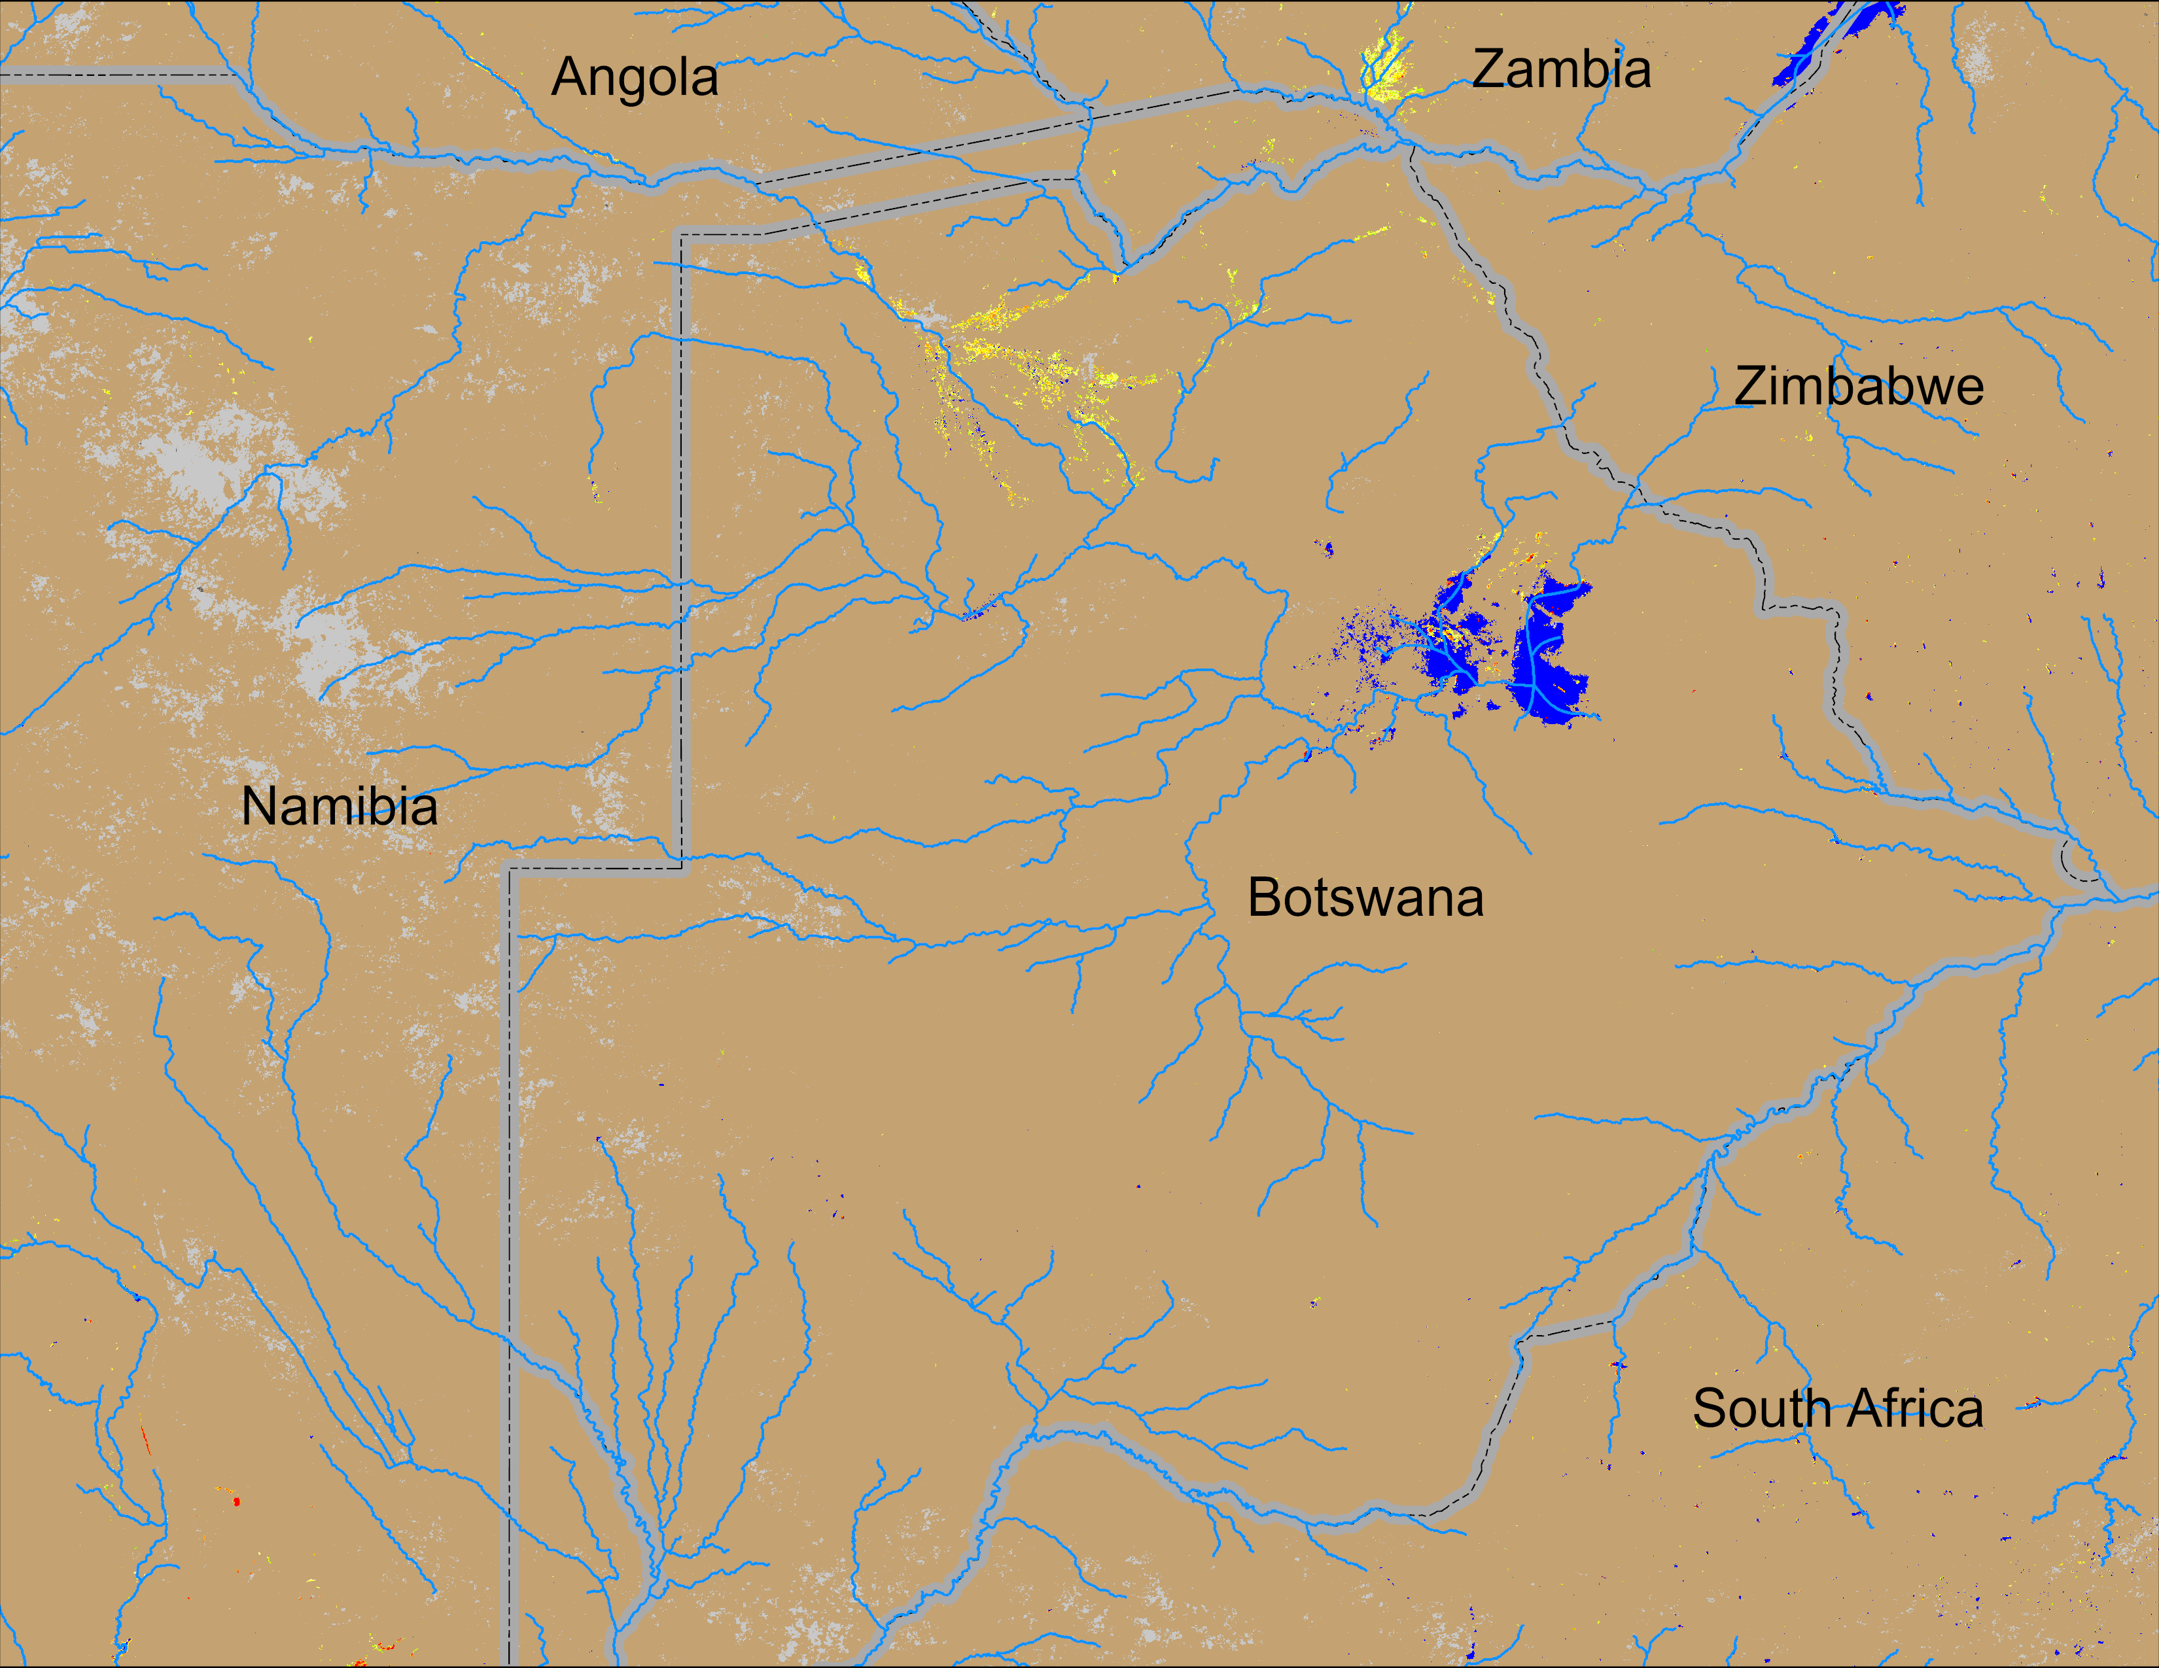
Flooding Conditions in Botswana
NOAA VIIRS derived map: 19 – 23 Feb 2026
NOAA VIIRS 5-day comp.: 04 – 08 Mar 2026
Flooding conditions remained unchanged in northern Botswana.

