Slide 1
FEWS NET Enhanced Flood Monitoring and Forecast
FEWS NET Science Team
Janunary 26, 2026
Notes:
Default title slide

Slide 2

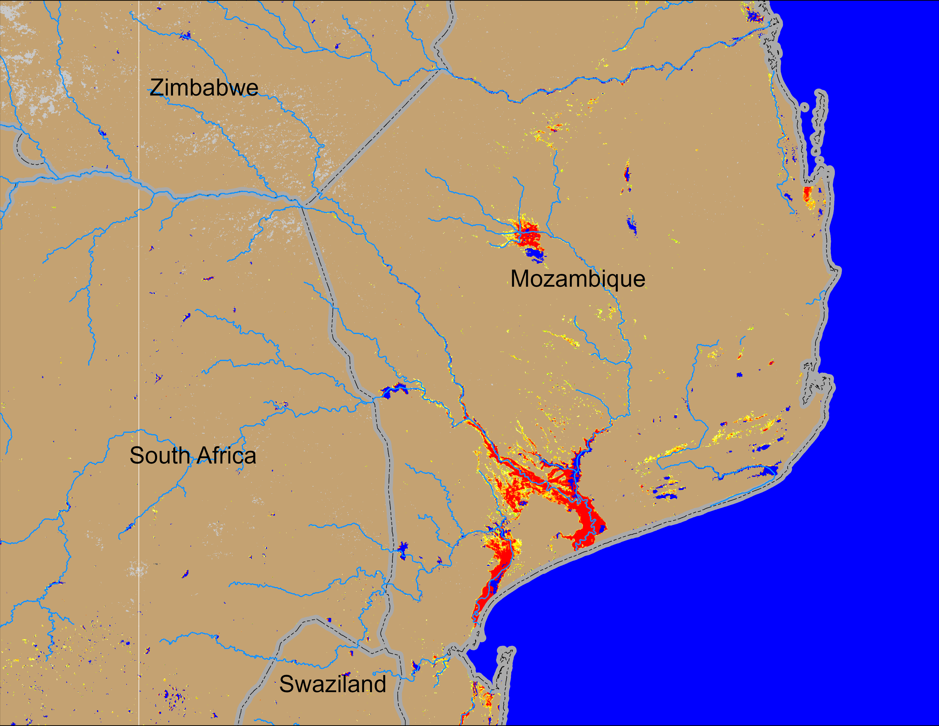
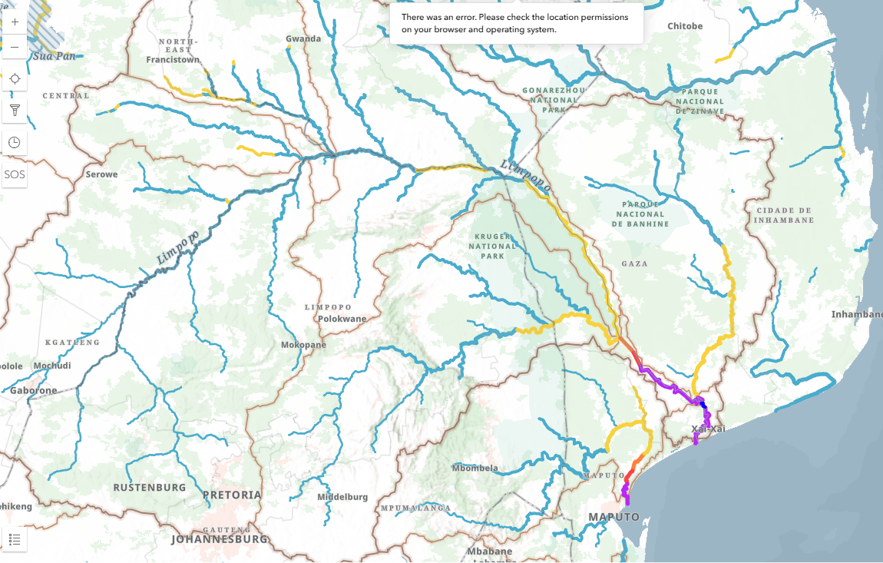
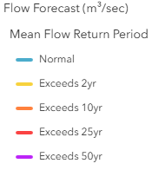
Flooding Conditions in Mozambique
GEOGLOWS River Forecast: 26 Jan – 10 Feb 2026 (two weeks)
NOAA VIIRS derived map: 21 – 25 Jan 2026
Downstream of Limpopo River in southern Mozambique is exprenceing catestrophic level of flooding with river discharges expected to surpass 50-yr return period level.

Slide 3
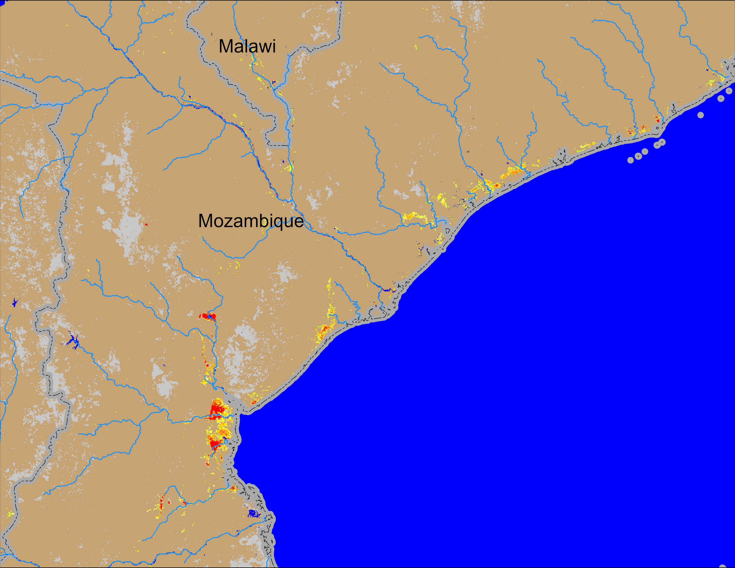
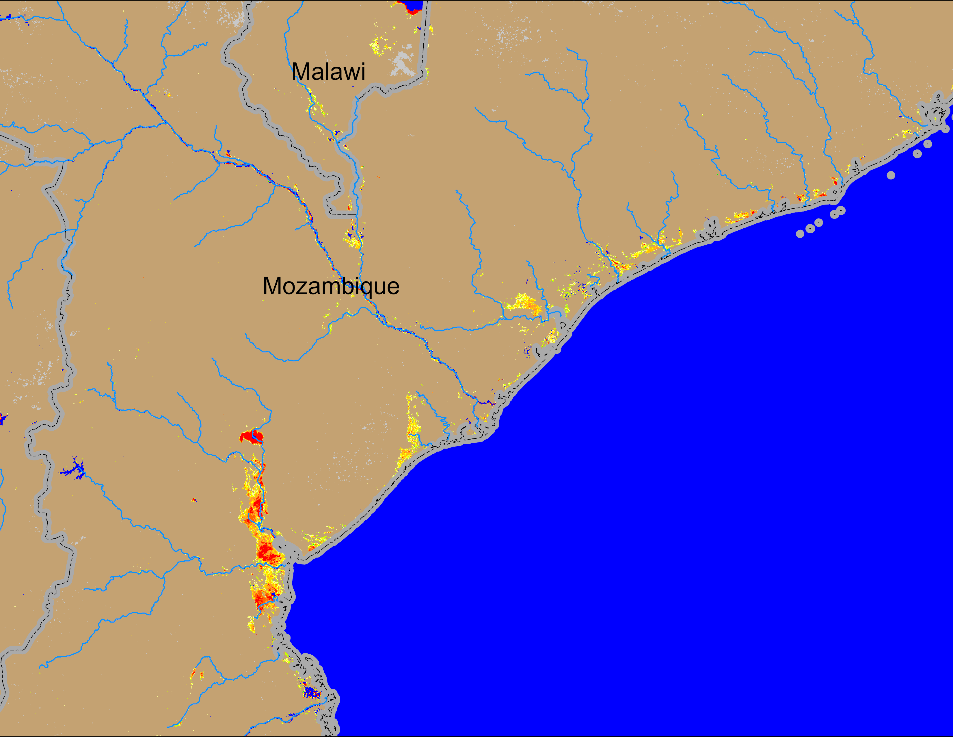
Flooding Conditions in Mozambique
NOAA VIIRS derived map: 12 – 16 Jan 2026
NOAA VIIRS 5-day comp.: 21 – 25 Jan 2026
Flooding remained unchanged in central Mozambique and southern Malawi.

Slide 4
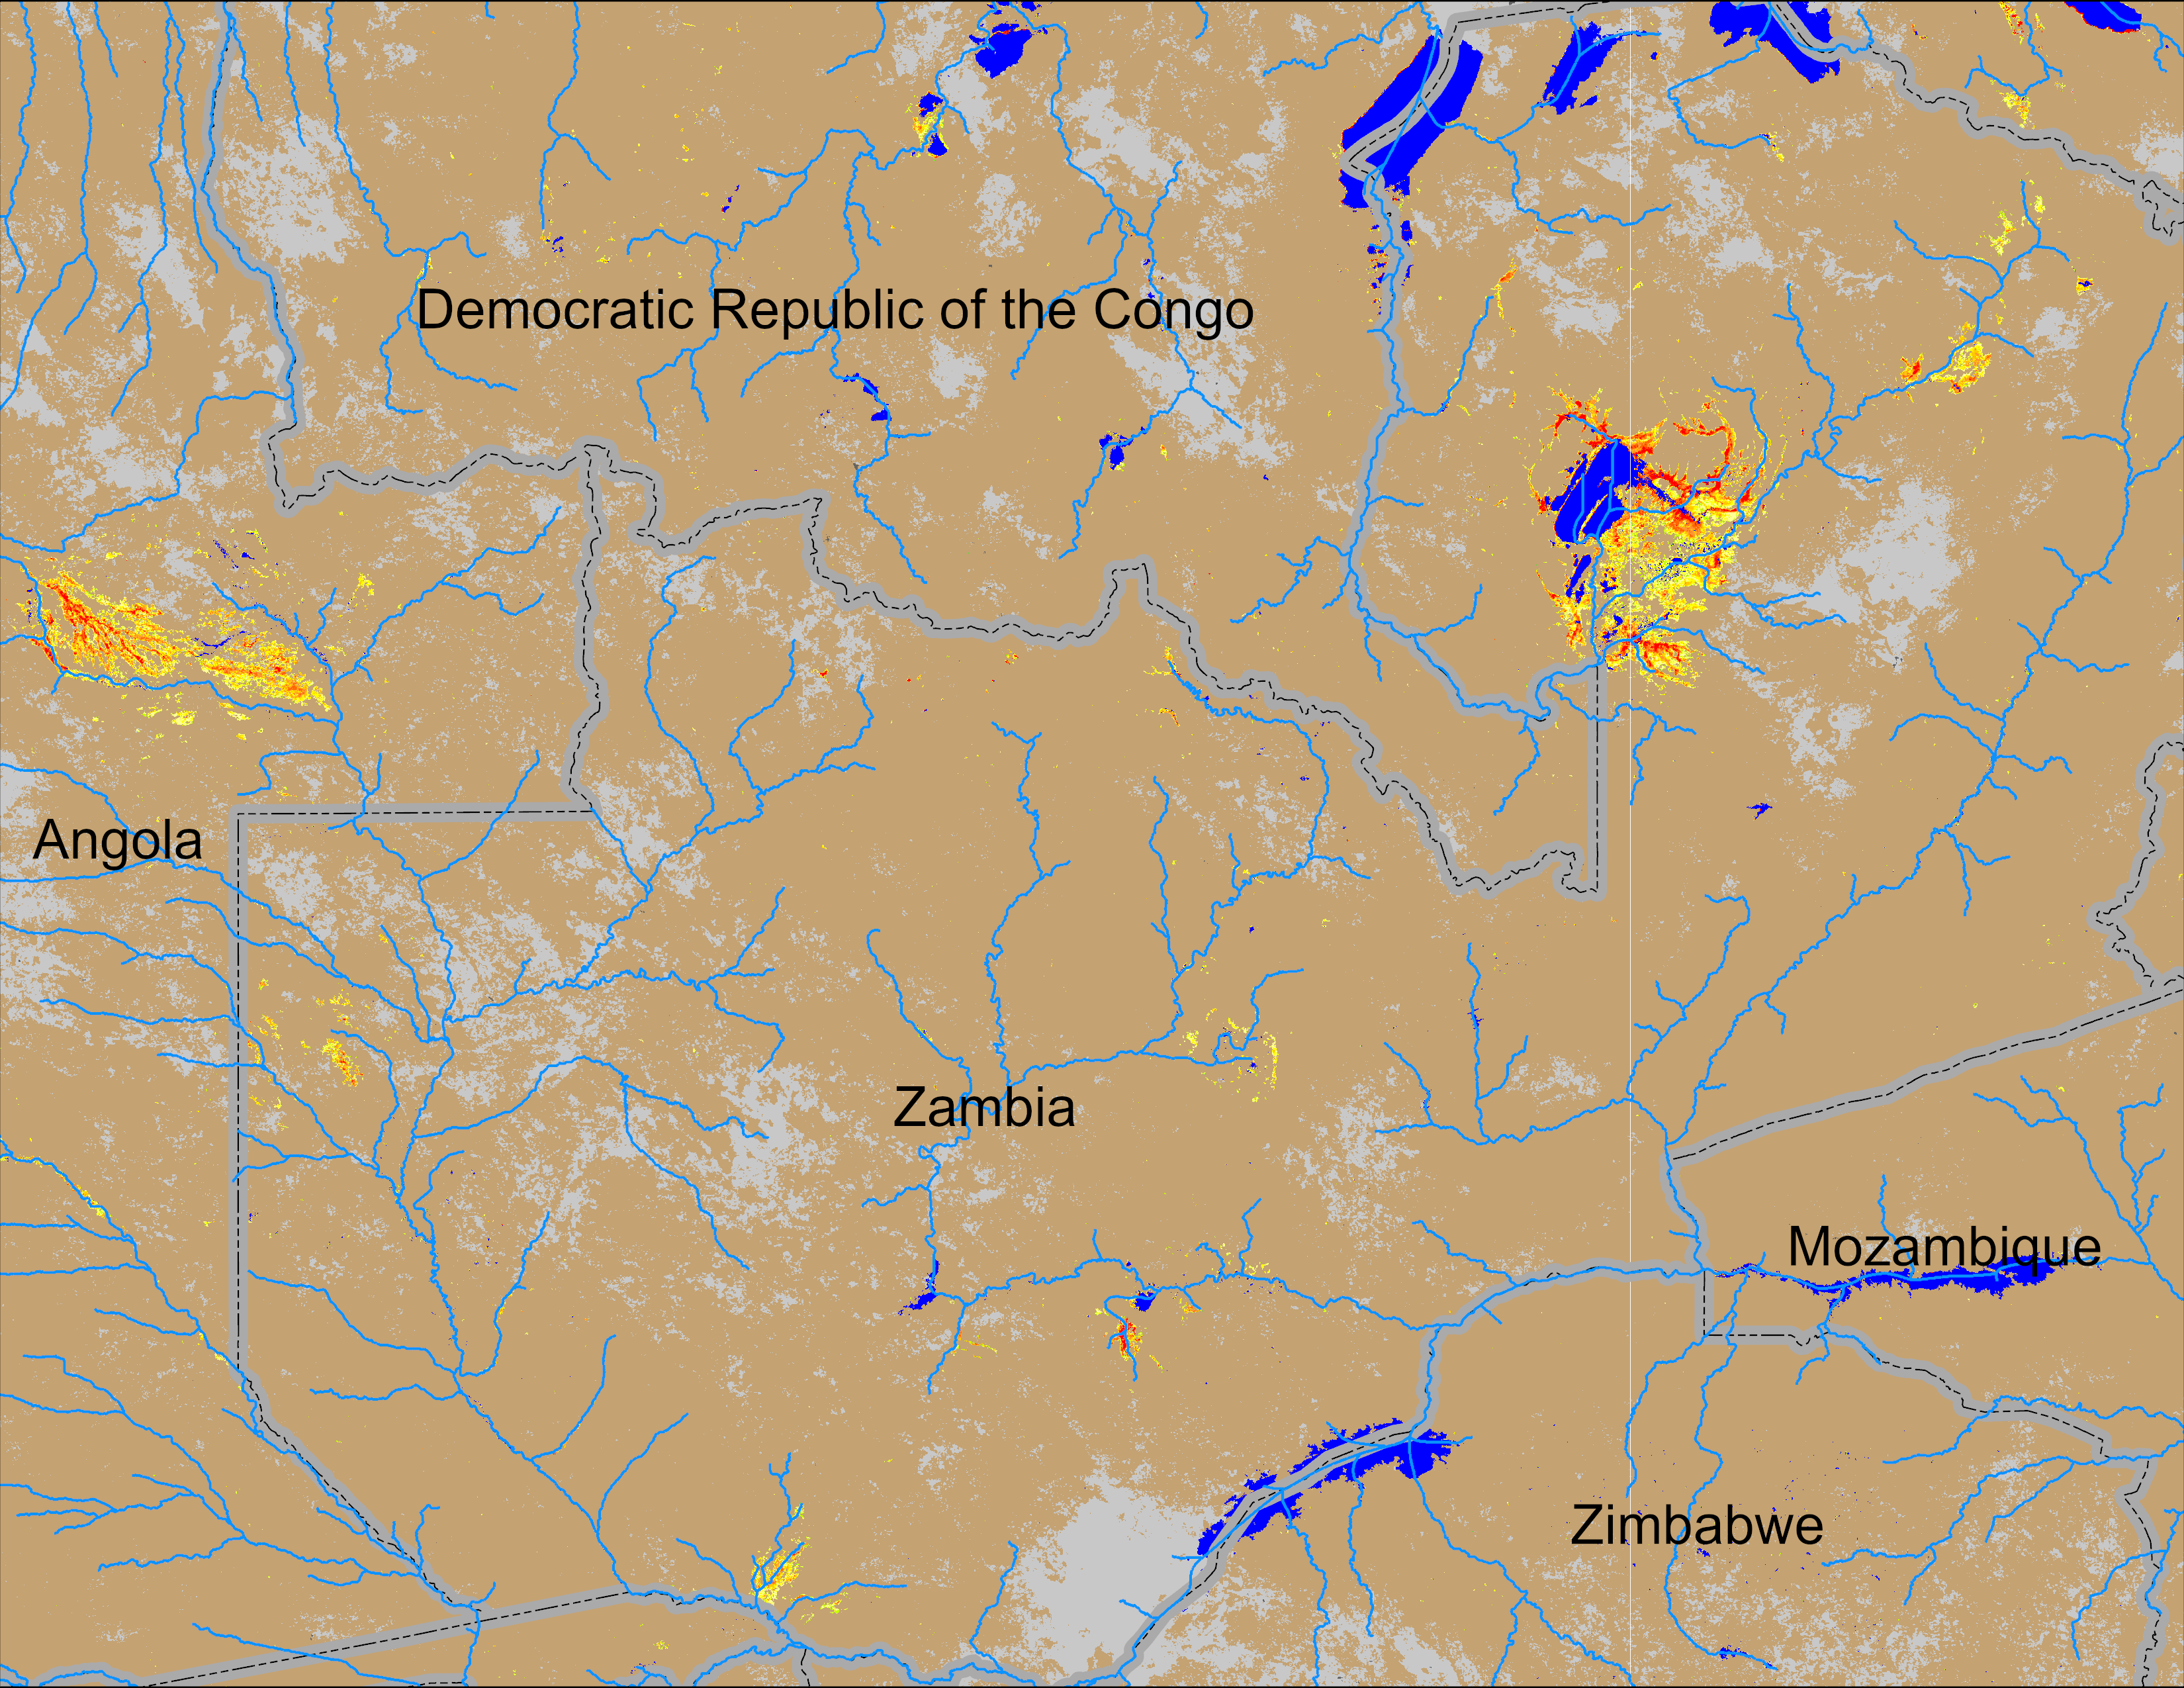
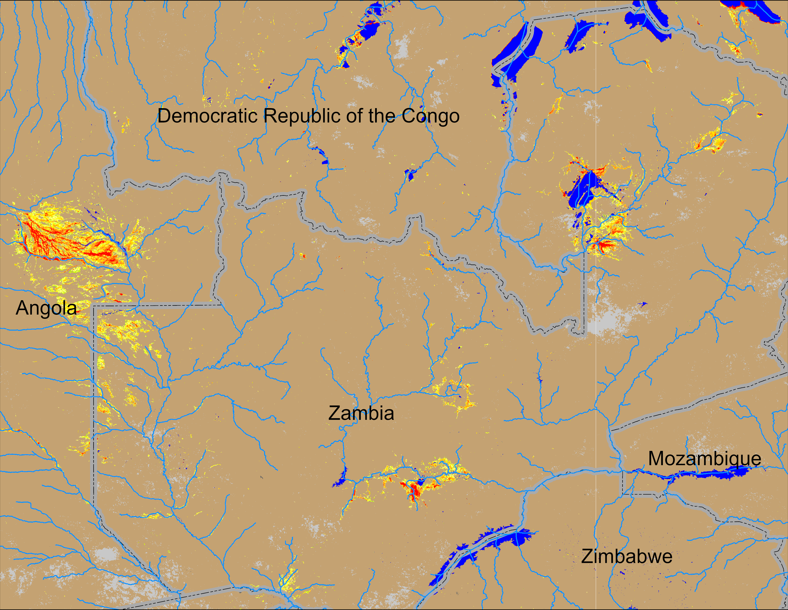
Flooding Conditions in Zambia
NOAA VIIRS derived map: 12 – 16 Jan 2026
NOAA VIIRS 5-day comp.: 21 – 25 Jan 2026
Inundated area increased substantially in eastern Angola and across Zambia.

Slide 5
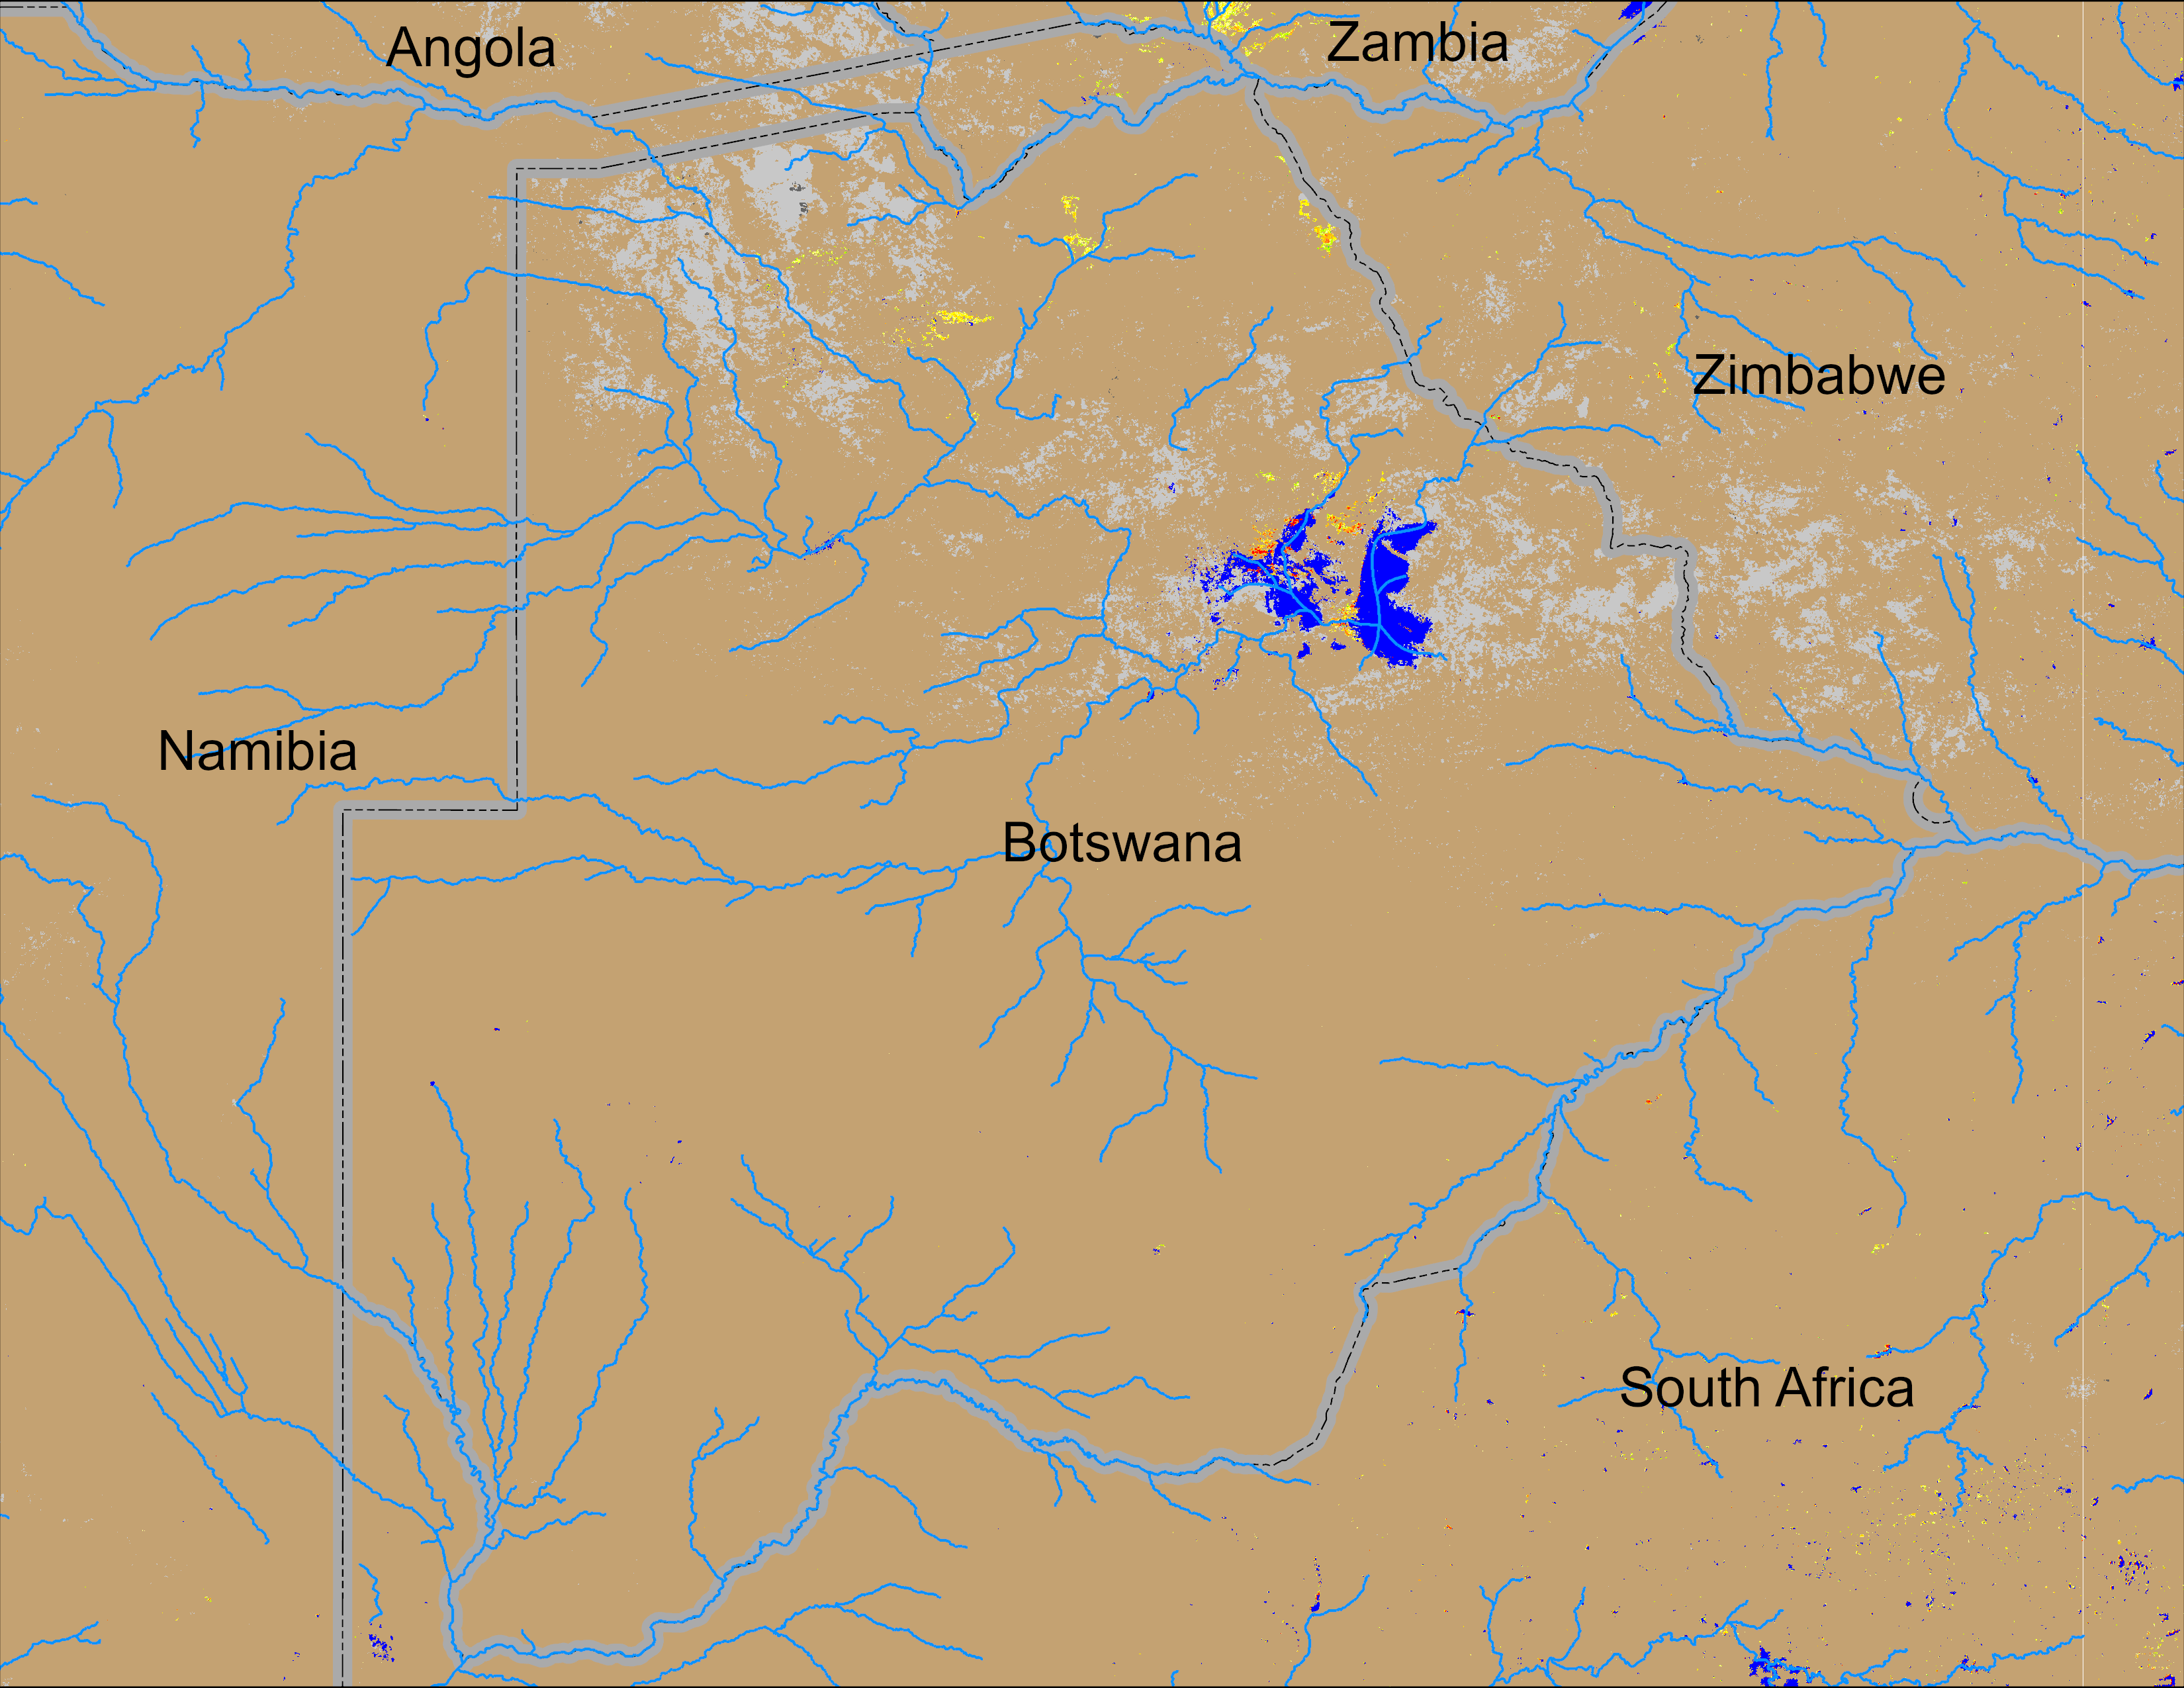
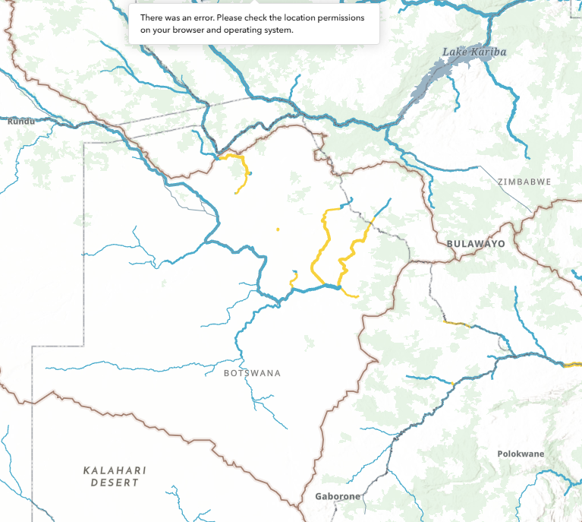
Flooding Conditions in Botswana
NOAA VIIRS derived map: 21 – 25 Jan 2026
GEOGLOWS River Forecast: 26 Jan – 10 Feb 2026 (two weeks)
Although latest VIIRS Flood Map (VFM) was impacted by cloud, river discharges forecast at 2-yr return period level suggest continuation of flooding in northern Botswana.

