Slide 1
FEWS NET Enhanced Flood Monitoring and Forecast
FEWS NET Science Team
February 09, 2026
Notes:
Default title slide

Slide 2

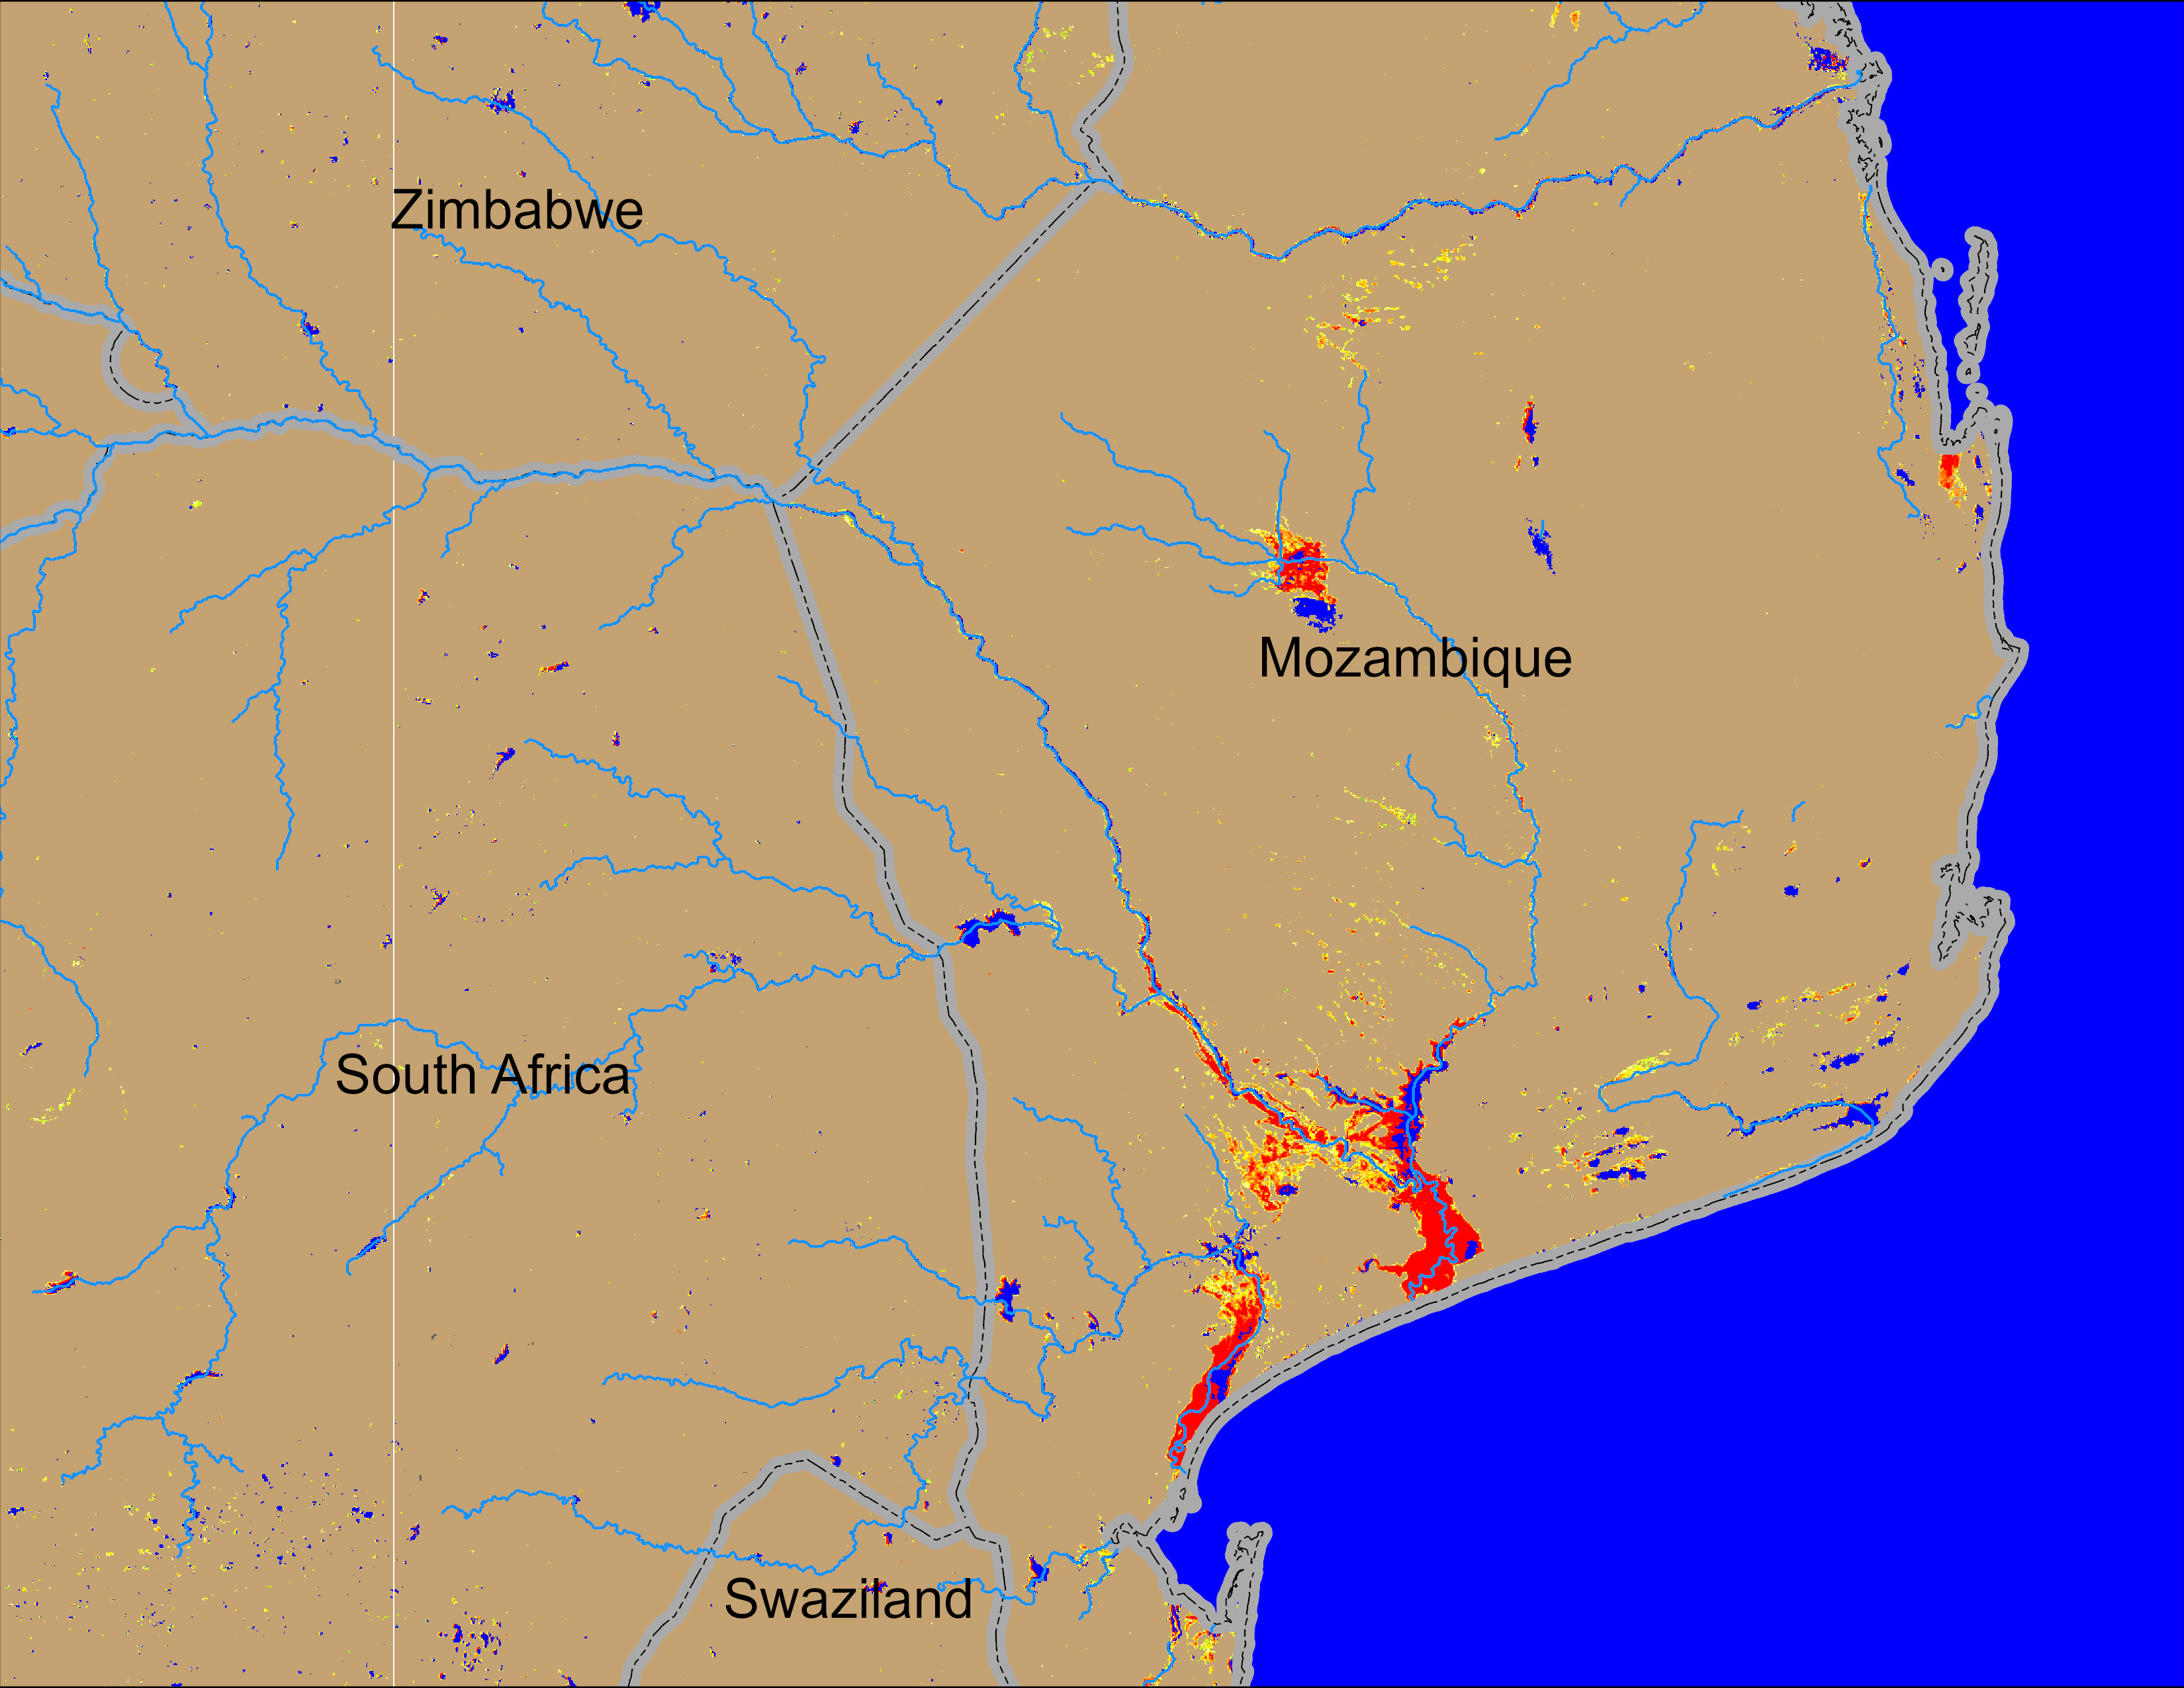
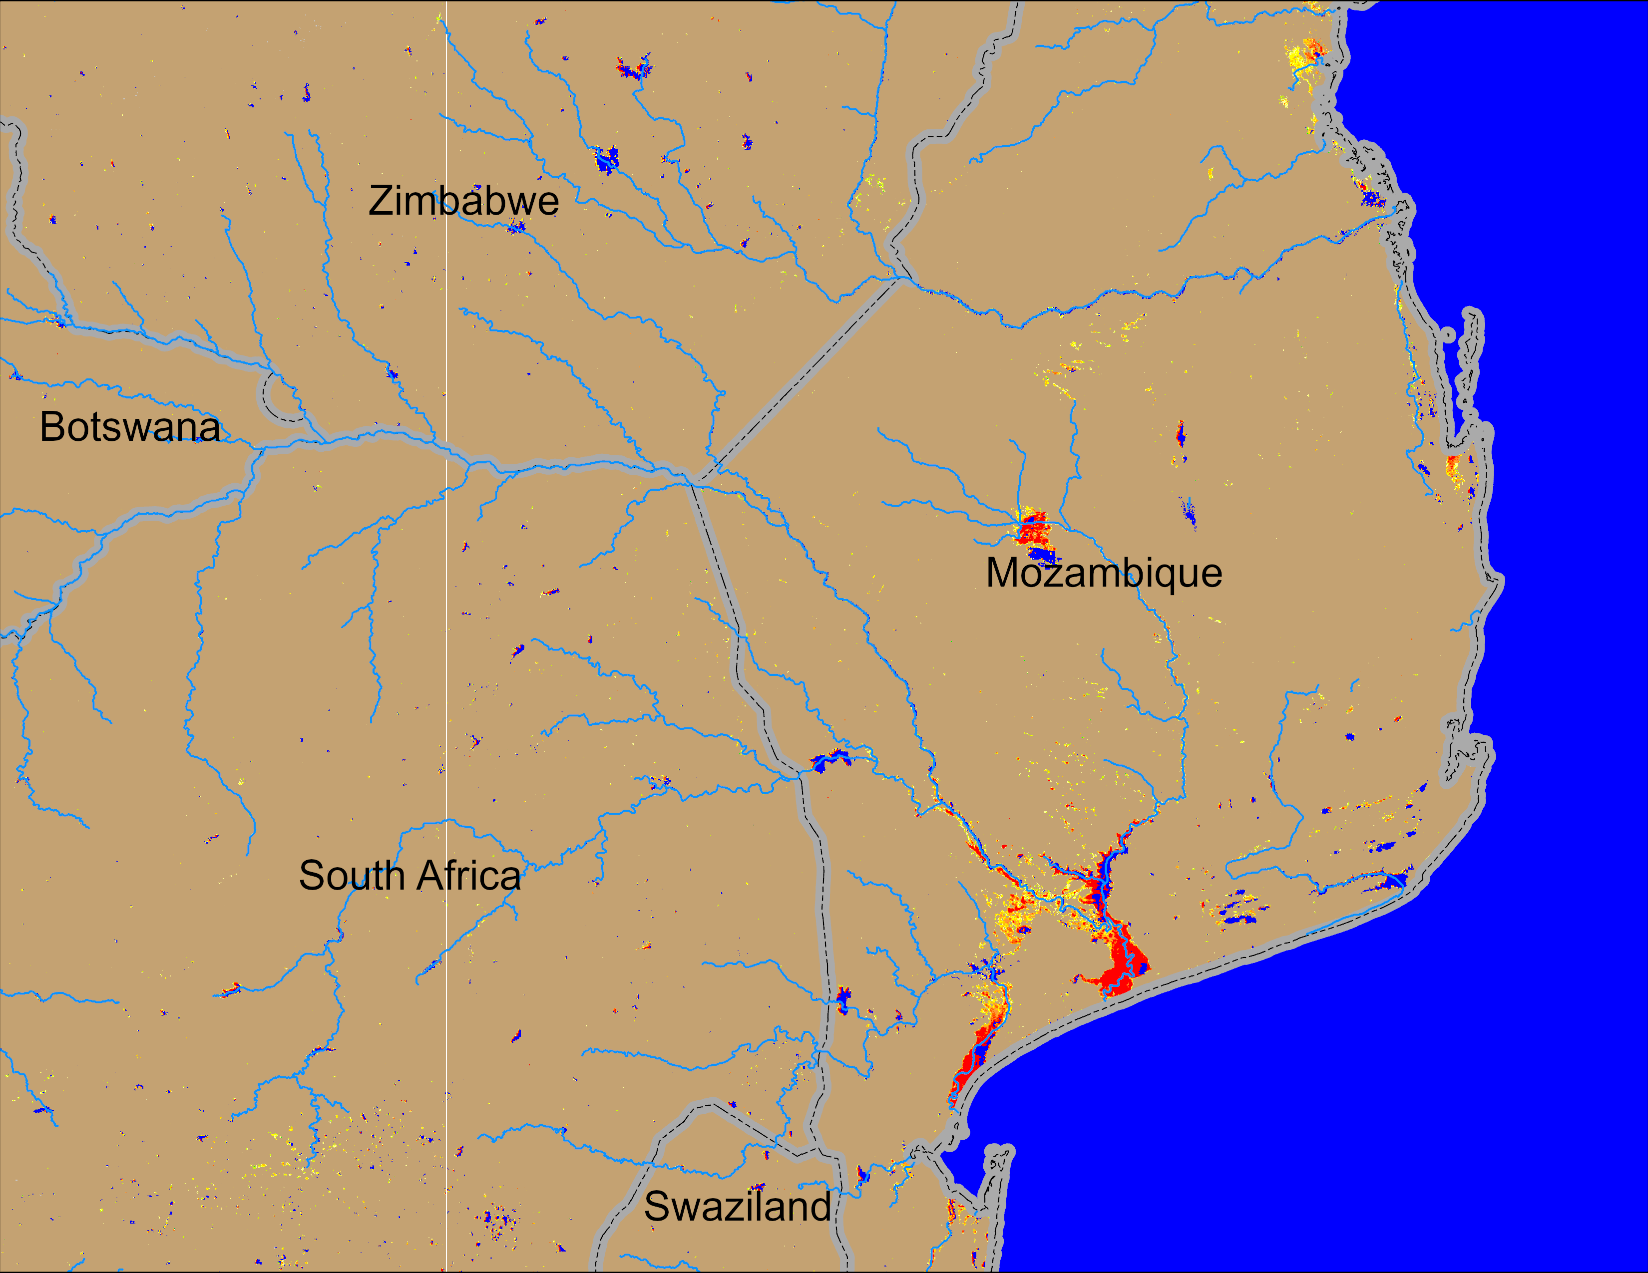
Flooding Conditions in Mozambique
NOAA VIIRS derived map: 28 Jan – 01 Feb 2026
NOAA VIIRS 5-day comp.: 04 – 08 Feb 2026
Flooding continues in the downstream of Limpopo River in southern Mozambique.

Slide 3
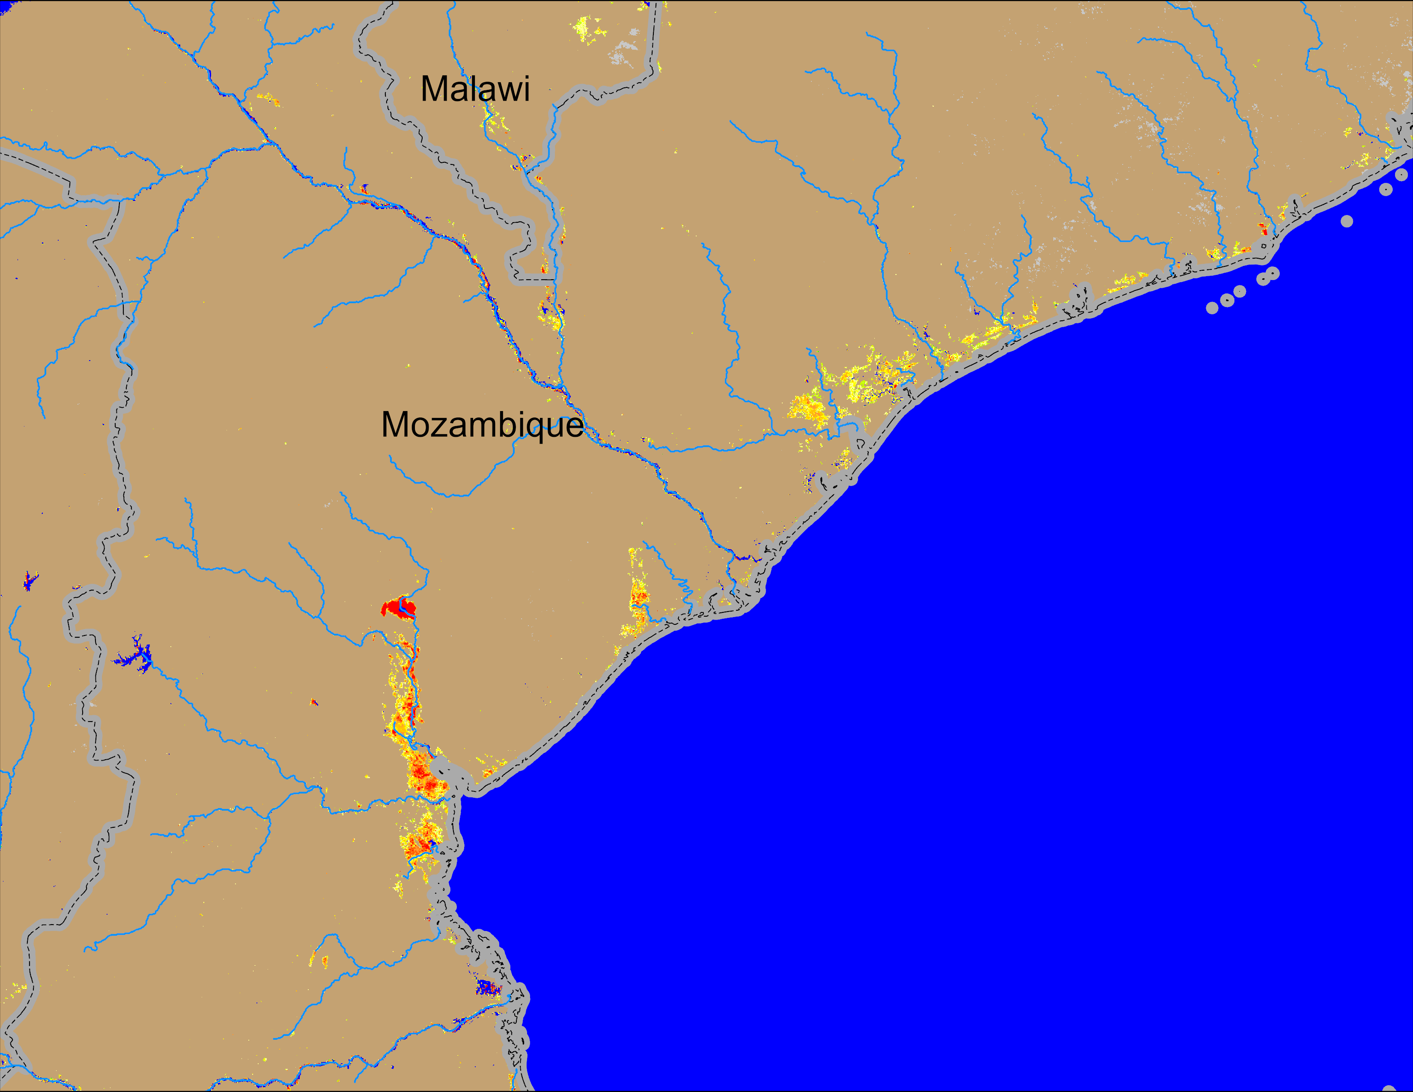
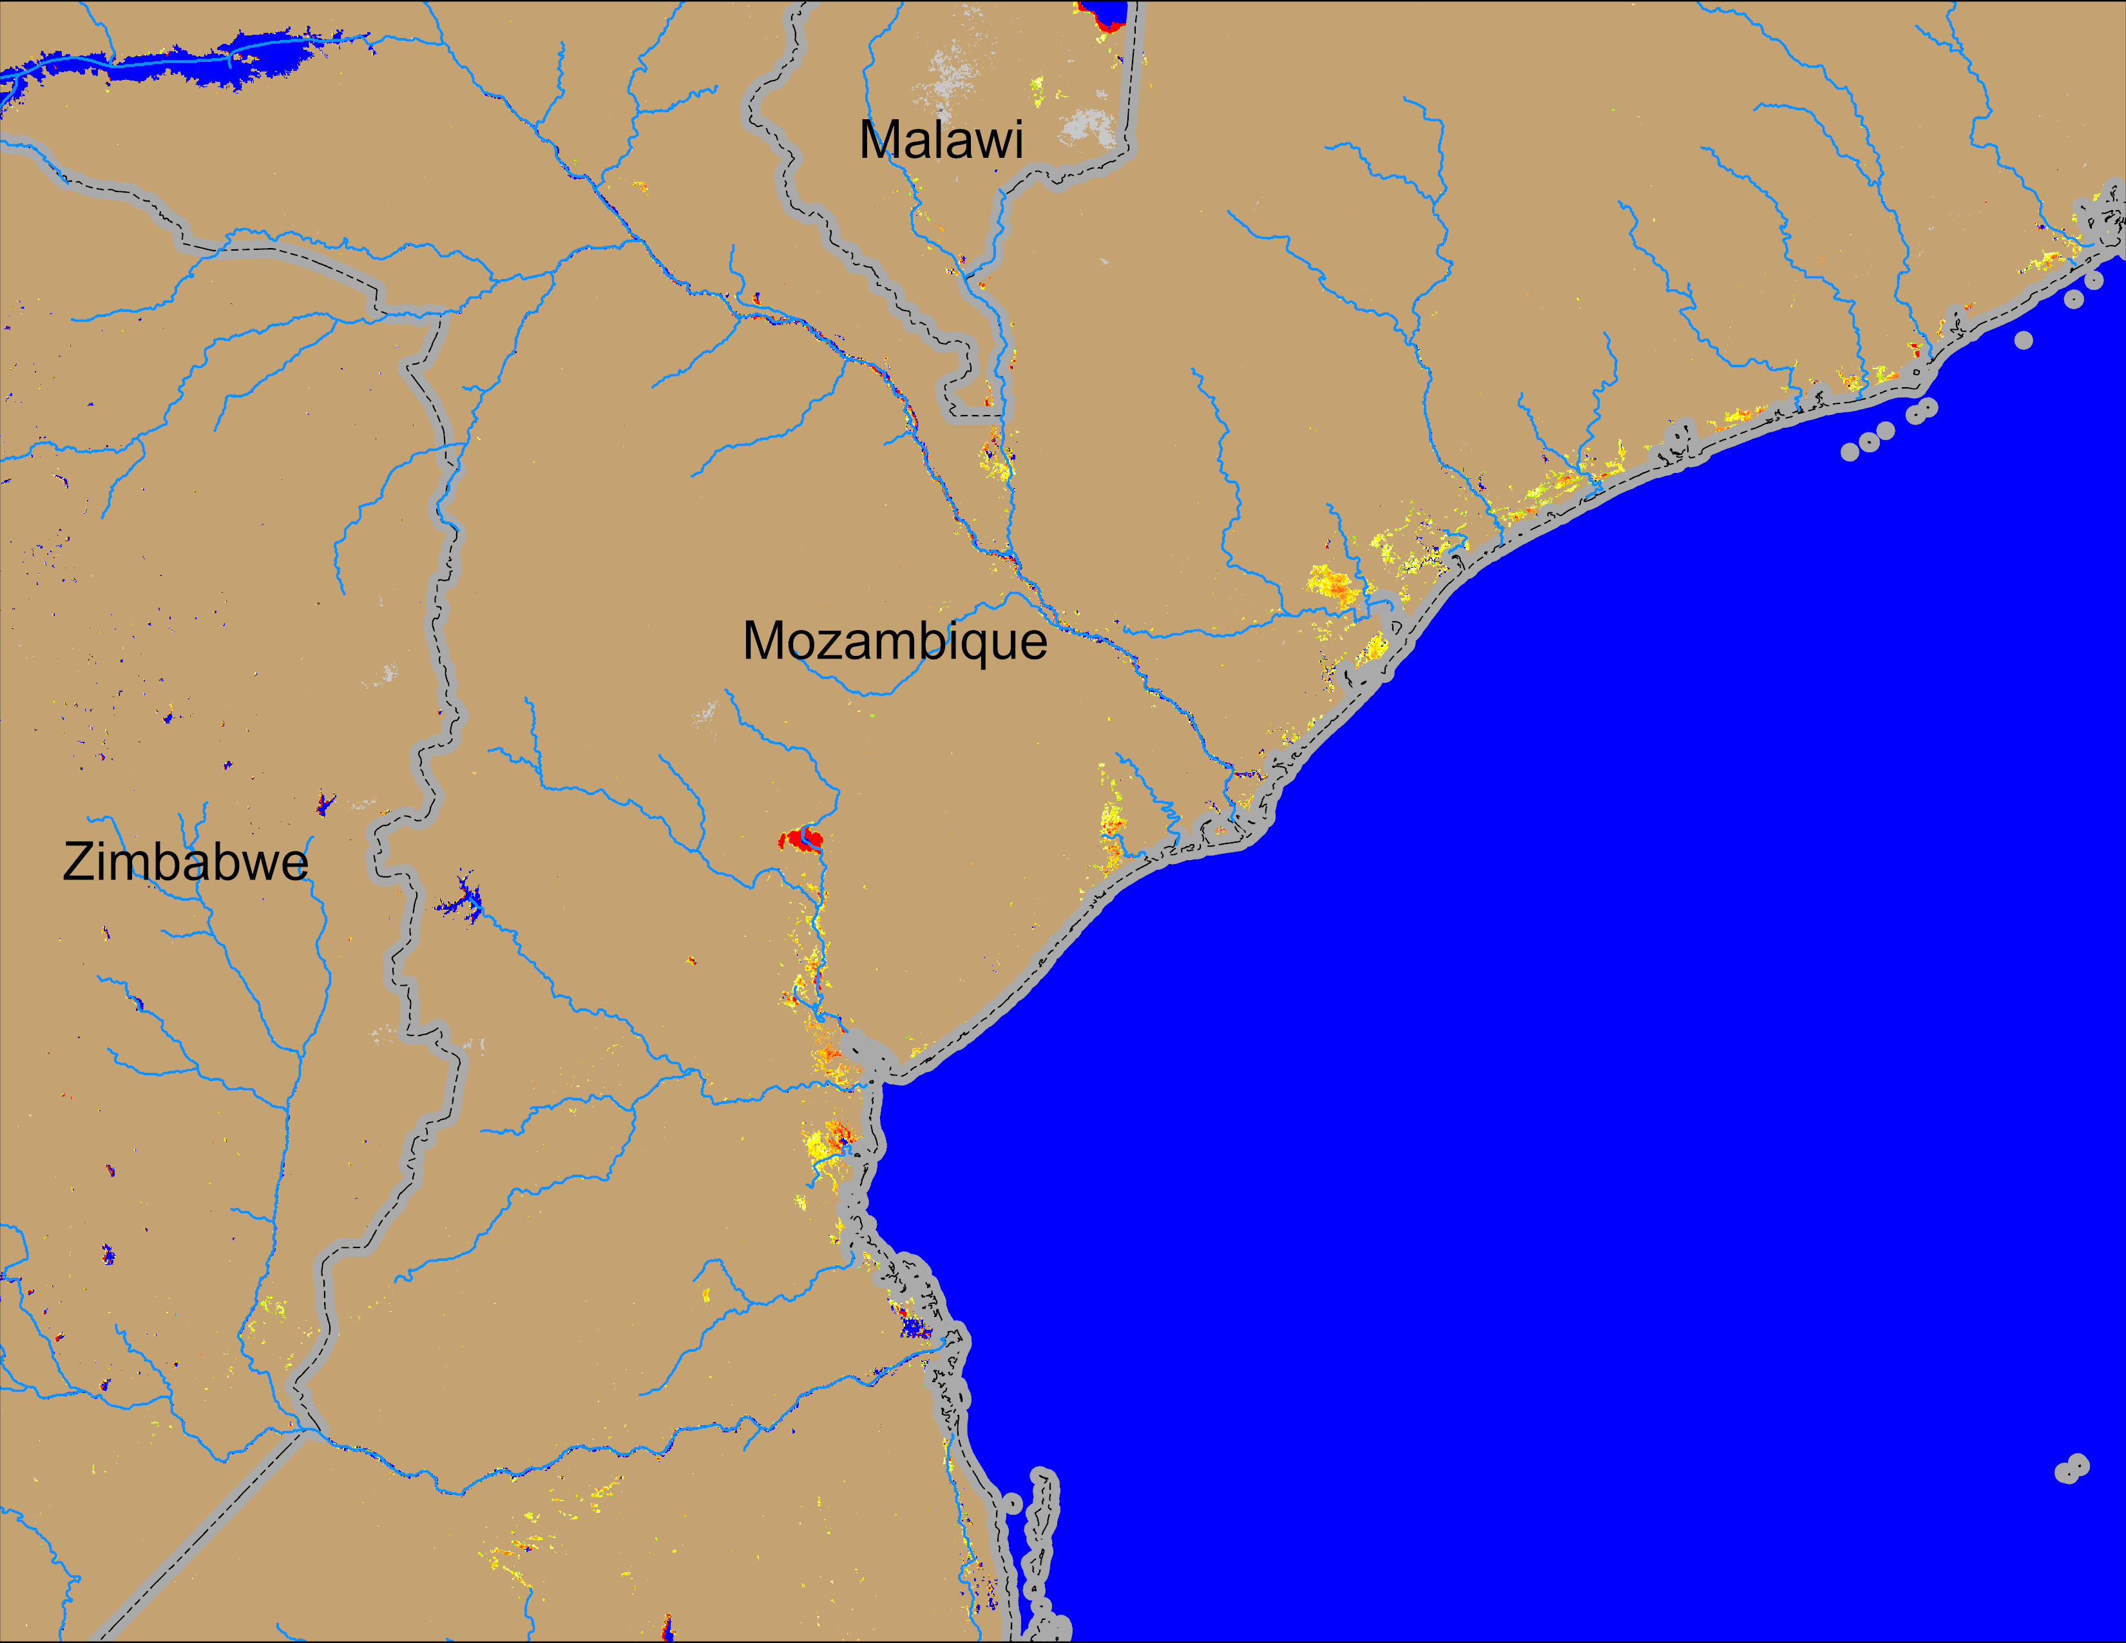
Flooding Conditions in Mozambique
NOAA VIIRS derived map: 28 Jan – 01 Feb 2026
NOAA VIIRS 5-day comp.: 04 – 08 Feb 2026
Flooding conditions improved significantly in central Mozambique and southern Malawi.

Slide 4
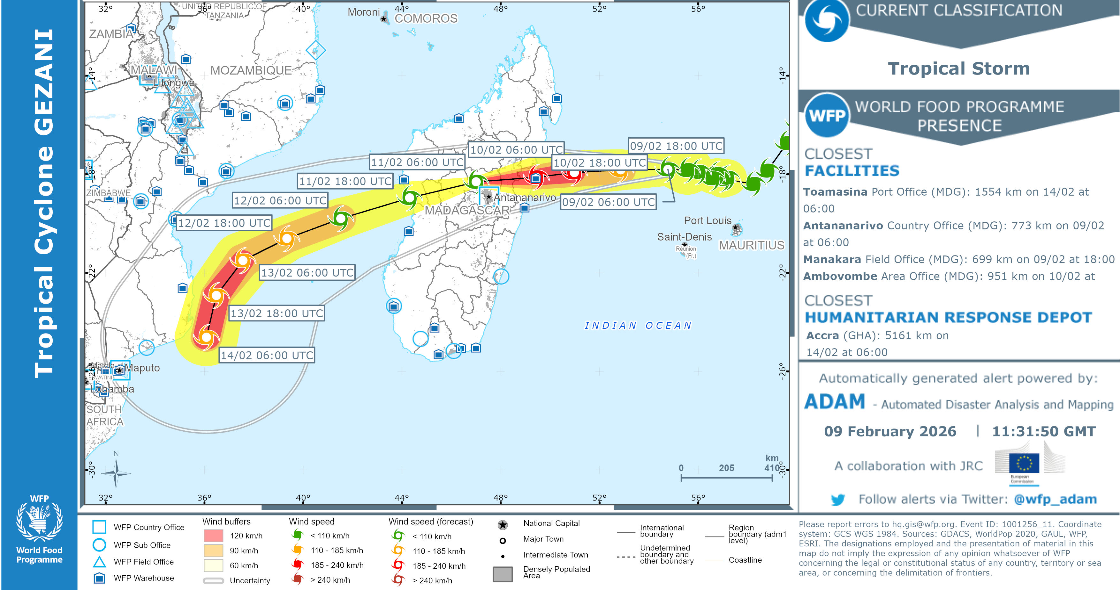
Tropical Cyclone GEZANI
TC GEZANI expected to make landfall on Feb 9th in northeastern Madagascar.

Slide 5
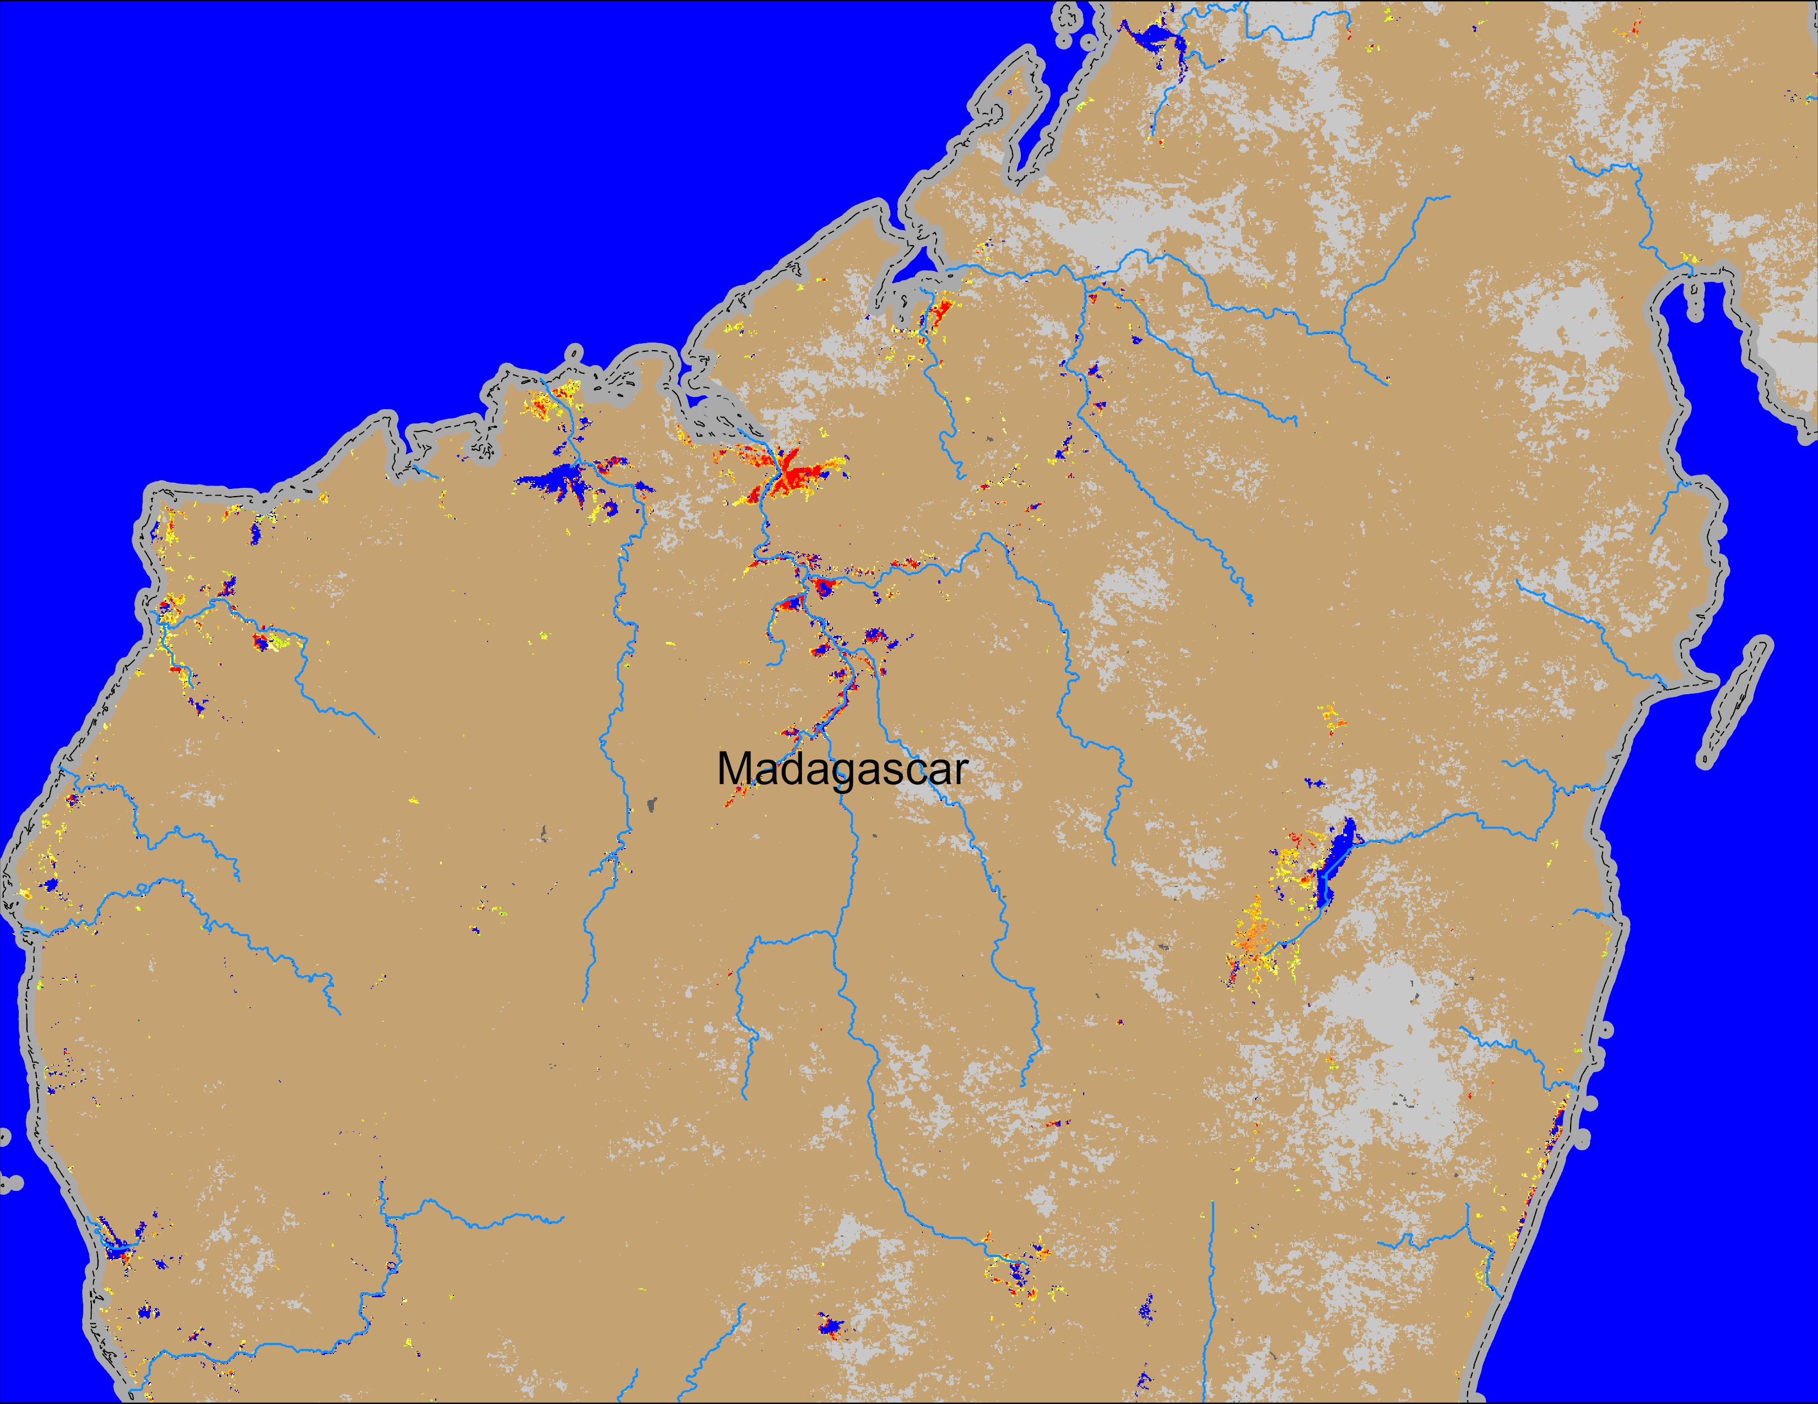
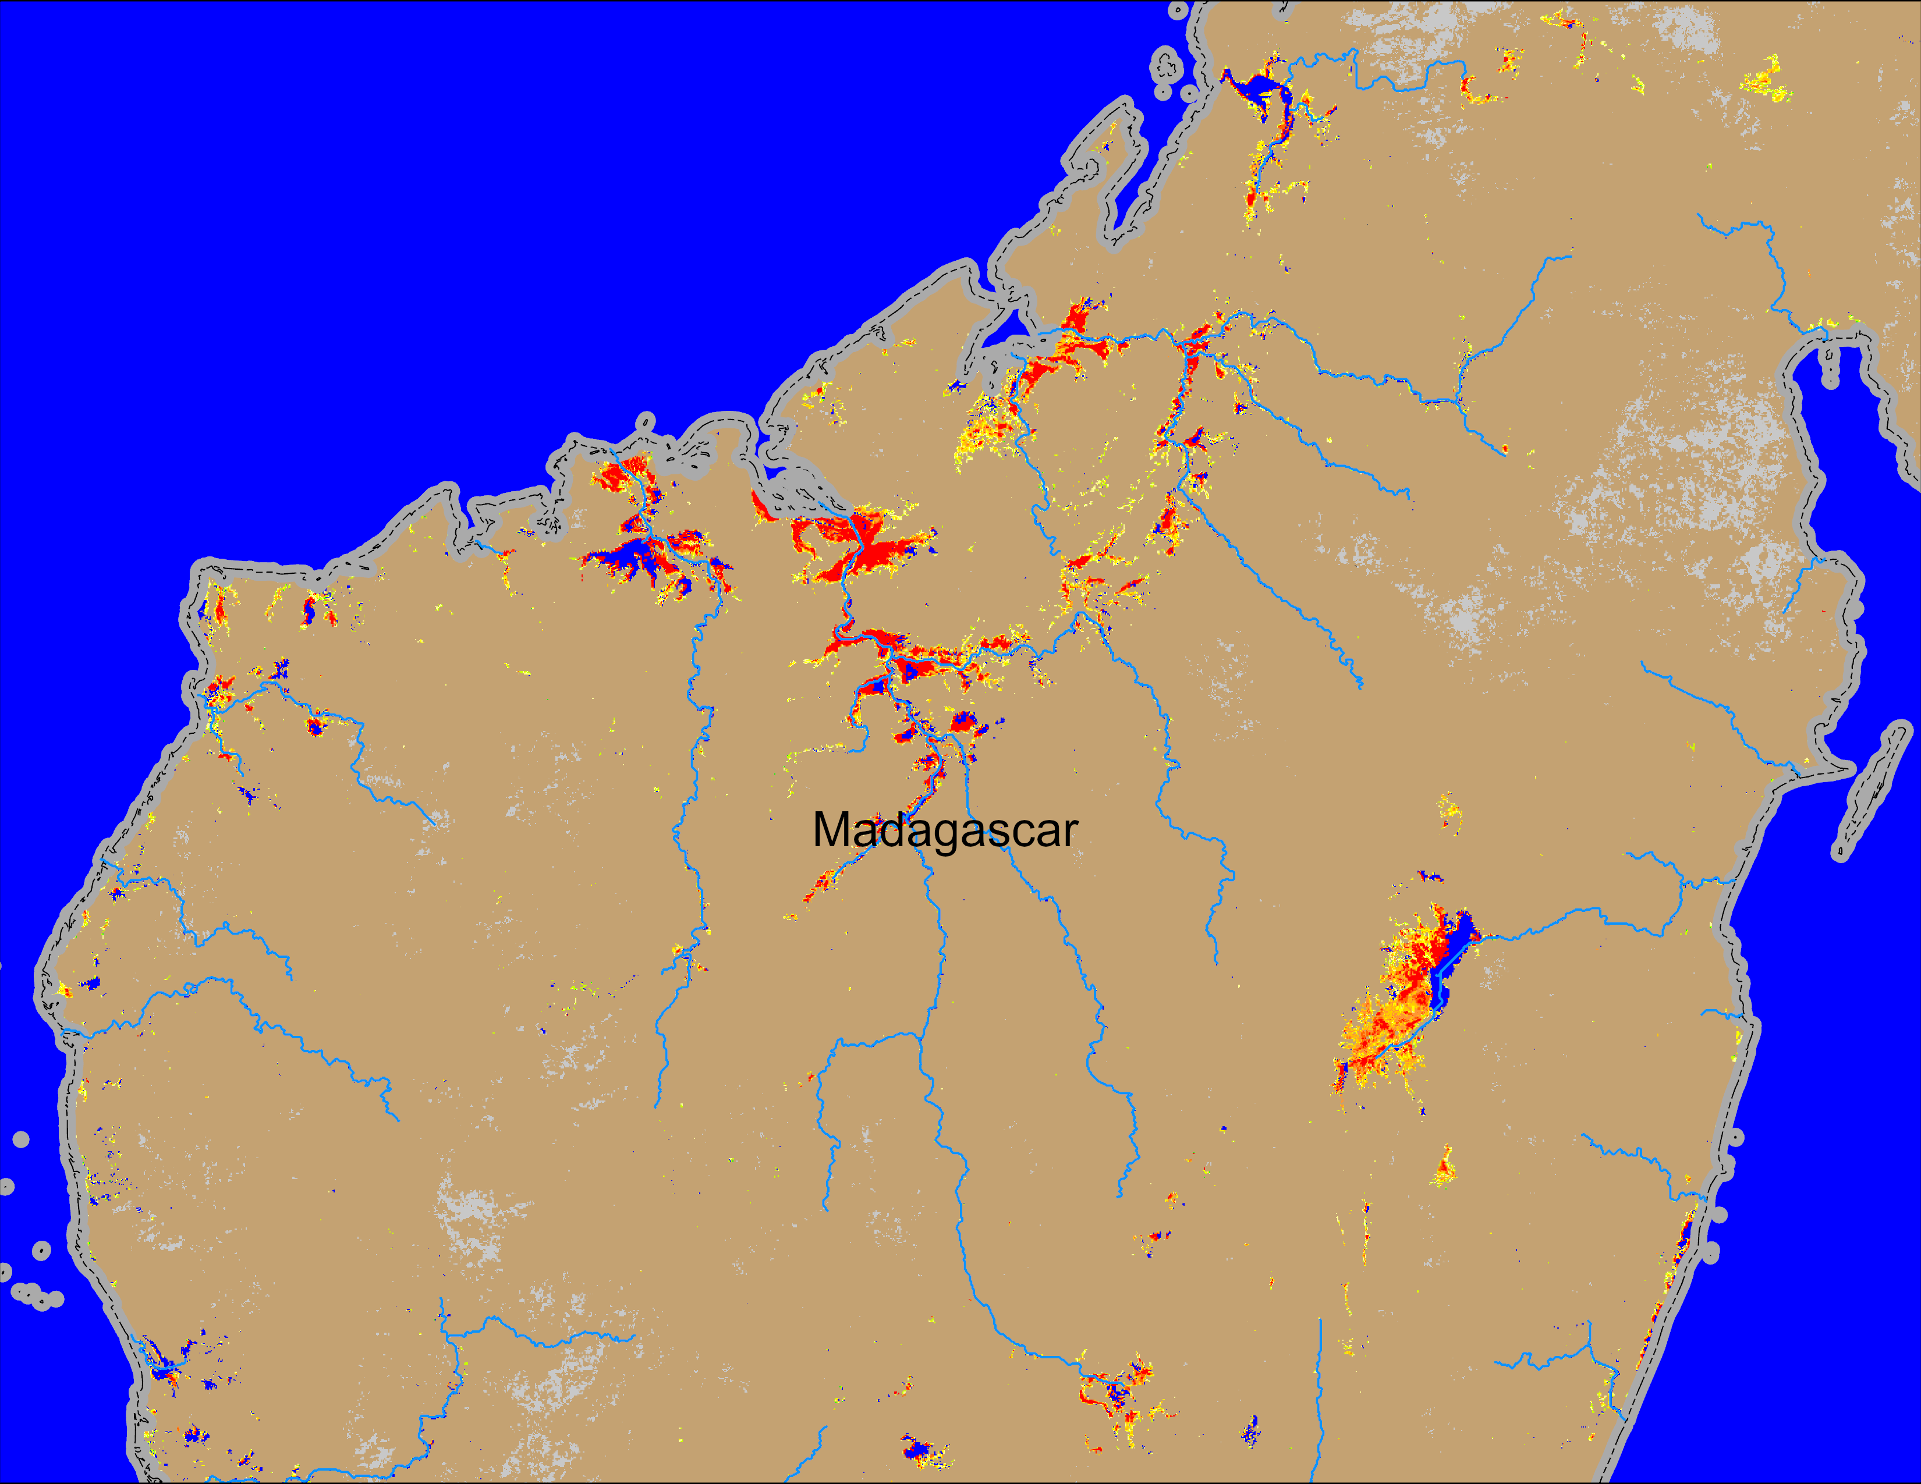
Flooding Conditions in Madagascar
NOAA VIIRS derived map: 21 – 25 Jan 2026
NOAA VIIRS 5-day comp.: 04 – 08 Feb 2026
Significant increase in flooding in the wake of TC GEZANI making landfall in northern Madagascar. More flooding expected in coming days.

Slide 6
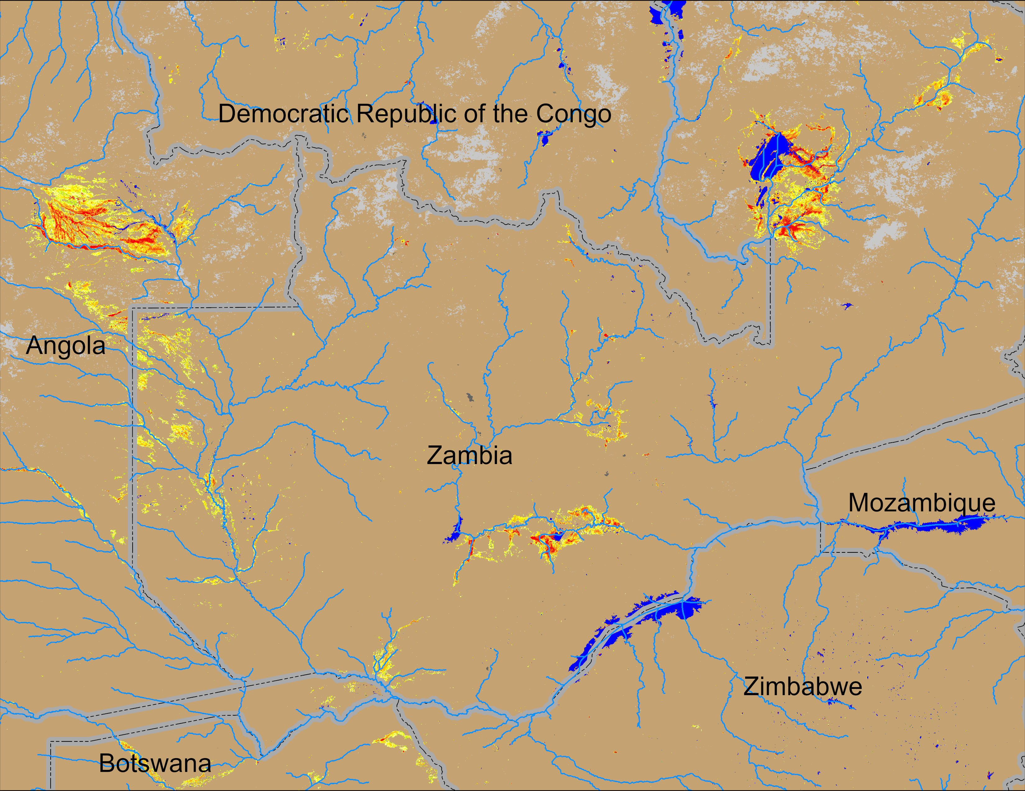
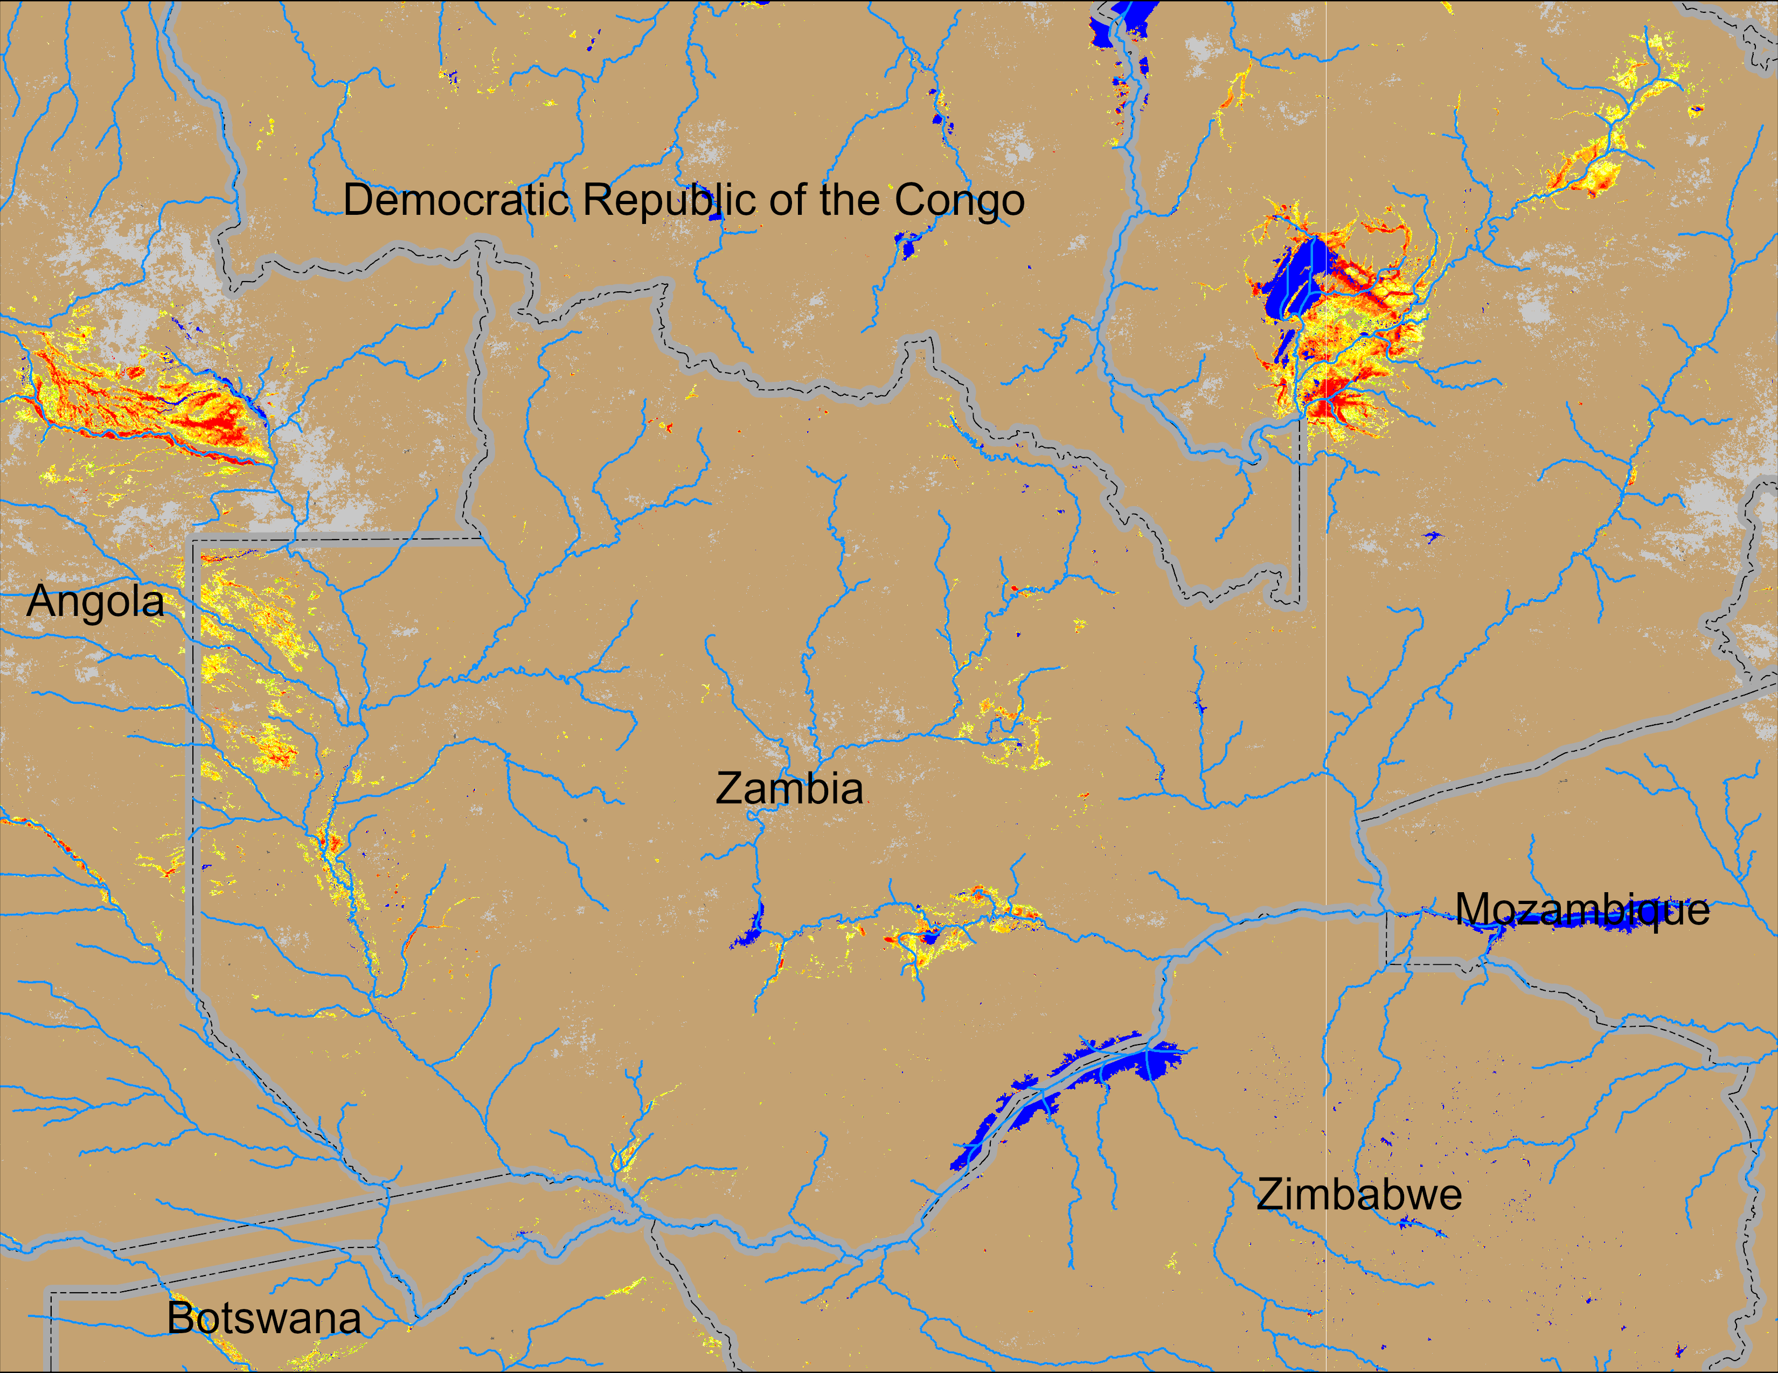
Flooding Conditions in Zambia
NOAA VIIRS derived map: 28 Jan – 01 Feb 2026
NOAA VIIRS 5-day comp.: 04 – 08 Feb 2026
Flooding conditions across Zambia deteriorating.

Slide 7
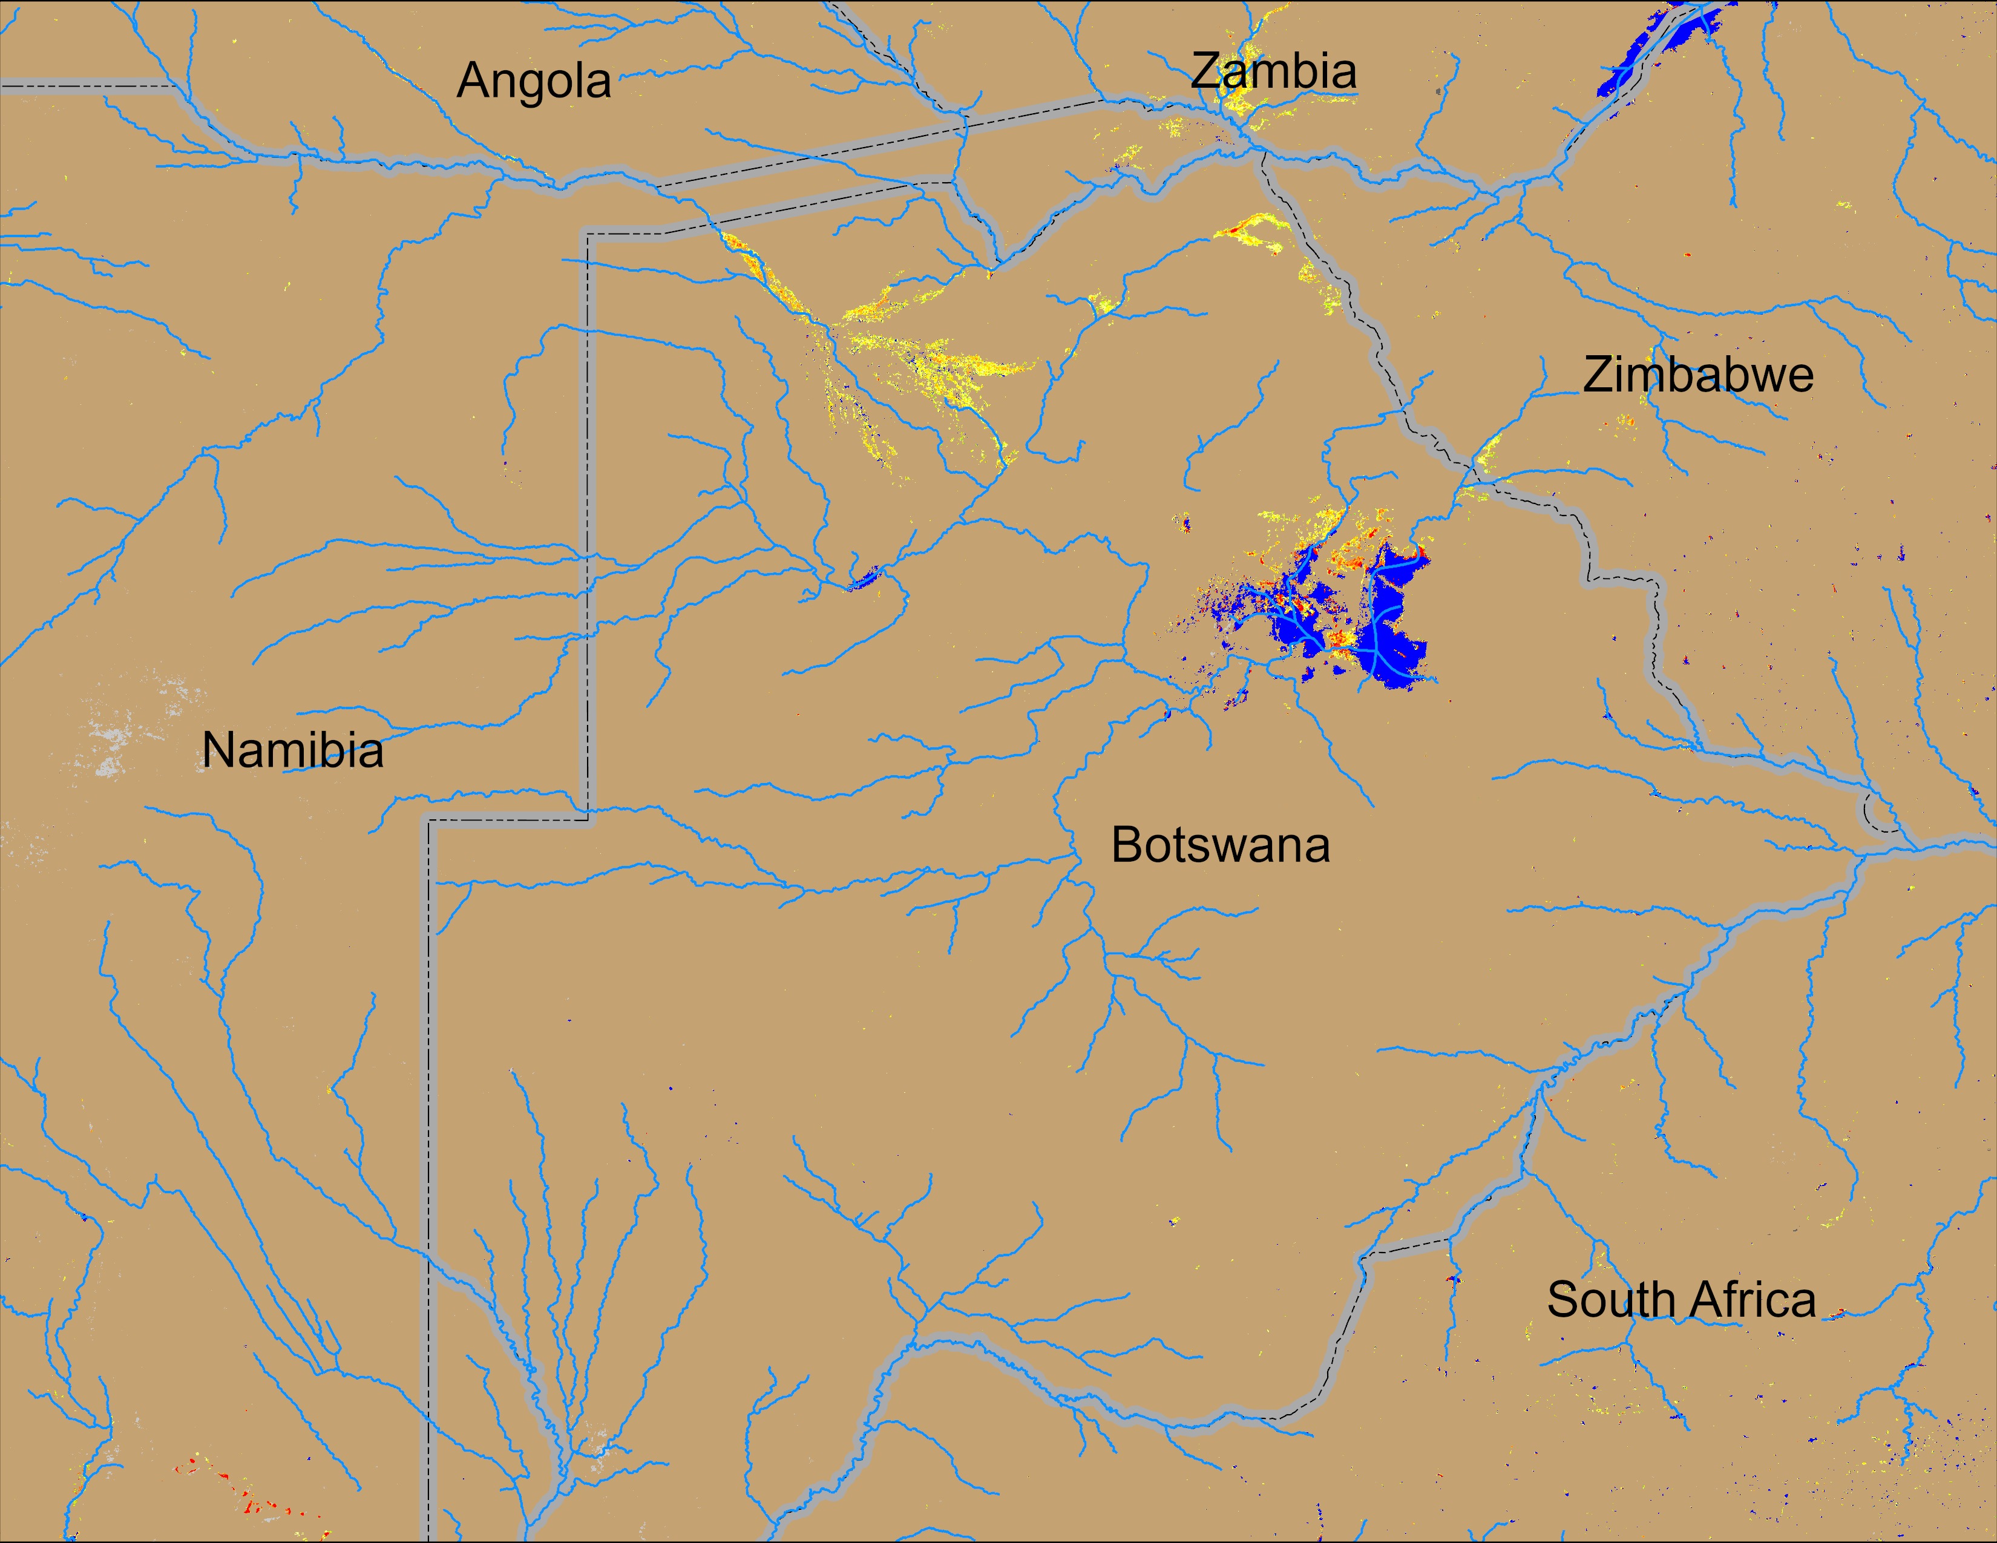
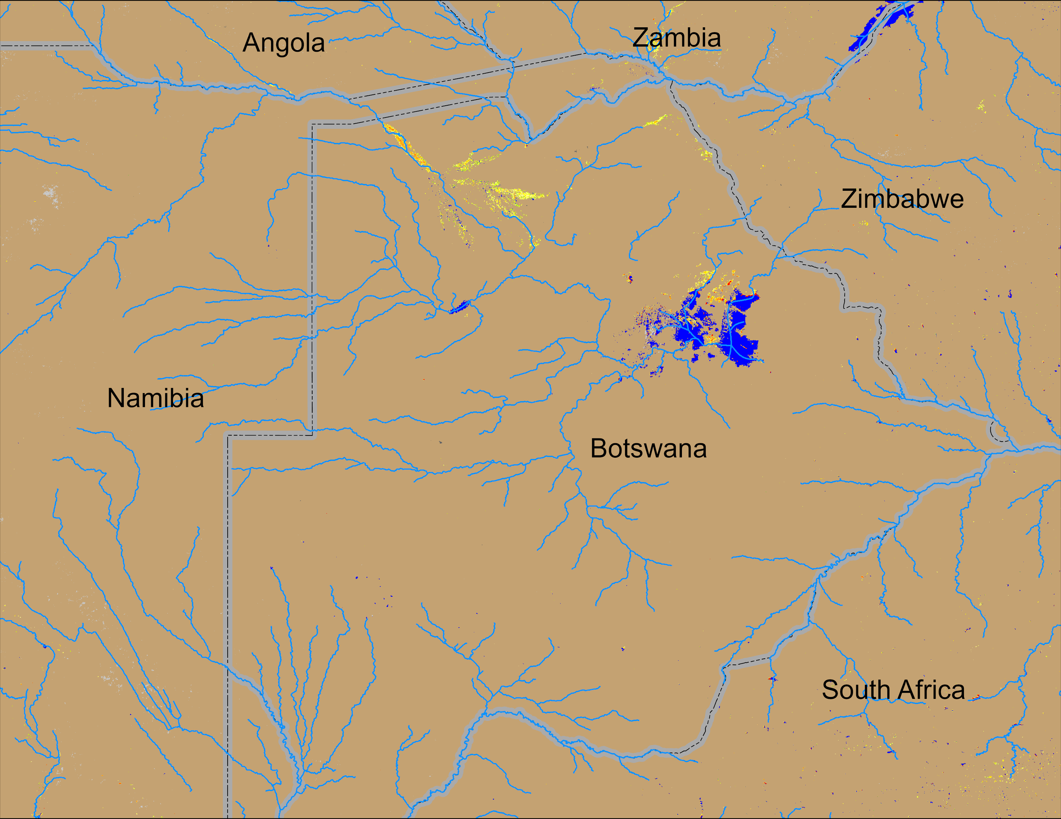
Flooding Conditions in Botswana
NOAA VIIRS derived map: 28 Jan – 01 Feb 2026
NOAA VIIRS 5-day comp.: 04 – 08 Feb 2026
Flooding conditions improved marginally in northern Botswana.

