Slide 1
FEWS NET Enhanced Flood Monitoring and Forecast
FEWS NET Science Team
February 02, 2026
Notes:
Default title slide

Slide 2

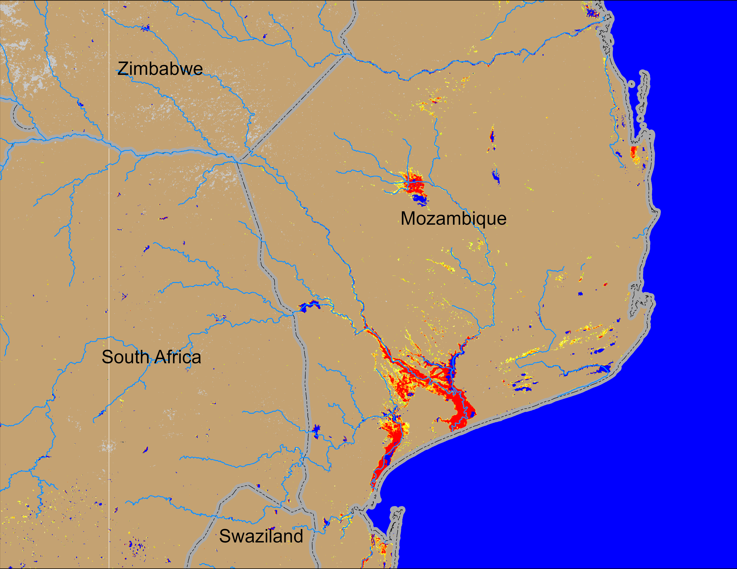
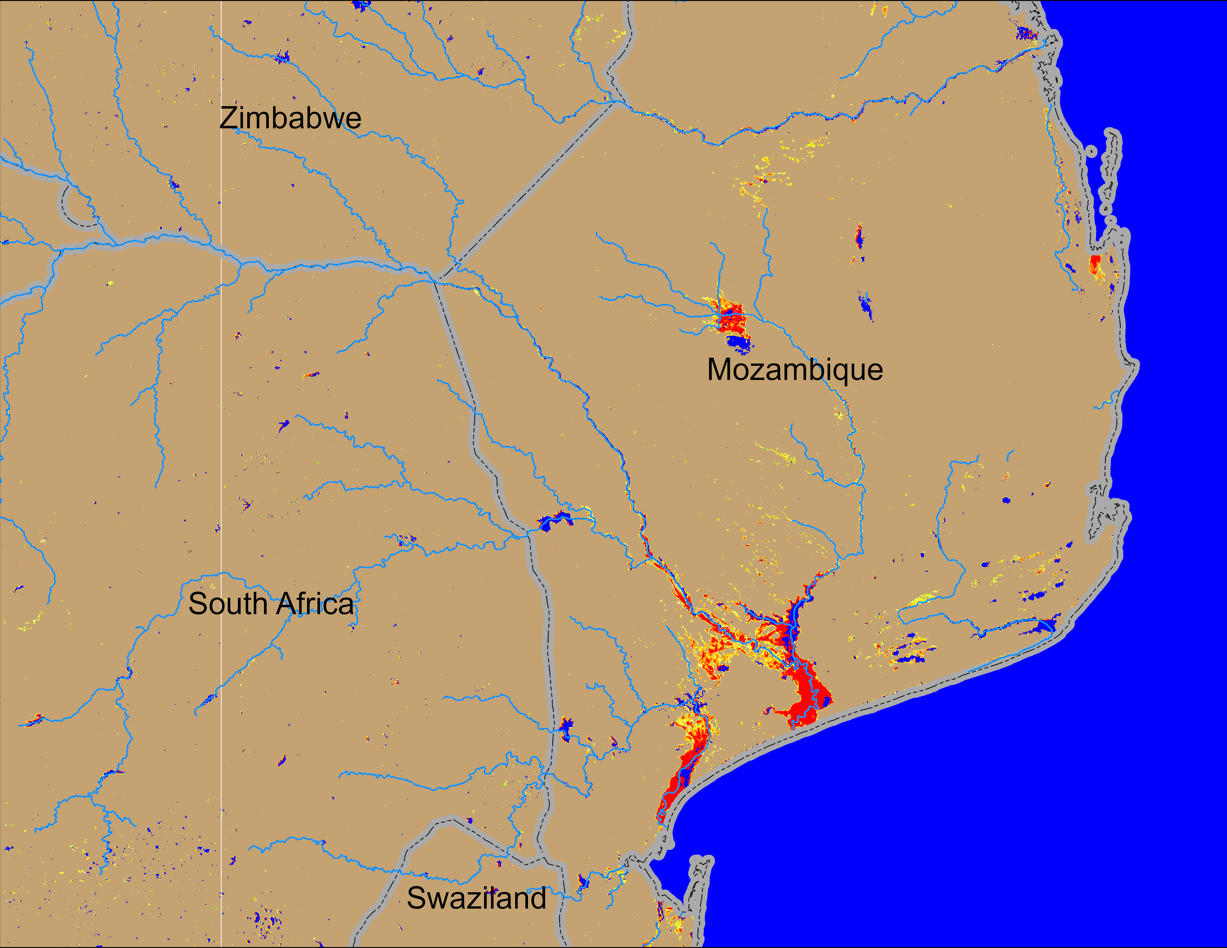
Flooding Conditions in Mozambique
NOAA VIIRS derived map: 21 – 25 Jan 2026
NOAA VIIRS 5-day comp.: 28 Jan – 01 Feb 2026
Substantial flooding continues in the downstream of Limpopo River in southern Mozambique.

Slide 3
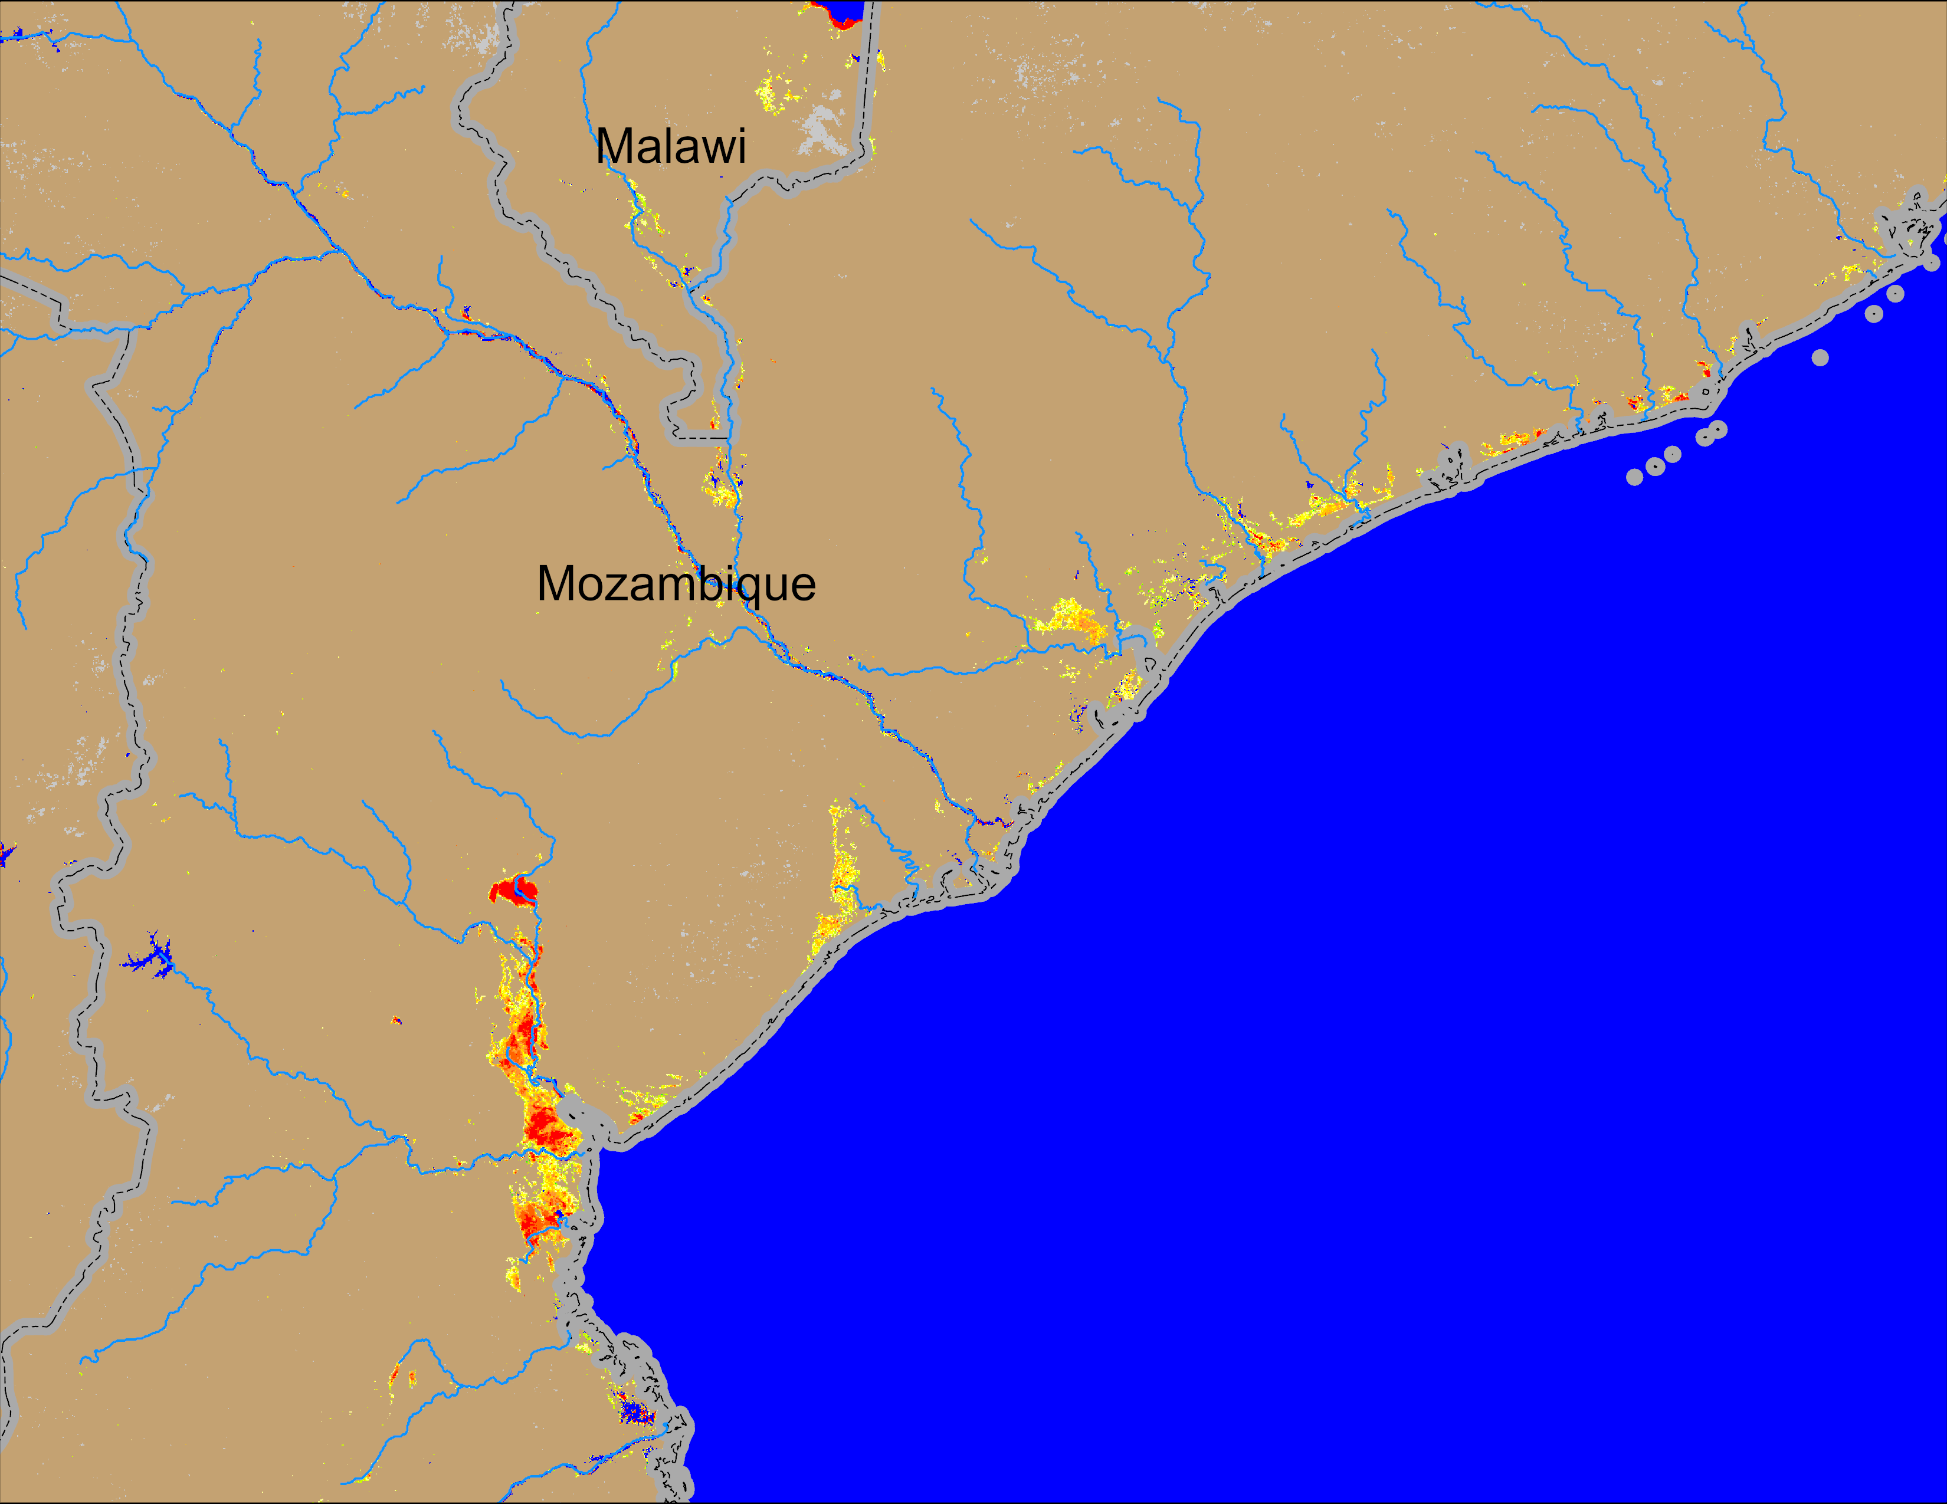
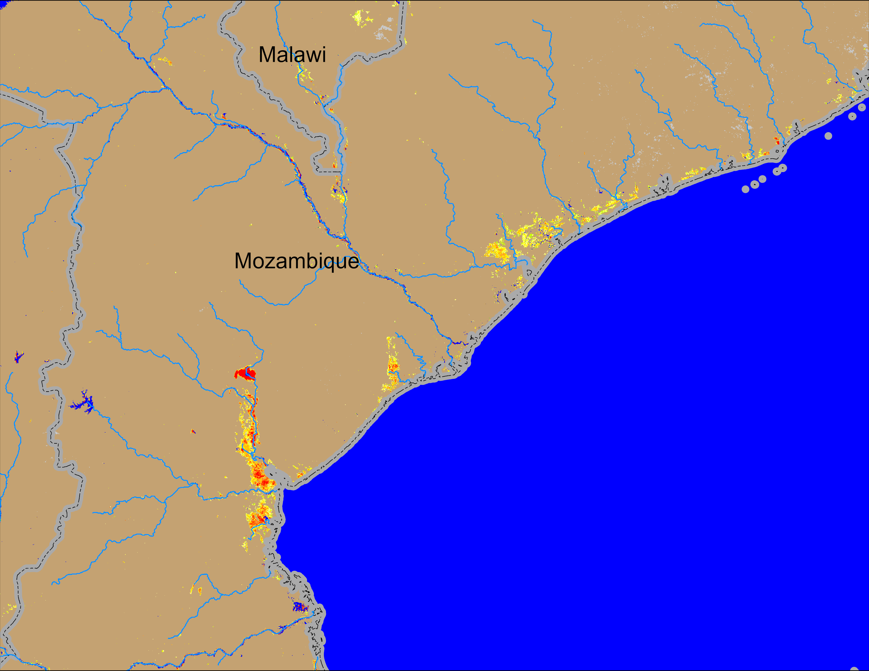
Flooding Conditions in Mozambique
NOAA VIIRS derived map: 21 – 25 Jan 2026
NOAA VIIRS 5-day comp.: 28 Jan – 01 Feb 2026
Marginal improvement in flooding conditions in central Mozambique and southern Malawi.

Slide 4
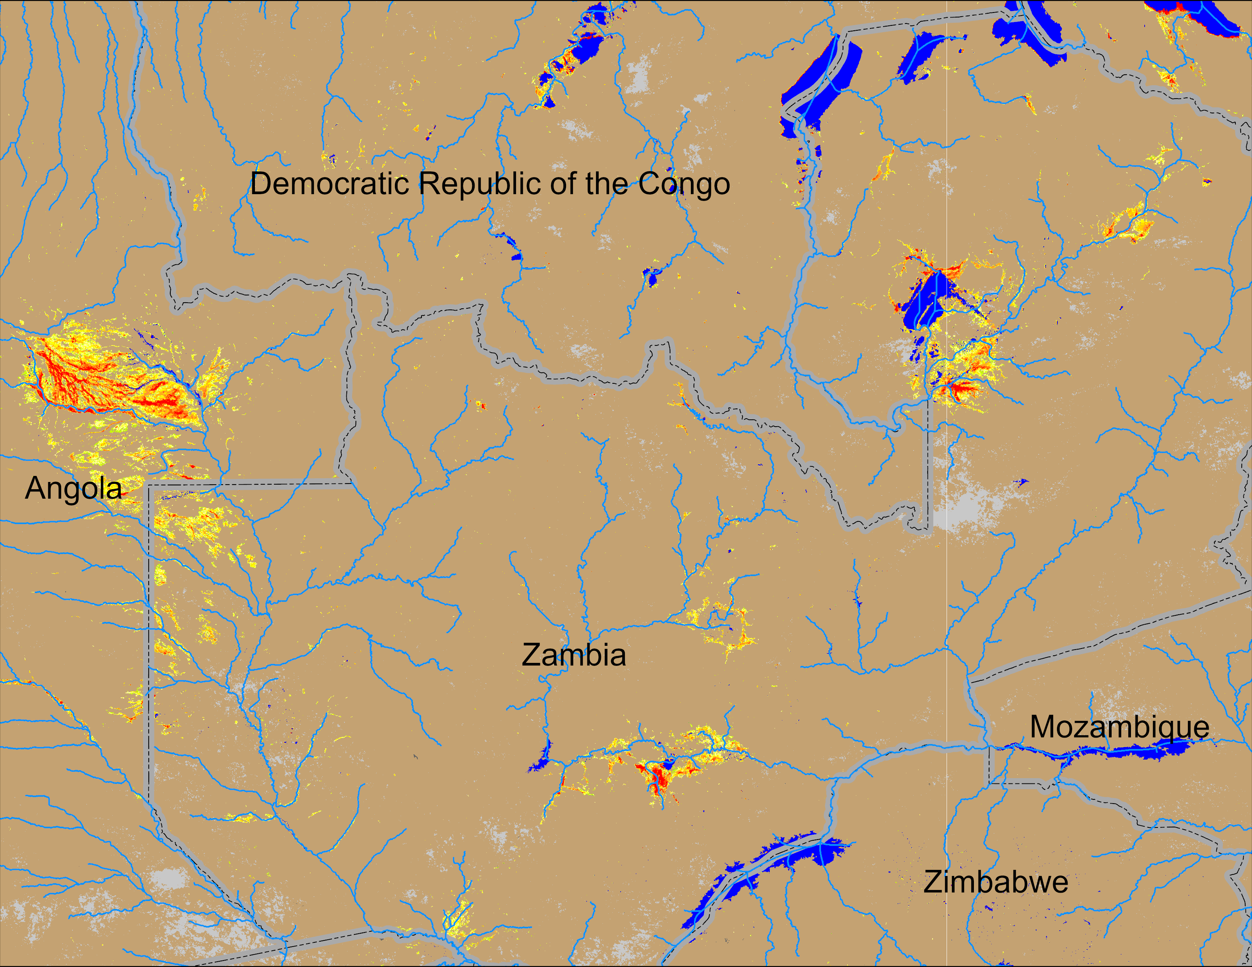
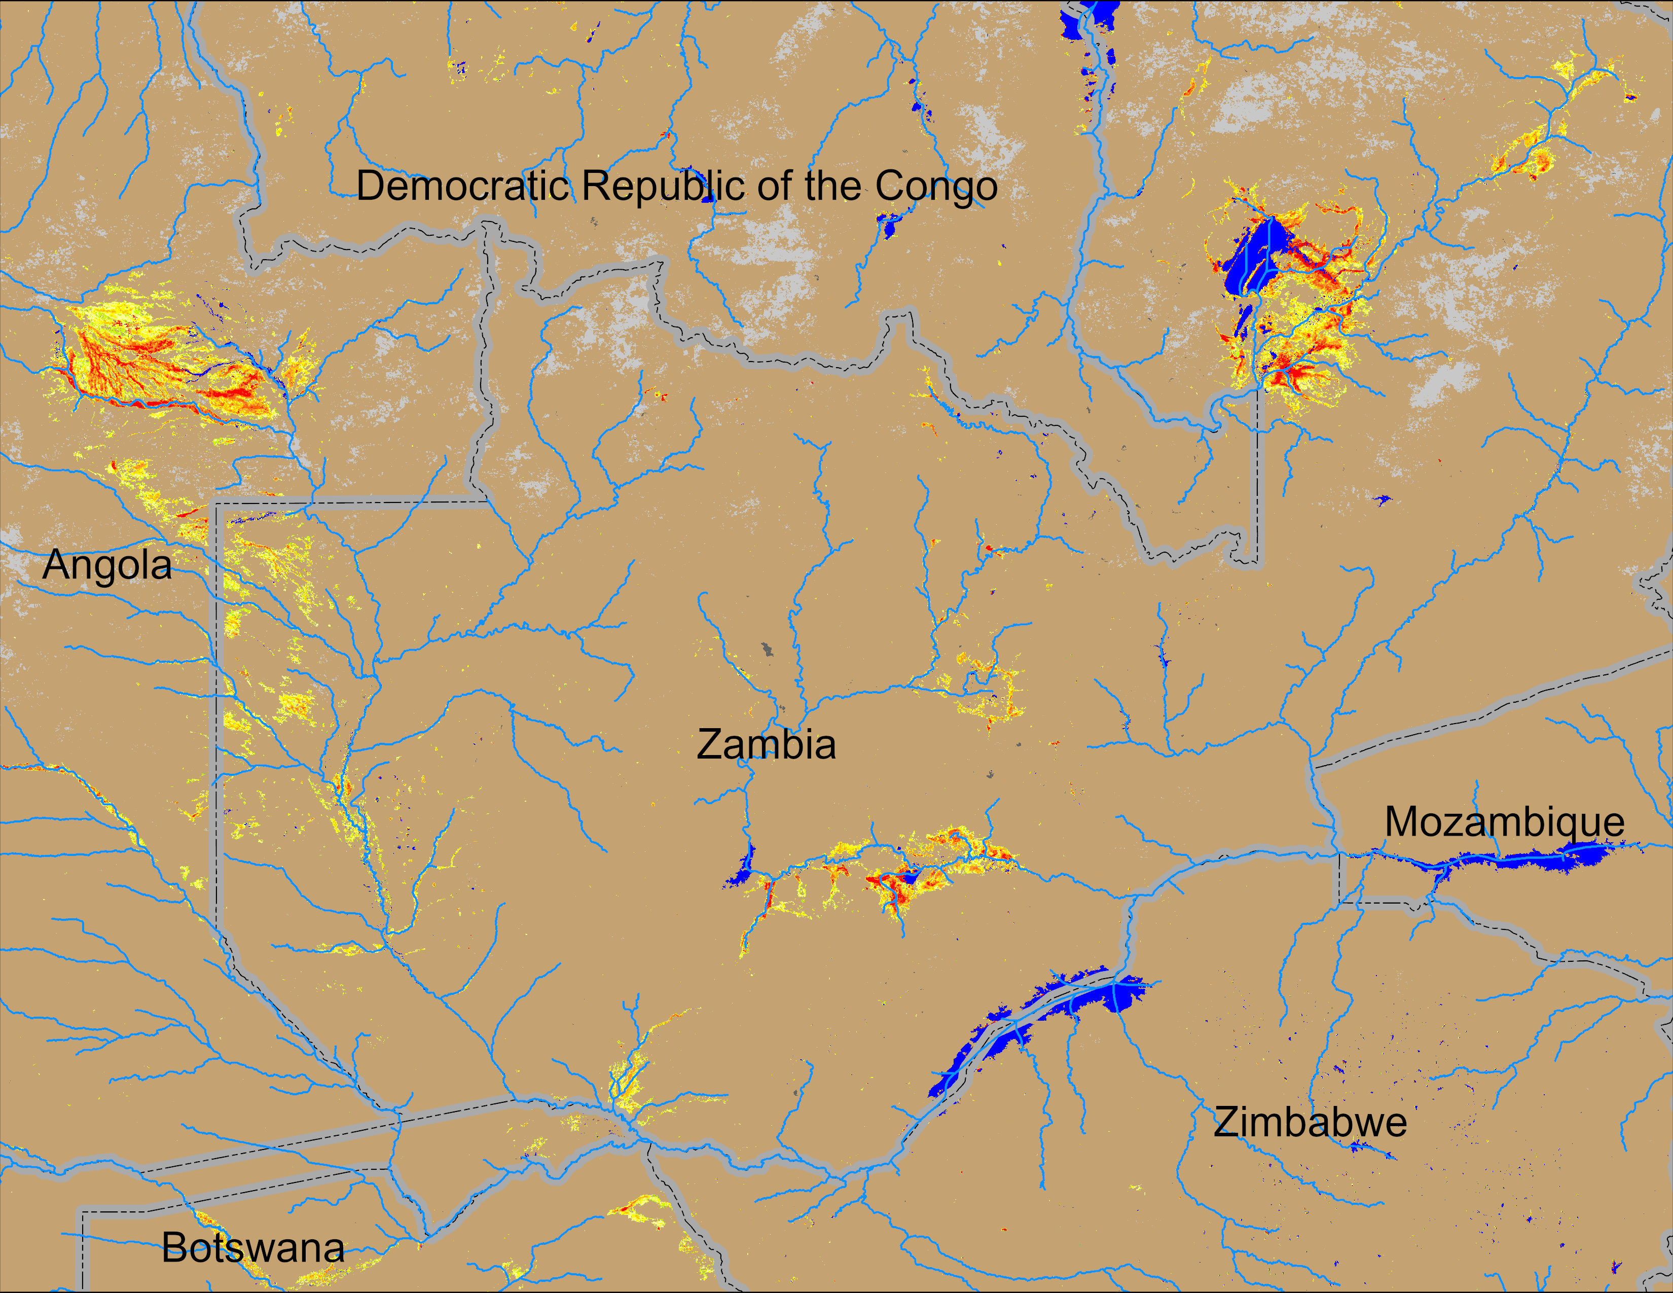
Flooding Conditions in Zambia
NOAA VIIRS derived map: 21 – 25 Jan 2026
NOAA VIIRS 5-day comp.: 28 Jan – 01 Feb 2026
Flooding intensifyting across Zambia.

Slide 5
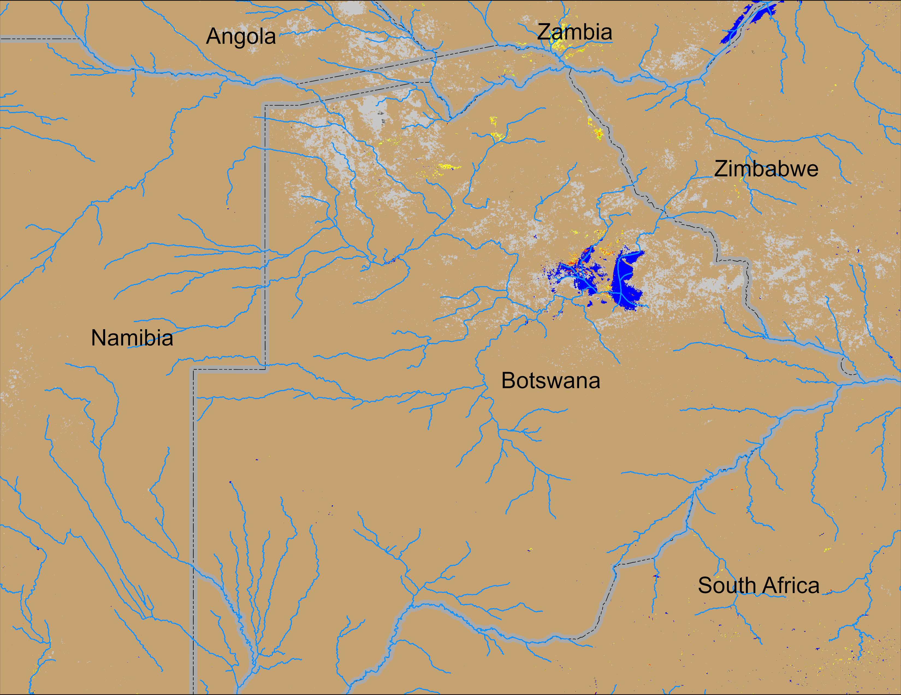
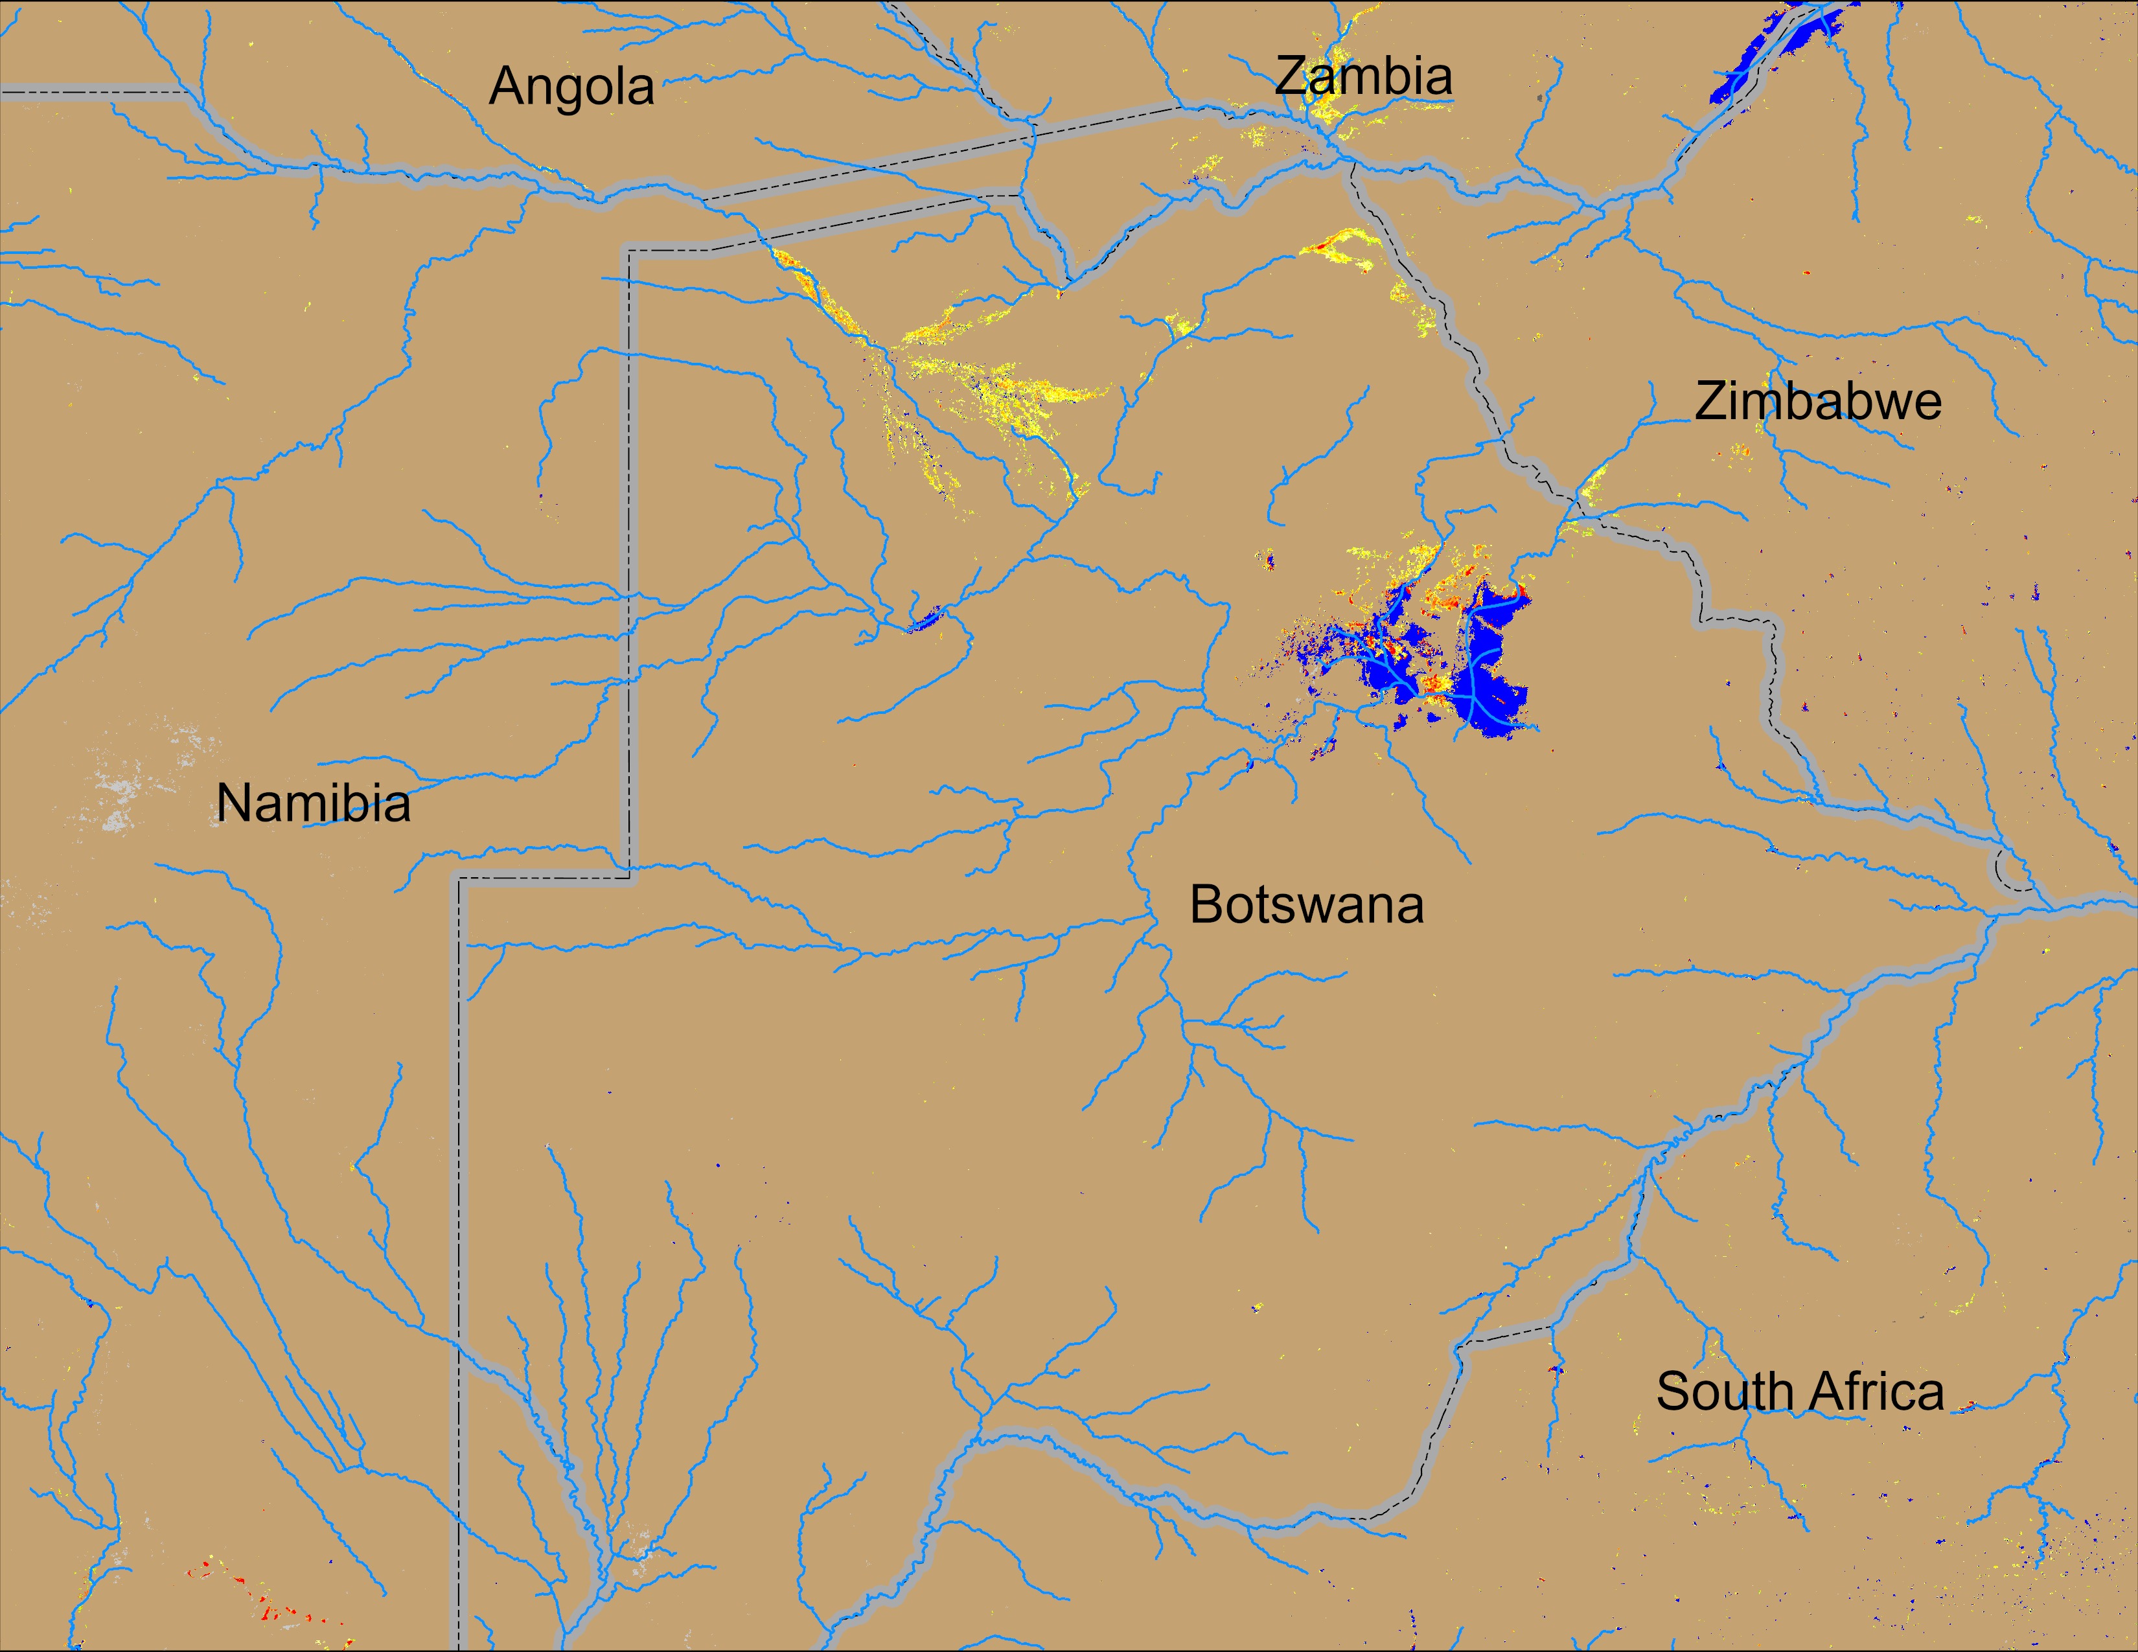
Flooding Conditions in Botswana
NOAA VIIRS derived map: 21 – 25 Jan 2026
NOAA VIIRS 5-day comp.: 28 Jan – 01 Feb 2026
Inundated areas have increaed in northern Botswana.

