Slide 1
FEWS NET Enhanced Flood Monitoring and Forecast
FEWS NET Science Team
April 27, 2026
Notes:
Default title slide

Slide 2
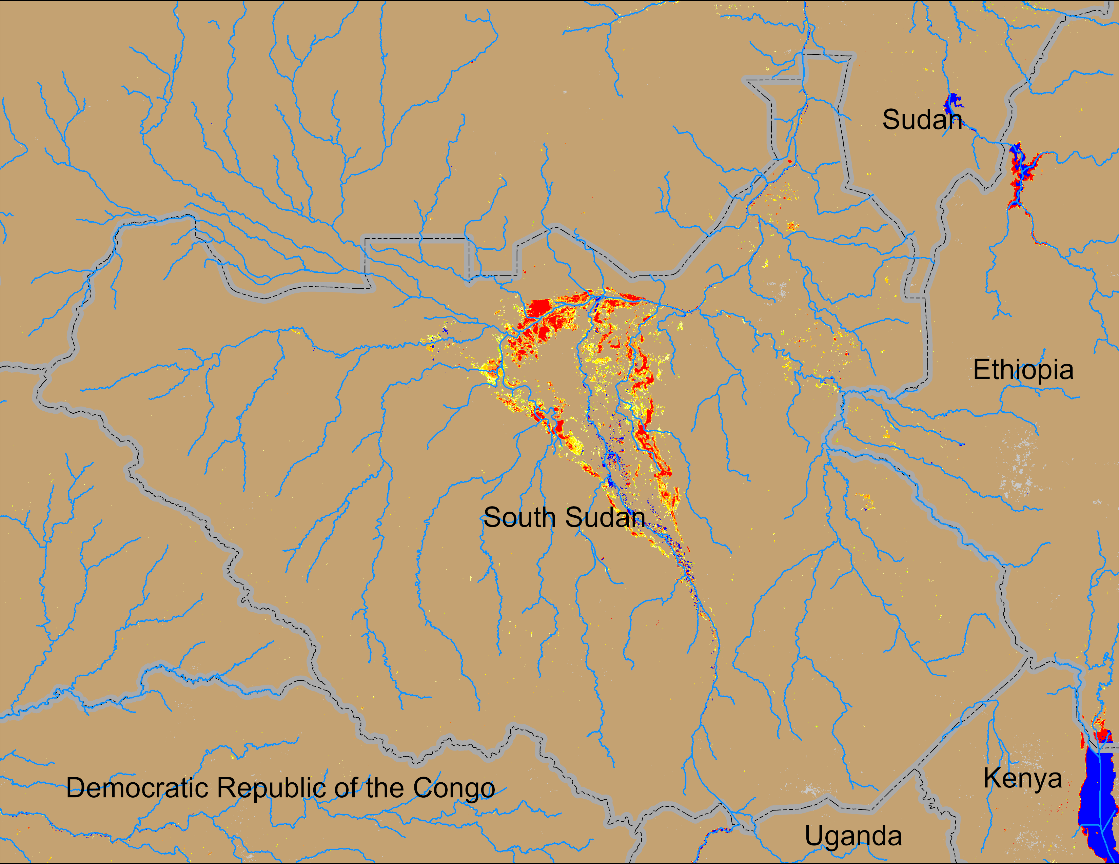
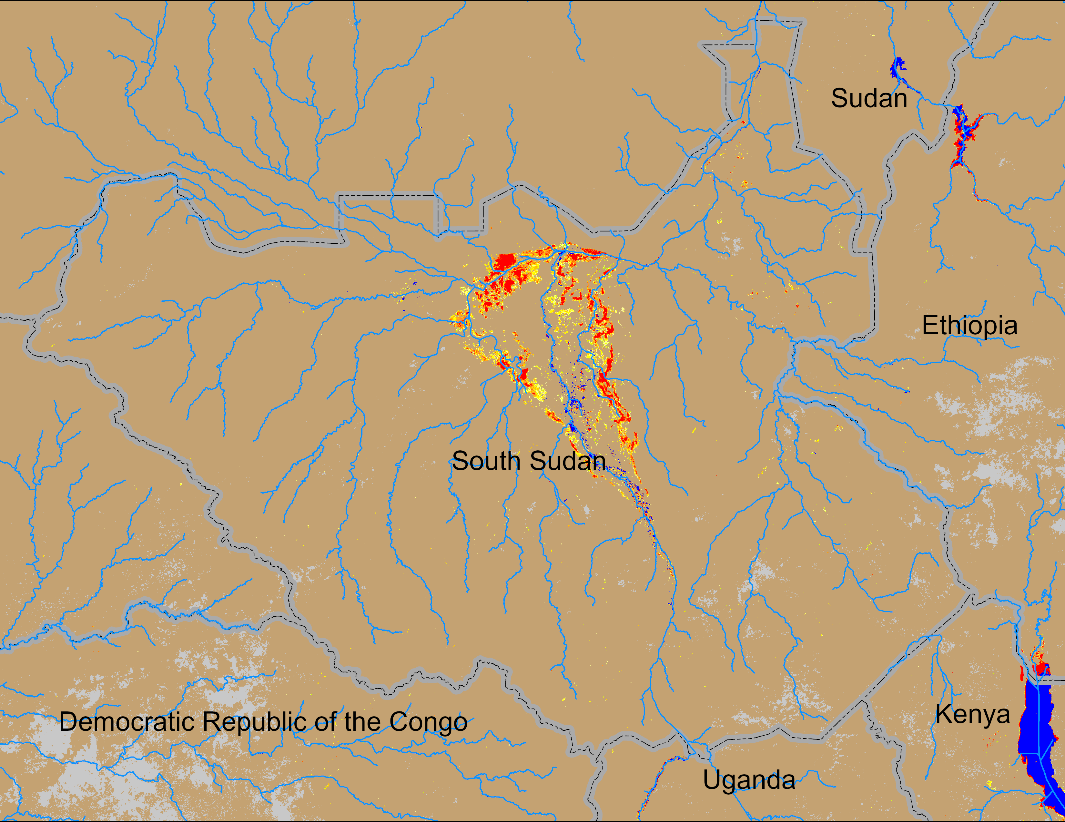

Flooding Conditions in South Sudan
NOAA VIIRS derived map: 15 – 19 Apr 2026
NOAA VIIRS 5-day comp.: 22 – 26 Apr 2026
Persistent inundation suggest, it may be at its lowest seasonal extent.

Slide 3
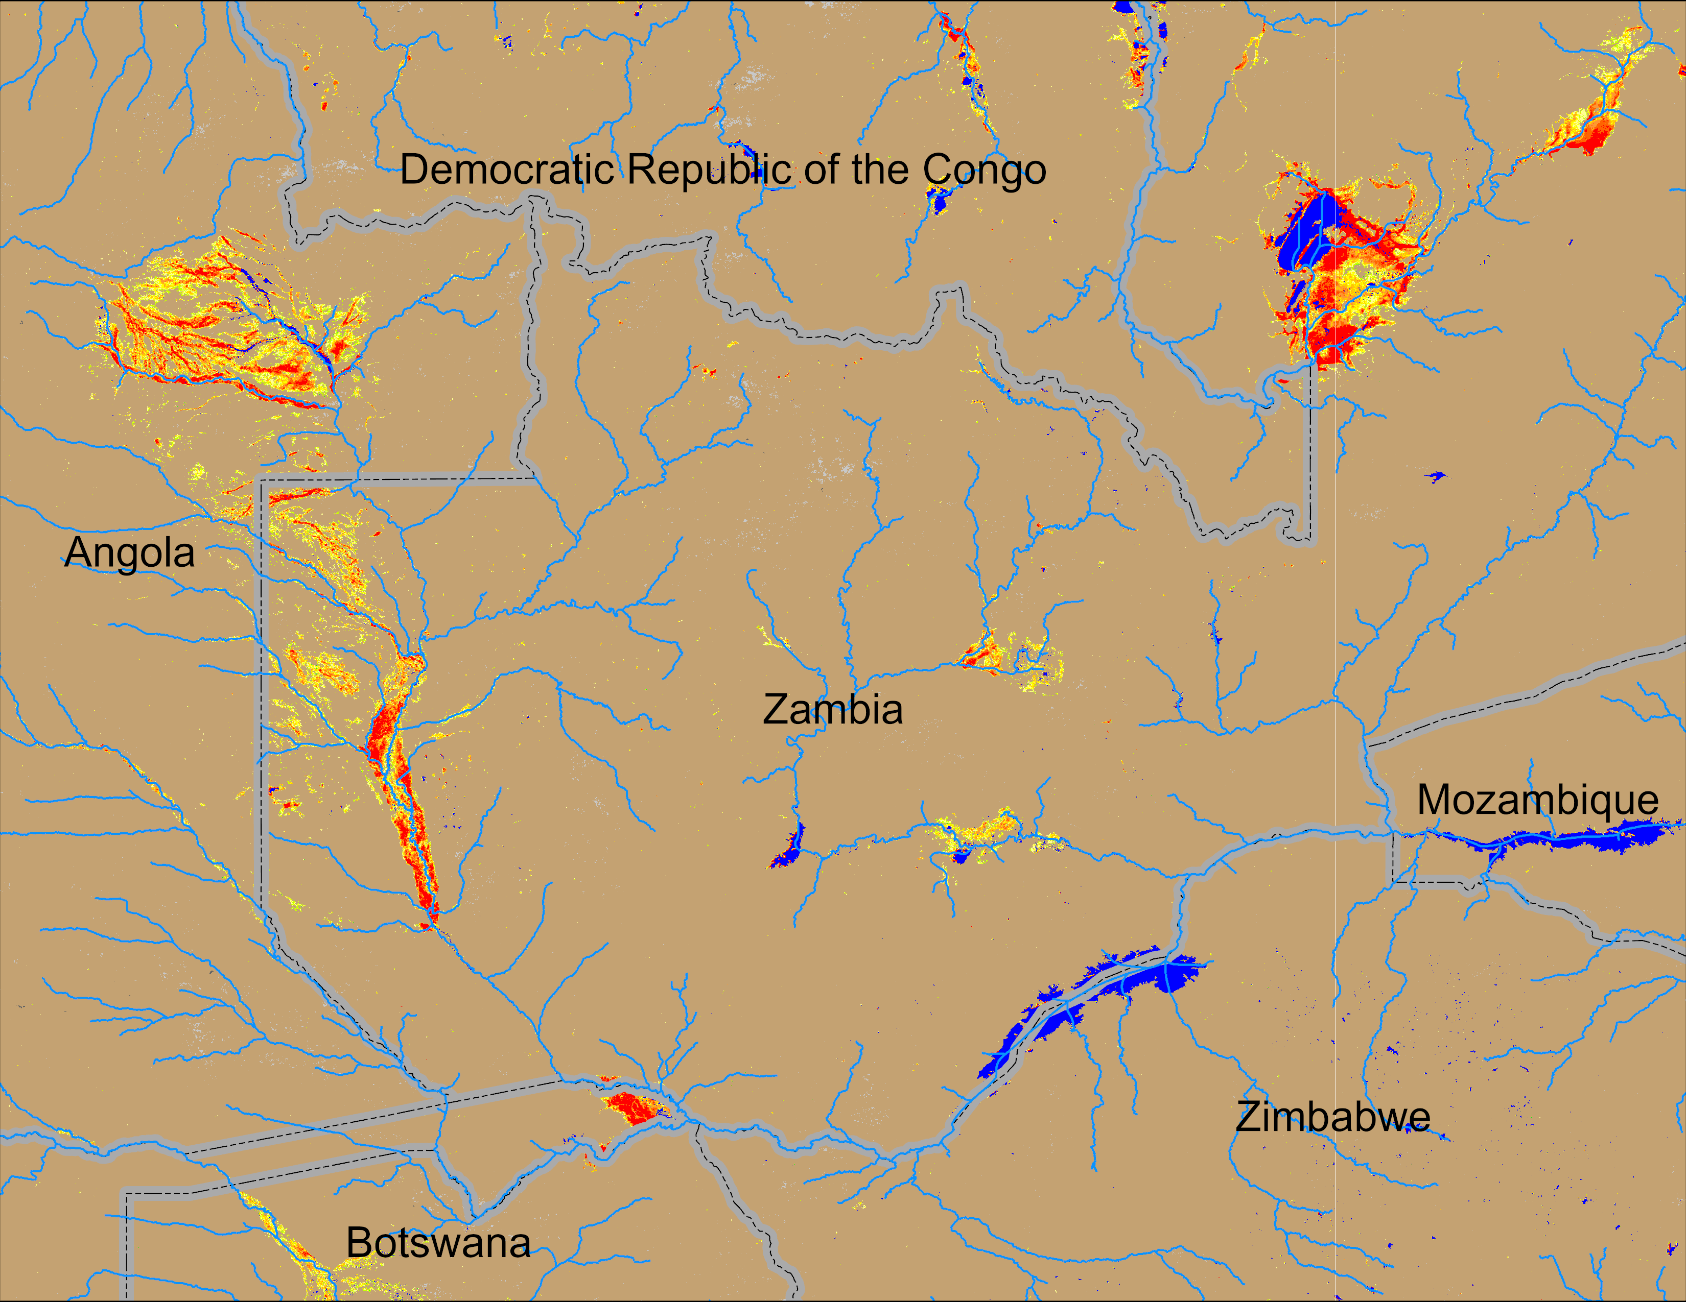
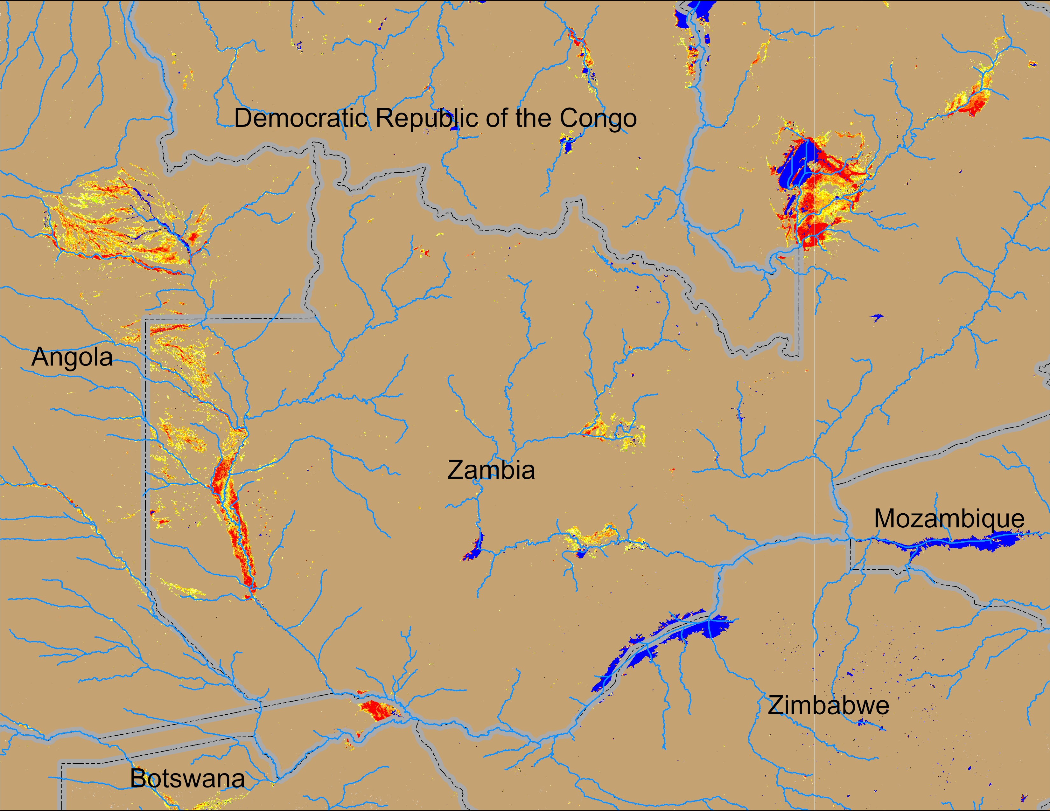
Flooding Conditions in Zambia
NOAA VIIRS derived map: 15 – 19 Apr 2026
NOAA VIIRS 5-day comp.: 22 – 26 Apr 2026
Intensifyed flooding remained unchanged across Zambia.

Slide 4
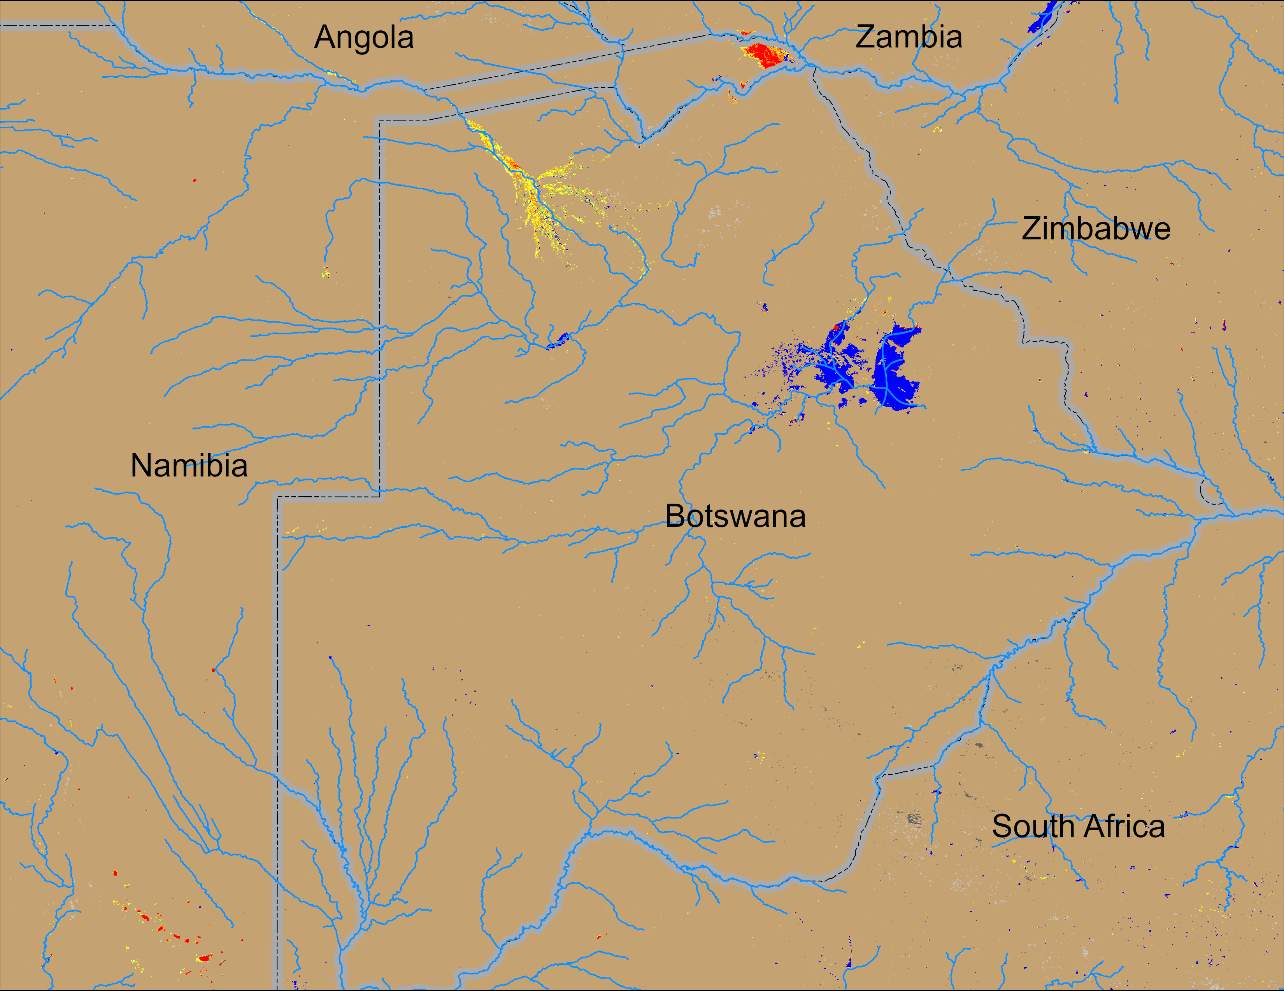
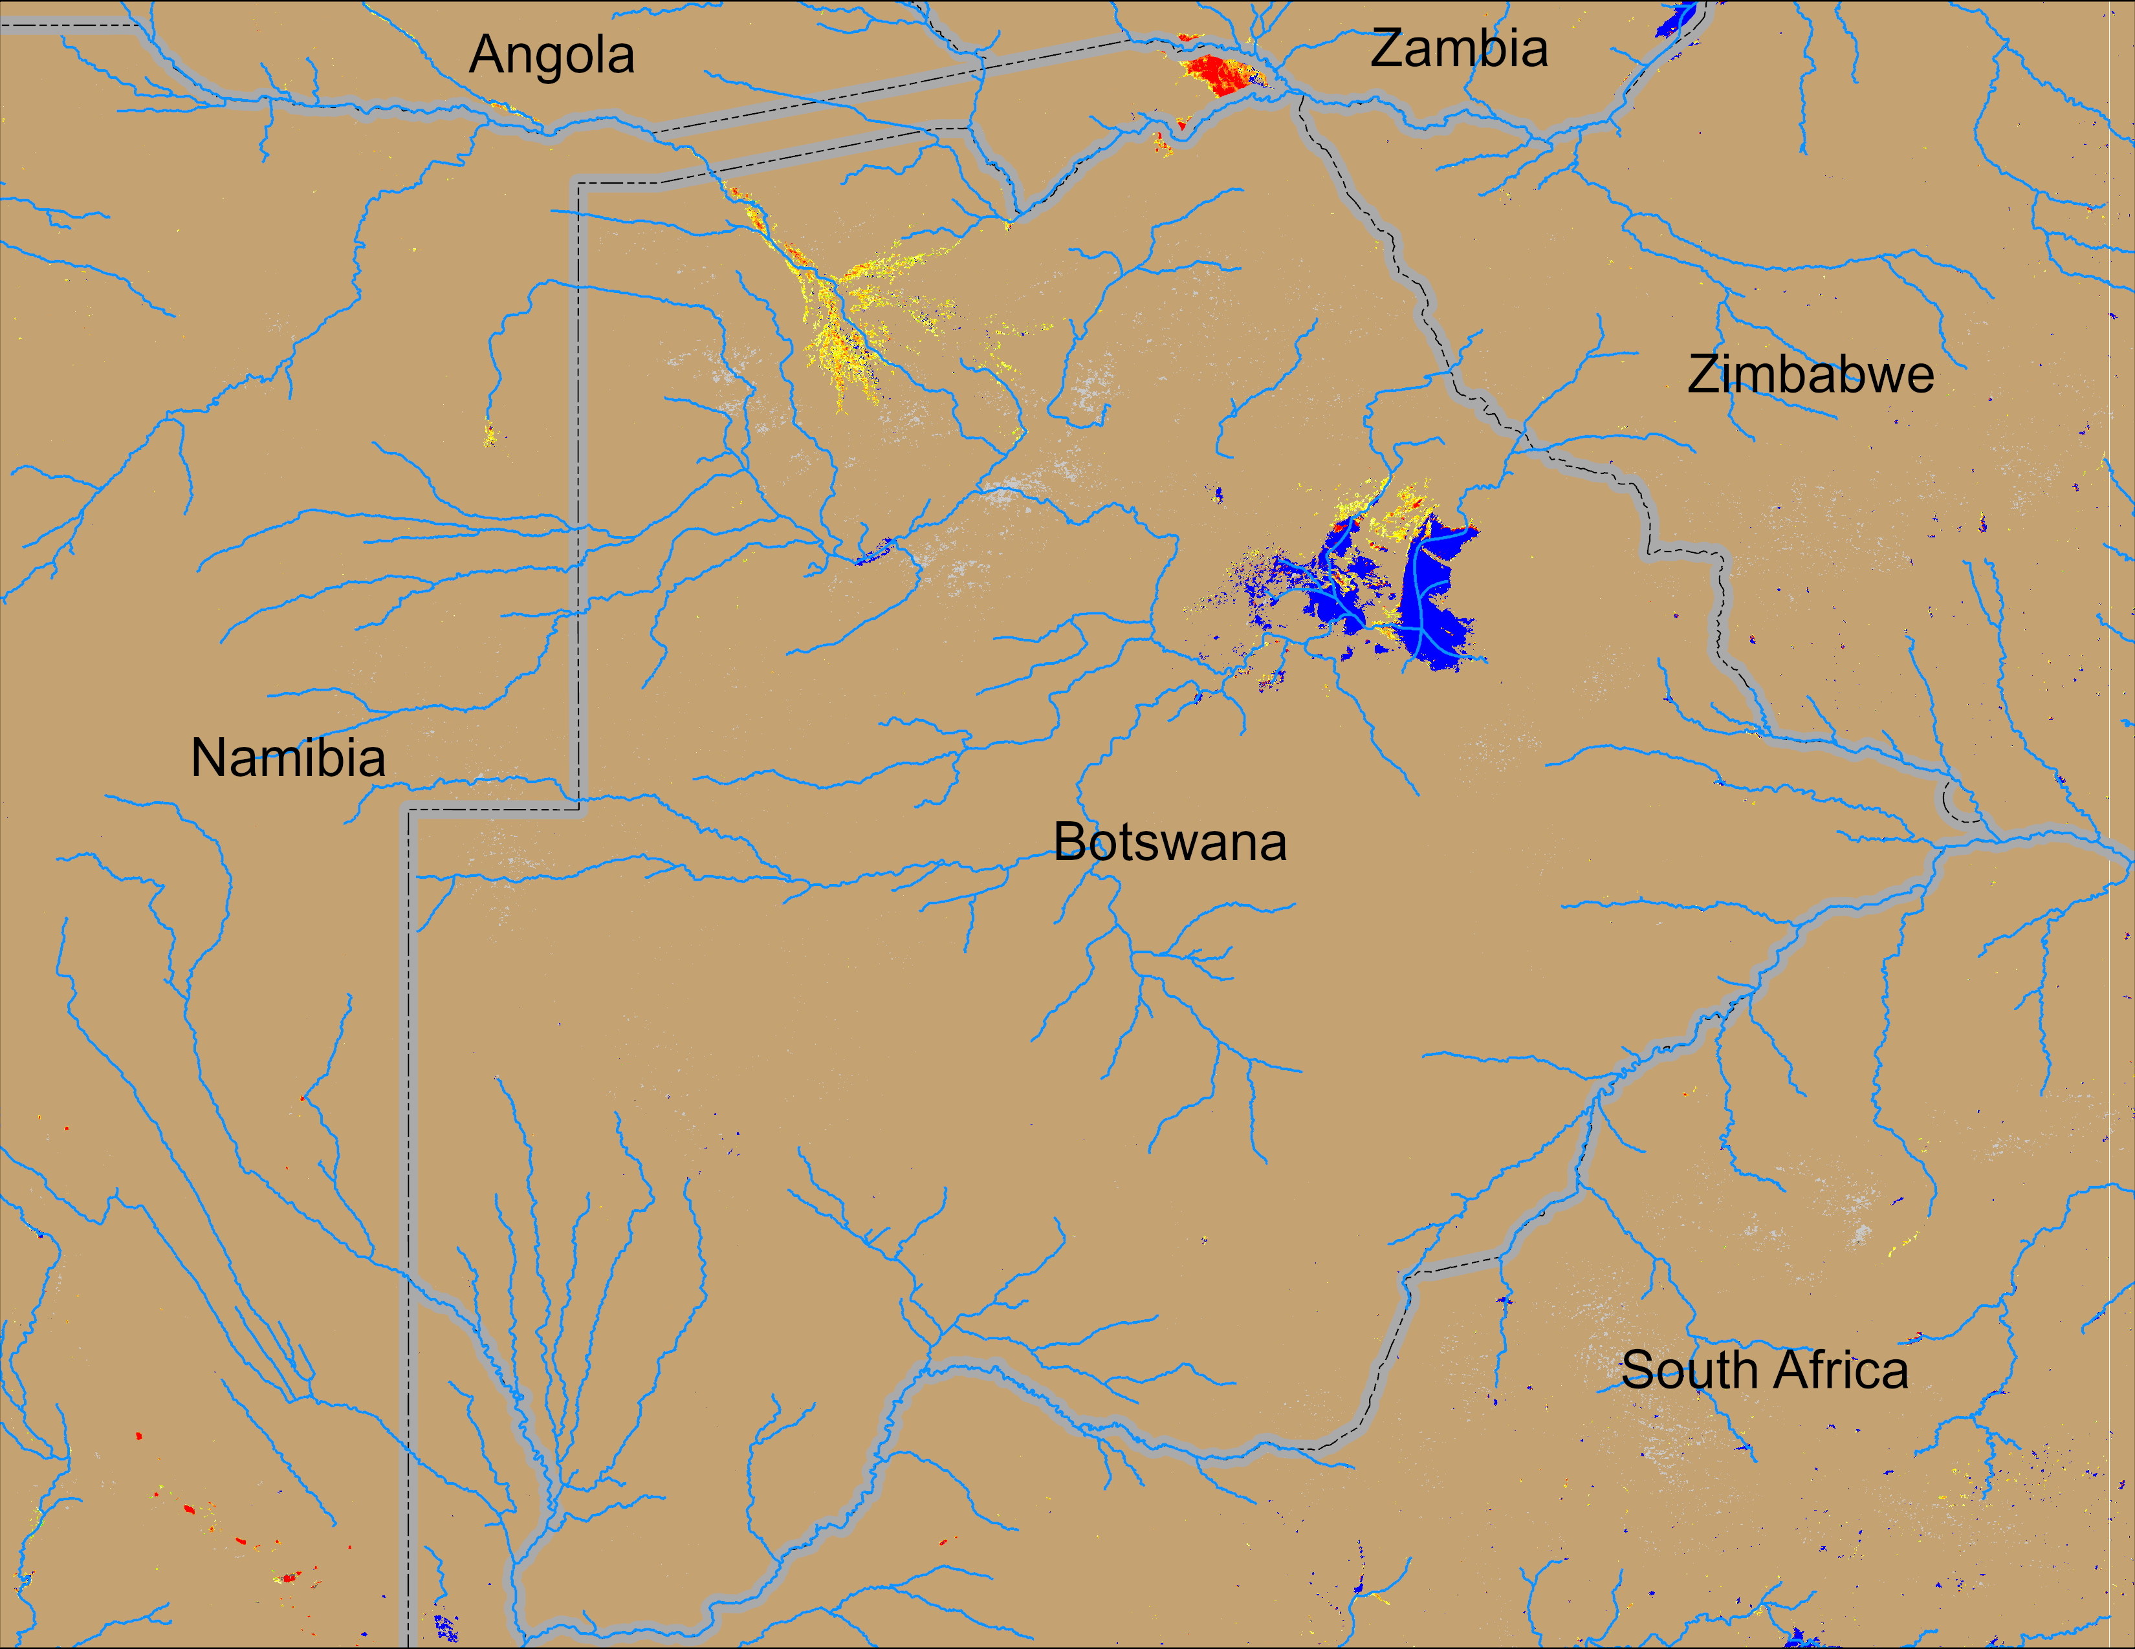
Flooding Conditions in Botswana
NOAA VIIRS derived map: 15 – 19 Apr 2026
NOAA VIIRS 5-day comp.: 22 – 26 Apr 2026
Flooding conditions ditoriorated slightly in northern Botswana.

Slide 5
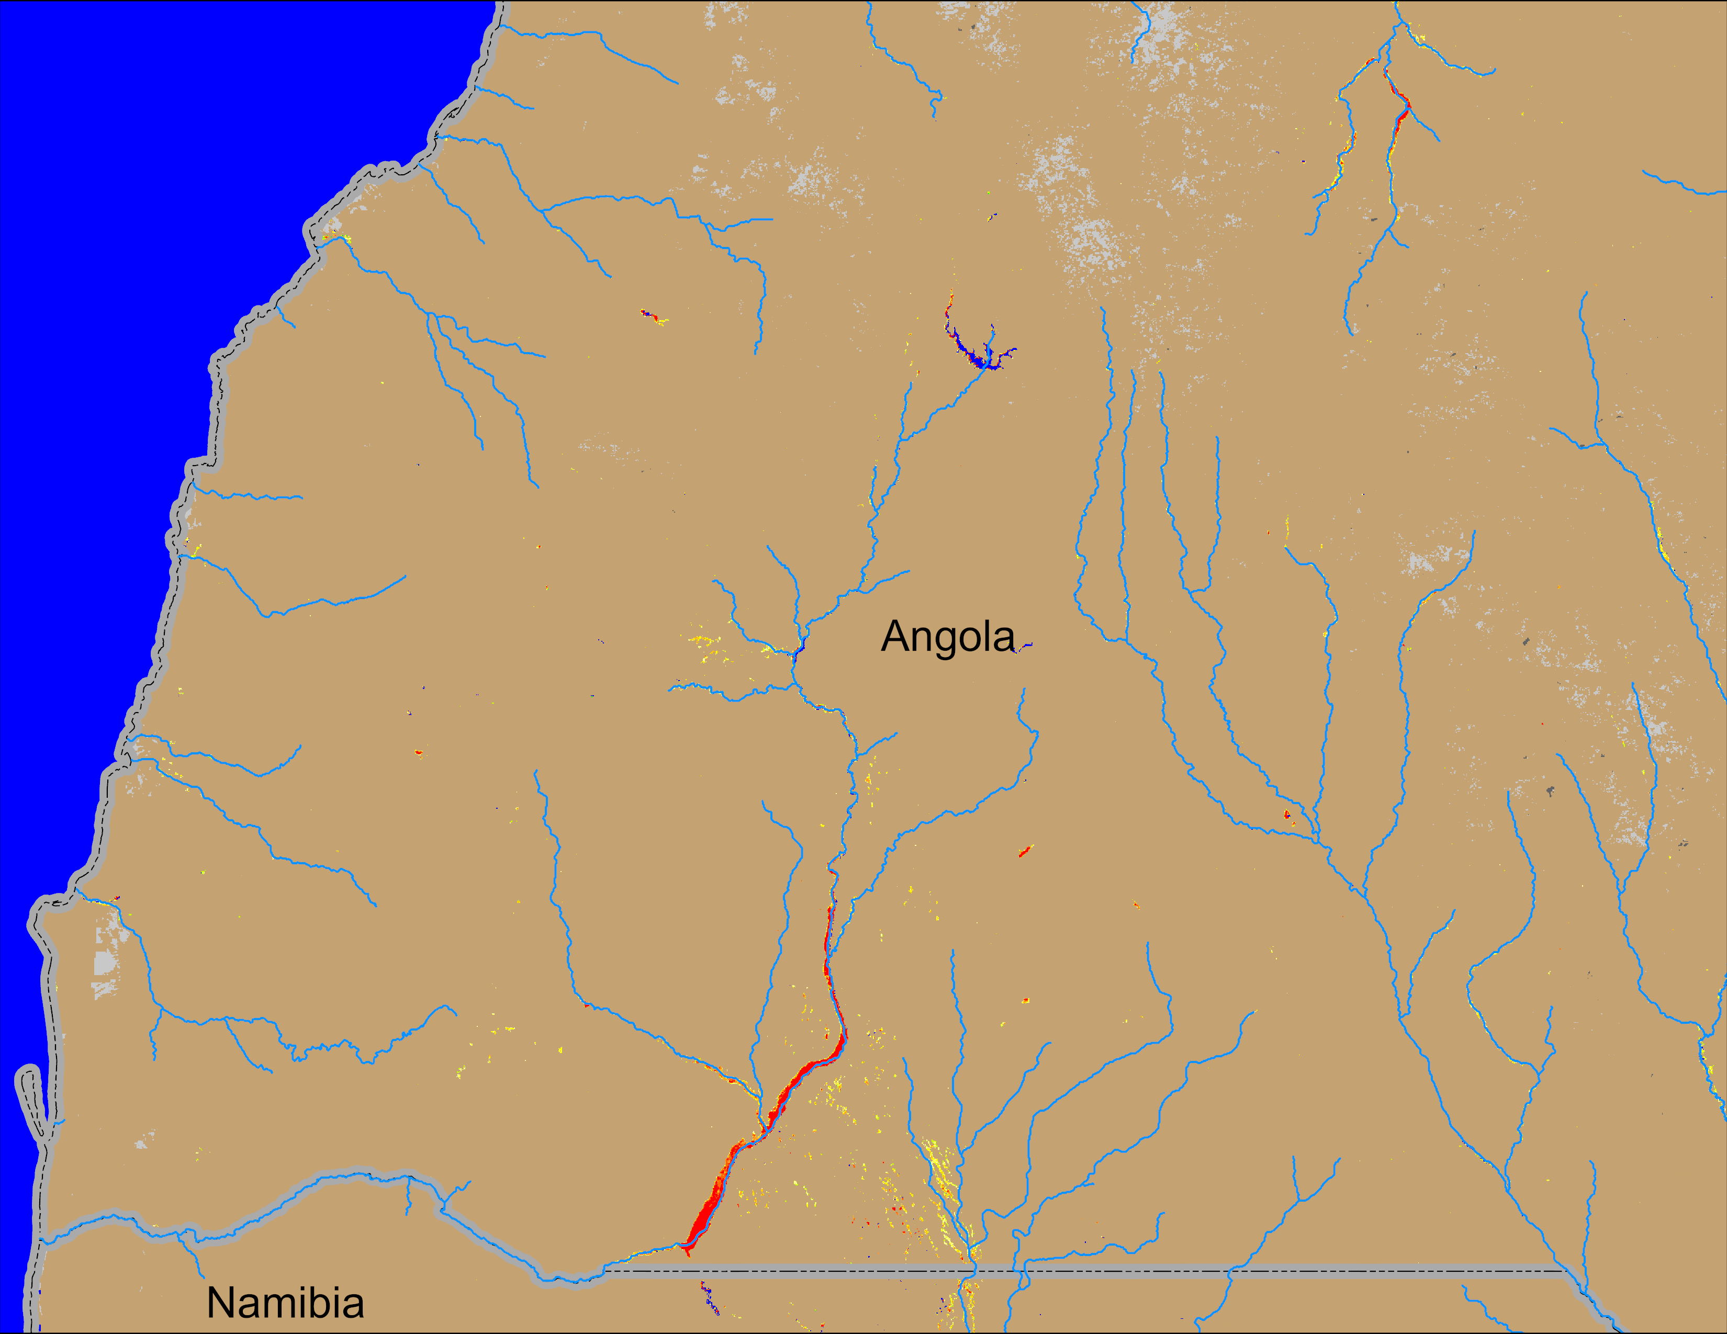
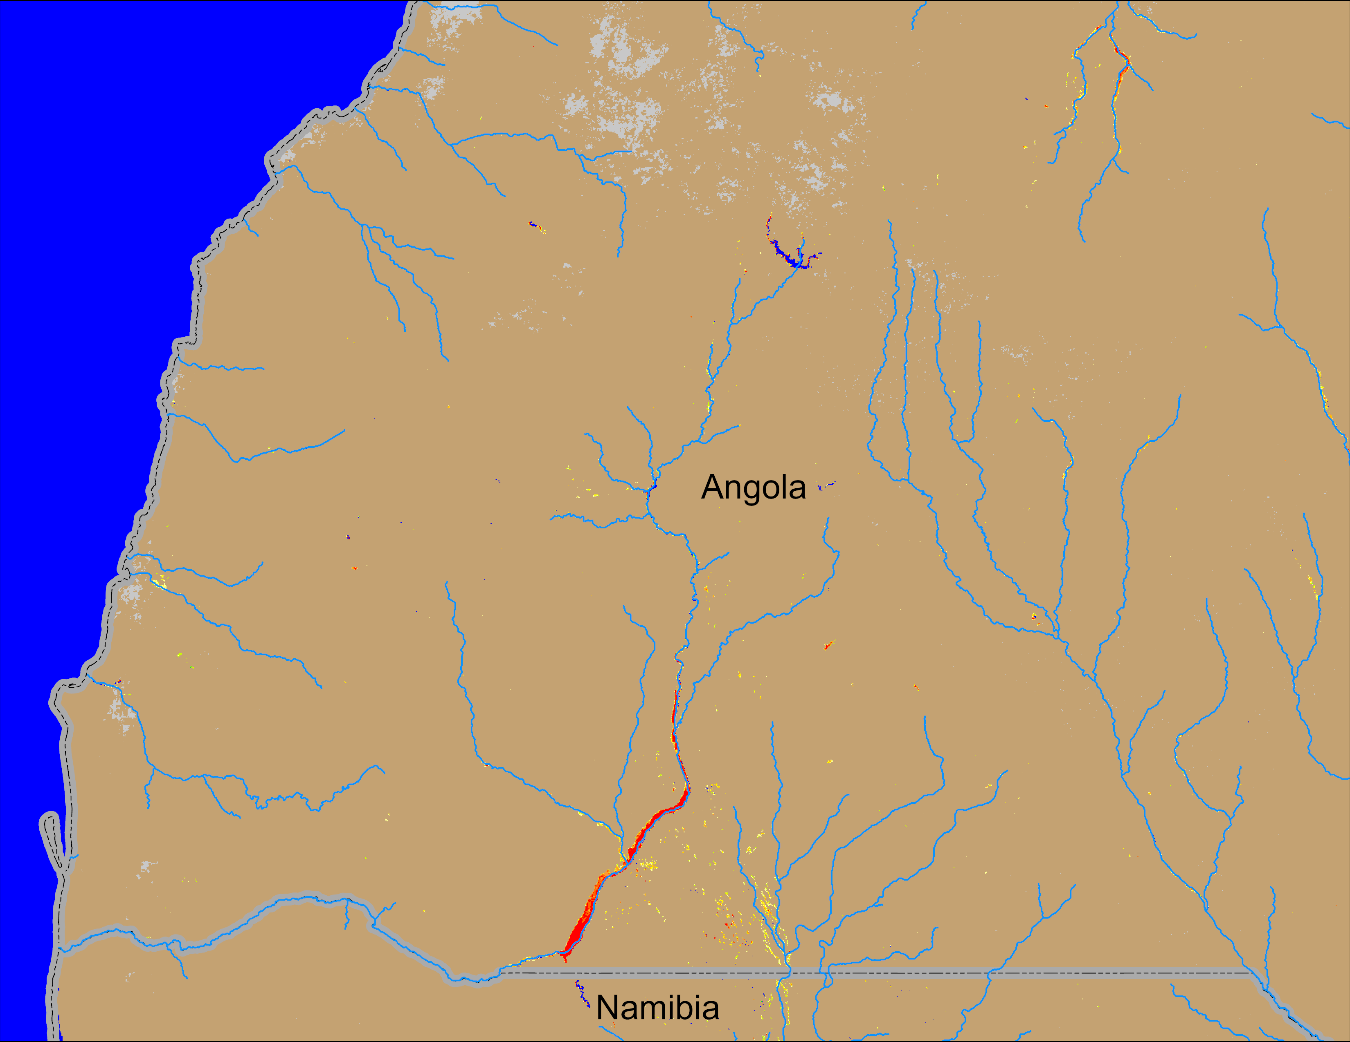
Flooding Conditions in Angola
NOAA VIIRS derived map: 15 – 19 Apr 2026
NOAA VIIRS 5-day comp.: 22 – 26 Apr 2026
Flooding conditions remained unchanged in southern Angola.

Slide 6
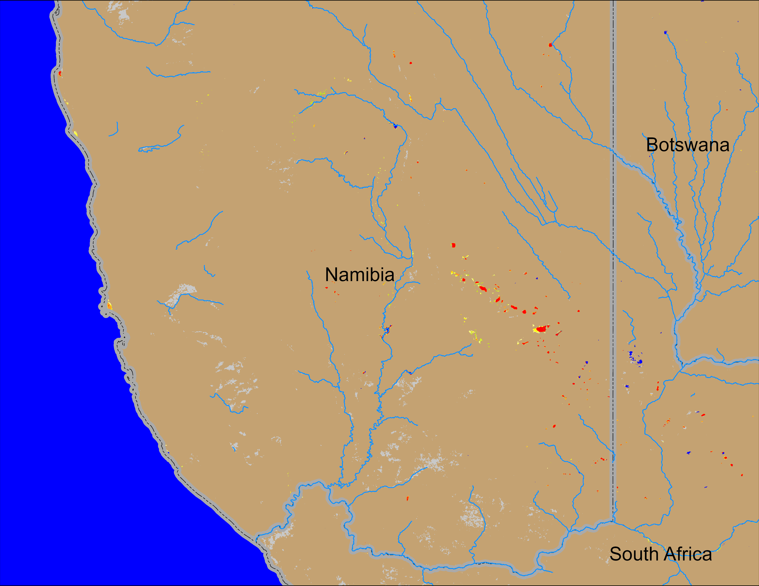
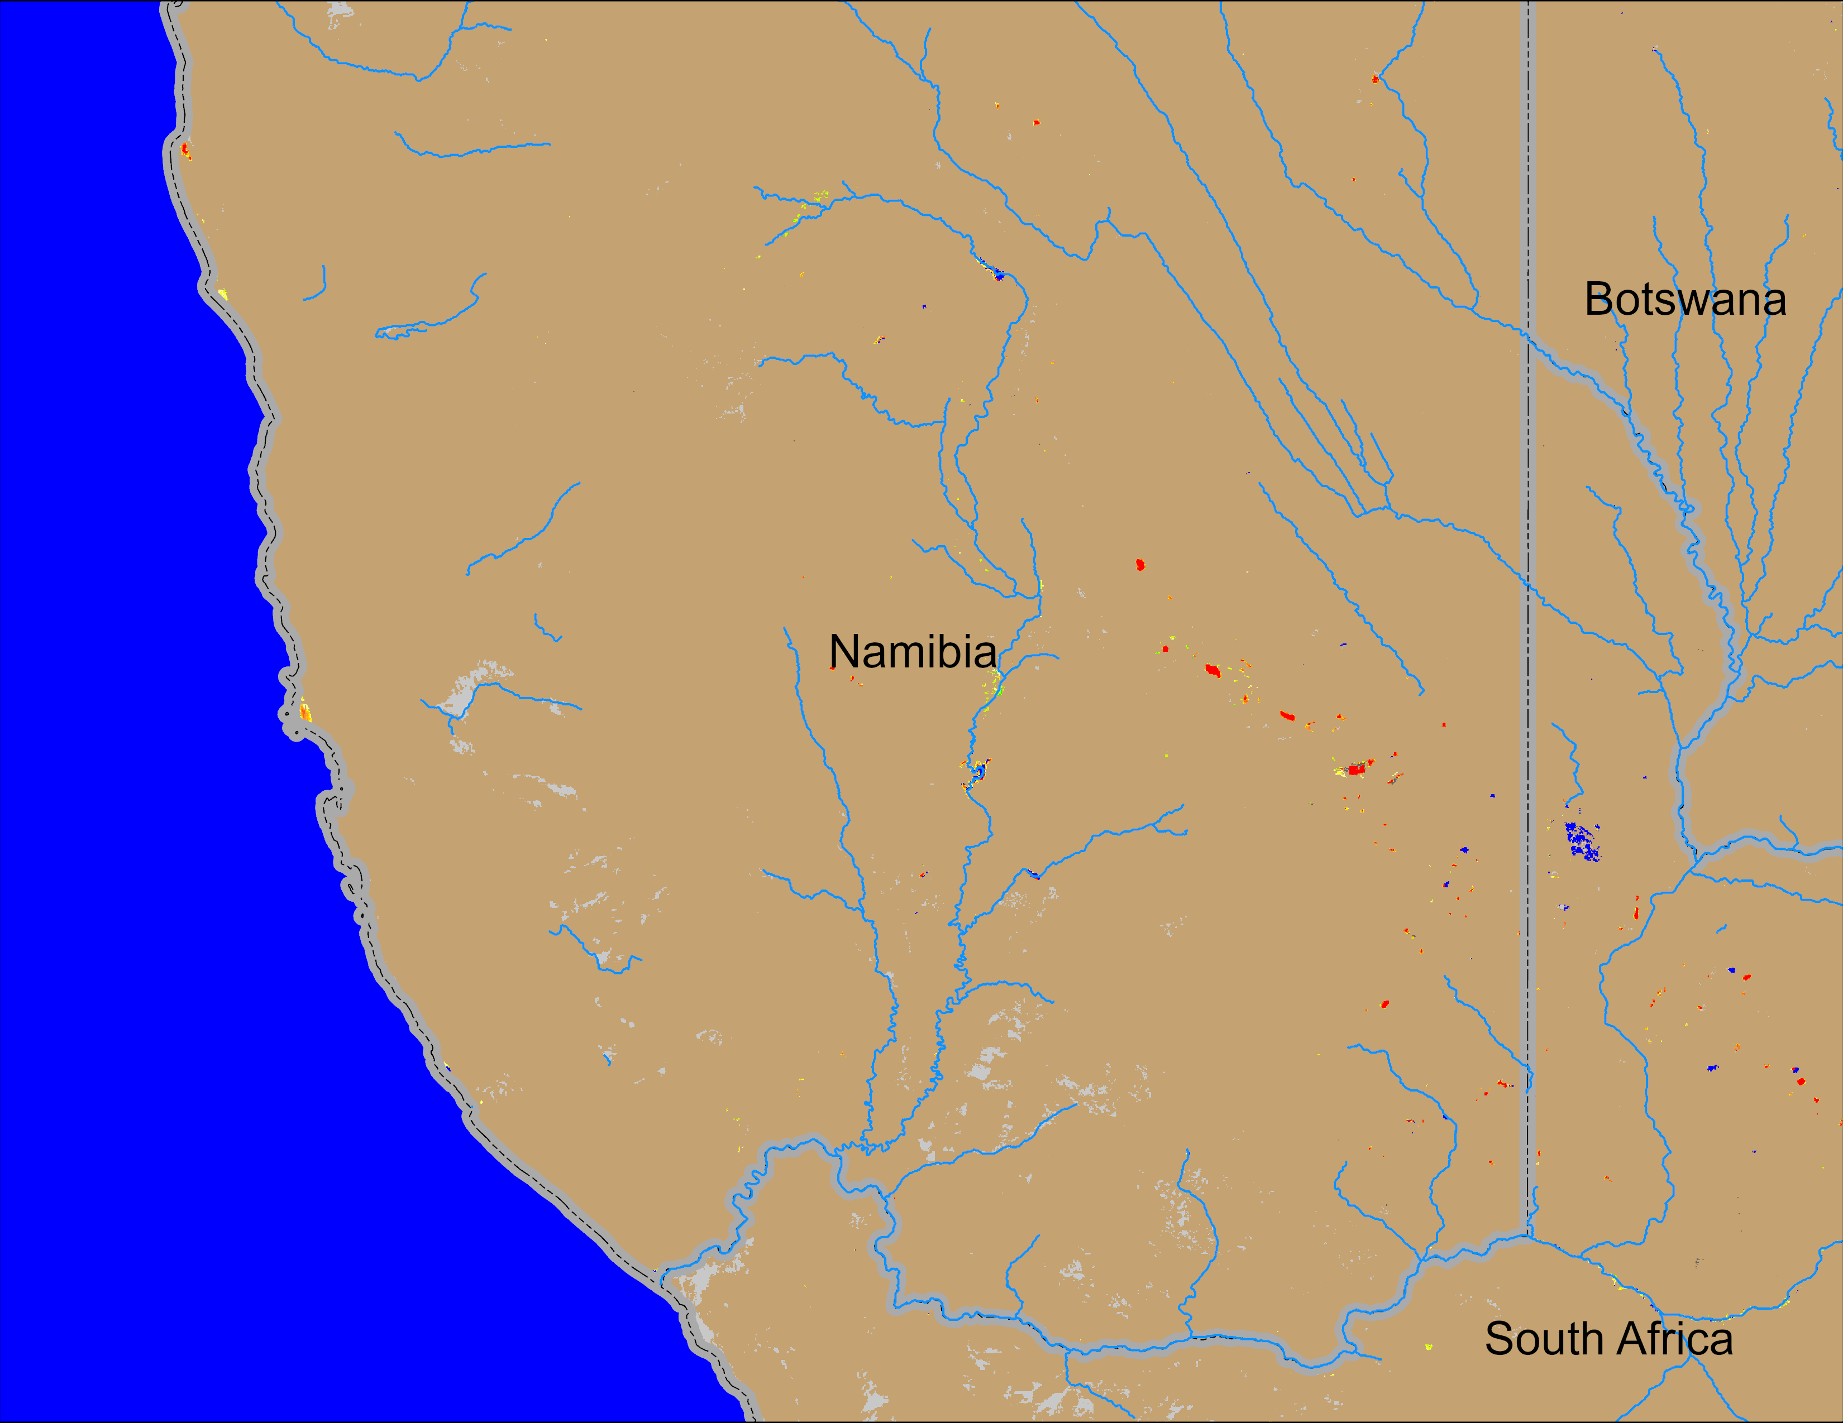
Flooding Conditions in Namibia
NOAA VIIRS derived map: 15 – 19 Apr 2026
NOAA VIIRS 5-day comp.: 22 – 26 Apr 2026
Flooding conditions improved marginaly in southern Namibia.

