Slide 1
FEWS NET Enhanced Flood Monitoring and Forecast
FEWS NET Science Team
September 22, 2025
Notes:
Default title slide

Slide 2

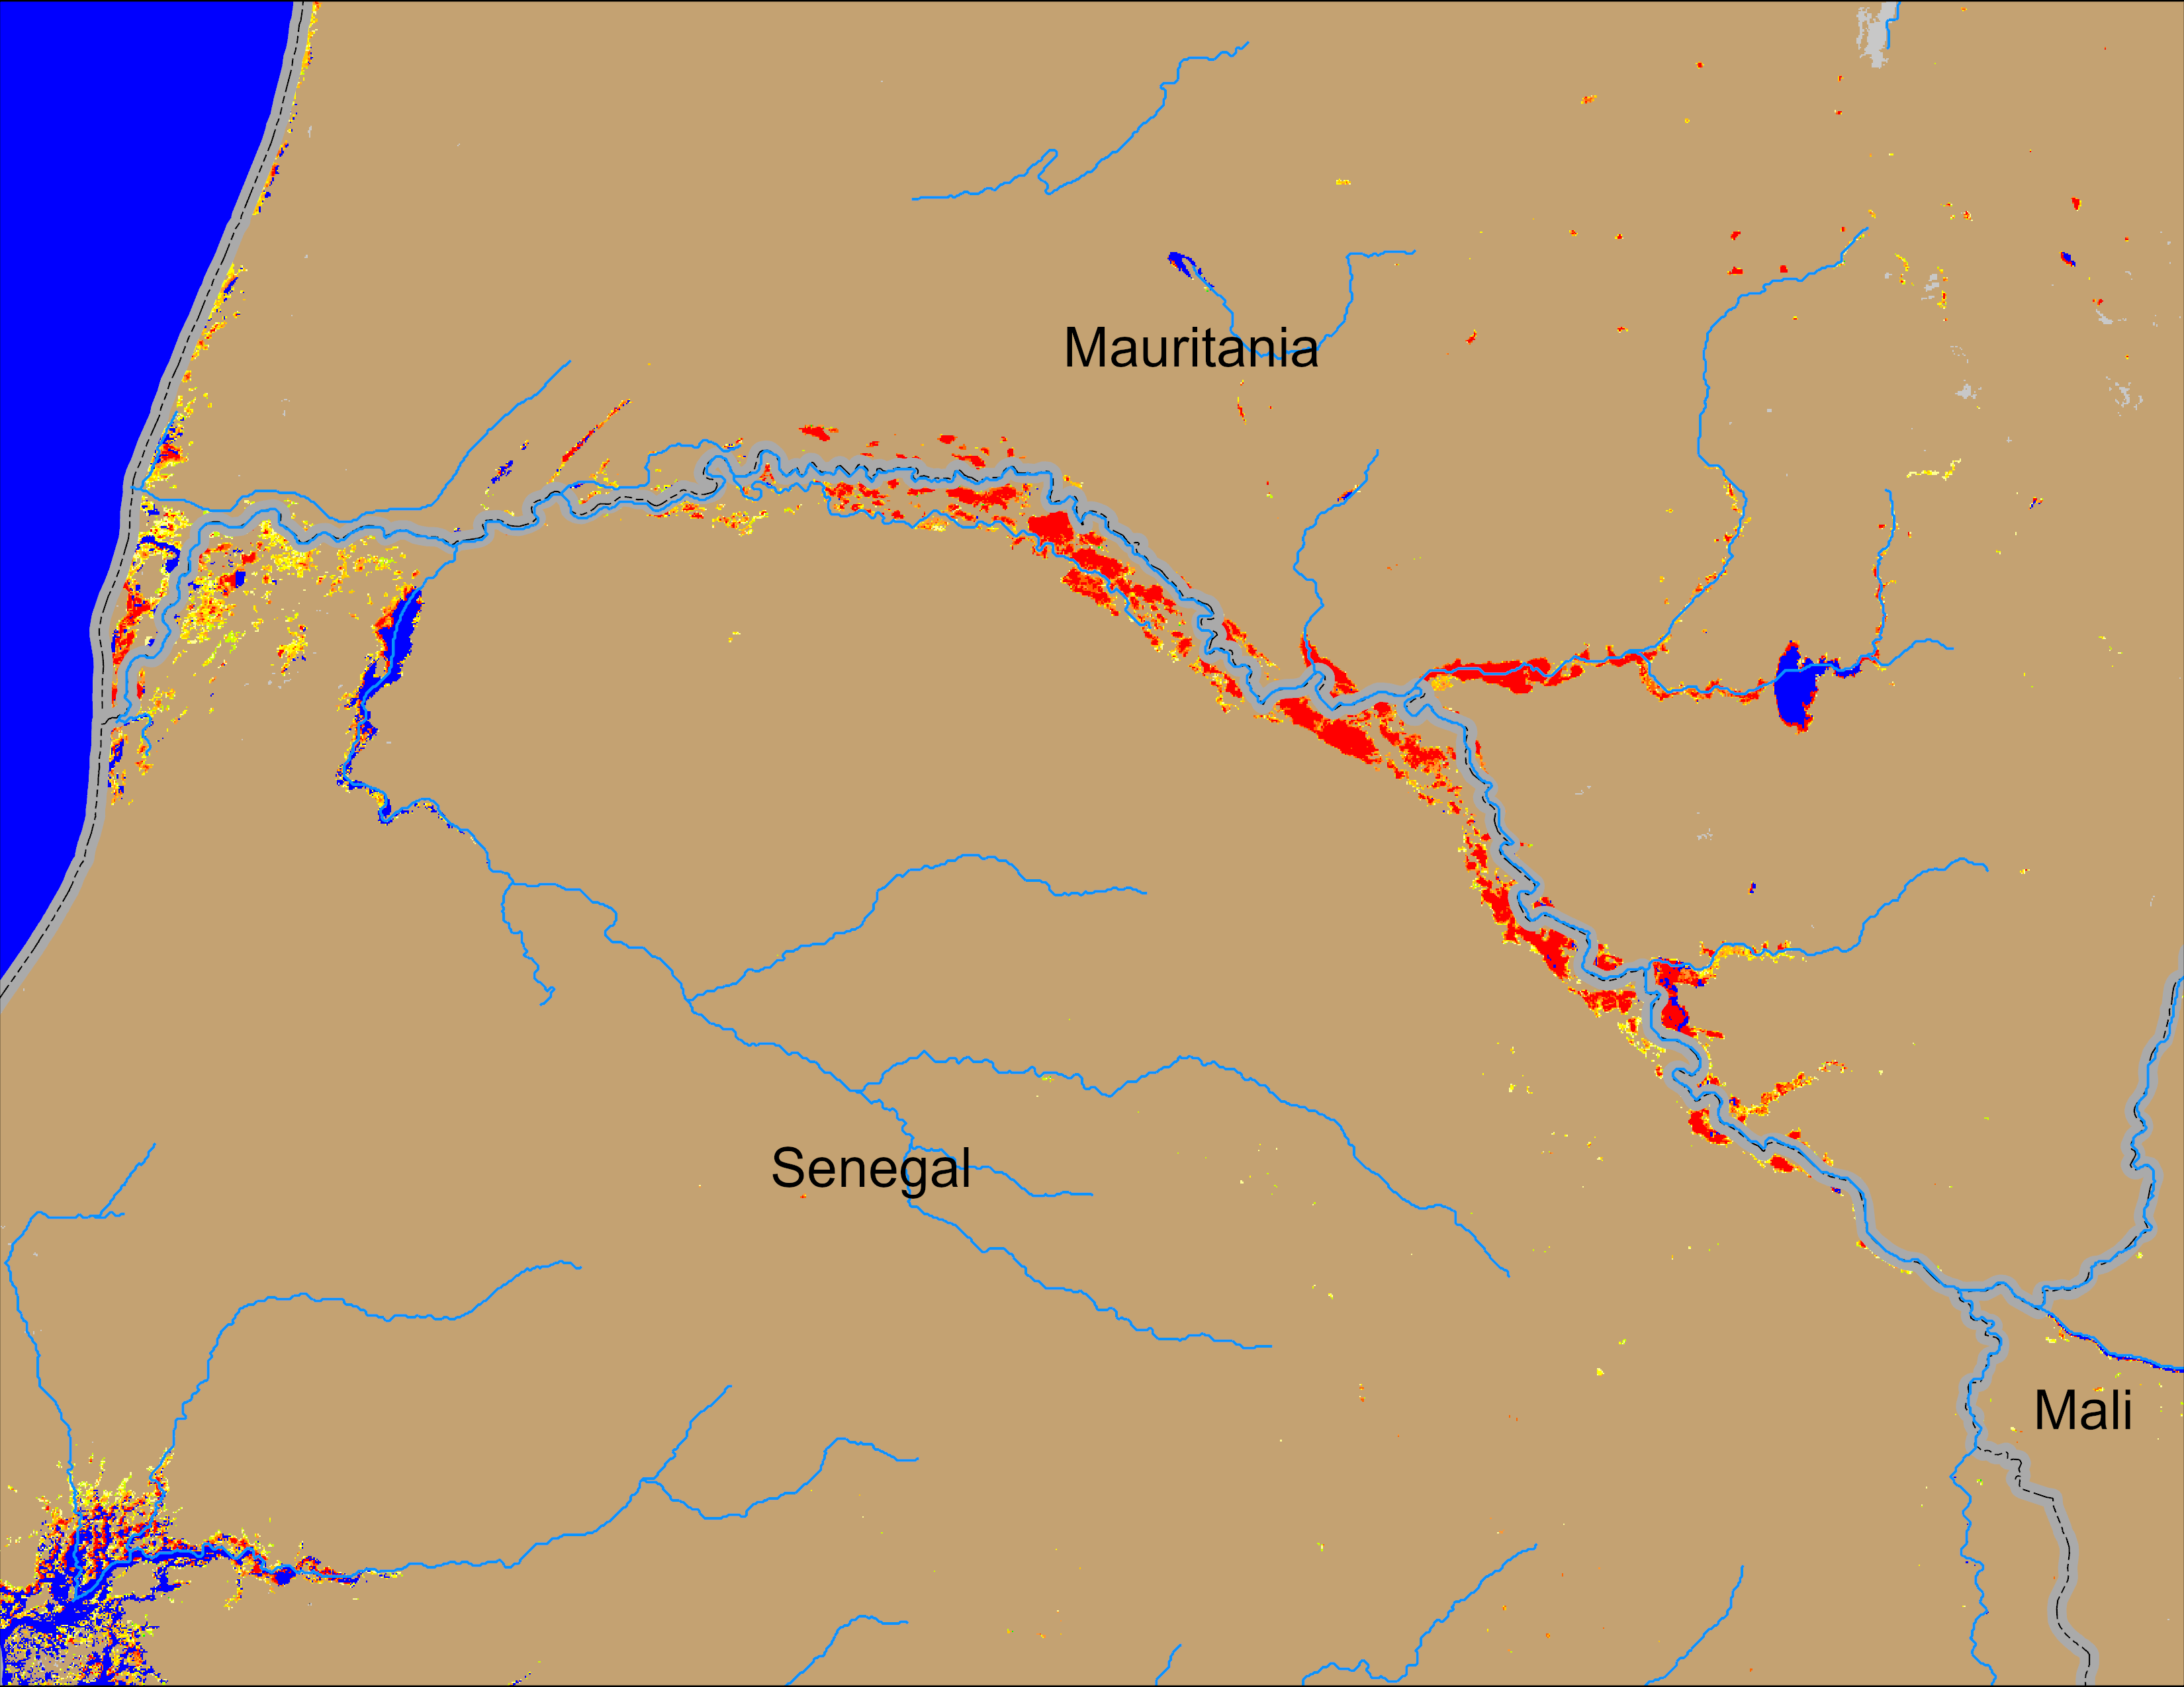
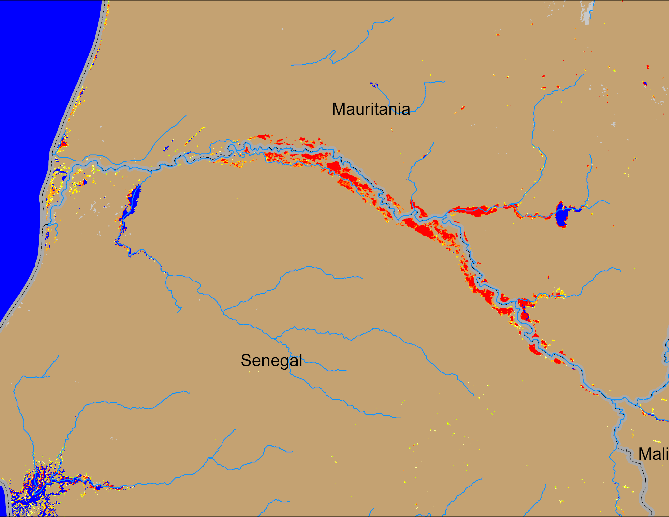
Flooding Conditions in Senegal
NOAA VIIRS derived map: 17 – 21 Sep 2025
NOAA VIIRS 5-day comp.: 24 – 28 Sep 2025
Flooding conditions intensified along the Senegal River.

Slide 3
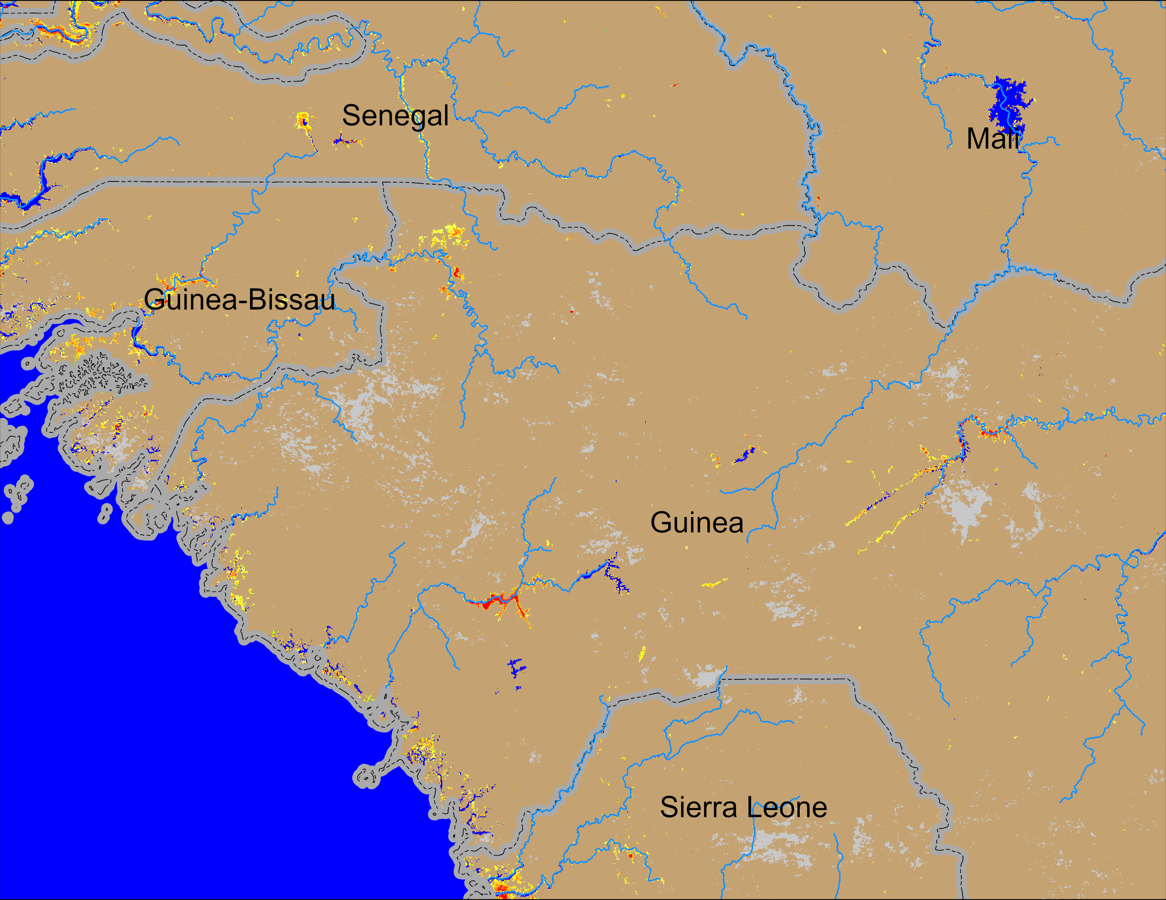
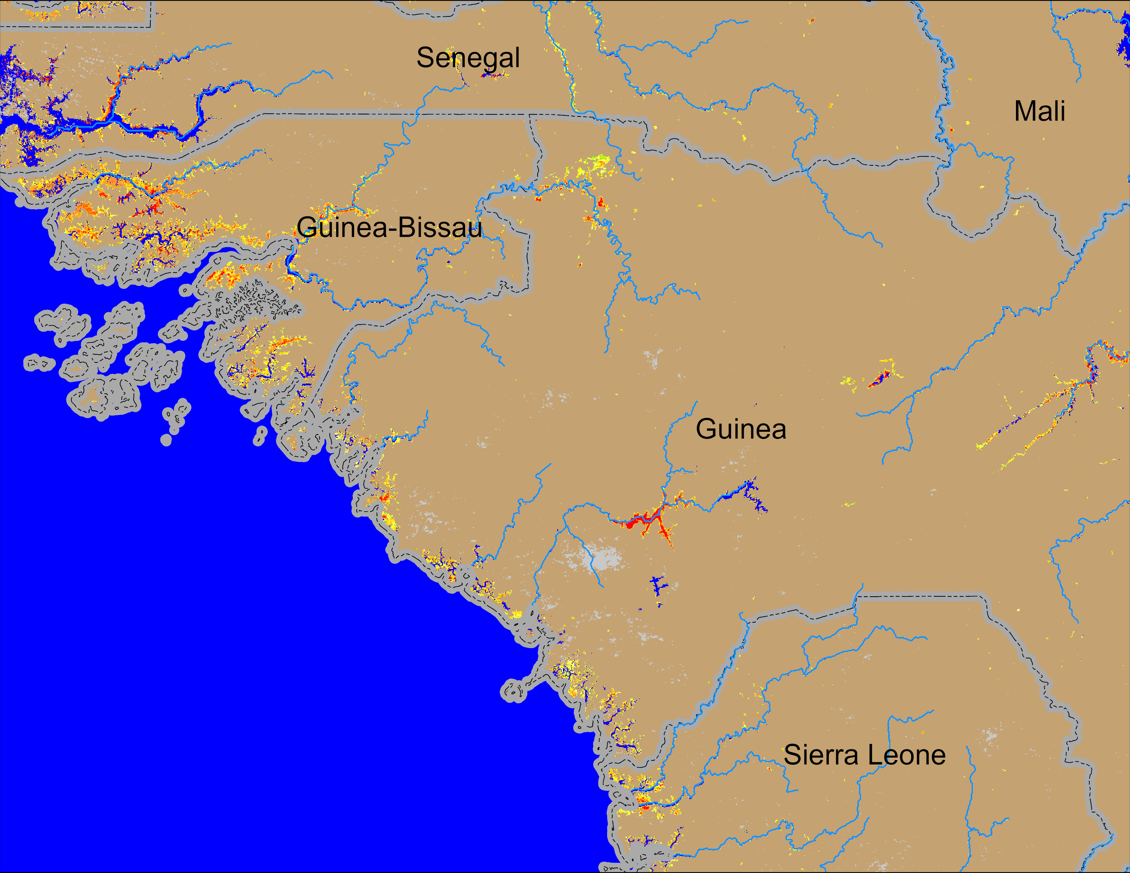
Flooding Conditions in Guinea
NOAA VIIRS derived map: 17 – 21 Sep 2025
NOAA VIIRS 5-day comp.: 24 – 28 Sep 2025
Flooding conditions worsen in Guinea and Guinea-Bissau especially in the coastal area.

Slide 4
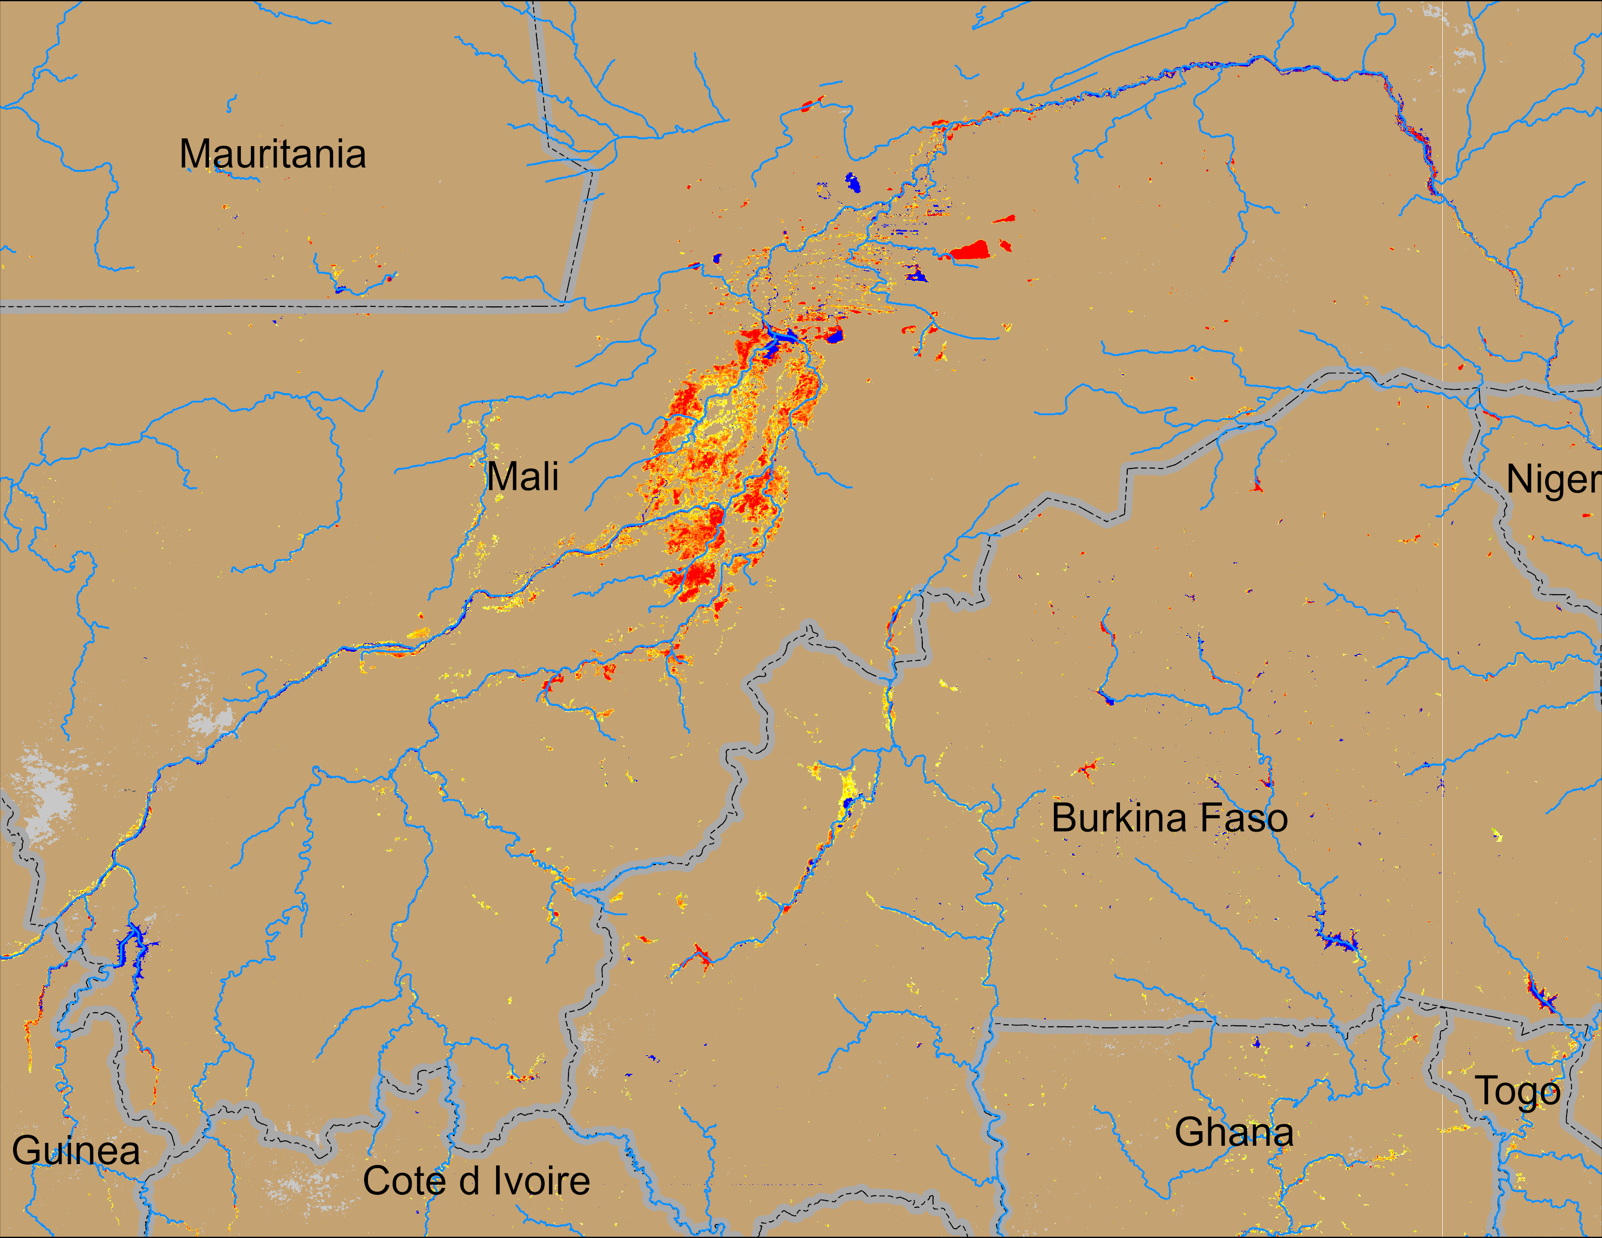
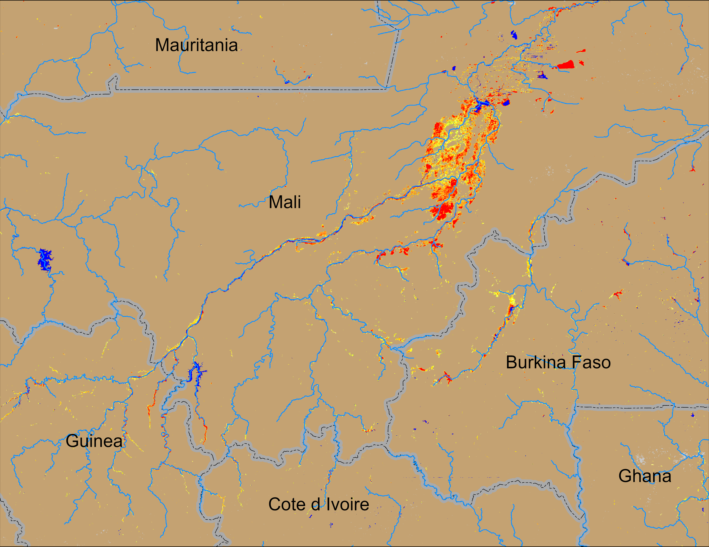
Flooding Conditions in Central Mali
NOAA VIIRS derived map: 17 – 21 Sep 2025
NOAA VIIRS 5-day comp.: 24 – 28 Sep 2025
Flooding conditions deteriorated in the head water of Niger in Mali, Burkina Faso, and Guinea.

Slide 5
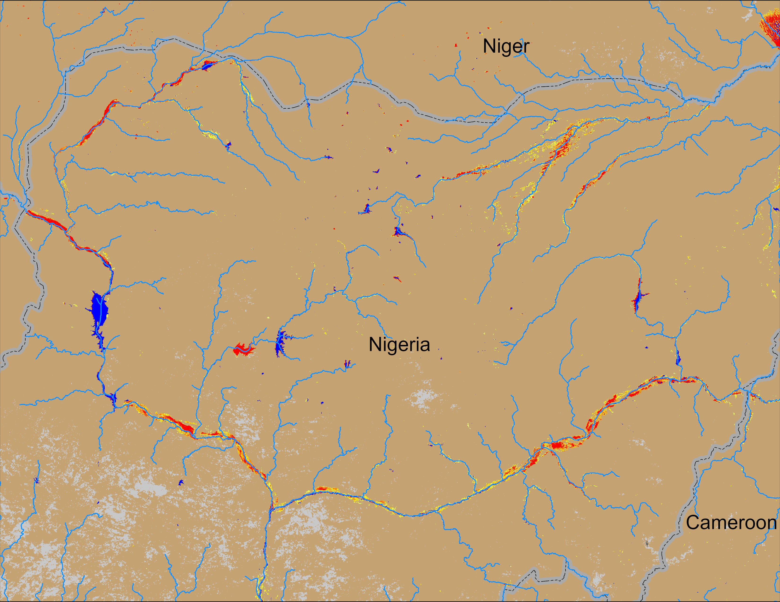
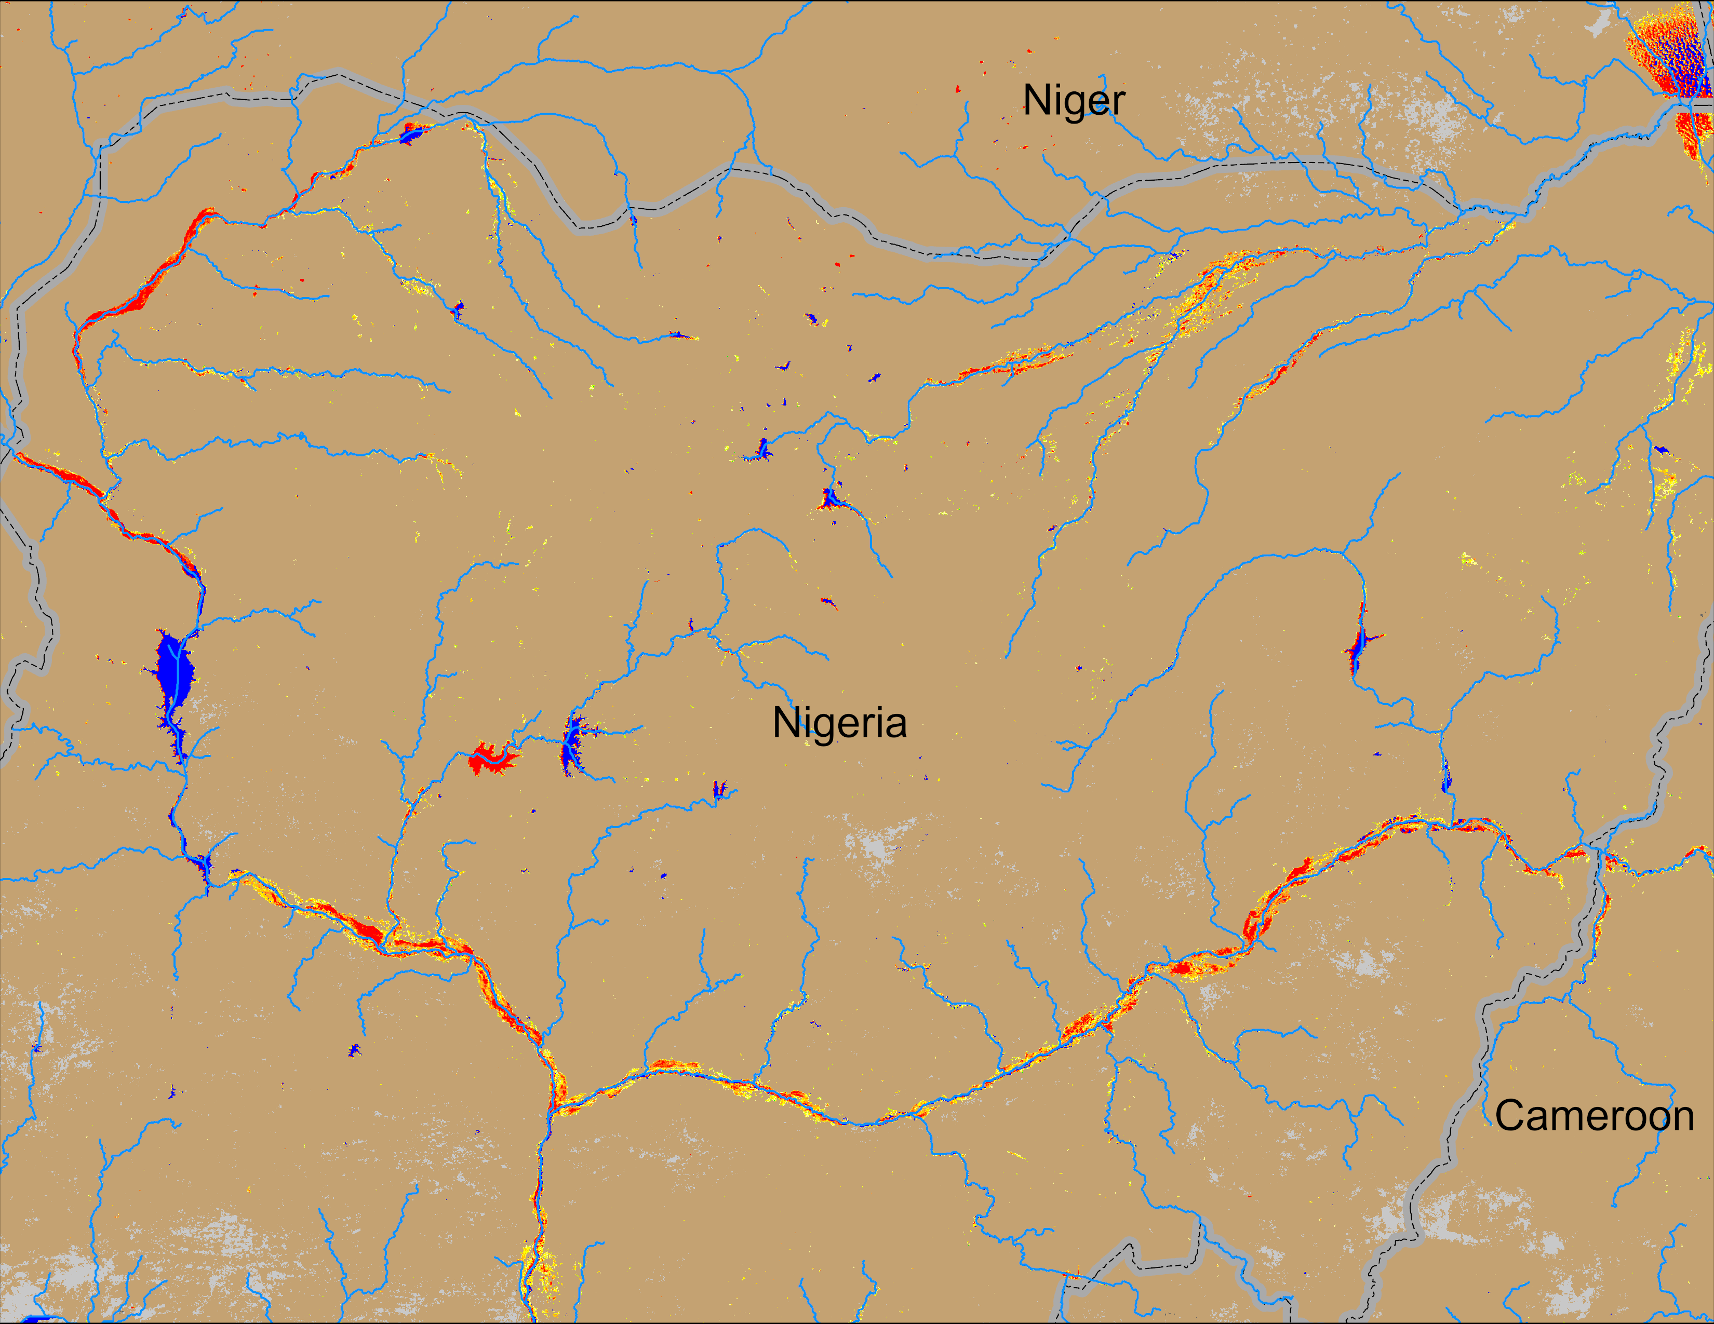
Flooding Conditions in Nigeria
Sokoto
Komadugu
Niger
Benue
NOAA VIIRS derived map: 17 – 21 Sep 2025
NOAA VIIRS 5-day comp.: 24 – 28 Sep 2025
Flooding conditins remain unchanged Sokoto and Niger but deteriorated along Beneu River in Nigeria.

Slide 6
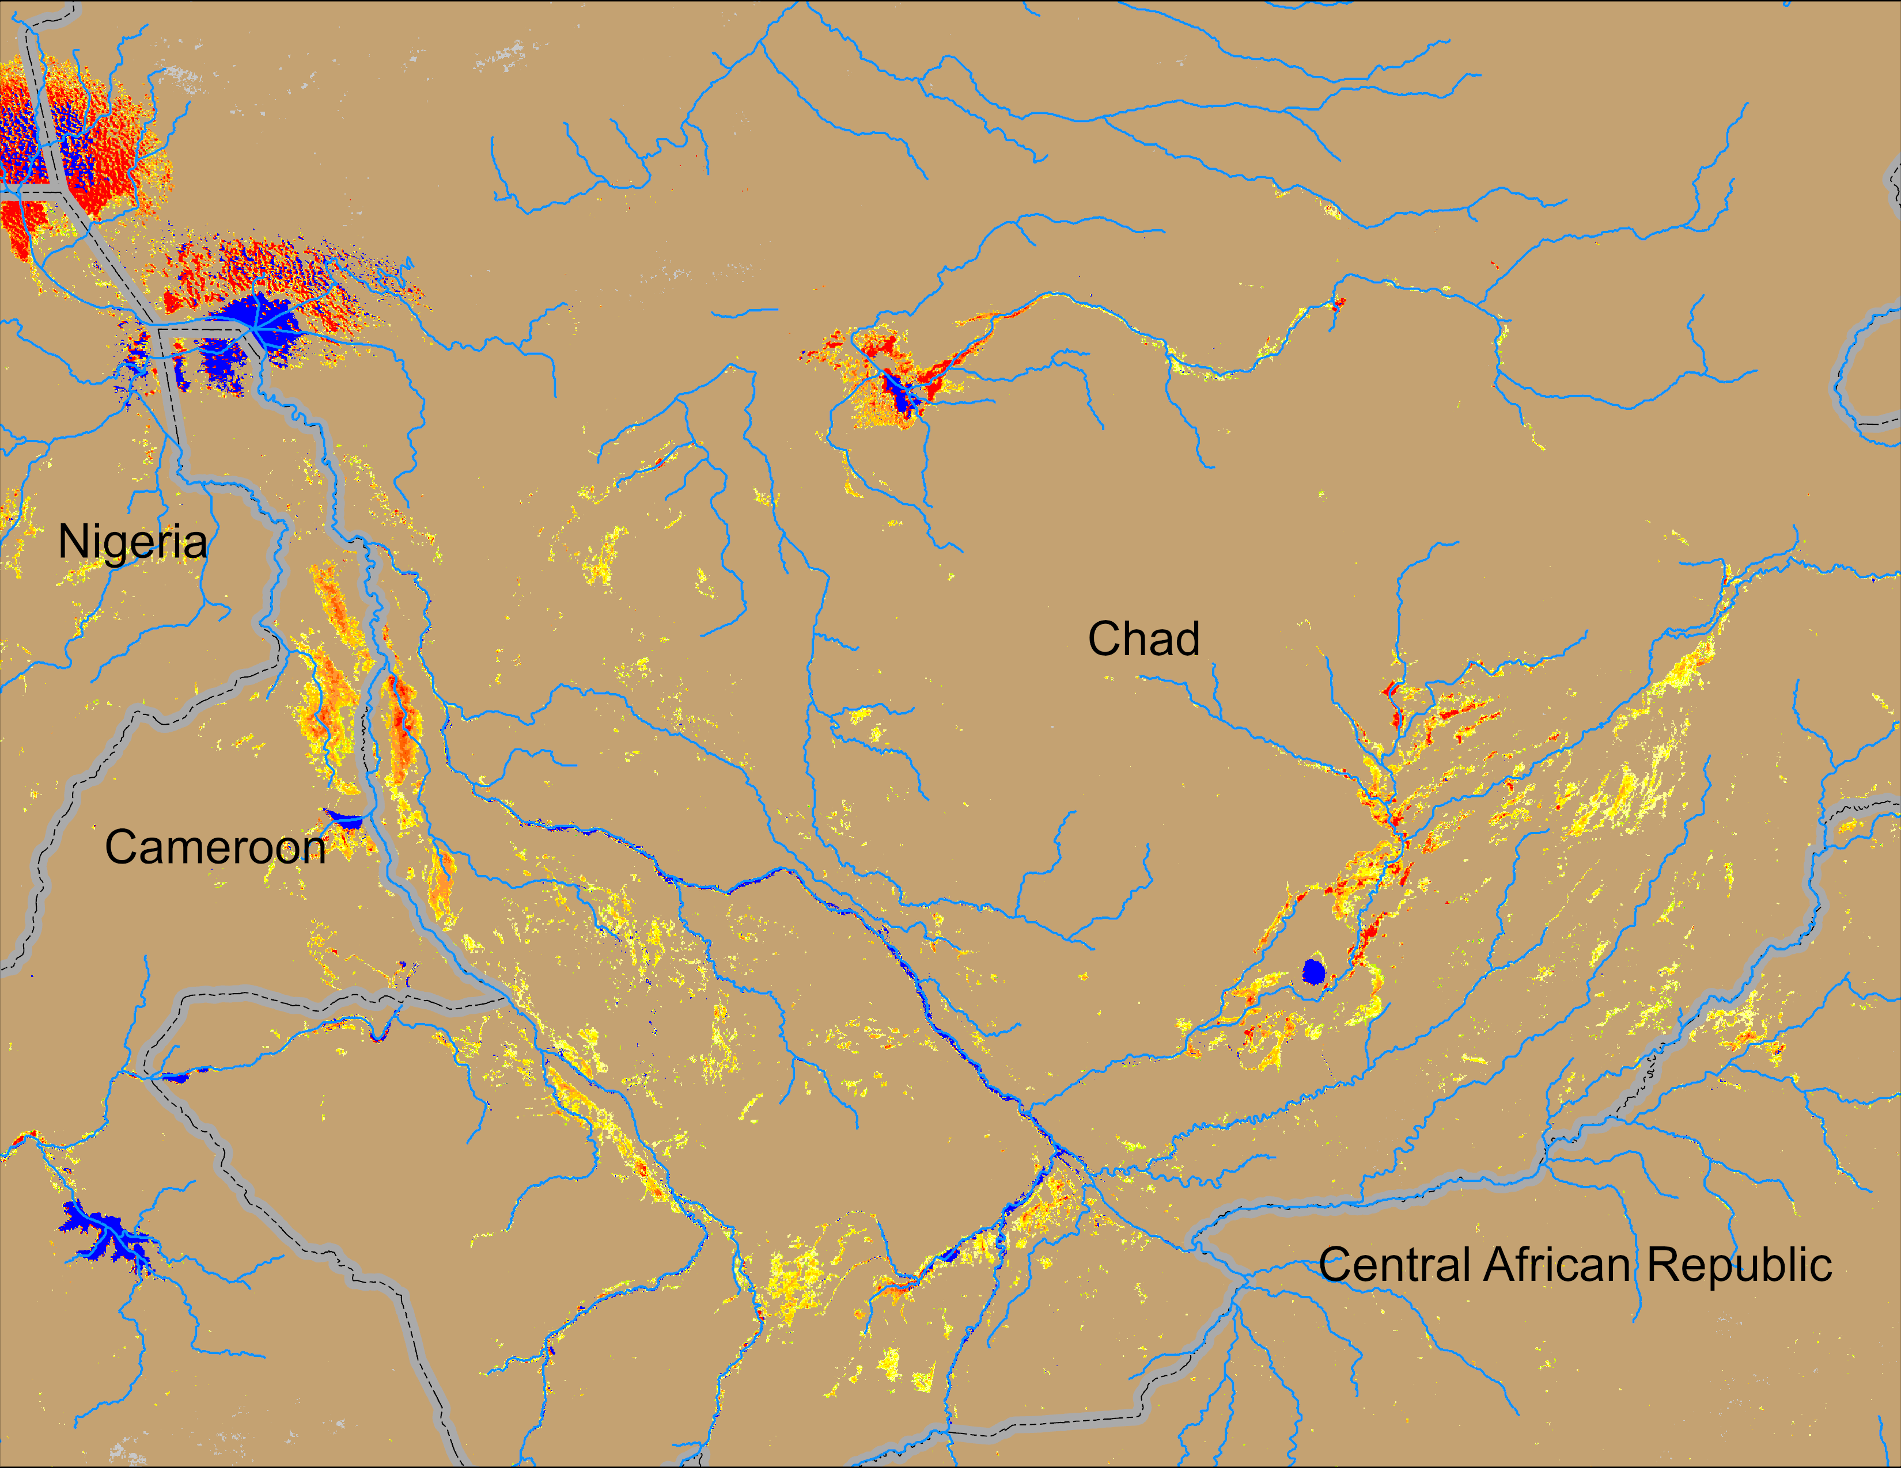
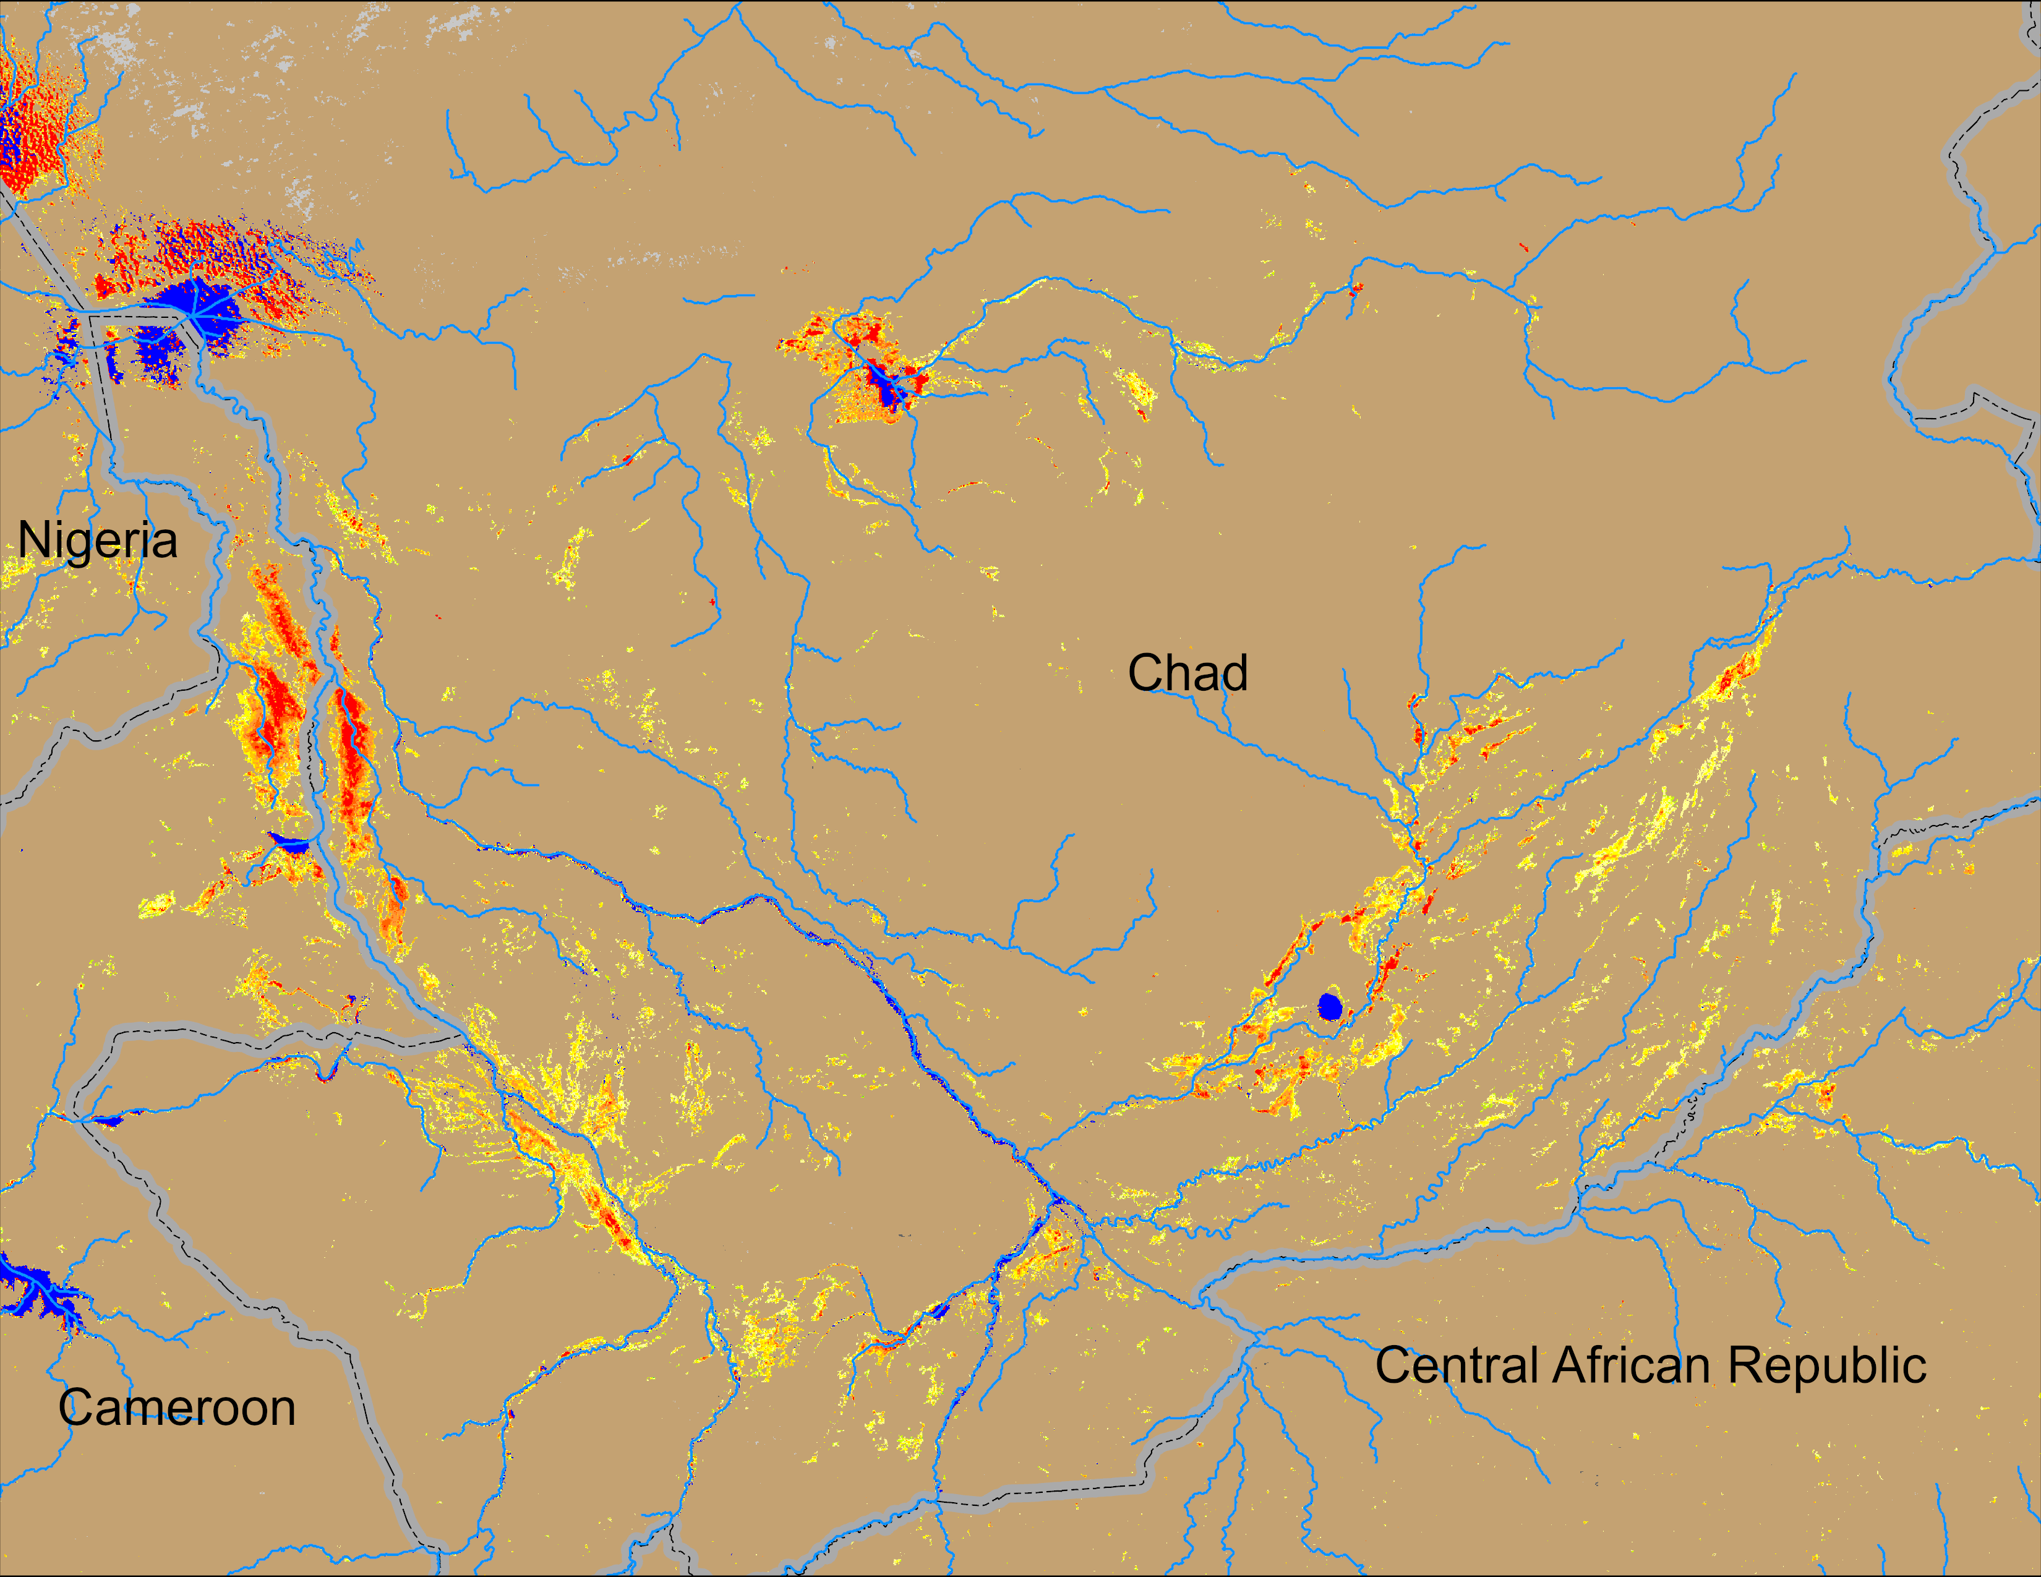
Flooding Conditions in Chad
Logone
Chari
NOAA VIIRS derived map: 17 – 21 Sep 2025
NOAA VIIRS 5-day comp.: 24 – 28 Sep 2025
Flooding conditions worsen along Logone but remained unchanged along the Chari River in Chad.

Slide 7
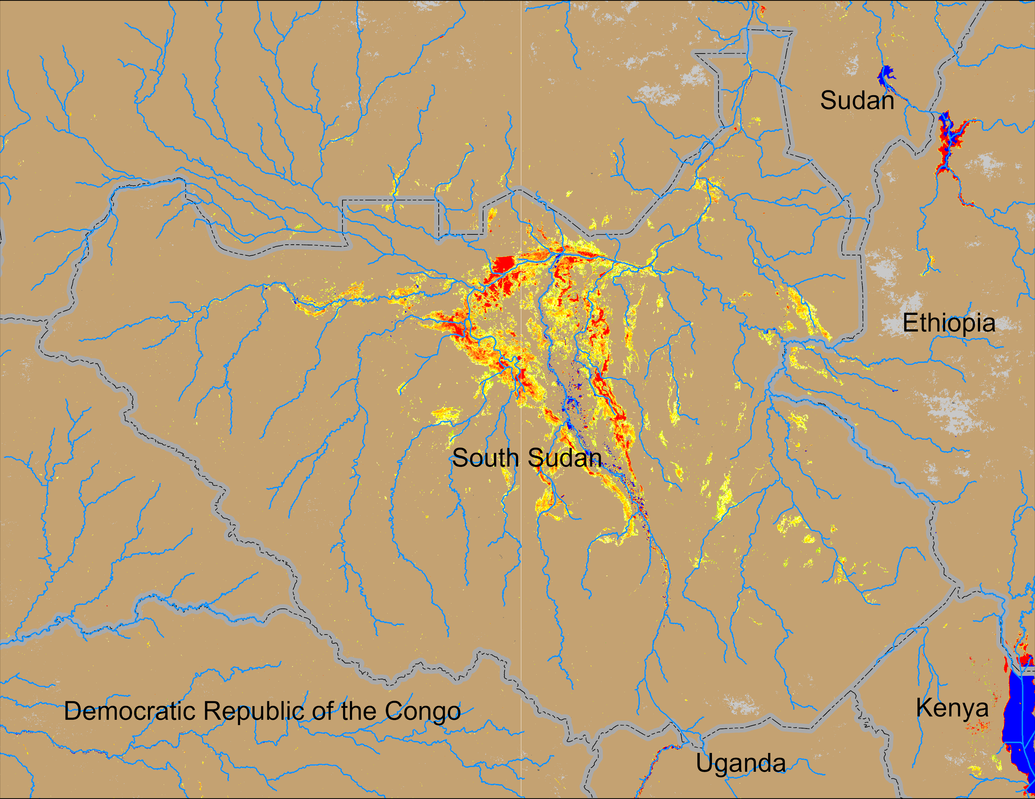
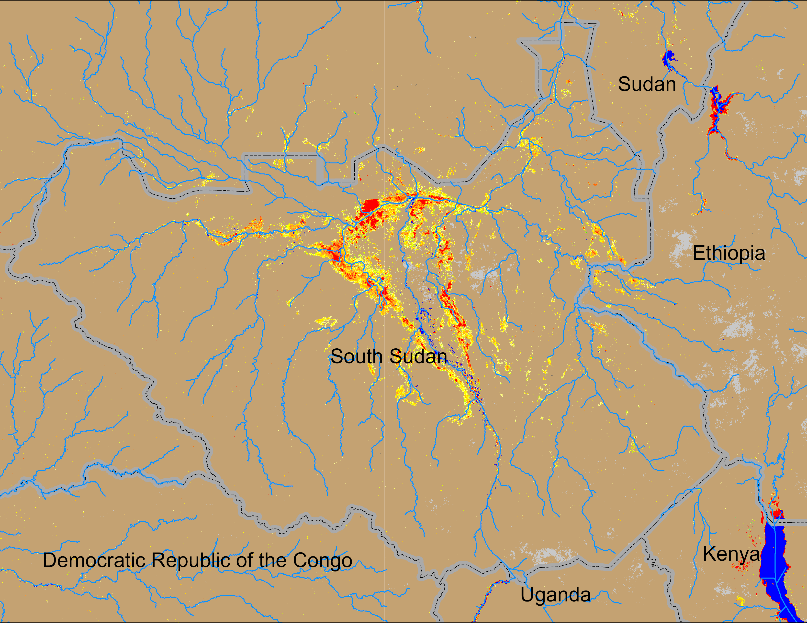
Flooding Conditions in South Sudan
NOAA VIIRS derived map: 17 – 21 Sep 2025
NOAA VIIRS 5-day comp.: 24 – 28 Sep 2025
Inundated areas have intensified in South Sudan.

Slide 8
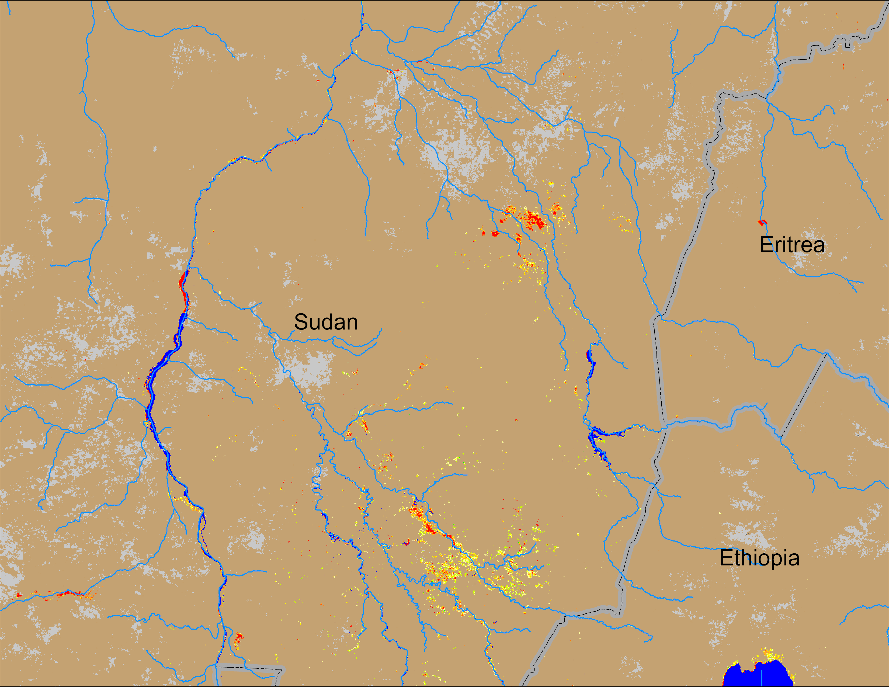
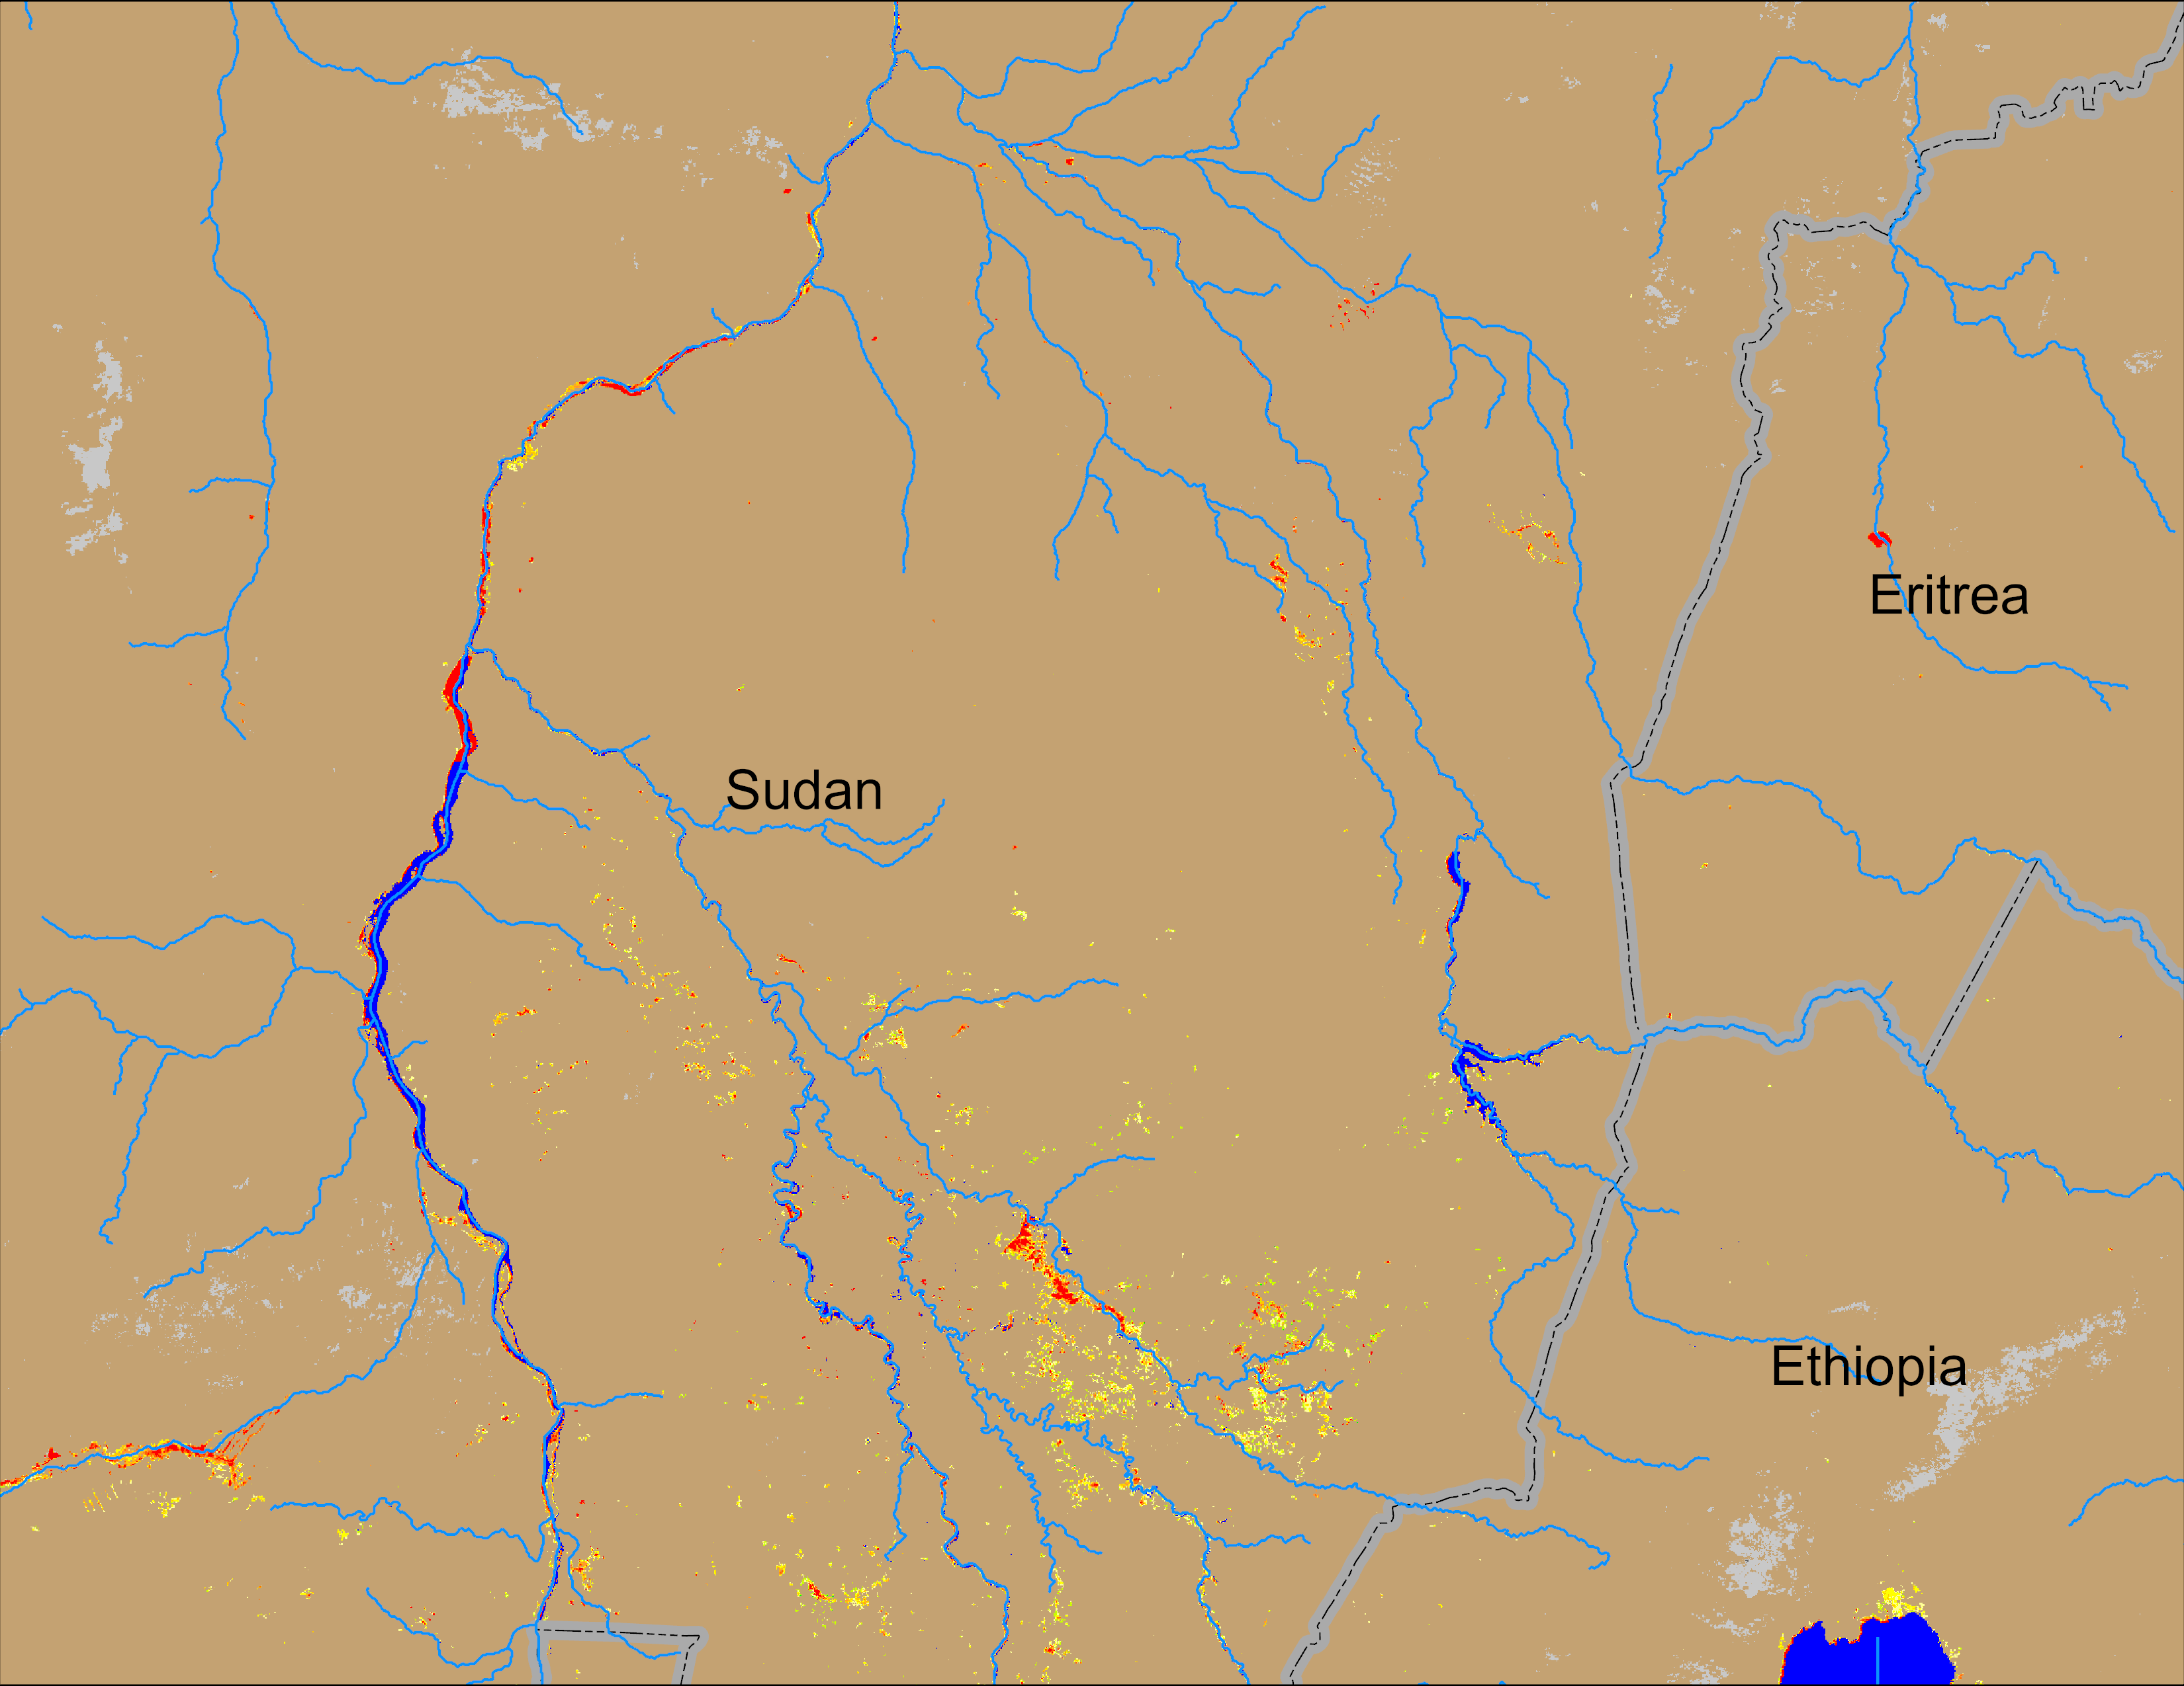
Flooding Conditions in Sudan
Atbara
Blue Nile
NOAA VIIRS derived map: 17 – 21 Sep 2025
NOAA VIIRS 5-day comp.: 24 – 28 Sep 2025
Flooding conditions remained unchange in the Blue Nile but improved in Atbara catchment.

