Slide 1
FEWS NET Enhanced Flood Monitoring and Forecast
FEWS NET Science Team
September 22, 2025
Notes:
Default title slide

Slide 2

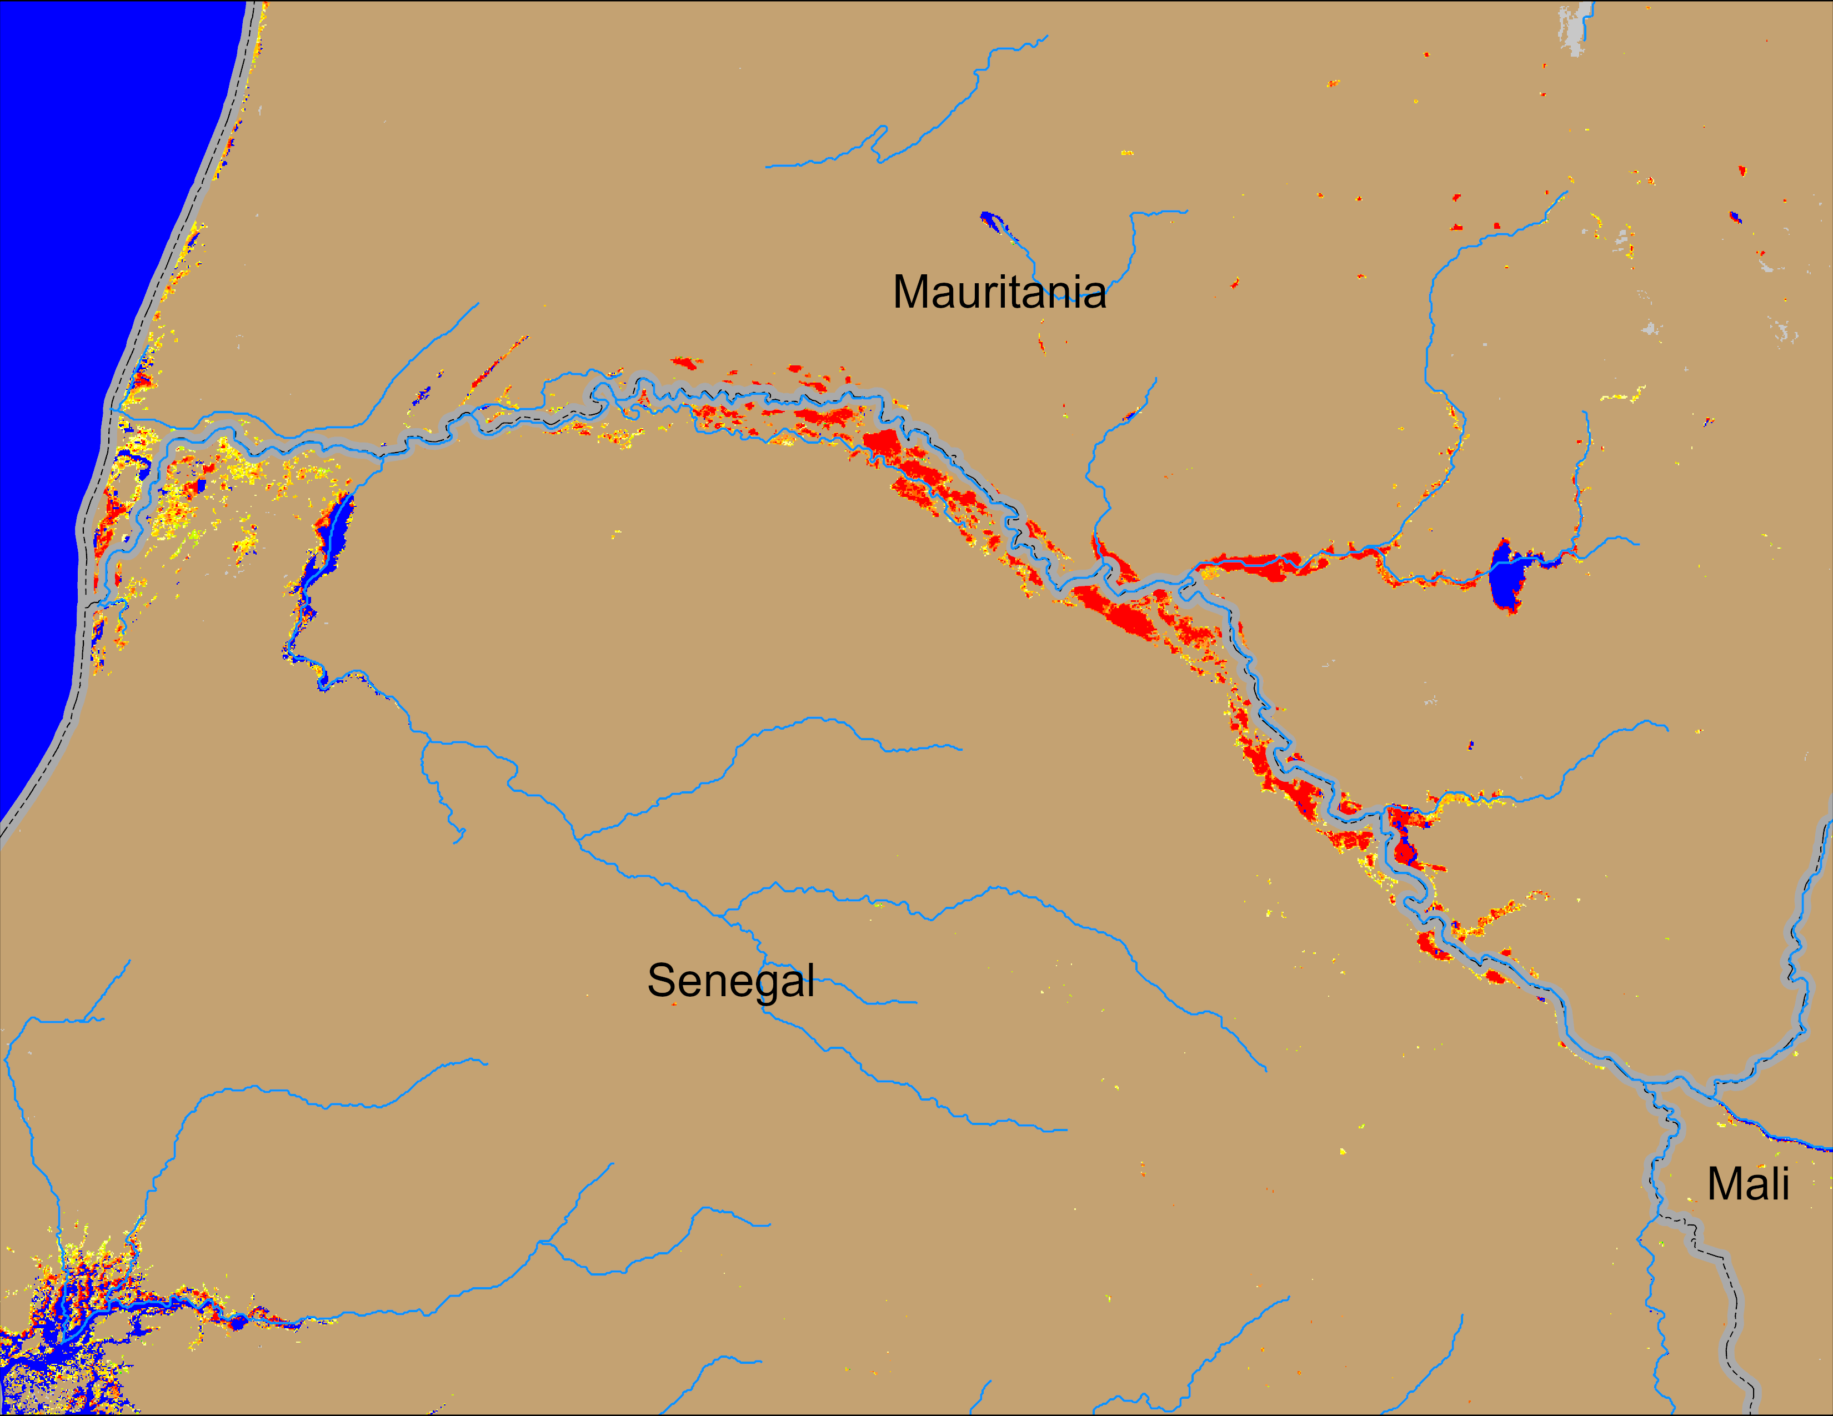
Flooding Conditions in Senegal
NOAA VIIRS derived map: 10 – 14 Sep 2025
NOAA VIIRS 5-day comp.: 17 – 21 Sep 2025
Flooding conditions remain unchanged along the Senegal River.

Slide 3
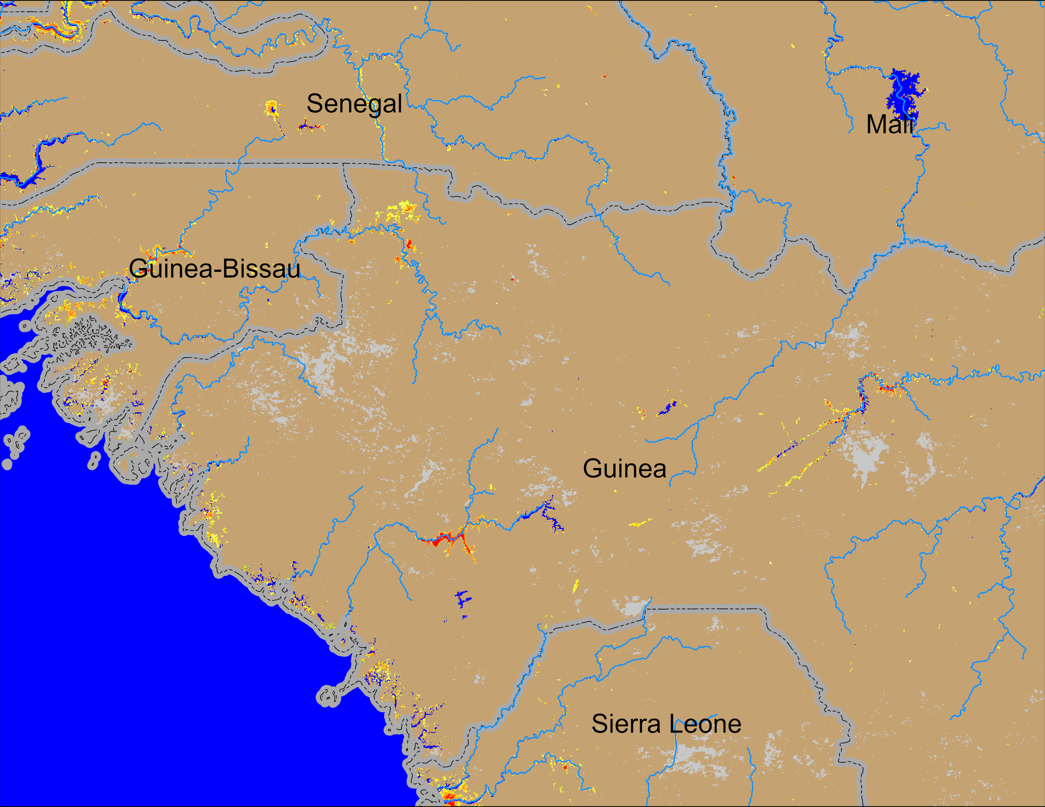

Flooding Conditions in Guinea
NOAA VIIRS derived map: 10 – 14 Sep 2025
NOAA VIIRS 5-day comp.: 17 – 21 Sep 2025
Flooding conditions remain unchanged in Guinea and Guinea-Bissau.

Slide 4
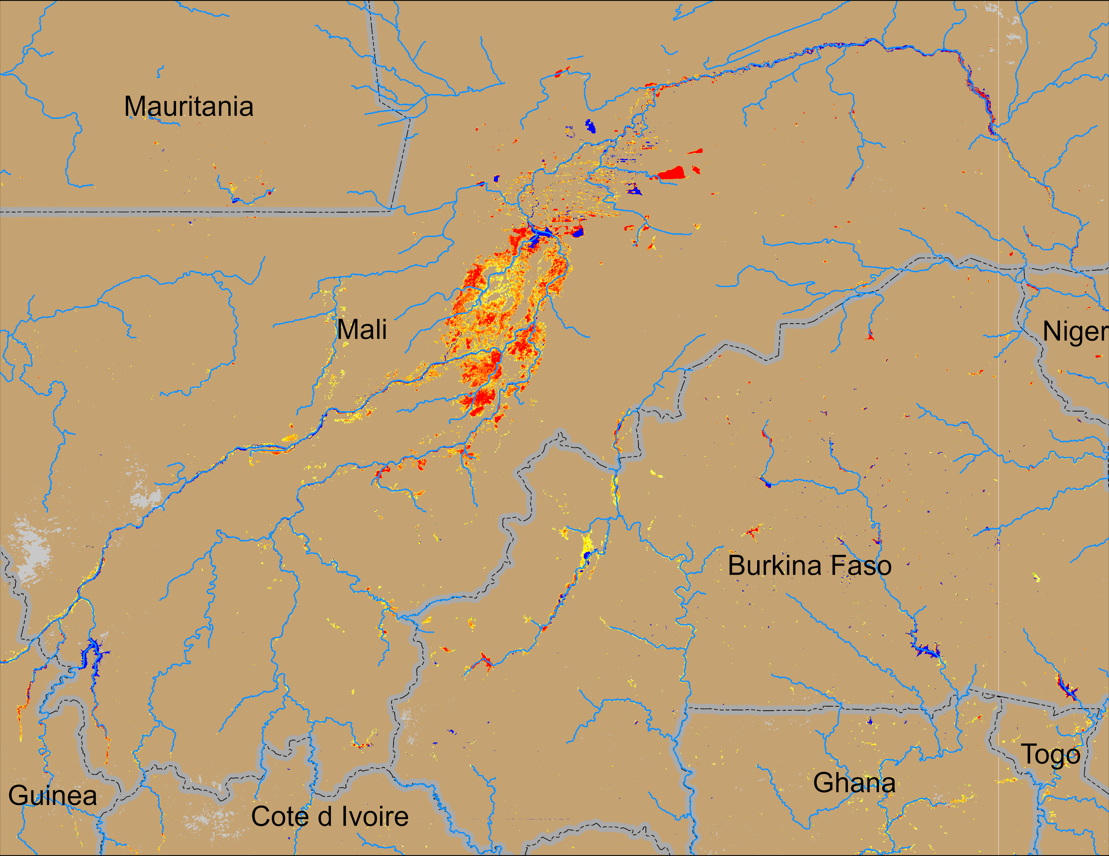
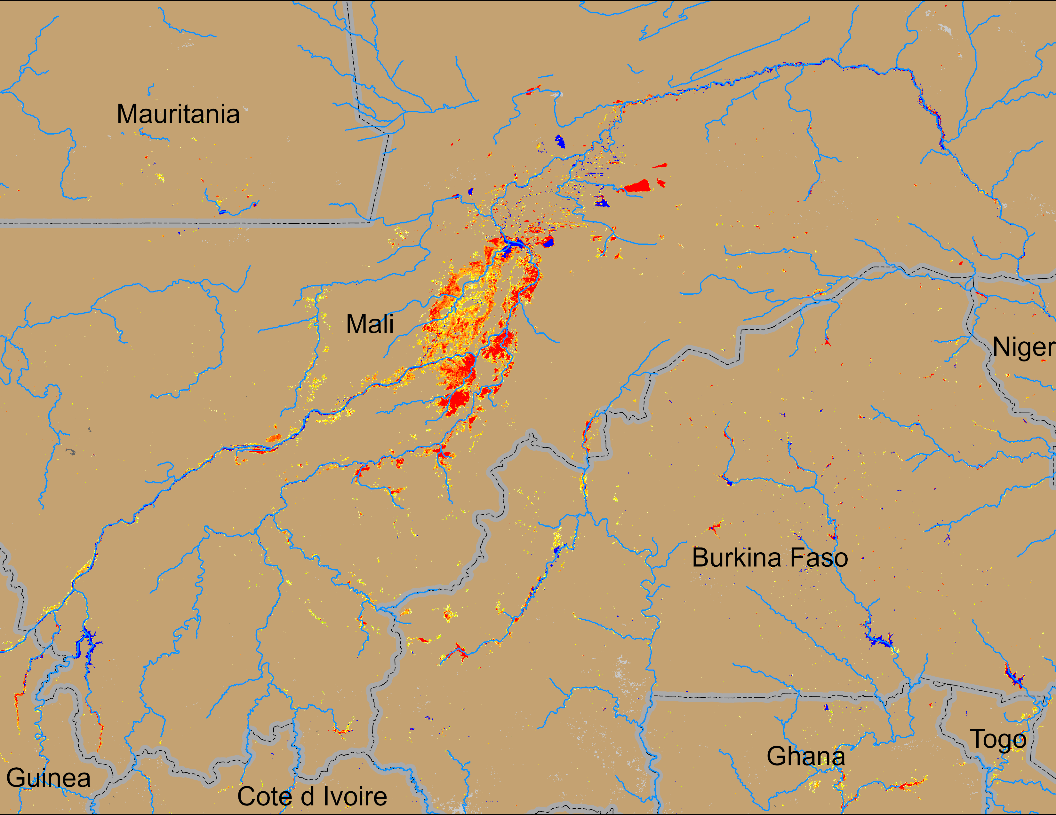
Flooding Conditions in Central Mali
NOAA VIIRS derived map: 10 – 14 Sep 2025
NOAA VIIRS 5-day comp.: 17 – 21 Sep 2025
Flooding conditions remain unchanged in Central Mali and Burkina Faso.

Slide 5
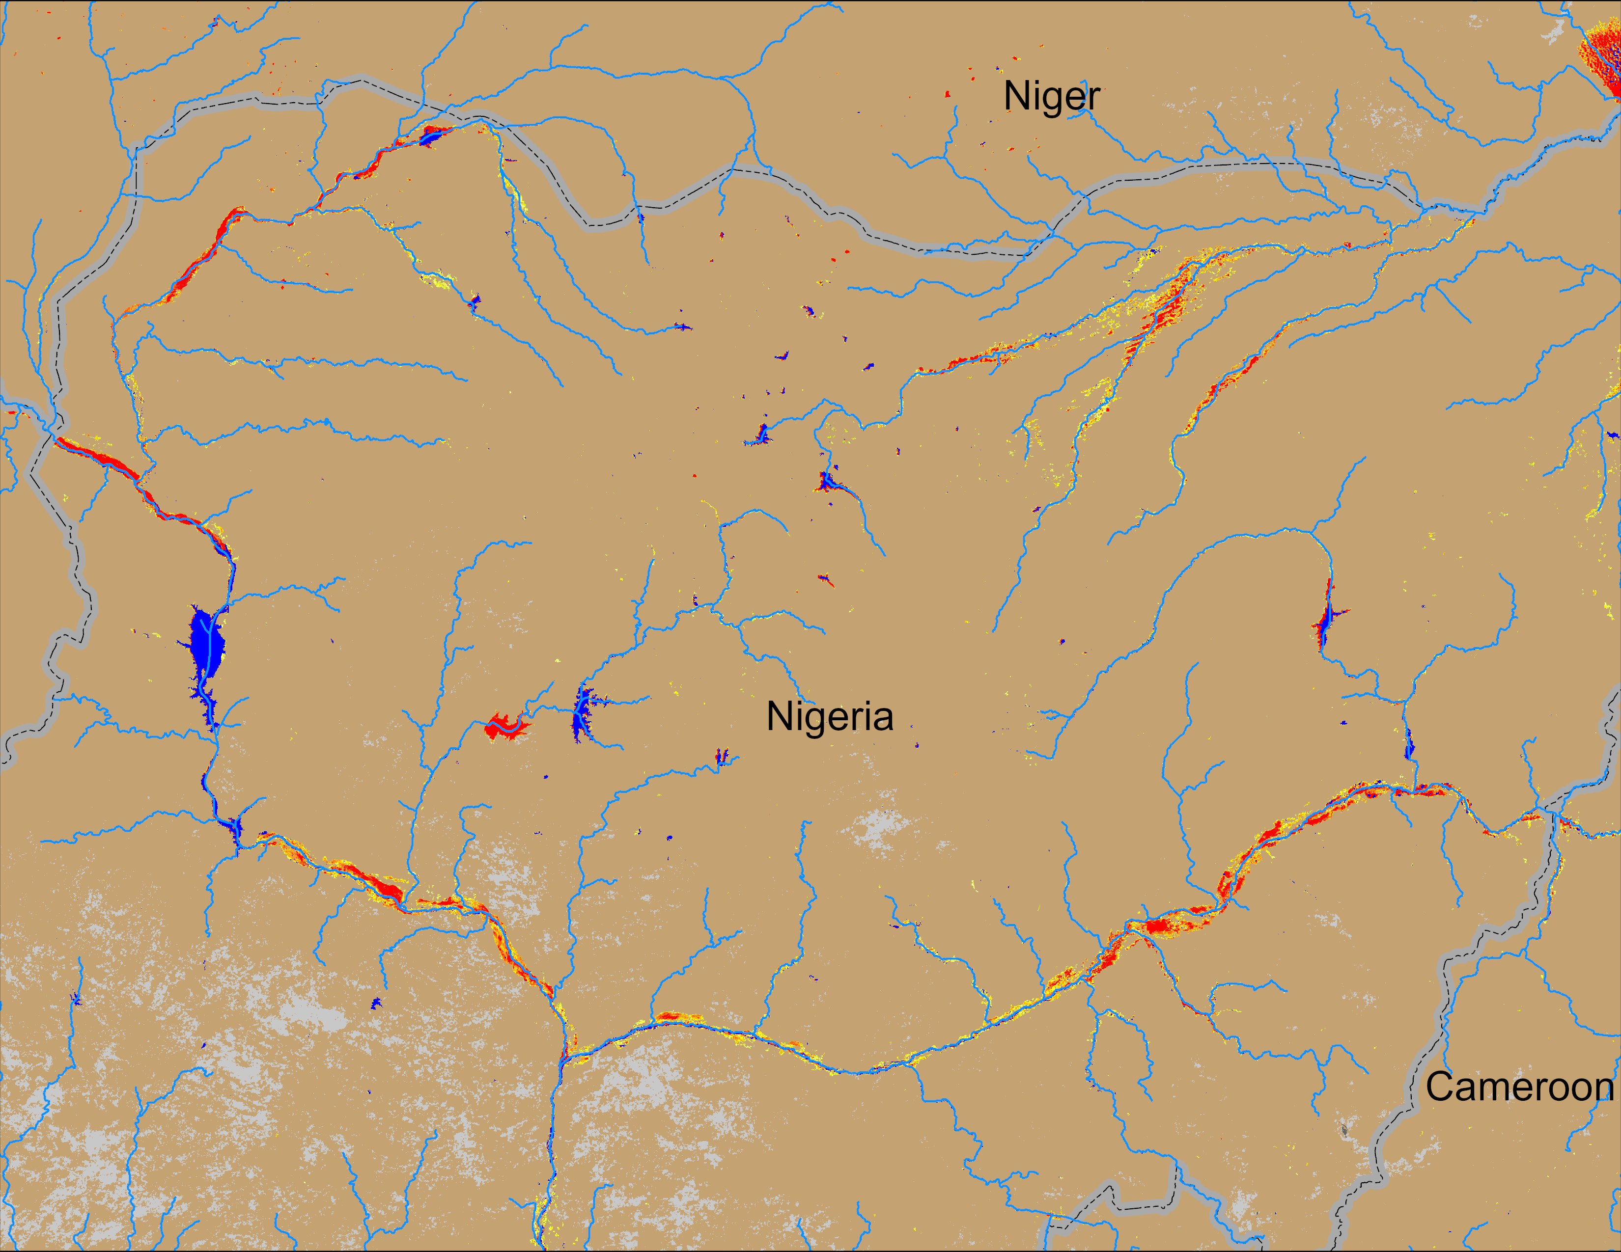
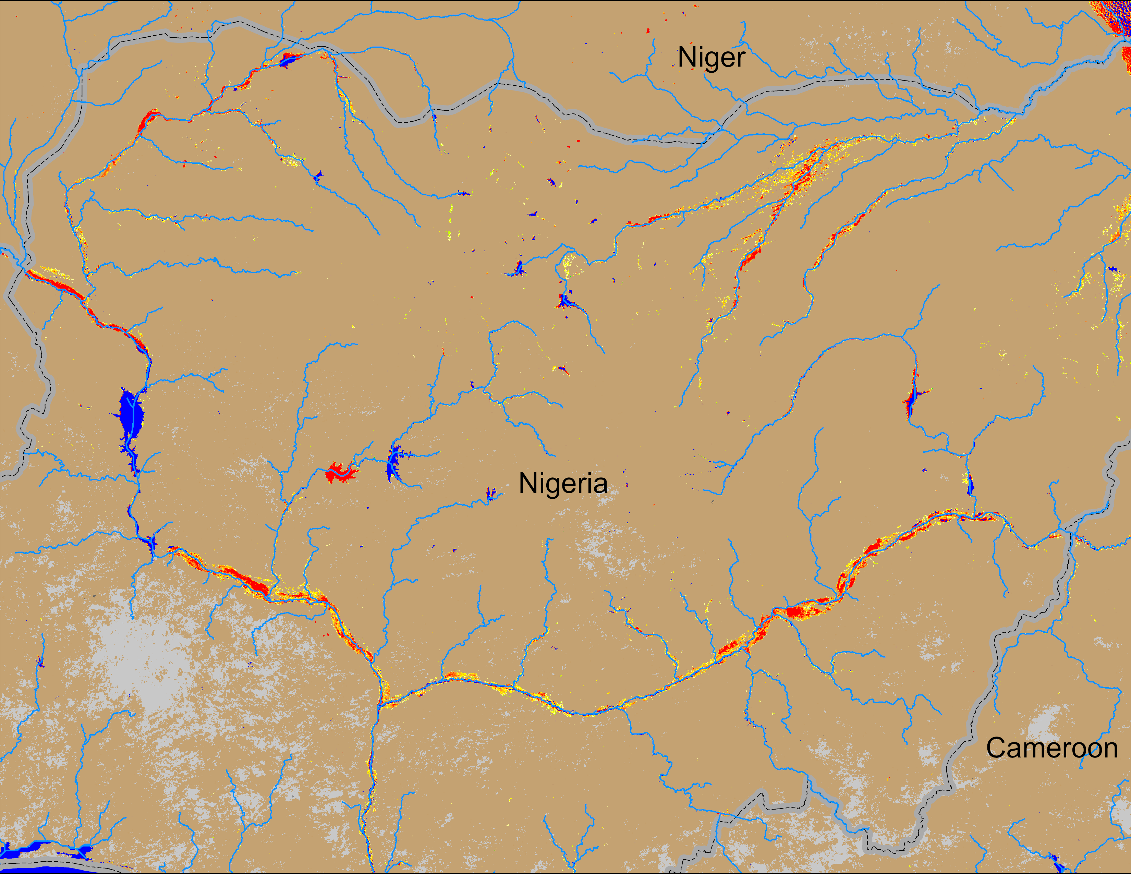
Flooding Conditions in Nigeria
Sokoto
Komadugu
Niger
Benue
NOAA VIIRS derived map: 10 – 14 Sep 2025
NOAA VIIRS 5-day comp.: 17 – 21 Sep 2025
Flooding conditins remain unchanged in all four major river systems (Sokoto, Niger, Komadudu, Beneu) in Nigeria.

Slide 6
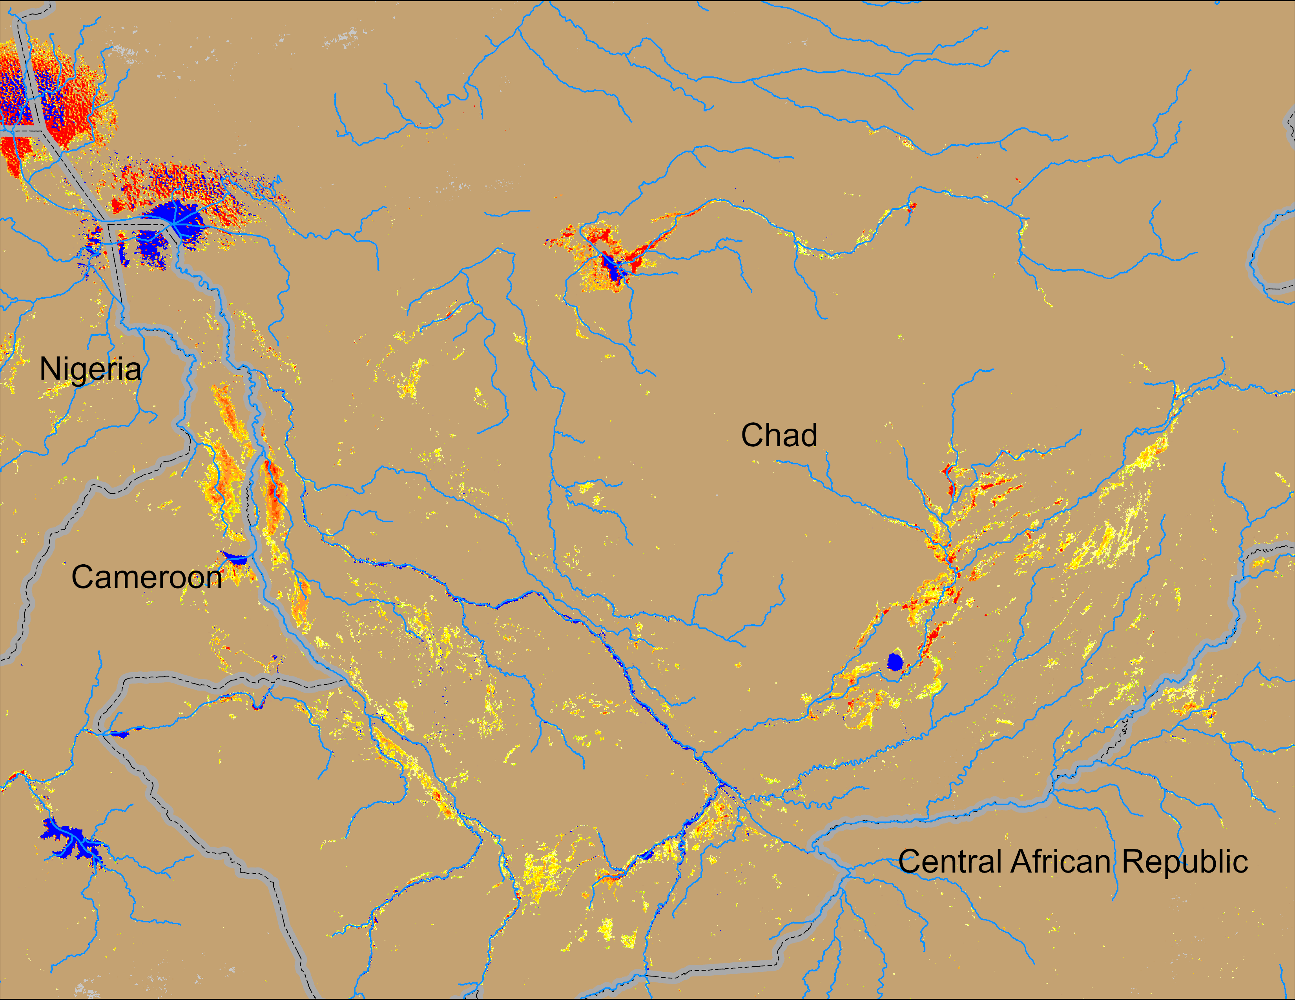
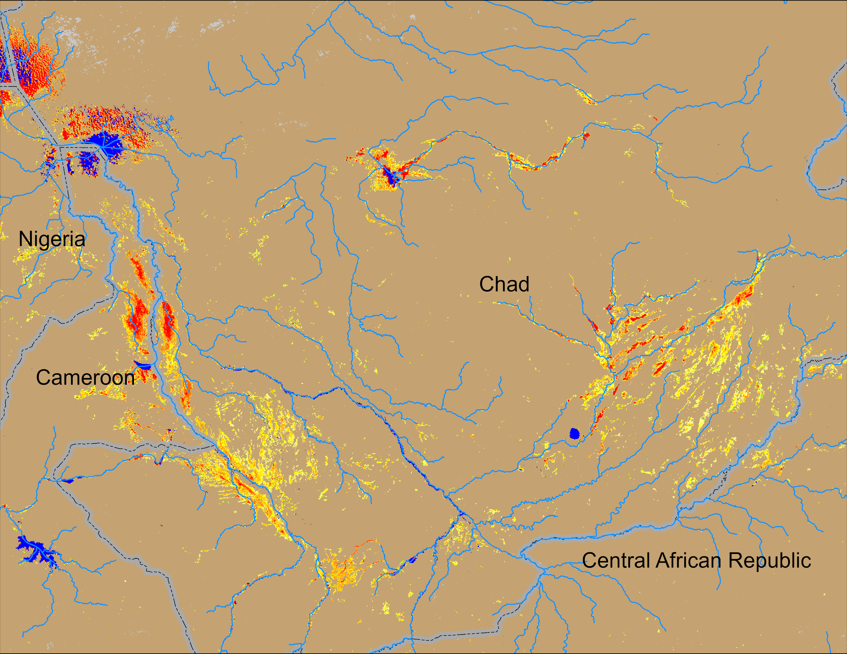
Flooding Conditions in Chad
Logone
Chari
NOAA VIIRS derived map: 10 – 14 Sep 2025
NOAA VIIRS 5-day comp.: 17 – 21 Sep 2025
Flooding conditions improved marginally along the Chari and Logone Rivers in Chad.

Slide 7
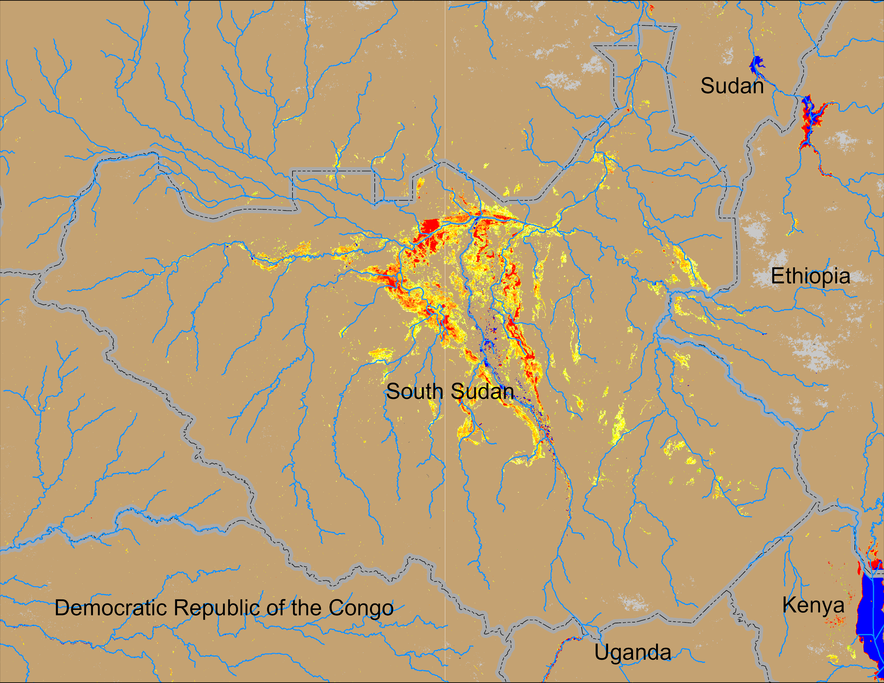
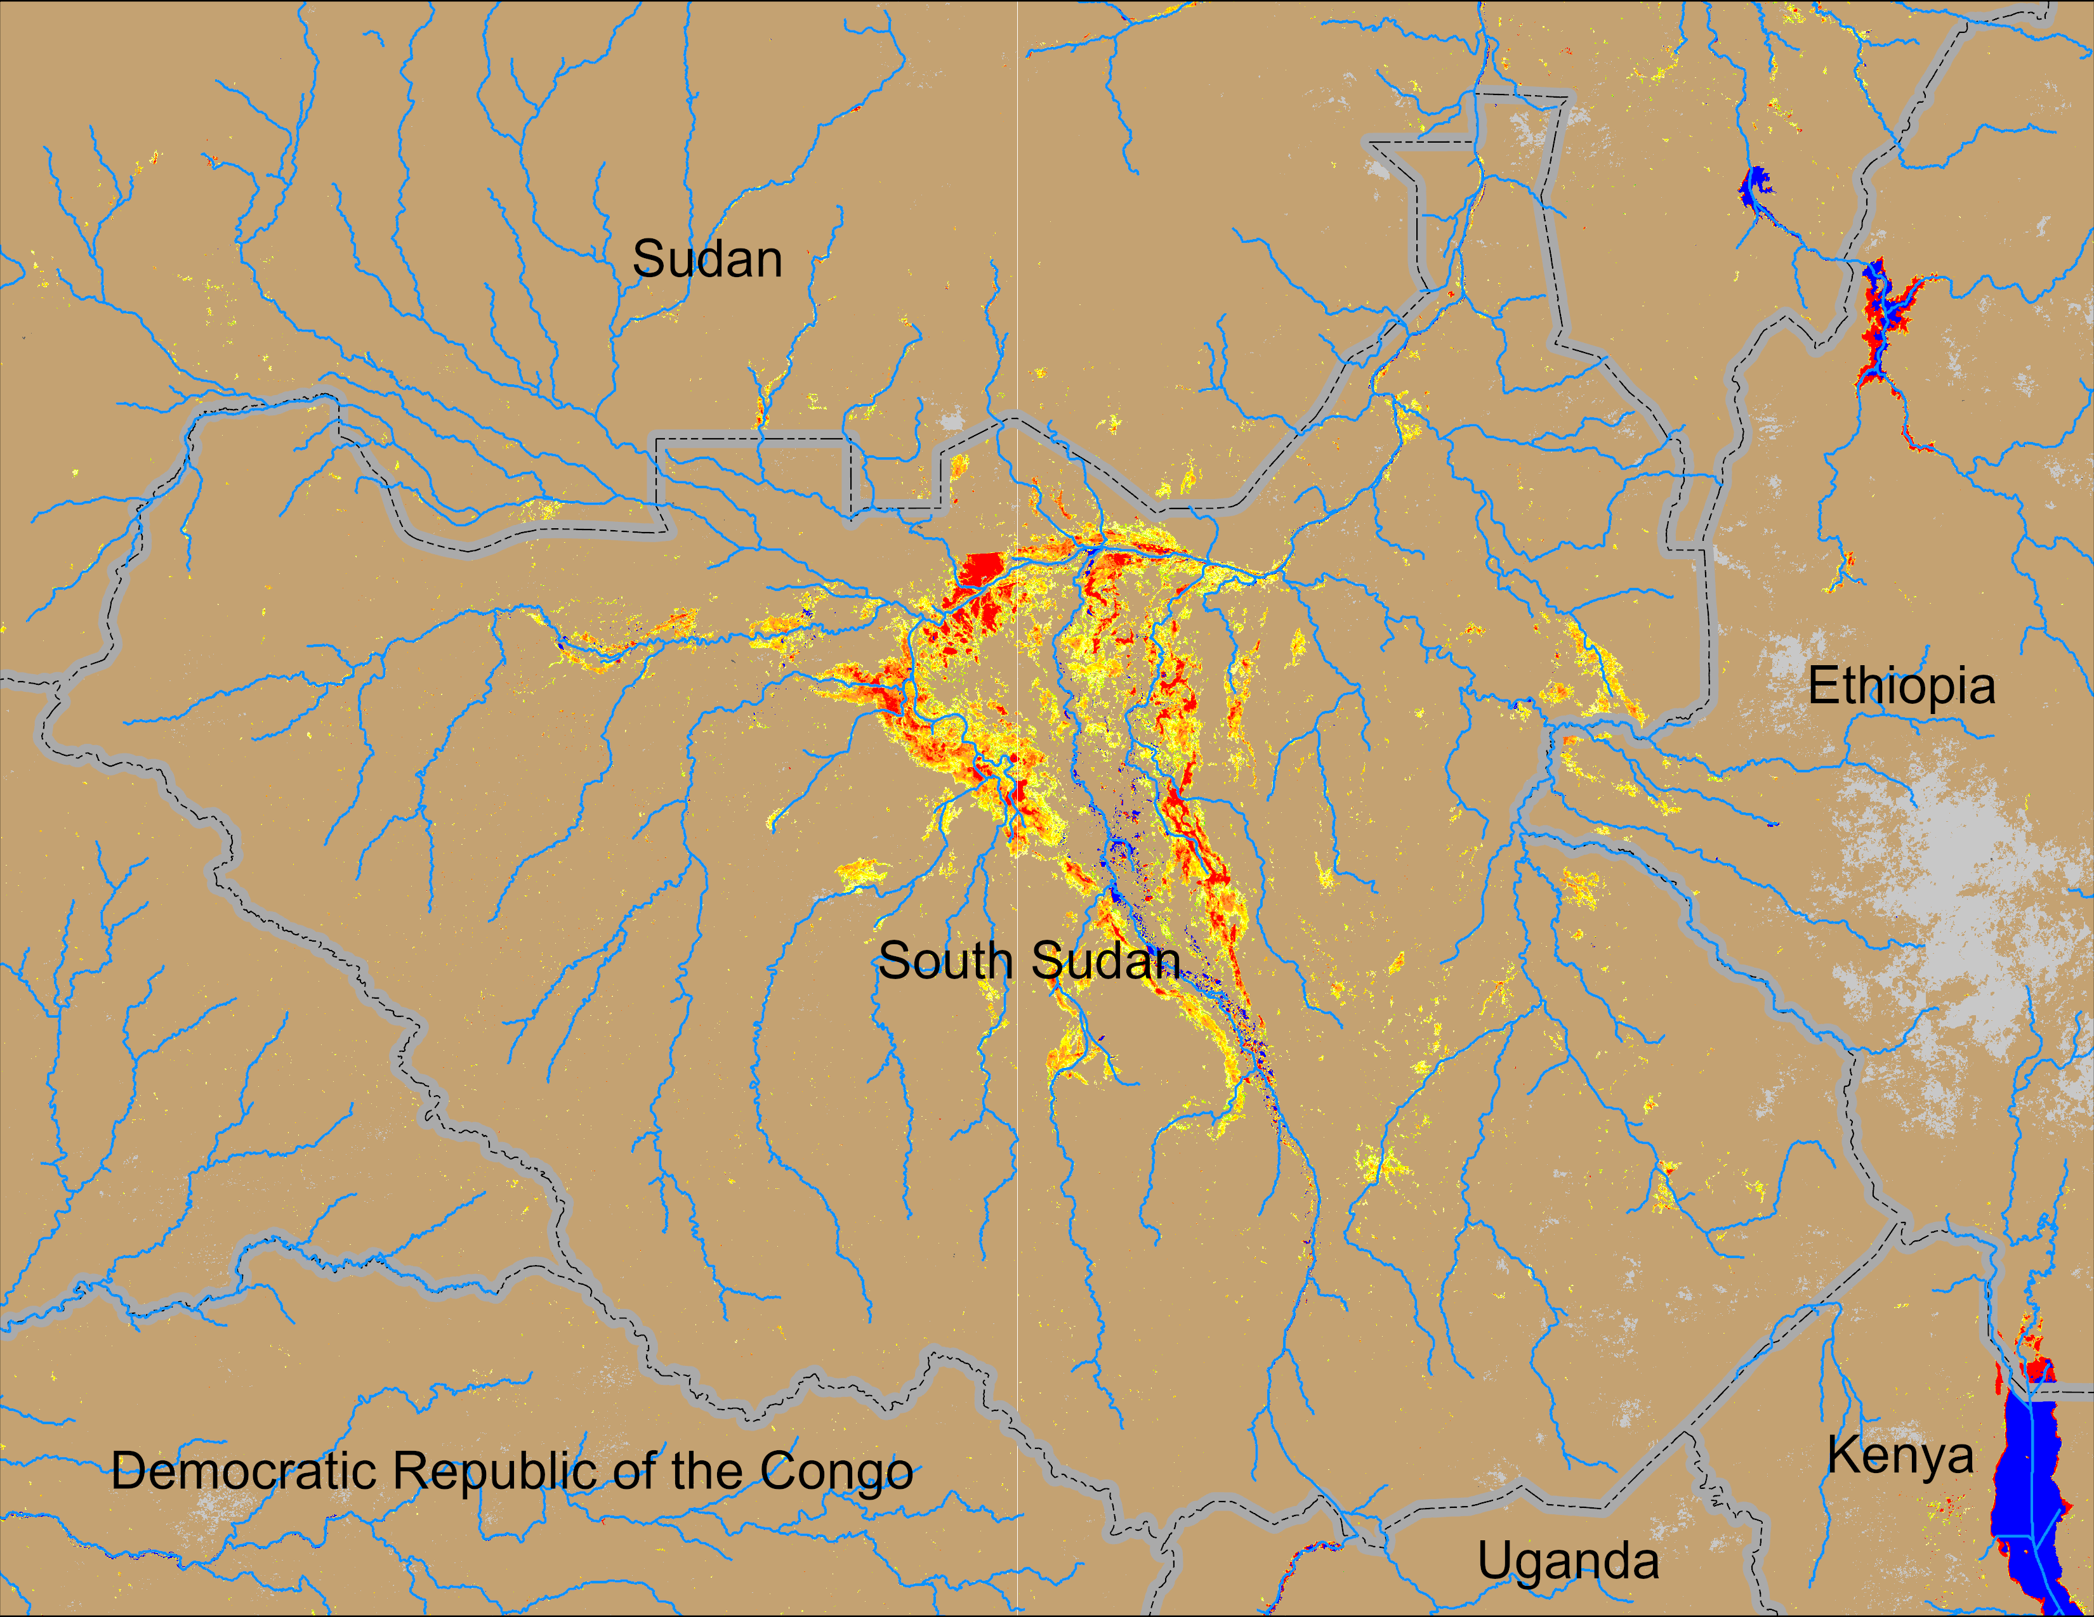
Flooding Conditions in South Sudan
NOAA VIIRS derived map: 10 – 14 Sep 2025
NOAA VIIRS 5-day comp.: 17 – 21 Sep 2025
Inundated areas have increased in South Sudan.

Slide 8
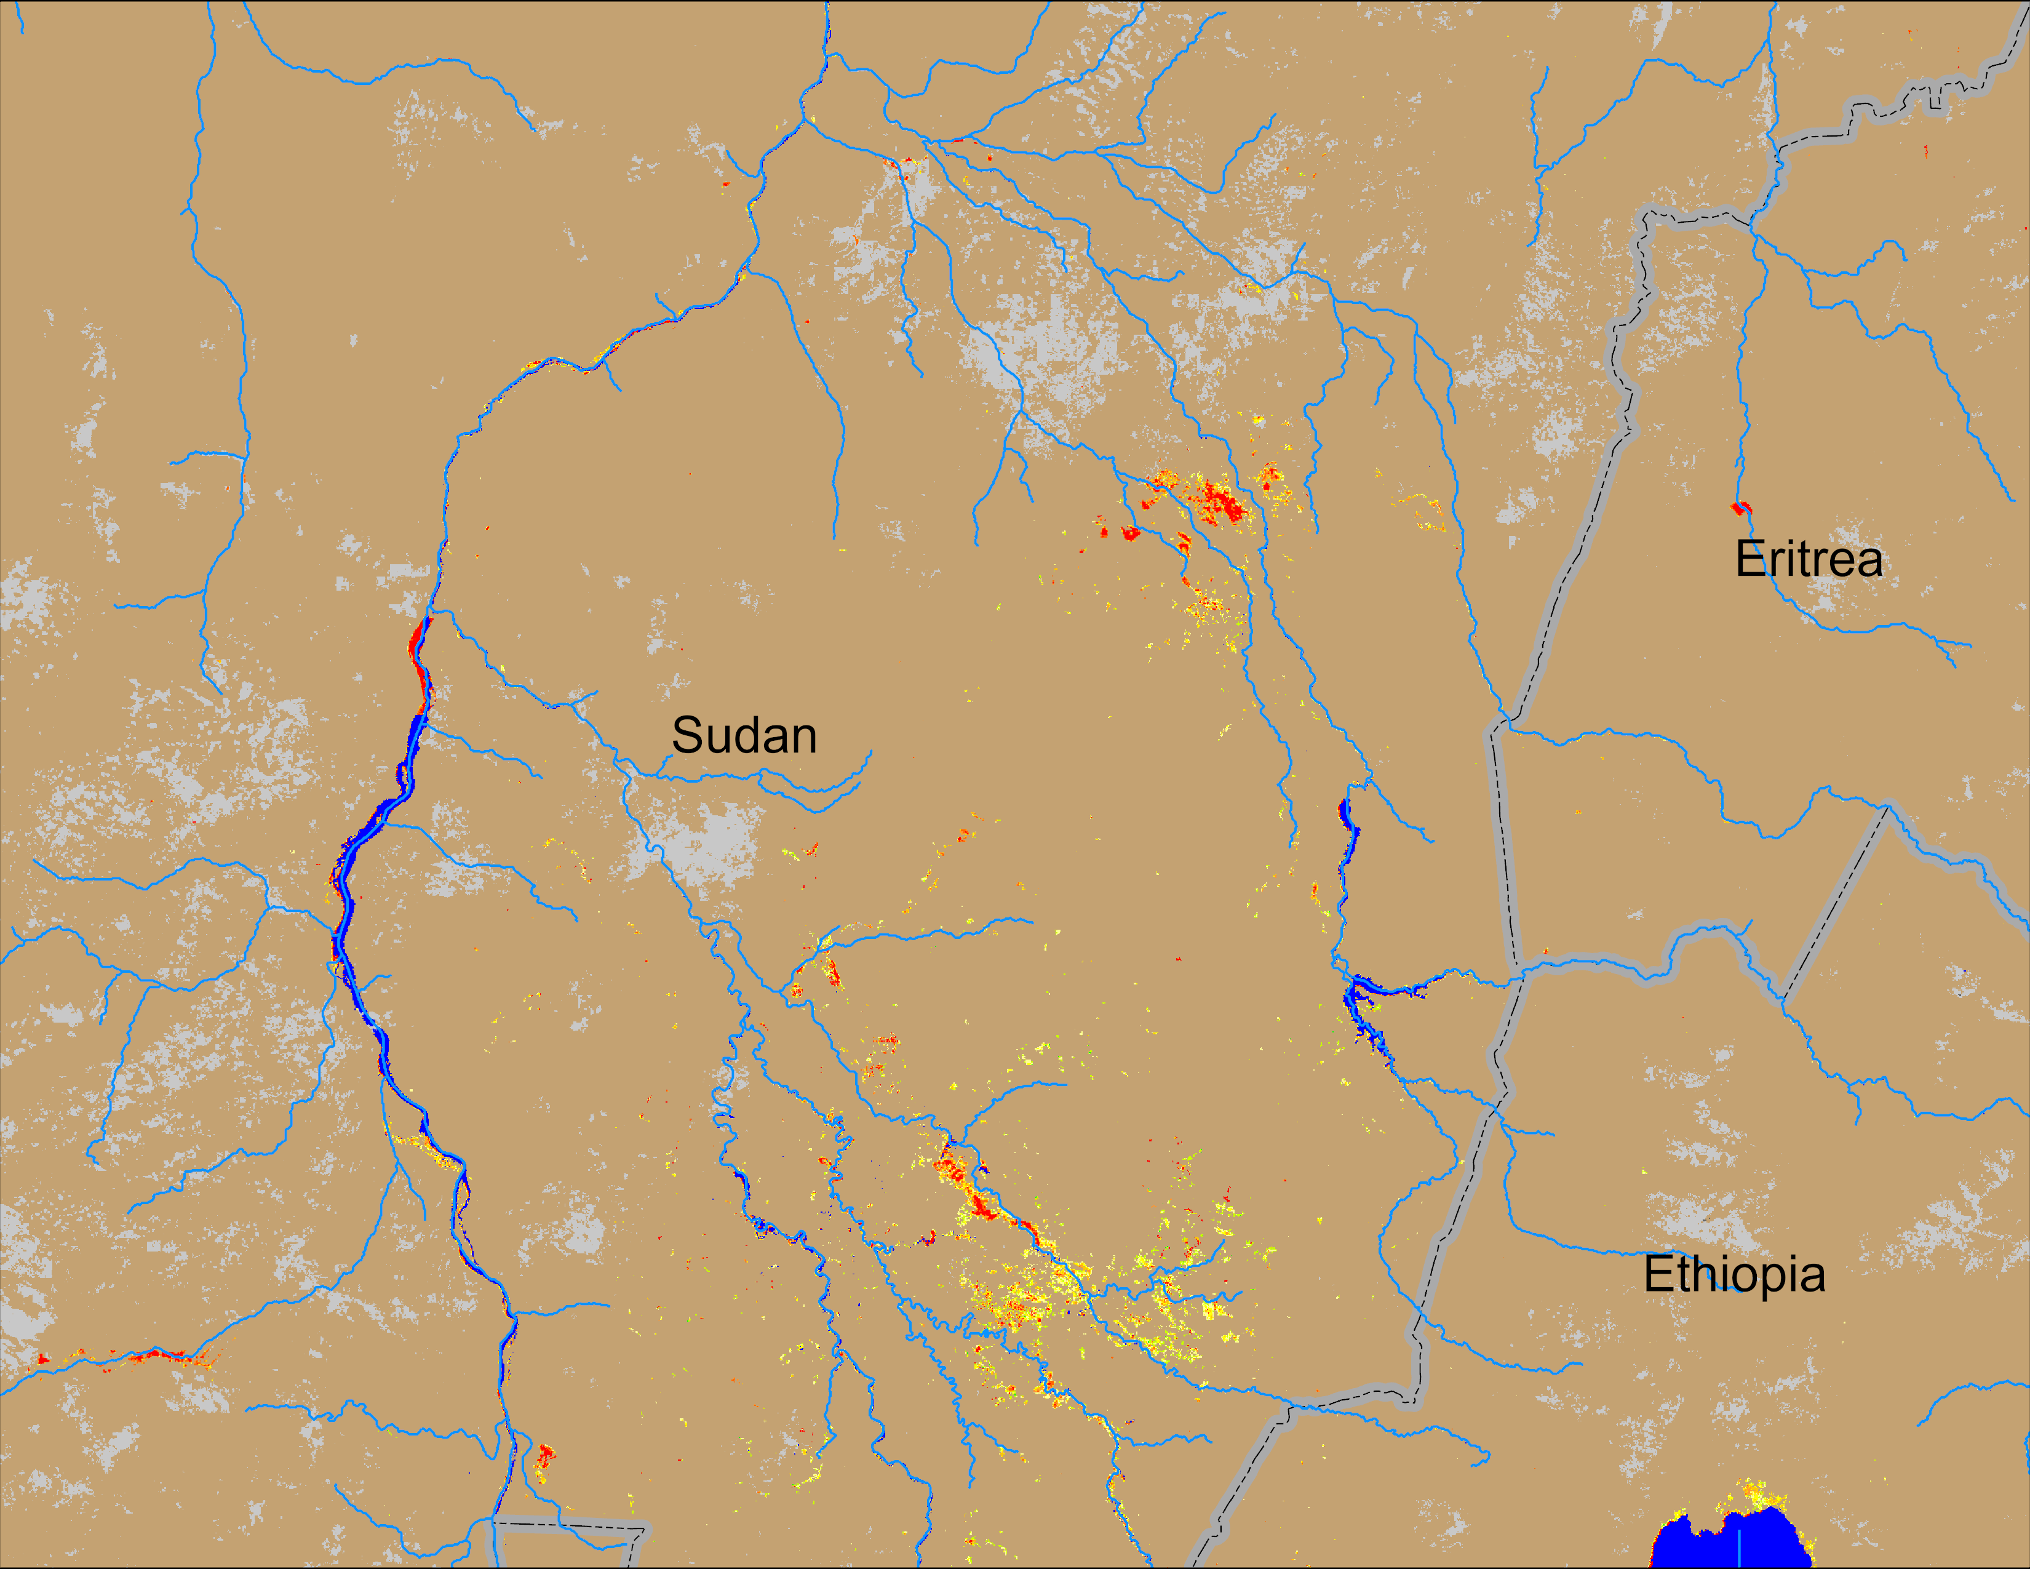
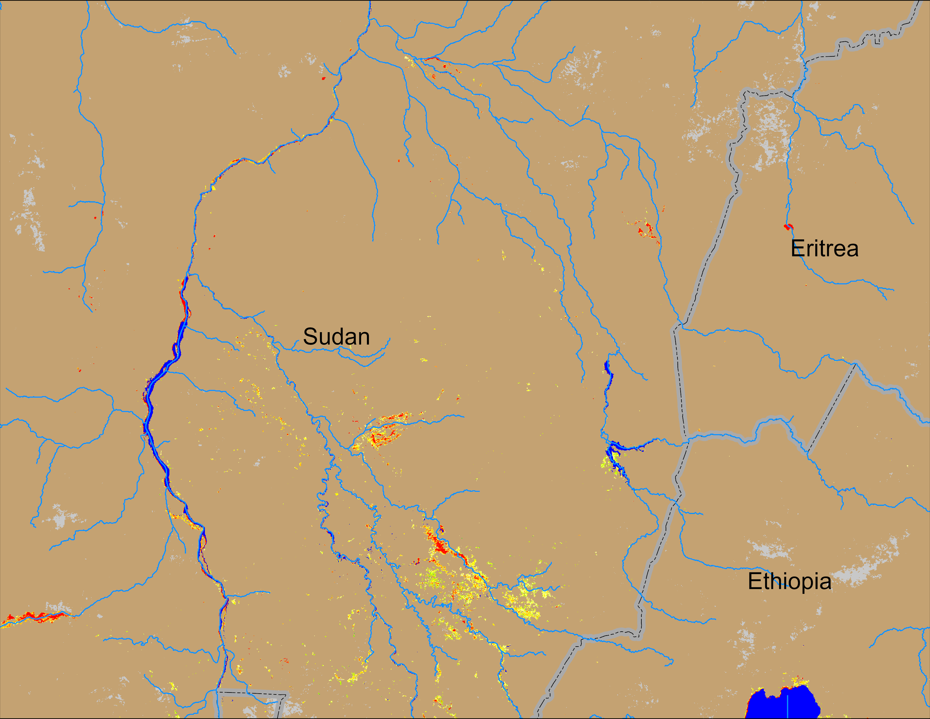
Flooding Conditions in Sudan
Atbara
Blue Nile
NOAA VIIRS derived map: 10 – 14 Sep 2025
NOAA VIIRS 5-day comp.: 17 – 21 Sep 2025
Flooding conditions improved in the Blue Nile but deteriorated in Atbara catchment.

