Slide 1
FEWS NET Enhanced Flood Monitoring and Forecast
FEWS NET Science Team
September 15, 2025
Notes:
Default title slide

Slide 2
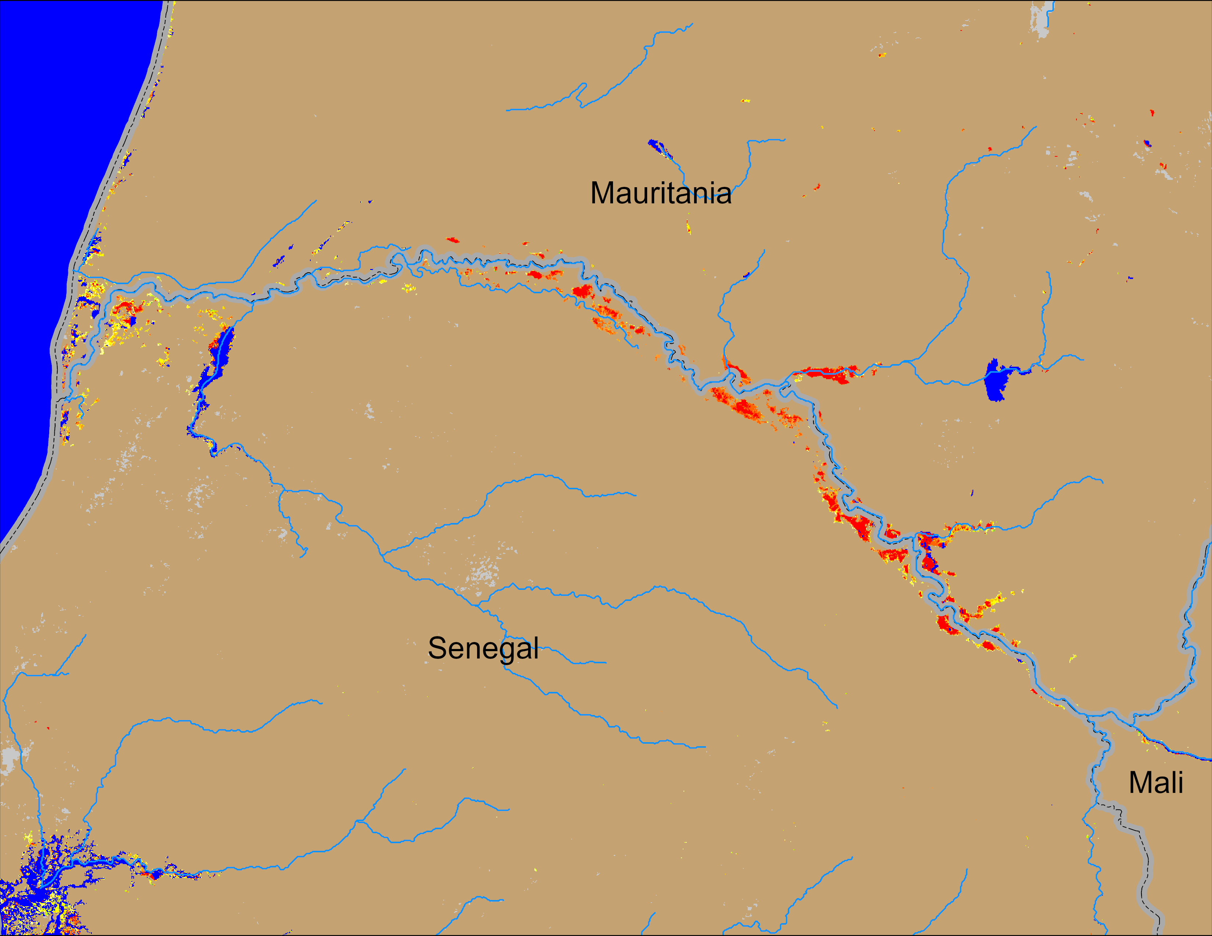
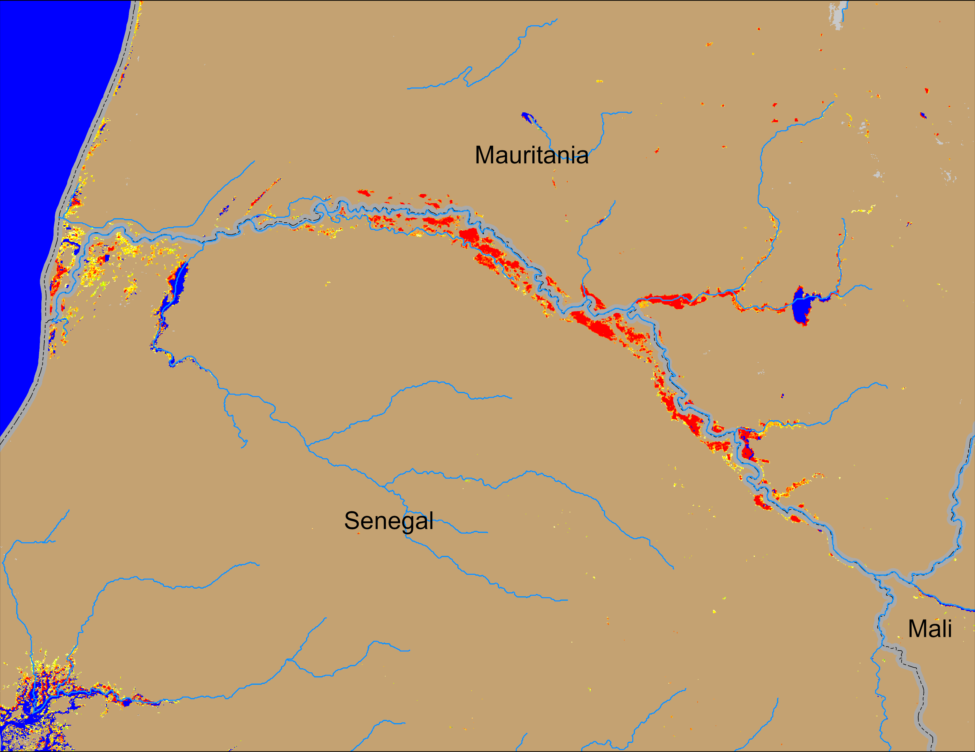
Flooding Conditions in Senegal
NOAA VIIRS derived map: 28 Aug – 01 Sep 2025
NOAA VIIRS 5-day comp.: 10 – 14 Sep 2025
Flooding conditions deteriorated along the Senegal River.

Slide 3
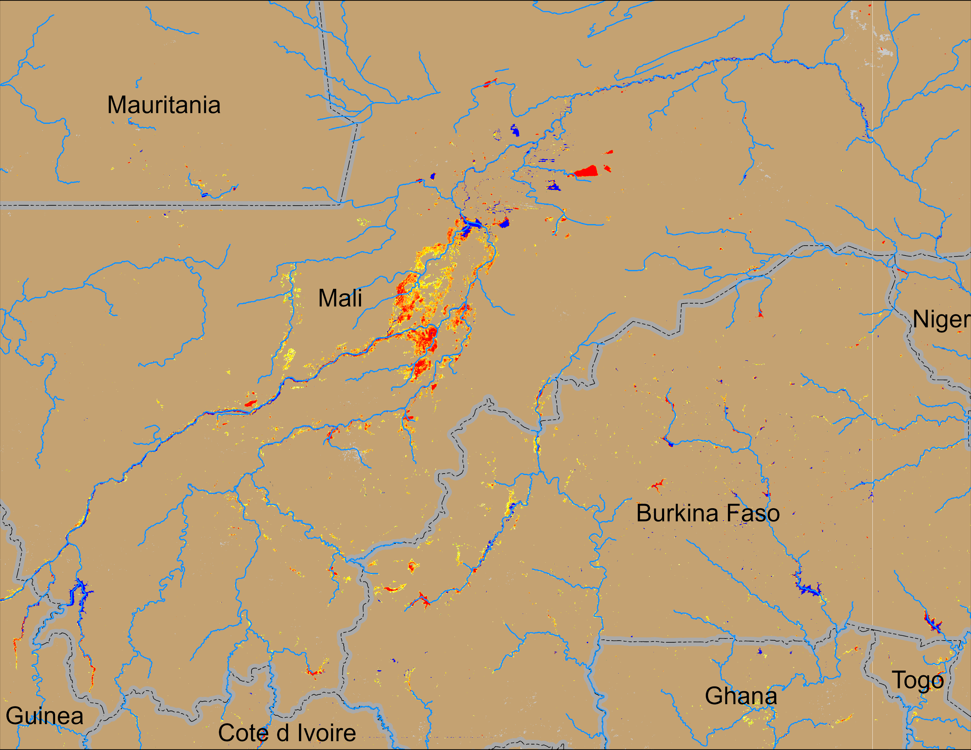
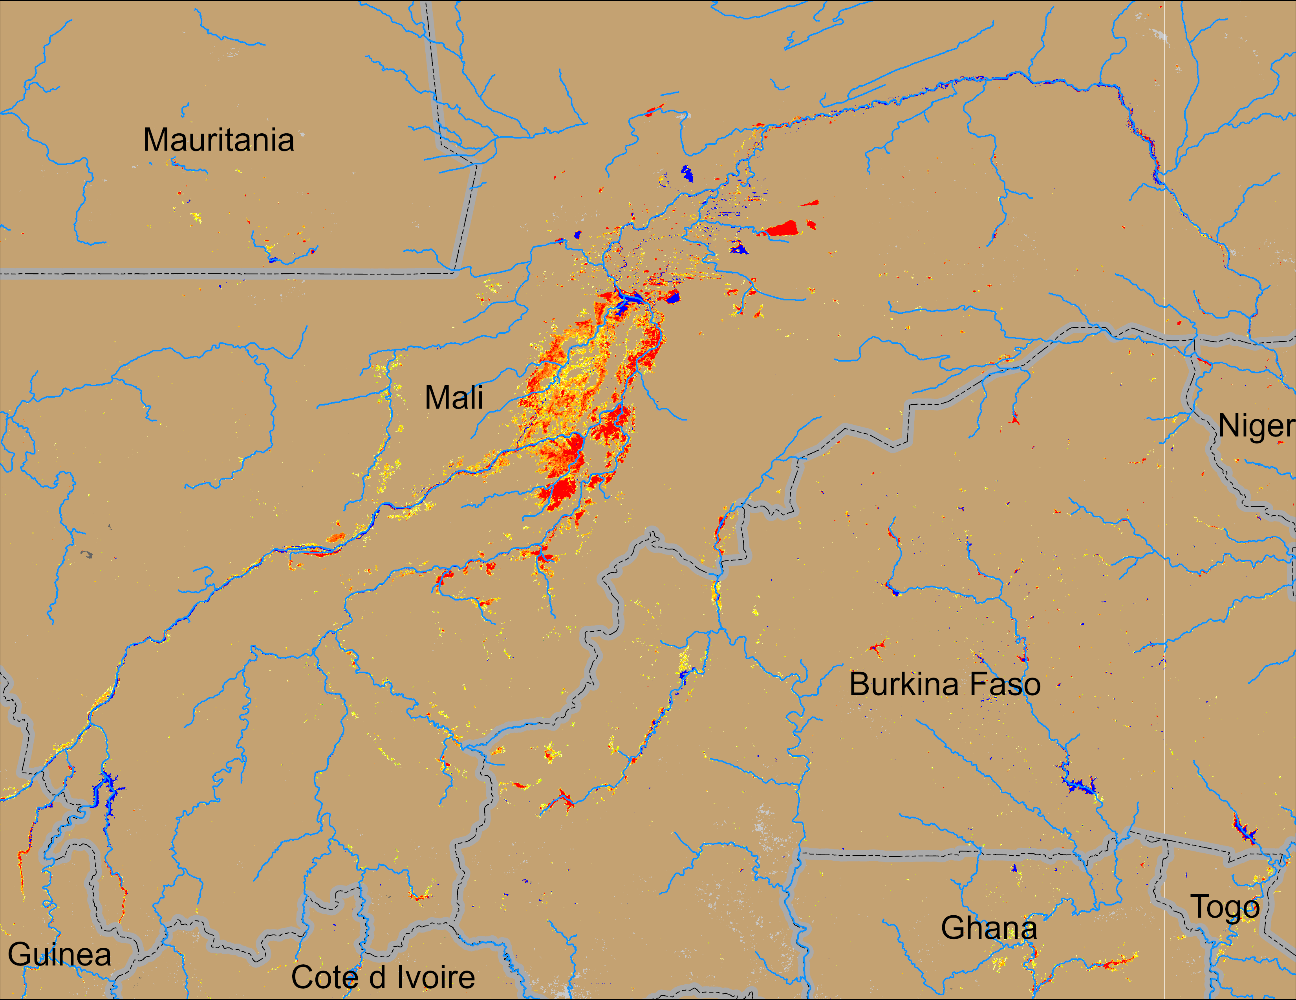
Flooding Conditions in Central Mali
NOAA VIIRS derived map: 28 Aug – 01 Sep 2025
NOAA VIIRS 5-day comp.: 10 – 14 Sep 2025
Flooding area expanced in Central Mali and into Burkina Faso.

Slide 4
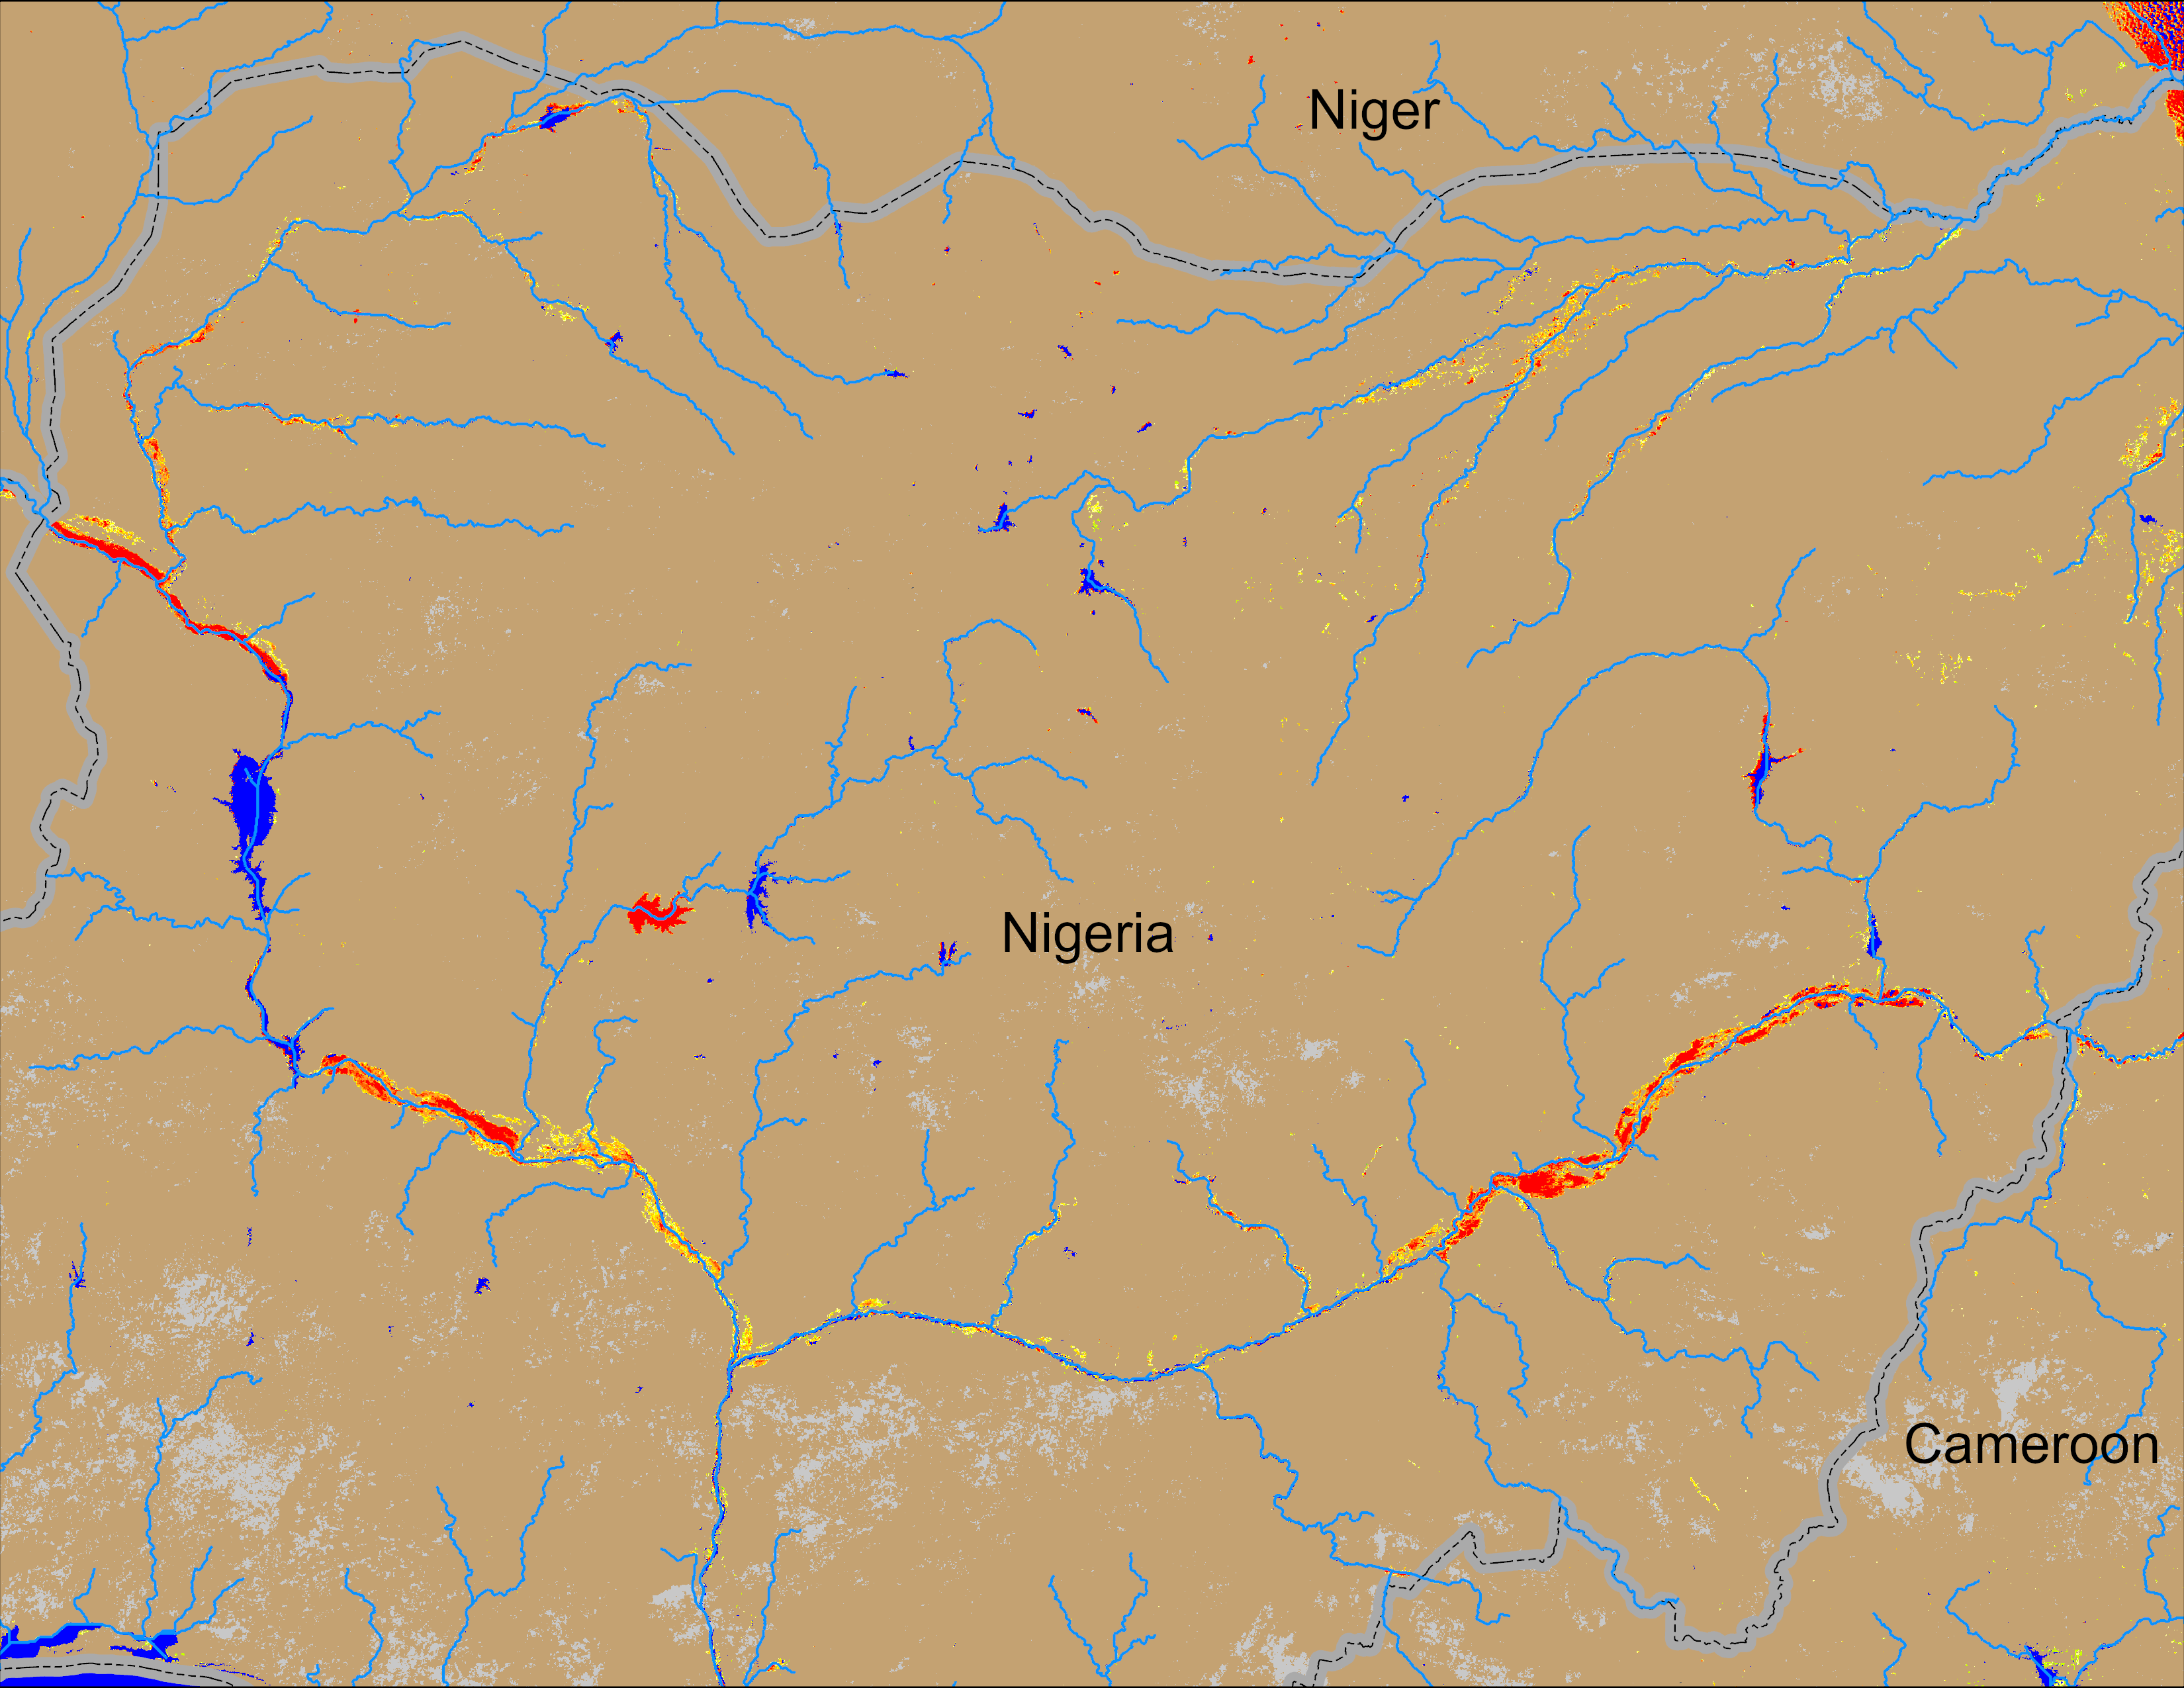
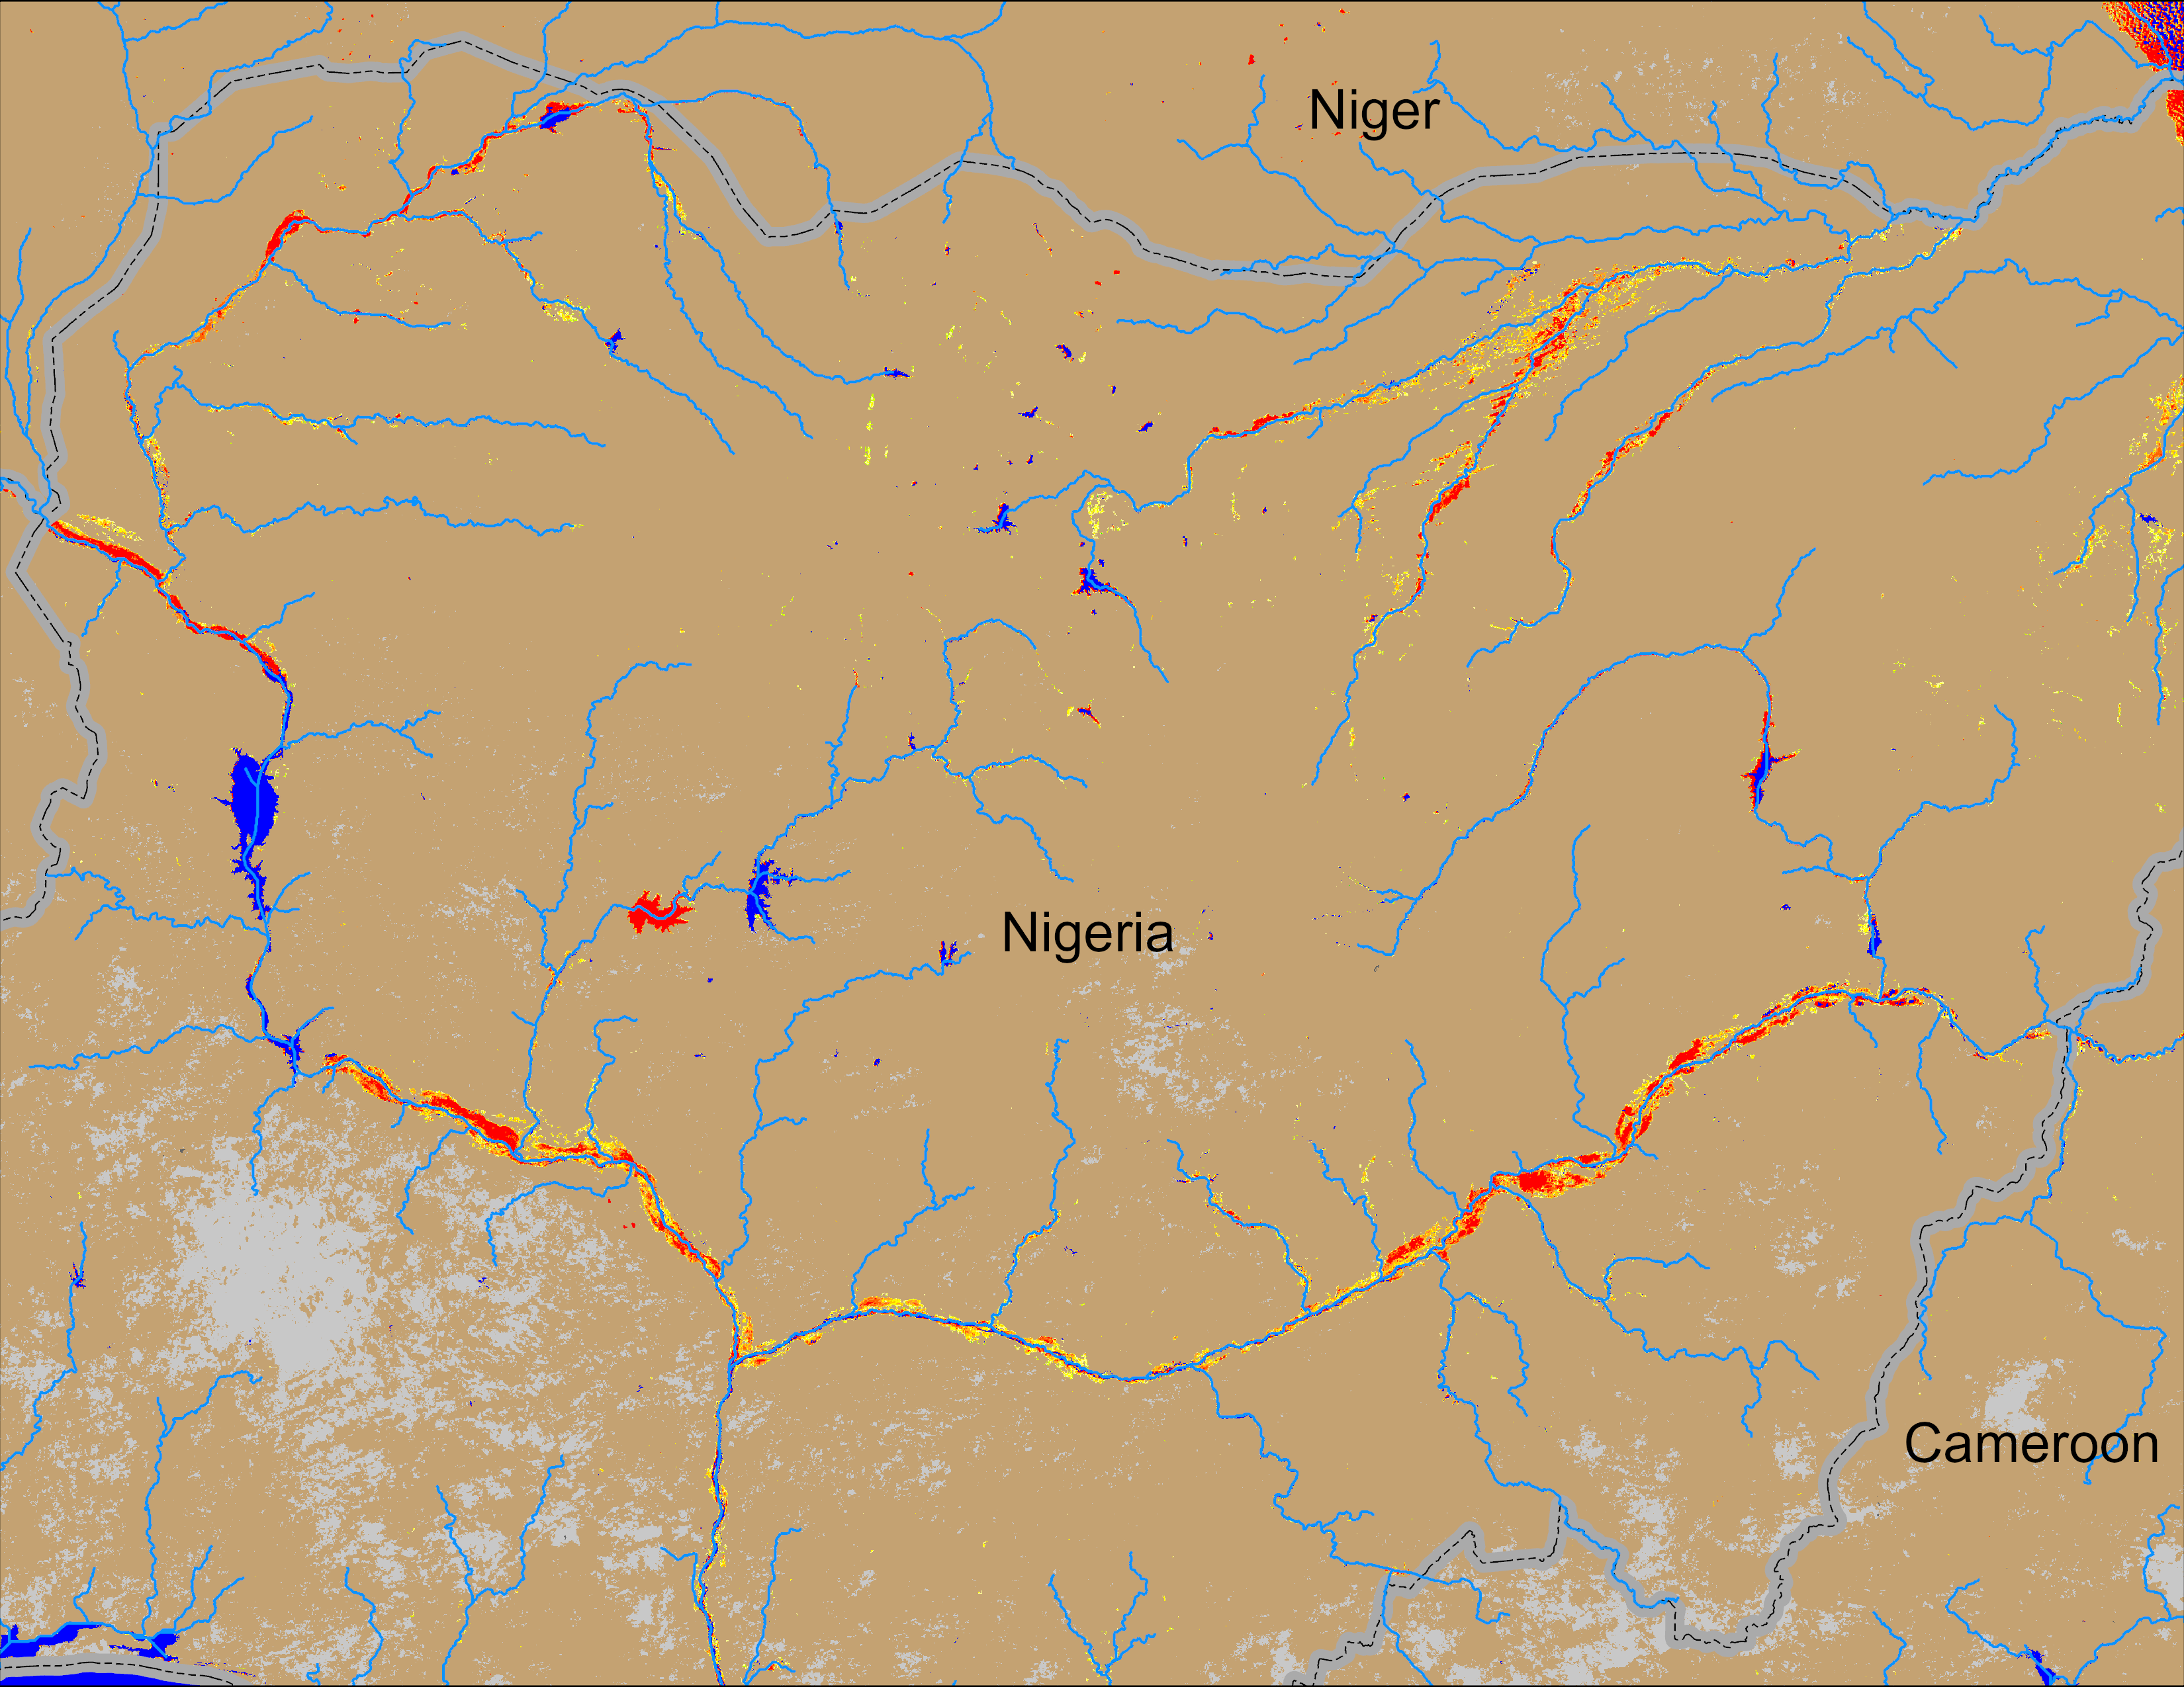
Flooding Conditions in Nigeria
NOAA VIIRS derived map: 28 Aug – 01 Sep 2025
NOAA VIIRS 5-day comp.: 10 – 14 Sep 2025
All four major river systems (Sokoto, Niger, Komadudu, Beneu) in Nigeria are experiencing flooding.

Slide 5
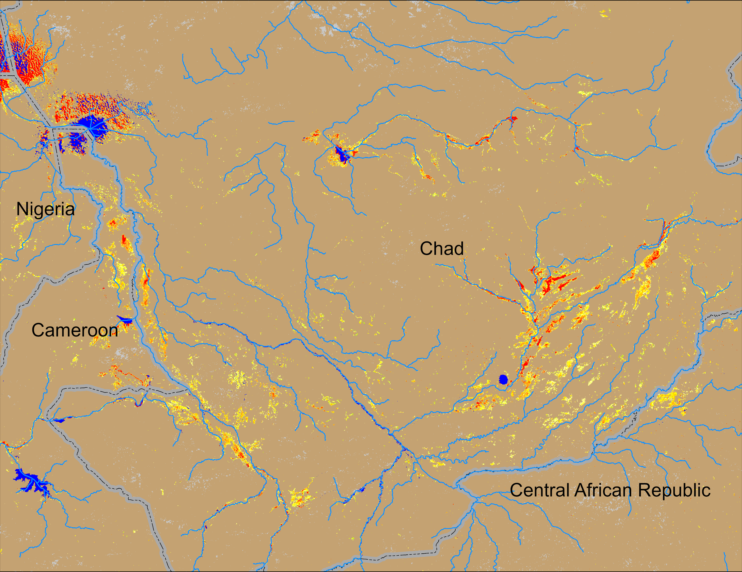
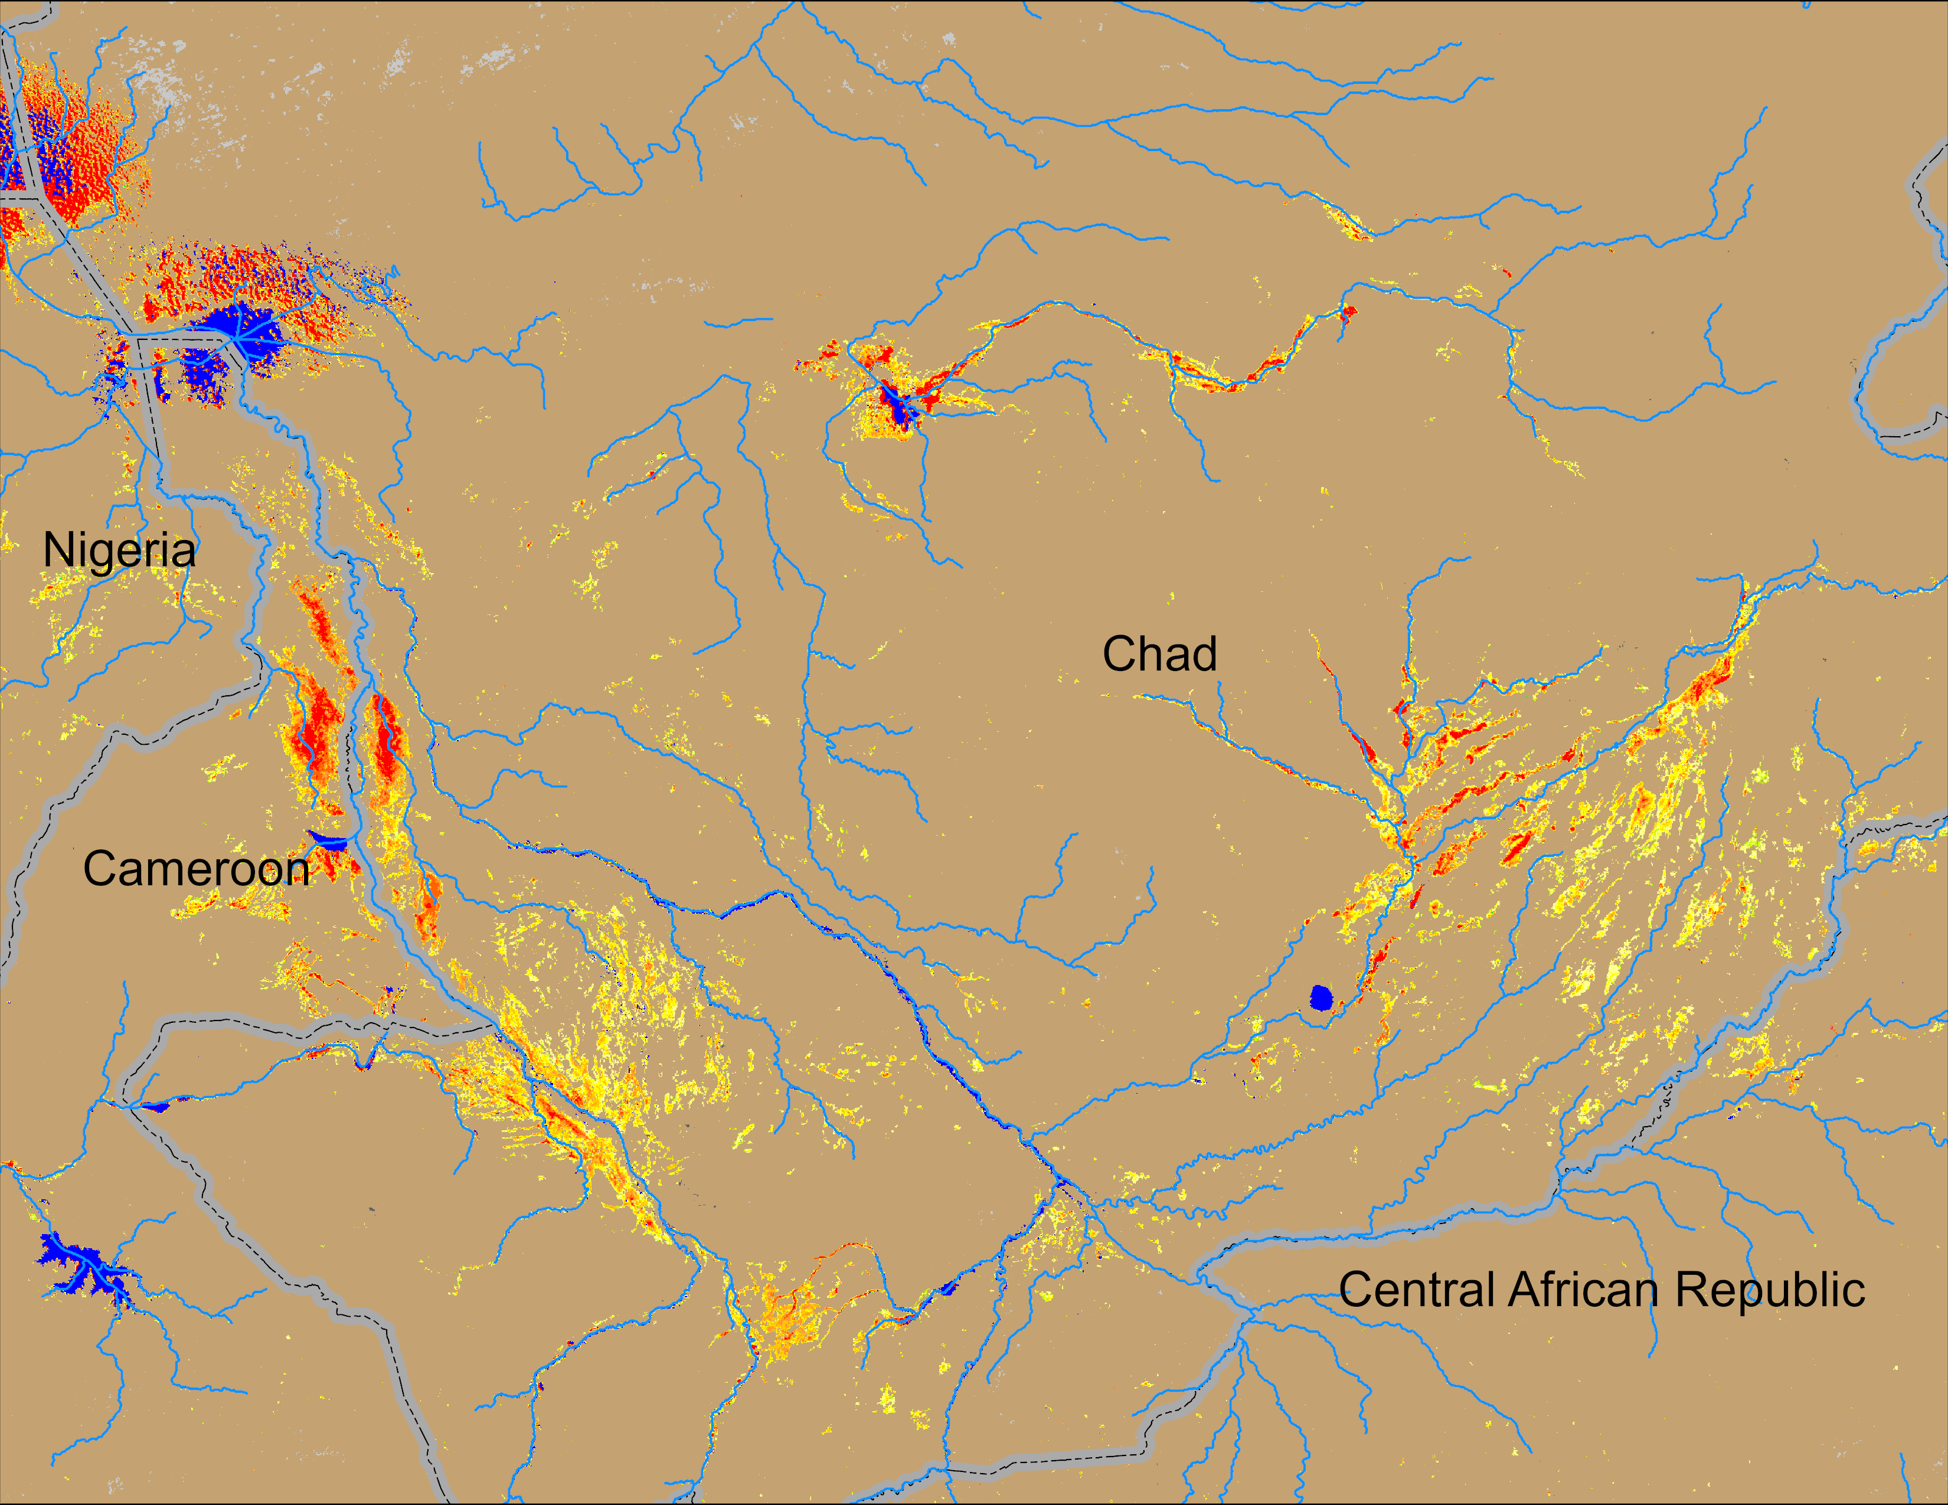
Flooding Conditions in Chad
NOAA VIIRS derived map: 28 Aug – 01 Sep 2025
NOAA VIIRS 5-day comp.: 10 – 14 Sep 2025
Flooding conditions worsen especially along the Logone River in Chad.

Slide 6
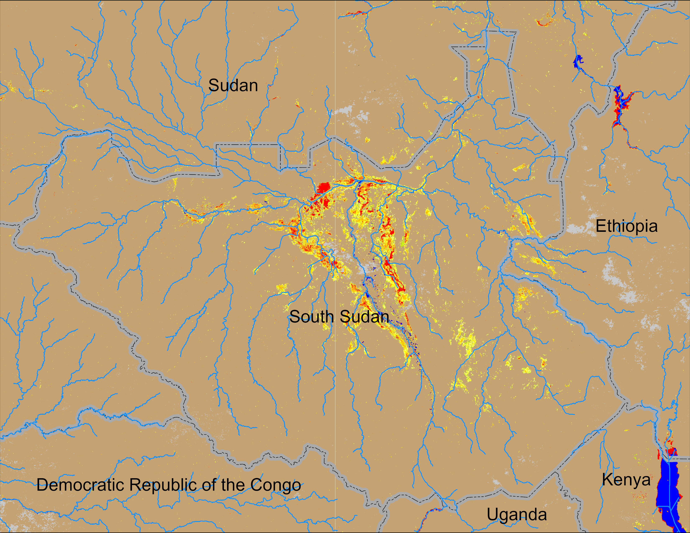
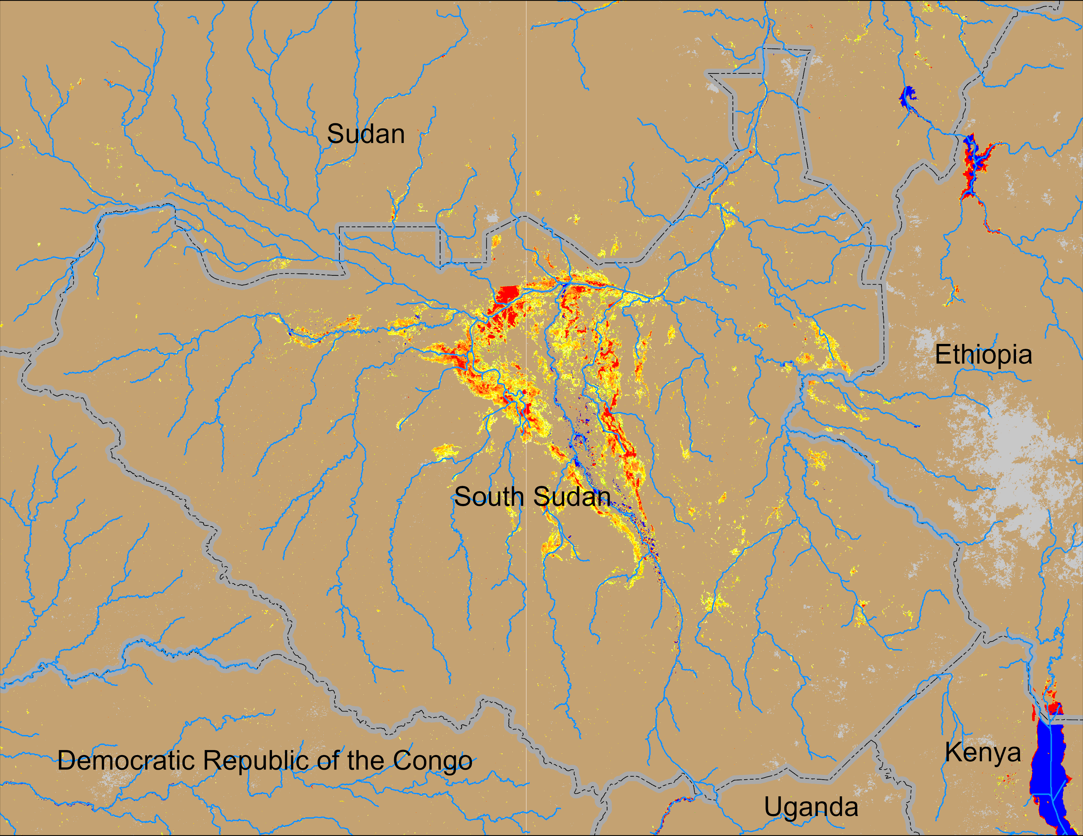
Flooding Conditions in South Sudan
NOAA VIIRS derived map: 28 Aug – 01 Sep 2025
NOAA VIIRS 5-day comp.: 10 – 14 Sep 2025
Flooding conditions intensifying in South Sudan.

Slide 7
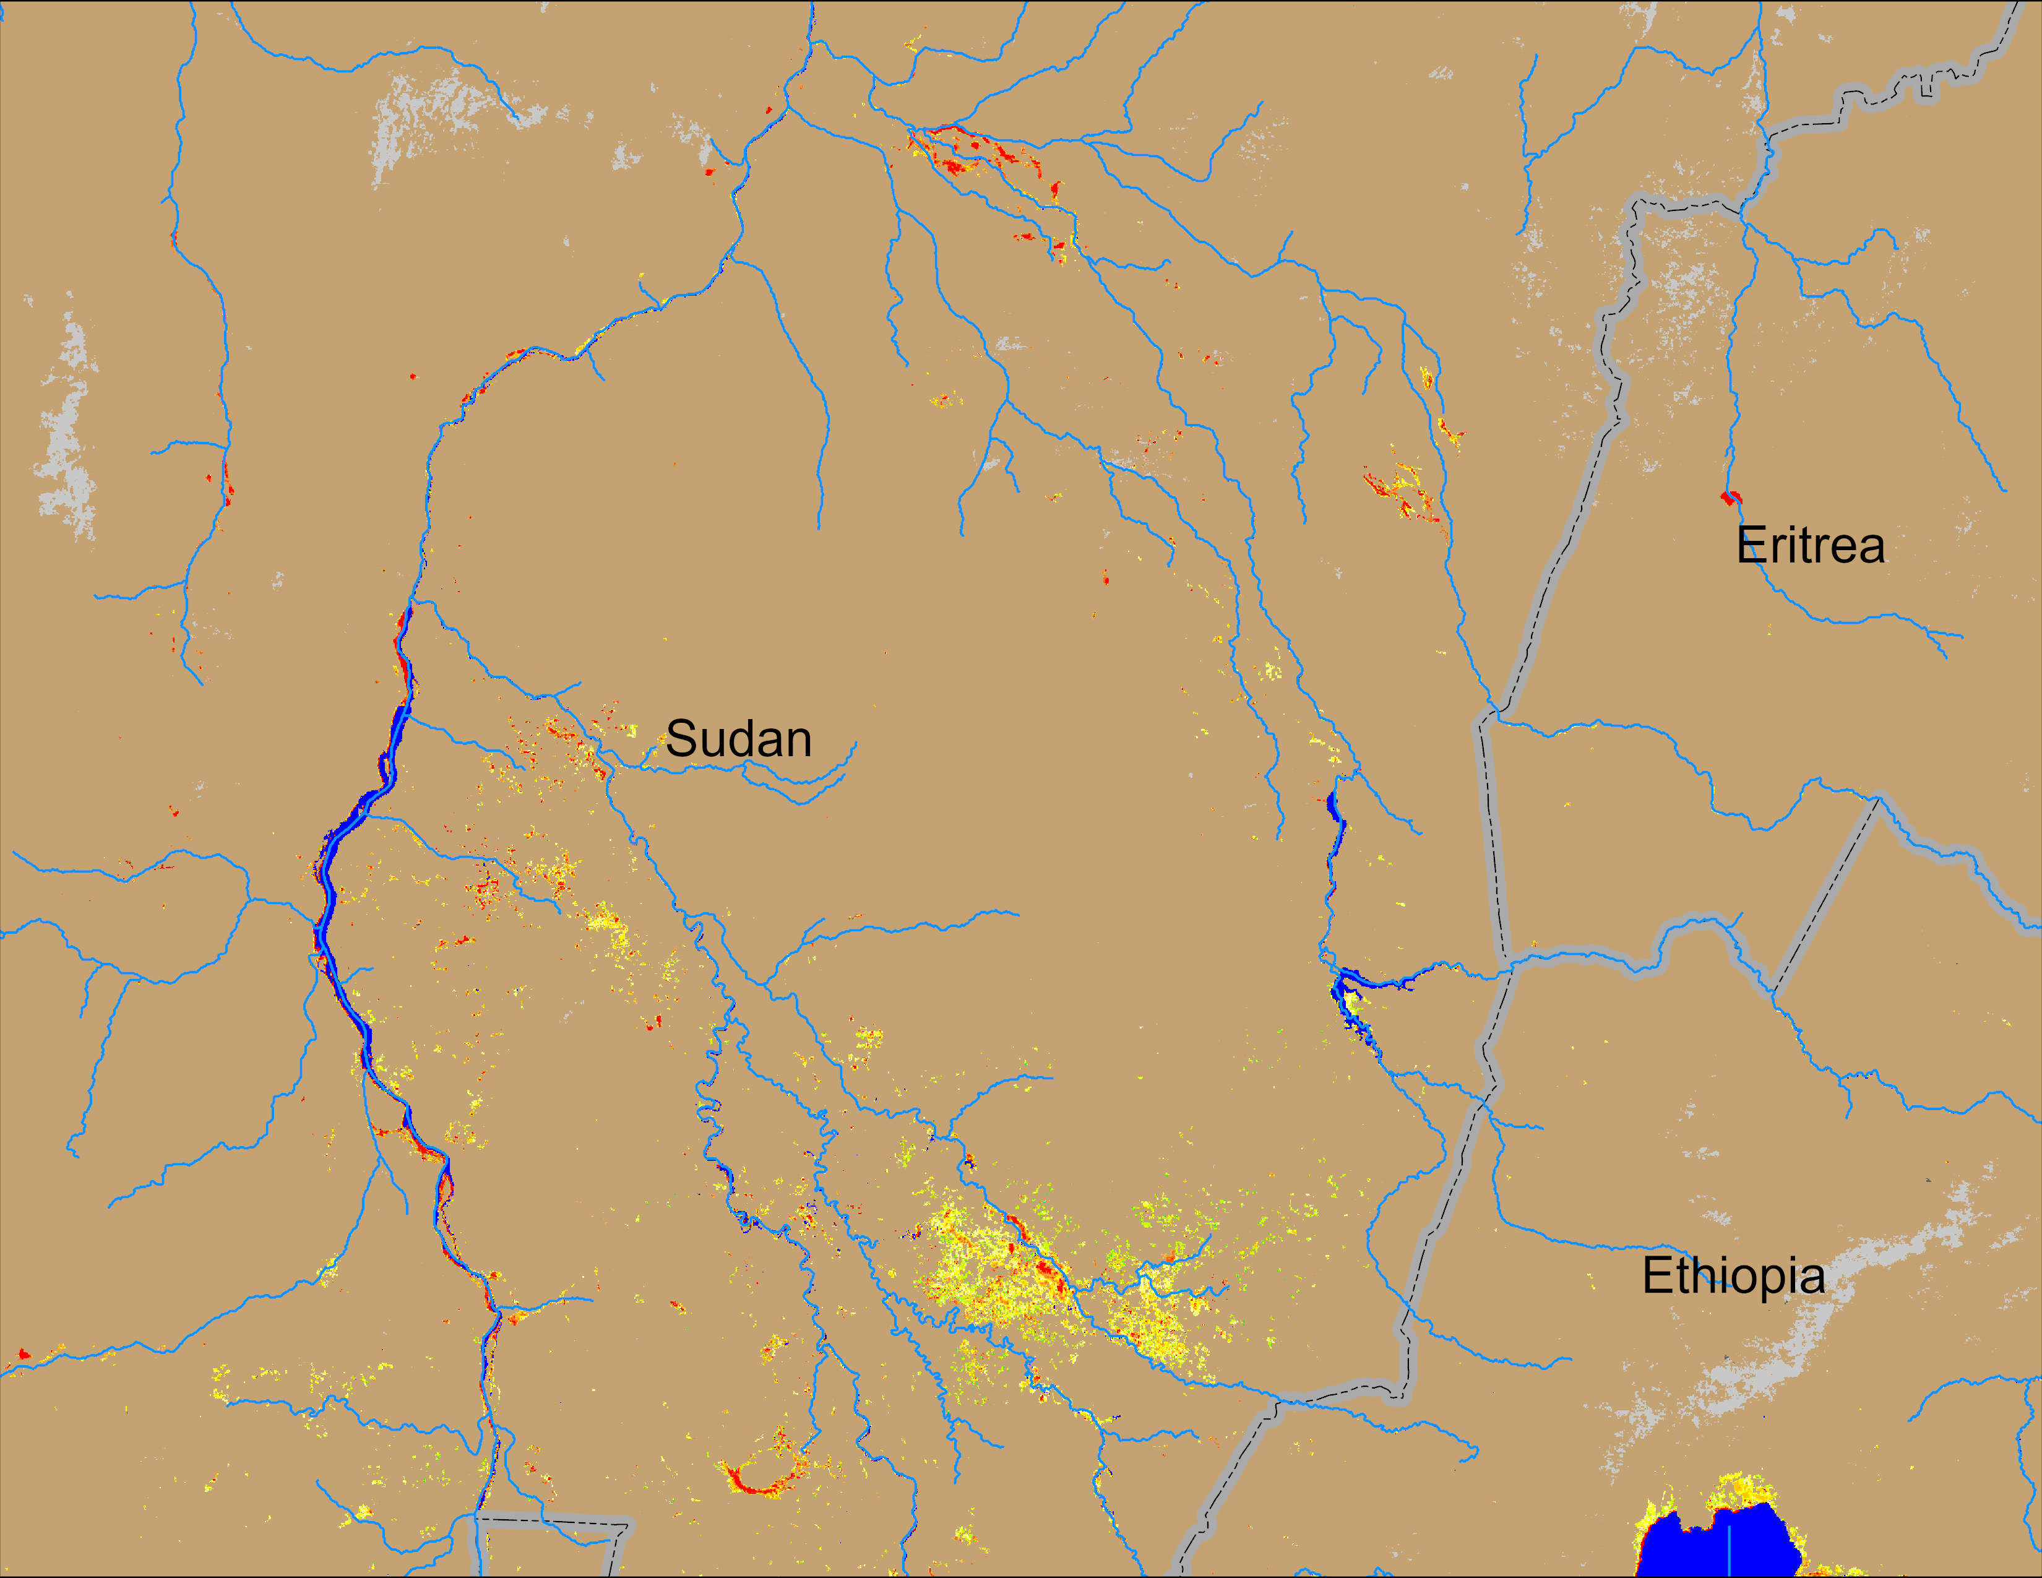
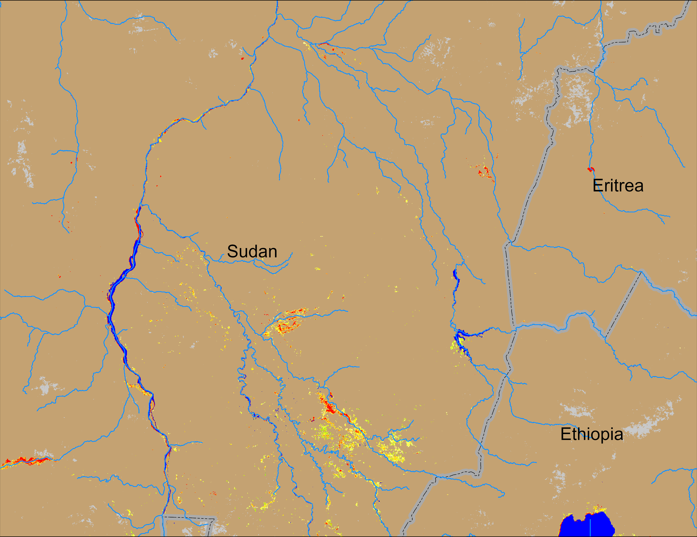
Flooding Conditions in Sudan
NOAA VIIRS derived map: 28 Aug – 01 Sep 2025
NOAA VIIRS 5-day comp.: 10 – 14 Sep 2025
Flooding conditions improved in the Blue Nile and Atbara catchments.

