Slide 1
FEWS NET Enhanced Flood Monitoring
FEWS NET Science Team
May 19, 2025

Slide 2
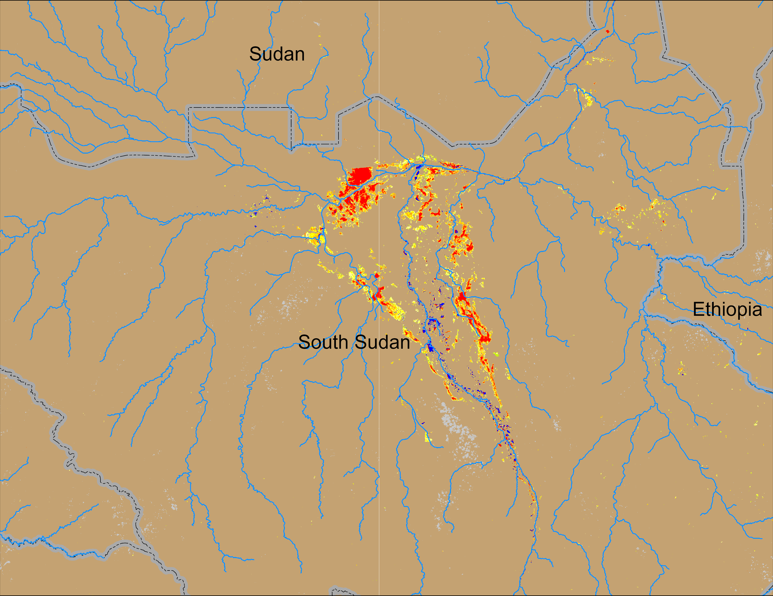
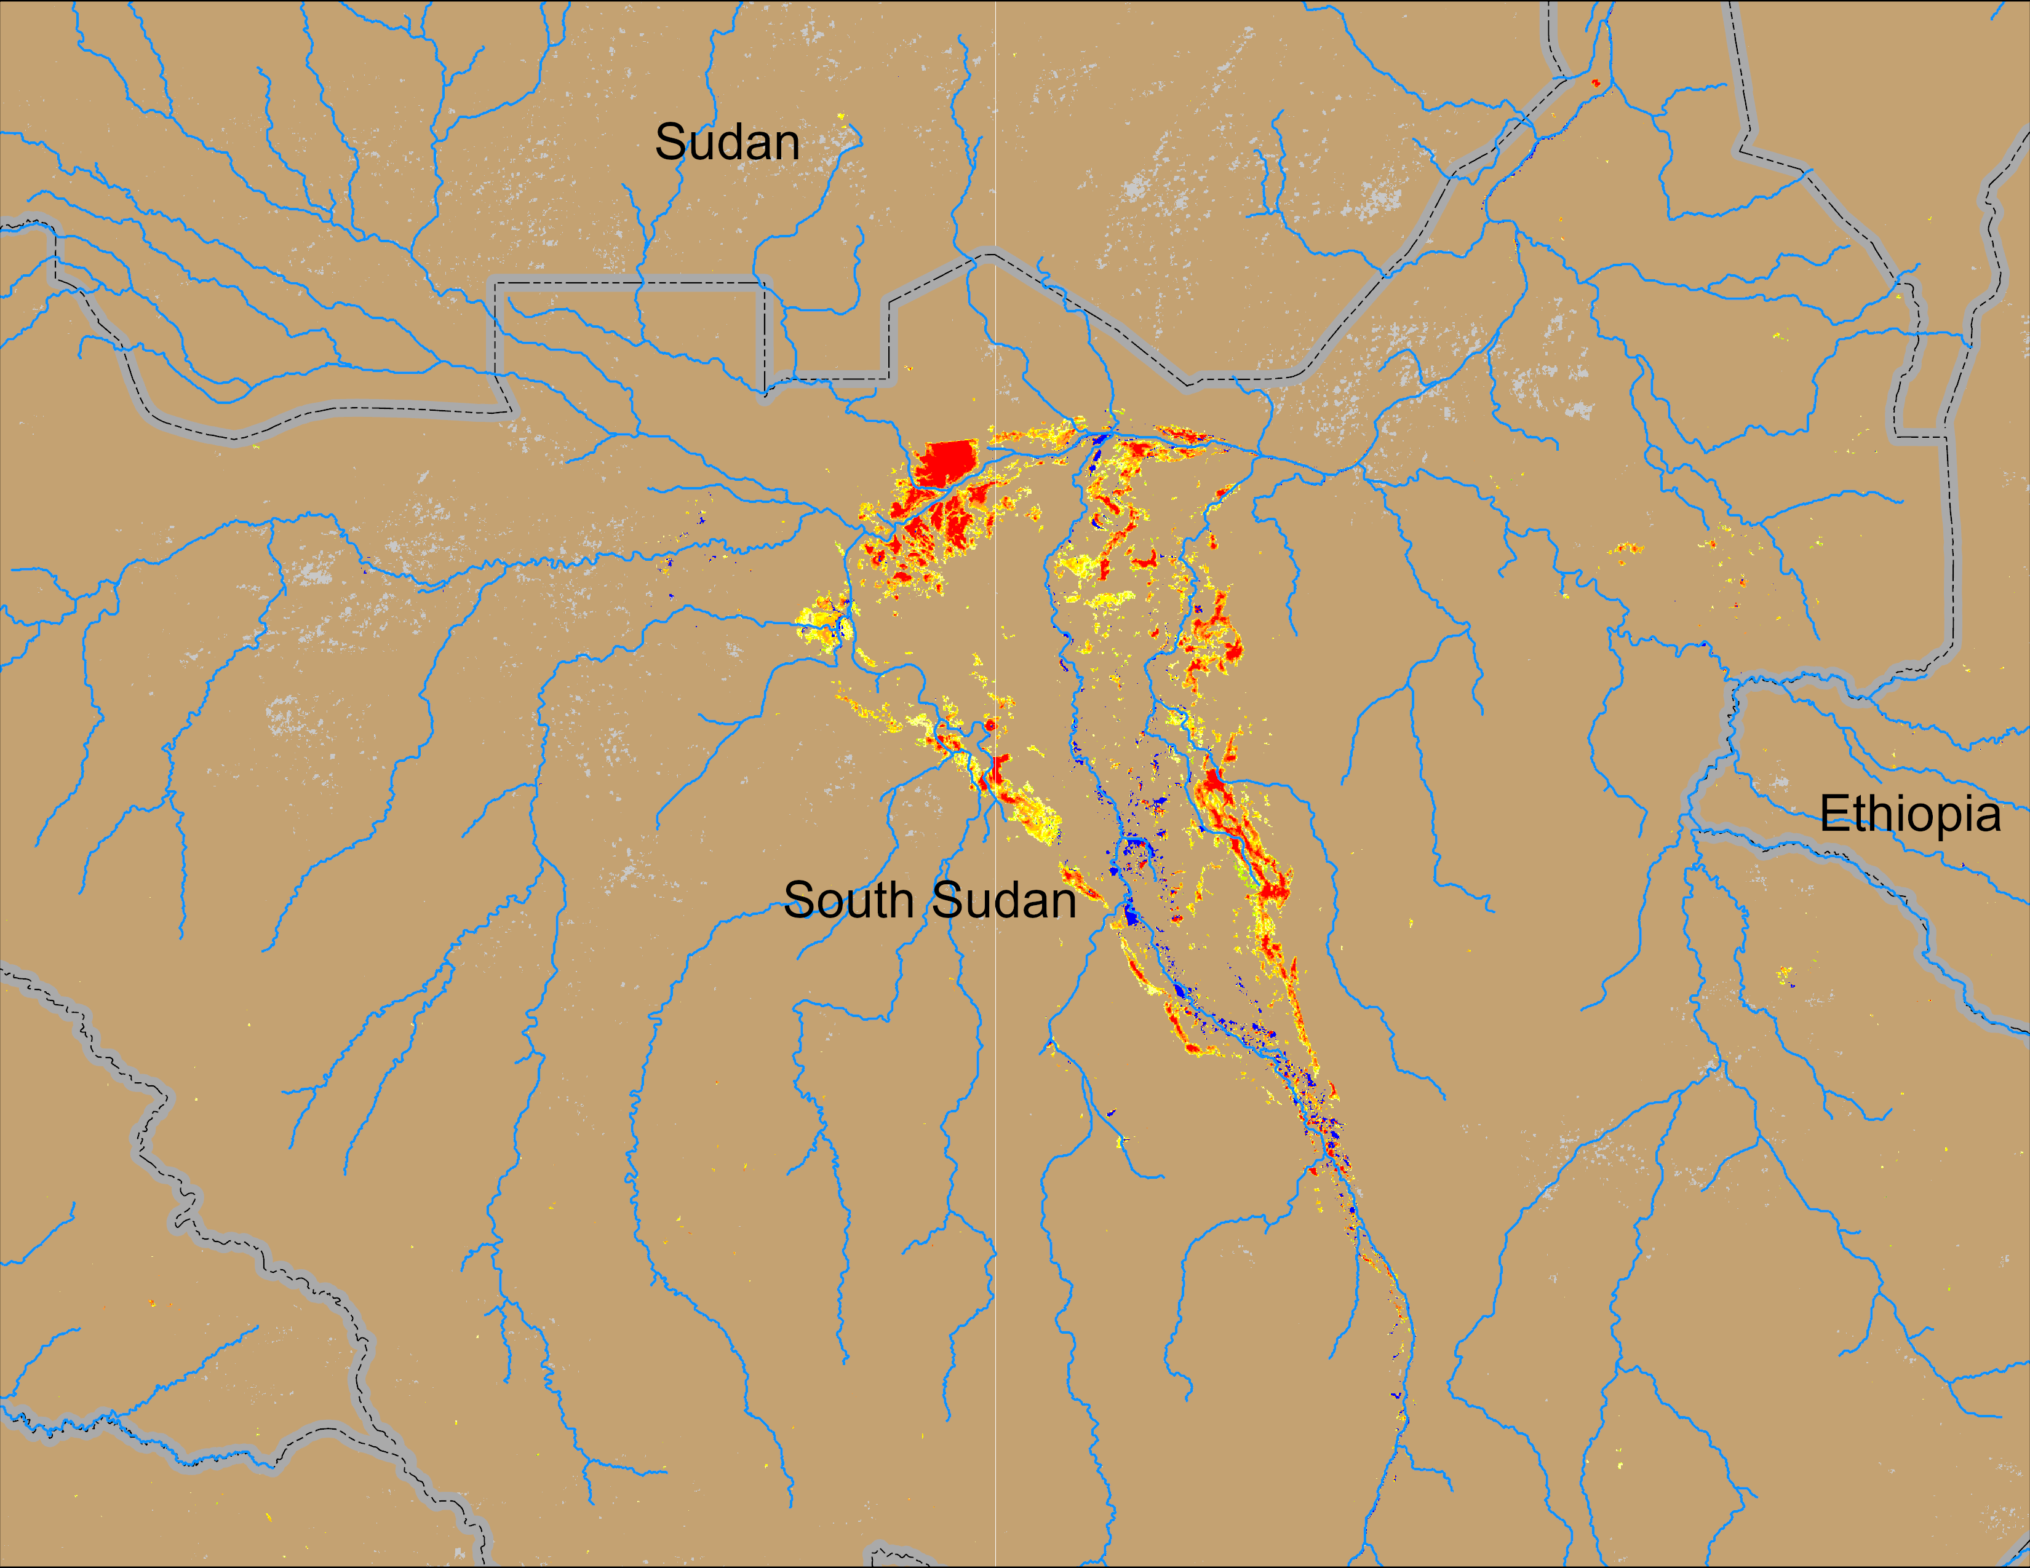
Flooding Conditions in South Sudan
(% of the pixel)
(% of the pixel)
NOAA VIIRS 5-day comp.: 07 – 11 May 2025
NOAA VIIRS 5-day comp.: 14 – 18 May 2025
A decent level of inundation persisted in central South Sudan throughout the dry period and into pre-rainfall season.

Slide 3
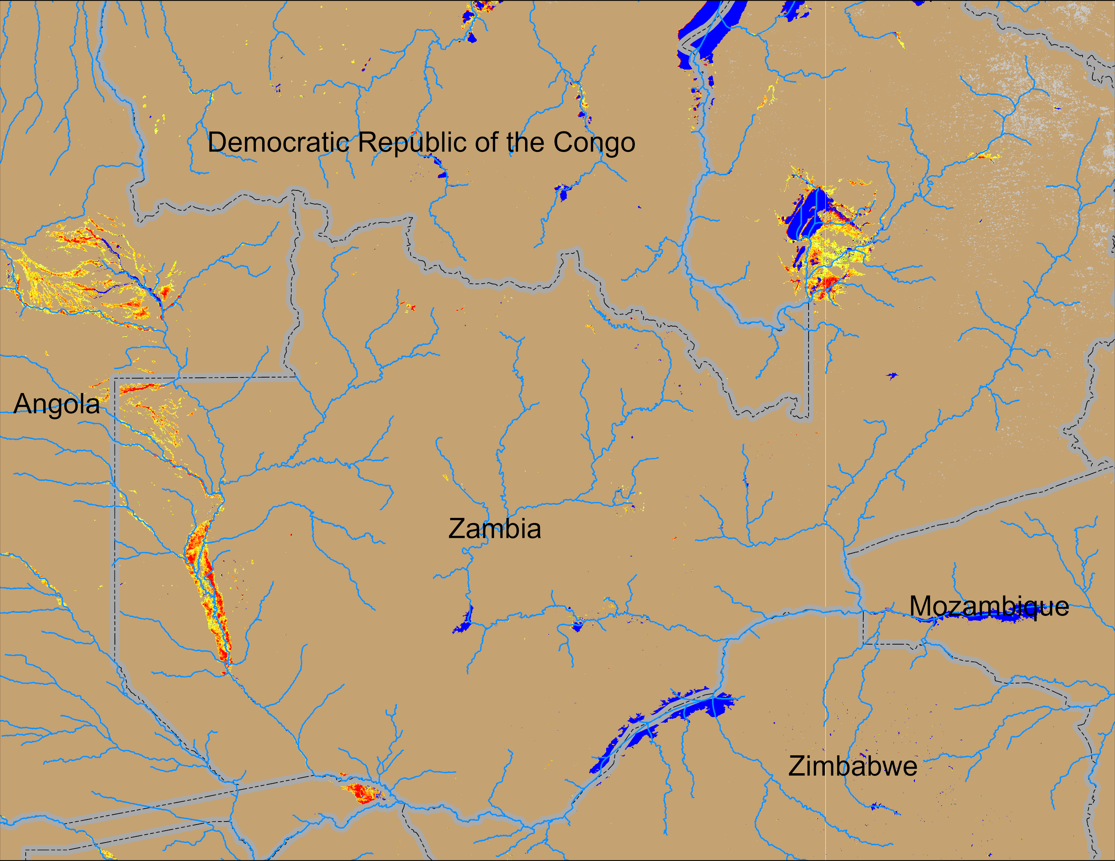
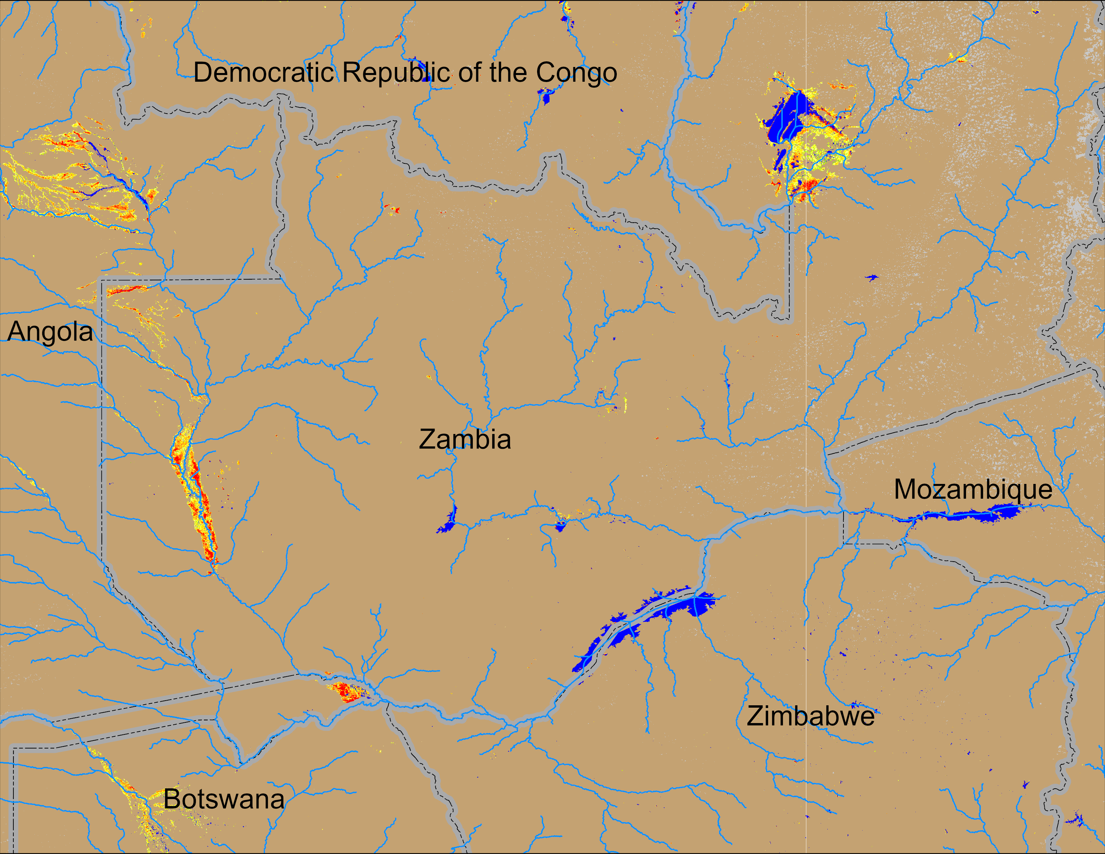
Flooding Conditions in Zambia
(% of the pixel)
(% of the pixel)
NOAA VIIRS 5-day comp.: 07 – 11 May 2025
NOAA VIIRS 5-day comp.: 14 – 18 May 2025
Flooding conditions improving slowly in western Zambia and Eastern Angola.

Slide 4
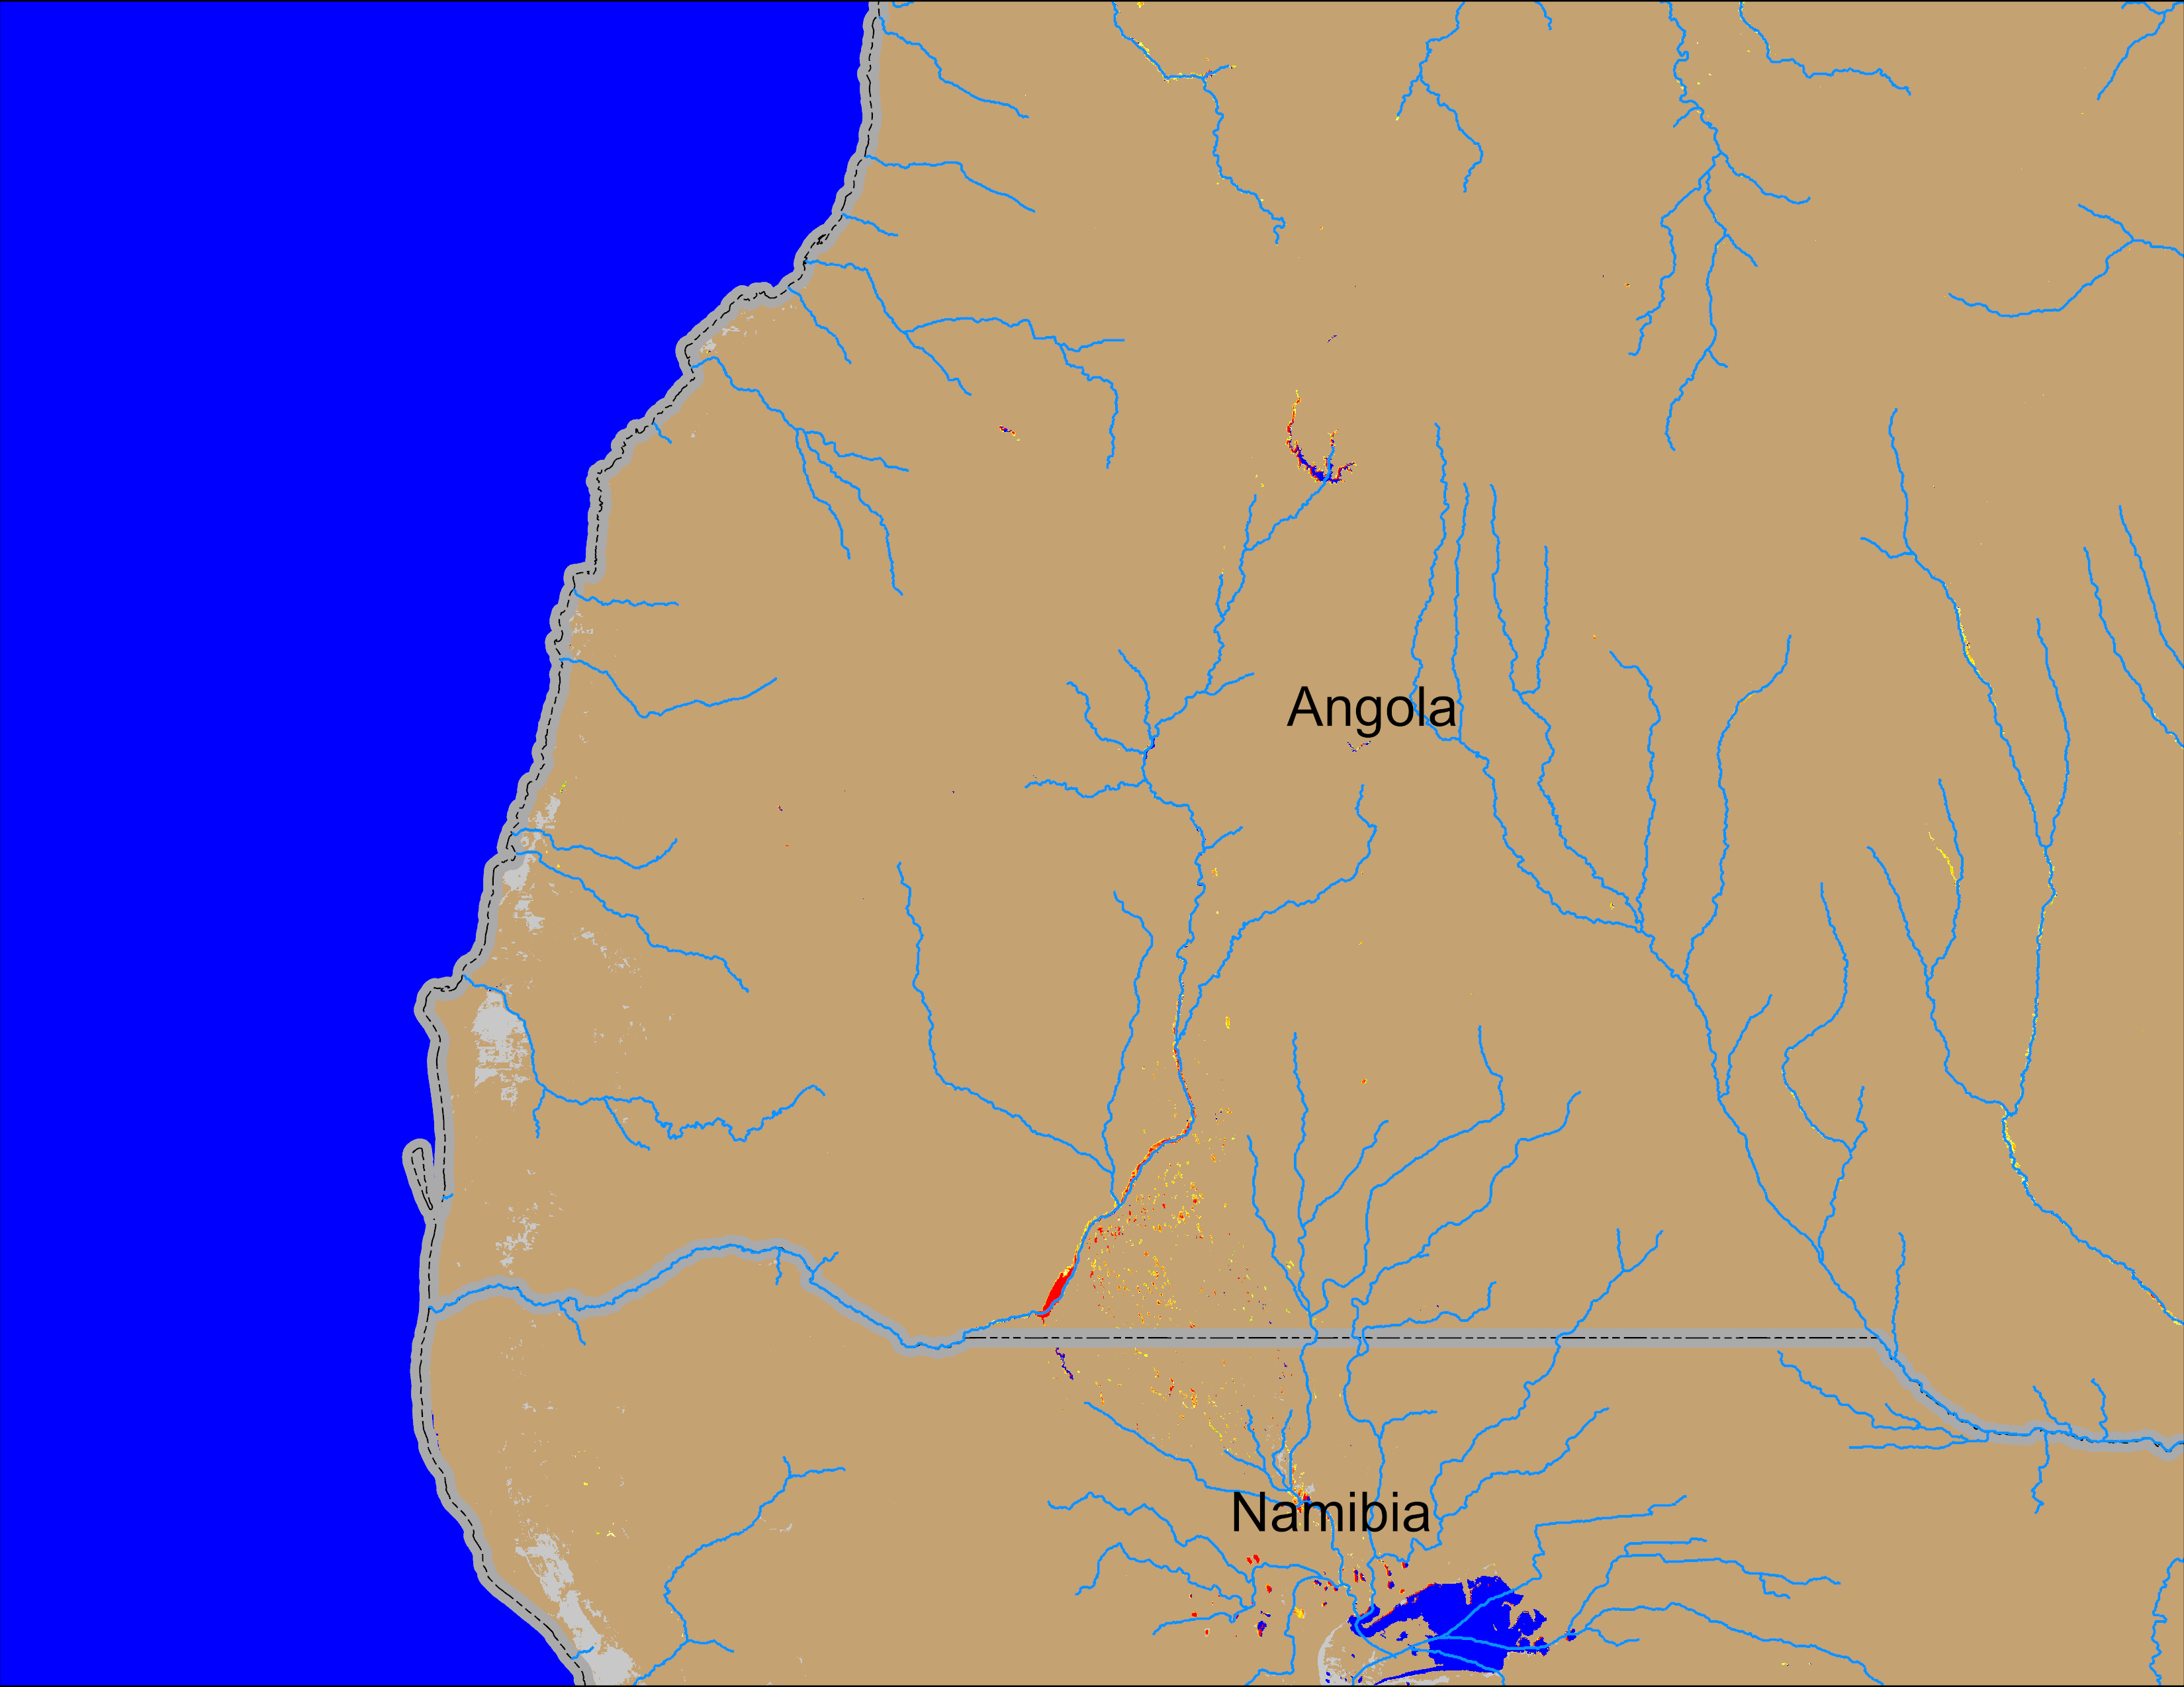
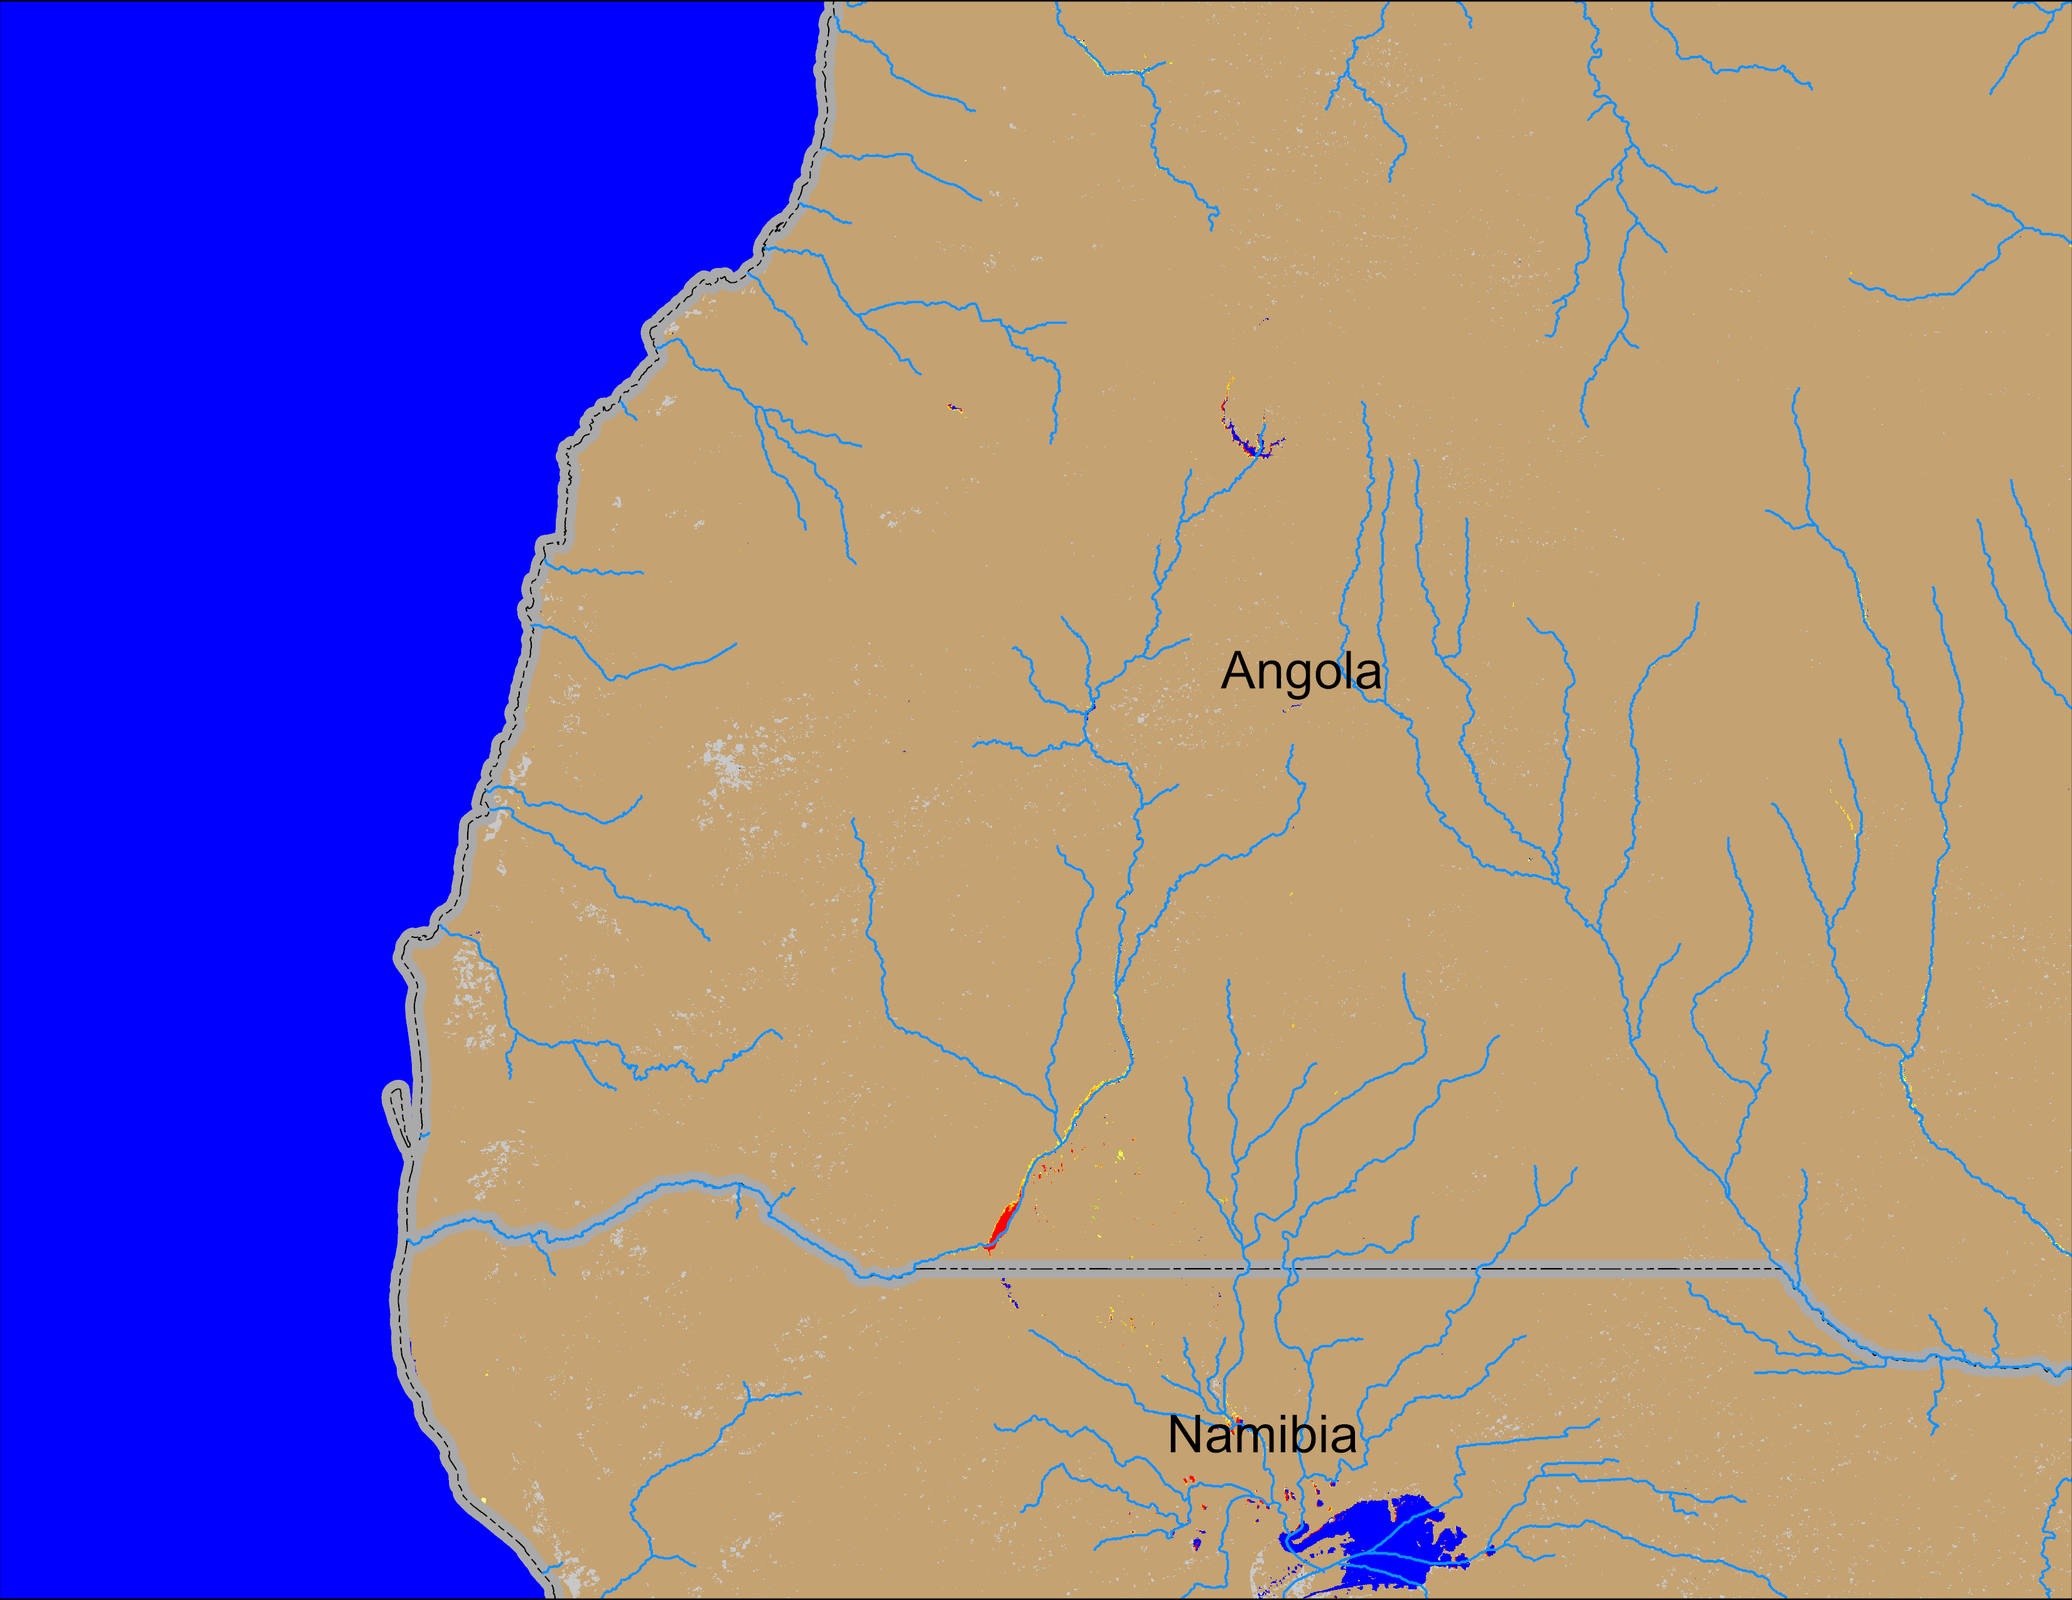
Flooding Conditions in Angola
(% of the pixel)
(% of the pixel)
NOAA VIIRS 5-day comp.: 07 – 11 May 2025
NOAA VIIRS 5-day comp.: 14 – 18 May 2025
Inundation receded in southern Angola into northern Namibia.

