Slide 1
FEWS NET Enhanced Flood Monitoring
FEWS NET Science Team
May 12, 2025

Slide 2

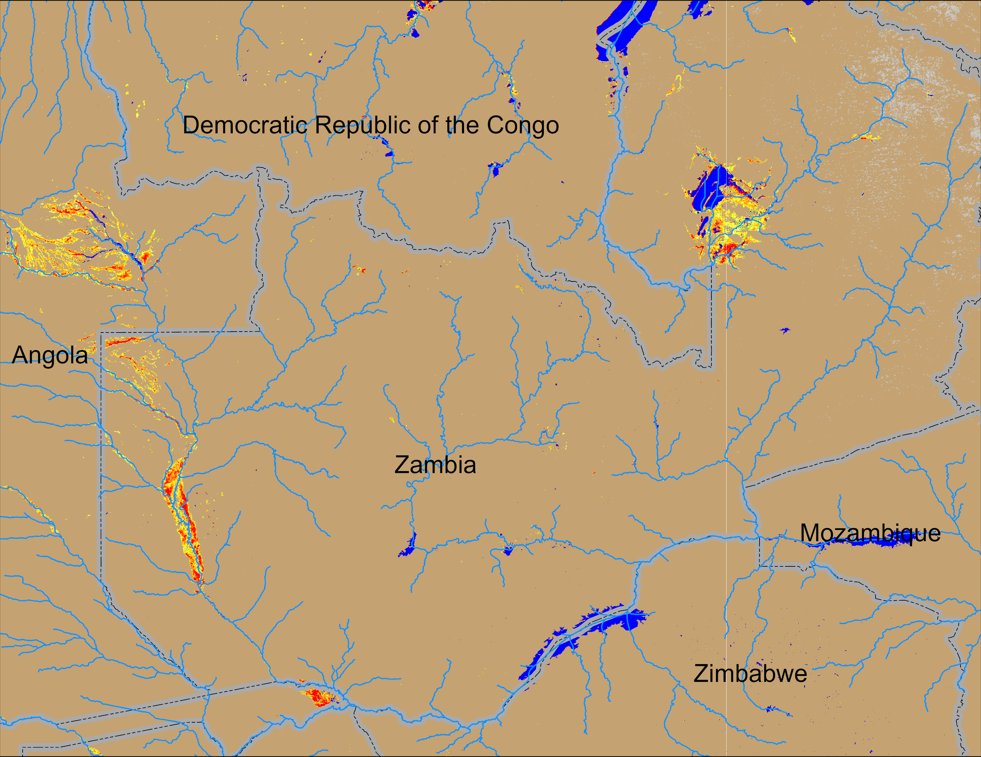
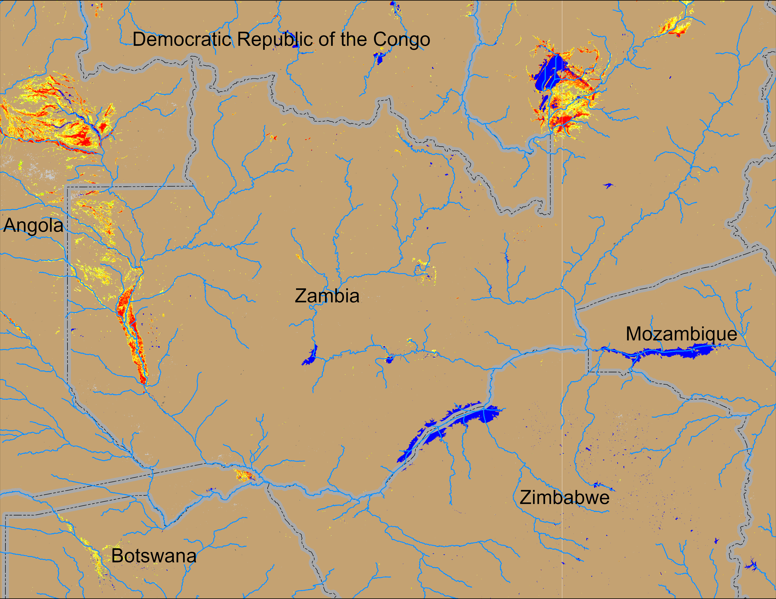
Flooding Conditions in Zambia
(% of the pixel)
(% of the pixel)
NOAA VIIRS 5-day comp.: 09 – 13 Apr 2025
NOAA VIIRS 5-day comp.: 07 – 11 May 2025
Flooding conditions improved in western Zambia and Eastern Angola.

Slide 3
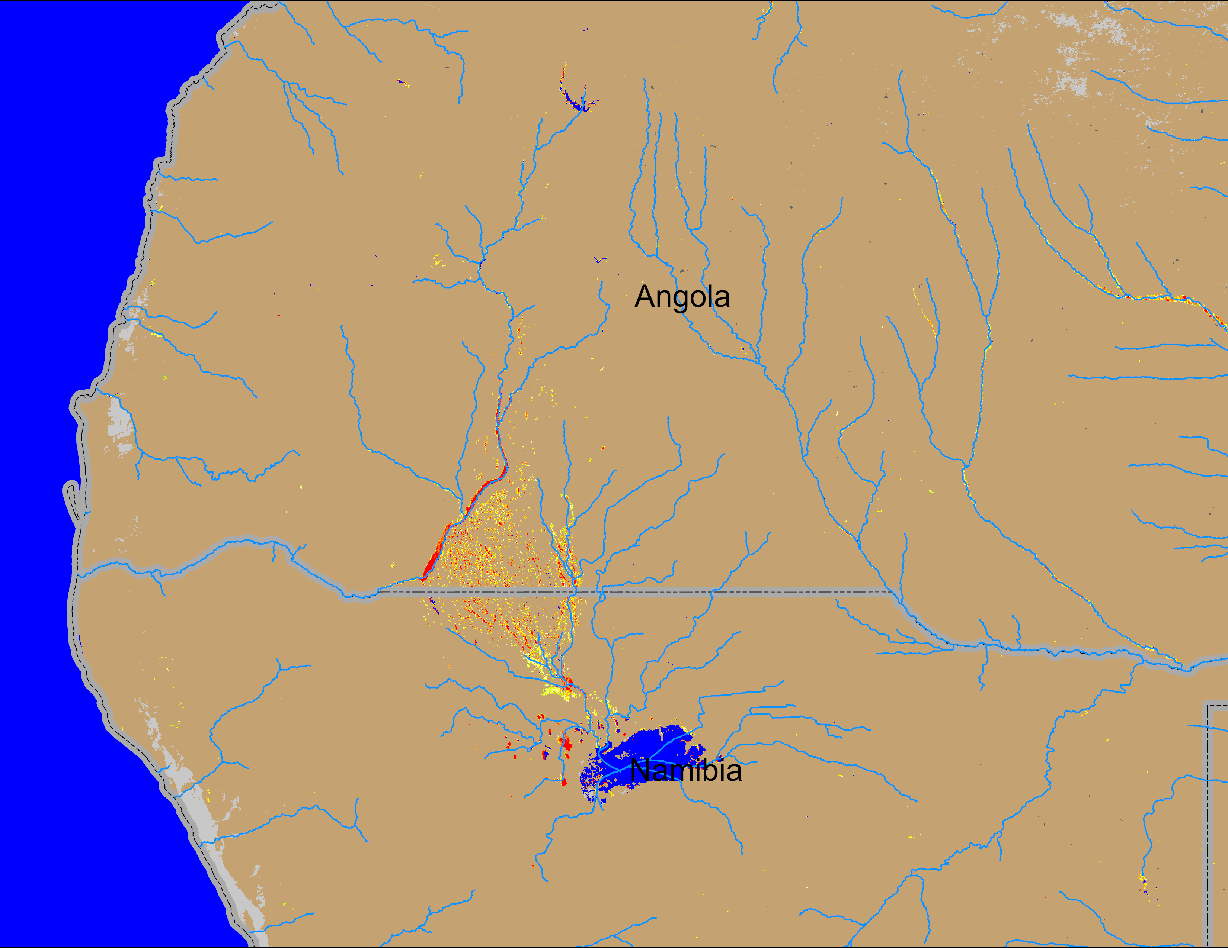
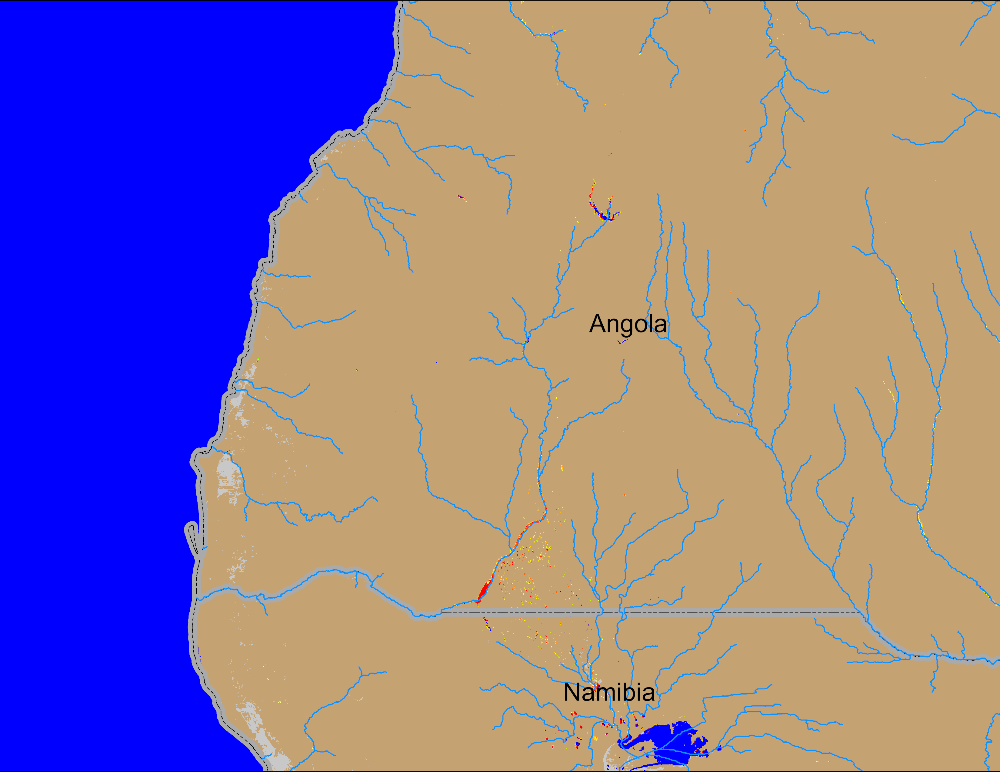
Flooding Conditions in Angola
(% of the pixel)
(% of the pixel)
NOAA VIIRS 5-day comp.: 09 – 13 Apr 2025
NOAA VIIRS 5-day comp.: 07 – 11 Apr 2025
Flooding conditions improved substantially in southern Angola into northern Namibia.

