Slide 1
FEWS NET Enhanced Flood Monitoring
FEWS NET Science Team
Mar 3, 2025

Slide 2
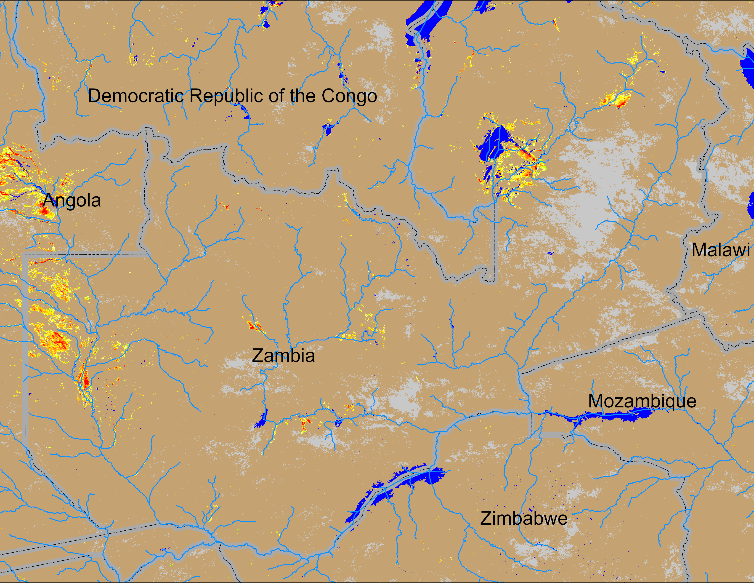
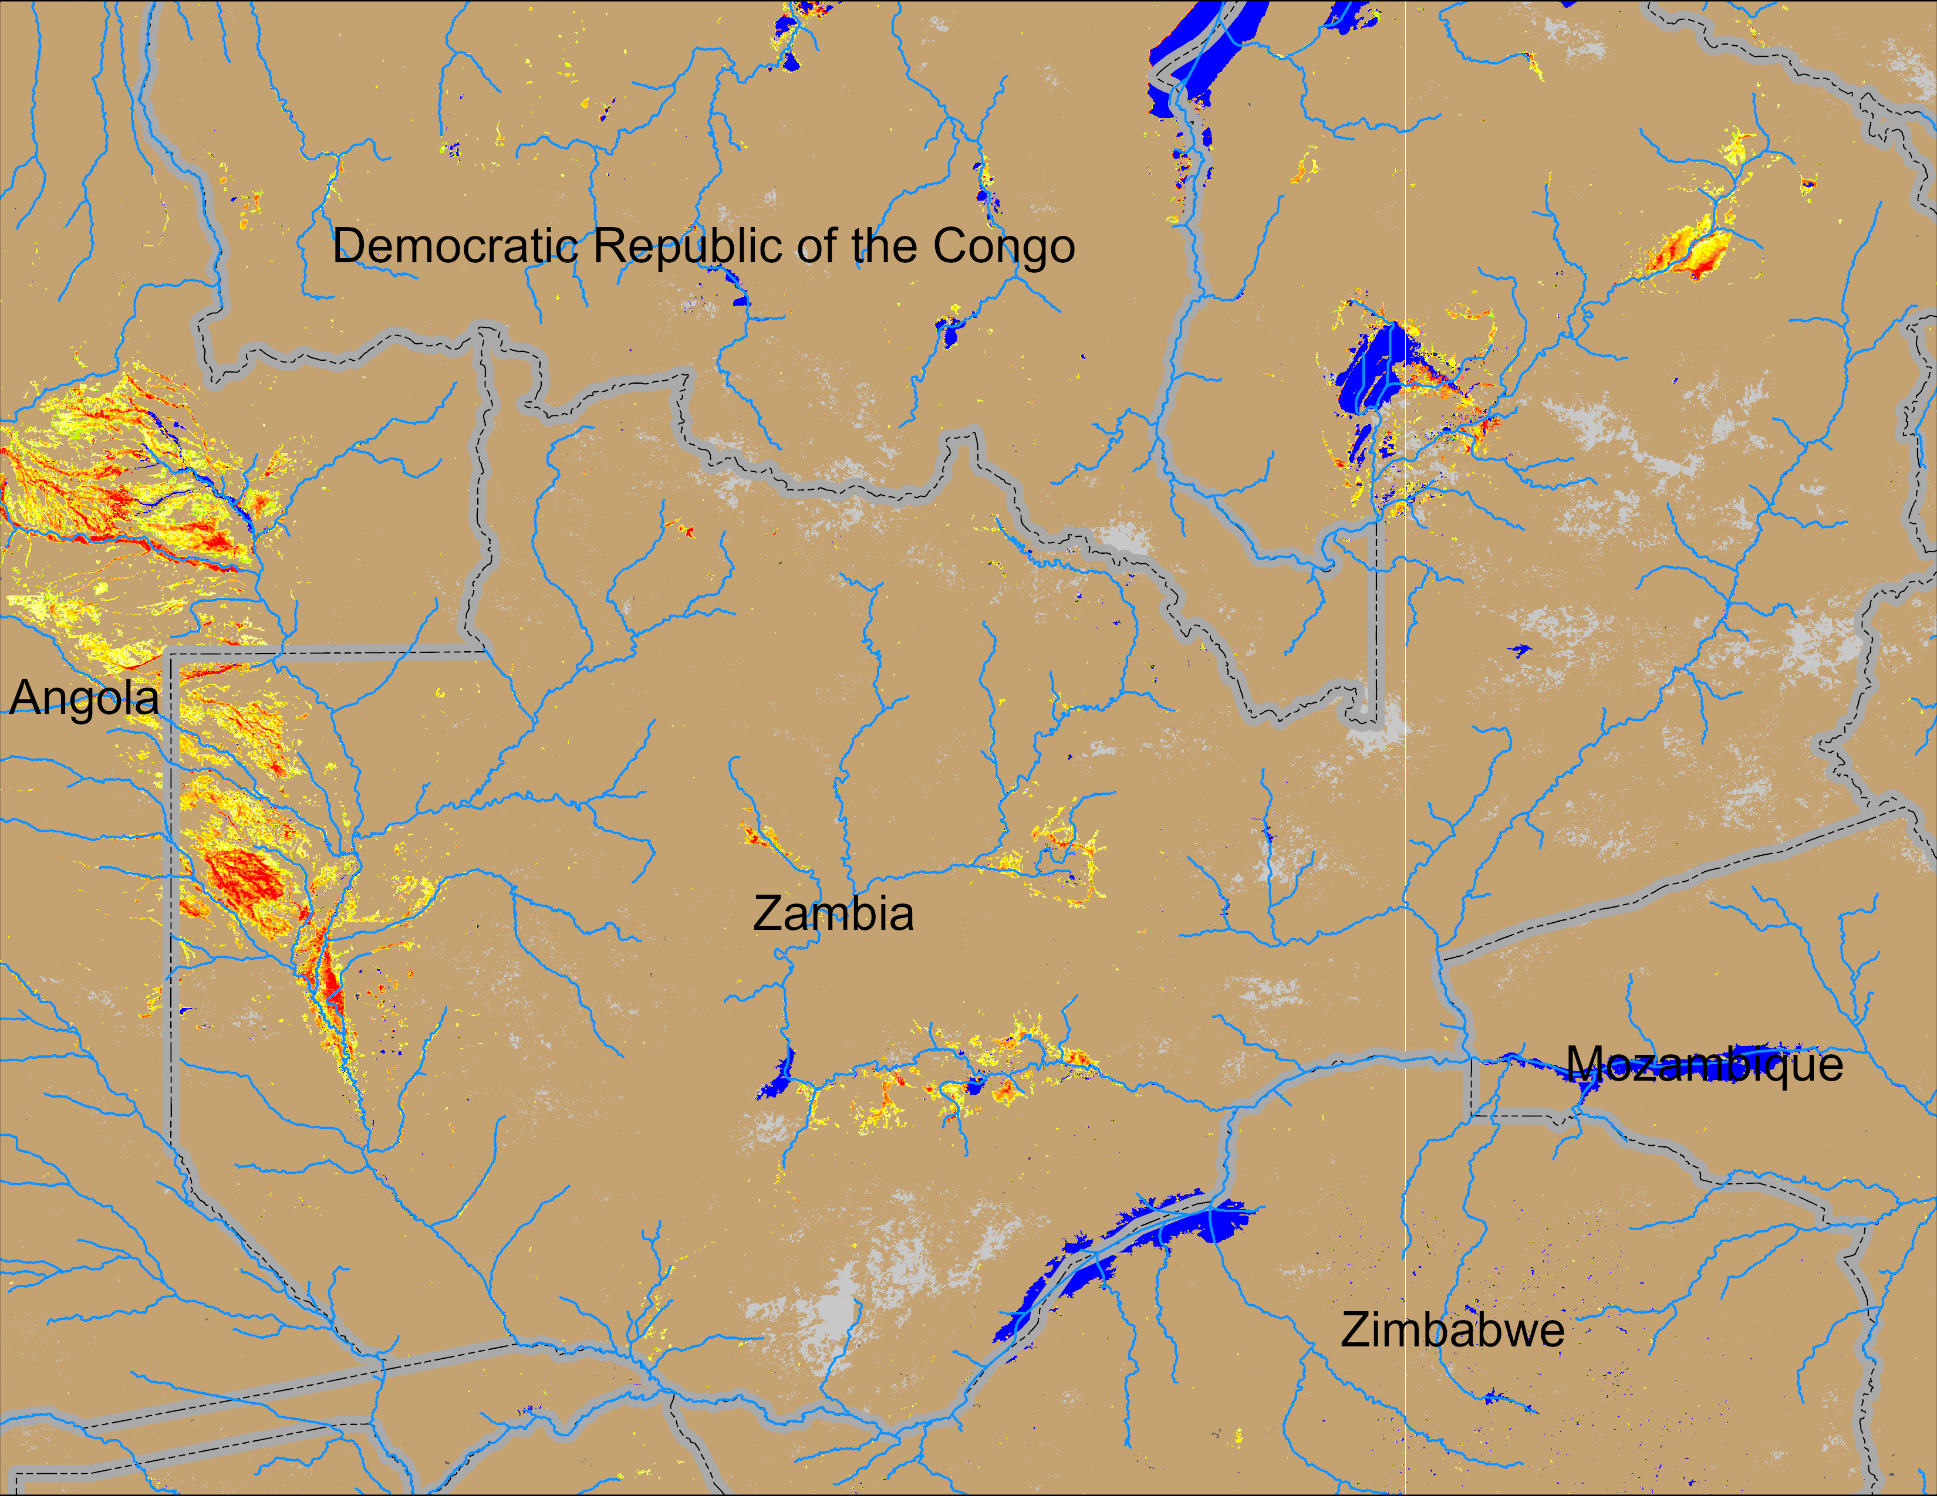
Flooding Conditions in Zambia
(% of the pixel)
NOAA VIIRS 5-day comp.: 19 – 23 Feb 2025
NOAA VIIRS 5-day comp.: 26 Feb – 2 Mar 2025
Flooding is intensifying in western and central Zambia and in eastern Angola.

Slide 3
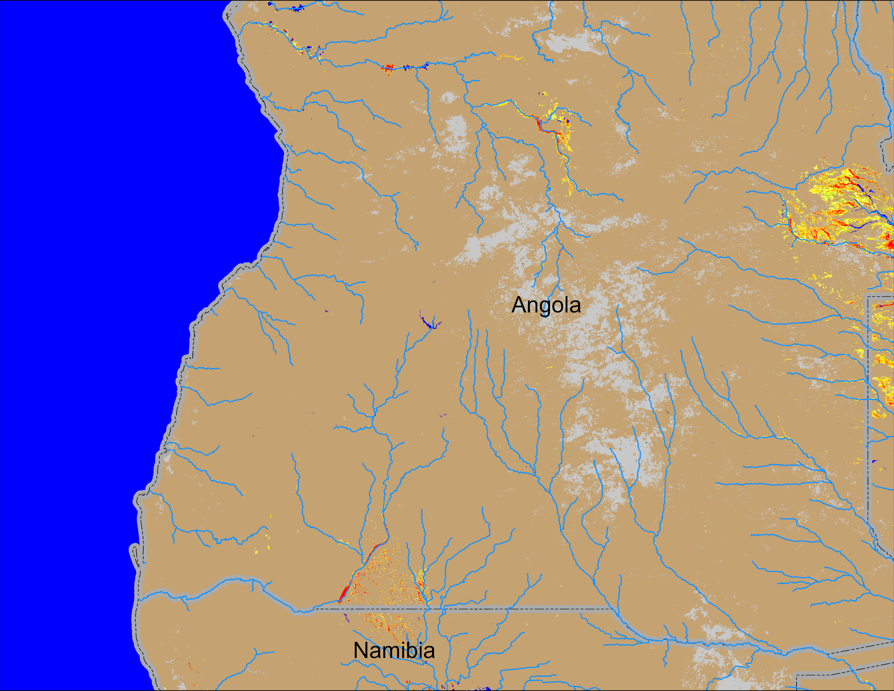
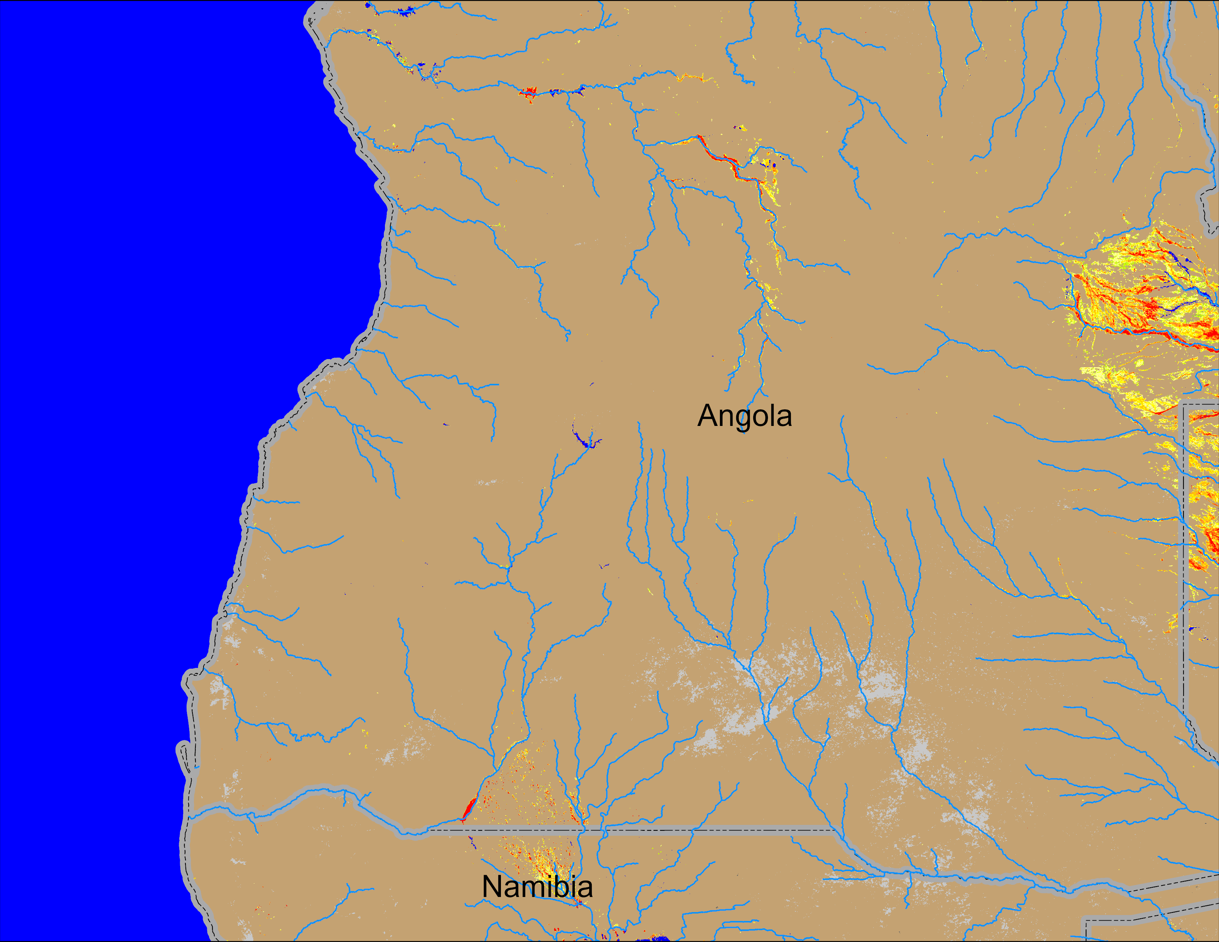
Flooding Conditions in Angola and Namibia
(% of the pixel)
NOAA VIIRS 5-day comp.: 19 – 23 Feb 2025
NOAA VIIRS 5-day comp.: 26 Feb – 2 Mar 2025
Marginal flooding along the upstream of Rio Cuanza river in Angola. days.

