Slide 1
FEWS NET Enhanced Flood Monitoring
FEWS NET Science Team
Mar 10, 2025

Slide 2
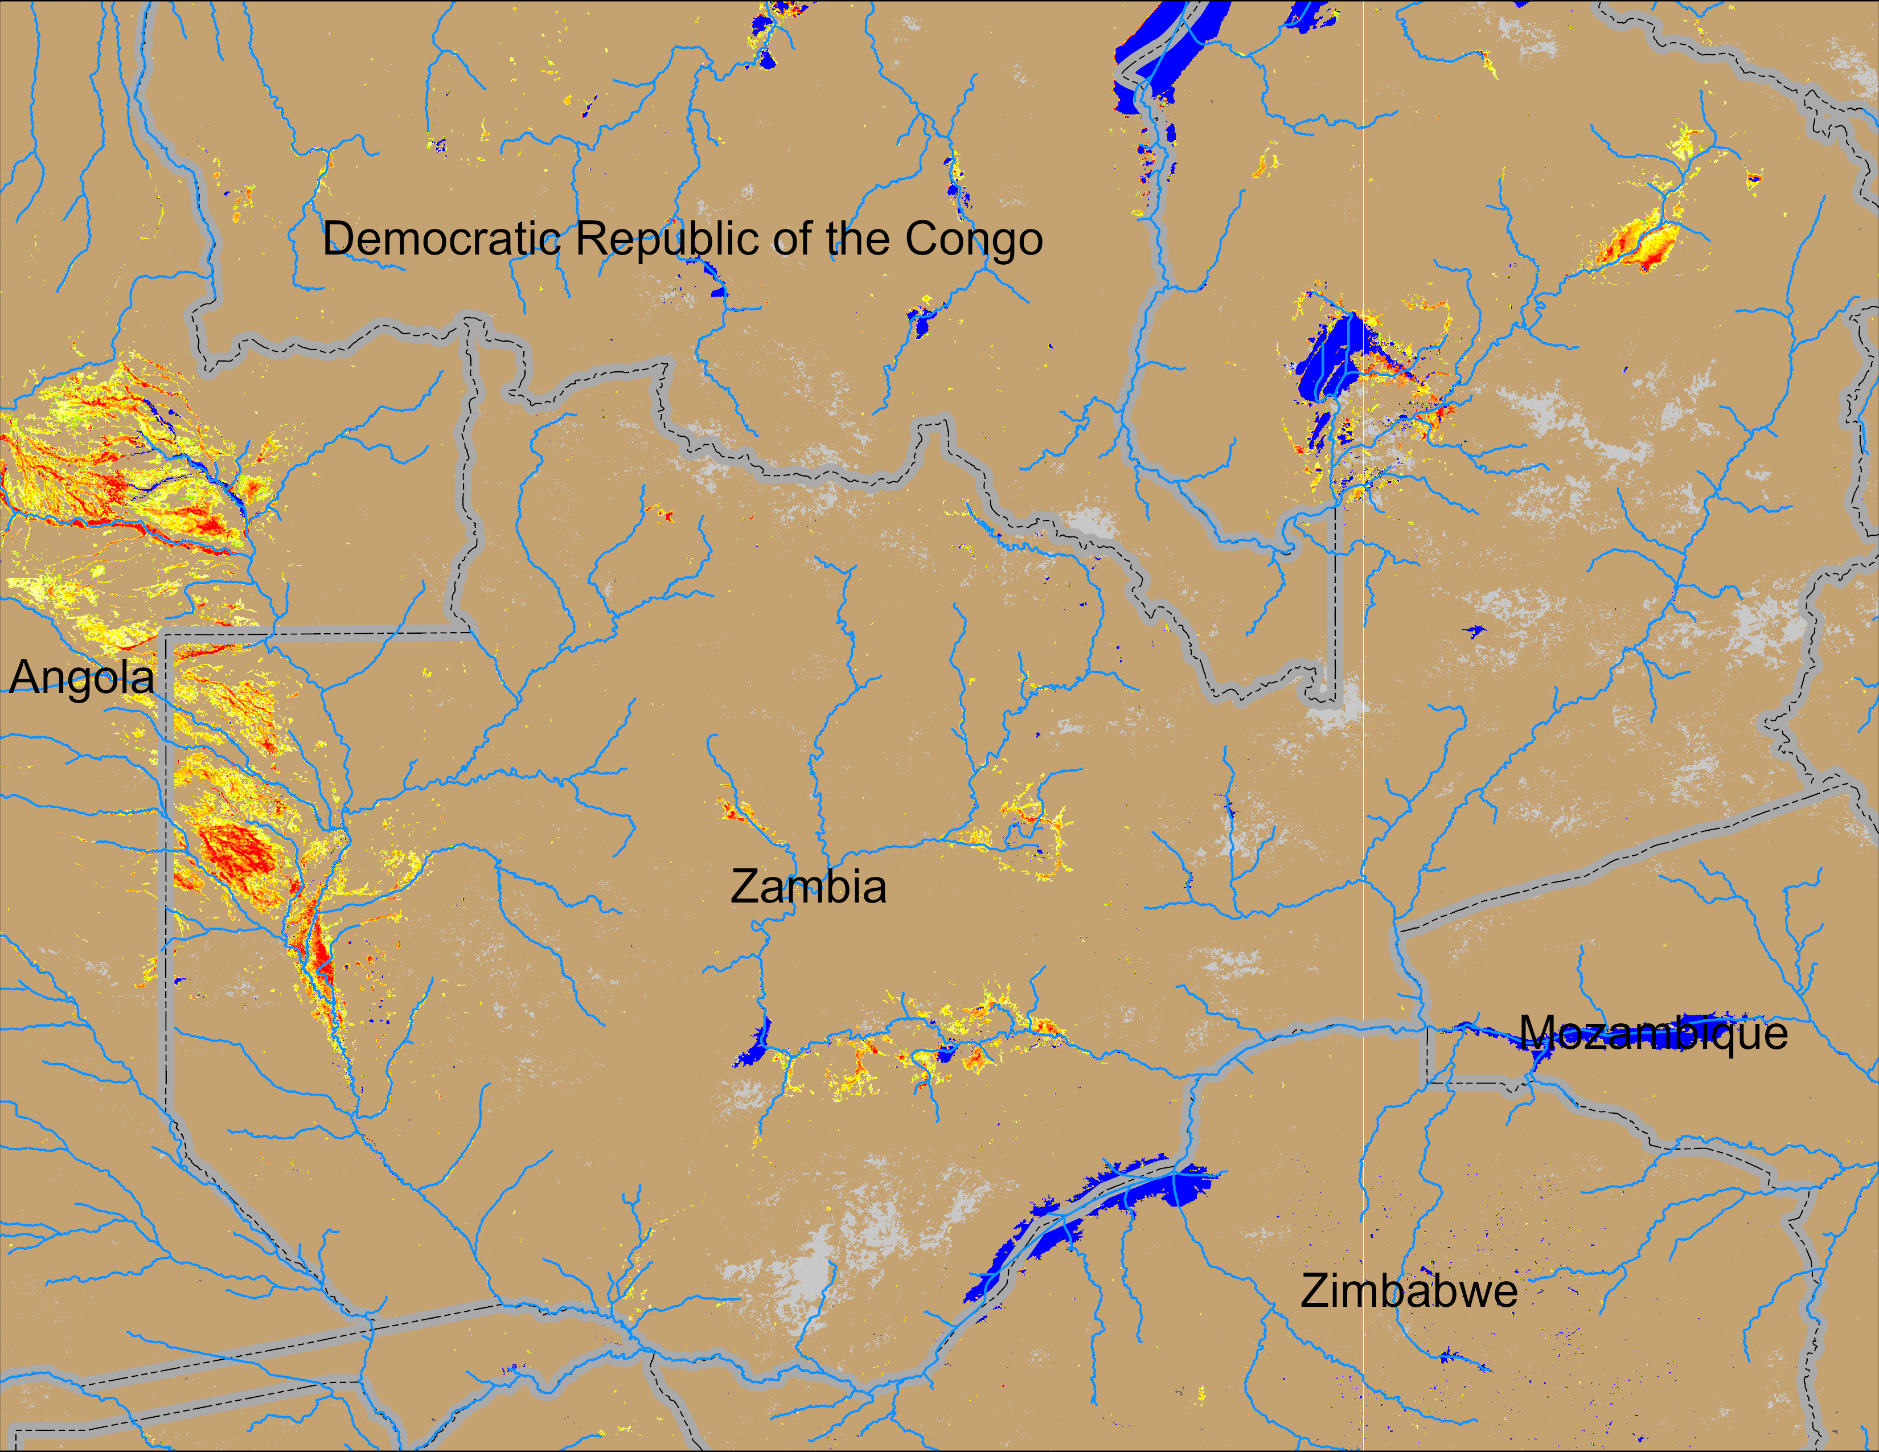
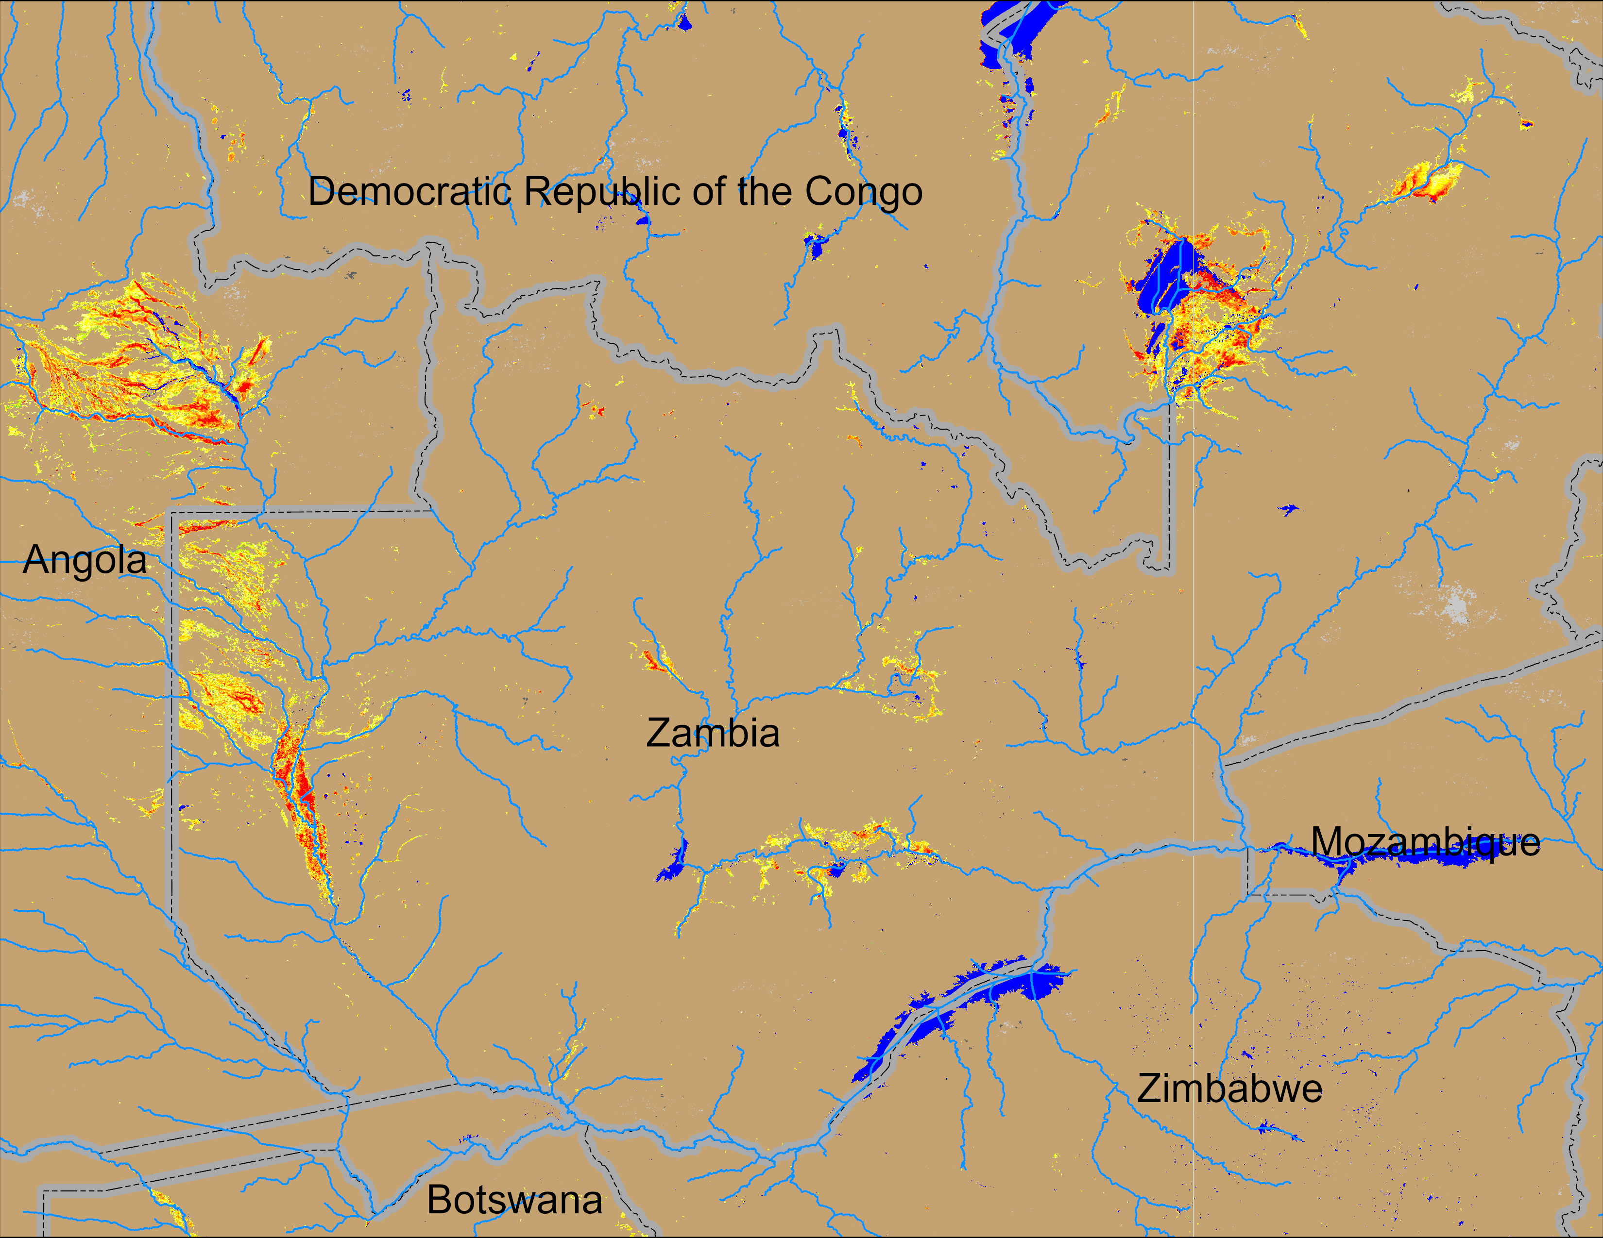
Flooding Conditions in Zambia
(% of the pixel)
(% of the pixel)
NOAA VIIRS 5-day comp.: 26 Feb – 02 Mar 2025
NOAA VIIRS 5-day comp.: 05 – 09 Mar 2025
Flooding is intensifying in central and northeastern Zambia.

Slide 3
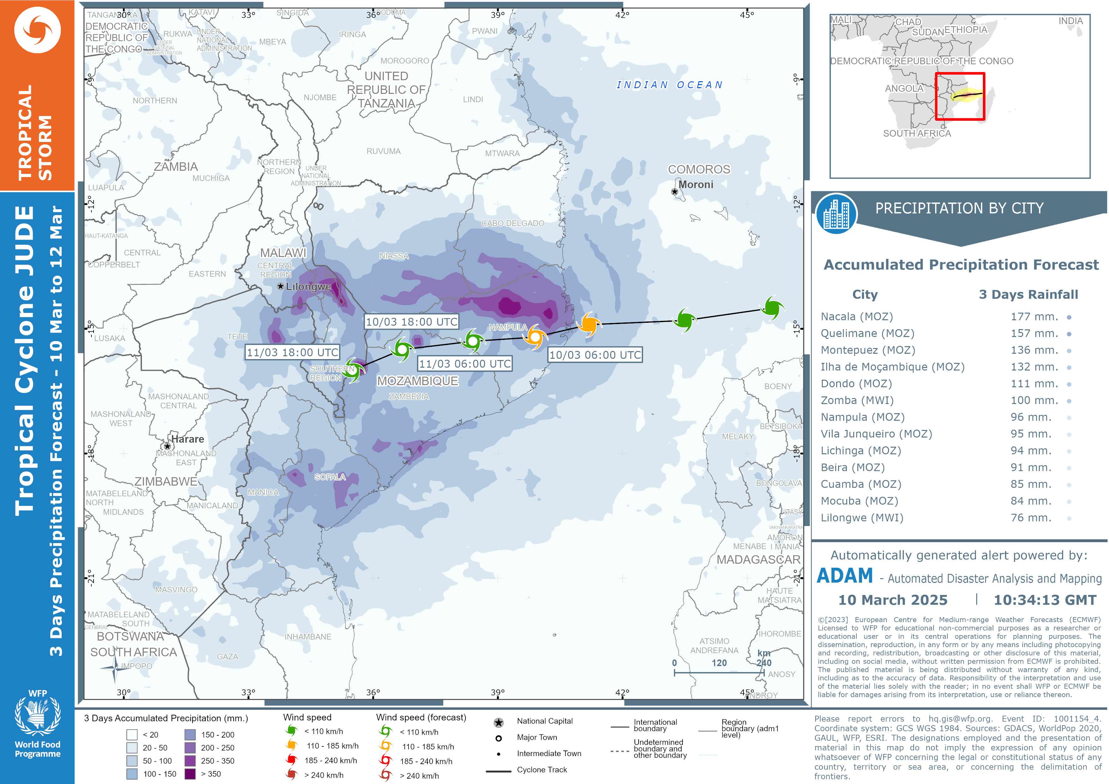
Tropical Cyclone JUDE
TC JUDE expected to bring intense rainfall over northern half of Mozambique and southern Malawi which could cause flooding in the region between 10 and 25 March.

