Slide 1
FEWS NET Enhanced Flood Monitoring
FEWS NET Science Team
Jan 21, 2025

Slide 2
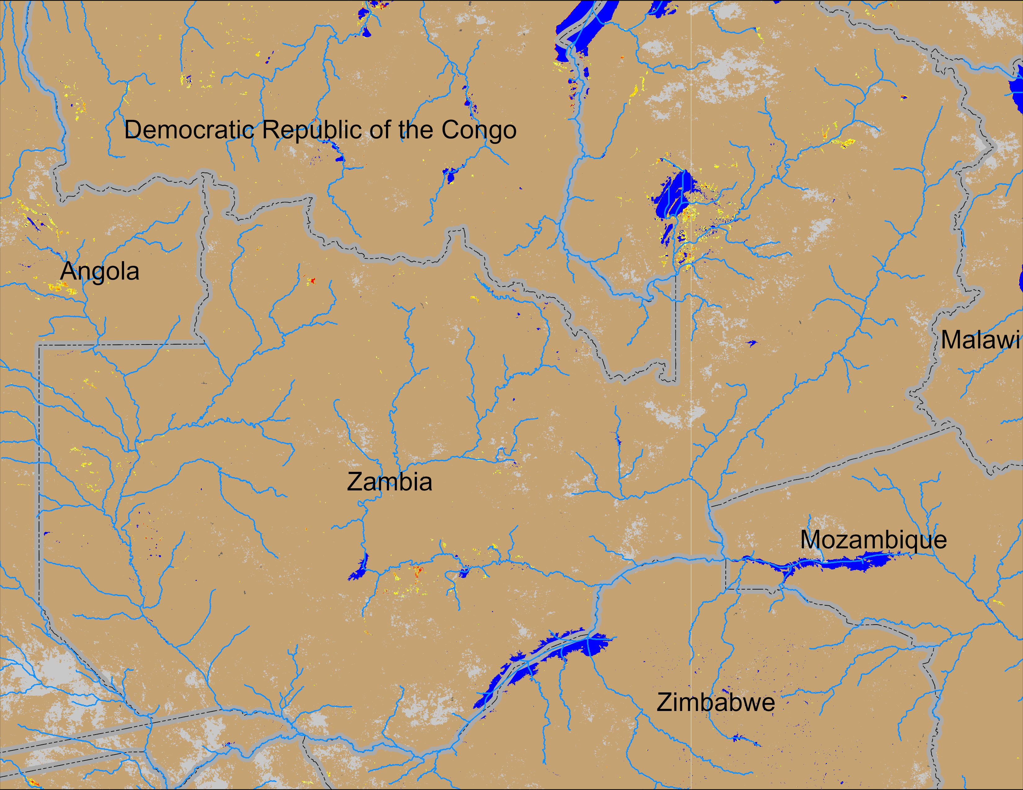
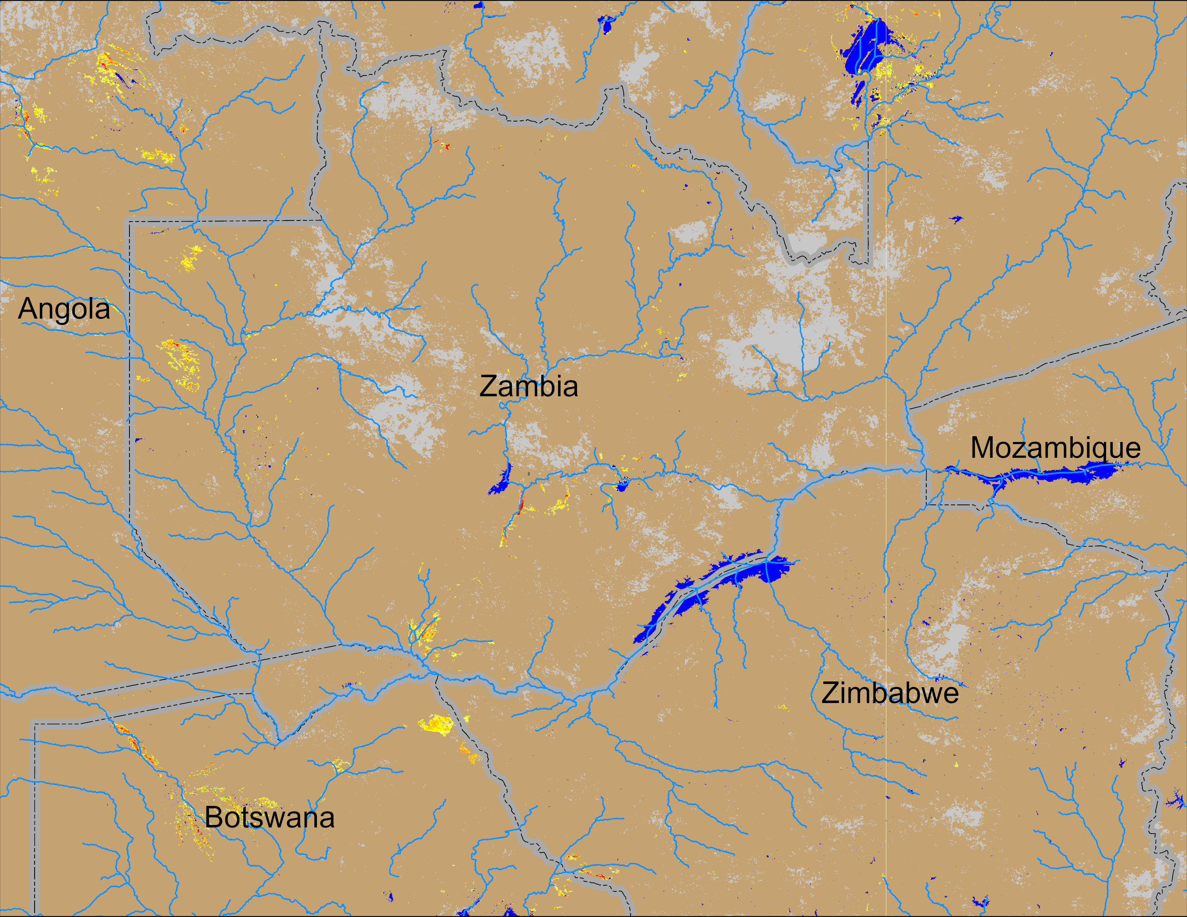
Flooding Conditions in Zambia, Botswana
(% of the pixel)
NOAA VIIRS 5-day comp.: 8 – 12 Jan 2025
NOAA VIIRS 5-day comp.: 16 – 20 Jan 2025
Marginal flooding is showing up in western and northeastern Zambia, and northern Botswana.

