Slide 1
FEWS NET Enhanced Flood Monitoring
FEWS NET Science Team
Jan 13, 2025

Slide 2
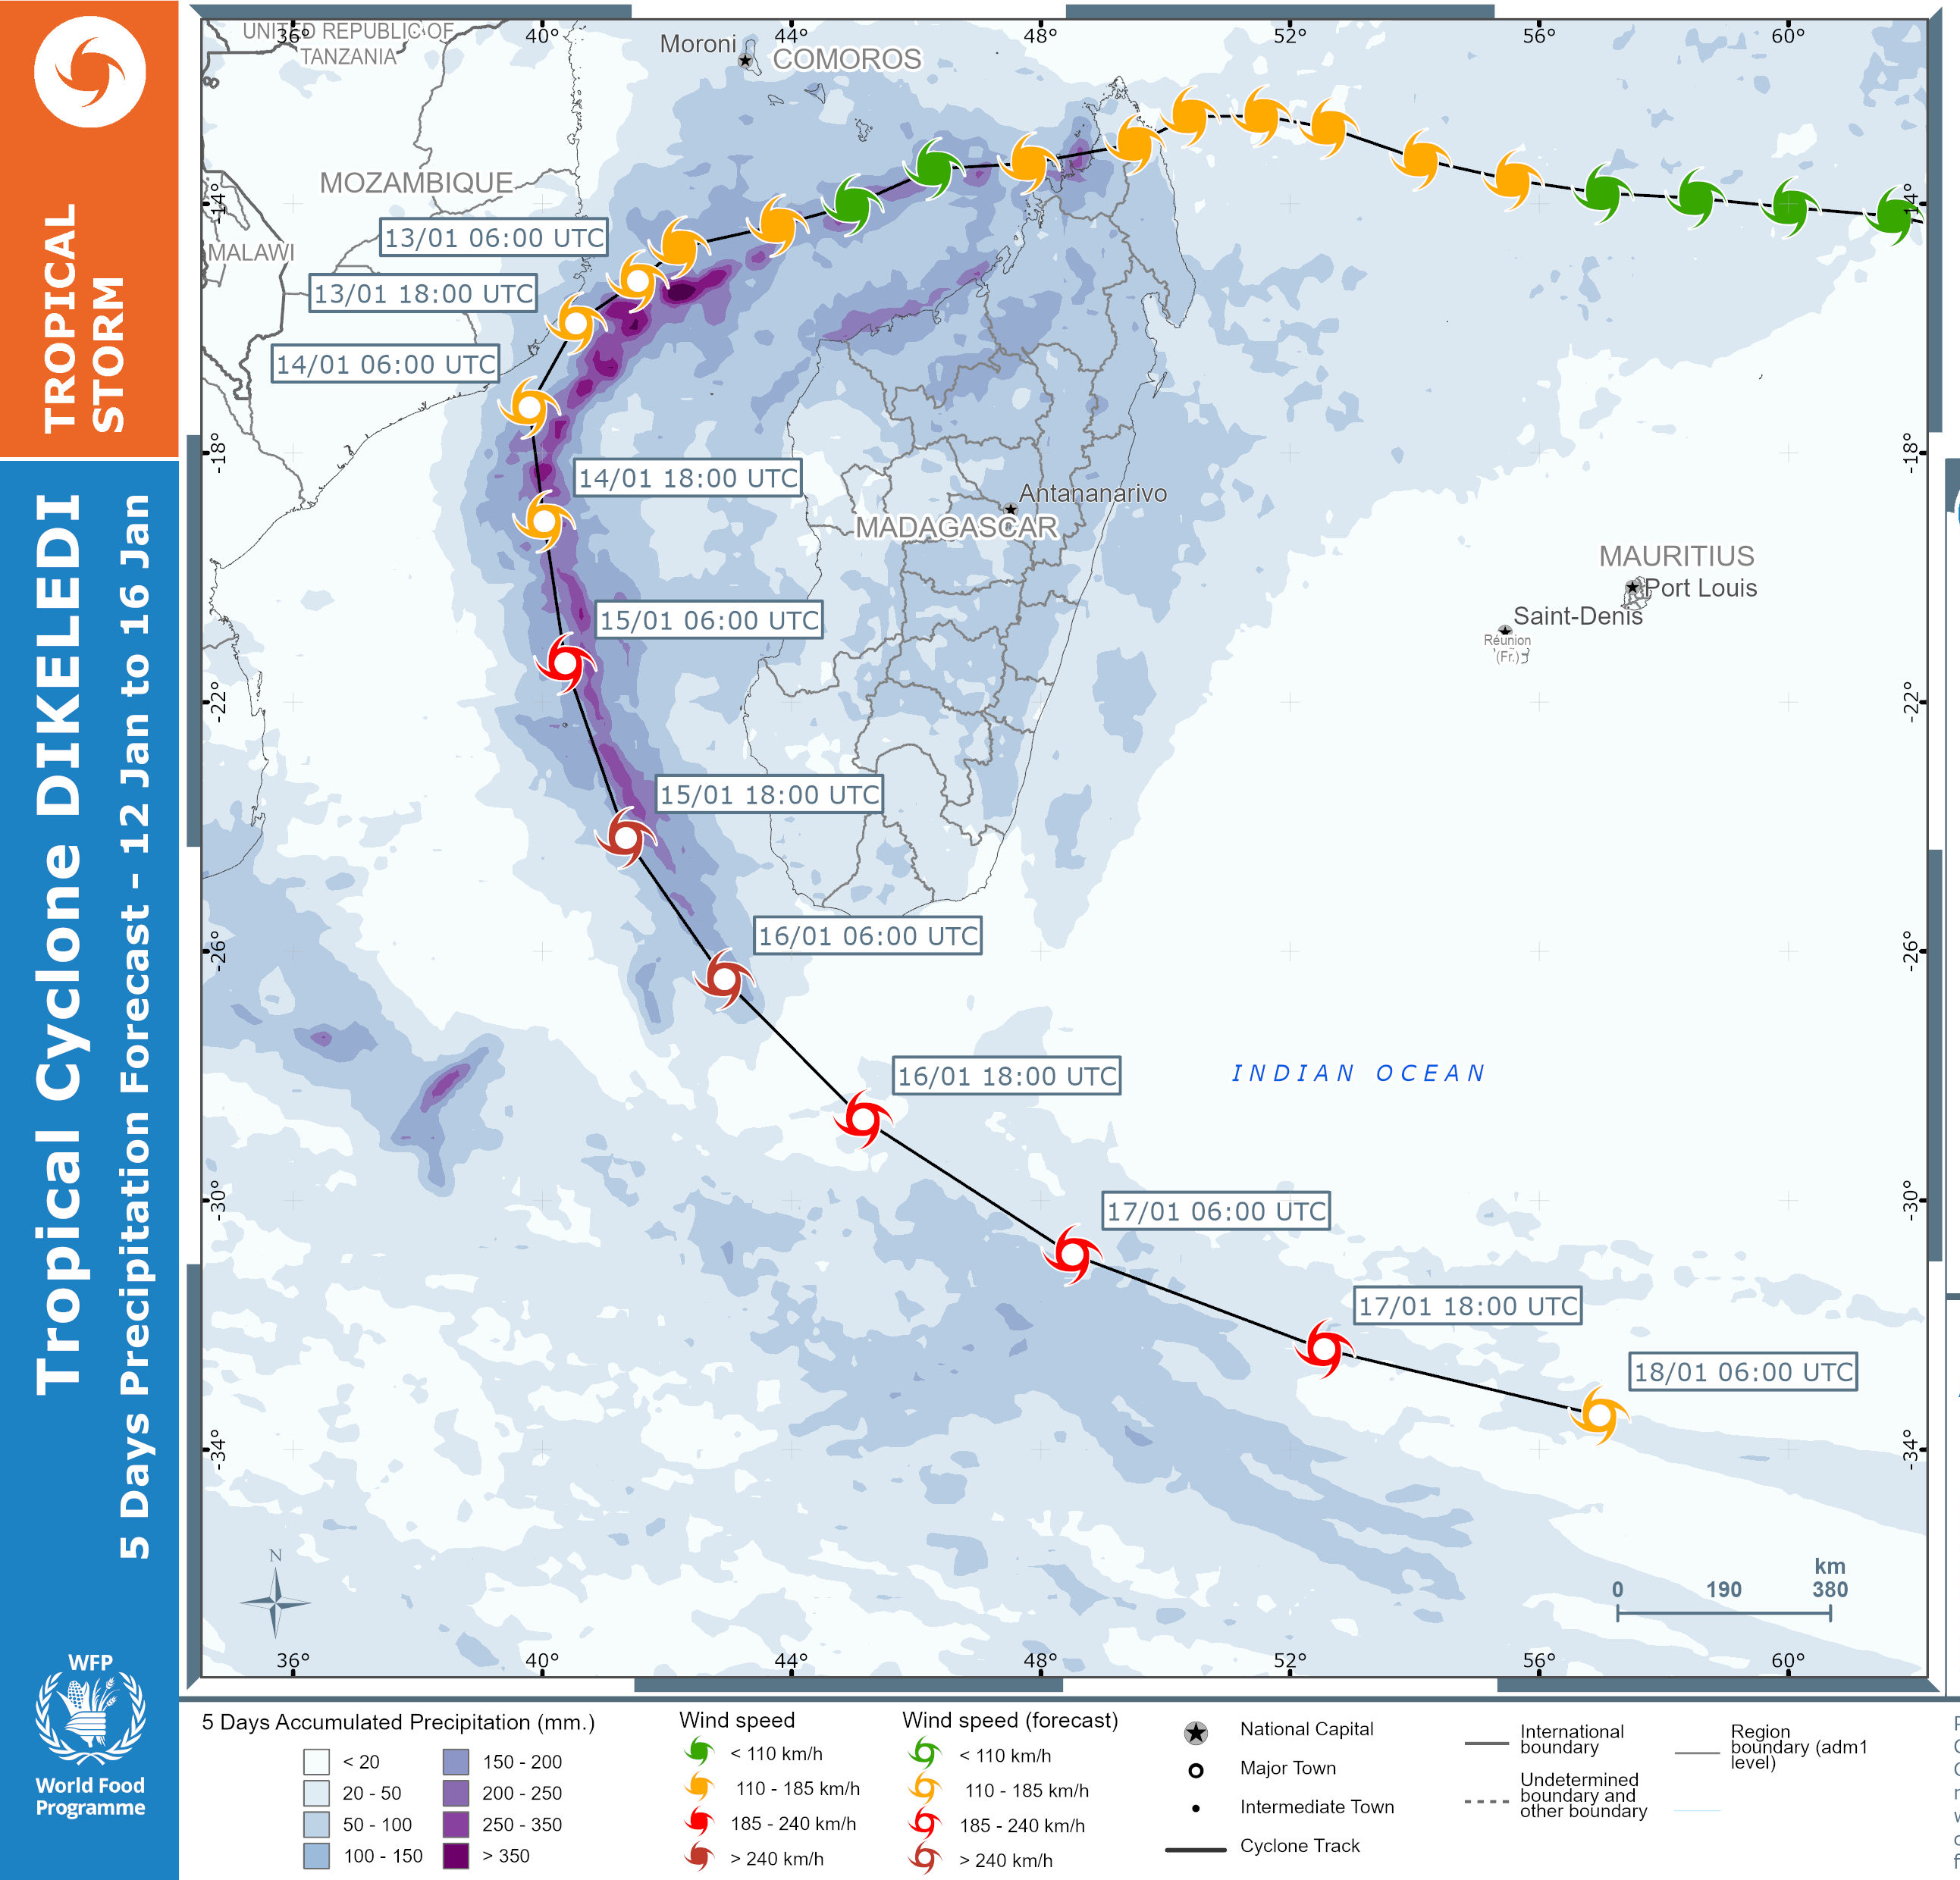
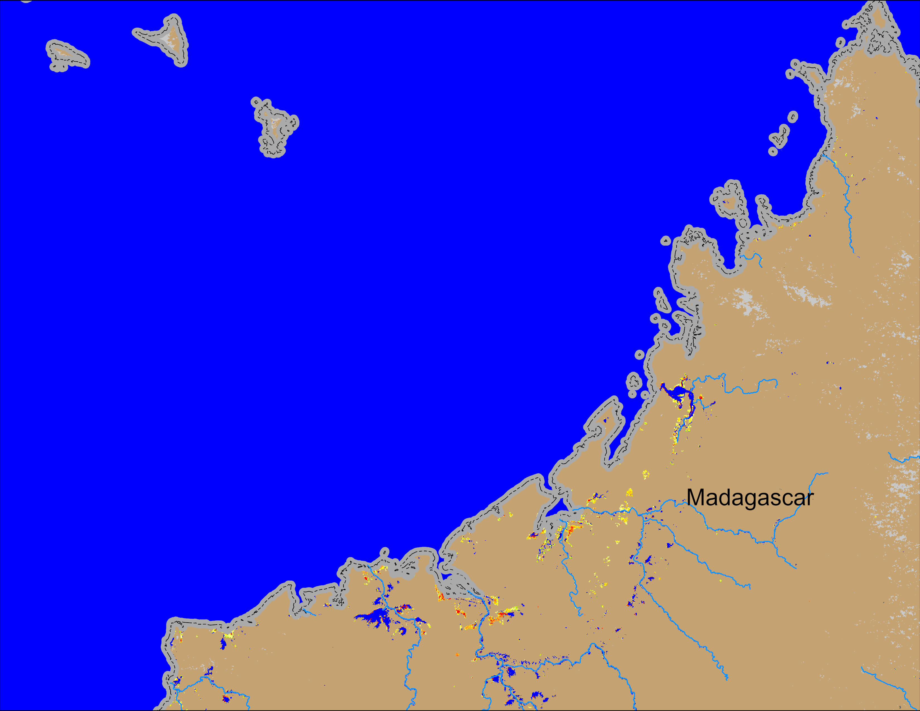
Tropical Cyclone DIKELEDI
(% of the pixel)
NOAA VIIRS 5-day comp.: 8 – 12 Jan 2025
Most of the rains caused by TC DIKELEDI was over Ocean.
Very minimal flooding was observed in Madagascar and Mozambique due to TC DIKELEDI.

Slide 3
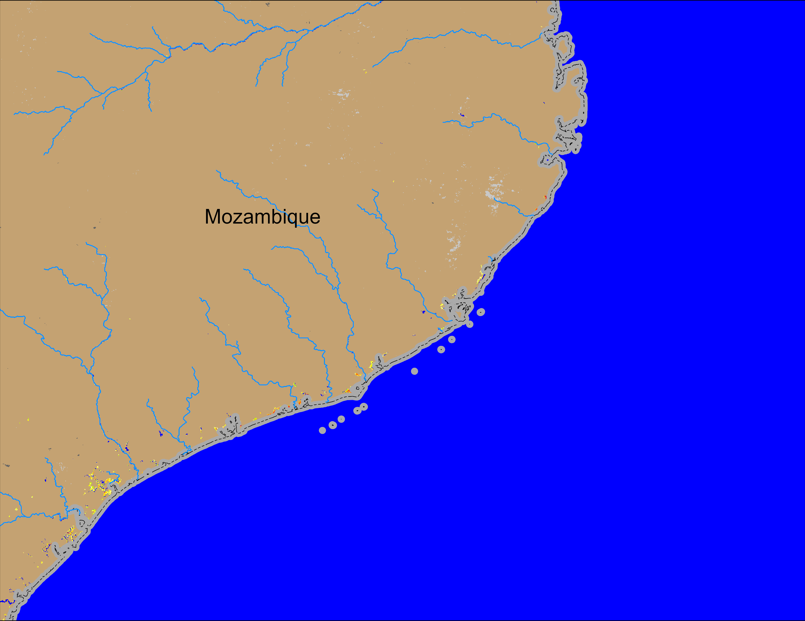
Tropical Cyclone DIKELEDI
(% of the pixel)
NOAA VIIRS 5-day comp.: 8 – 12 Jan 2025
Most of the rains caused by TC DIKELEDI was over Ocean.
Very minimal flooding was observed in Madagascar and Mozambique due to TC DIKELEDI.

Slide 4
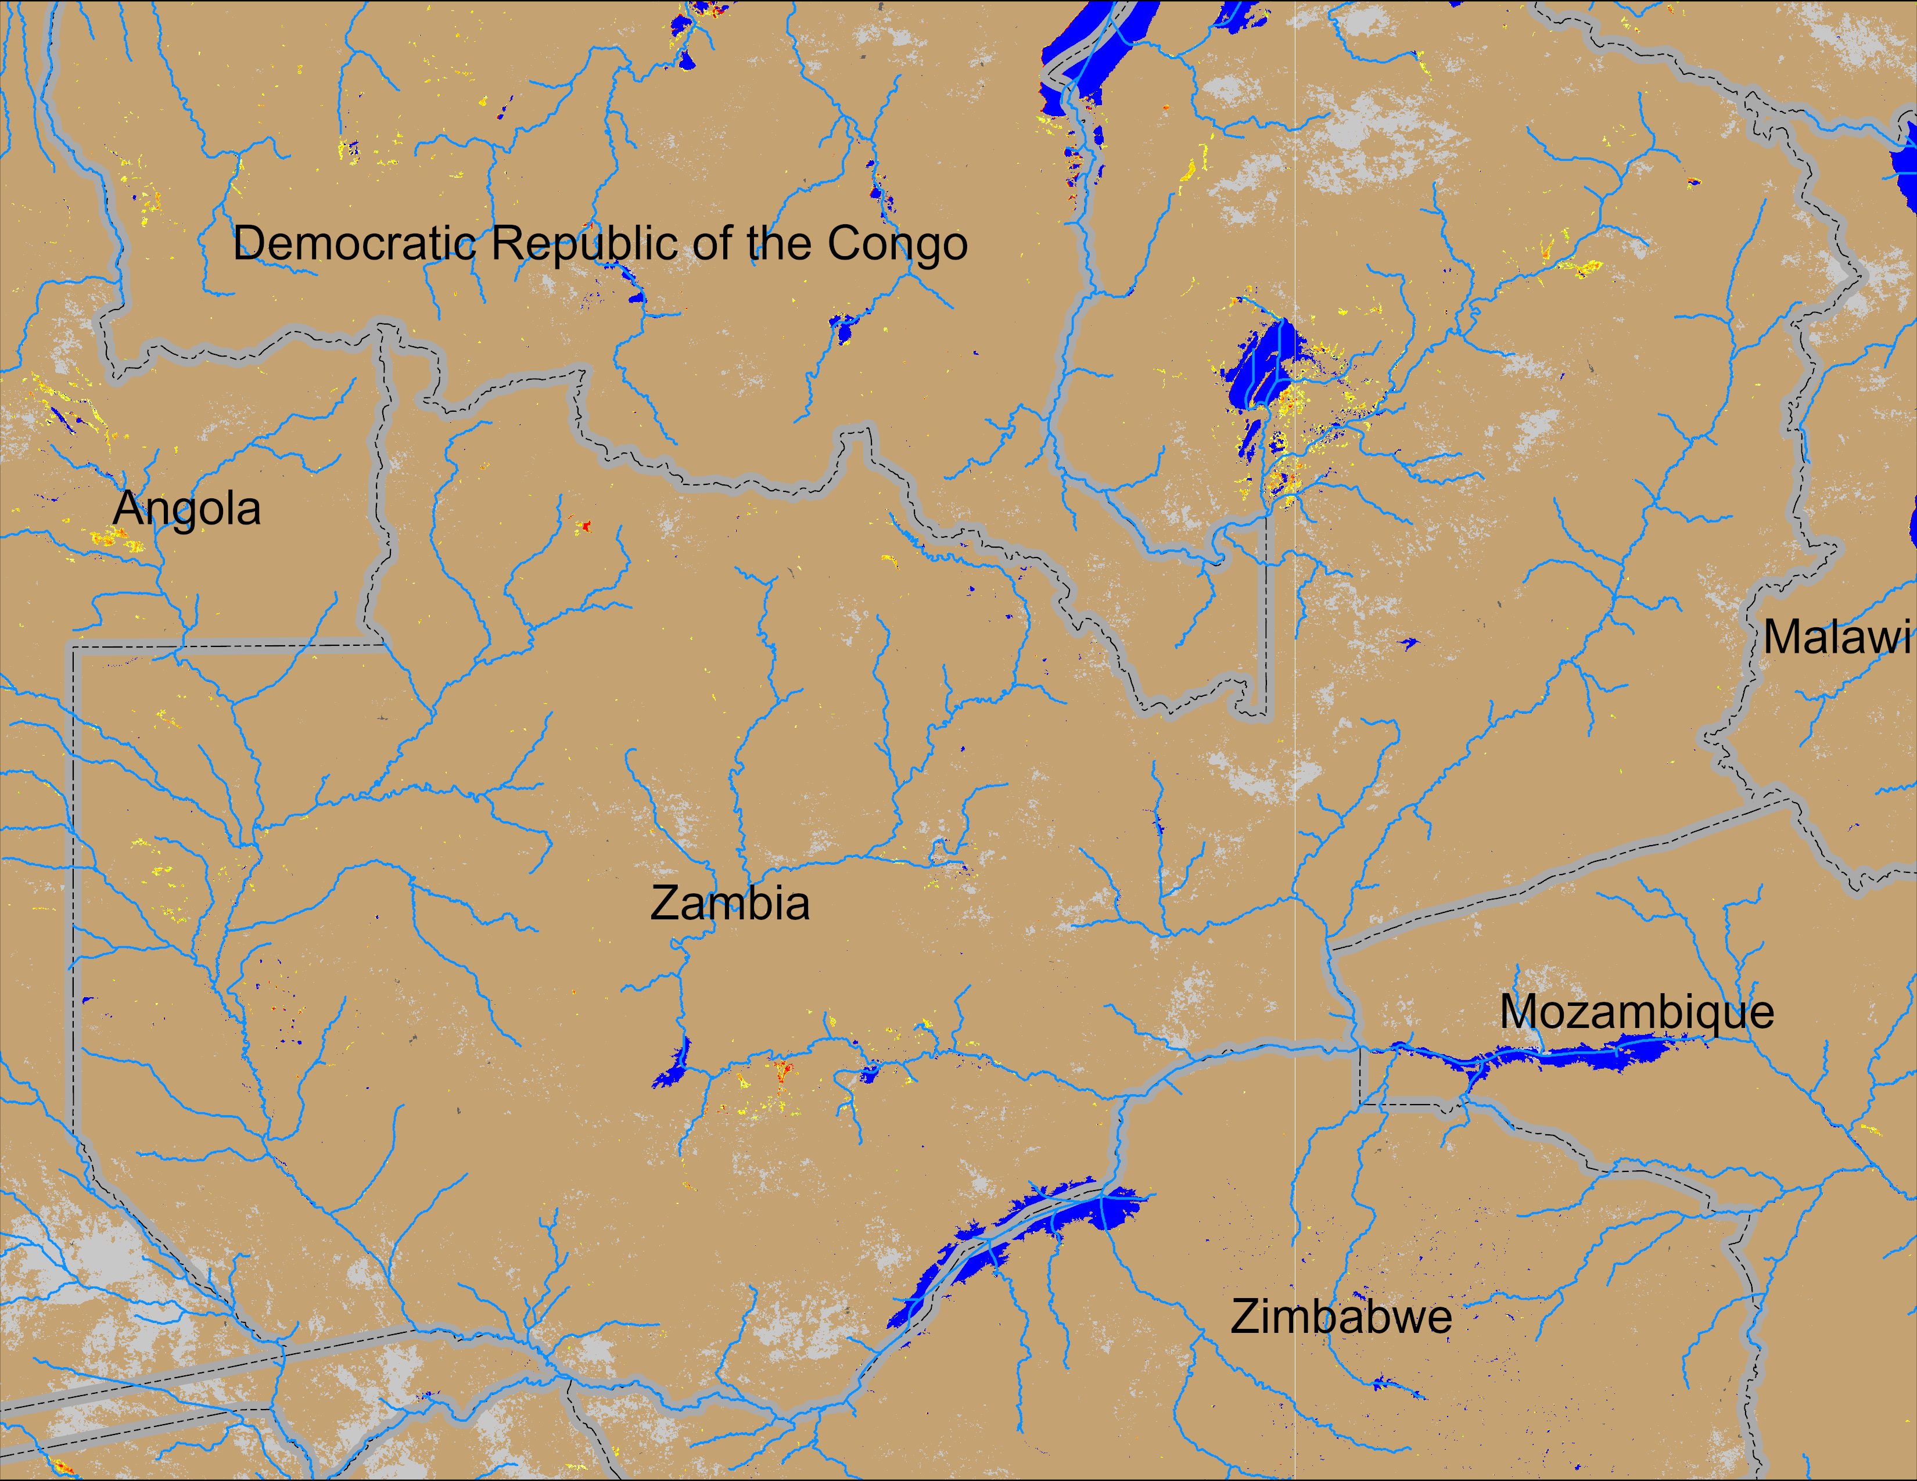
Flooding Conditions in Zambia
(% of the pixel)
NOAA VIIRS 5-day comp.: 8 – 12 Jan 2025
Minor flooding is showing up in northeastern Zambia.

Slide 5
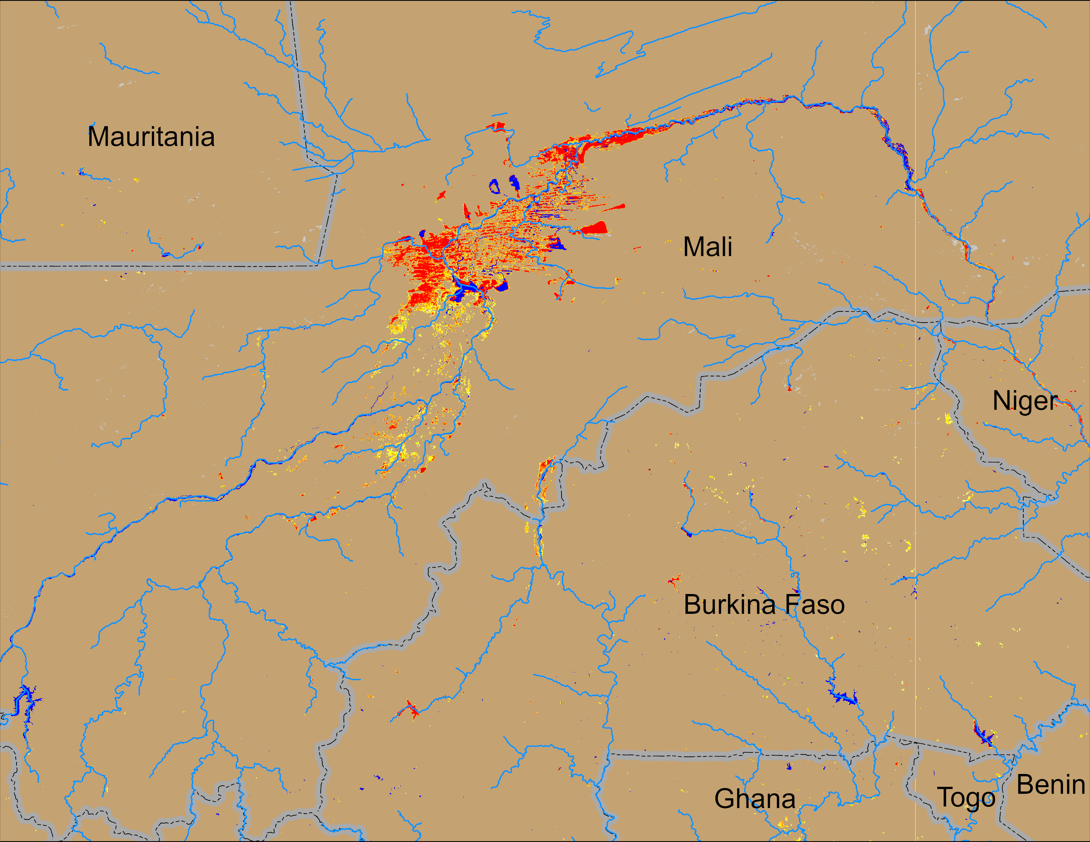
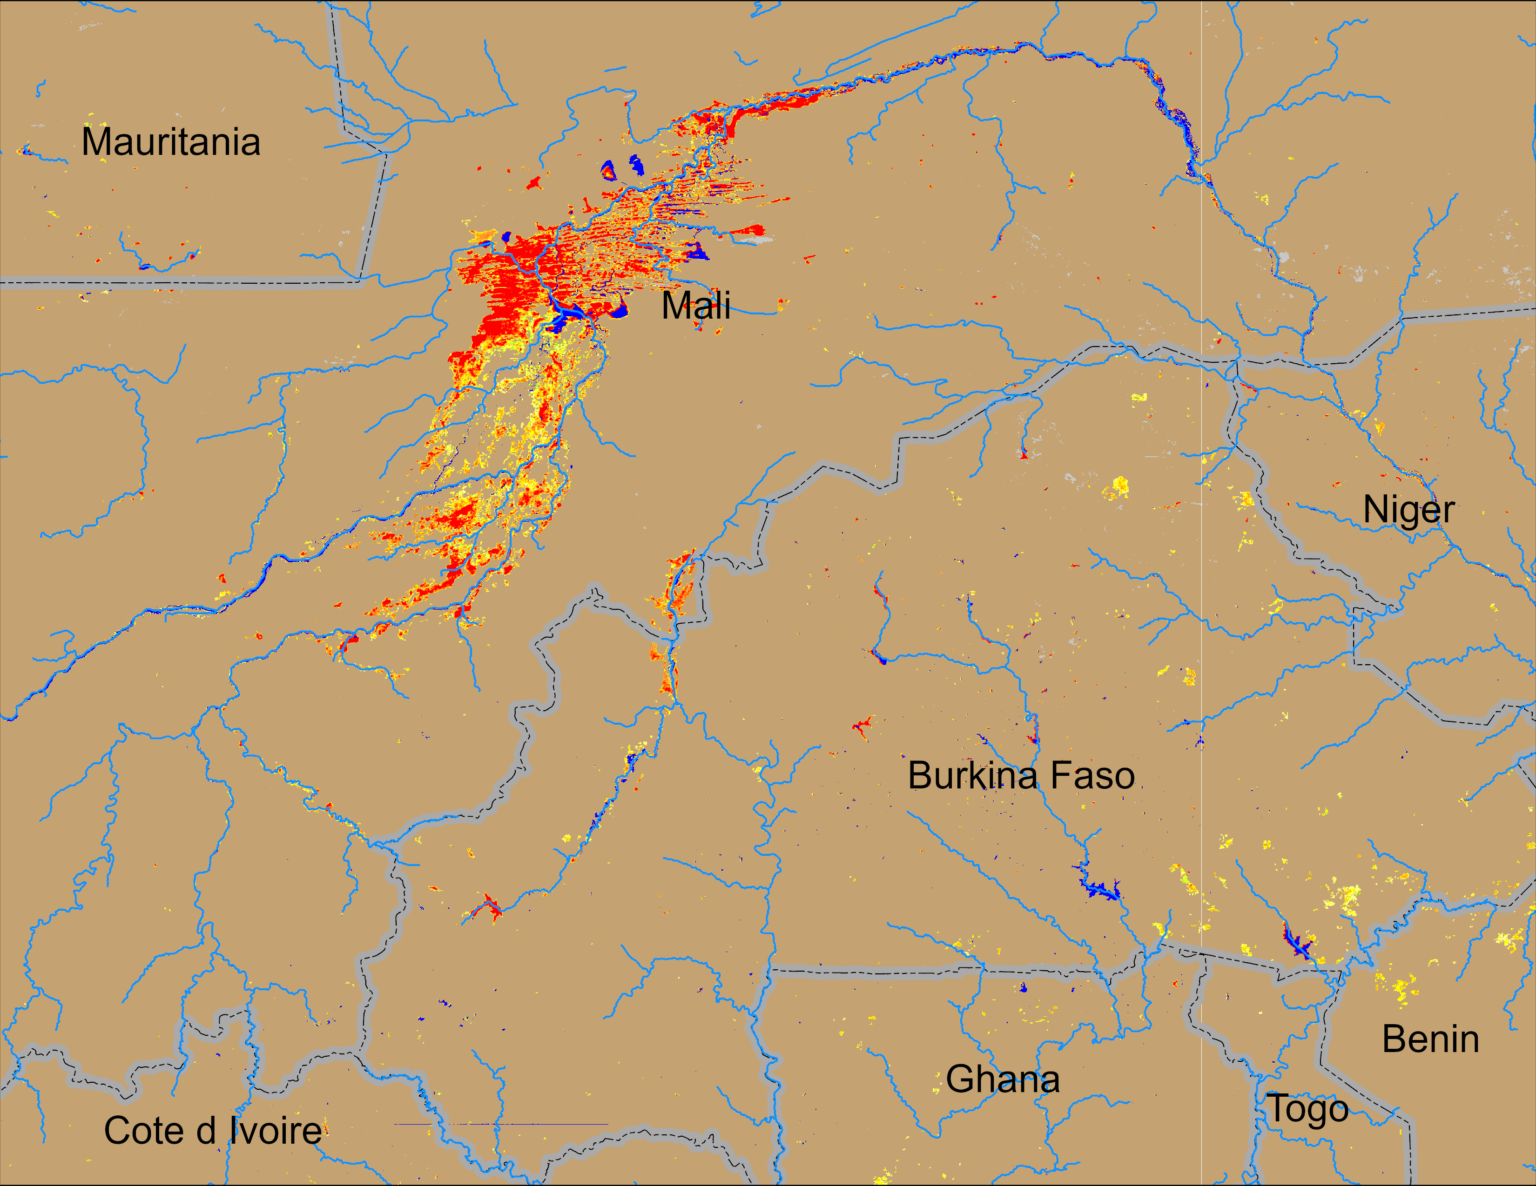
Flooding Conditions in Mali
(% of the pixel)
(% of the pixel)
NOAA VIIRS 5-day comp.: 26 – 30 Nov 2024
NOAA VIIRS 5-day comp.: 8 – 12 Jan 2025
In West Africa, only central Mali is yet to completely dry out in this season.

