Slide 1
FEWS NET Enhanced Flood Monitoring
FEWS NET Science Team
Feb 3, 2025

Slide 2
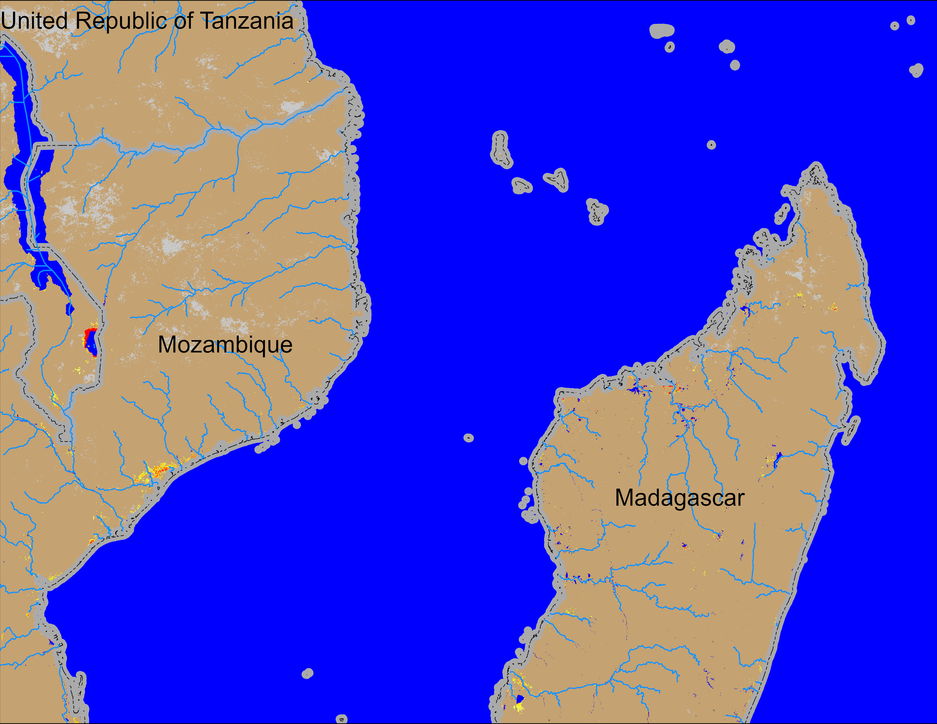
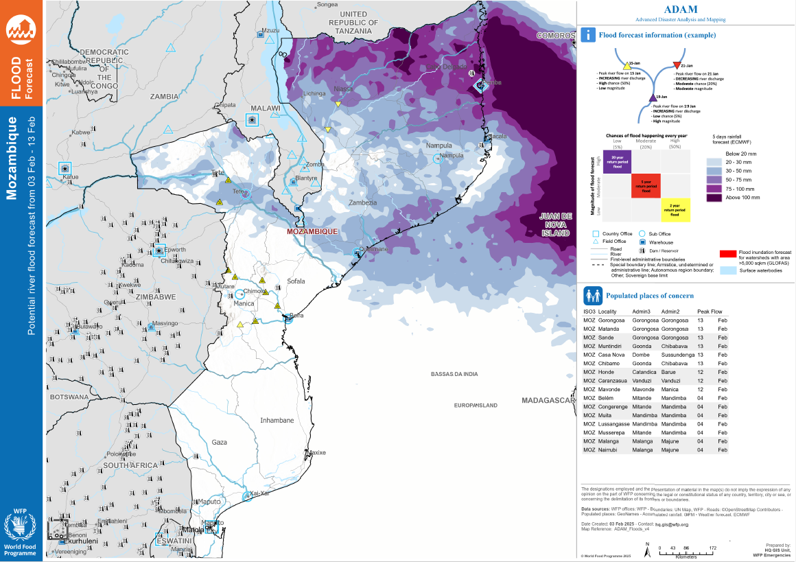
Flooding Conditions in Mozambique
NOAA VIIRS 5-day comp.: 29 Jan – 2 Feb 2025
ADAM flood forecast: 3 – 13 Feb 2025
Marginal flooding along the coast of central area and more flooding possible in northern Mozambique in next 10 days.

Slide 3
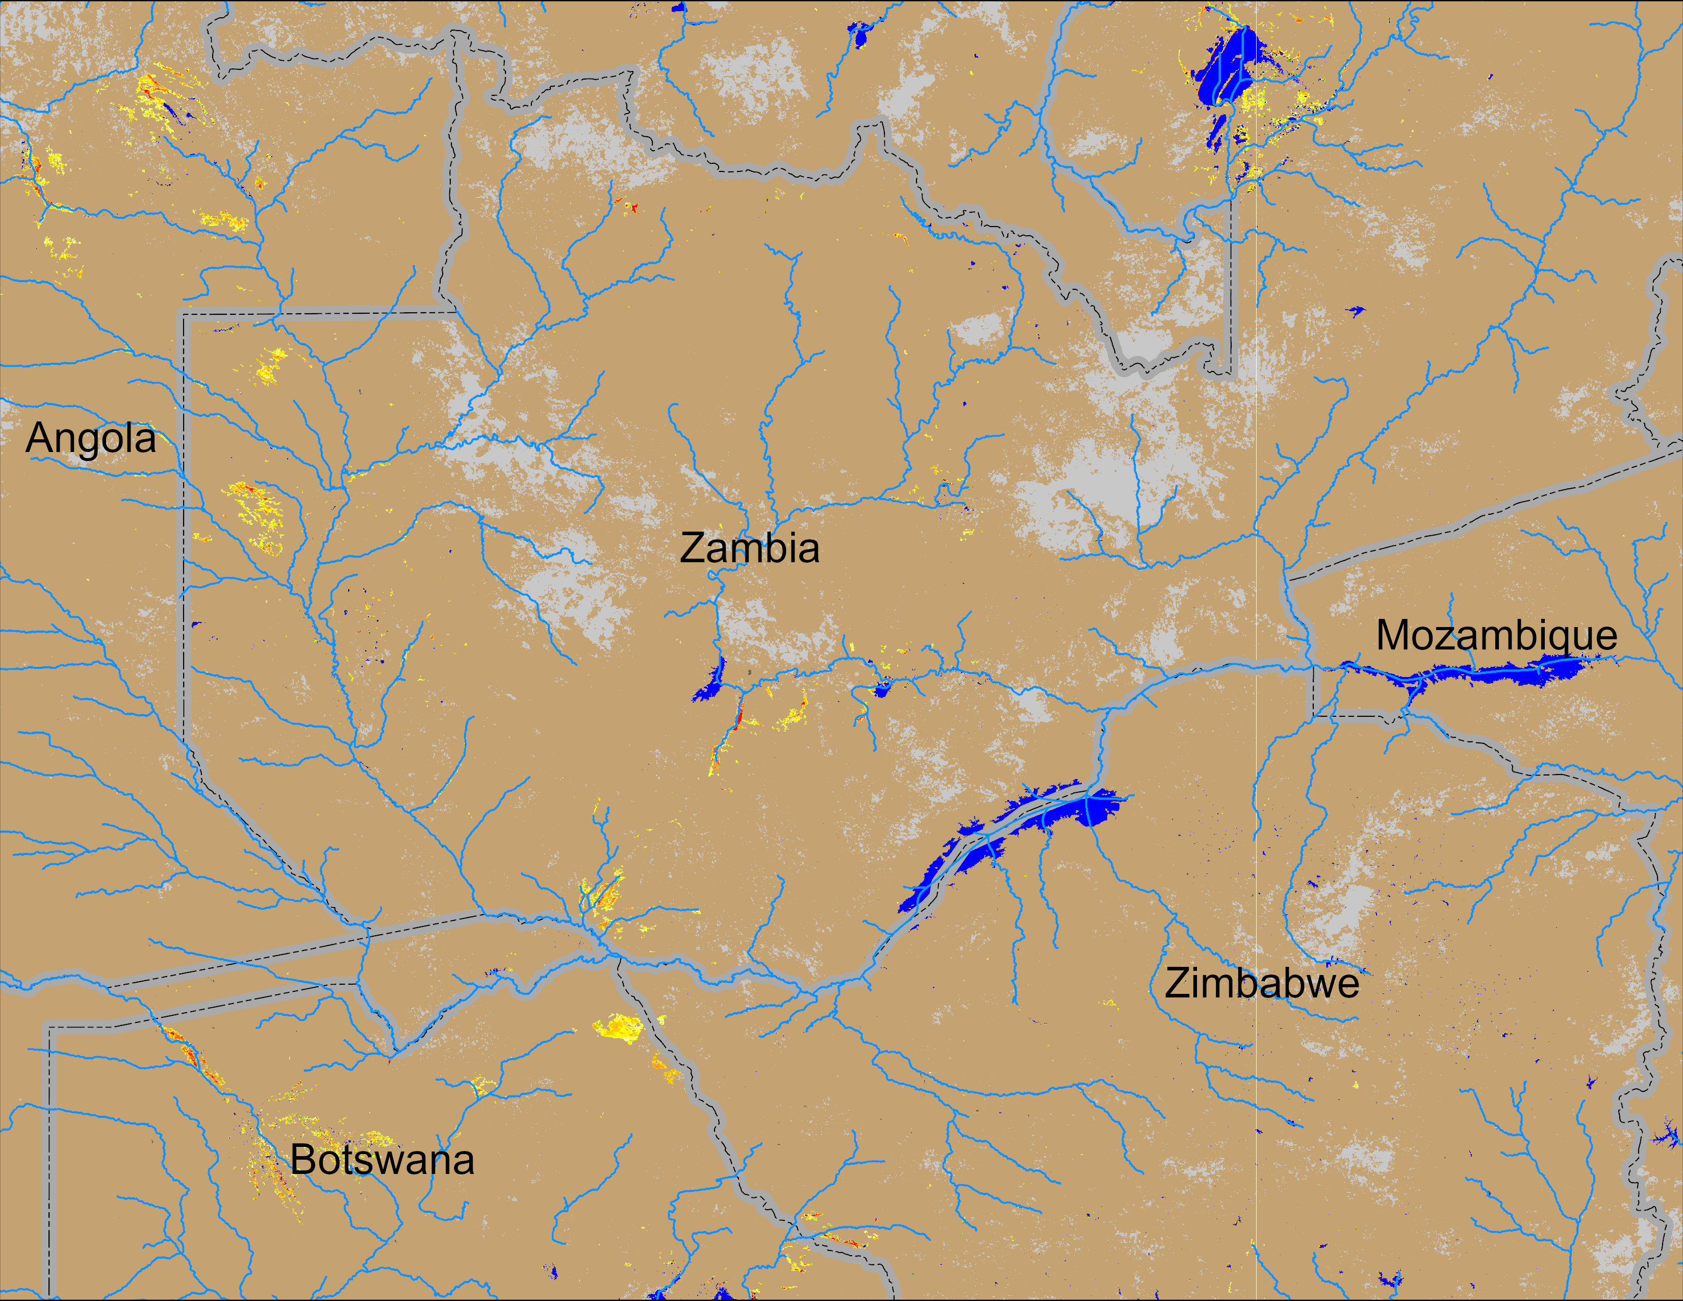
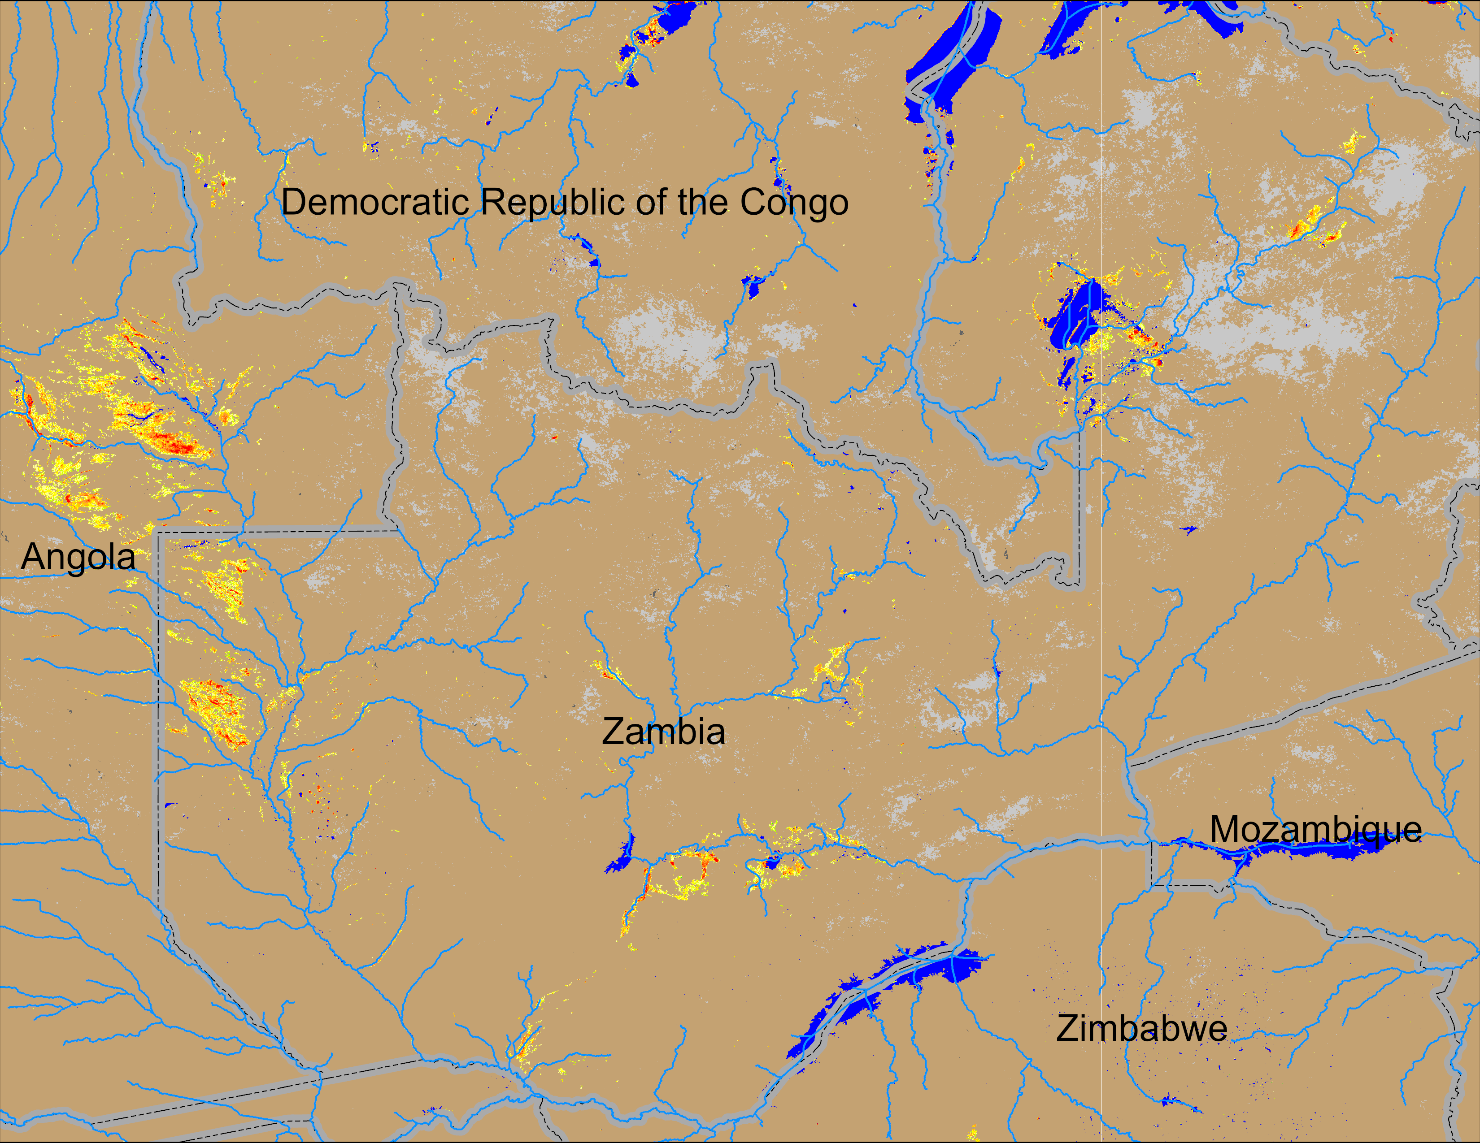
Flooding Conditions in Zambia
(% of the pixel)
NOAA VIIRS 5-day comp.: 16 – 20 Jan 2025
NOAA VIIRS 5-day comp.: 29 Jan – 2 Feb 2025
Flooding is intensifying in western Zambia and into Angola.

