Slide 1
FEWS NET Enhanced Flood Monitoring
FEWS NET Science Team
Aug 04, 2025

Slide 2


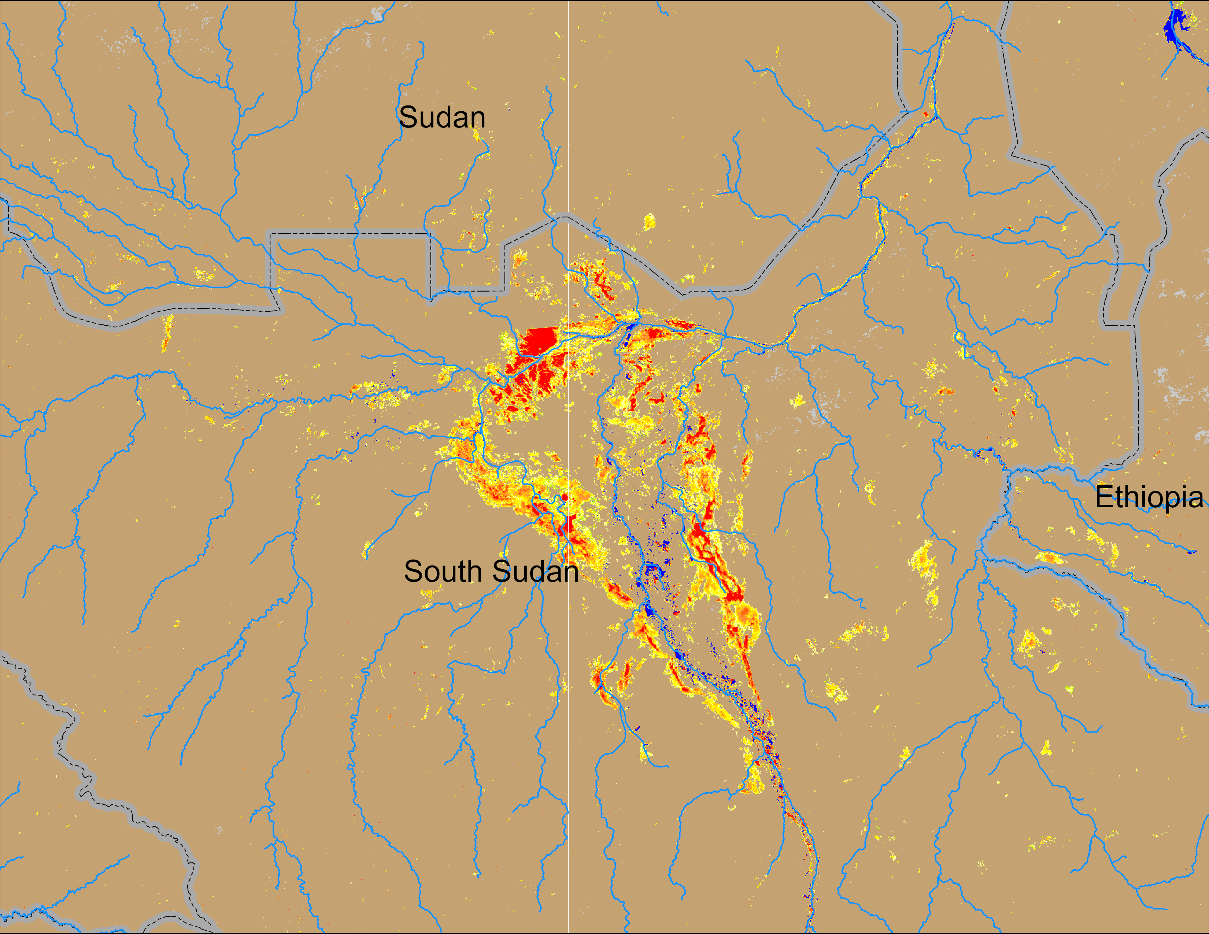
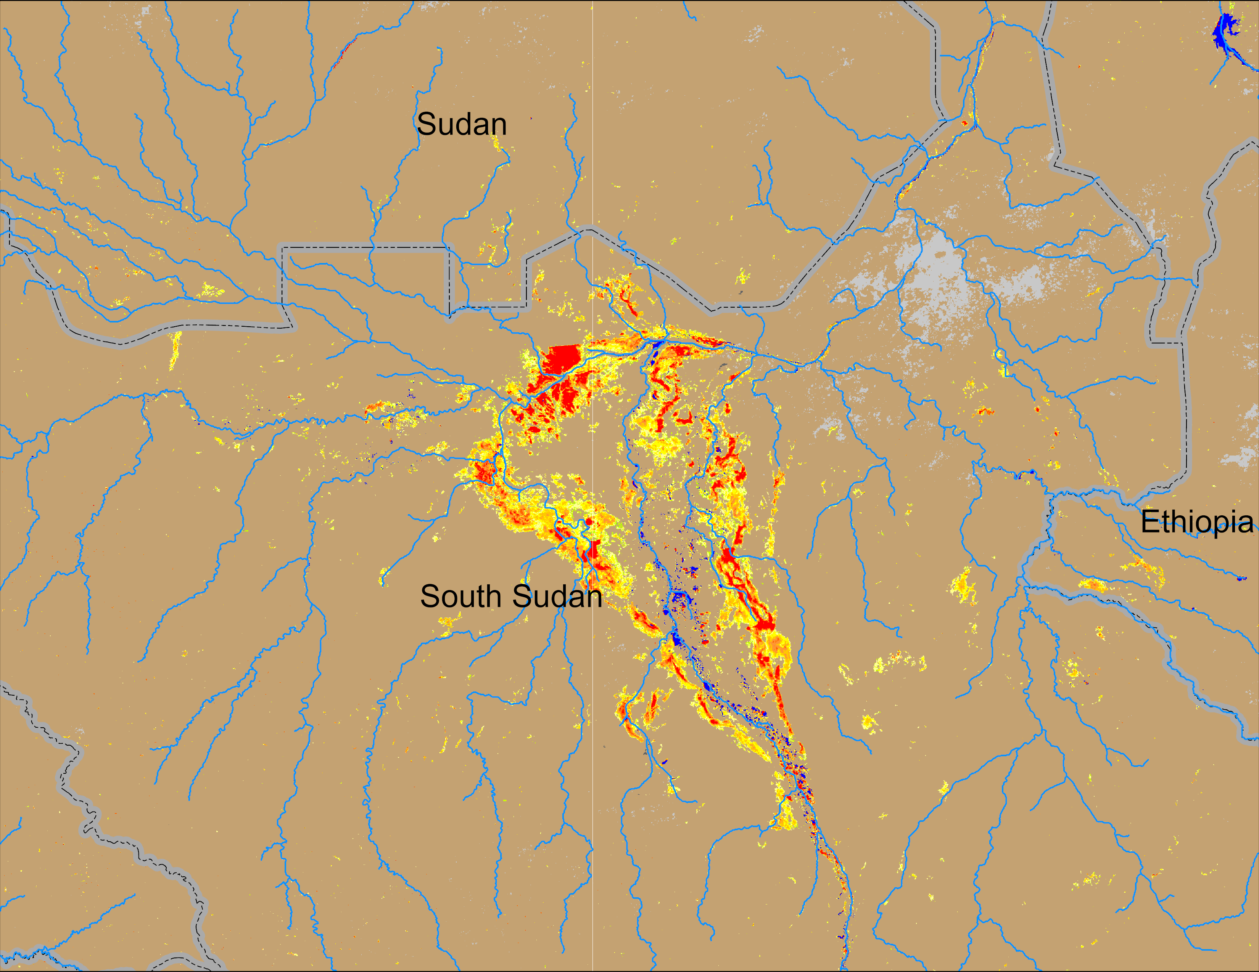
Flooding Conditions in South Sudan
(% of the pixel)
NOAA VIIRS derived map: 23 – 27 Jul 2025
NOAA VIIRS 5-day comp.: 30 Jul – 03 Aug 2025
Inundation kept increasing in South Sudan especially in Sobet-Akobo-Pibor catchment.

Slide 3
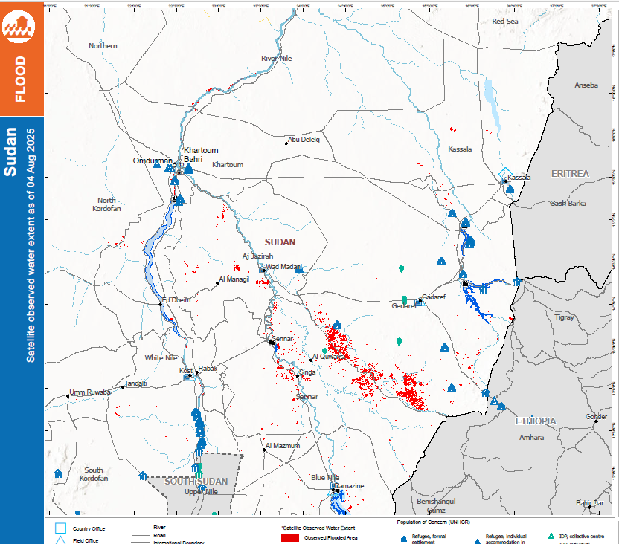
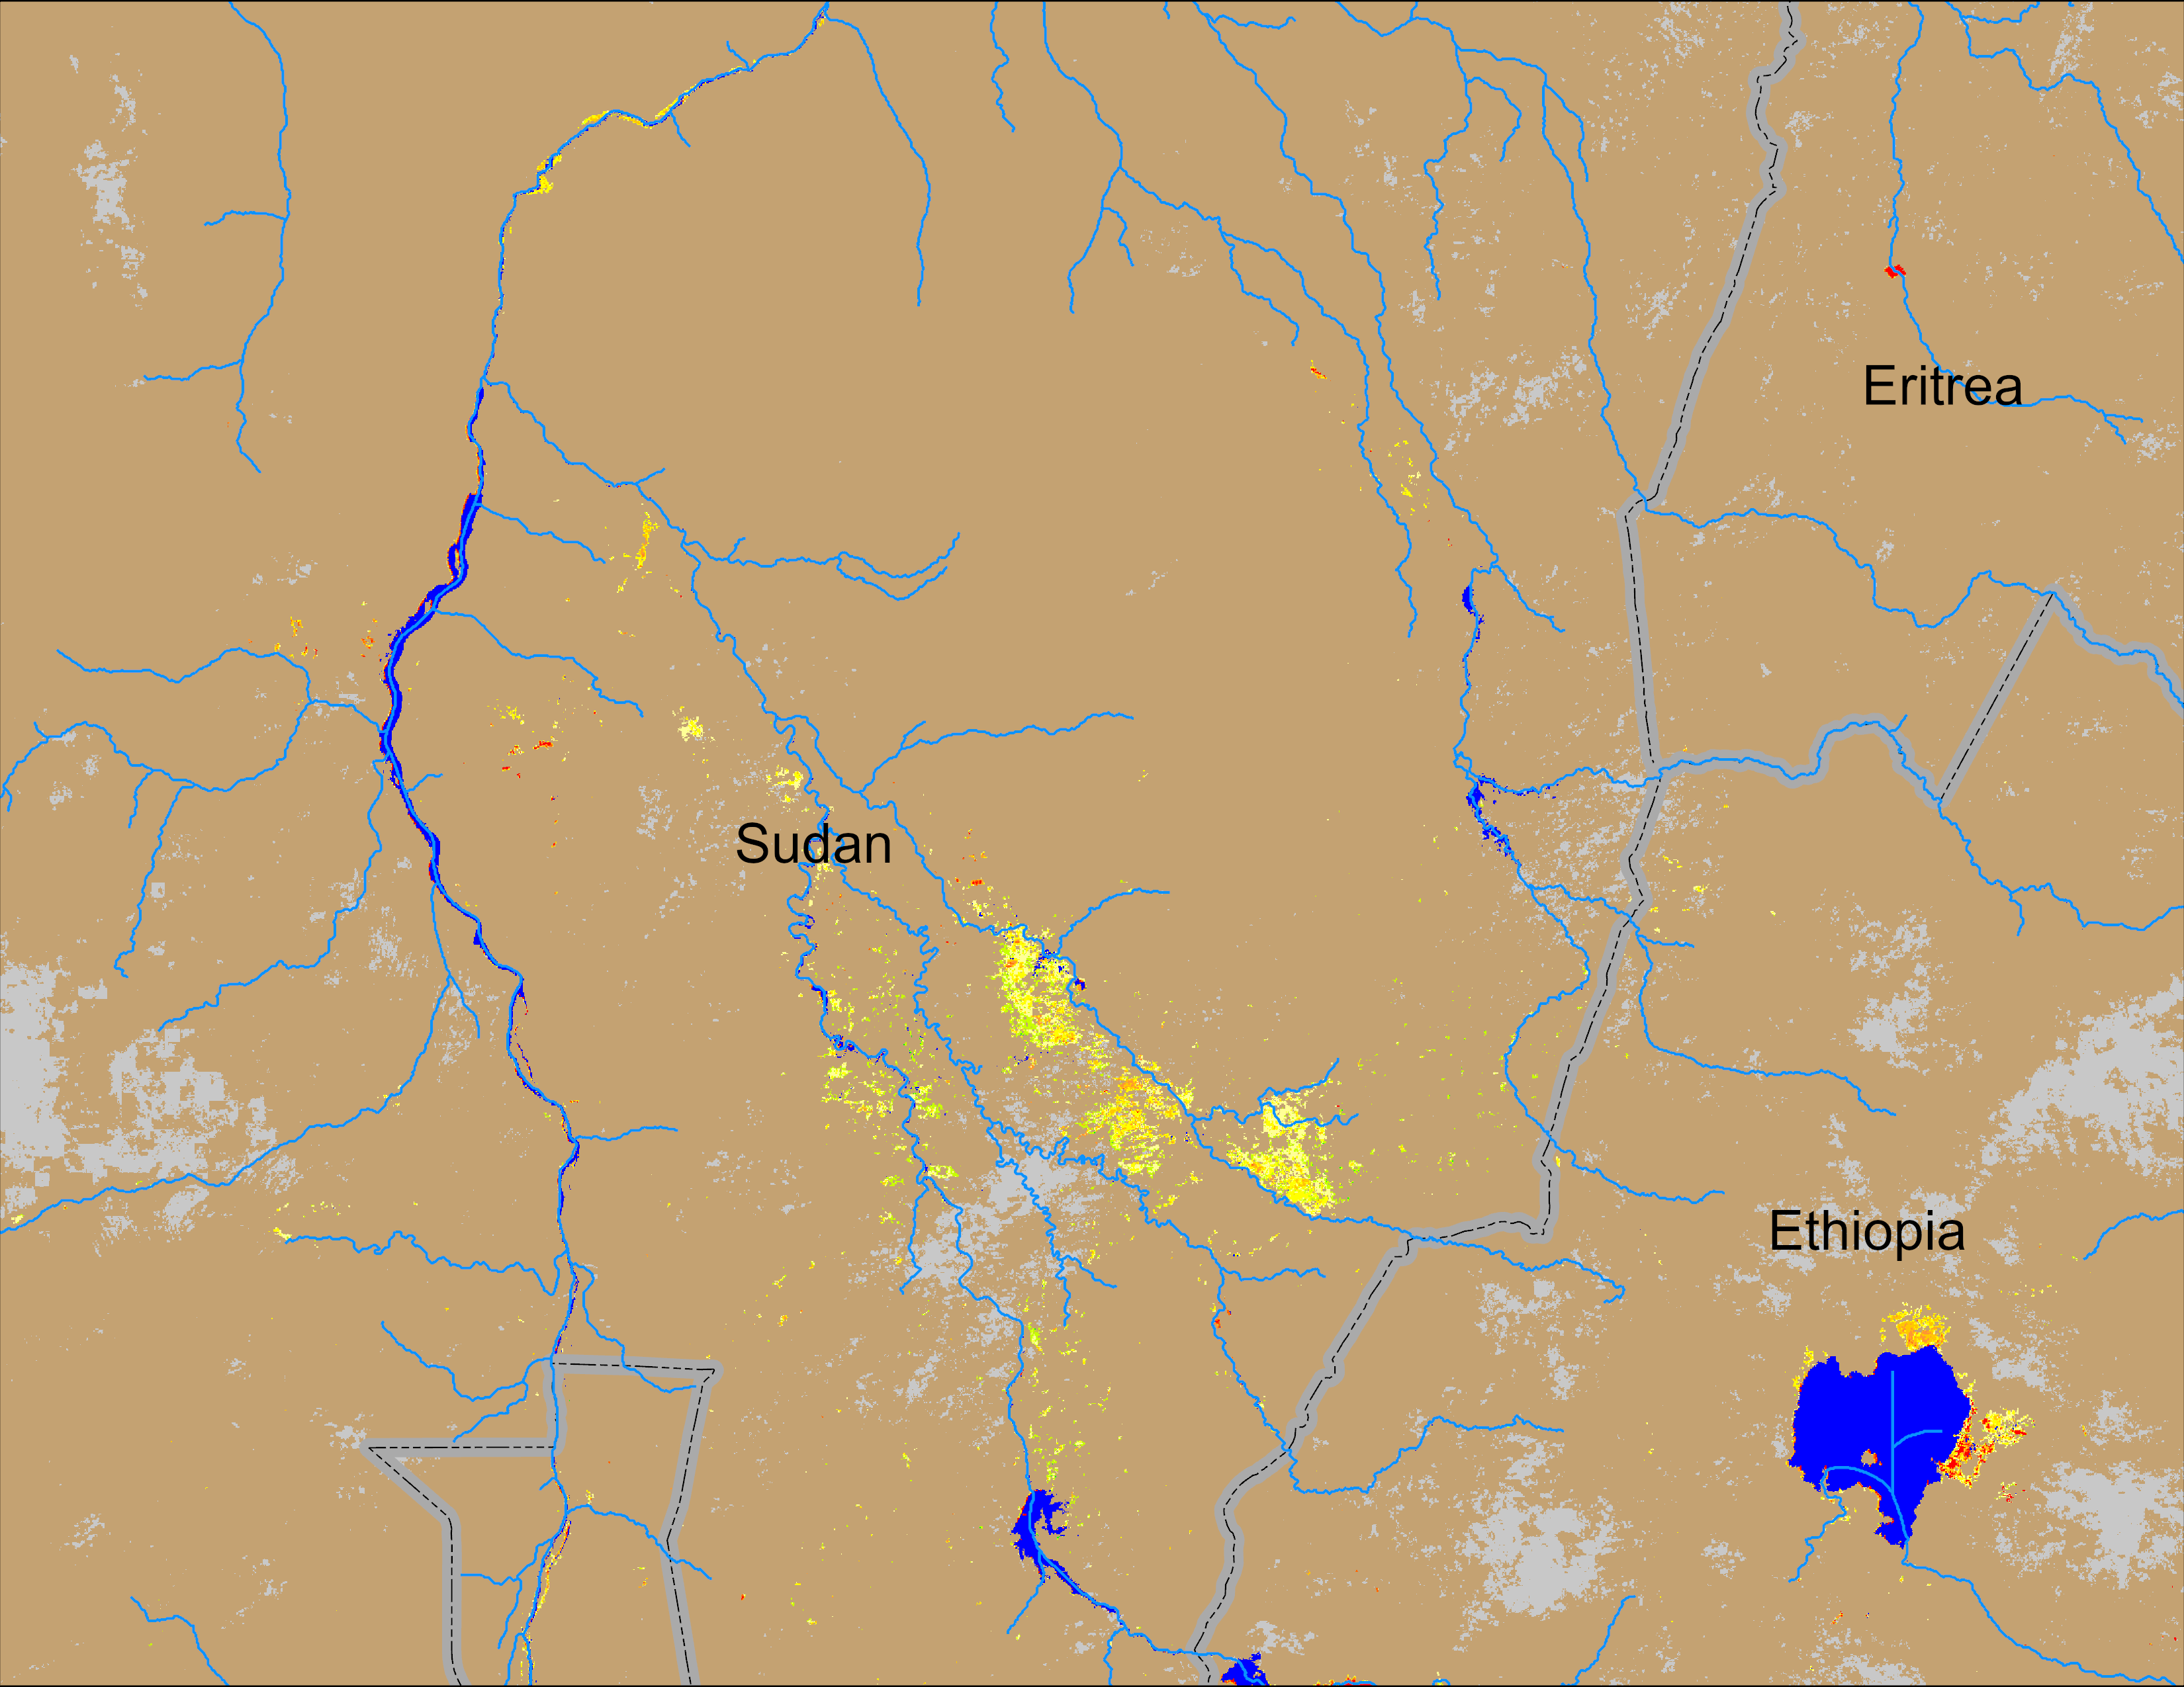
Flooding Conditions in Sudan
(% of the pixel)
ADAM Observed flooded area: 04 Aug 2025
NOAA VIIRS 5-day comp.: 30 Jul – 03 Aug 2025
Flooding gradually increasing along Blue Nile in Sudan.

Slide 4
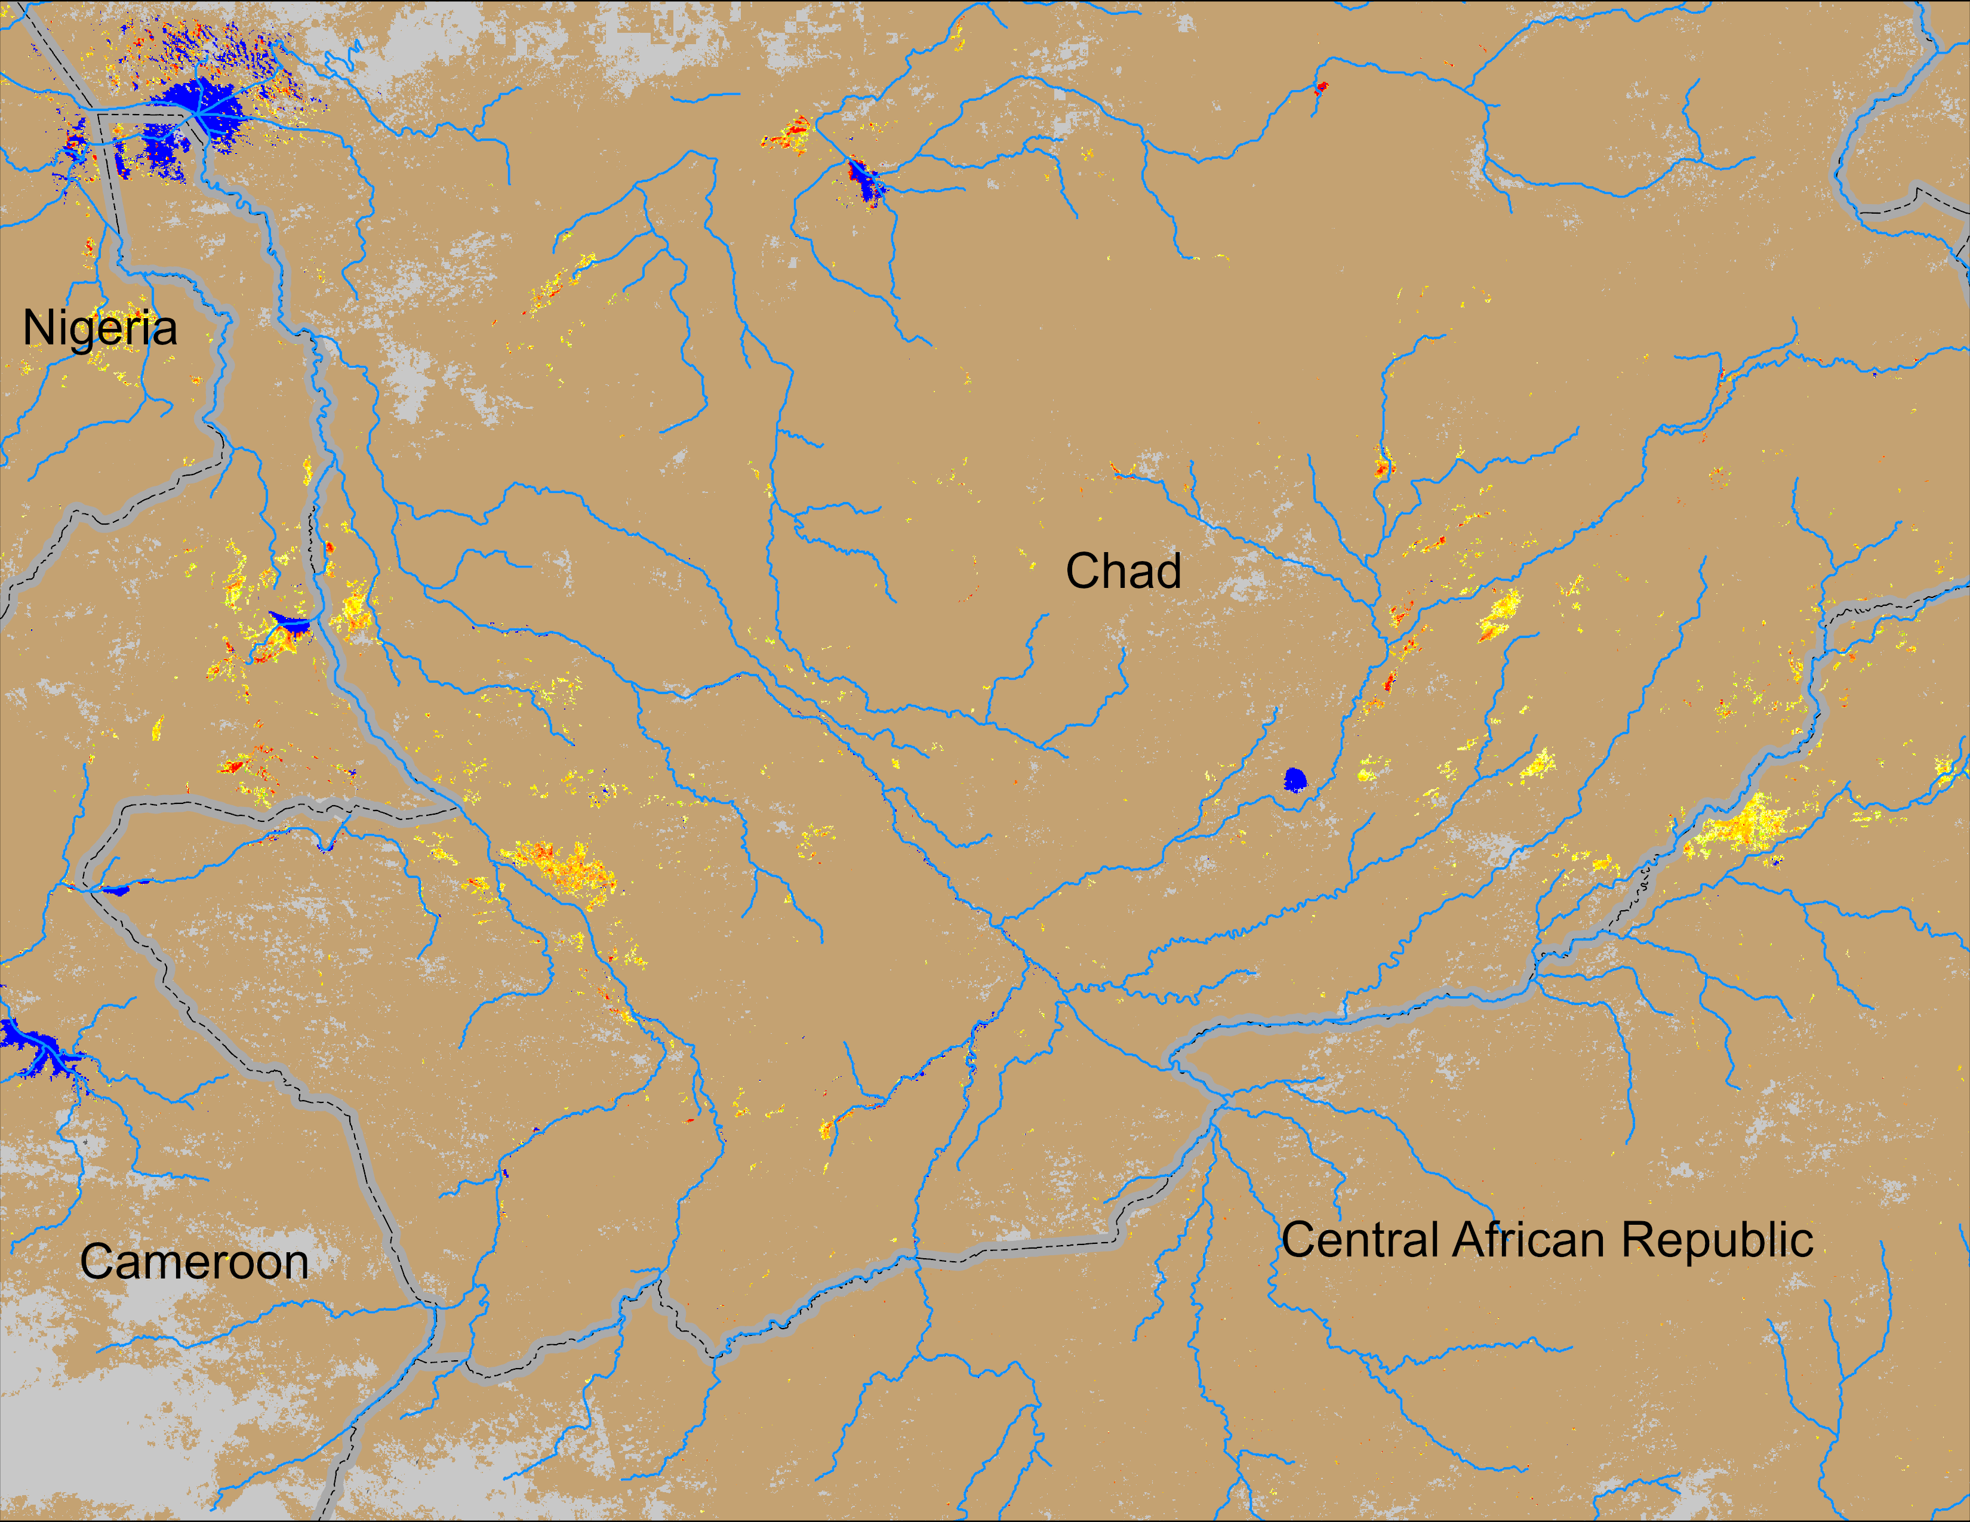
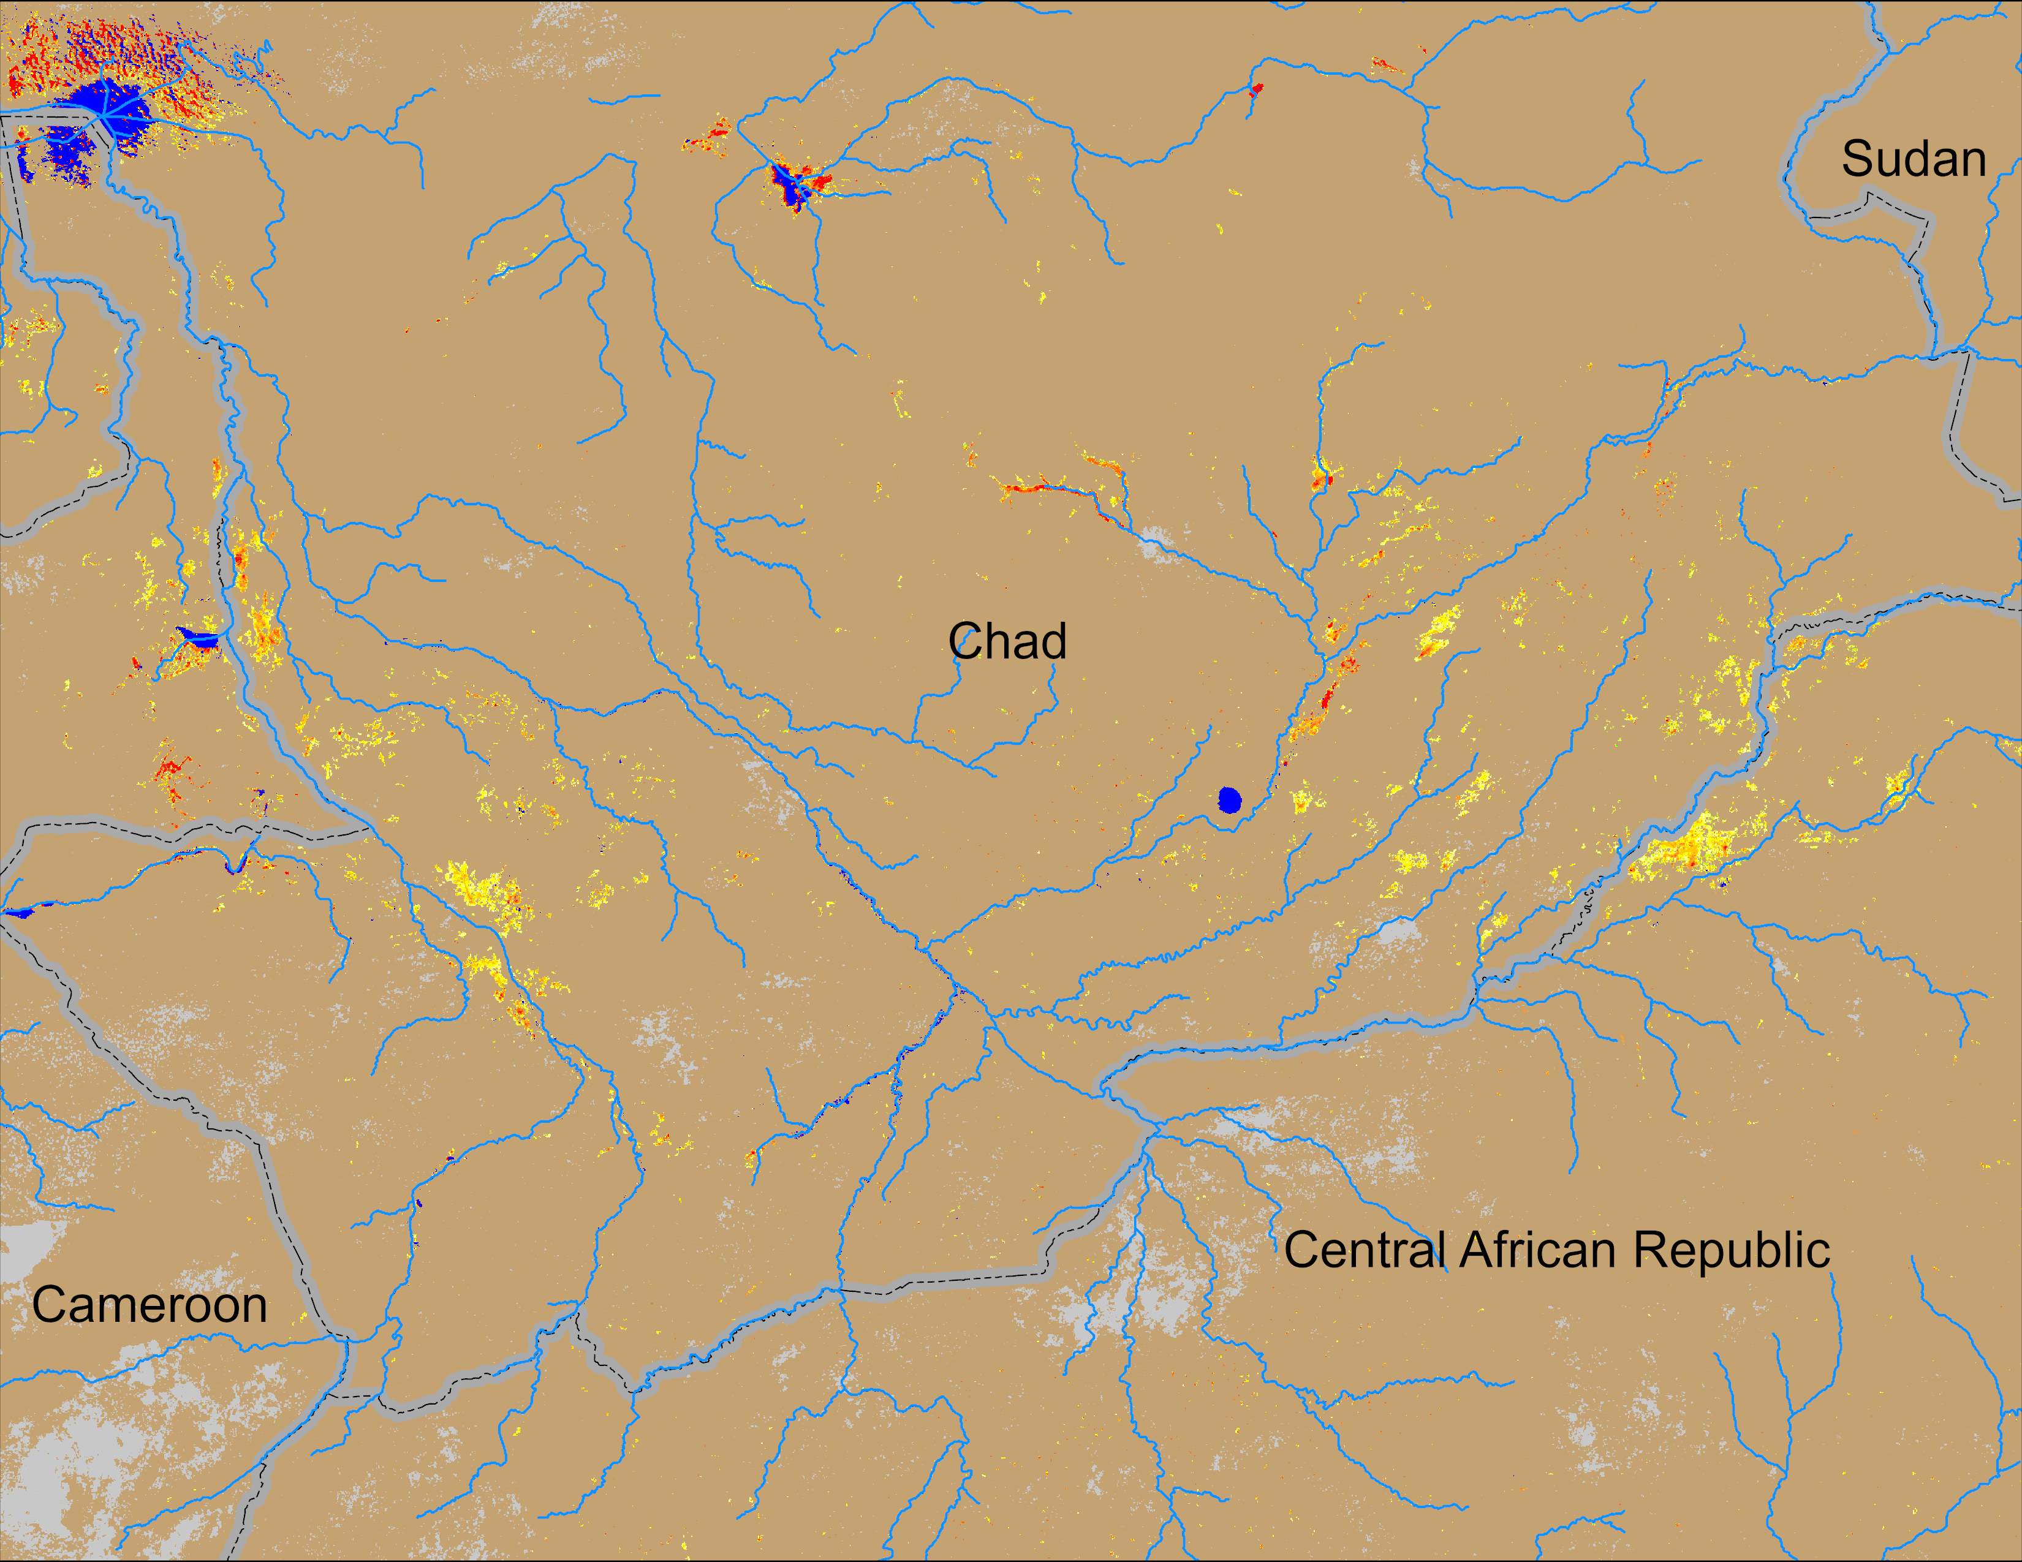
Flooding Conditions in Chad
(% of the pixel)
(% of the pixel)
NOAA VIIRS derived map: 23 – 27 Jul 2025
NOAA VIIRS 5-day comp.: 30 Jul – 03 Aug 2025
Flooding increasing slowly along the Logone and Chari Rivers in Chad.

