Slide 1
FEWS NET Enhanced Flood Monitoring
FEWS NET Science Team
Apr 7, 2025

Slide 2

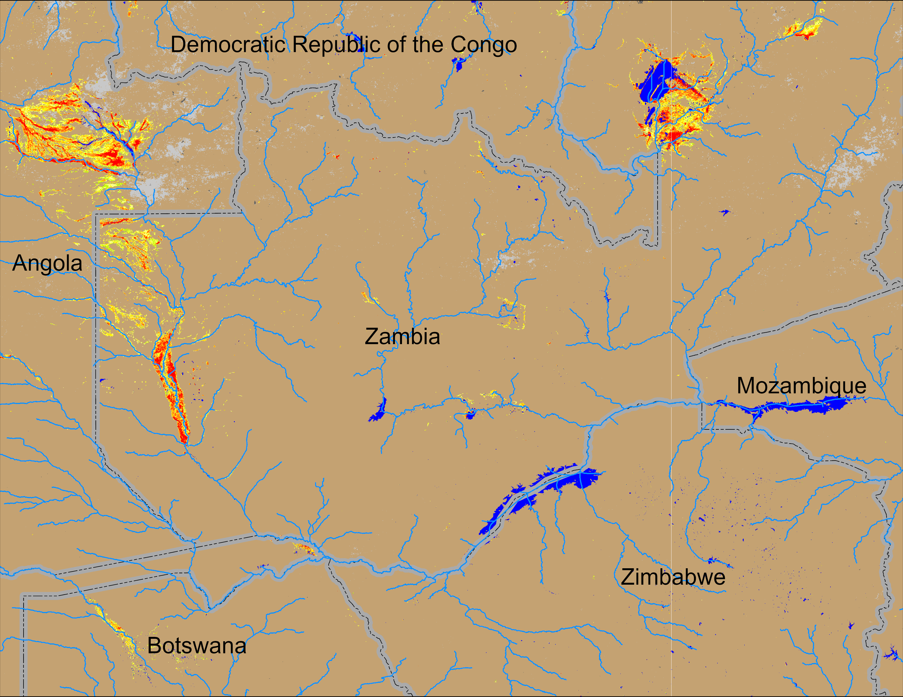
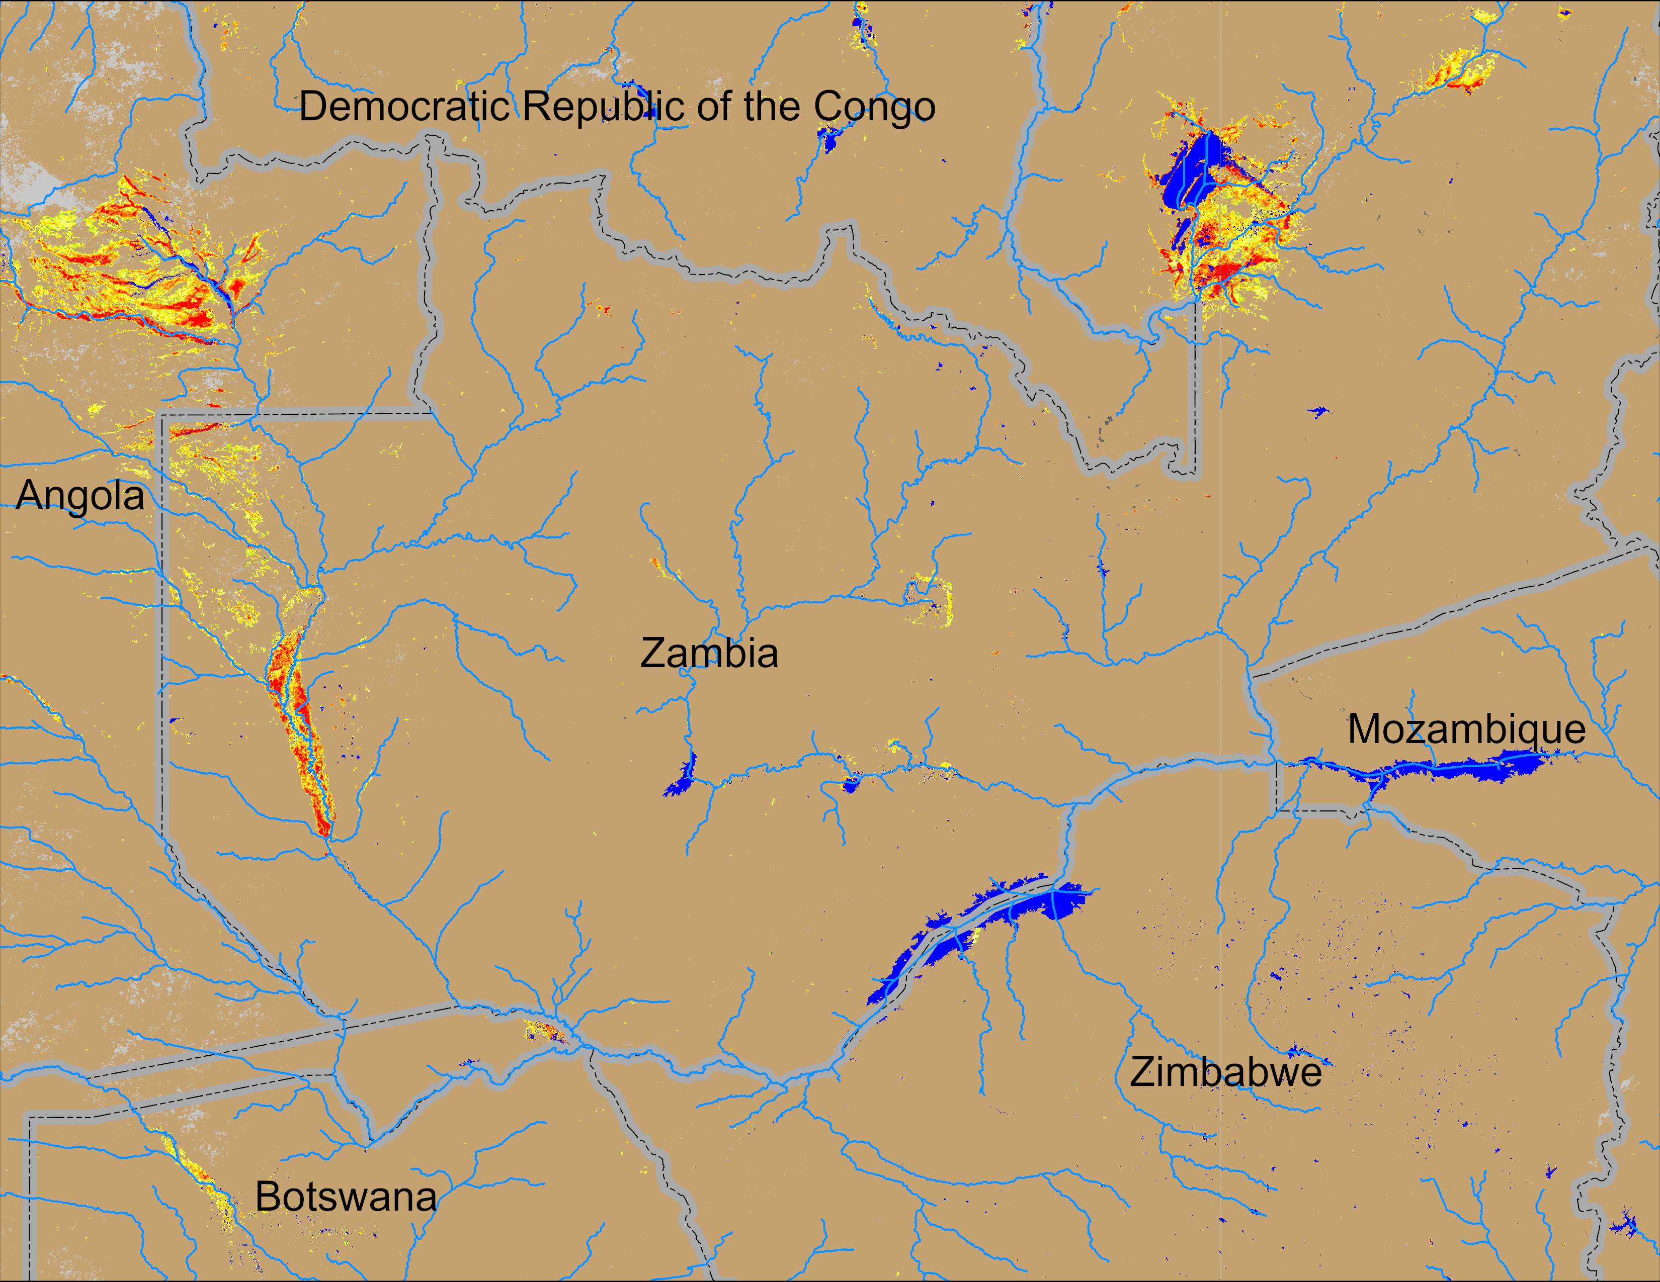
Flooding Conditions in Zambia
(% of the pixel)
(% of the pixel)
NOAA VIIRS 5-day comp.: 27 – 31 Mar 2025
NOAA VIIRS 5-day comp.: 02 – 06 Apr 2025
Flooding conditions remained unchanged in western Zambia, Eastern Angola and northern Botswana.

Slide 3
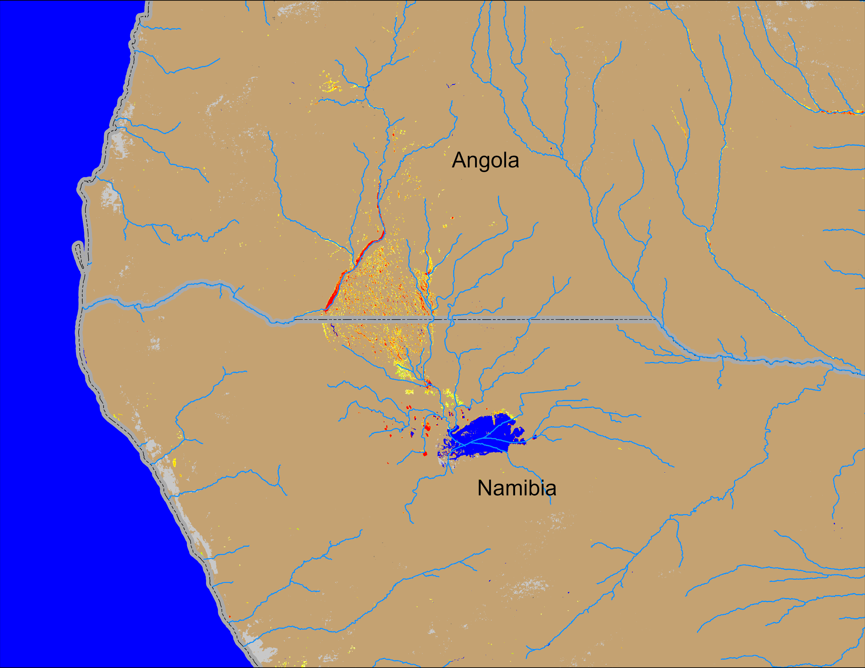
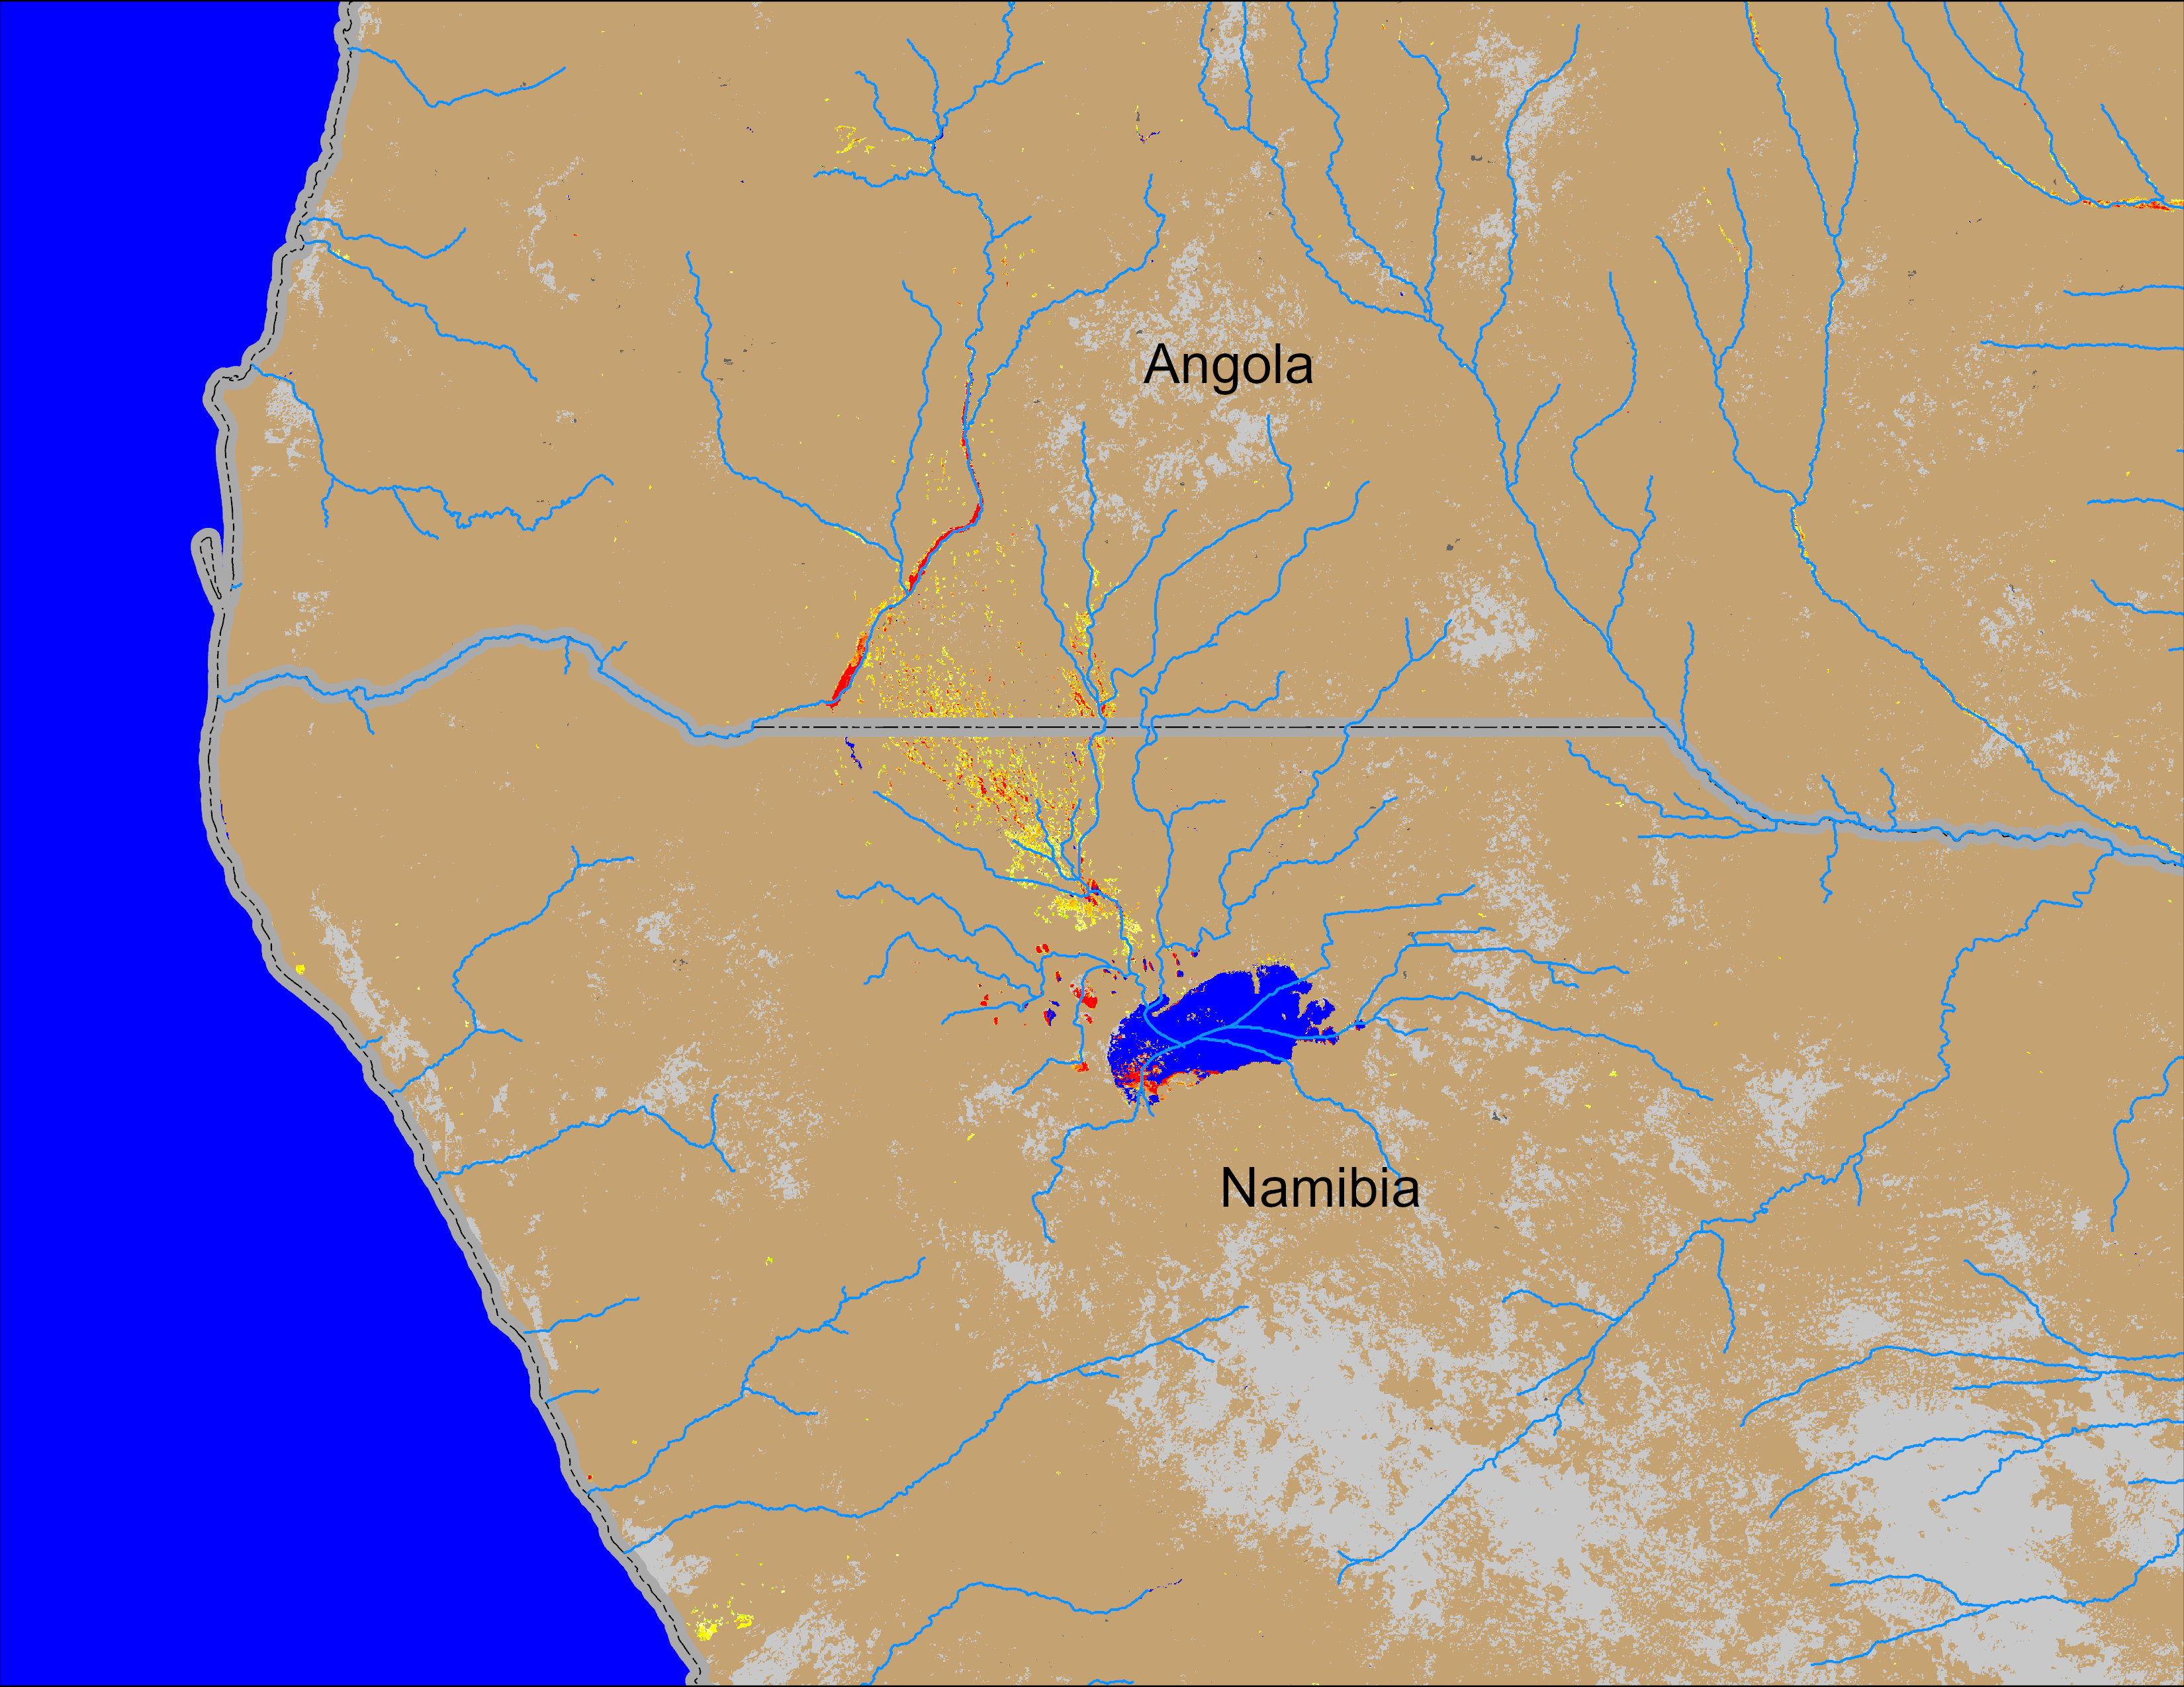
Flooding Conditions in Angola
(% of the pixel)
(% of the pixel)
NOAA VIIRS 5-day comp.: 27 – 31 Mar 2025
NOAA VIIRS 5-day comp.: 02 – 06 Apr 2025
Flooding conditions intensifying in southern Angola into northern Namibia.

Slide 4
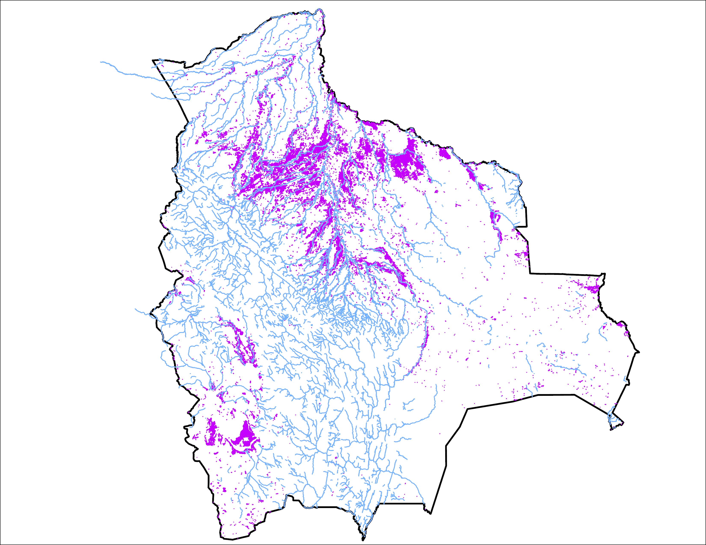
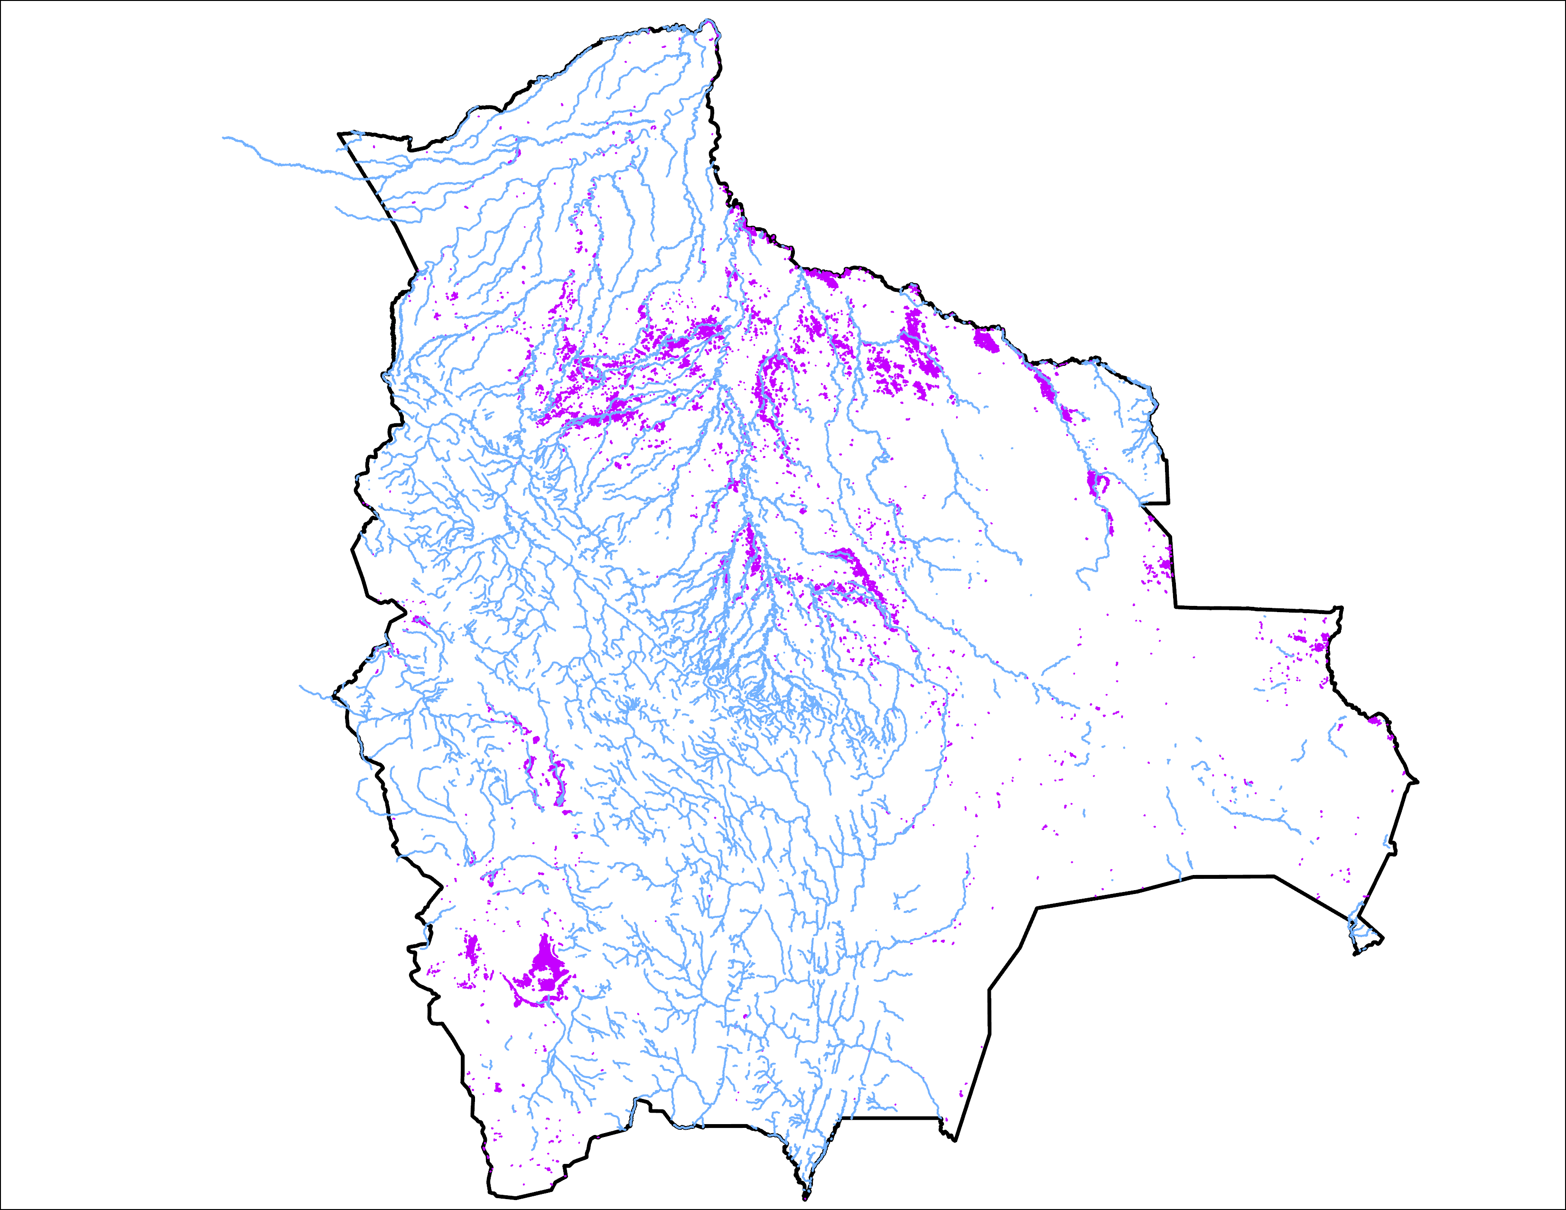
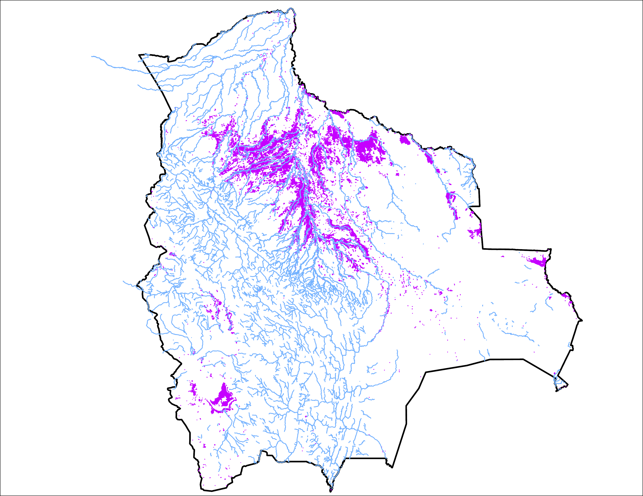
Flooding C0nditions in Bolivia
24 March 2025
01 Apr 2025
06 April 2025
40,567 km²
15,700 km²
36,132 km²
There is a significant increase in flooding in northern Bolivia in last 5 days.

Slide 5
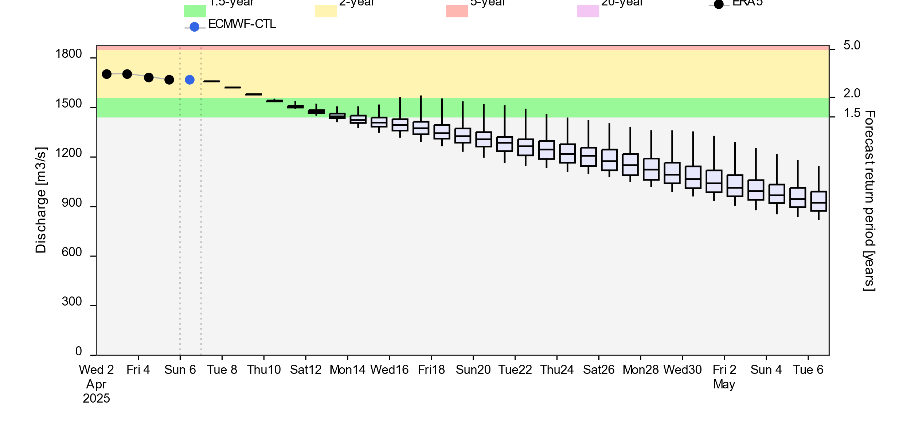
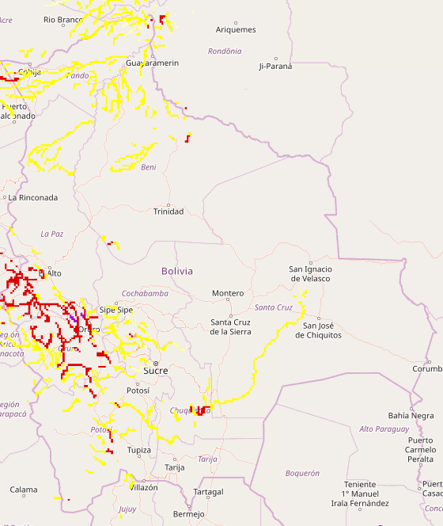
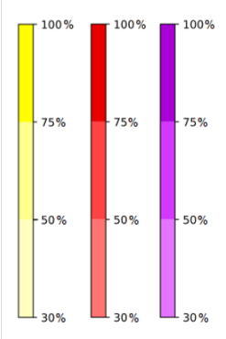
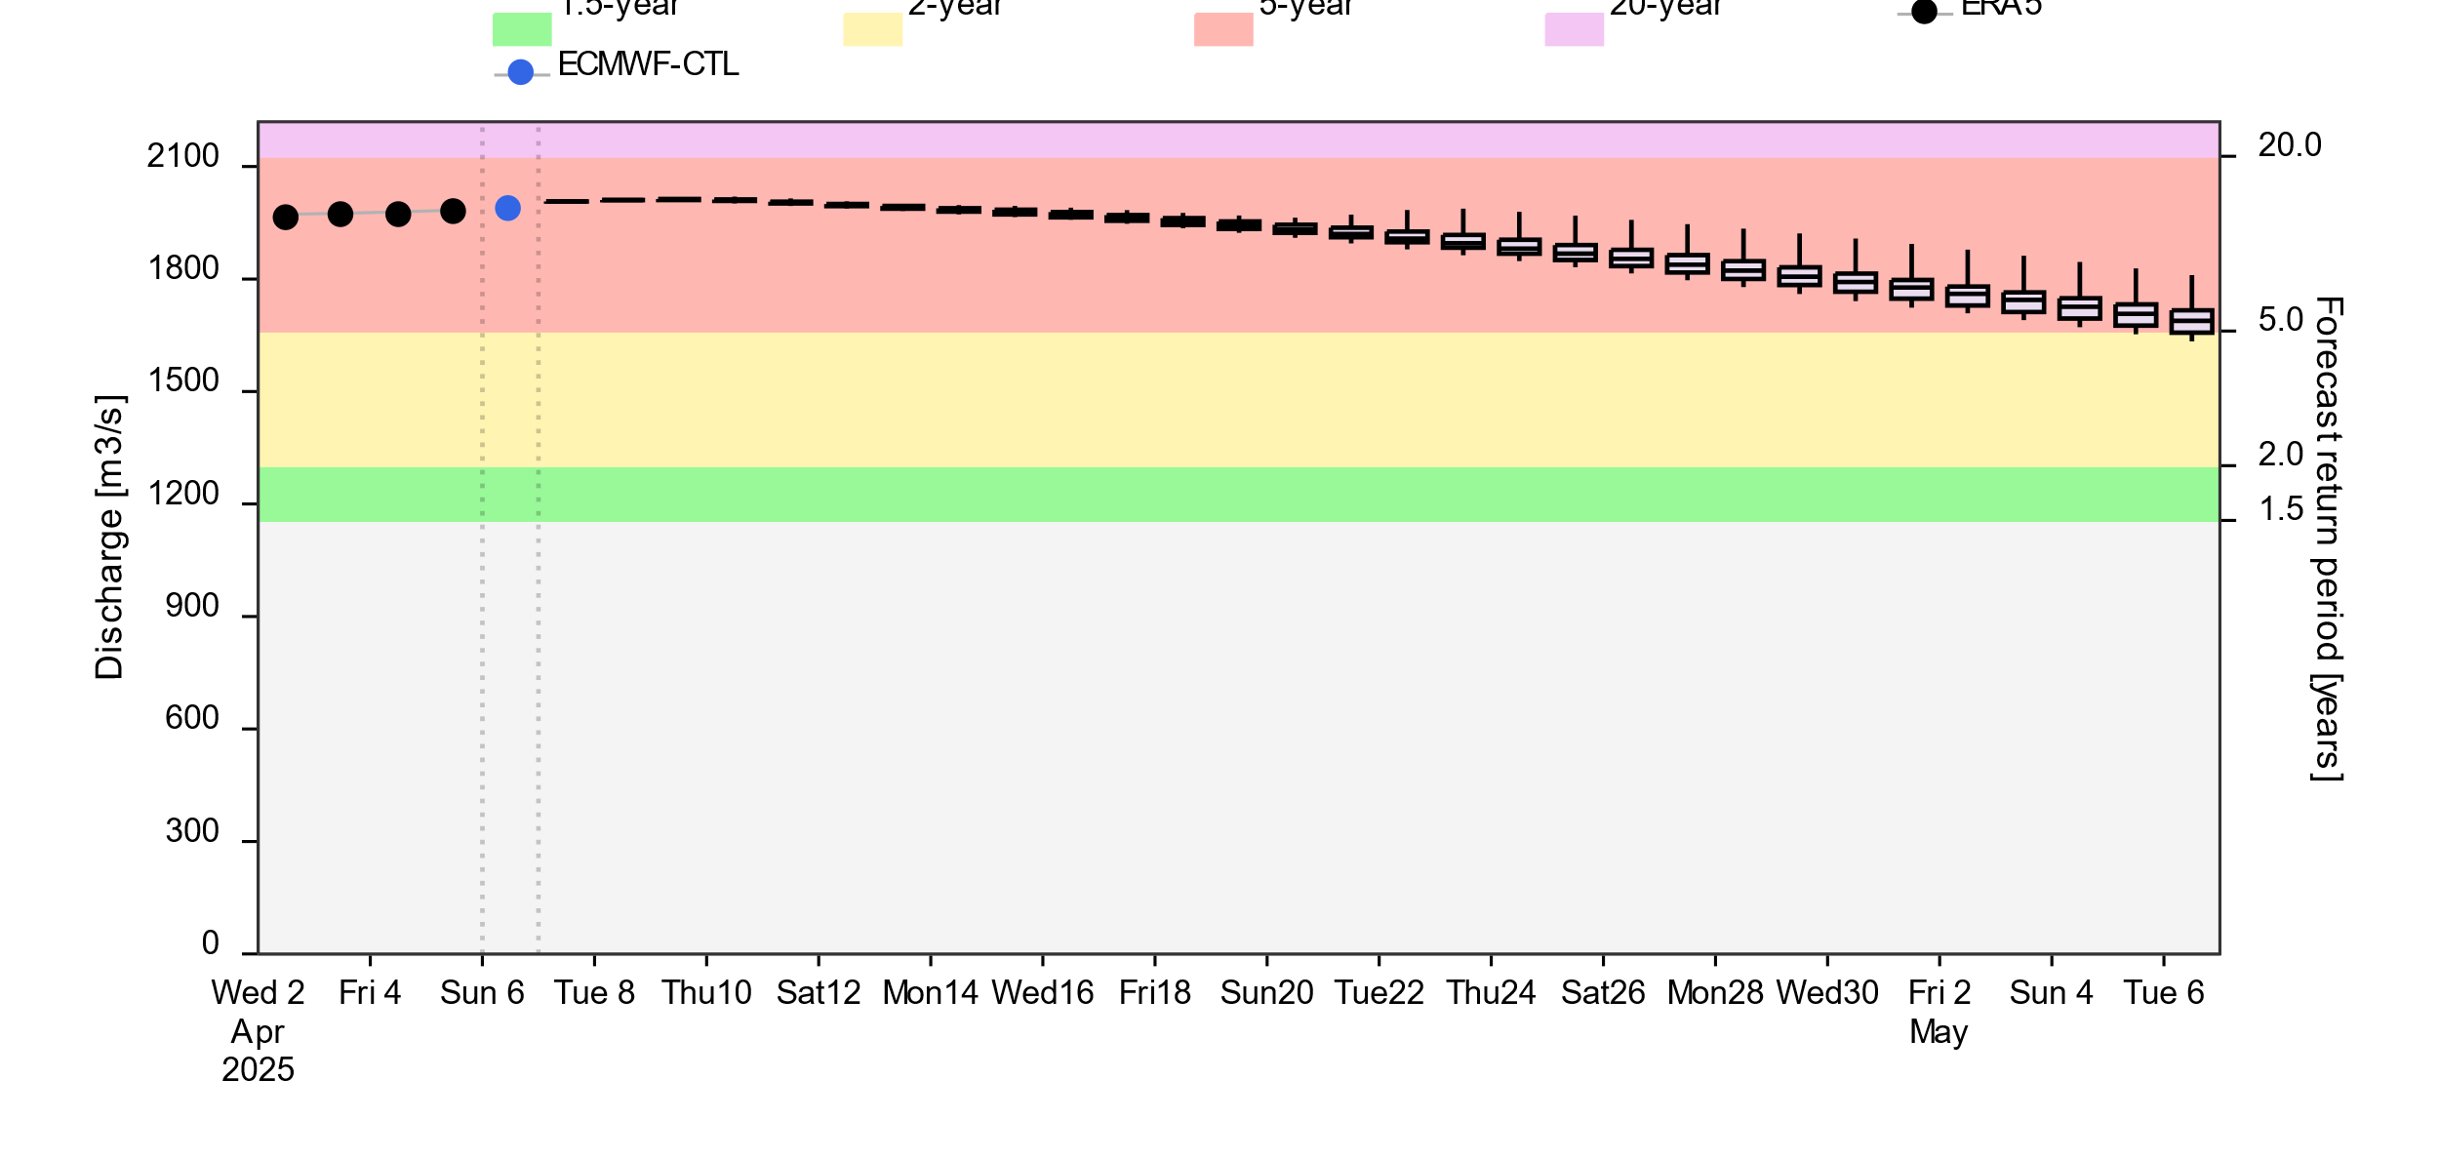
Streamflow Forecast
A
2-(yellow), 5-(red) and 20Year (purple) exceedance probabilities
@point A
B
@point B
Streamflow are expected to diminish in the north but continue to be at 5-yr return period level in the southwestern part of the country in next 30 days.
GloFAS forecast: 06 April – 06 May 2025 (30 days)

