Slide 1
FEWS NET Enhanced Flood Monitoring
FEWS NET Science Team
Apr 14, 2025

Slide 2
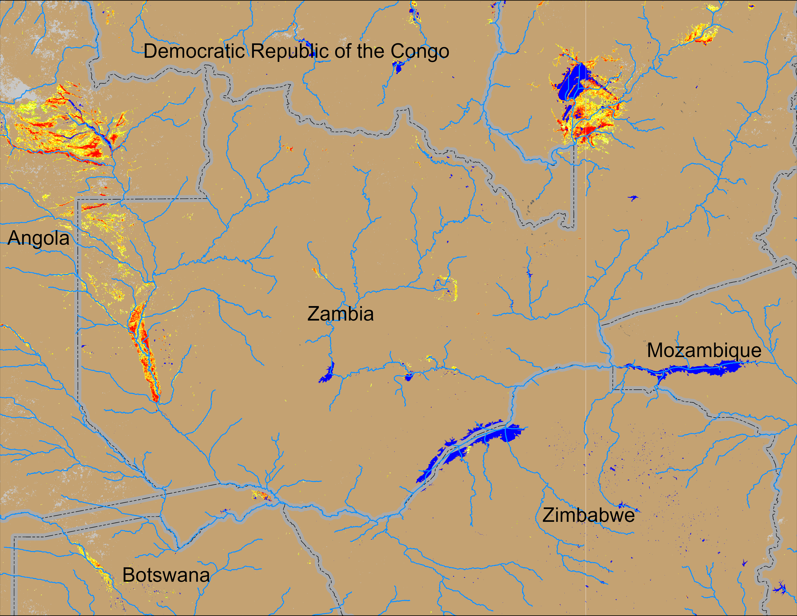
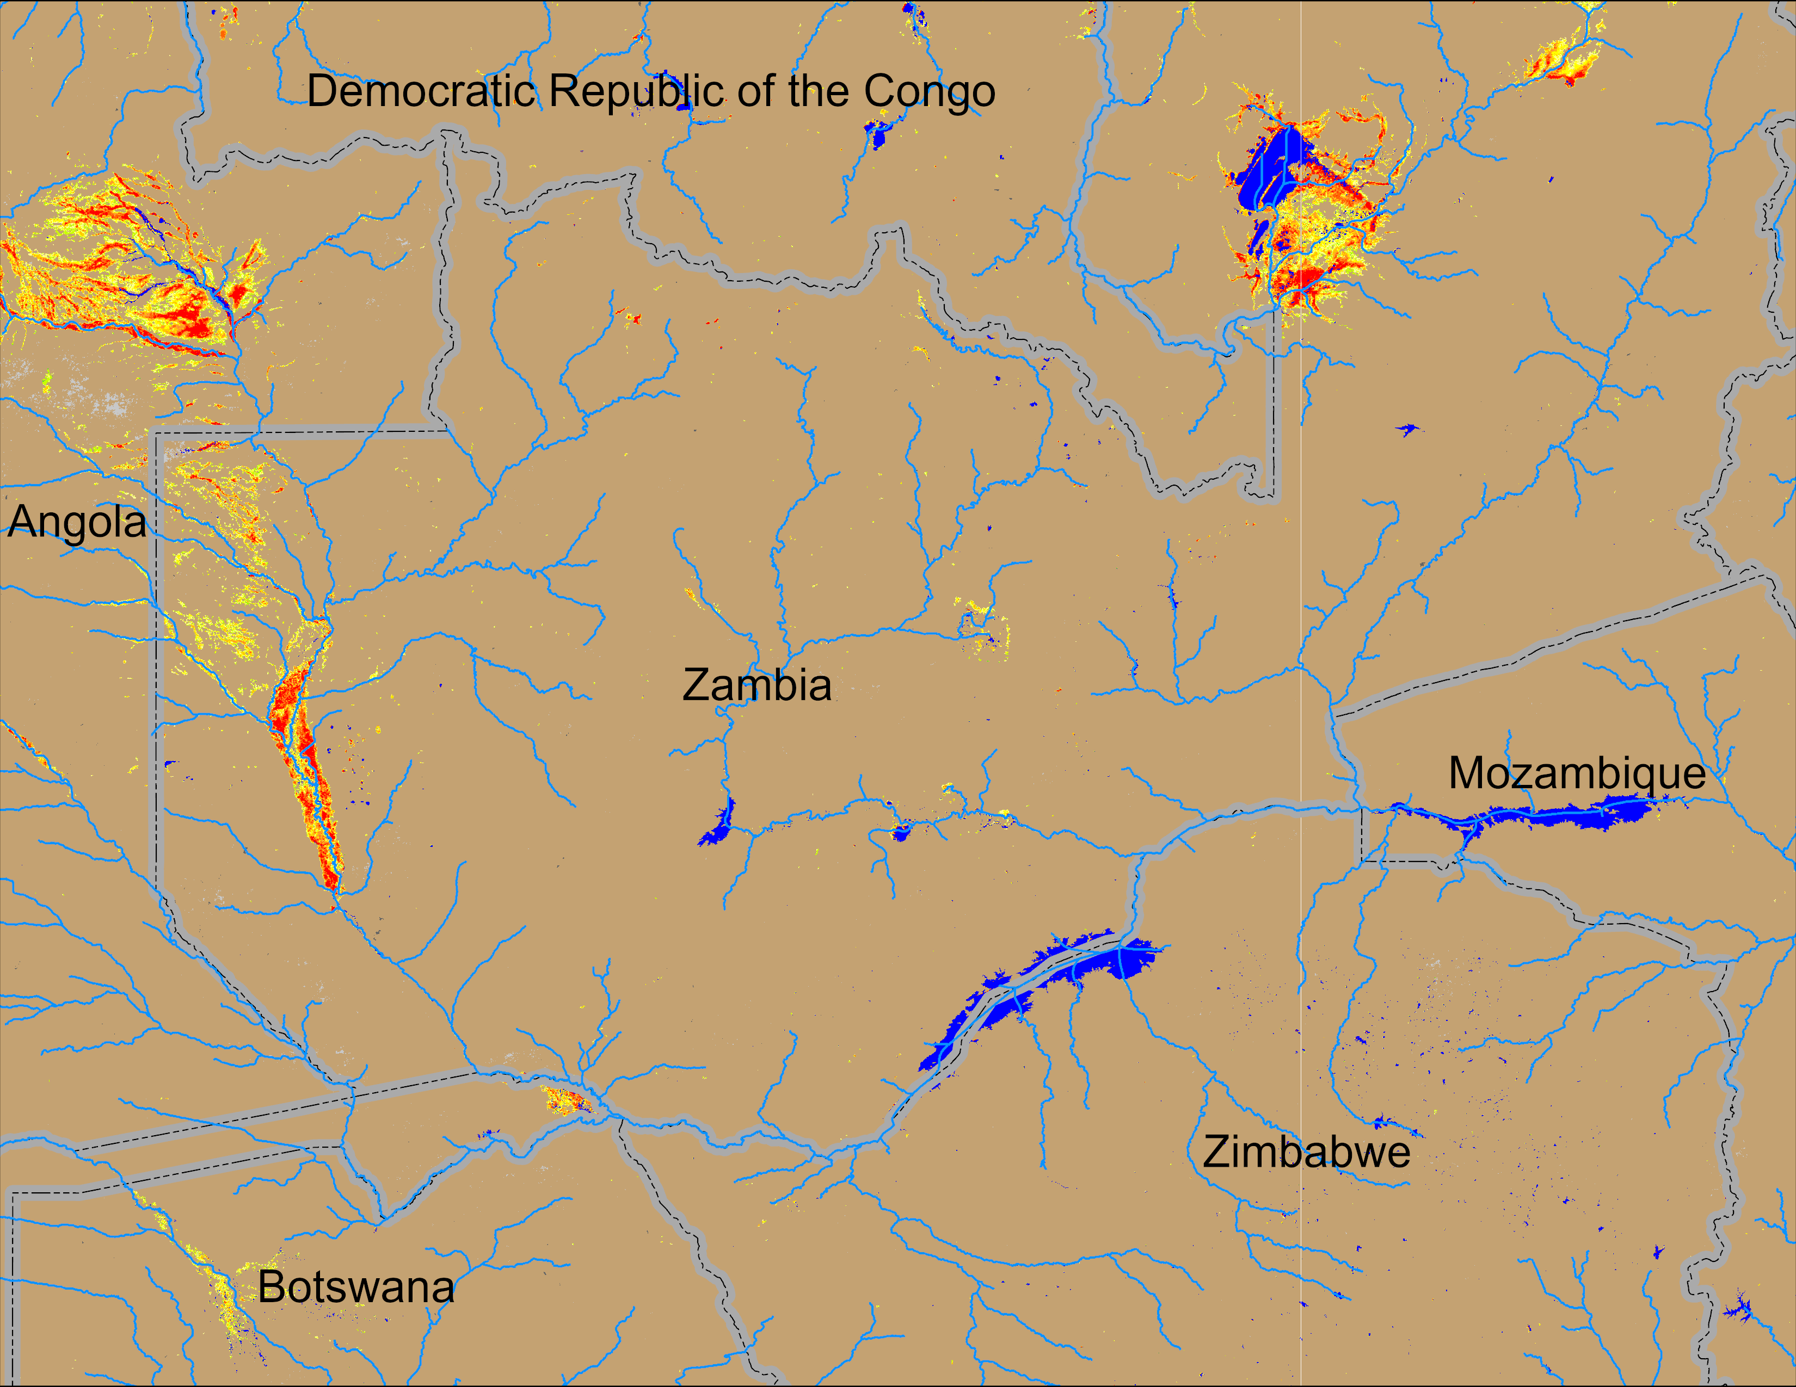
Flooding Conditions in Zambia
(% of the pixel)
(% of the pixel)
NOAA VIIRS 5-day comp.: 02 – 06 Apr 2025
NOAA VIIRS 5-day comp.: 09 – 13 Apr 2025
Flooding conditions remained unchanged in western Zambia, Eastern Angola and northern Botswana.

Slide 3
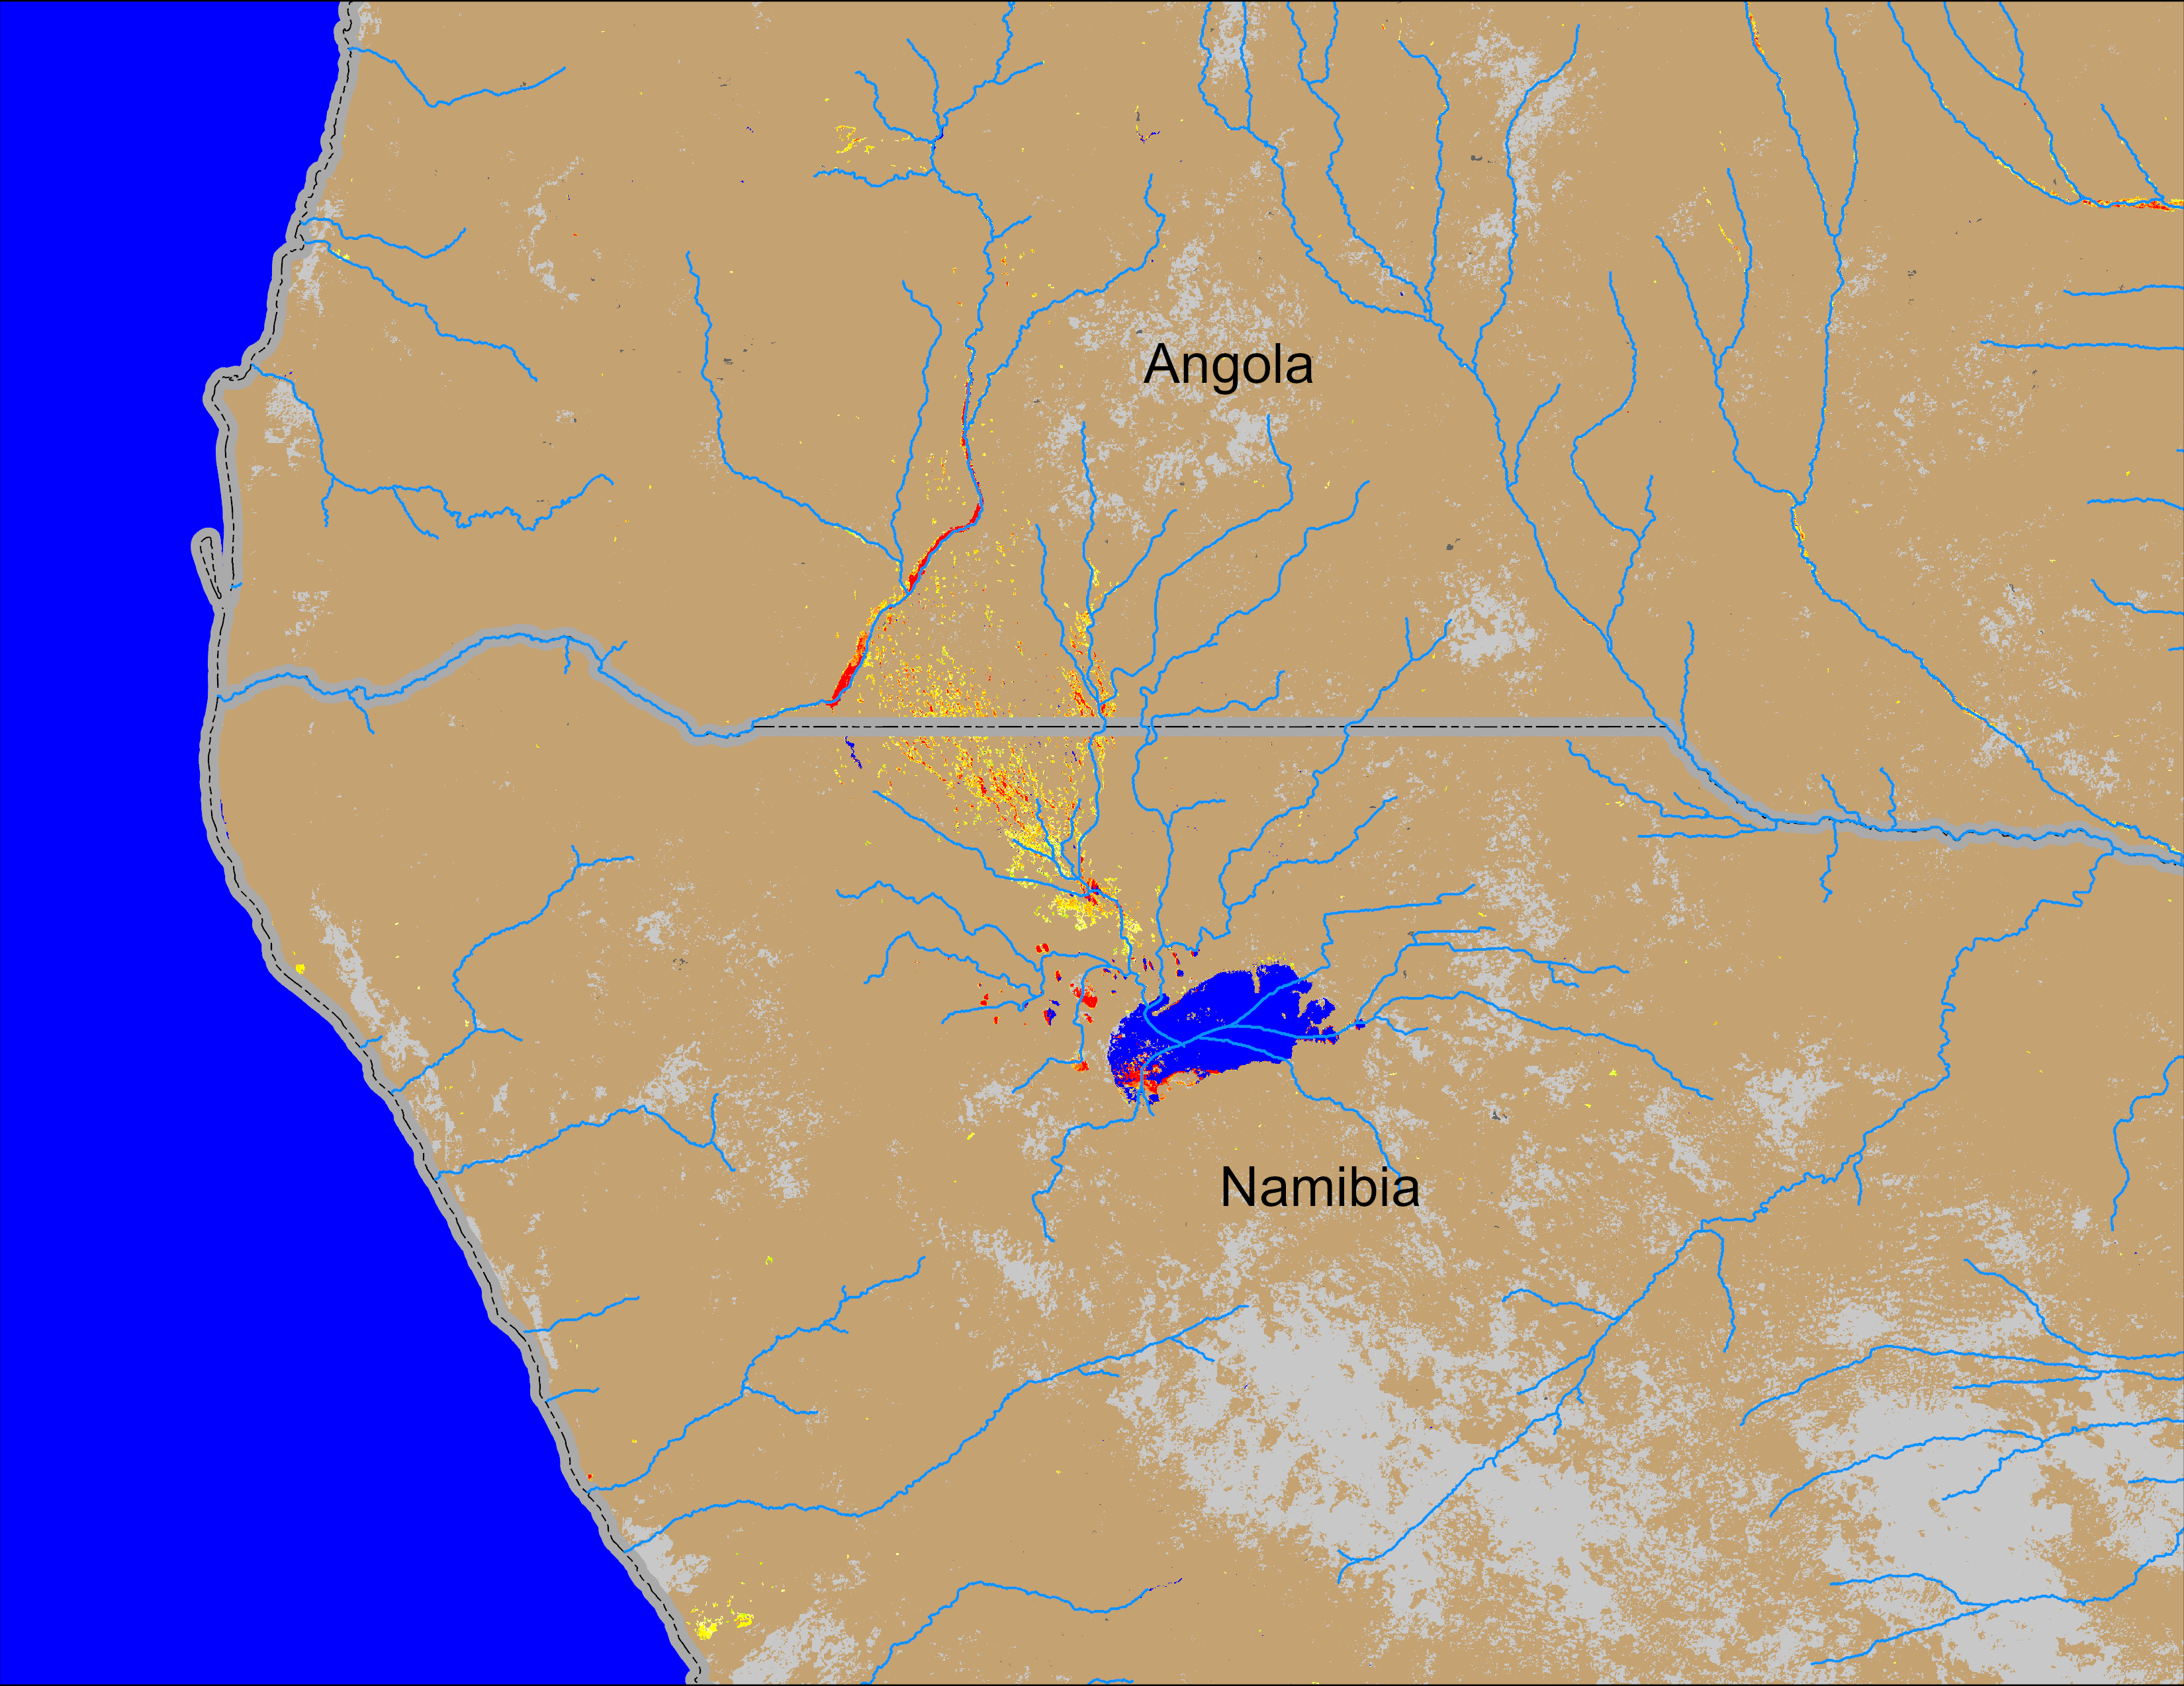
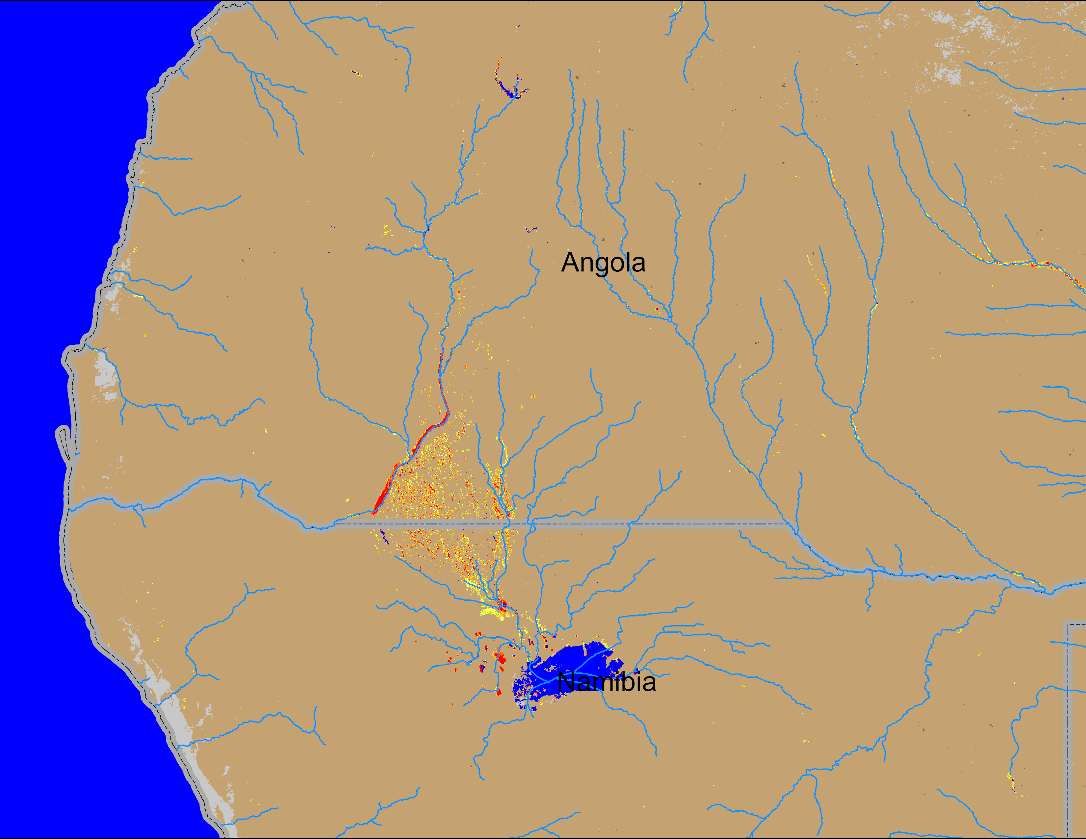
Flooding Conditions in Angola
(% of the pixel)
(% of the pixel)
NOAA VIIRS 5-day comp.: 02 – 06 Apr 2025
NOAA VIIRS 5-day comp.: 09 – 13 Apr 2025
Flooding conditions marginally deteriorated in southern Angola into northern Namibia.

Slide 4
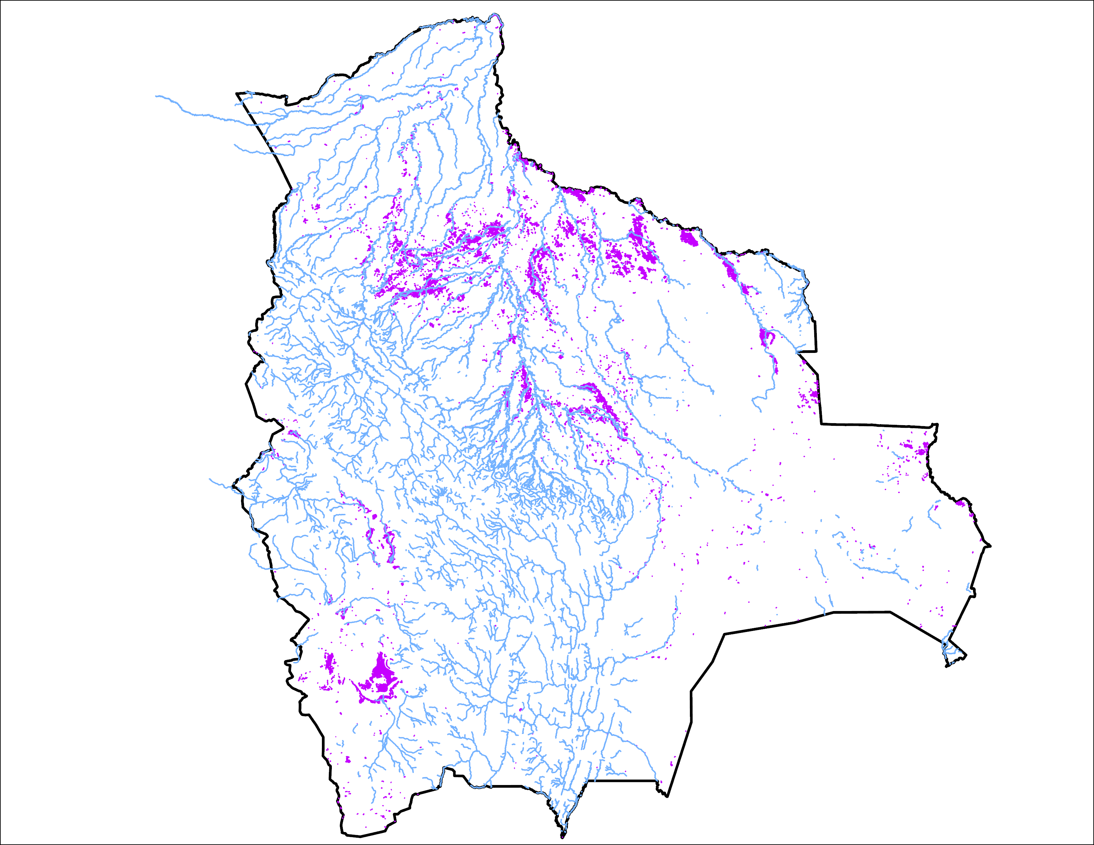
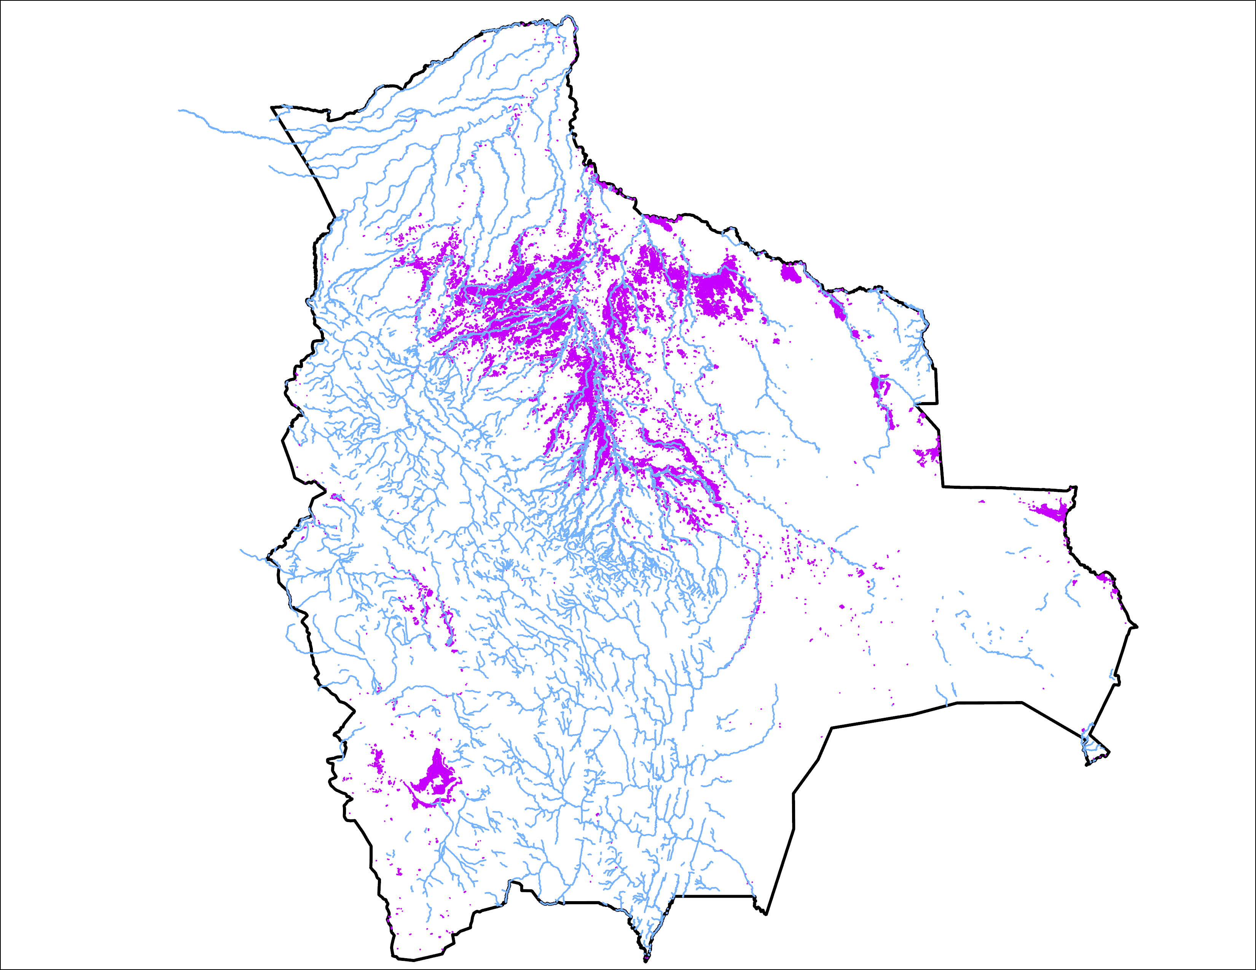
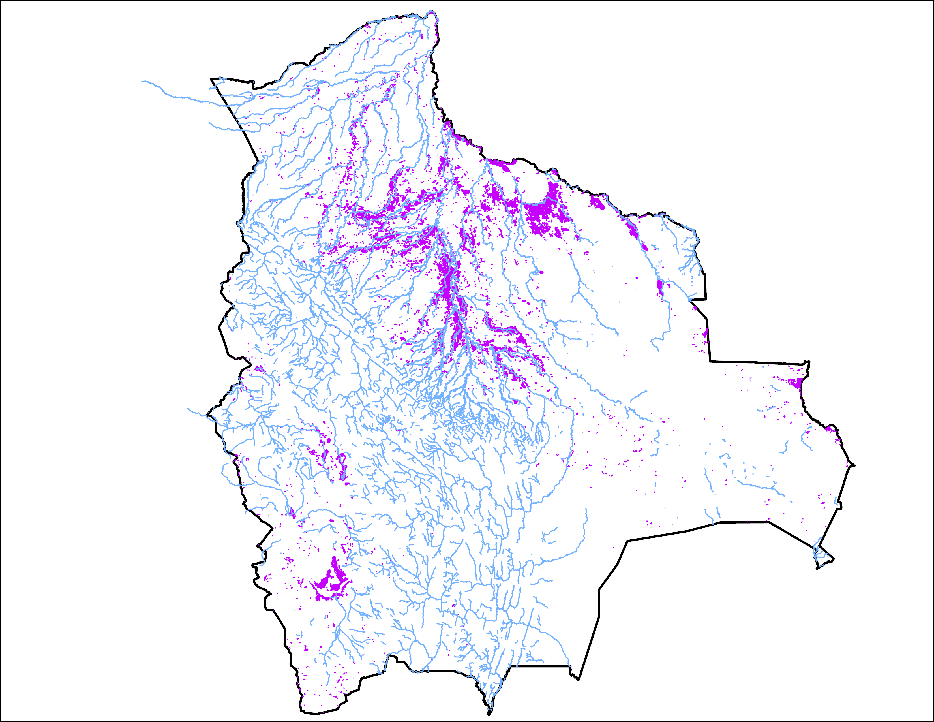
Flooding C0nditions in Bolivia
01 Apr 2025
06 Apr 2025
13 April 2025
15,700 km²
36,132 km²
26,274 km²
Flooding condition improved marginally.

Slide 5
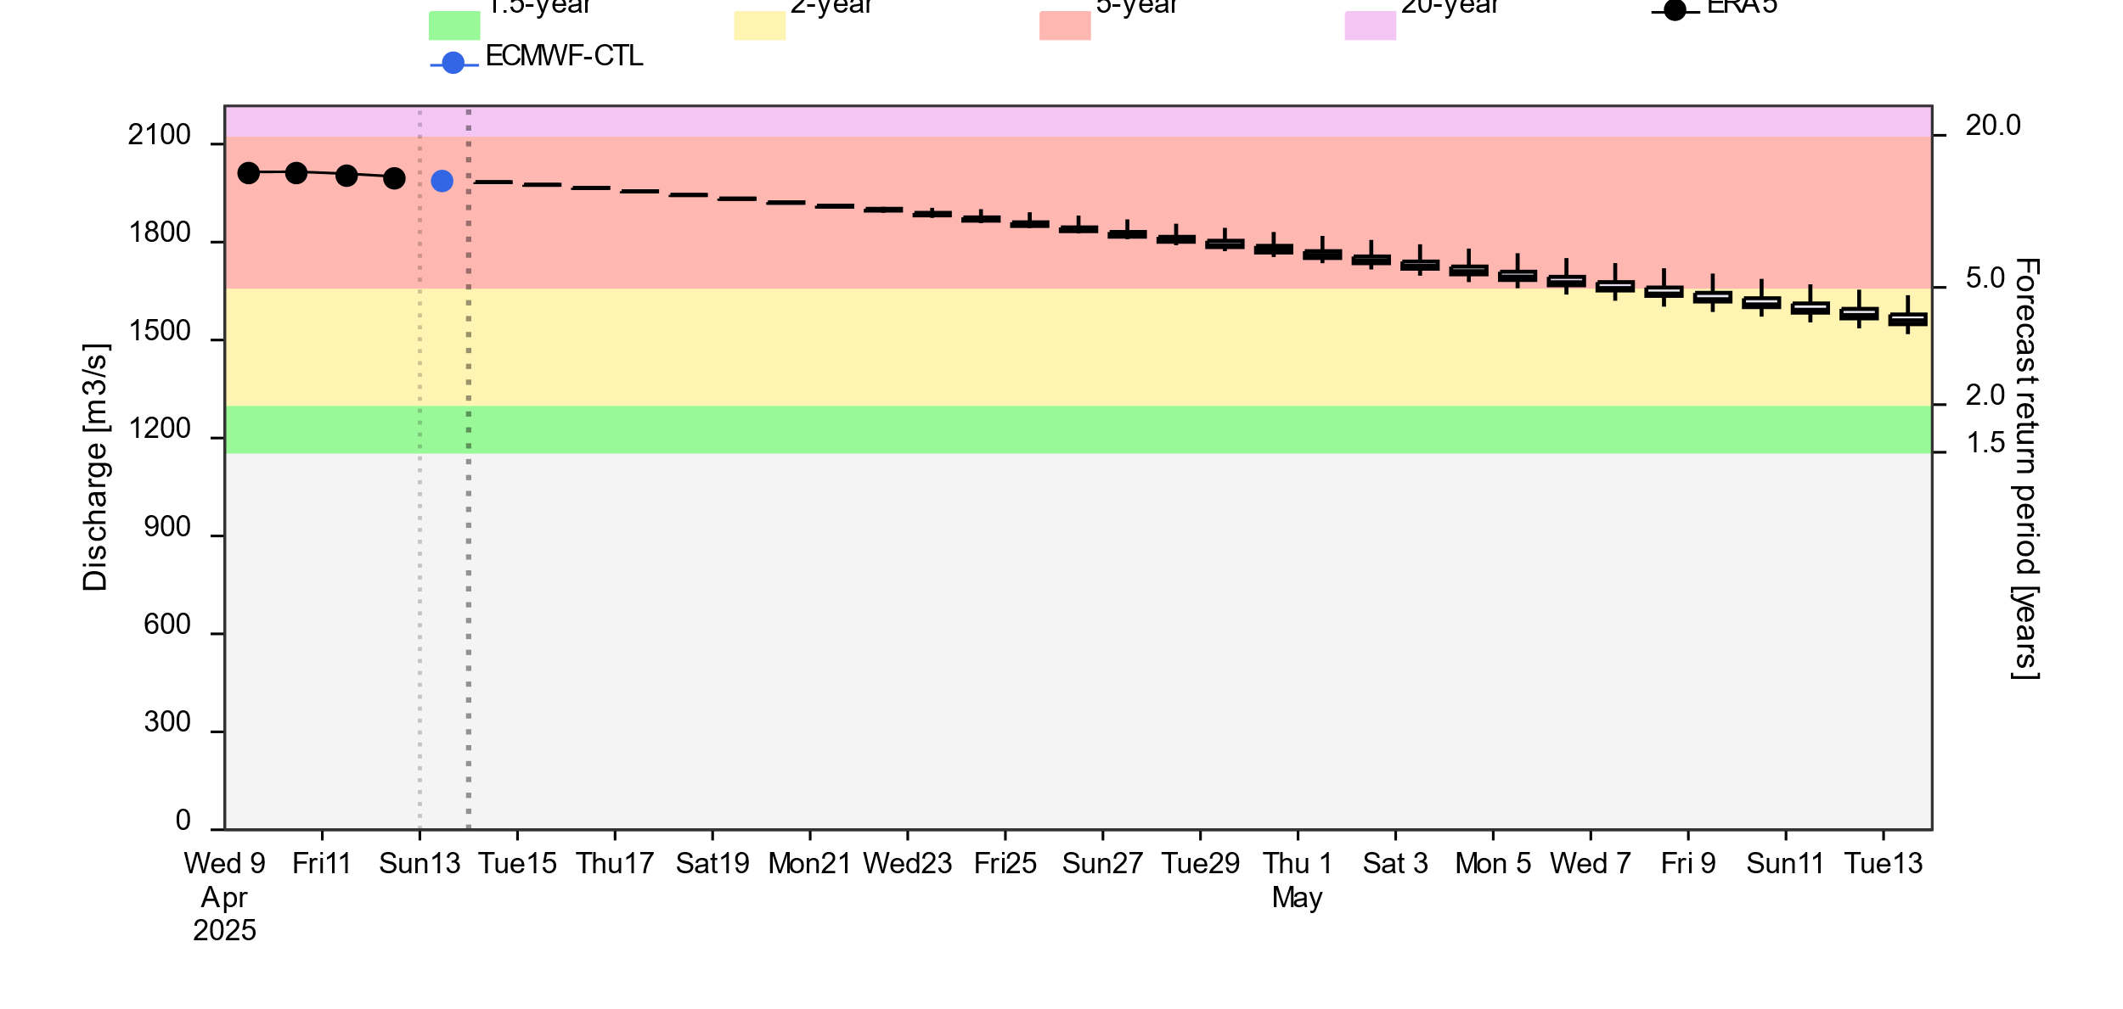
Streamflow Forecast
2-(yellow), 5-(red) and 20Year (purple) exceedance probabilities
@point A
A
Streamflow gradually diminishing across the country. However, they are expected to be at 5-yr return period level in the southwestern part of the country till the end of April.
GloFAS forecast: 13 April – 13 May 2025 (30 days)

