Slide 1
FEWS NET Enhanced Flood Monitoring
FEWS NET Science Team
Apr 1, 2025

Slide 2
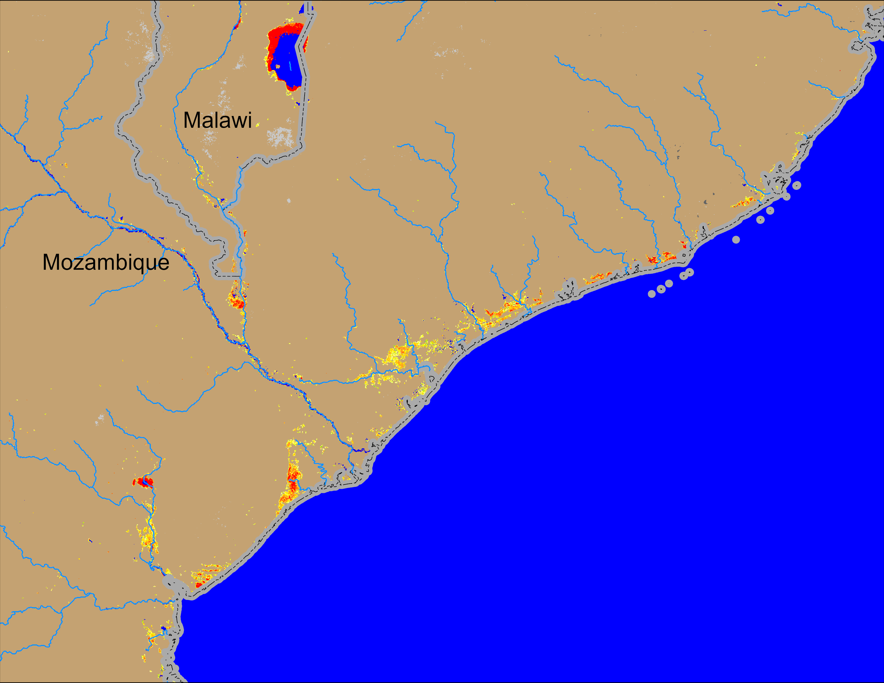
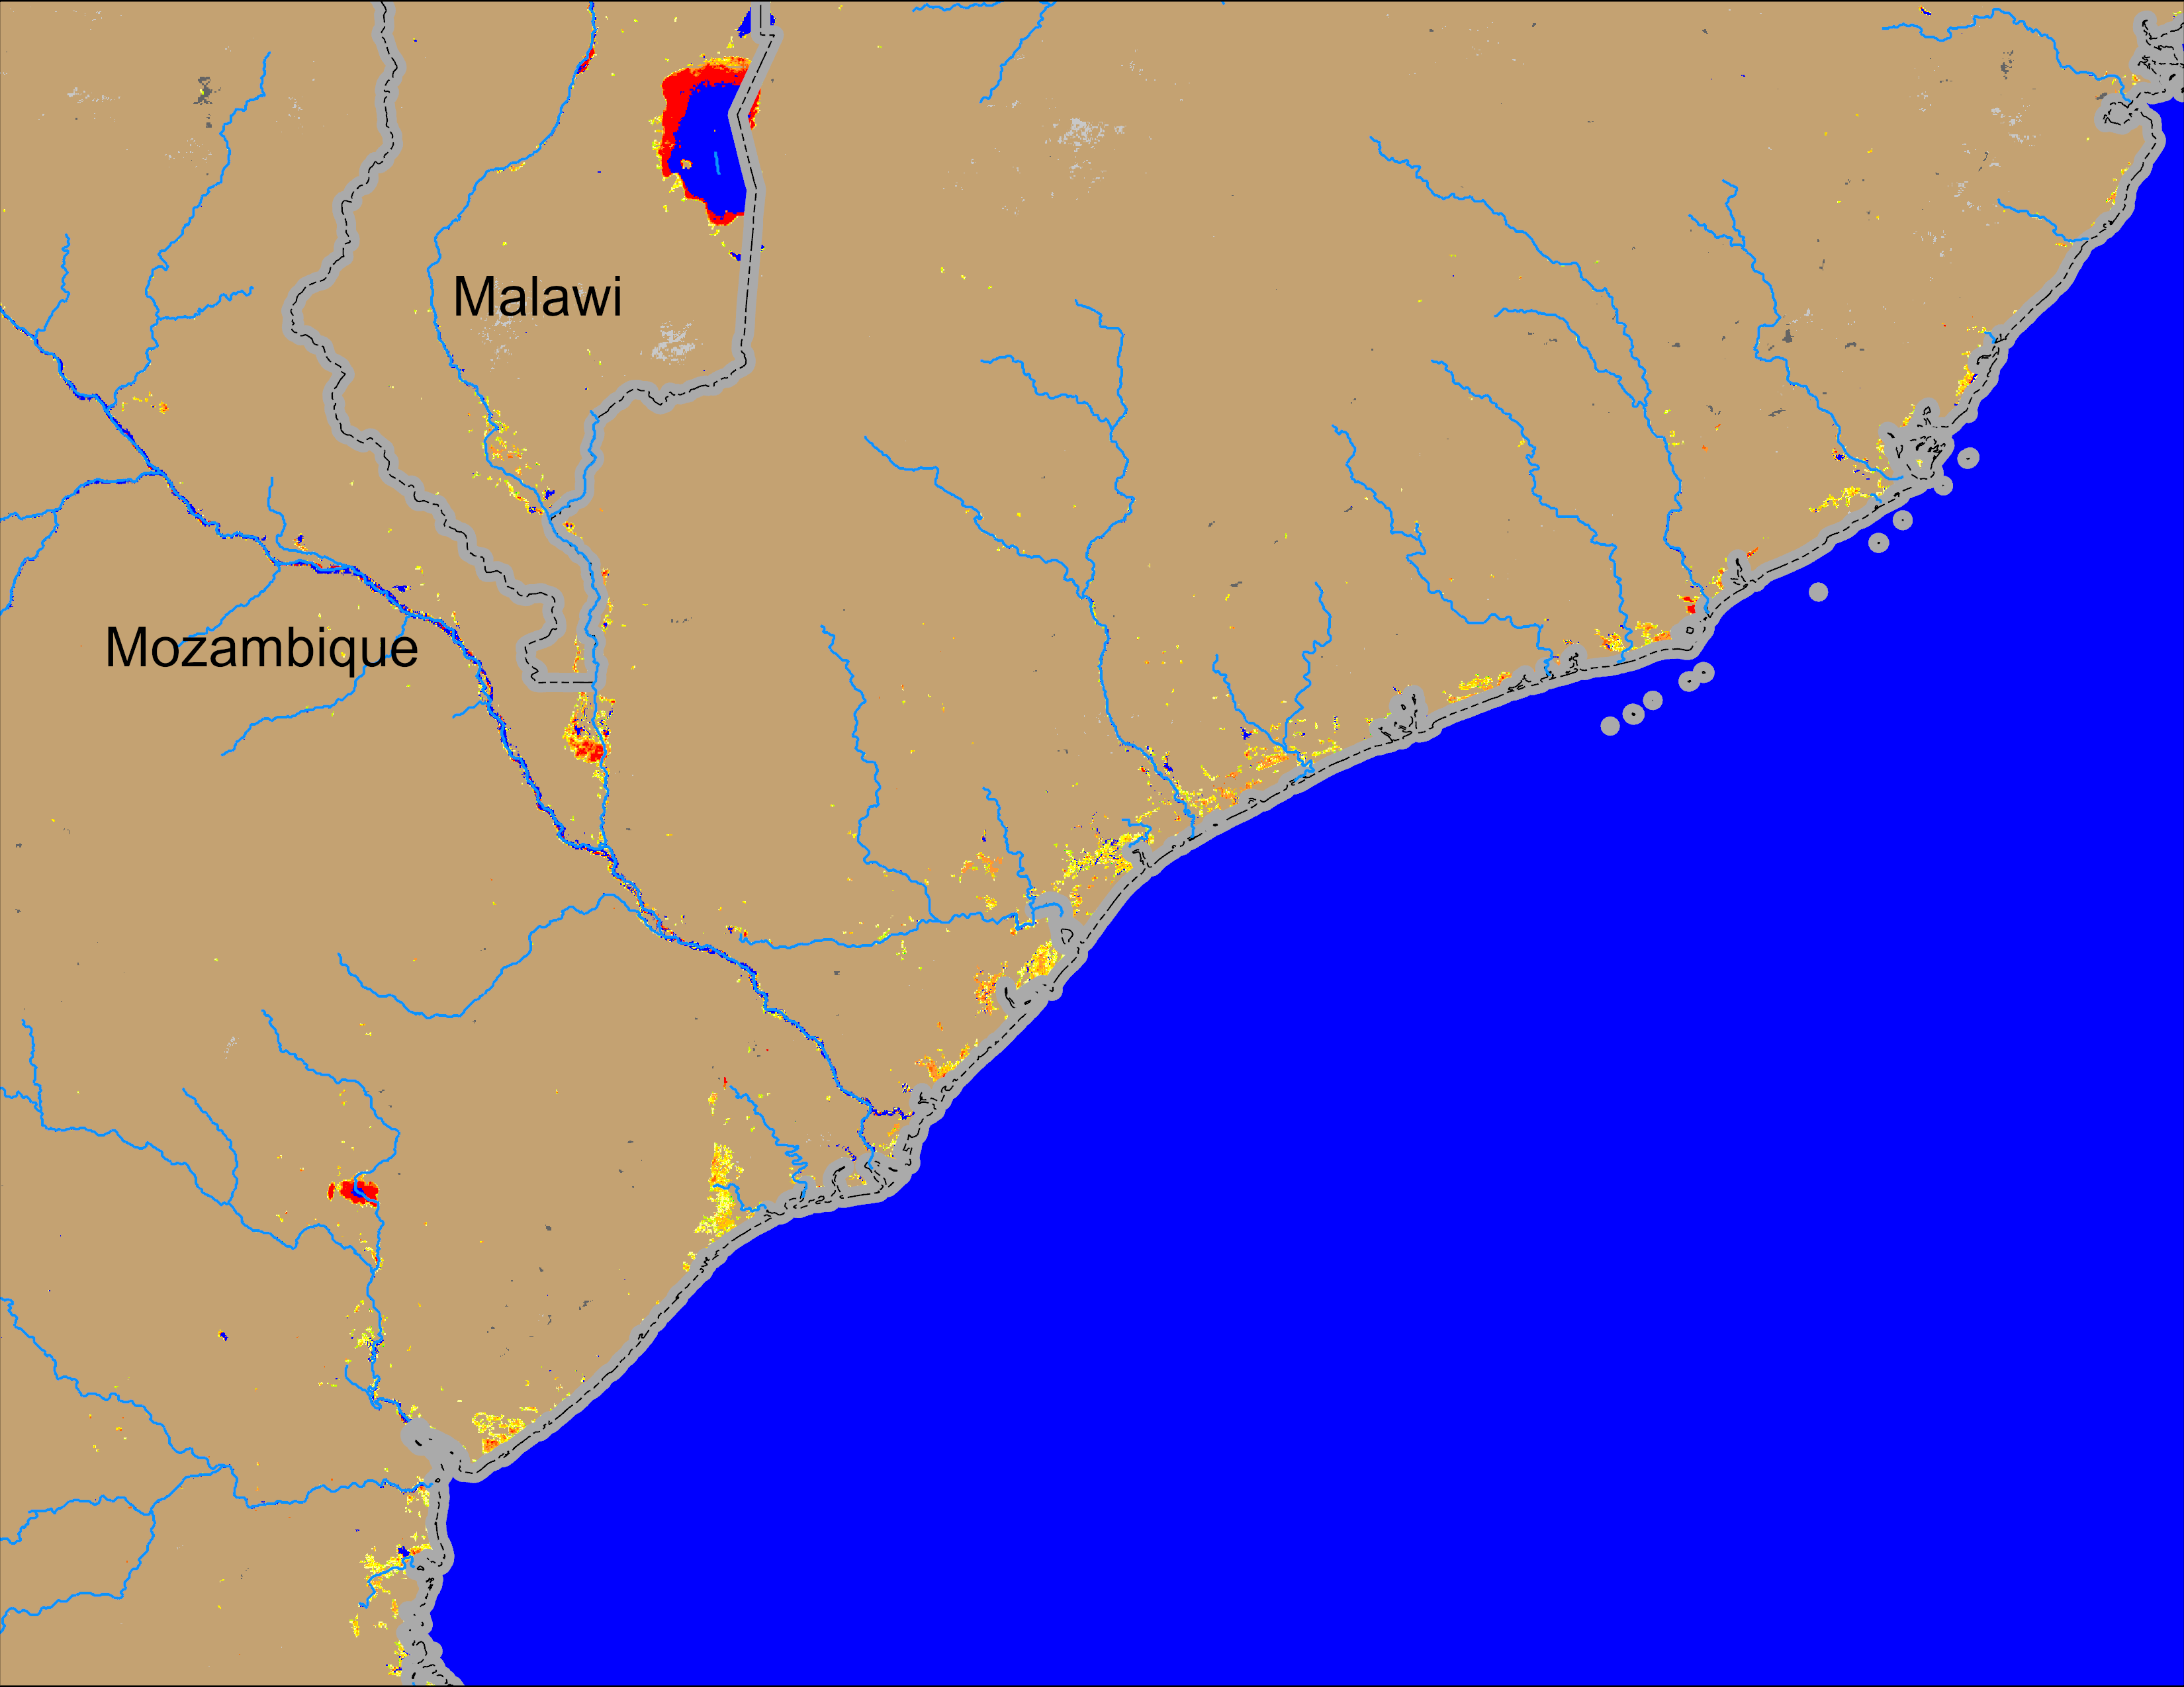
Flooding Conditions in Mozambique
(% of the pixel)
(% of the pixel)
NOAA VIIRS 5-day comp.: 19 – 23 Mar 2025
NOAA VIIRS 5-day comp.: 27 – 31 Mar 2025
Flooding conditions improved along the coastal regions of central Mozambique as well as in Southern Malawi.

Slide 3
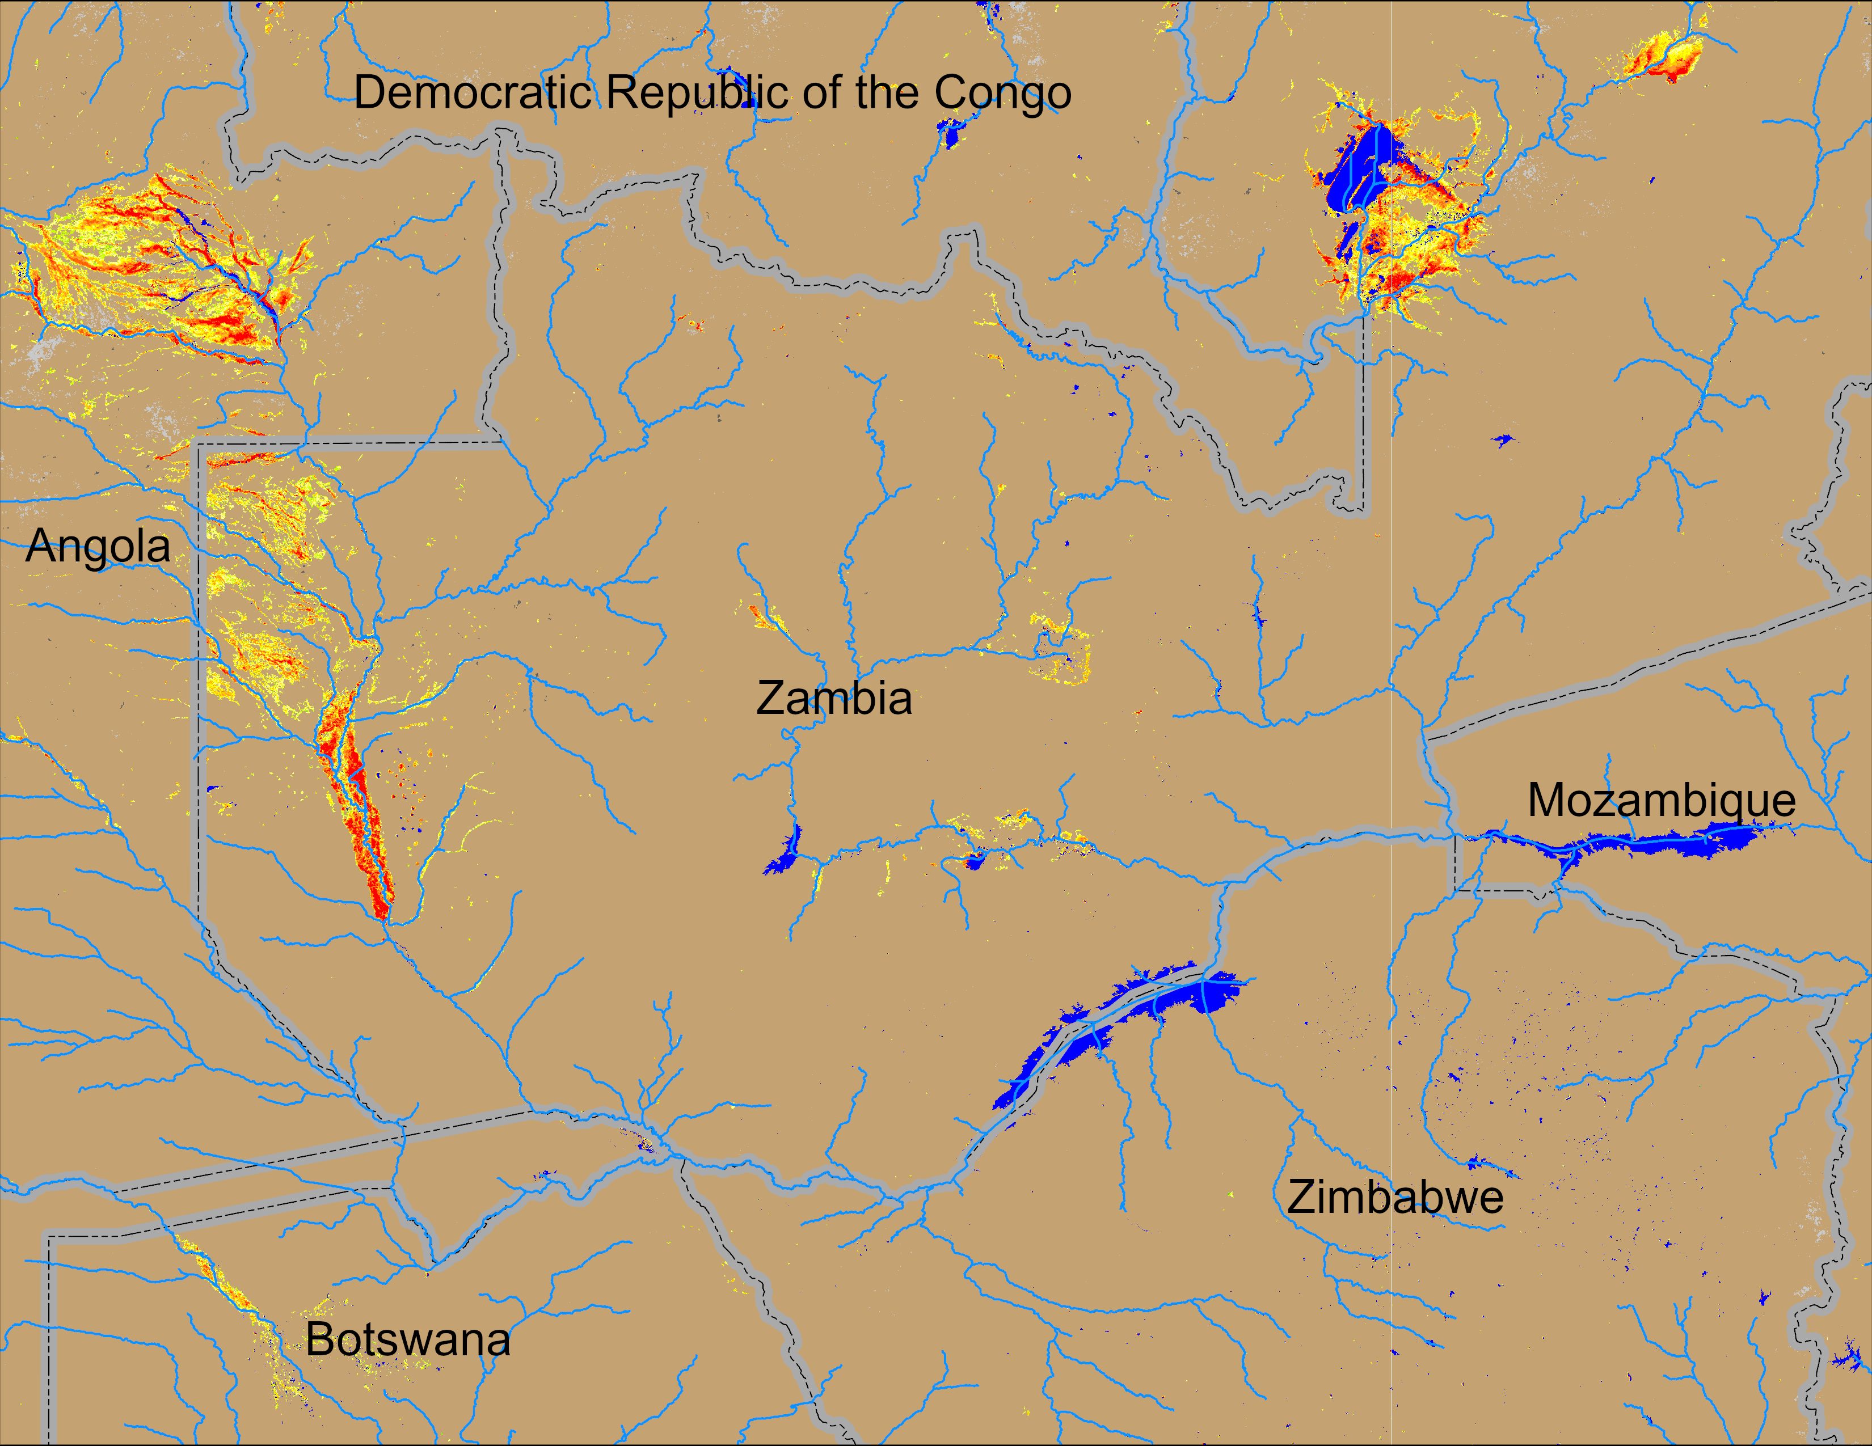
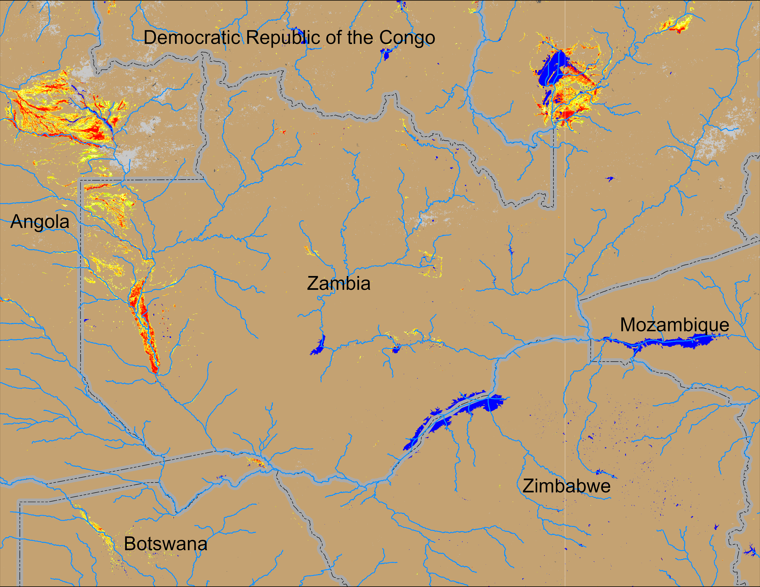
Flooding Conditions in Zambia
(% of the pixel)
(% of the pixel)
NOAA VIIRS 5-day comp.: 19 – 23 Mar 2025
NOAA VIIRS 5-day comp.: 27 – 31 Mar 2025
Flooding conditions improved along the Kafu River but remained unchanged elsewhere in Zambia, Eastern Angola and northern Botswana.

Slide 4
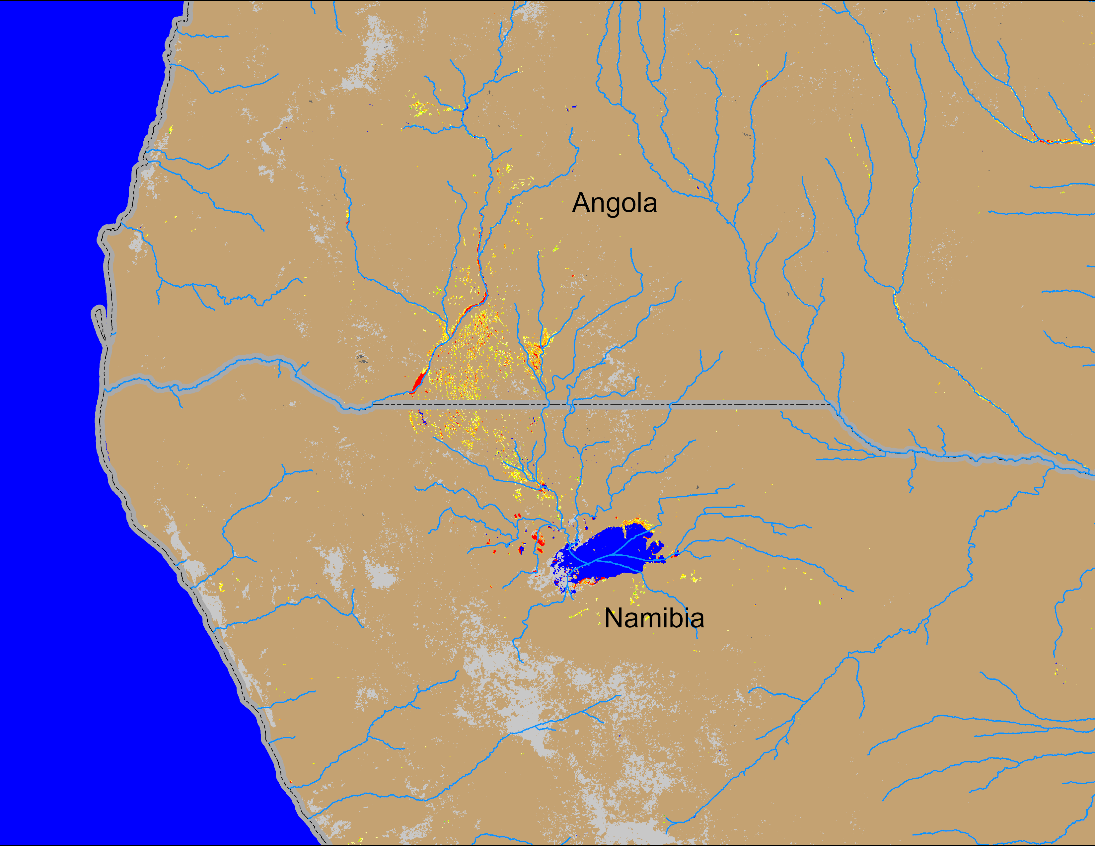
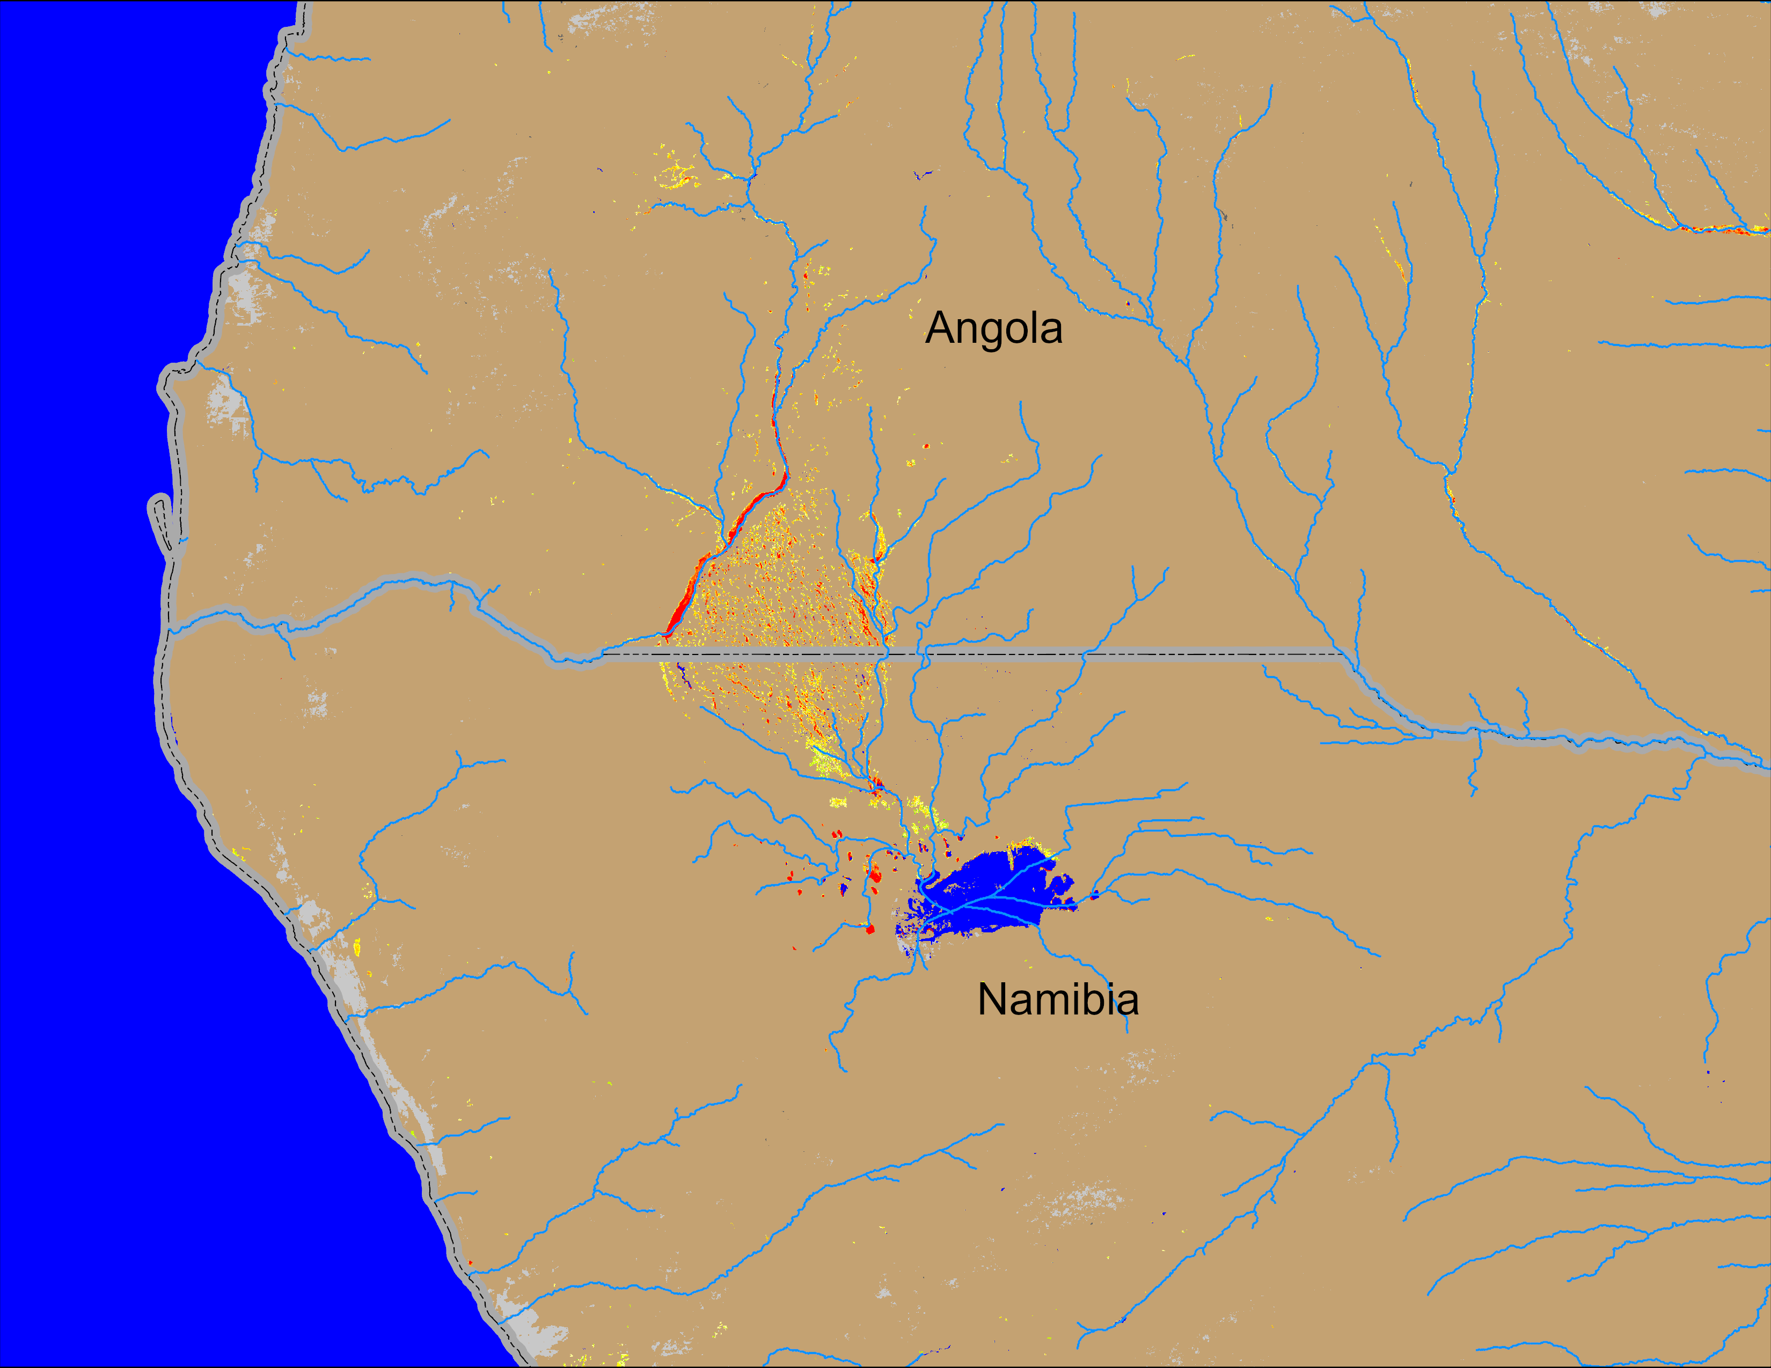
Flooding Conditions in Angola
(% of the pixel)
(% of the pixel)
NOAA VIIRS 5-day comp.: 19 – 23 Mar 2025
NOAA VIIRS 5-day comp.: 27 – 31 Mar 2025
Flooding conditions intensifying in southern Angola into northern Namibia.

