Slide 1
FEWS NET Enhanced Flood Monitoring
FEWS NET Science Team
Nov 18, 2024

Slide 2
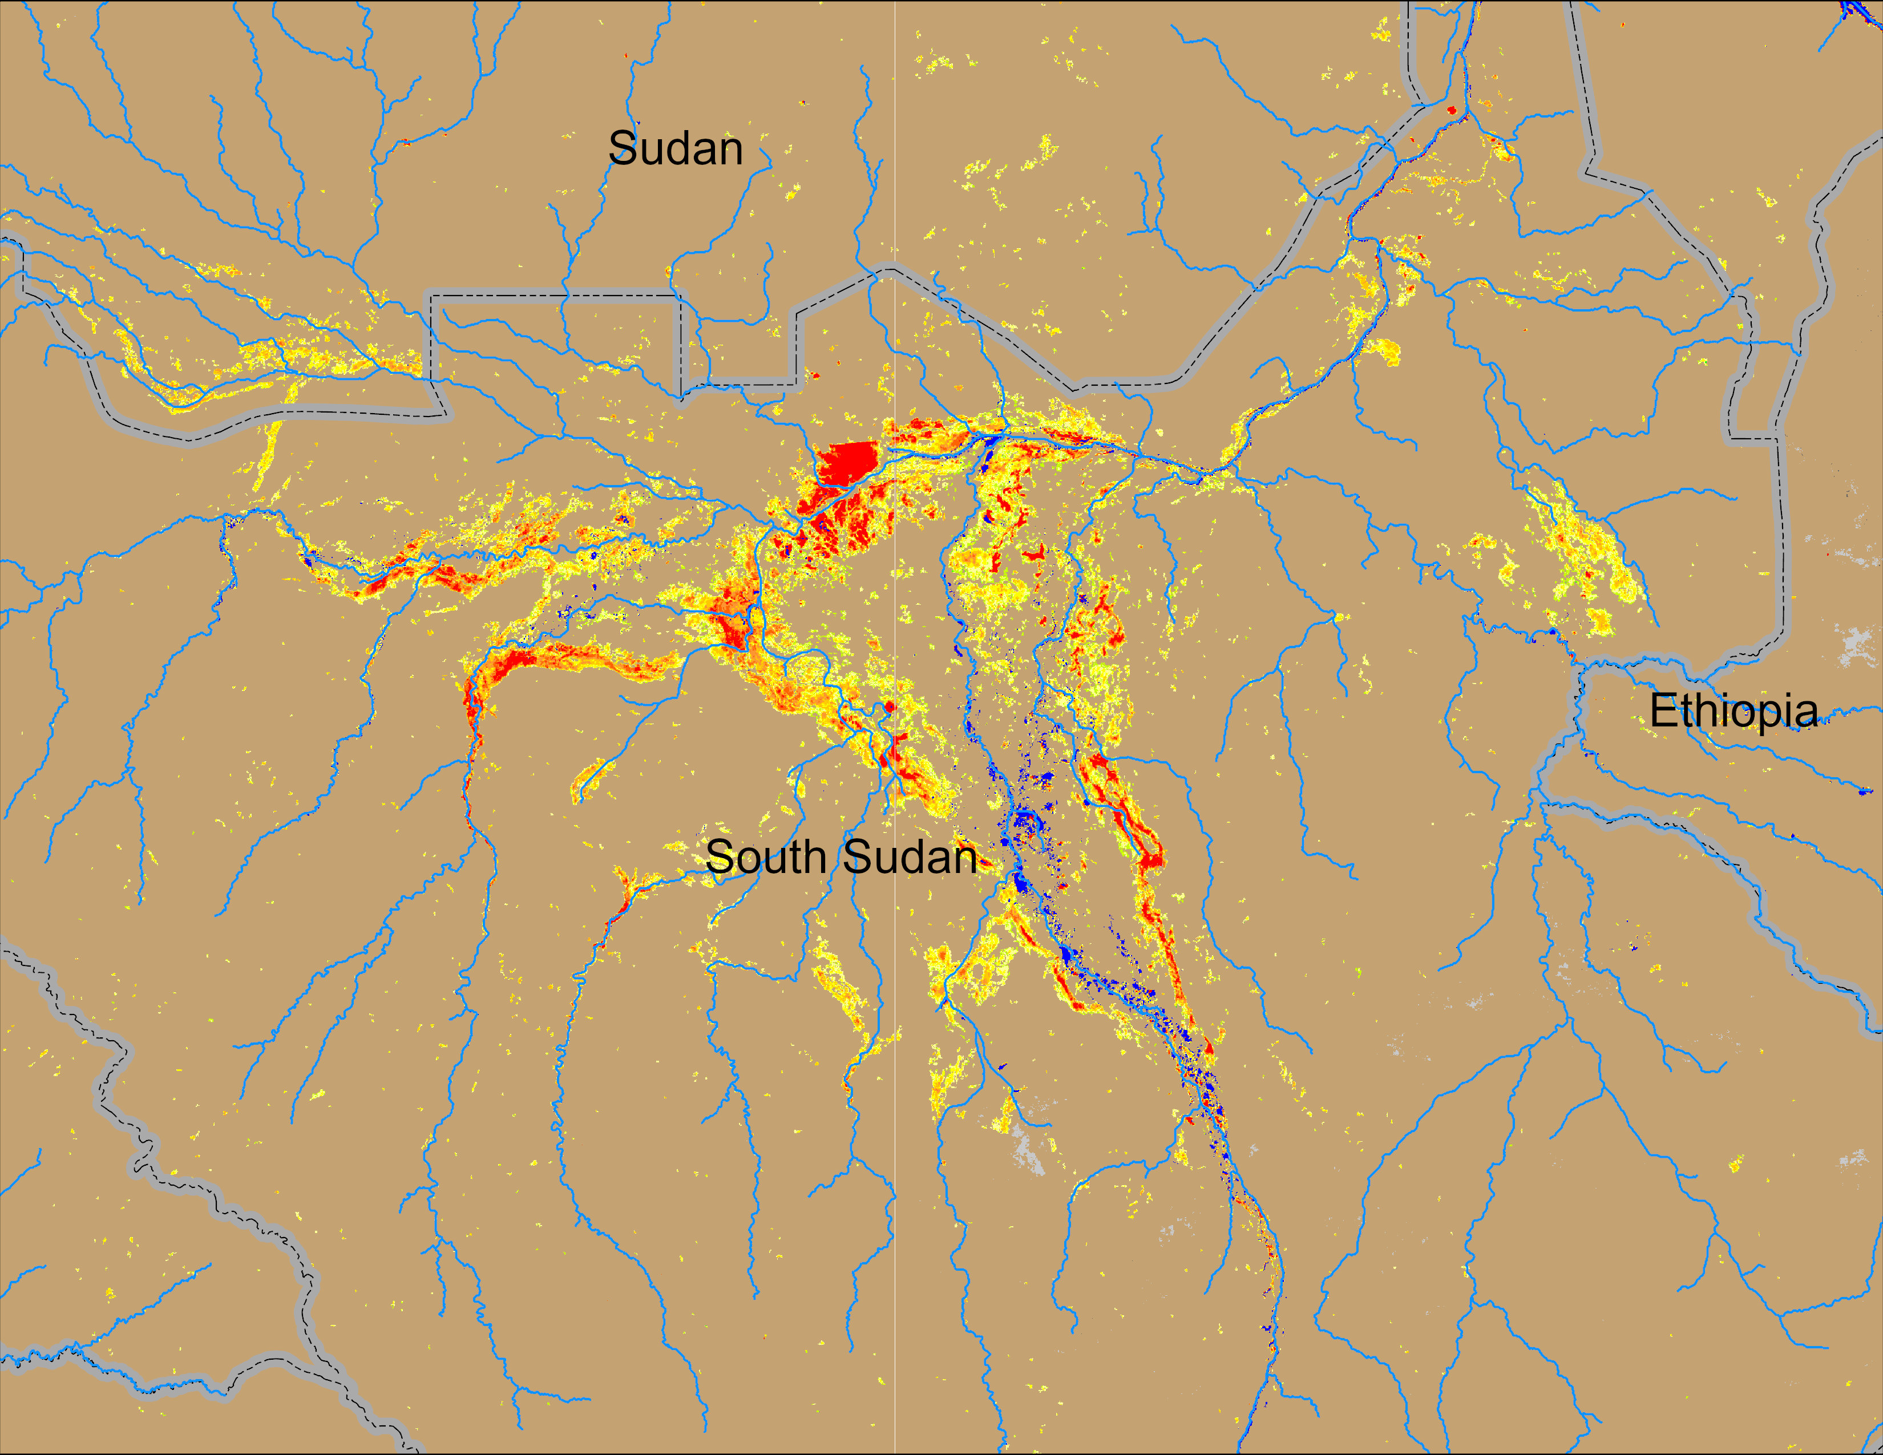
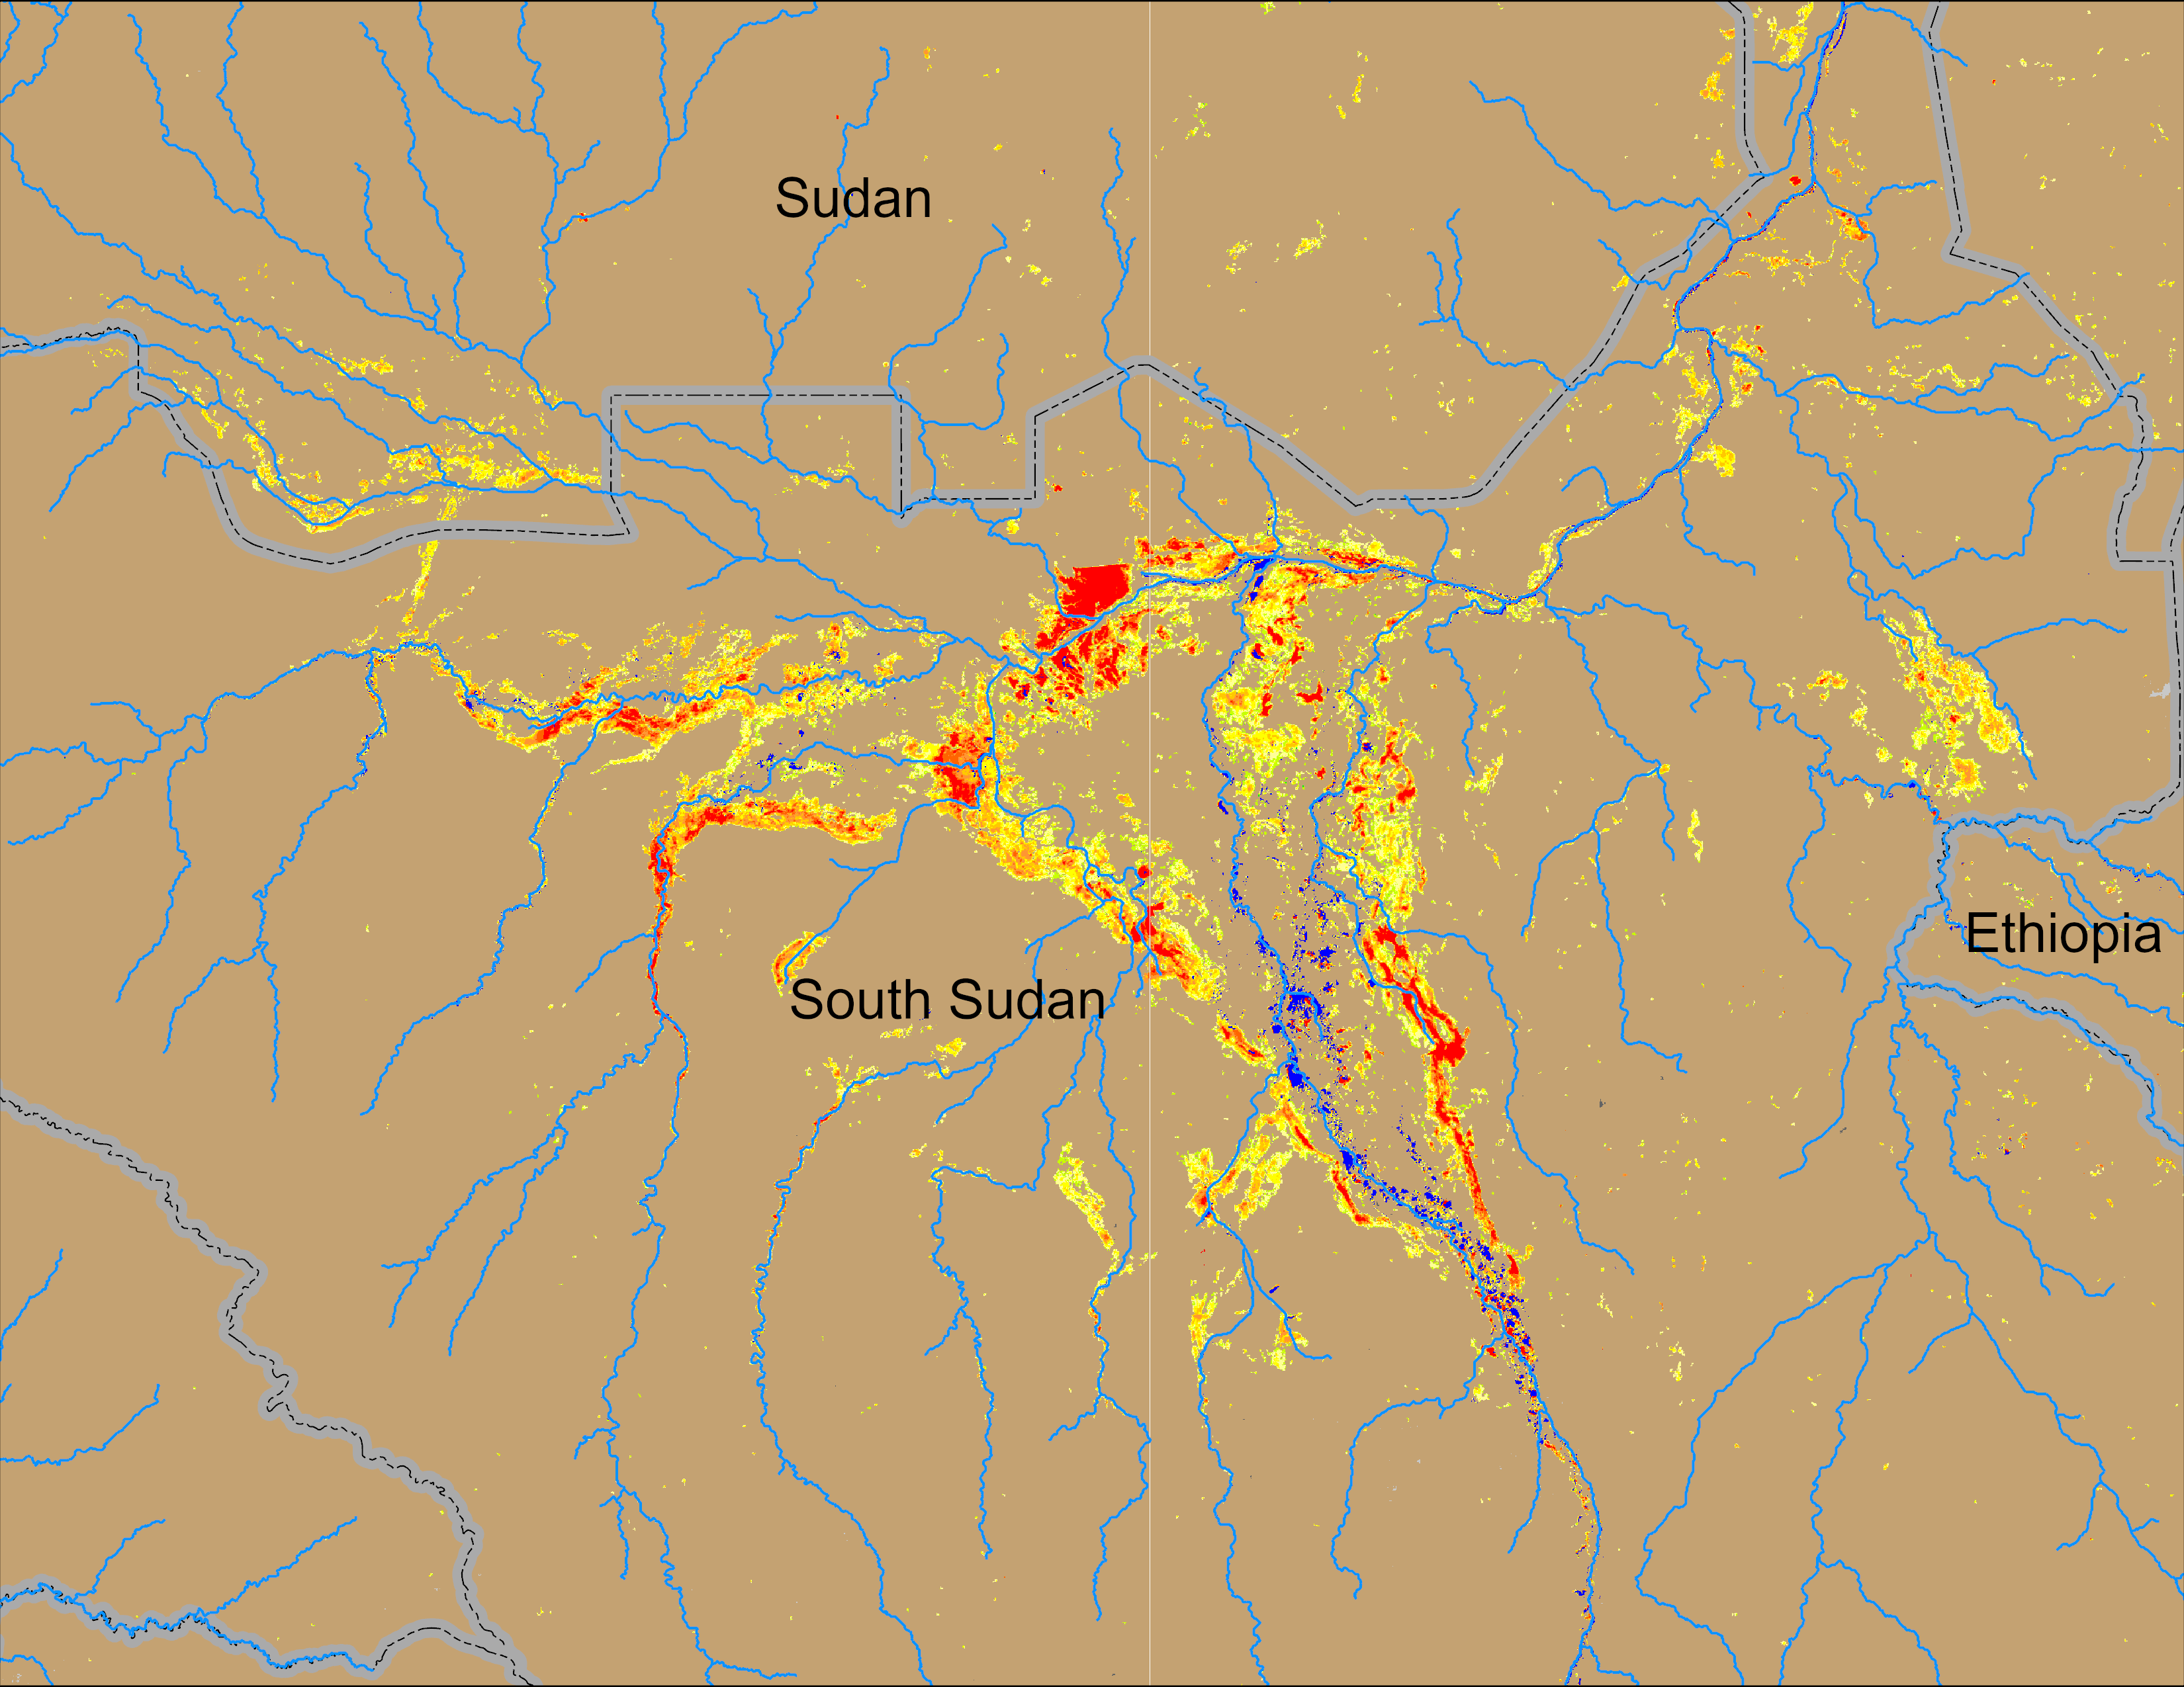
Flooding Conditions in South Sudan
(% of the pixel)
(% of the pixel)
Sobet
Sobet
Akobo
Akobo
Pibor
Pibor
NOAA VIIRS 5-day comp.: 07 – 11 Nov 2024
NOAA VIIRS 5-day comp.: 13 – 17 Nov 2024
Inundation remained mostly constant across South Sudan.

Slide 3
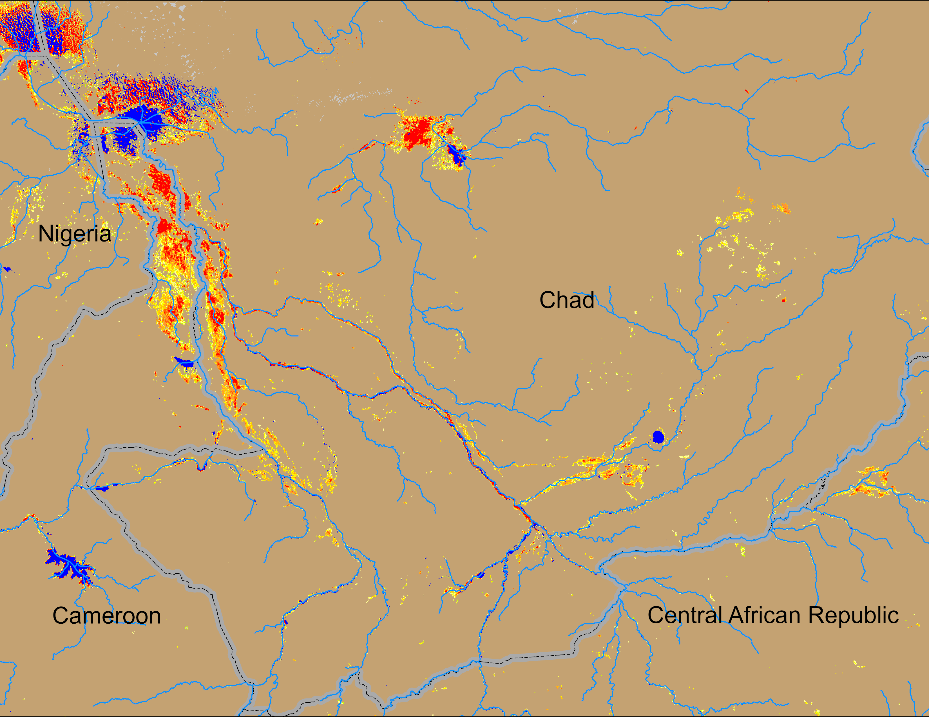
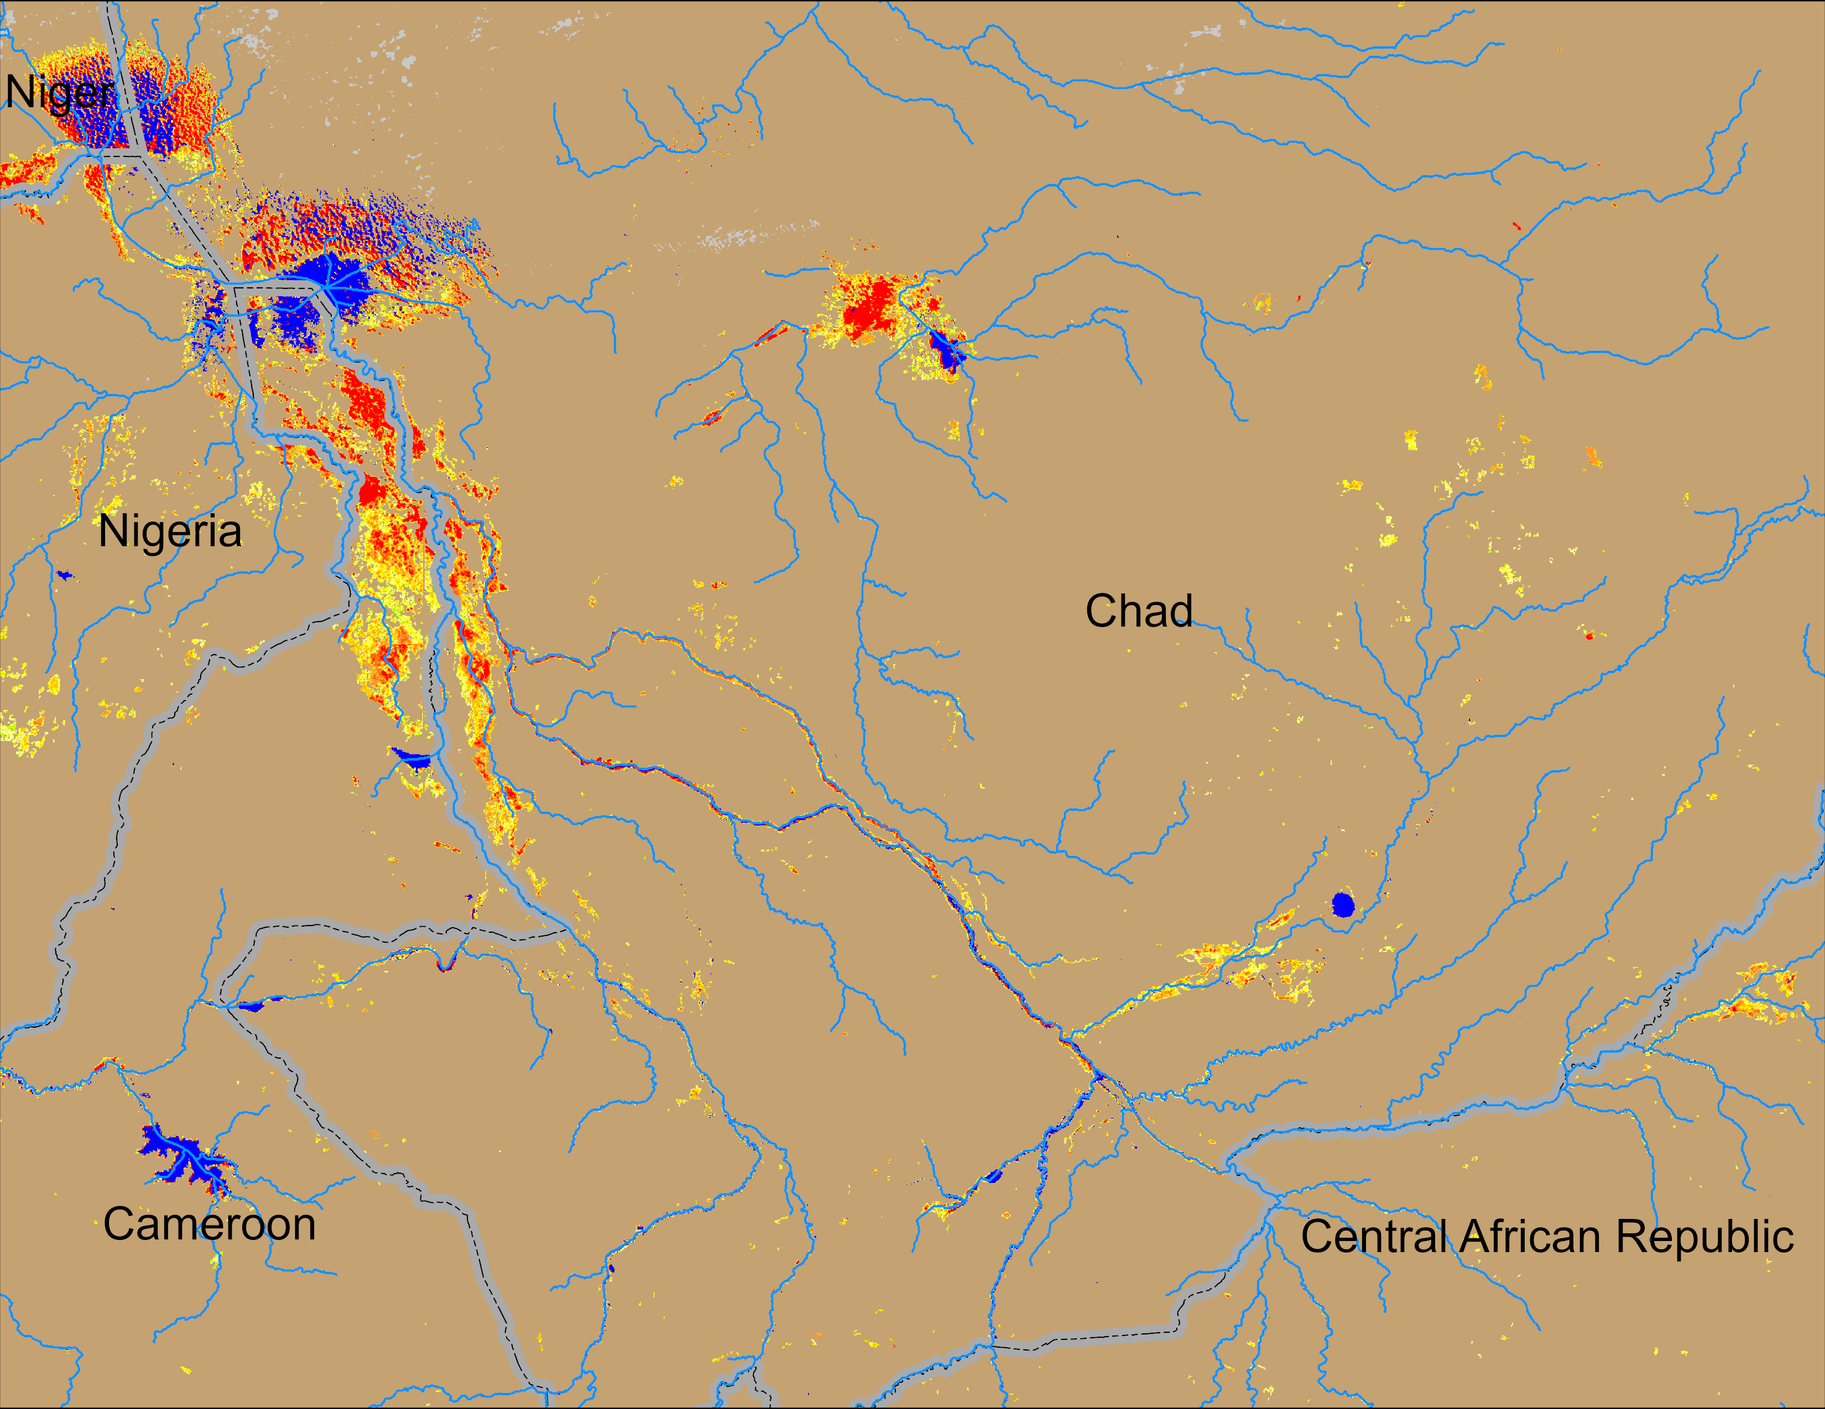
Flooding Conditions in Chad
(% of the pixel)
(% of the pixel)
NOAA VIIRS 5-day comp.: 07 – 11 Nov 2024
NOAA VIIRS 5-day comp.: 13 – 17 Nov 2024
Inundation receded substantially across Chad.

Slide 4
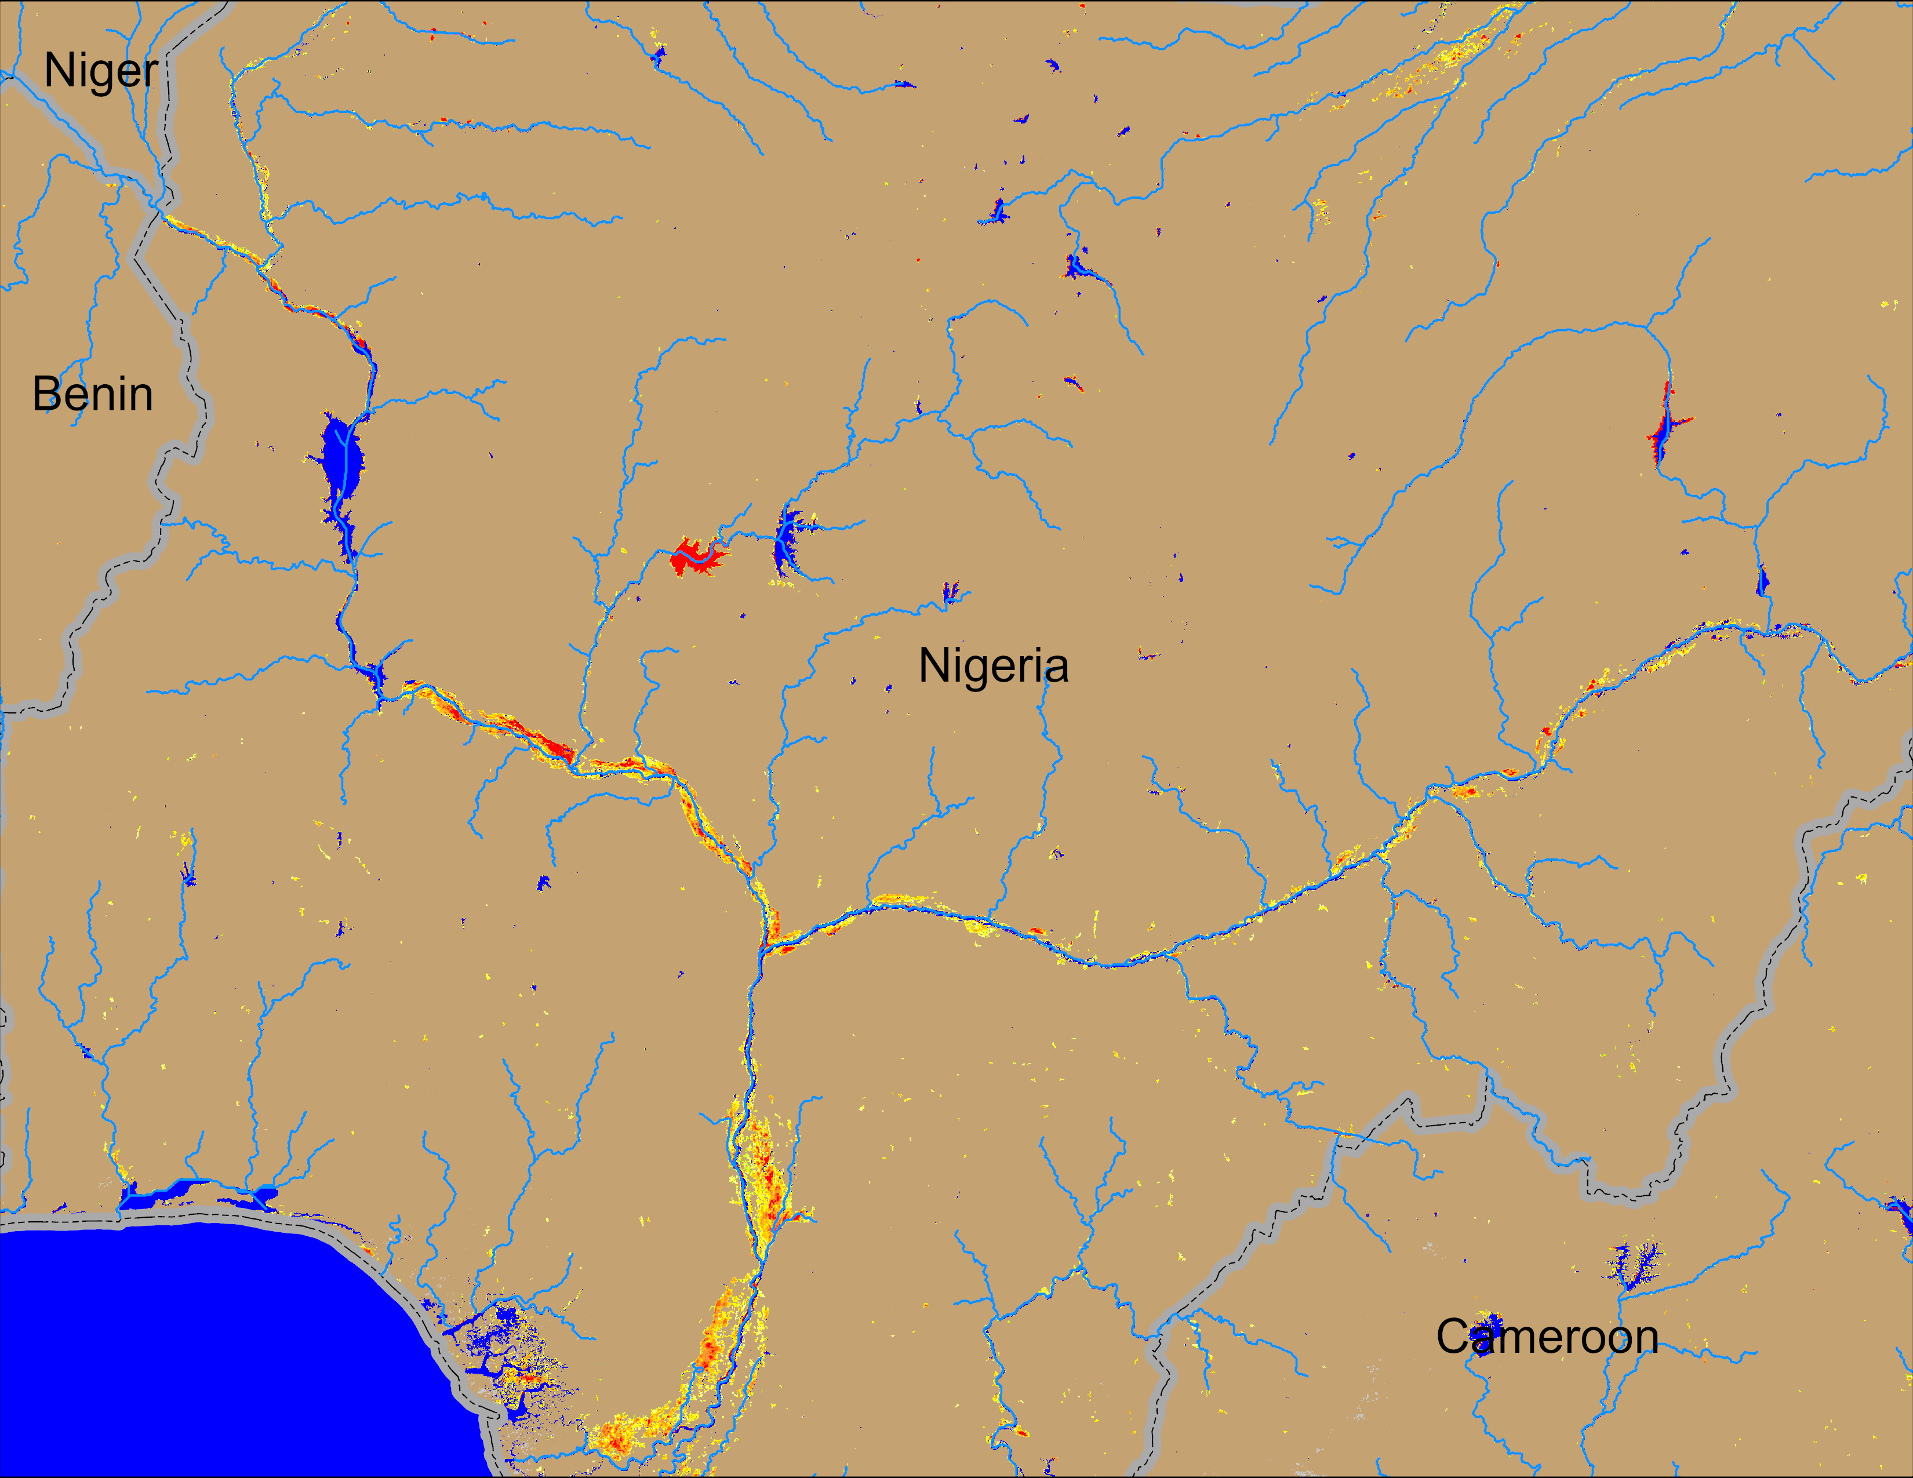
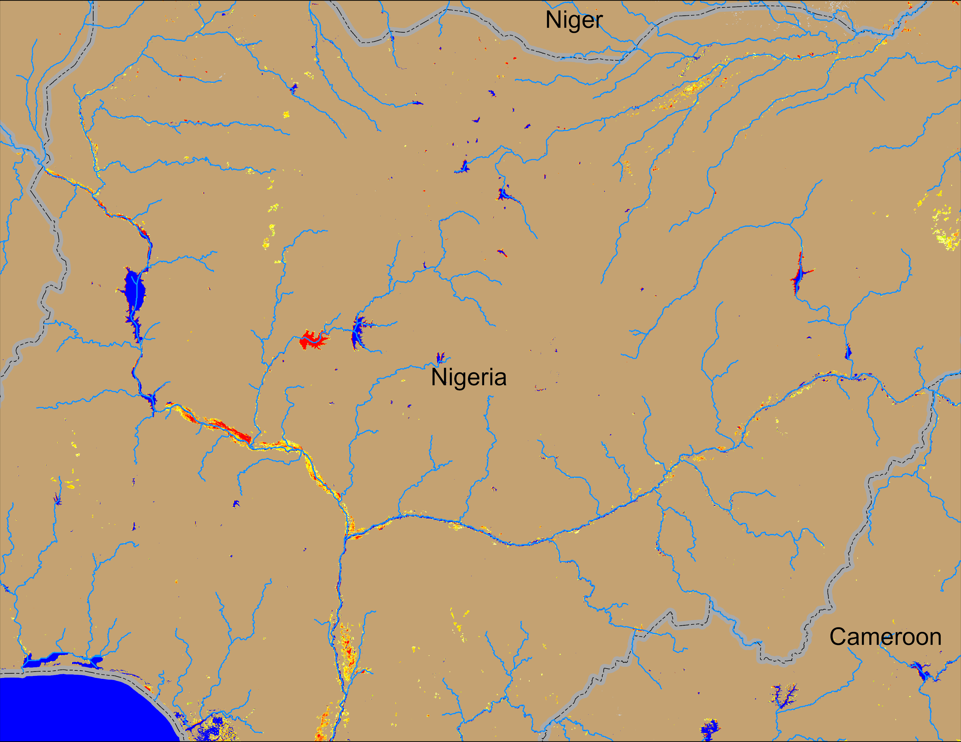
Flooding Conditions in Nigeria
(% of the pixel)
(% of the pixel)
Sokoto
Komadugu Rivers
Sokoto
Komadugu Rivers
Niger
Niger
Benue
Benue
NOAA VIIRS 5-day comp.: 07 – 11 Nov 2024
NOAA VIIRS 5-day comp.: 13 – 17 Nov 2024
Flooding conditions improved substantially across Nigeria especially along Benue River.

Slide 5
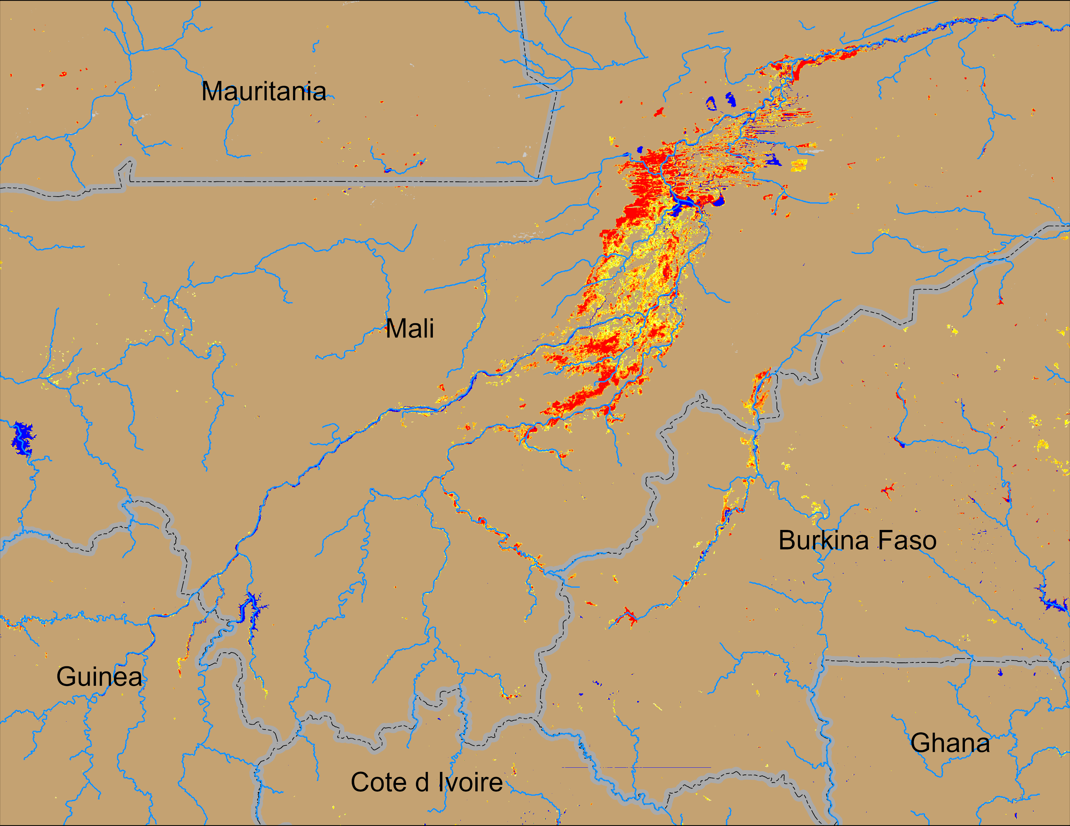
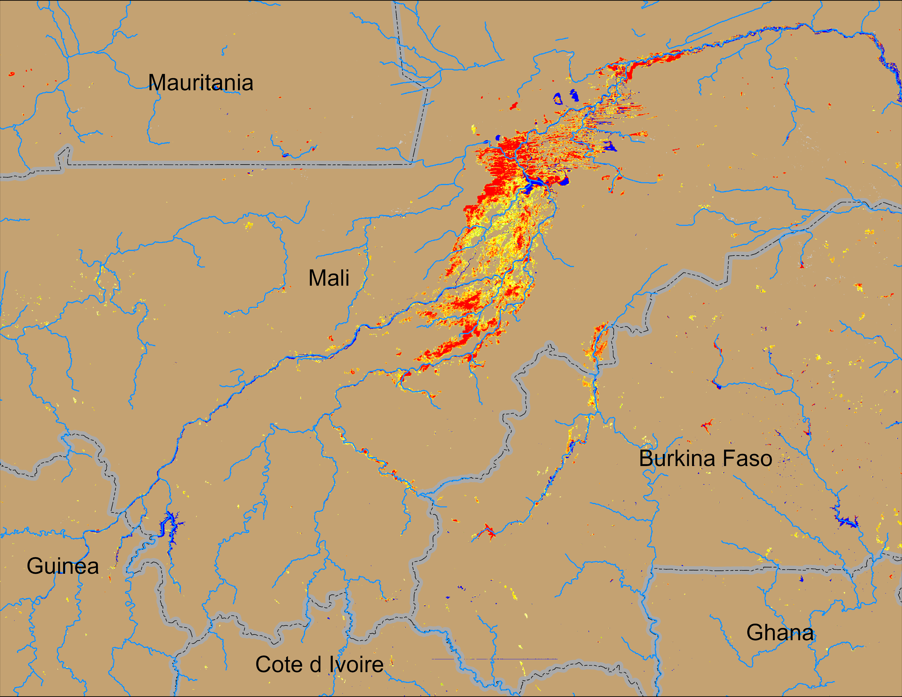
Flooding Conditions in Mali
(% of the pixel)
(% of the pixel)
NOAA VIIRS 5-day comp.: 07 – 11 Nov 2024
NOAA VIIRS 5-day comp.: 13 – 17 Nov 2024
Flooding remained unchanged in central Mali.

Slide 6
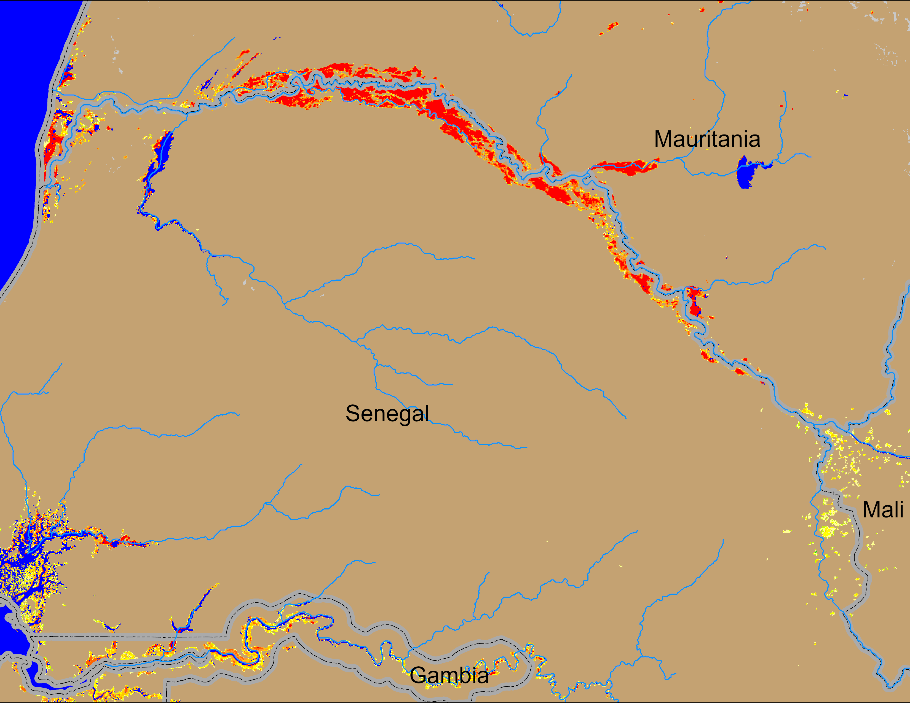
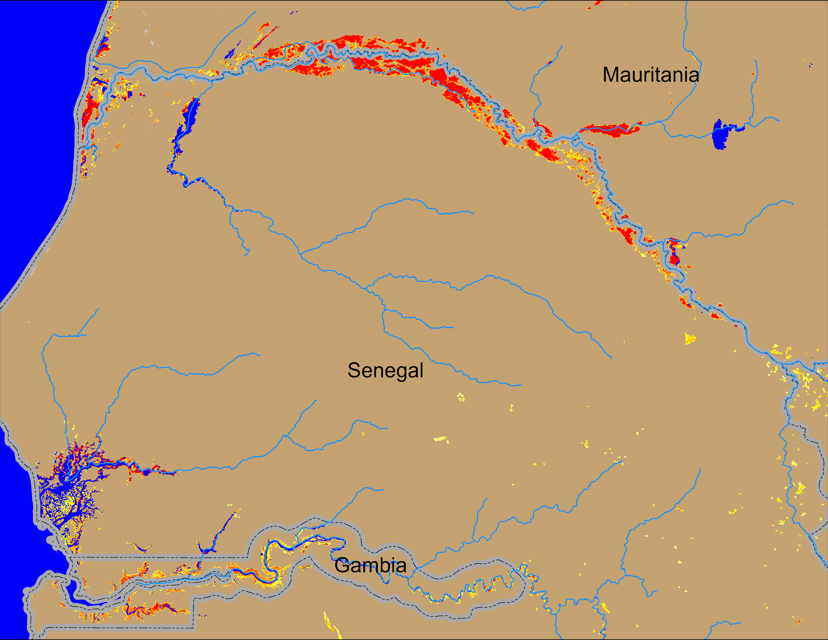
Flooding Conditions in Senegal
(% of the pixel)
(% of the pixel)
NOAA VIIRS 5-day comp.: 07 – 11 Nov 2024
NOAA VIIRS 5-day comp.: 13 – 17 Nov 2024
Flooding conditions gradually improving along the Senegal River.

