Slide 1
FEWS NET Enhanced Flood Monitoring – East Africa, West Africa, southern Africa and Yemen
May 13, 2024, Hazard Briefing
FEWS NET Science Team:
USGS, NASA, NOAA, UCSB+Regional Scientists

Slide 2
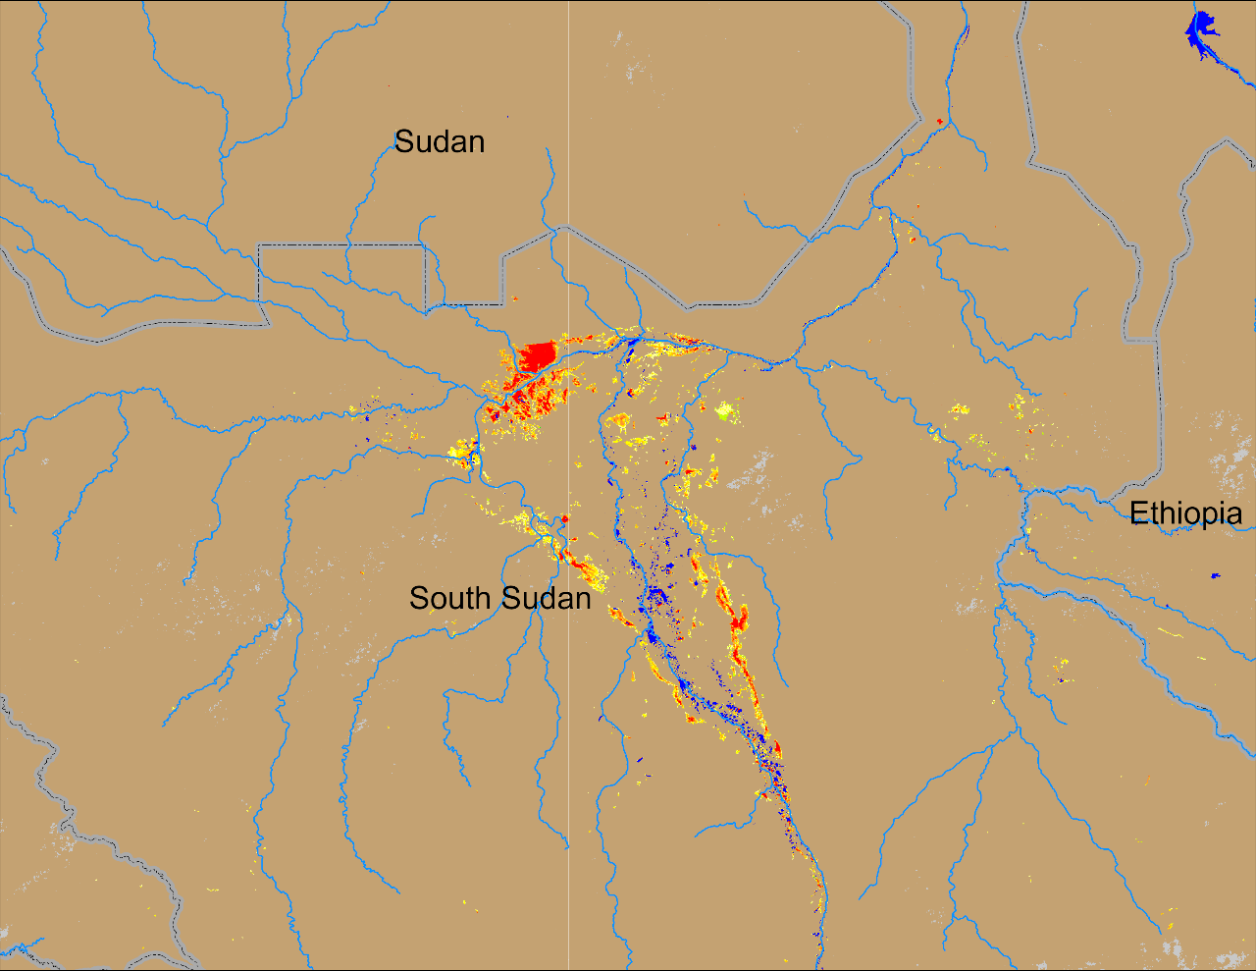
Flooding Conditions in South Sudan
(% of the pixel)
(% of the pixel)
Sobet
Sobet
Akobo
Akobo
Pibor
Pibor
NOAA VIIRS 5-day comp.: 01 – 05 May 2024
NOAA VIIRS 5-day comp.: 08 – 12 May 2024
Flooding conditions continue to be unchanged in South Sudan.

Slide 3
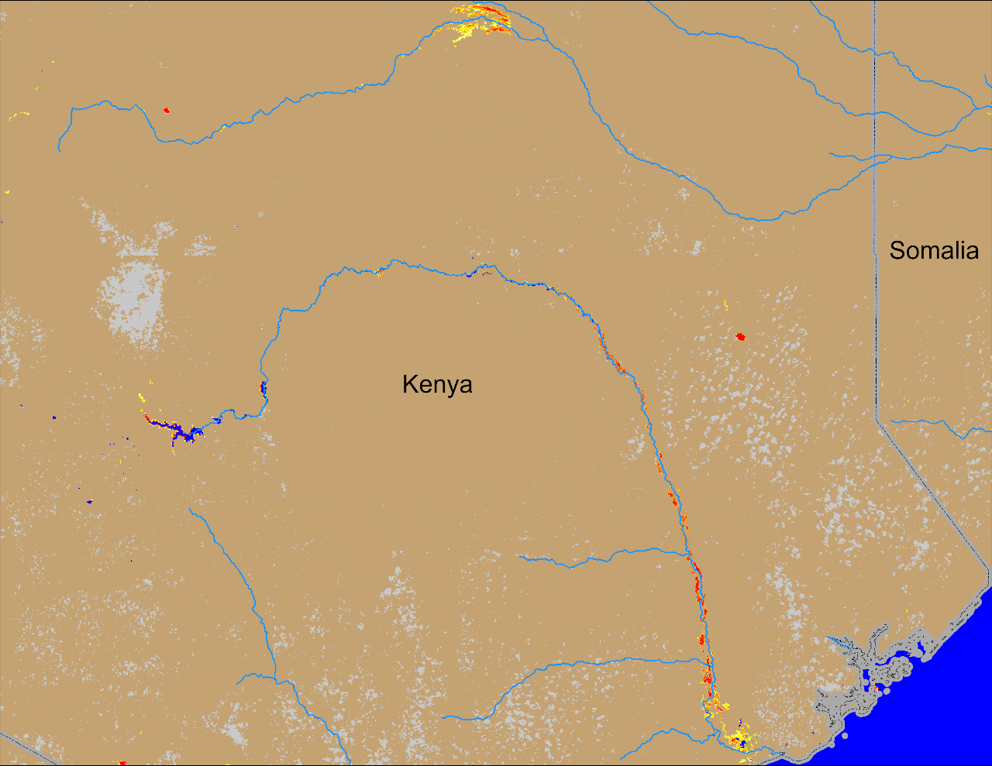
Flooding in Kenya
(% of the pixel)
NOAA VIIRS 5-day comp.: 08 – 12 May 2024
International Charter: flooding along Tana River near Garissa
Flooding along Tana and Lag Dera Rivers continue in Kenya

Slide 4
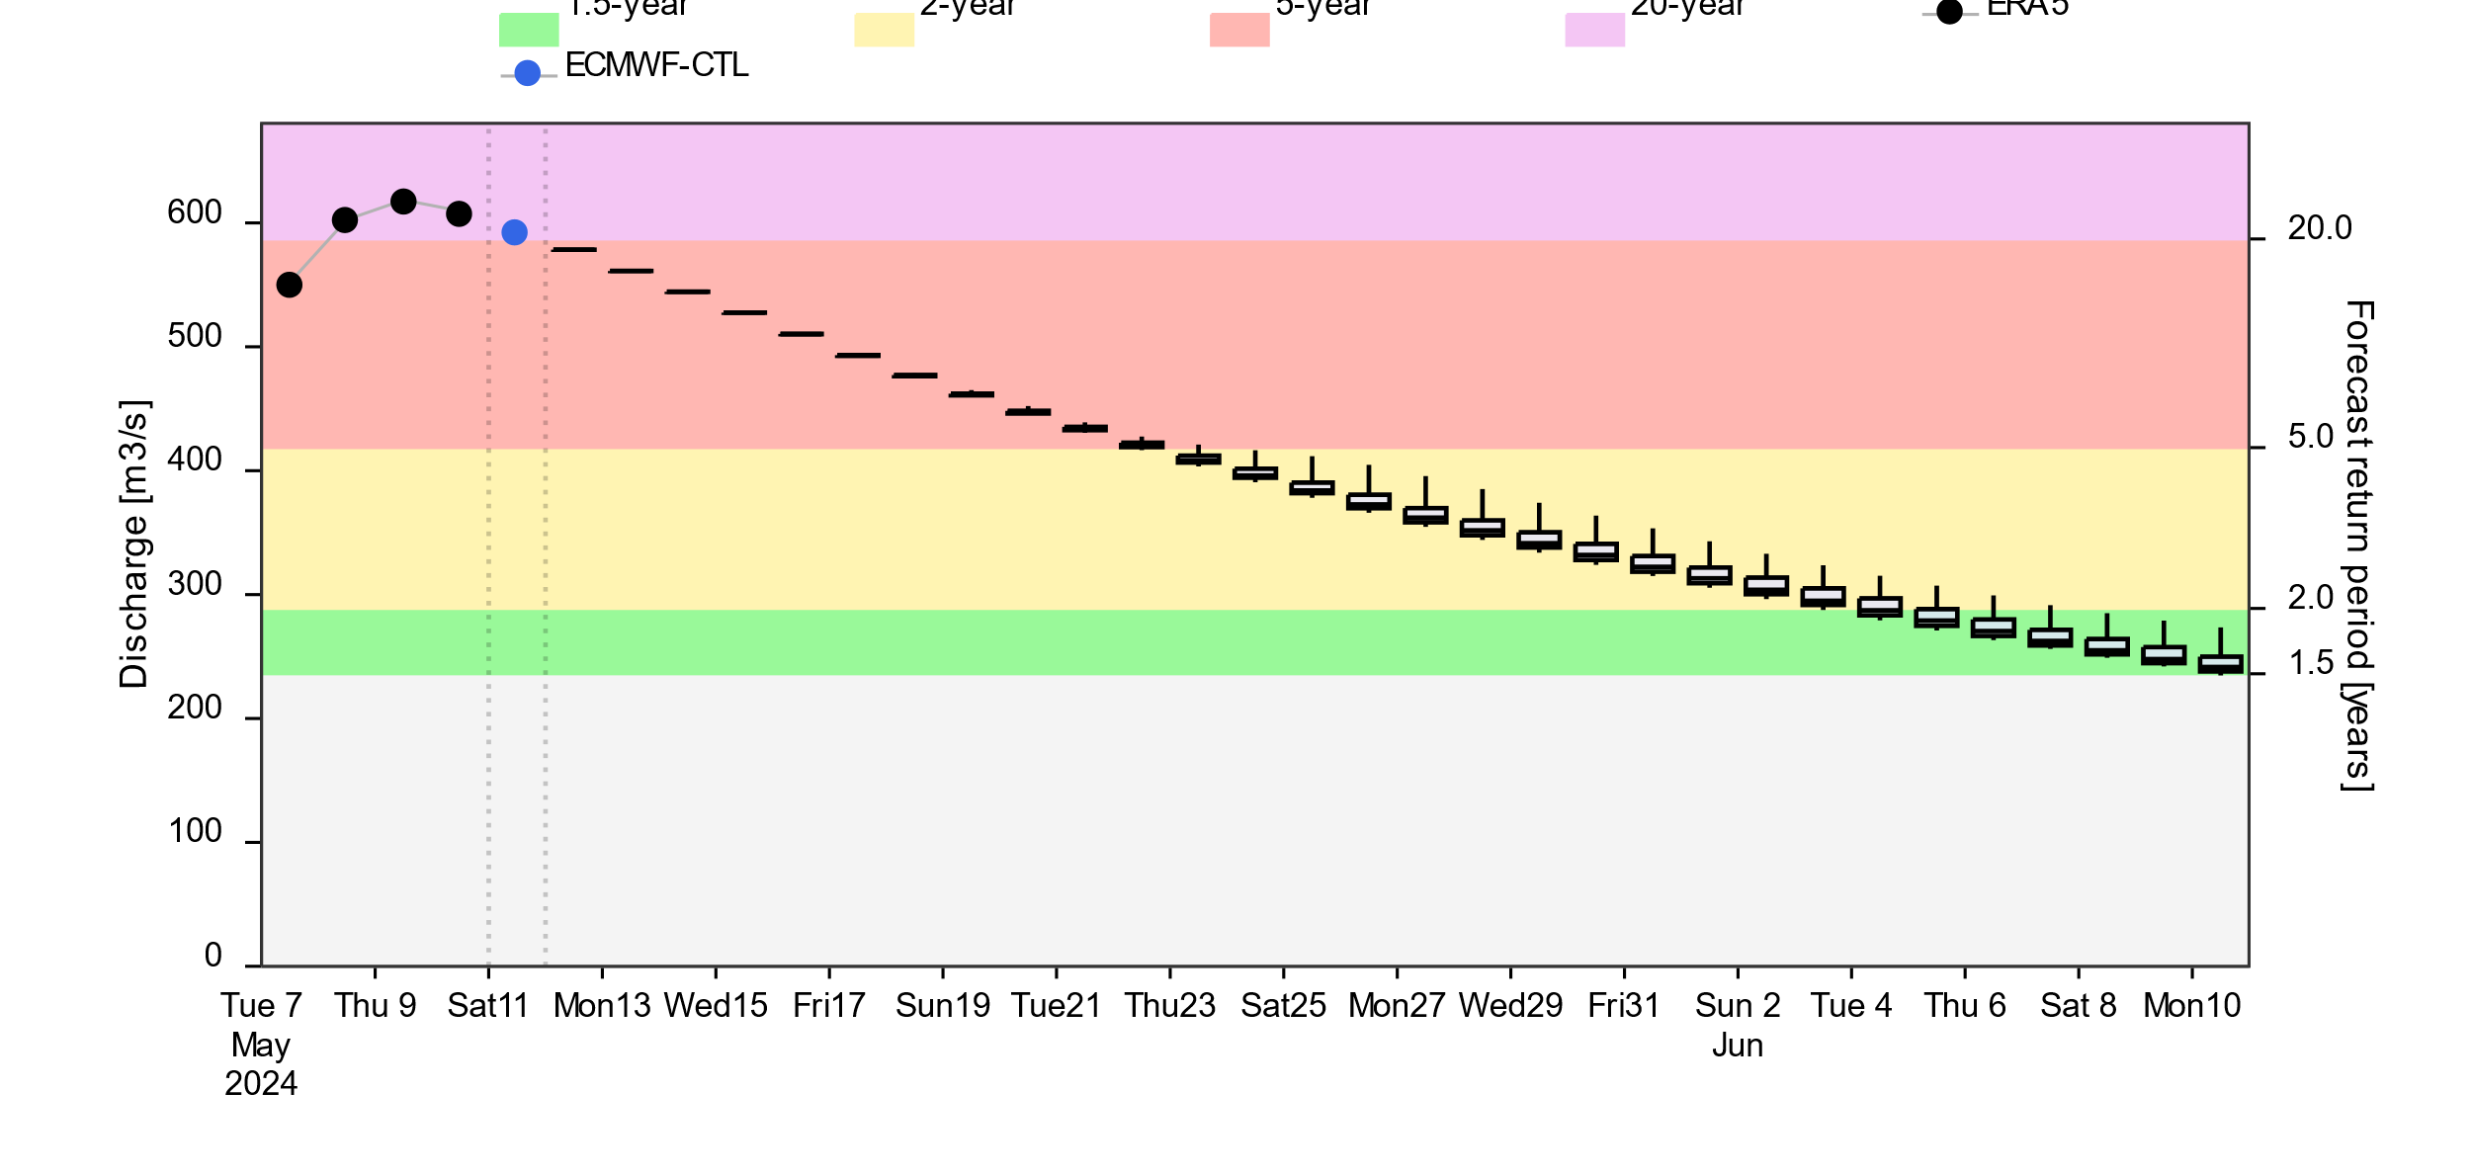
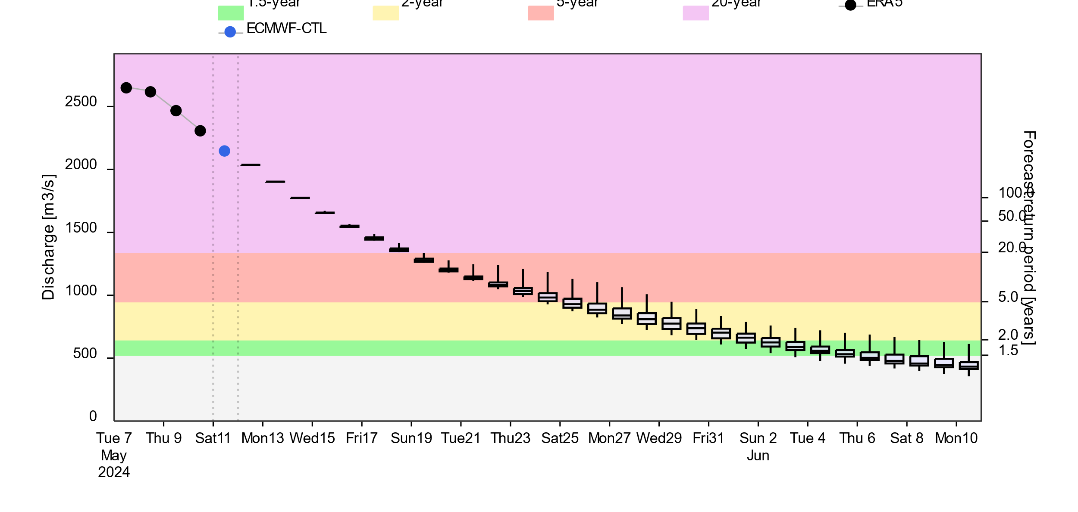
Flooding Conditions in Kenya, Ethiopia, and Somalia
@ point A: Lag Dera
@ point B: Tana
A
B
2-yr 5-yr 20-yr
GloFAS forecast: 11 May – 10 Jun 2024
GloFAS forecast: 11 May – 10 Jun 2024
Streamflow passed the peak in Southern Kenya and are on the decline. However, discharges are still at 5 to 20-yr return period level. Flooding expected to continue till end of May.

Slide 5
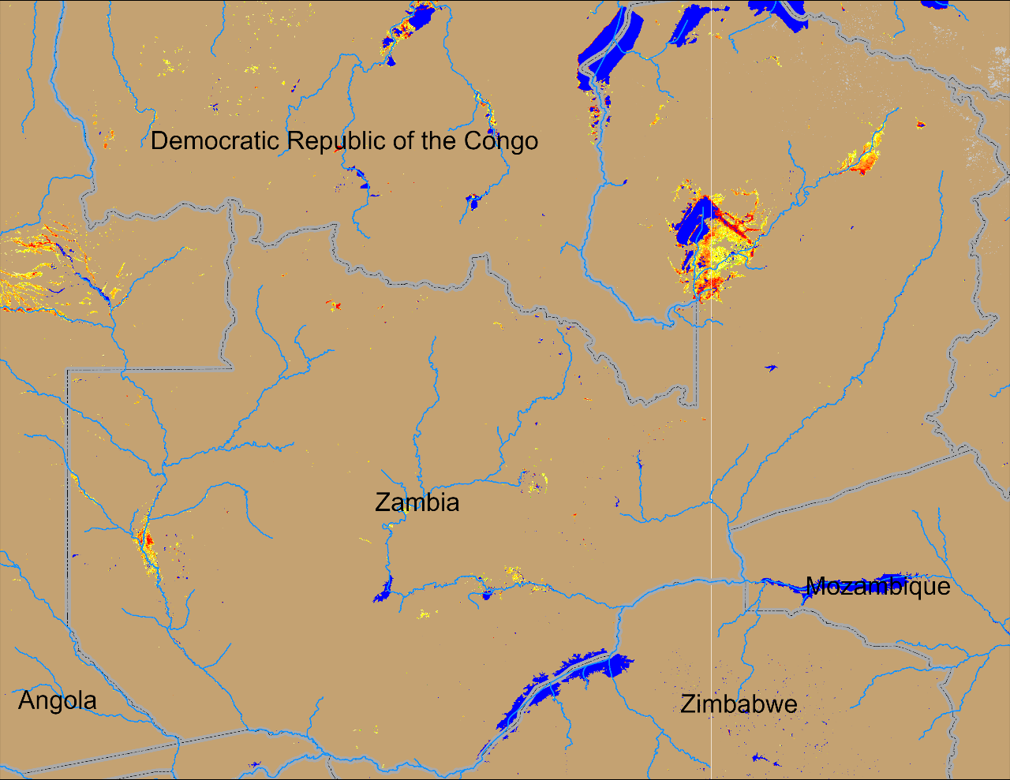
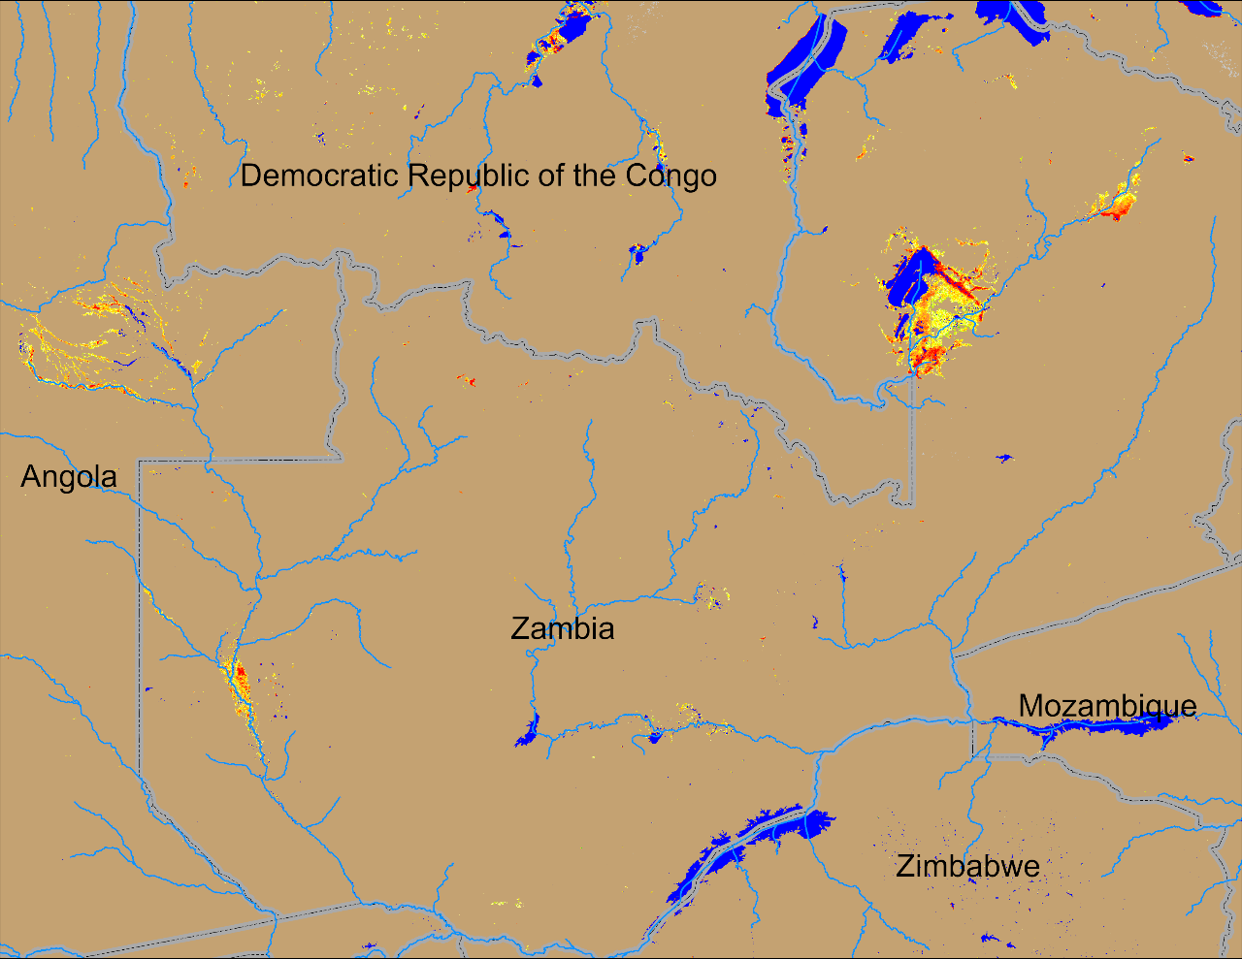
Flooding in Zambia and Eastern Angola
(% of the pixel)
(% of the pixel)
NOAA VIIRS 5-day comp.: 01 – 05 May 2024
NOAA VIIRS 5-day comp.: 08 – 12 May 2024
Conditions remained unchanged in the upstream of Zambezi River in Eastern Angola and Western Zambia.

