Slide 1
FEWS NET Enhanced Flood Monitoring – East Africa, West Africa, southern Africa and Yemen
Jan 22, 2024, Hazard Briefing
FEWS NET Science Team:
USGS, NASA, NOAA, UCSB+Regional Scientists

Slide 2
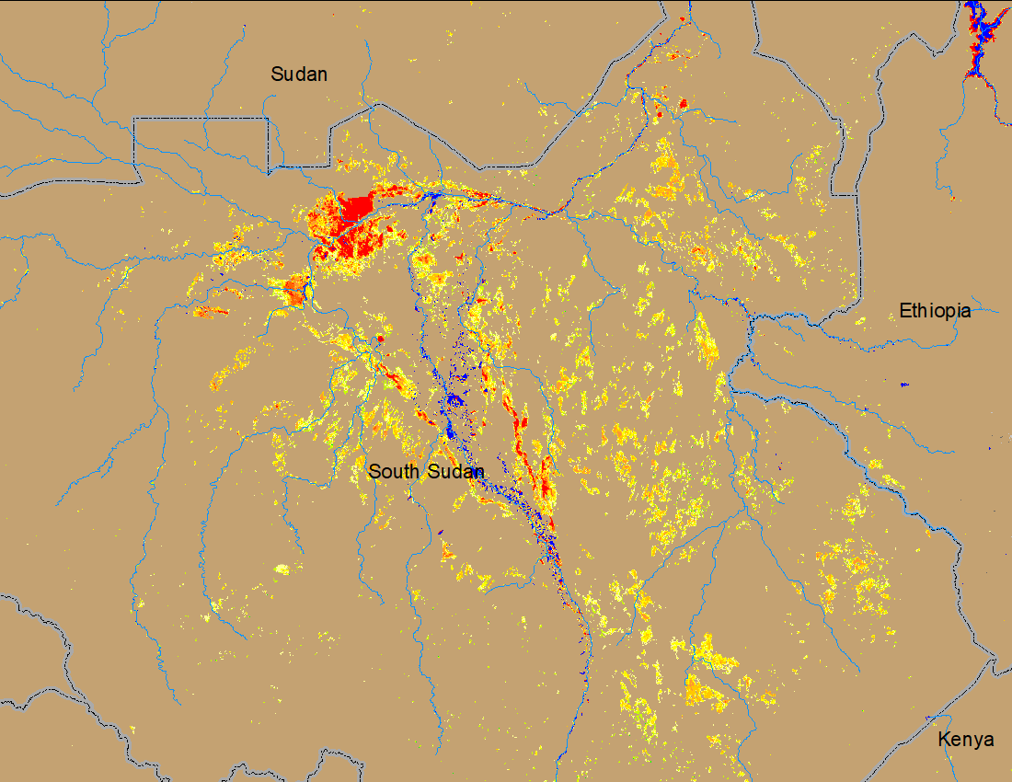
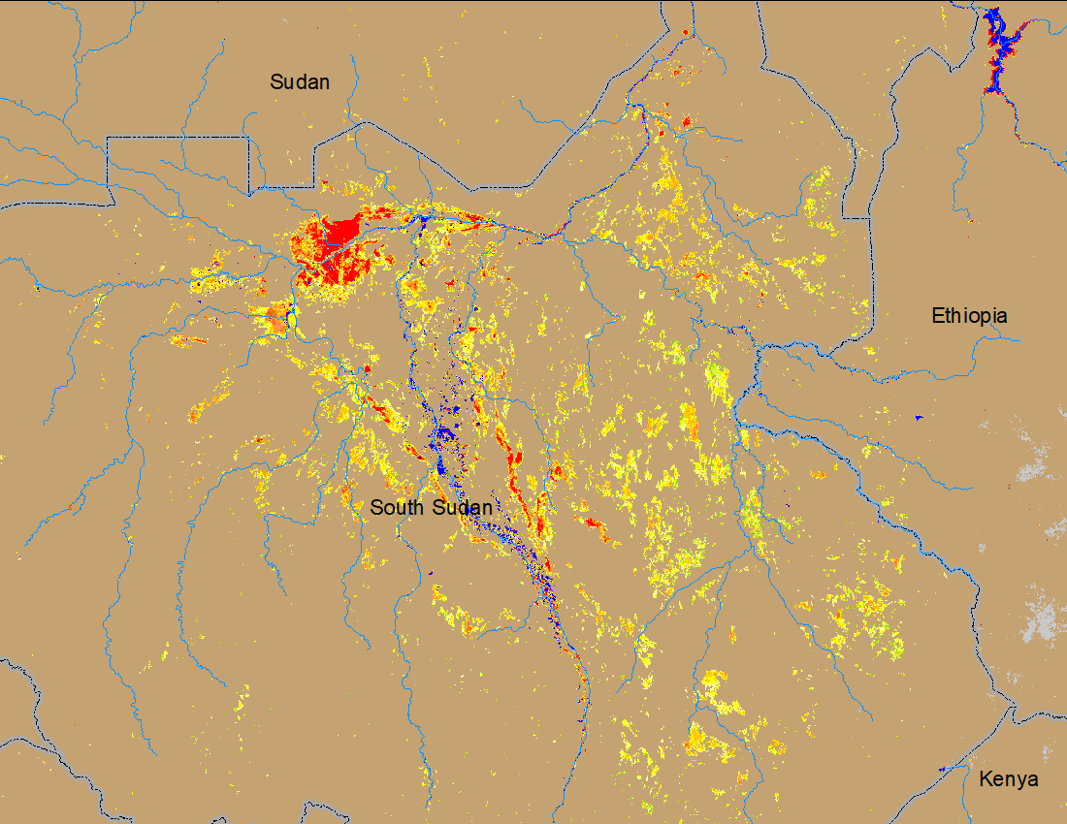
Flooding Conditions in South Sudan
(% of the pixel)
(% of the pixel)
NOAA VIIRS 5-day comp.: 11 – 15 Jan 2024
NOAA VIIRS 5-day comp.: 17 – 21 Jan 2024
Inundated areas remained unchanged in the Pibor-Akobo River catchments in South Sudan.

Slide 3
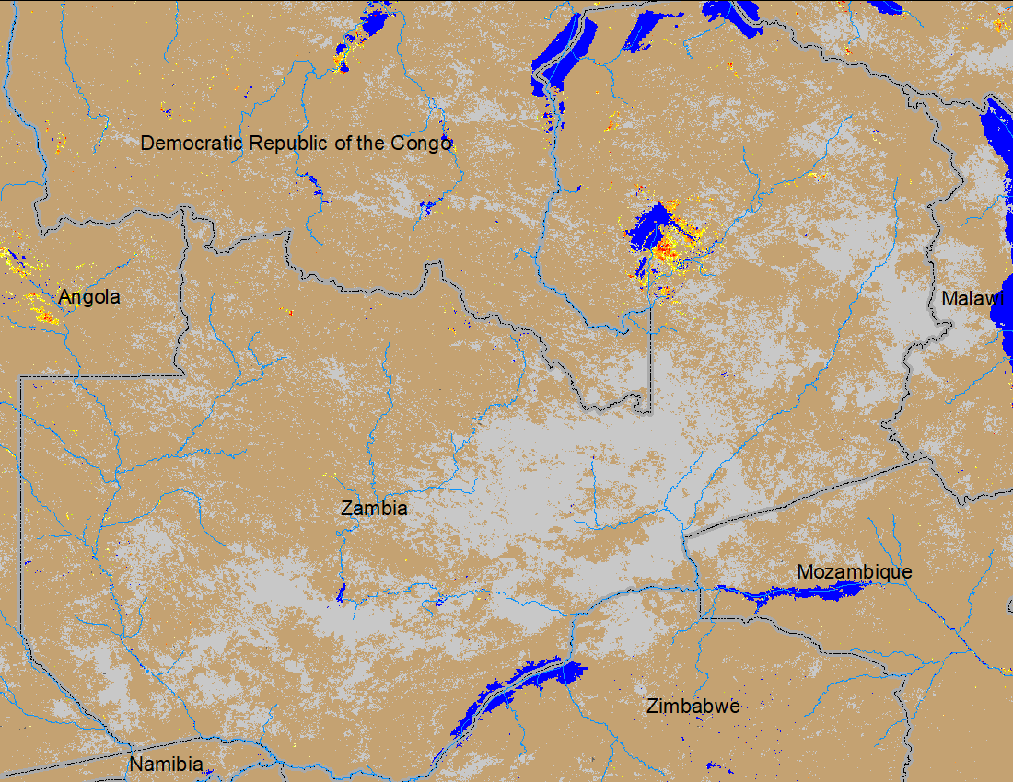
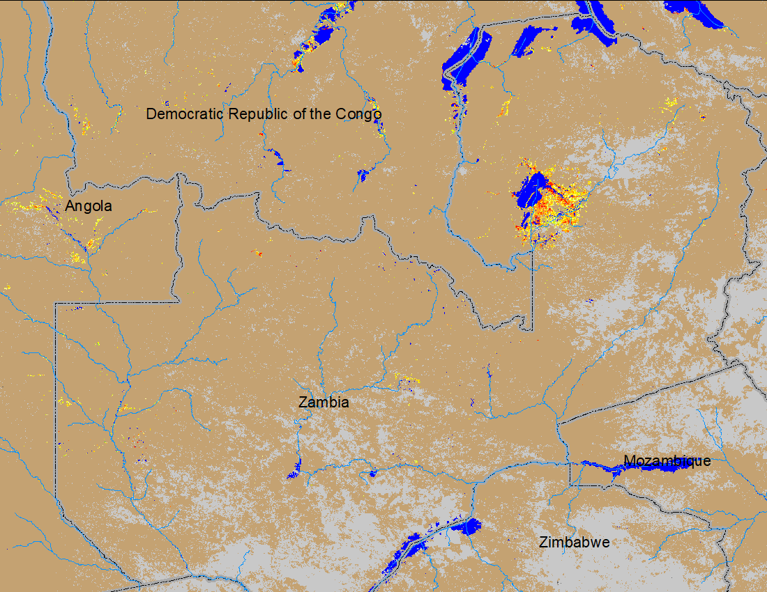
Flooding in Zambia and Eastern Angola
(% of the pixel)
(% of the pixel)
NOAA VIIRS 5-day comp.: 11 – 15 Jan 2024
NOAA VIIRS 5-day comp.: 17 – 21 Jan 2024
Inundated area increased marginally in Zambia.

