Slide 1
FEWS NET Enhanced Flood Monitoring
FEWS NET Science Team
Dec 02, 2024

Slide 2
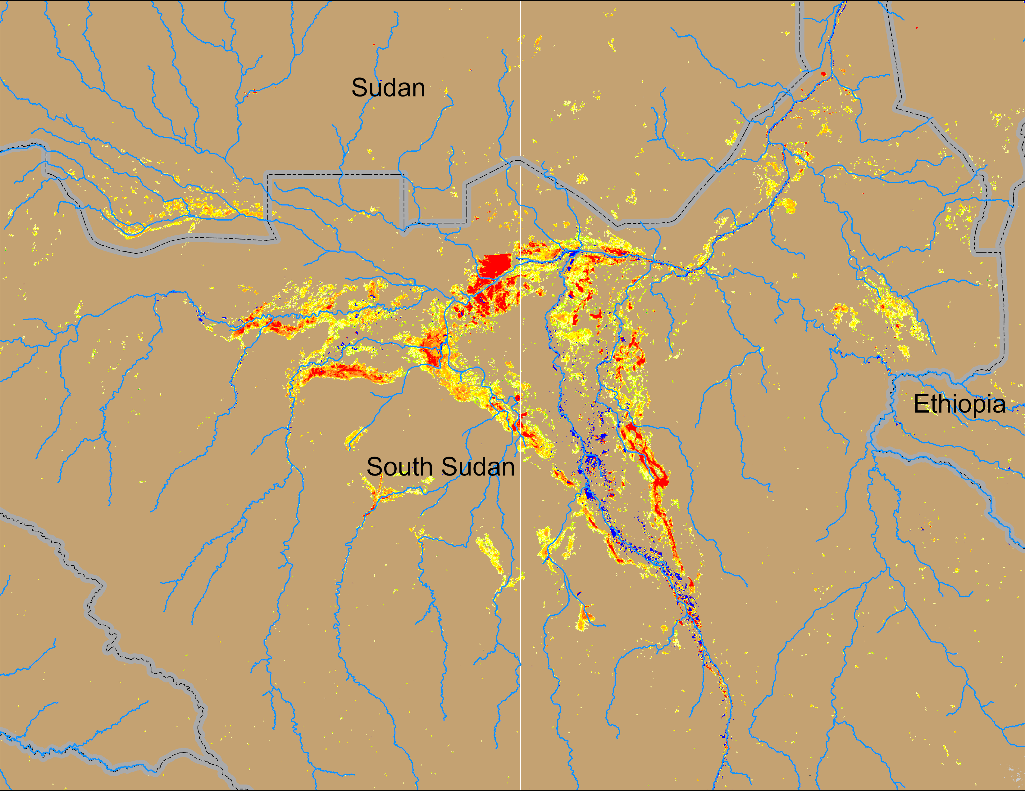
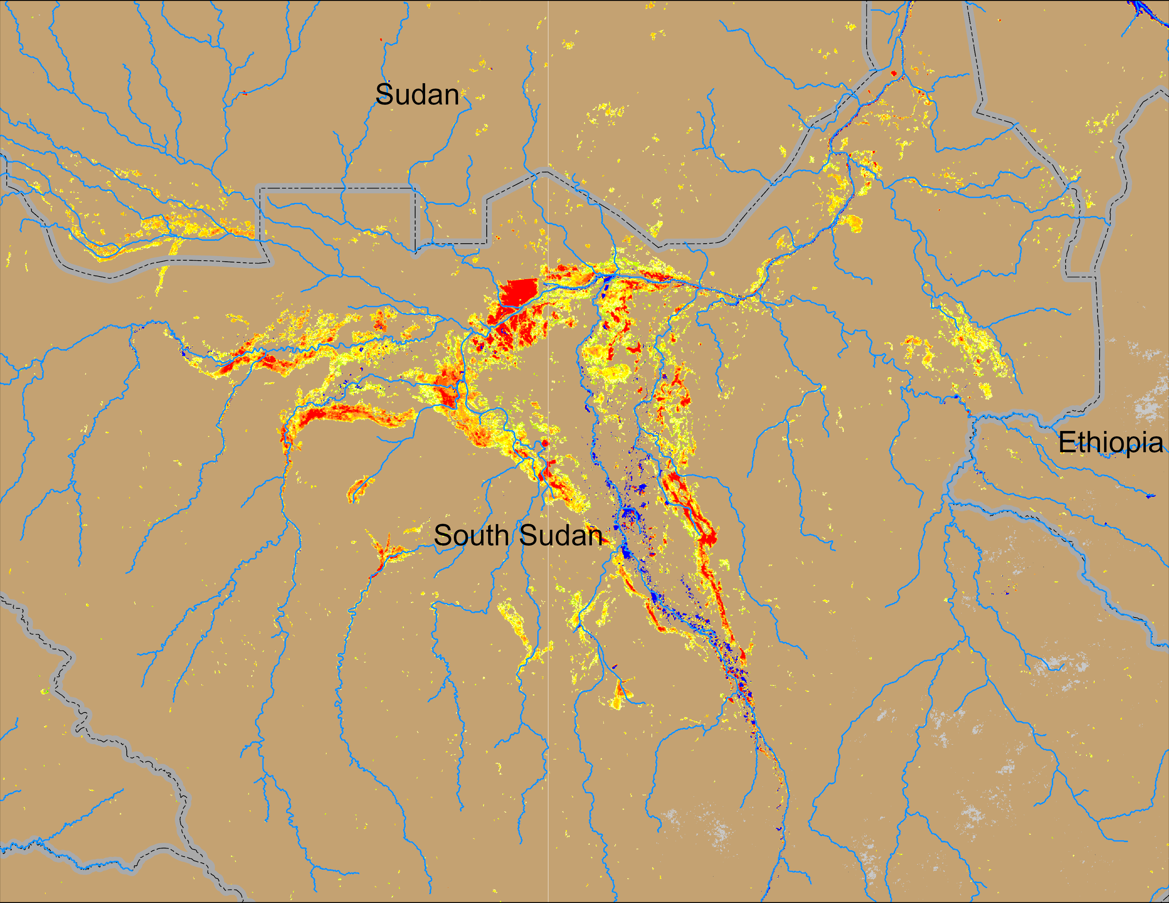
Flooding Conditions in South Sudan
(% of the pixel)
(% of the pixel)
Sobet
Sobet
Akobo
Akobo
Pibor
Pibor
NOAA VIIRS 5-day comp.: 20 – 24 Nov 2024
NOAA VIIRS 5-day comp.: 26 – 30 Nov 2024
Inundation slowly receding in South Sudan.

Slide 3
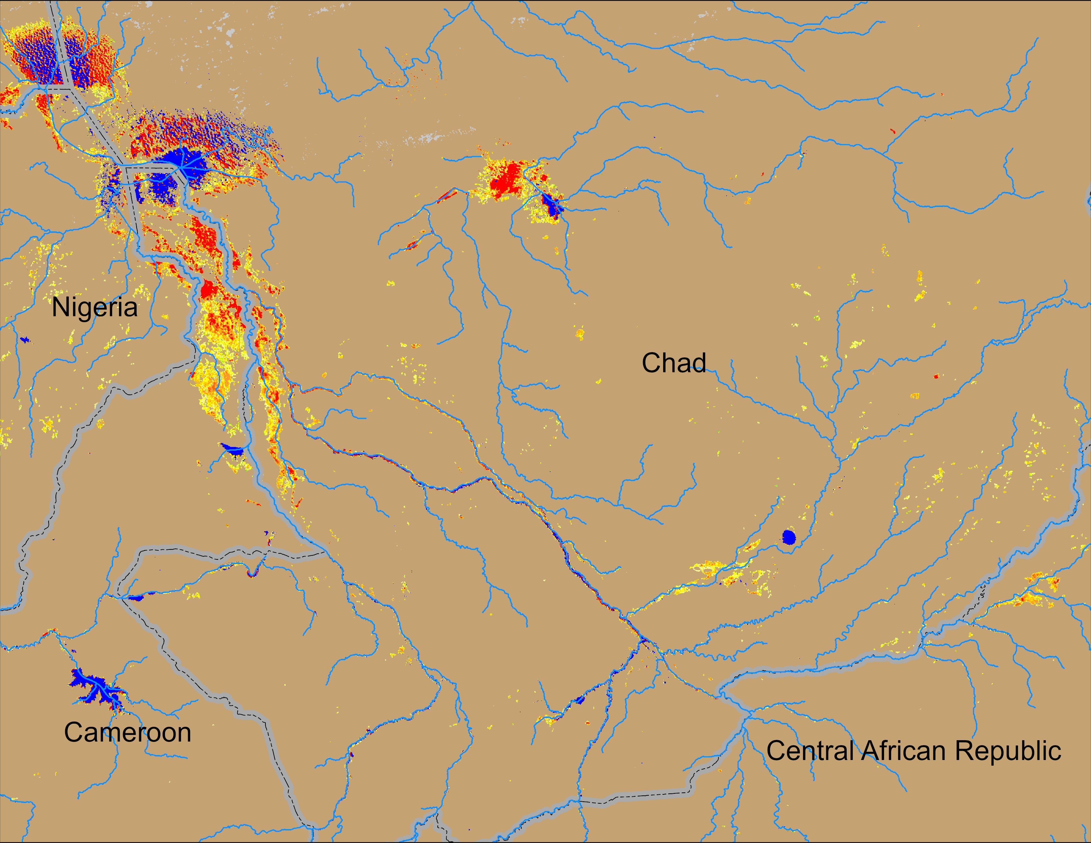
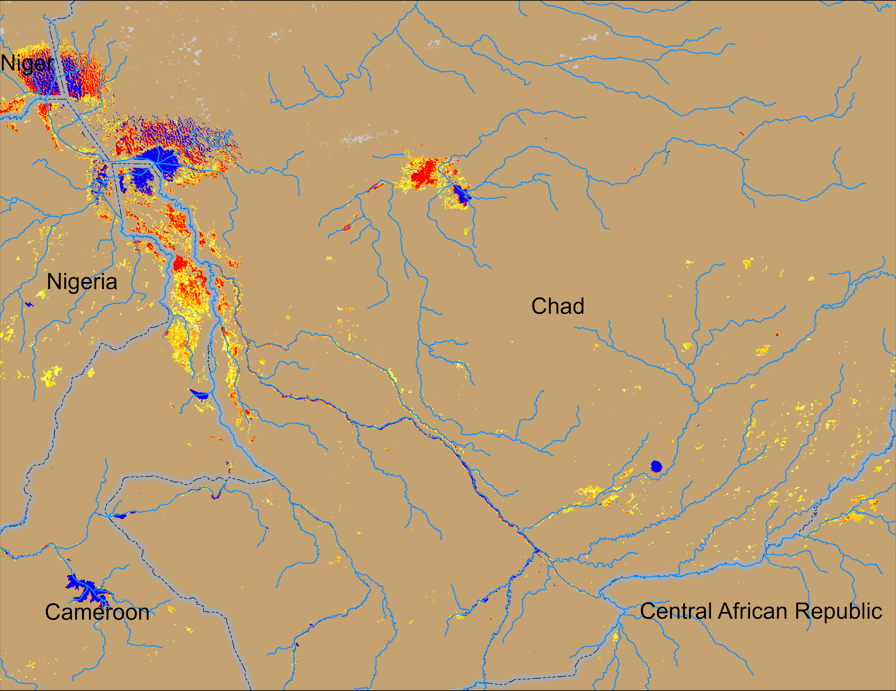
Flooding Conditions in Chad
(% of the pixel)
(% of the pixel)
NOAA VIIRS 5-day comp.: 20 – 24 Nov 2024
NOAA VIIRS 5-day comp.: 26 – 30 Nov 2024
Inundation remained unchanged across Chad.

Slide 4
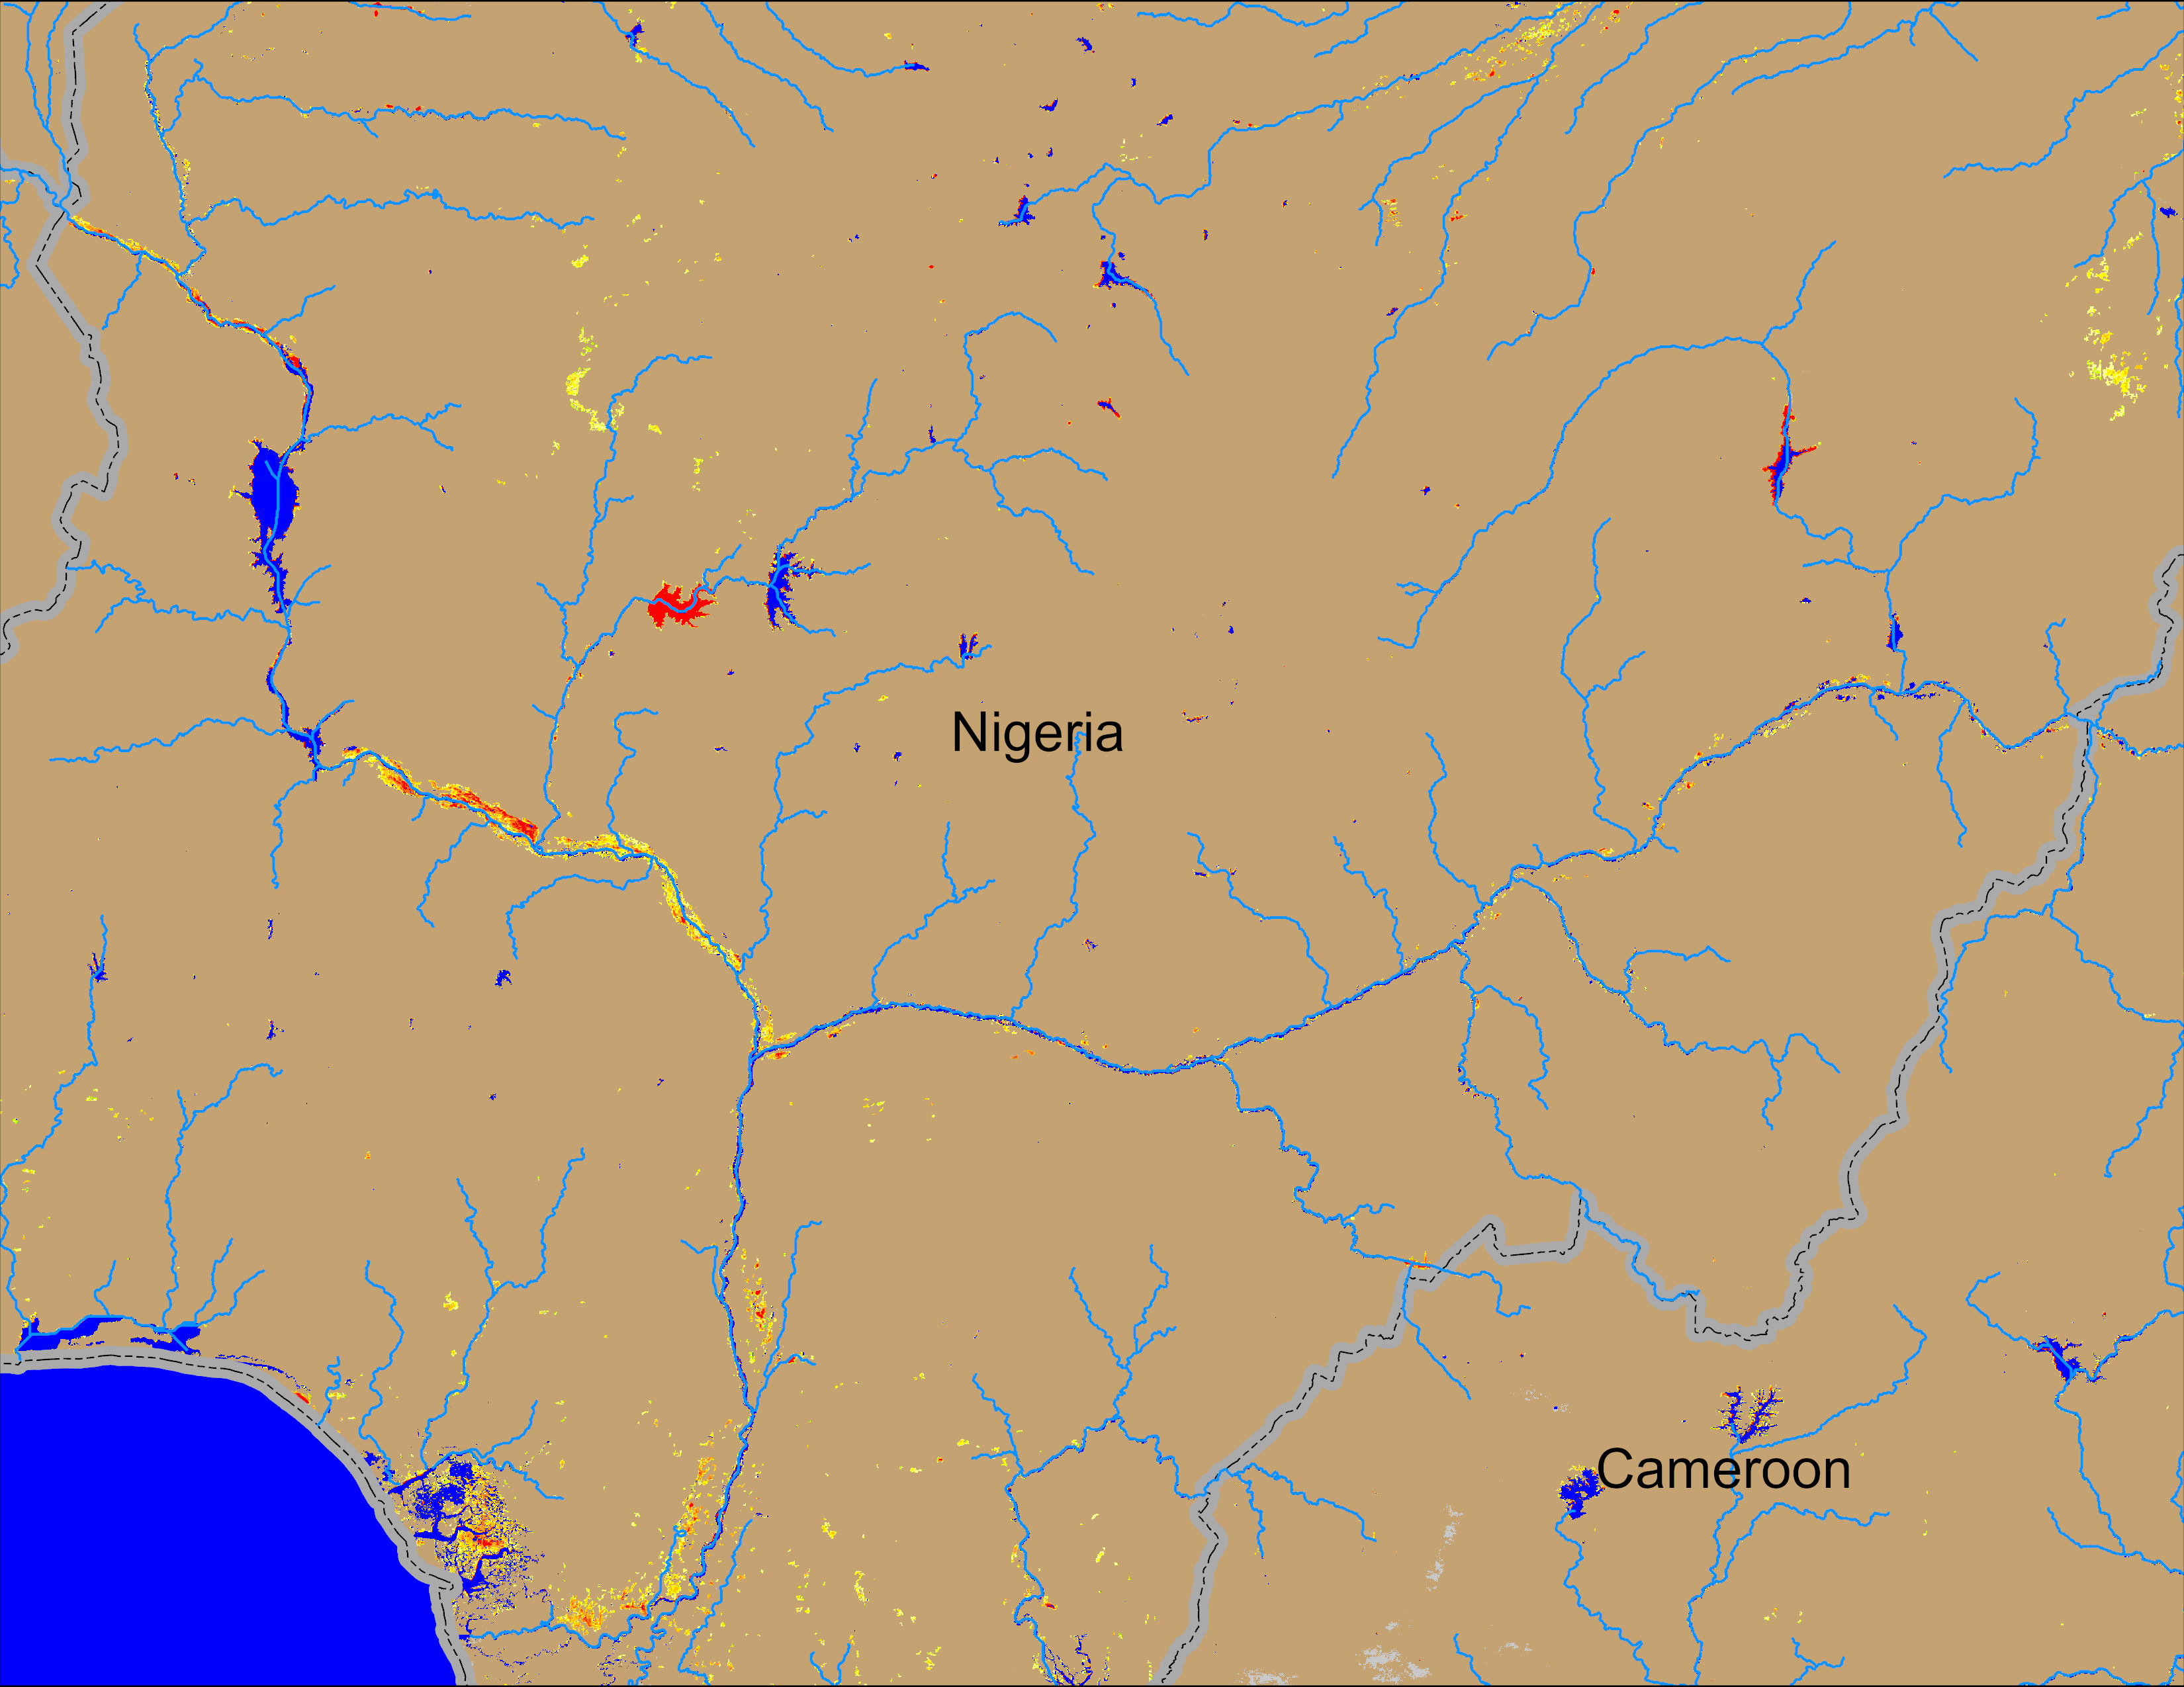
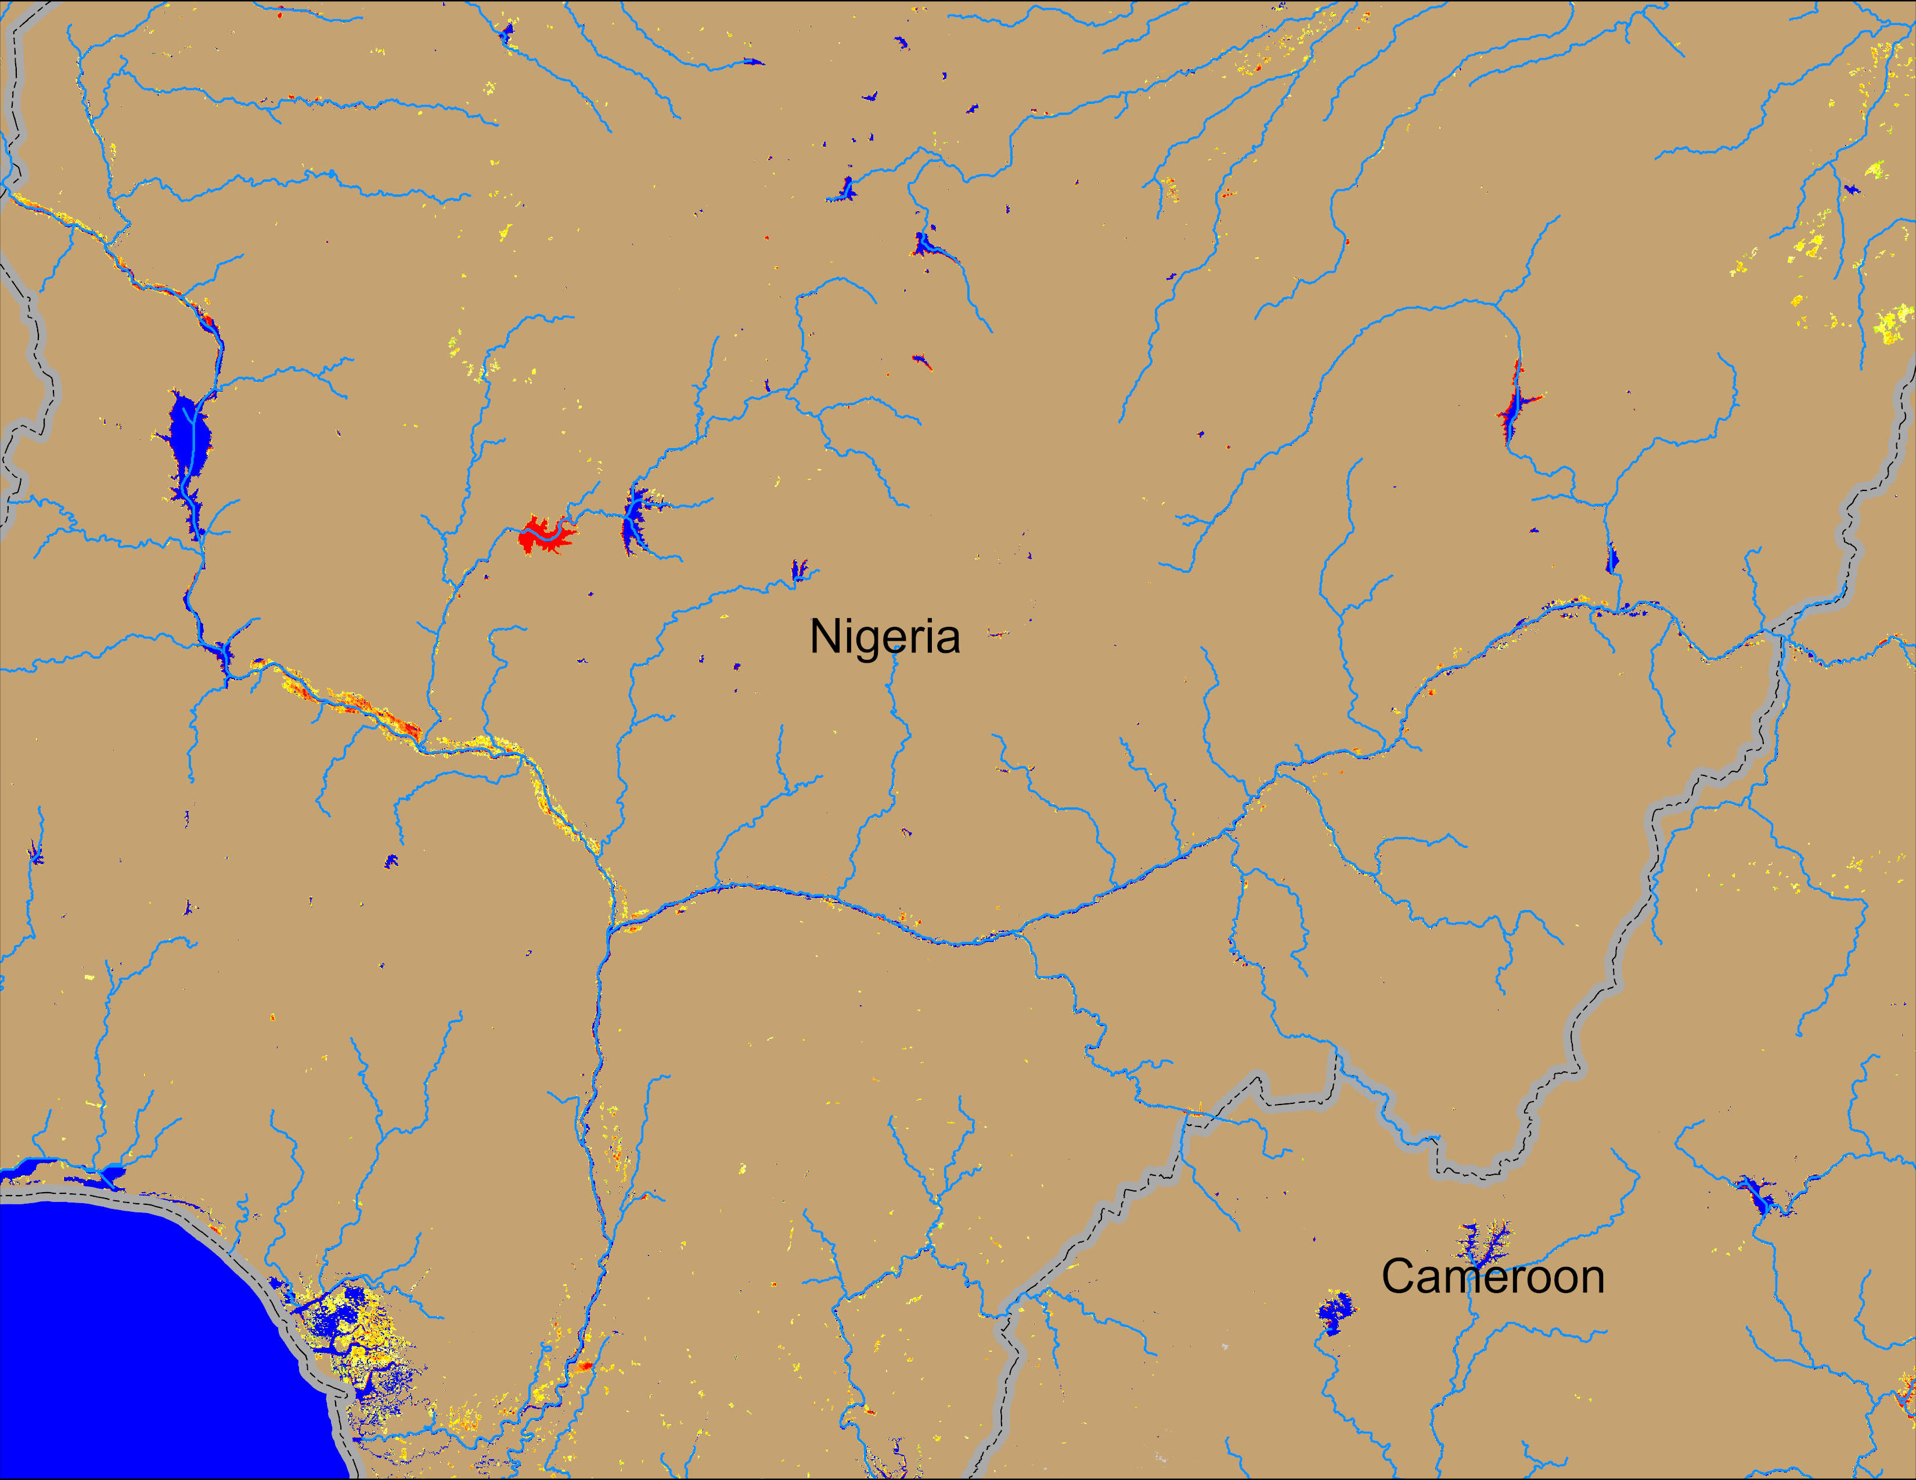
Flooding Conditions in Nigeria
(% of the pixel)
(% of the pixel)
Sokoto
Komadugu Rivers
Sokoto
Komadugu Rivers
Niger
Niger
Benue
Benue
NOAA VIIRS 5-day comp.: 20 – 24 Nov 2024
NOAA VIIRS 5-day comp.: 26 – 30 Nov 2024
Mostly flood free except some areas along Niger River in Western Nigeria.

Slide 5
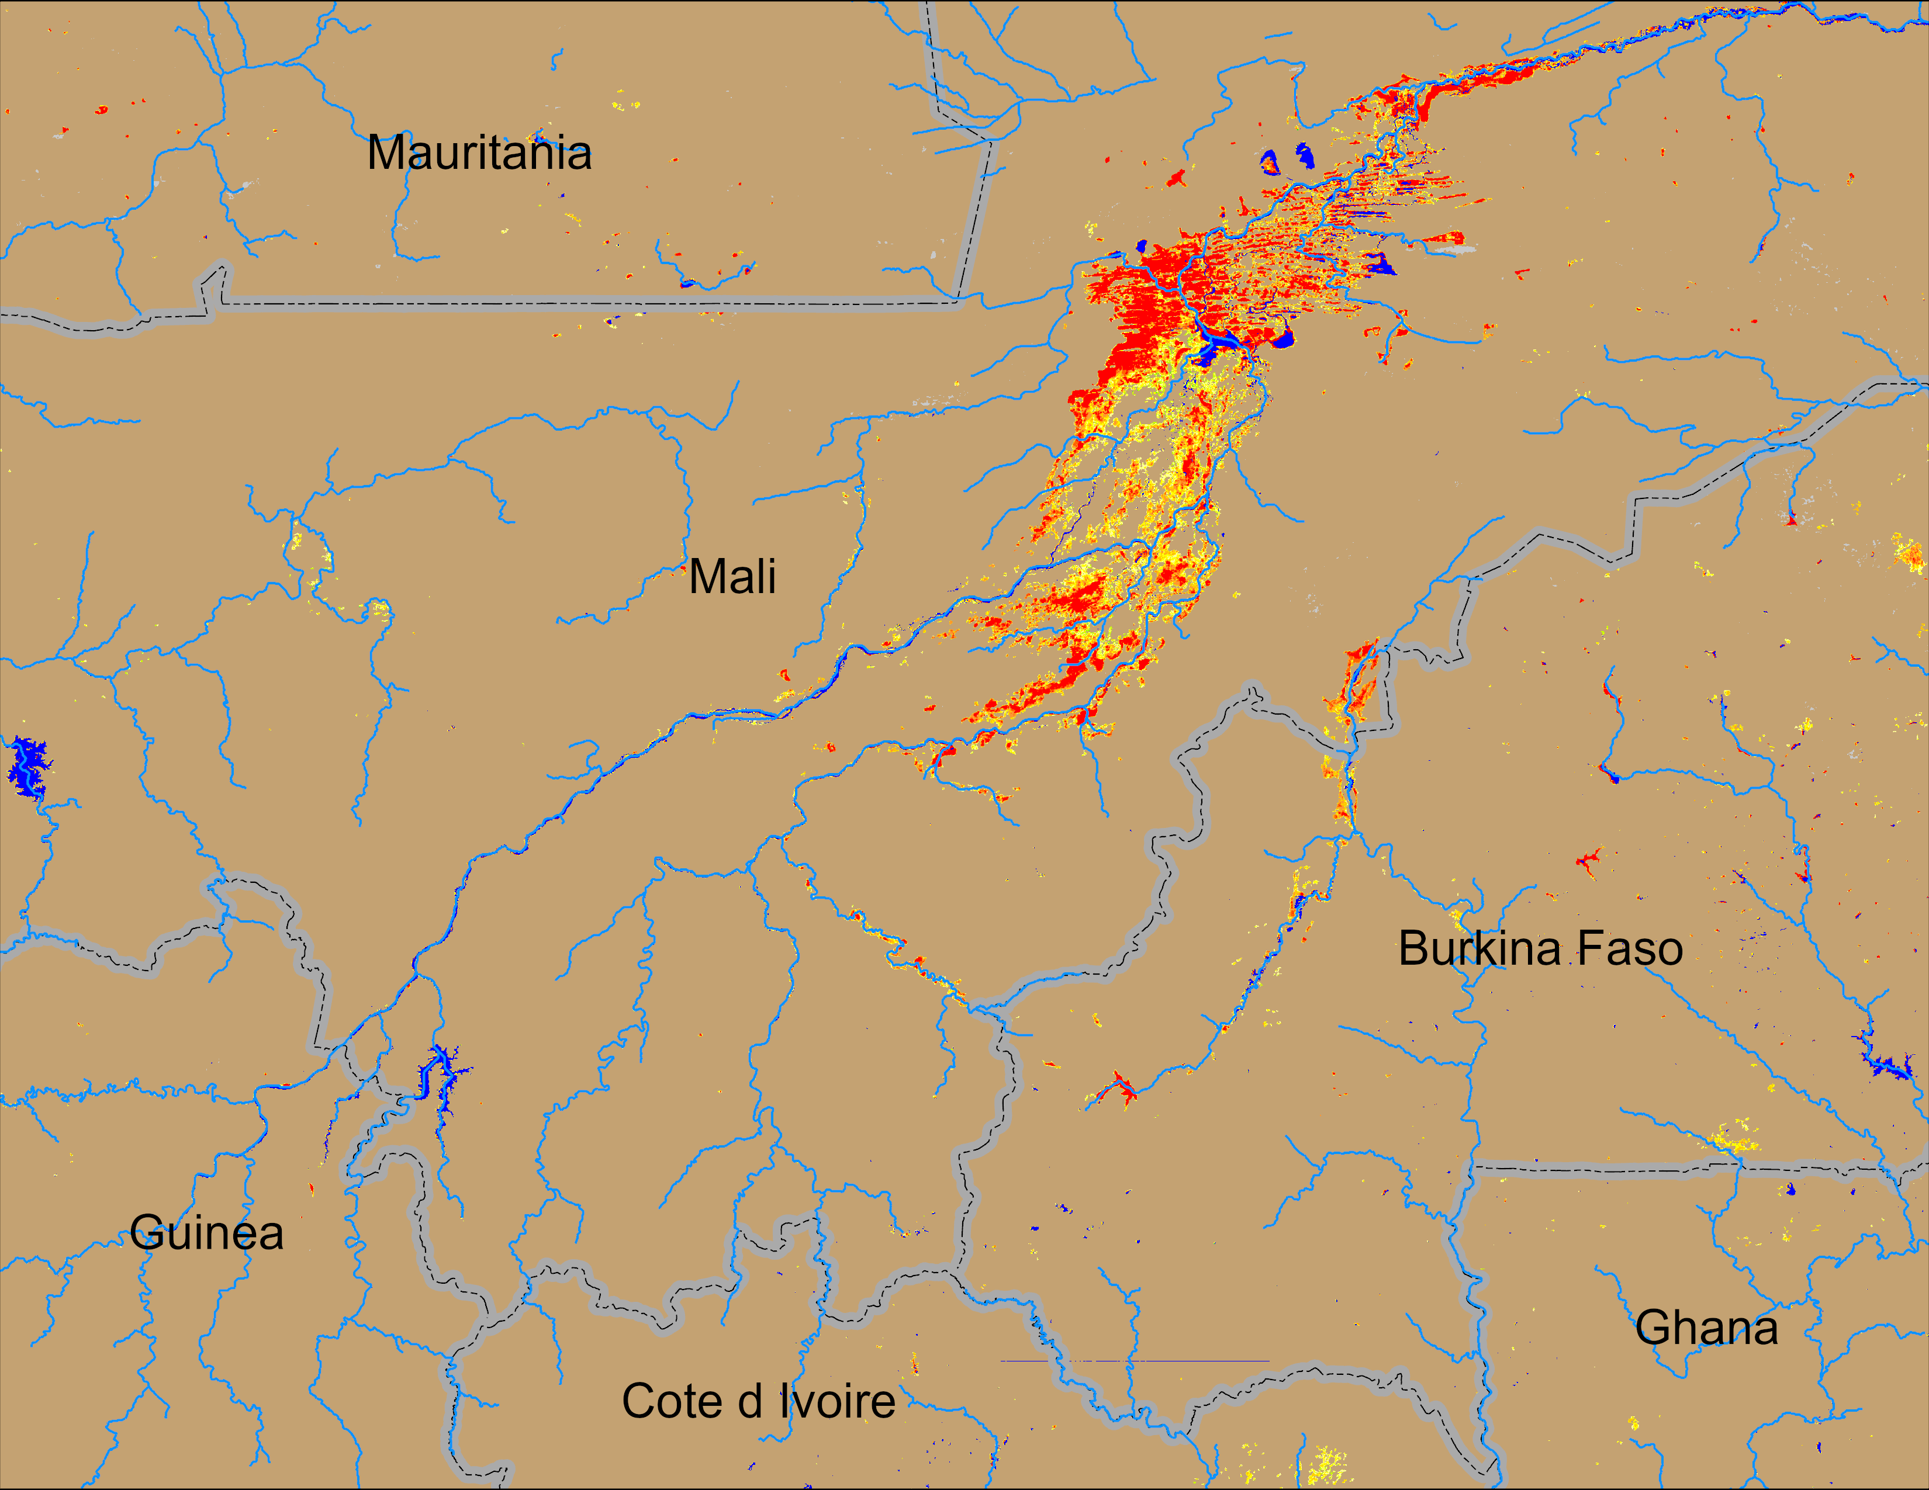
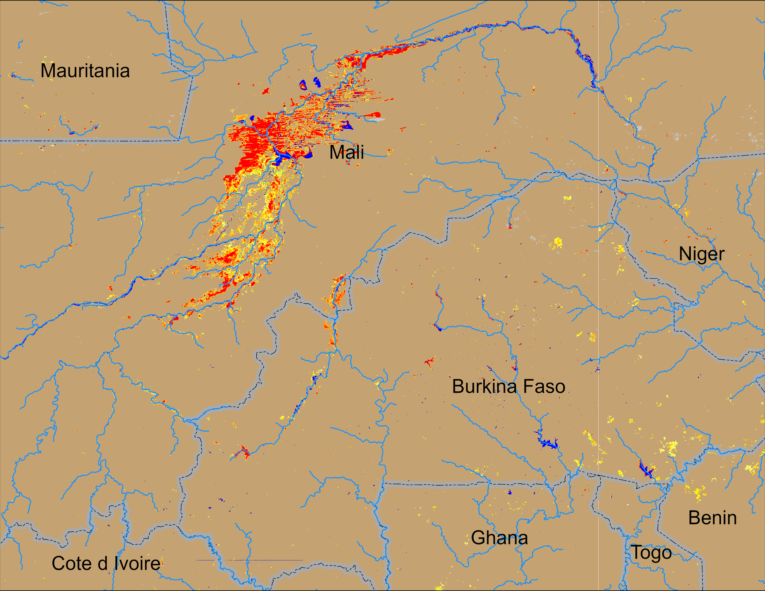
Flooding Conditions in Mali
(% of the pixel)
(% of the pixel)
NOAA VIIRS 5-day comp.: 20 – 24 Nov 2024
NOAA VIIRS 5-day comp.: 26 – 30 Nov 2024
Marginal improvement of flooding in central Mali.

Slide 6
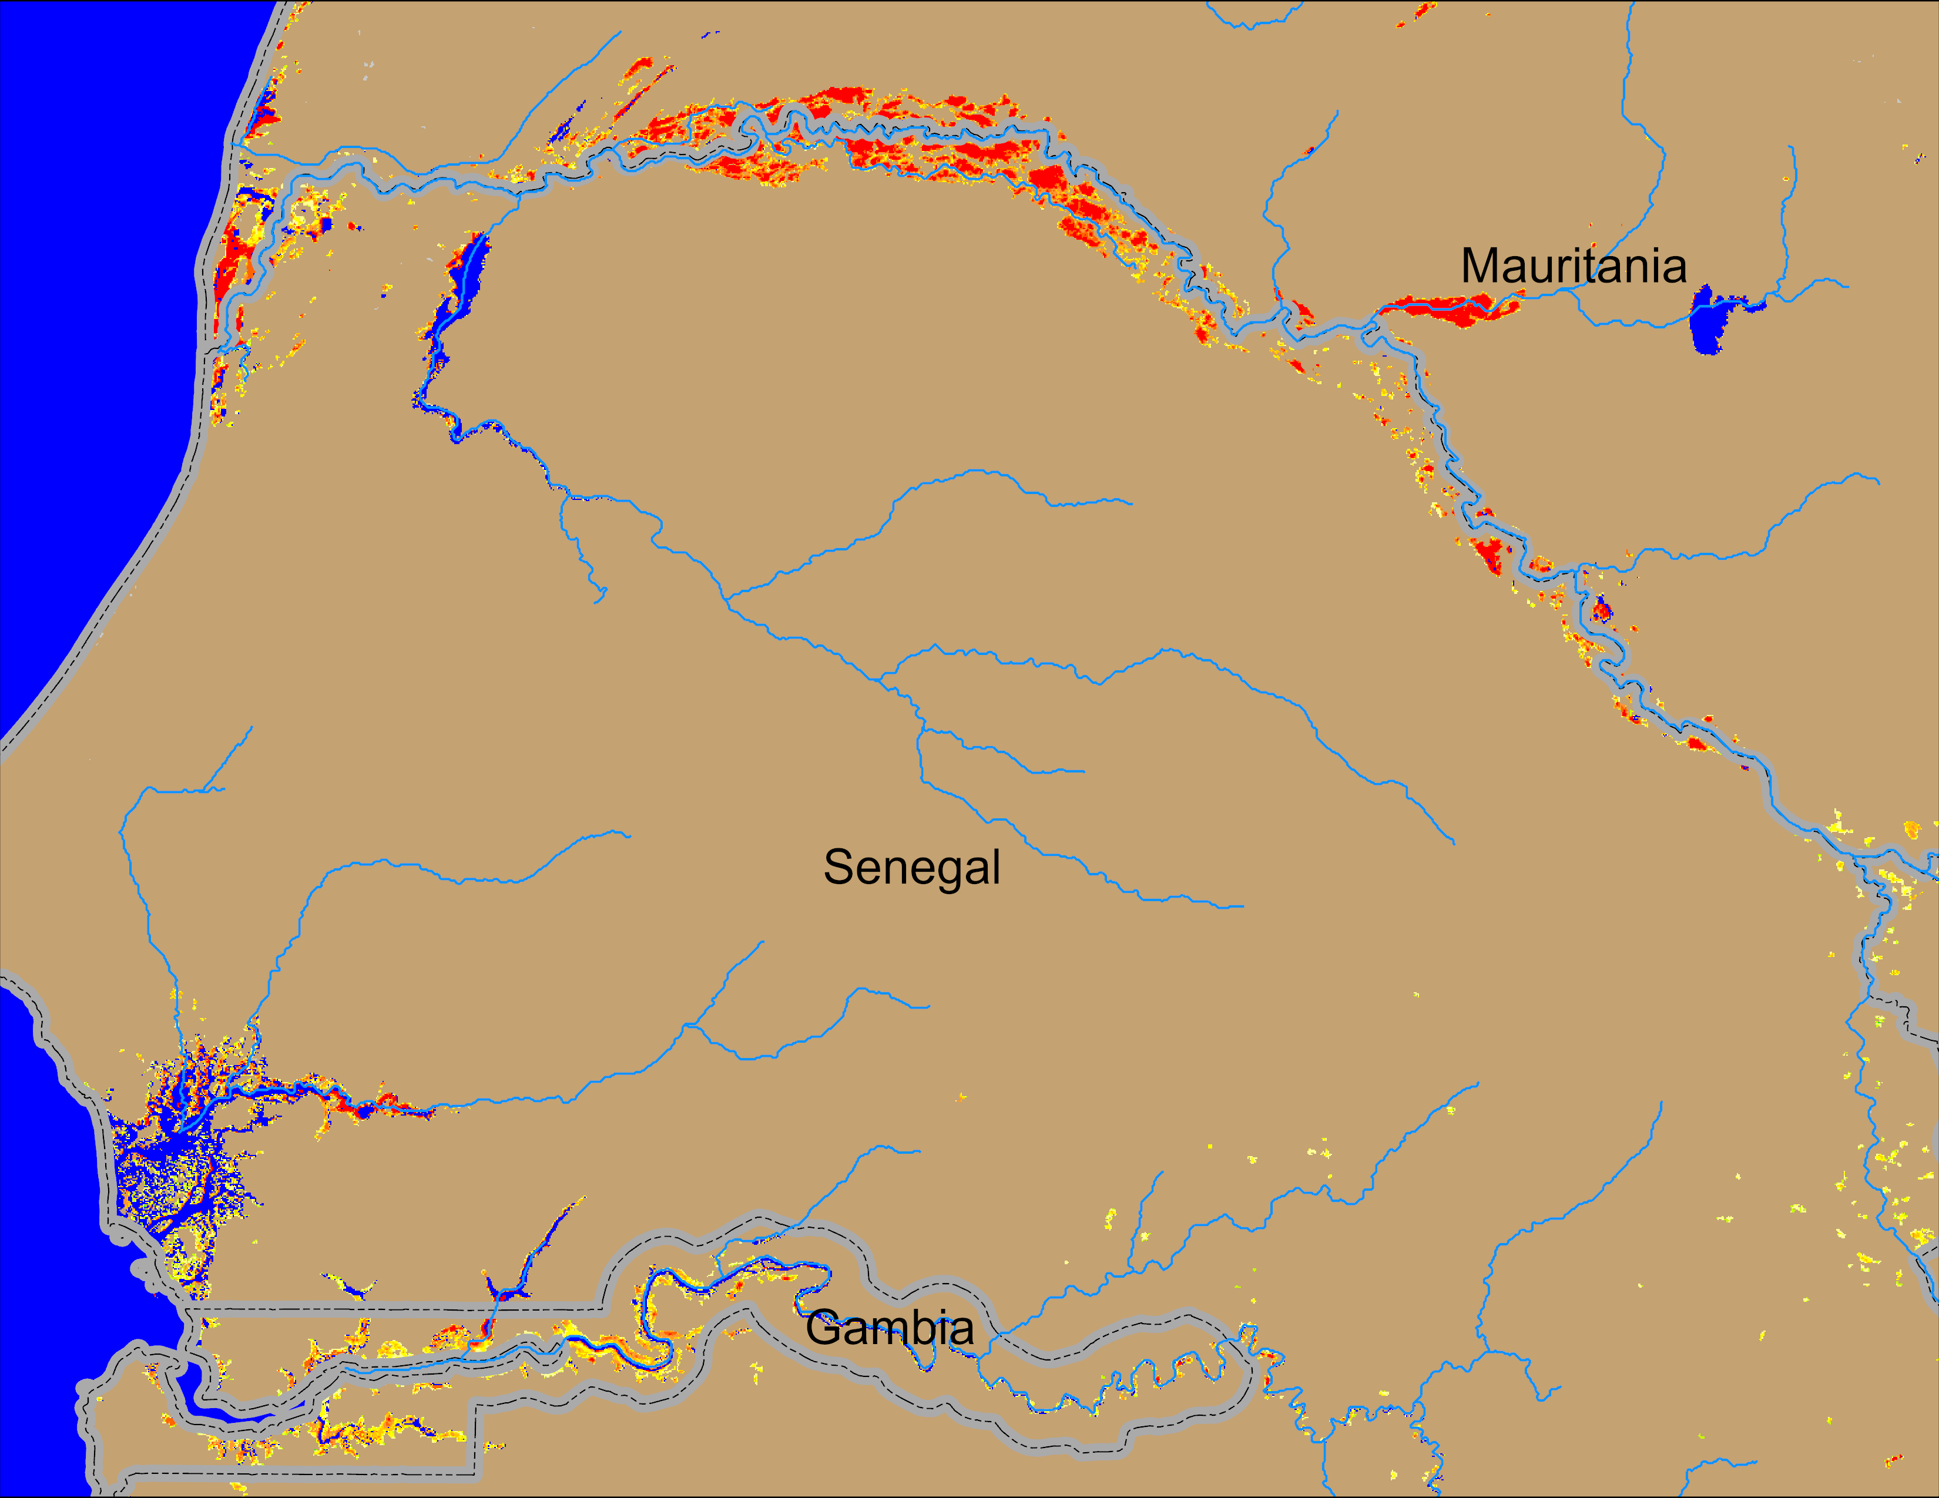
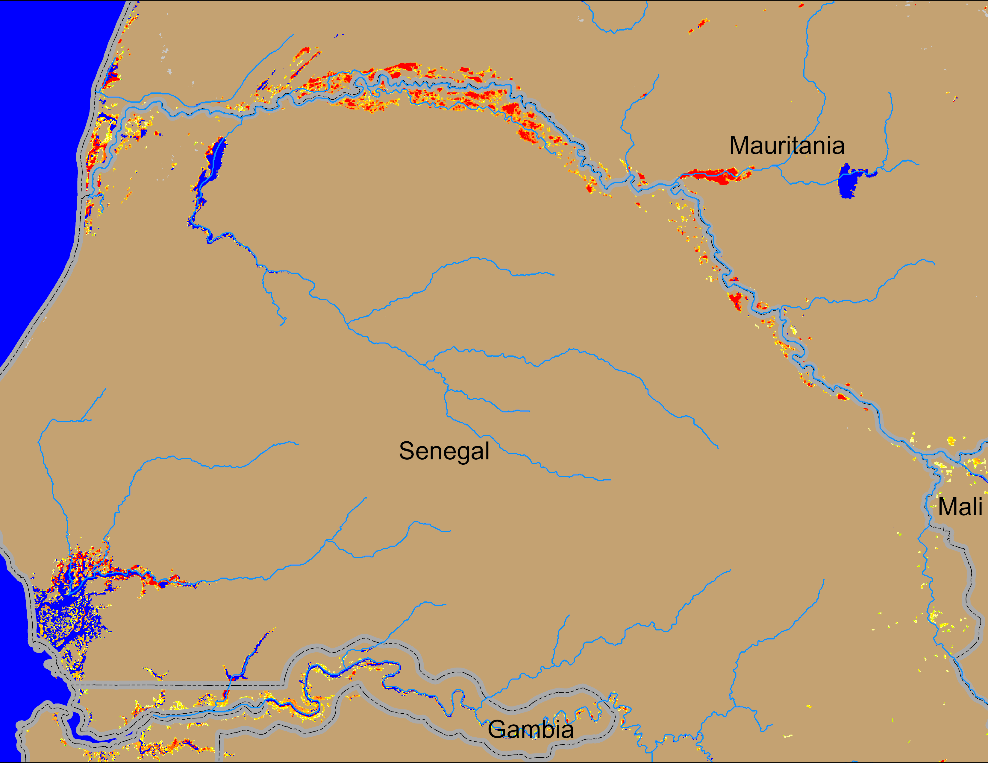
Flooding Conditions in Senegal
(% of the pixel)
(% of the pixel)
NOAA VIIRS 5-day comp.: 20 – 24 Nov 2024
NOAA VIIRS 5-day comp.: 26 – 30 Nov 2024
Substantial improvements of the flooding conditions along the Senegal River.

