Slide 1
FEWS NET Enhanced Flood Monitoring – East Africa, West Africa, southern Africa and Yemen
Apr 08, 2024, Hazard Briefing
FEWS NET Science Team:
USGS, NASA, NOAA, UCSB+Regional Scientists

Slide 2
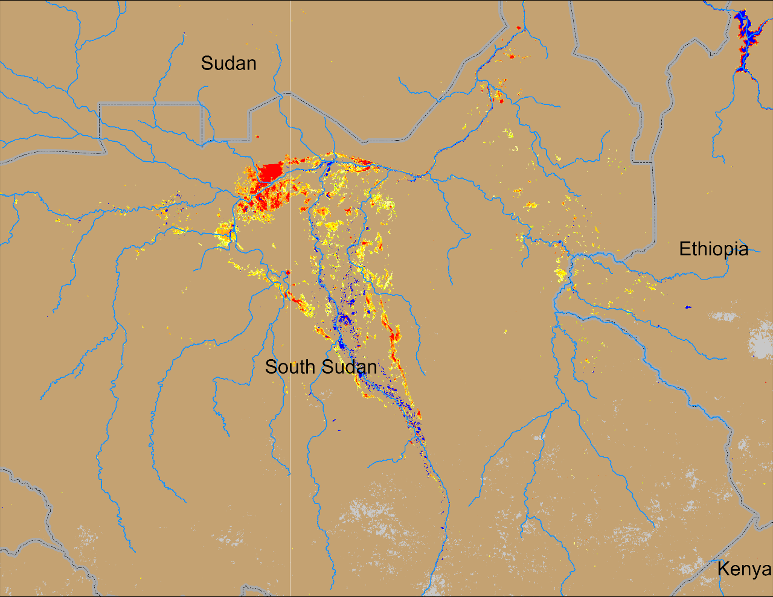
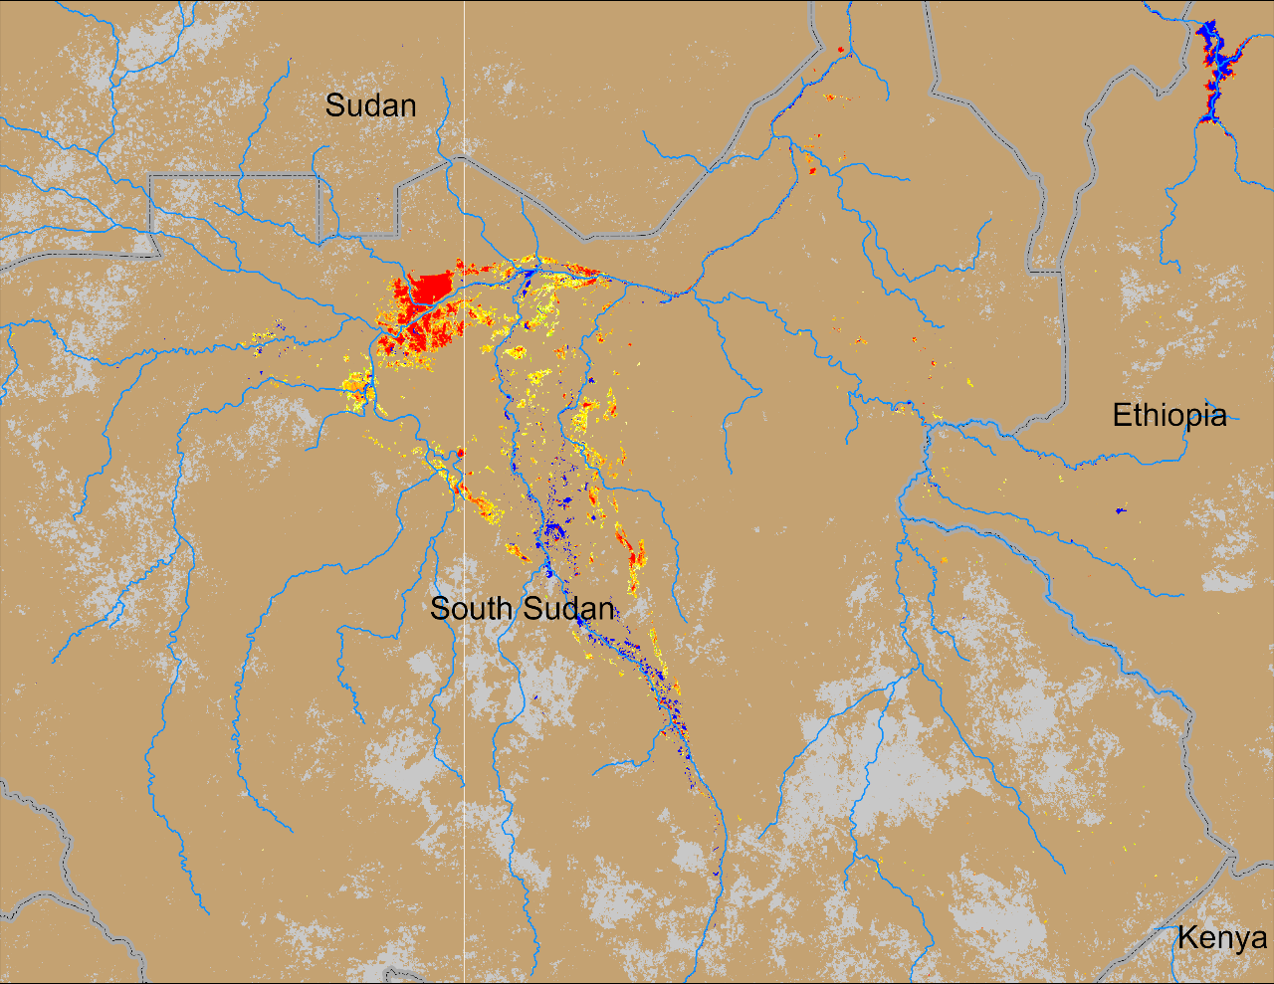
Flooding Conditions in South Sudan
(% of the pixel)
(% of the pixel)
Sobet
Sobet
Akobo
Akobo
Pibor
Pibor
NOAA VIIRS 5-day comp.: 27 – 31 Mar 2024
NOAA VIIRS 5-day comp.: 03 – 07 Apr 2024
Flooding conditions improved marginally especially along the Sobet and Akobo catchments in South Sudan.

Slide 3
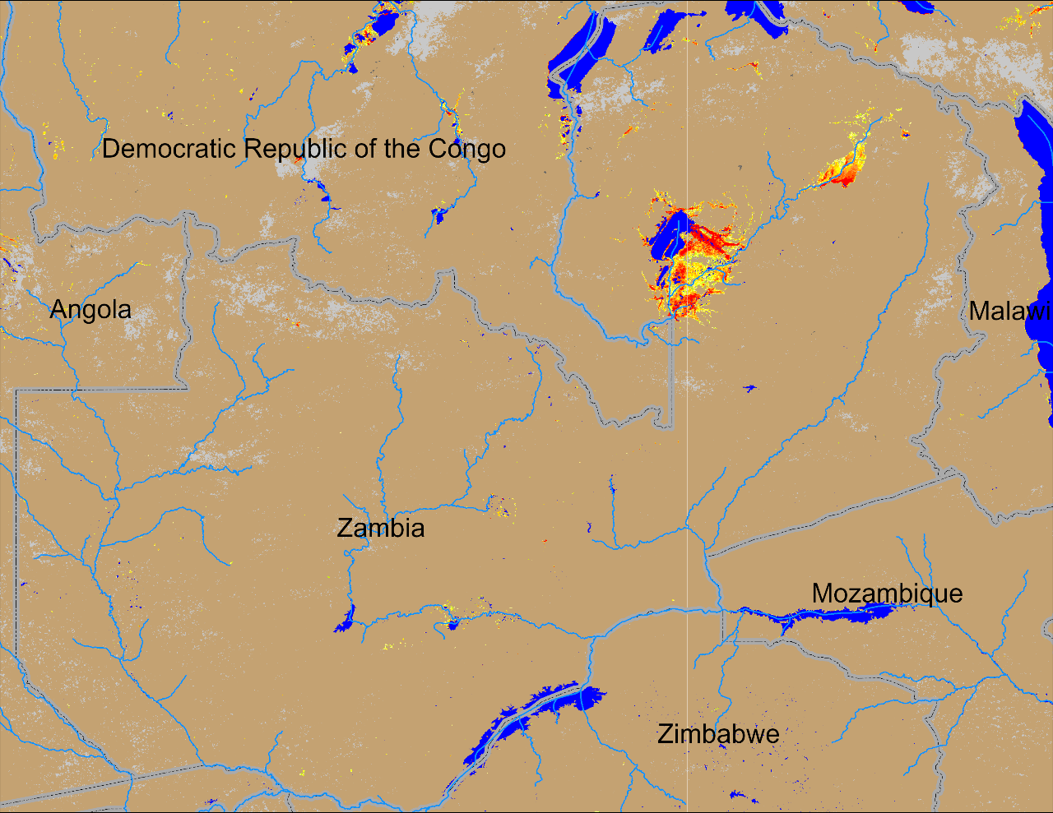
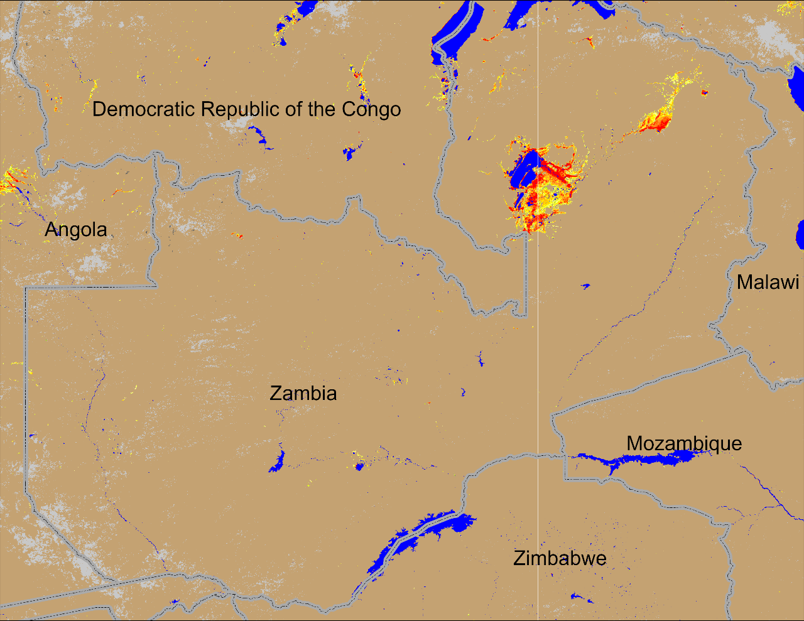
Flooding in Zambia and Eastern Angola
(% of the pixel)
(% of the pixel)
NOAA VIIRS 5-day comp.: 27 – 31 Mar 2024
NOAA VIIRS 5-day comp.: 03 – 07 Apr 2024
Flooding conditions remained consistently unchanged in northeastern Zambia for past several weeks.

Slide 4
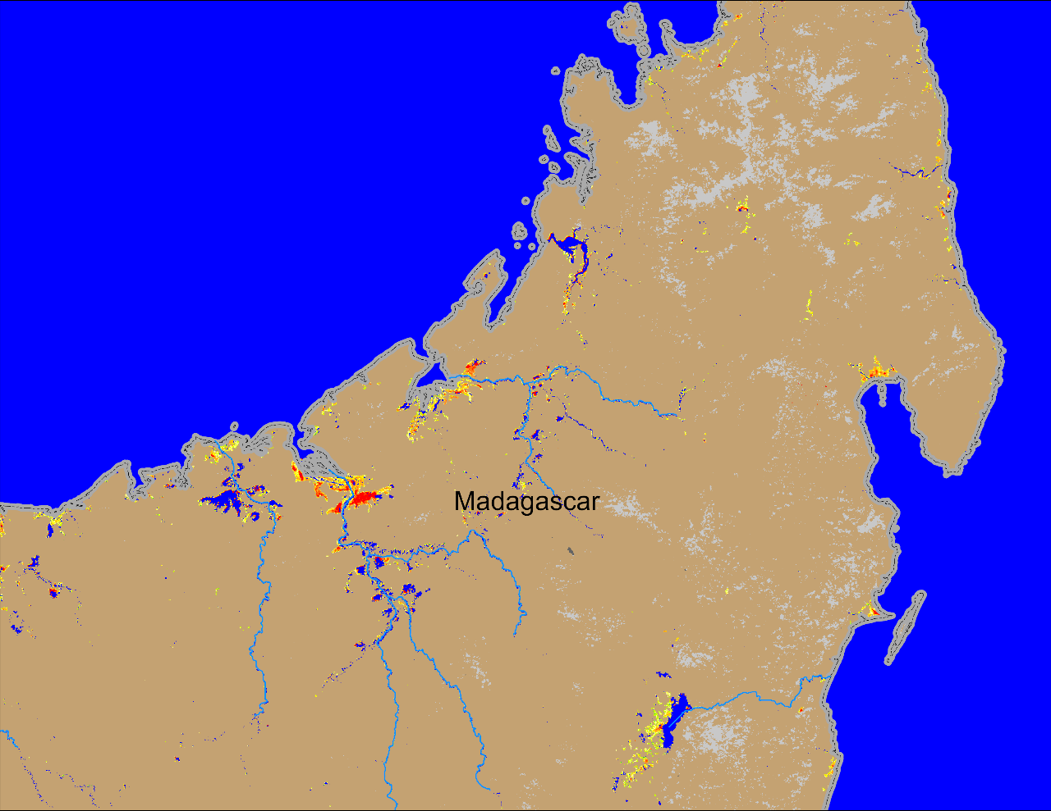
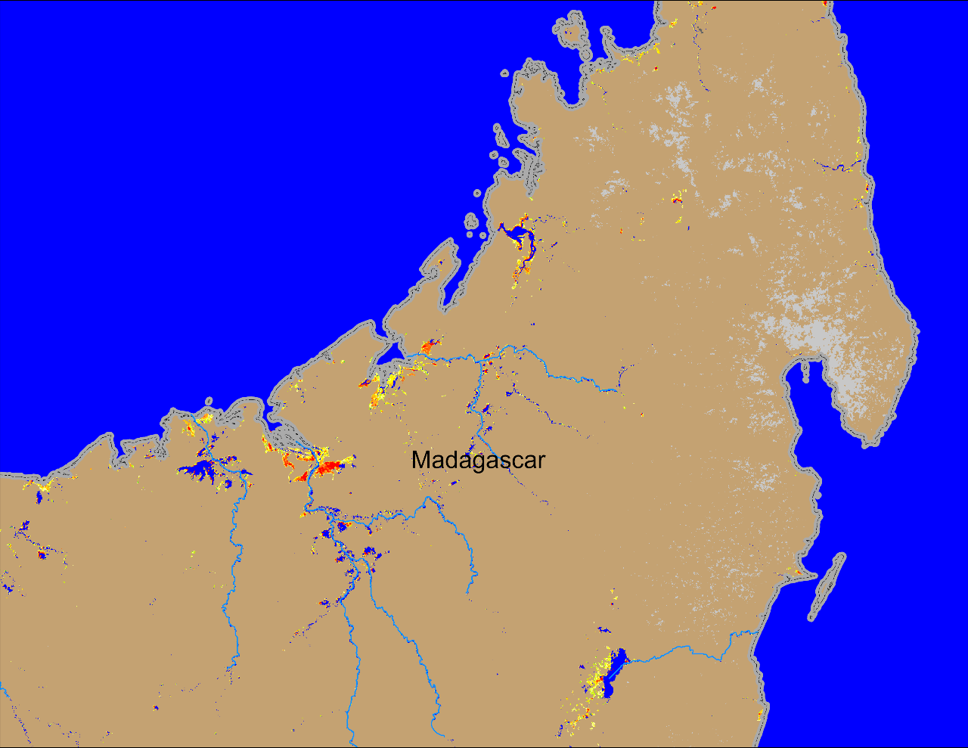
Flooding Conditions in Madagascar
(% of the pixel)
(% of the pixel)
NOAA VIIRS 5-day comp.: 27 – 31 Mar 2024
NOAA VIIRS 5-day comp.: 03 – 07 Apr 2024
Flooding conditions improved marginally in northern Madagascar.

