Slide 1
FEWS NET Enhanced Flood Monitoring – Madagascar
Mar 19, 2023, Hazard Briefing
FEWS NET Science Team:
USGS, NASA, NOAA, UCSB+Regional Scientists

Slide 2
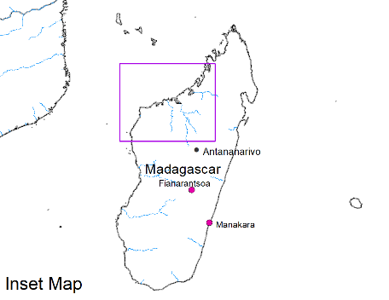
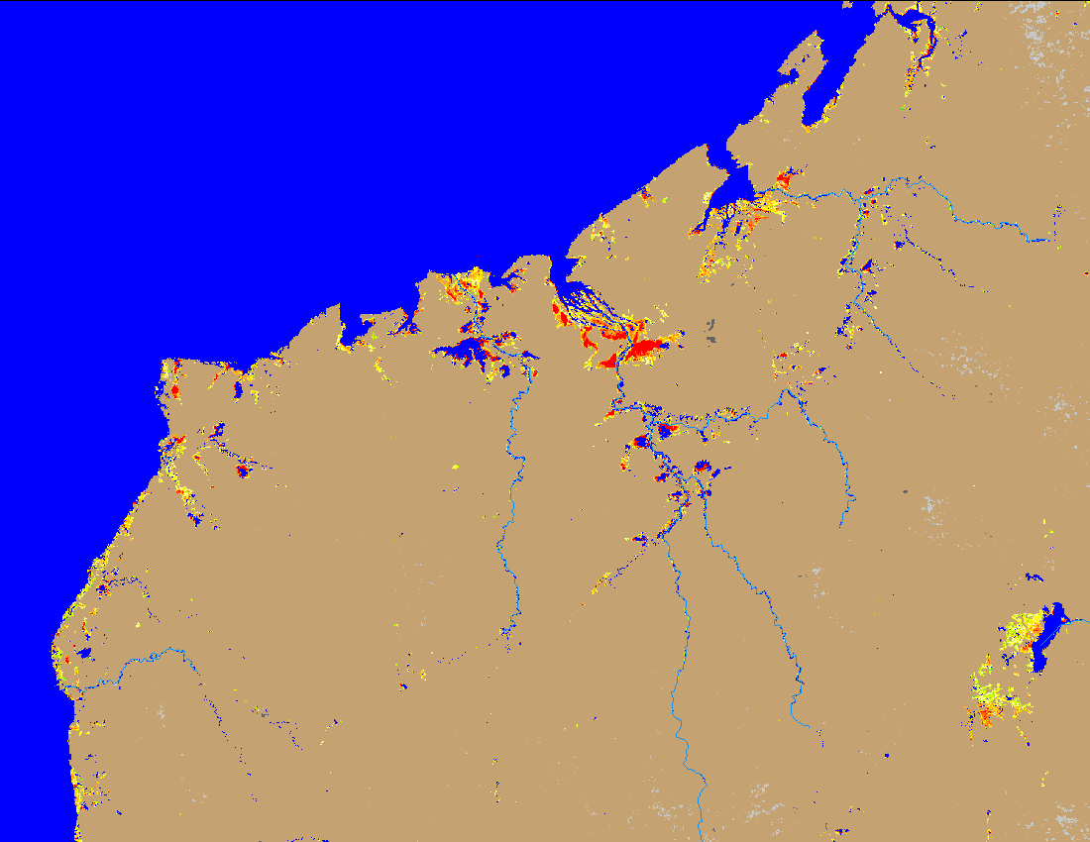
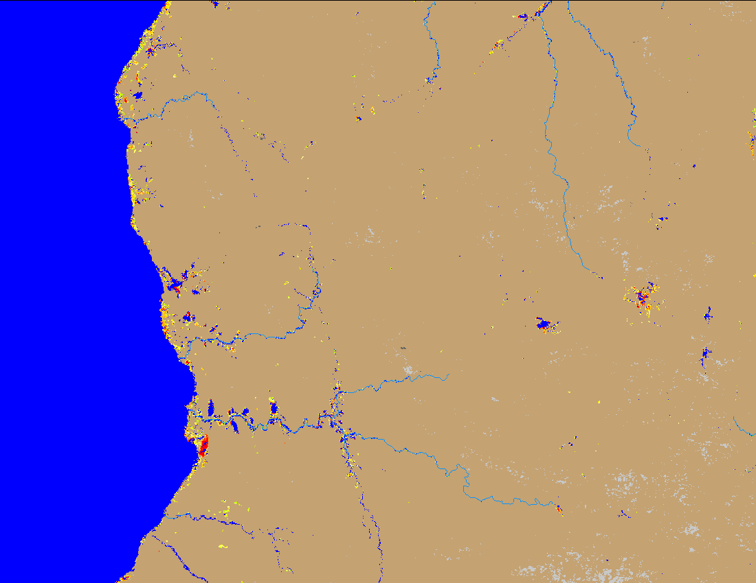
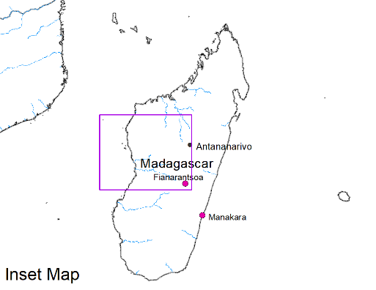
Flooding Conditions in Madagascar Due to TC Freddy
(% of the pixel)
(% of the pixel)
NOAA VIIRS 5-day comp.: 14 – 18 Mar 2023
NOAA VIIRS 5-day comp.: 14 – 18 Mar 2023
TC Freddy caused isolated flooding along the coastal rivers of western and southwestern Madagascar.

Slide 3
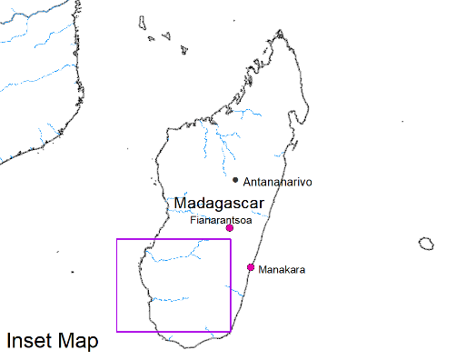
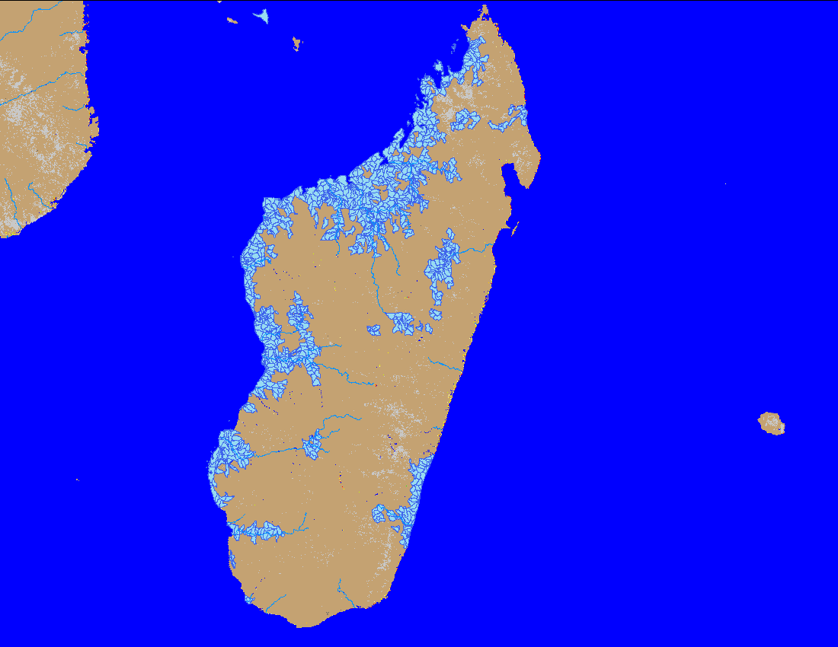
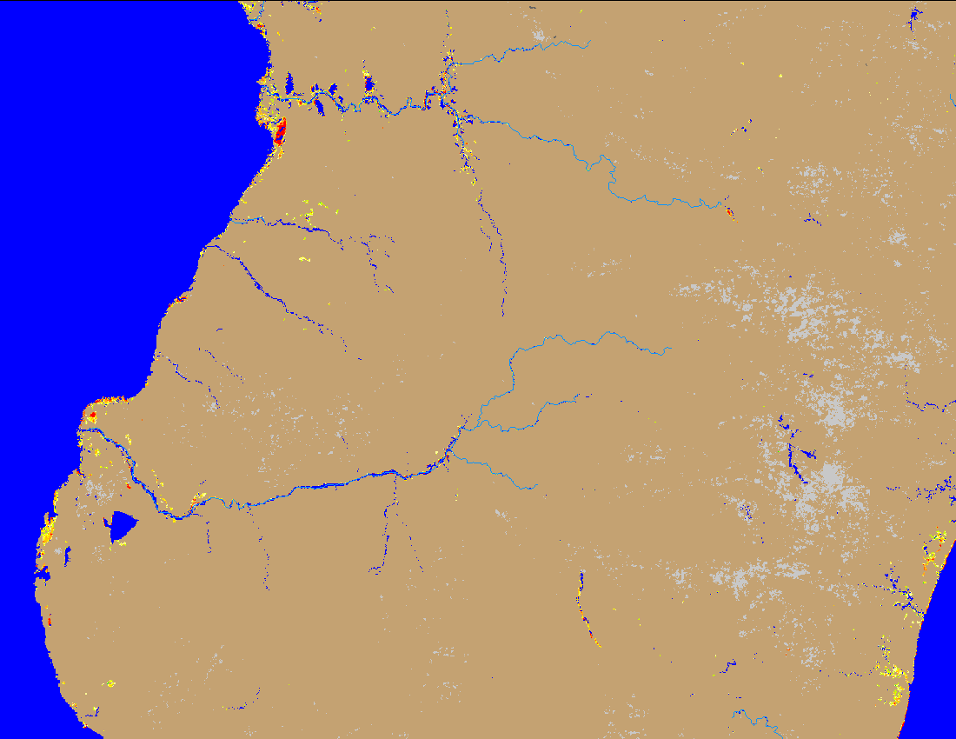
Flooding Conditions in Madagascar Caused by TC Freddy
(% of the pixel)
NOAA VIIRS 5-day comp.: 14 – 18 Mar 2023
Flooding polygons caused by TC Freddy: 14 – 18 Mar 2023
TC Freddy caused some flooding along the southwestern Madagascar, but they are not widespread.

