Slide 1
FEWS NET Enhanced Flood Monitoring – East Africa, West Africa, southern Africa and Yemen
Sep 18, 2023, Hazard Briefing
FEWS NET Science Team:
USGS, NASA, NOAA, UCSB+Regional Scientists

Slide 2
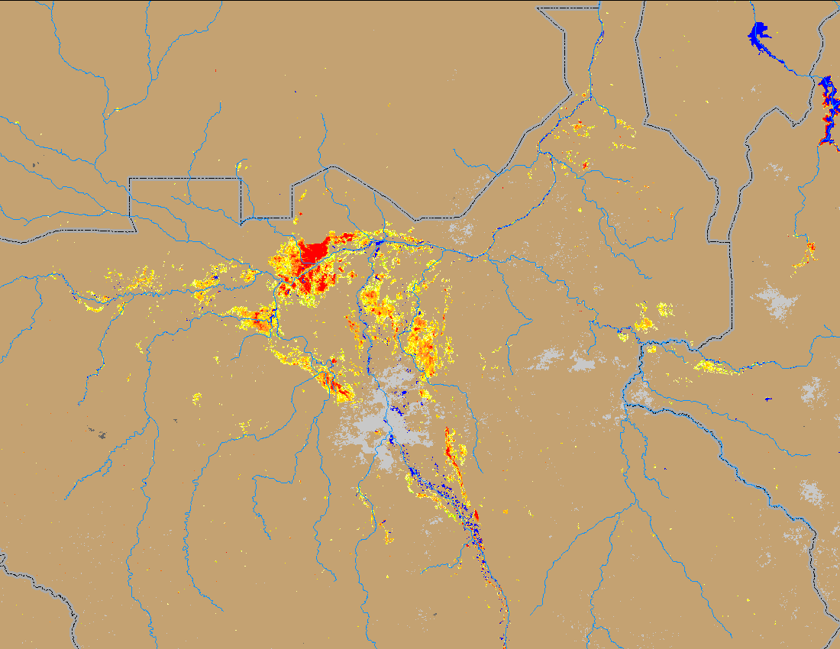
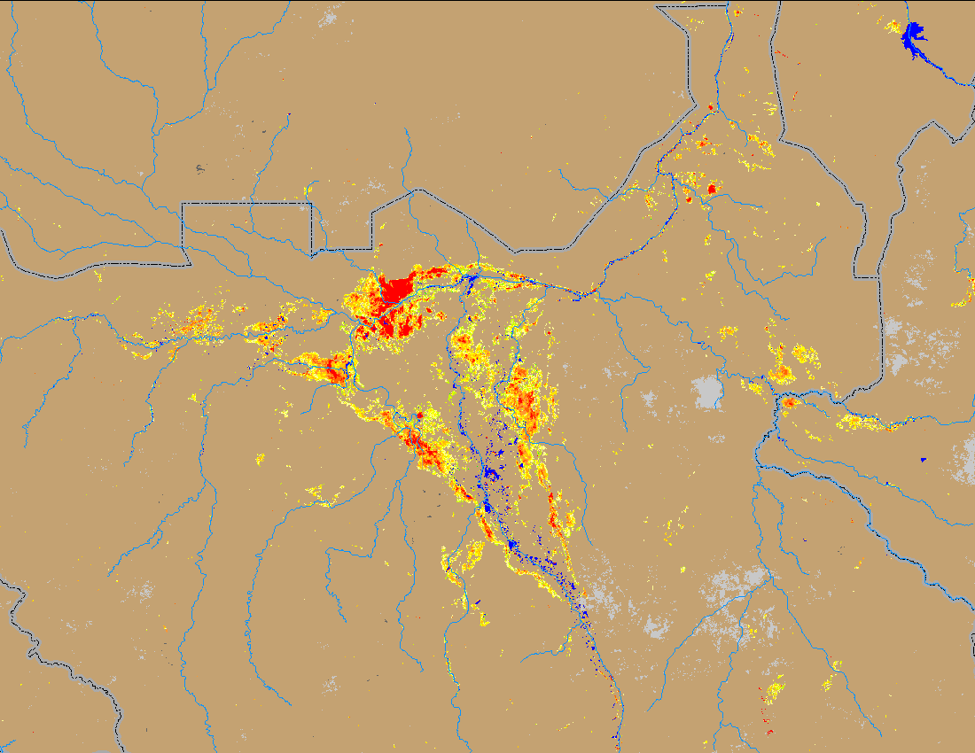
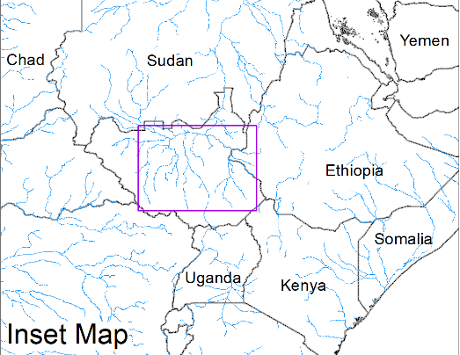
Flooding Conditions in South Sudan
(% of the pixel)
(% of the pixel)
NOAA VIIRS 5-day comp.: 07 – 11 Sep 2023
NOAA VIIRS 5-day comp.: 13 – 17 Sep 2023
Flooding conditions remained unchanged in South Sudan.

Slide 3
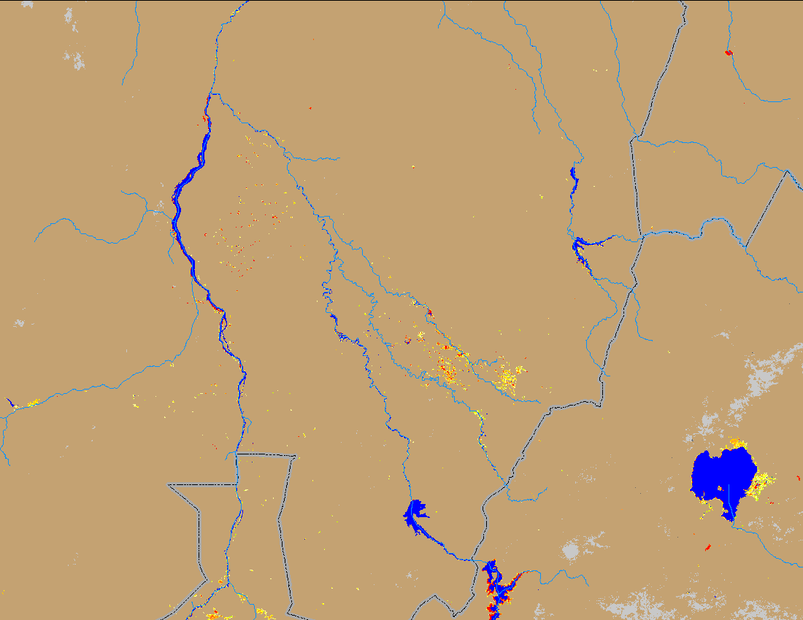
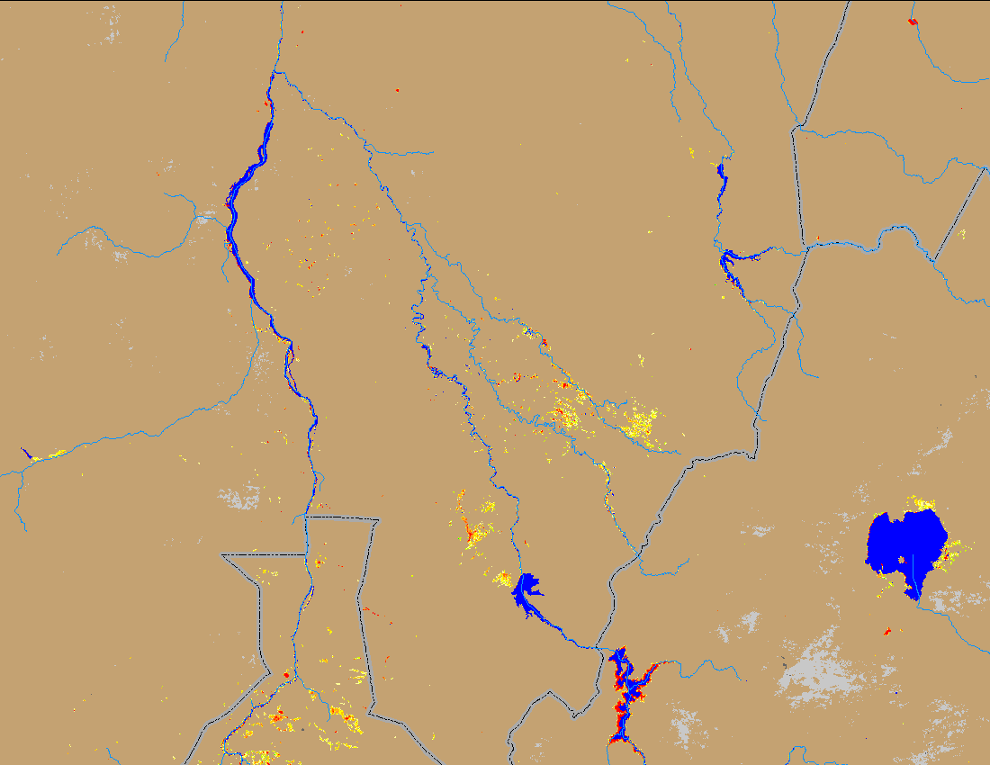
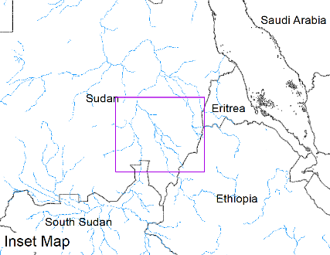
Flooding Conditions in Blue Nile River
(% of the pixel)
(% of the pixel)
NOAA VIIRS 5-day comp.: 07 – 11 Sep 2023
NOAA VIIRS 5-day comp.: 13 – 17 Sep 2023
Flooding also remained unchanged along White and Blue Nile Rivers in Sudan.

Slide 4
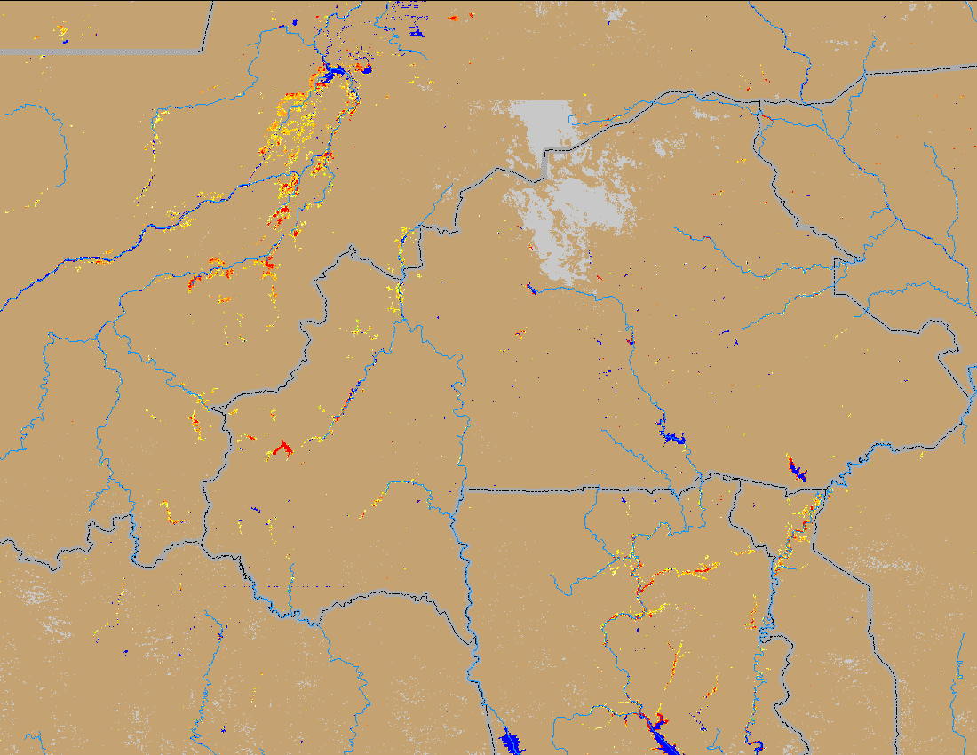
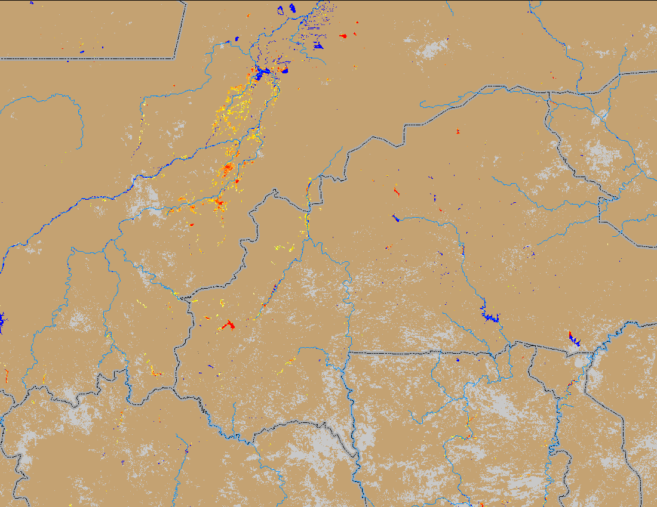
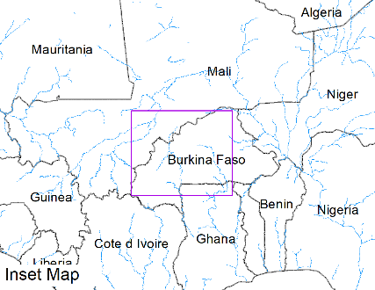
Flooding Conditions in Mali
(% of the pixel)
(% of the pixel)
NOAA VIIRS 5-day comp.: 07 – 11 Sep 2023
NOAA VIIRS 5-day comp.: 13 – 17 Sep 2023
Flooding remained unchanged in Central Mali and Burkina Faso.

Slide 5
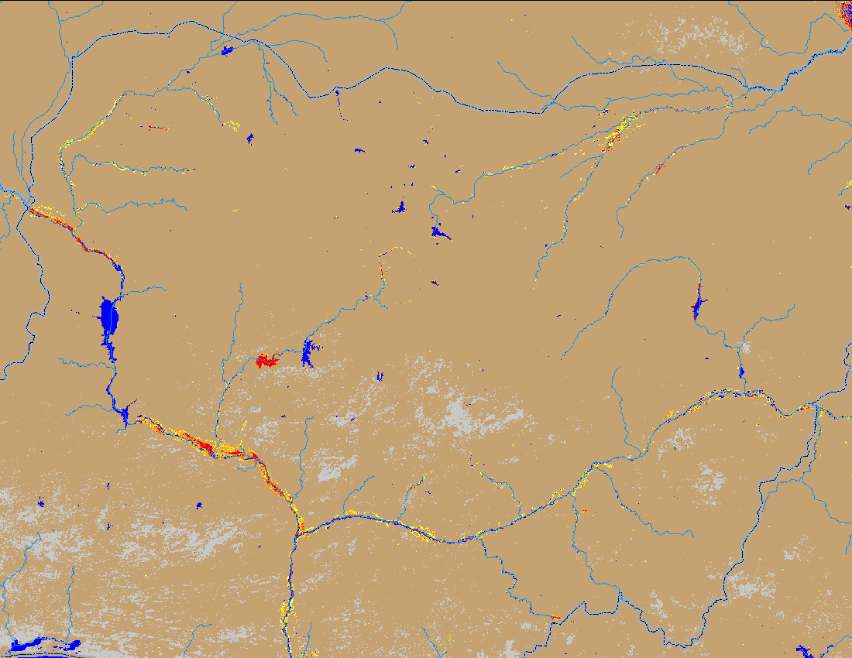
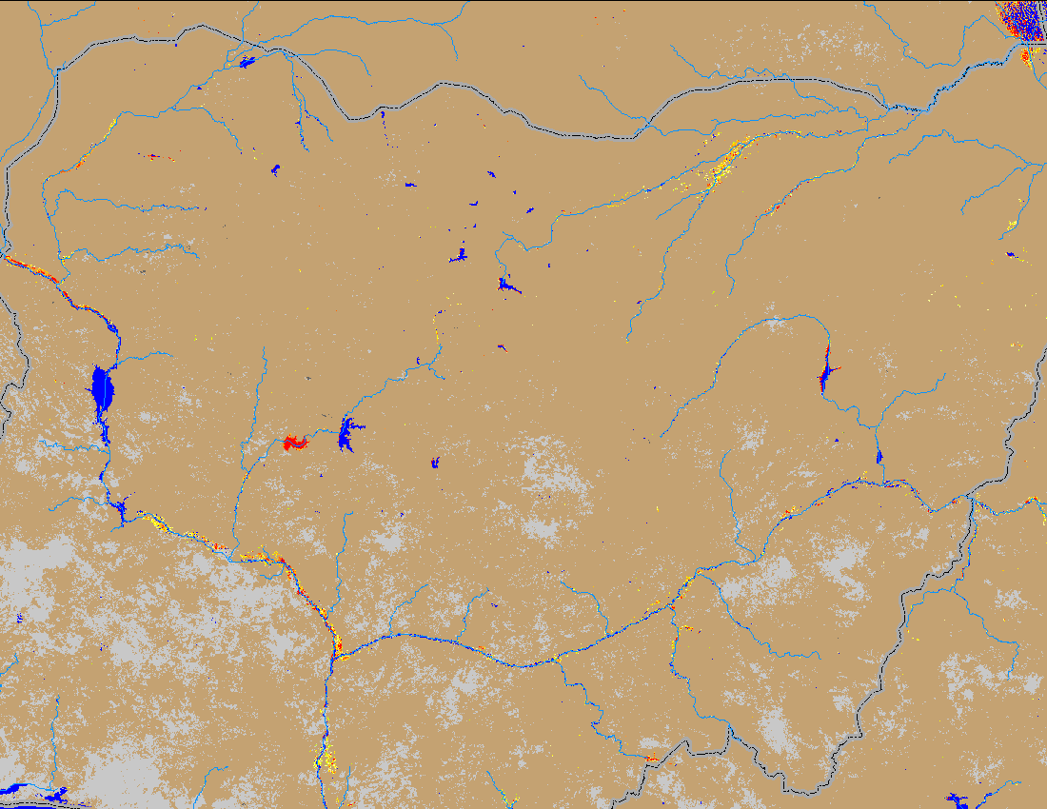
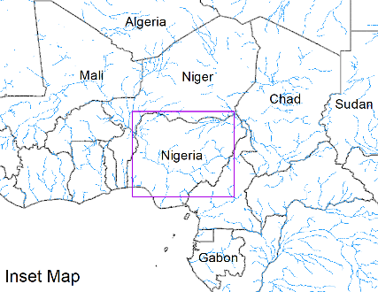
Flooding Conditions in Nigeria
(% of the pixel)
(% of the pixel)
NOAA VIIRS 5-day comp.: 07 – 11 Sep 2023
NOAA VIIRS 5-day comp.: 13 – 17 Sep 2023
Marginal improvement in flooding conditions across Nigeria has been observed.

Slide 6
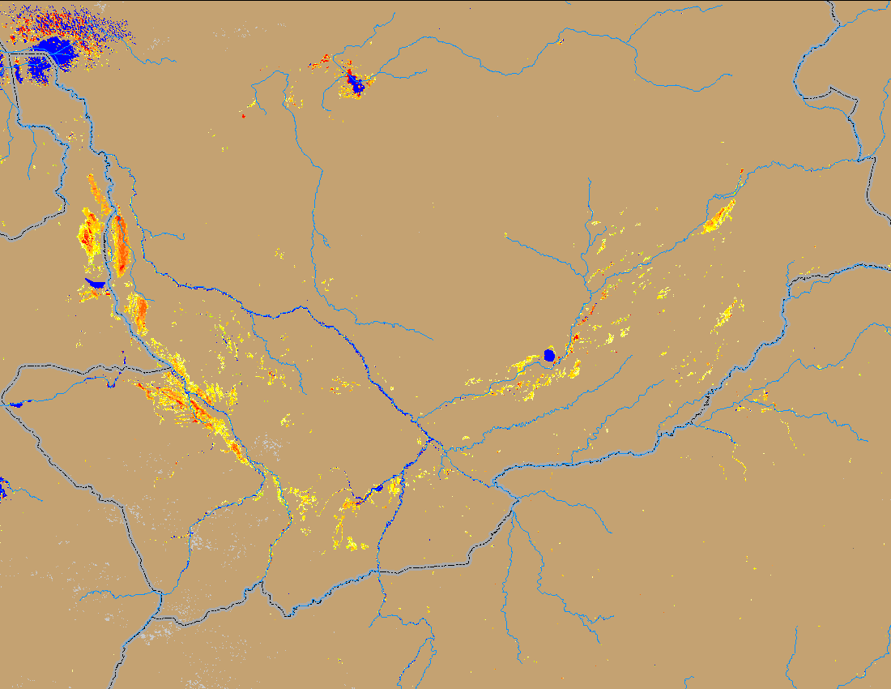
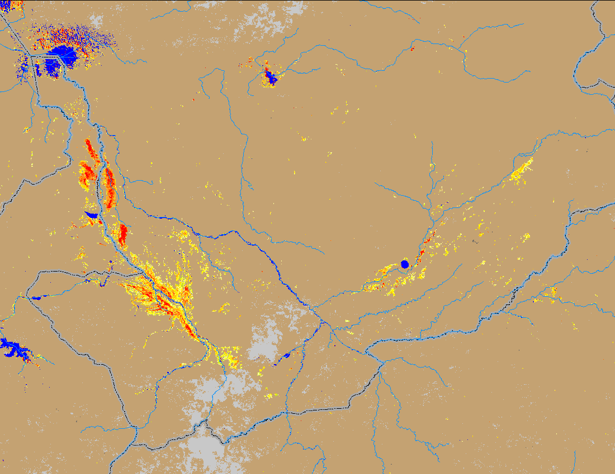
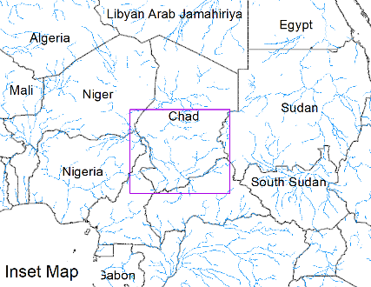
Flooding Conditions in Chad
(% of the pixel)
(% of the pixel)
NOAA VIIRS 5-day comp.: 07 – 11 Sep 2023
NOAA VIIRS 5-day comp.: 13 – 17 Sep 2023
Flooding conditions remained unchanged in southern Chad.

