Slide 1
FEWS NET Enhanced Flood Monitoring – East Africa, West Africa, southern Africa and Yemen
Oct 23, 2023, Hazard Briefing
FEWS NET Science Team:
USGS, NASA, NOAA, UCSB+Regional Scientists

Slide 2
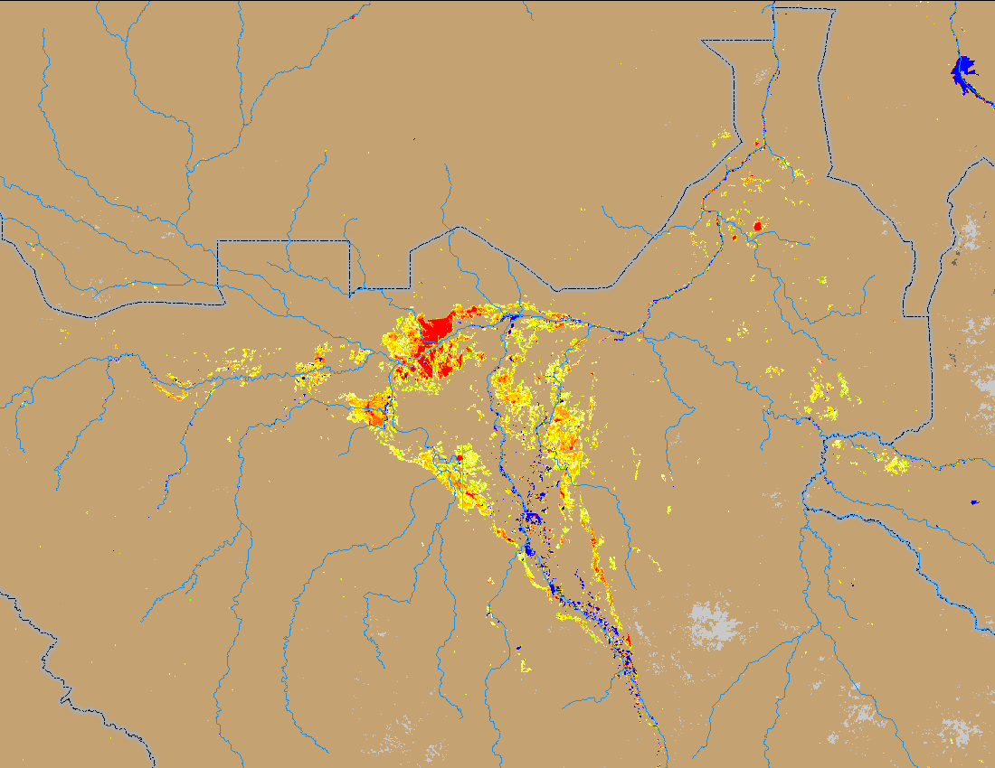
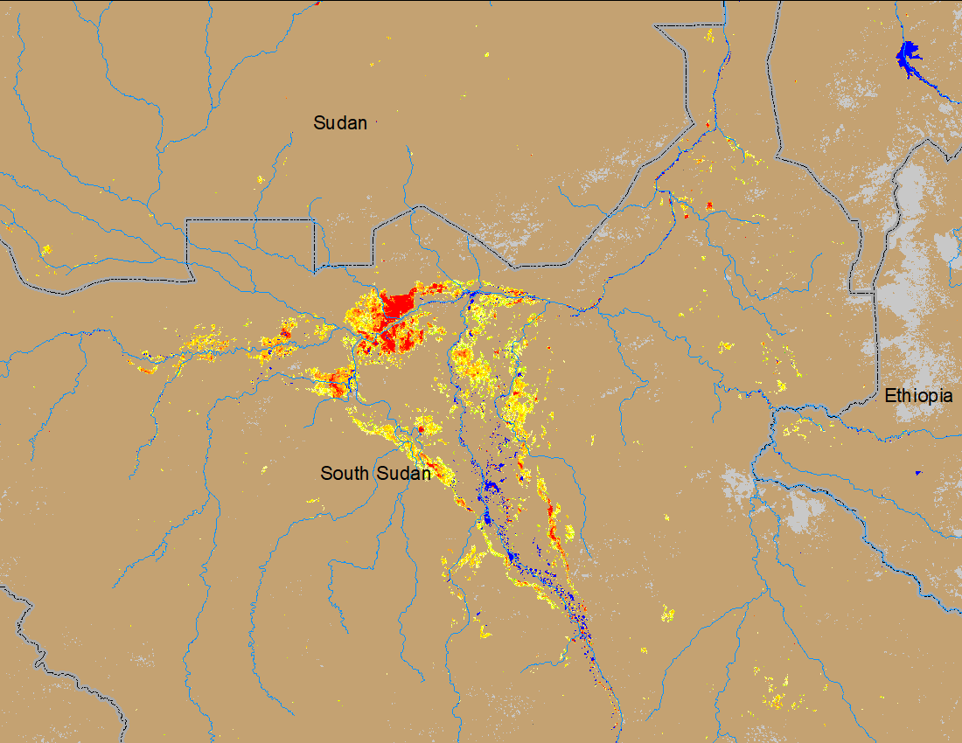
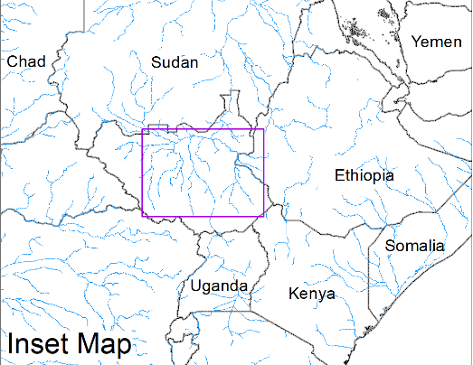
Flooding Conditions in South Sudan
(% of the pixel)
(% of the pixel)
NOAA VIIRS 5-day comp.: 11 – 15 Oct 2023
NOAA VIIRS 5-day comp.: 18 - 22 Oct 2023
Flooding conditions eased in the Sobet and Akobor catchments but remained unchanged elsewhere in South Sudan.

Slide 3
Flooding Conditions in Somalia
2-yr
5-yr
20-yr
2-yr
5-yr
20-yr
GloFAS Forecast: 24 – 26 Oct 2023
GloFAS Forecast: 27 – 05 Nov 2023
Due to expected heavy rainfall especially over the Juba catchment, there is increased likelihood of flooding along the Juba River in Somalia.

Slide 4
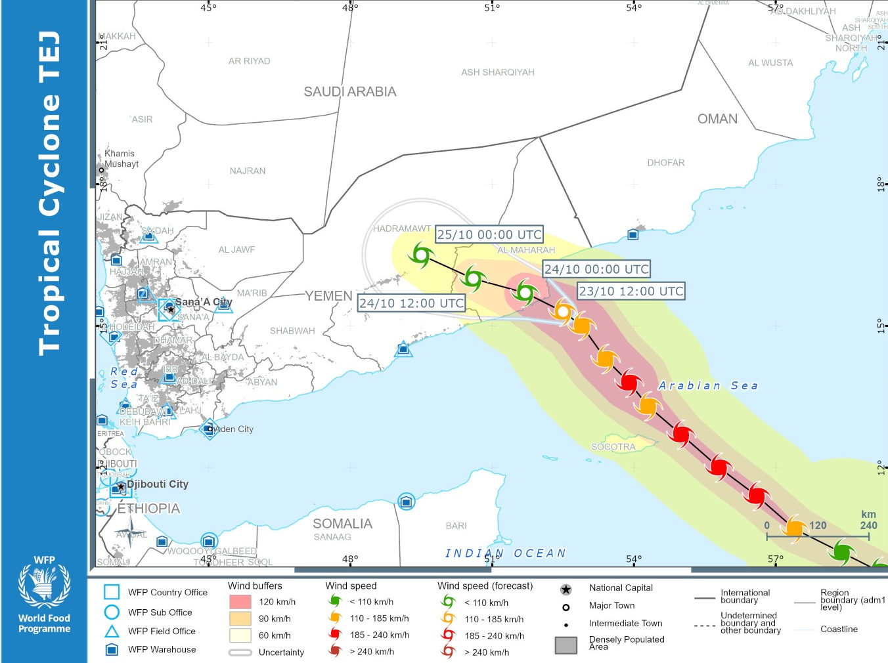
Flooding Conditions in Yemen
2-yr
5-yr
20-yr
ADAM: Tropical Cyclone TEJ track
GloFAS Forecast: 24 Oct – 05 Nov 2023
With TC making landfall in the eastern Yemen, there is increased likelihood of flooding in next 10 days in the eastern part of Yemen.

Slide 5
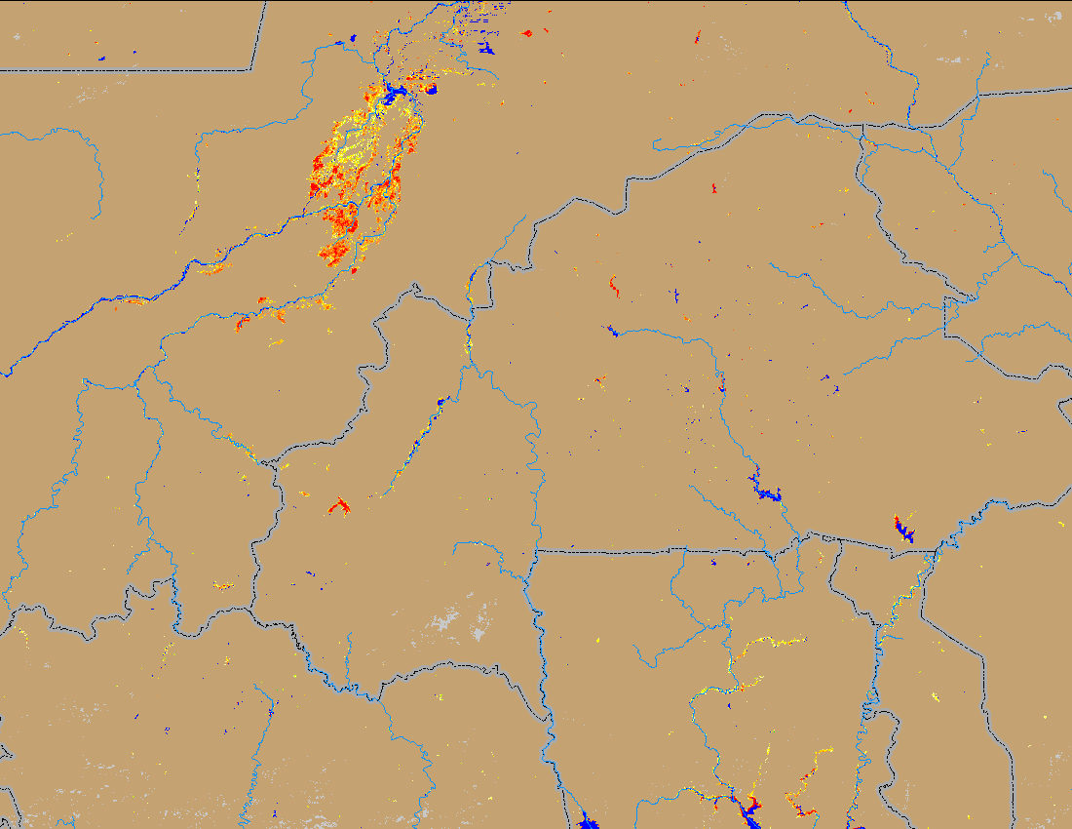
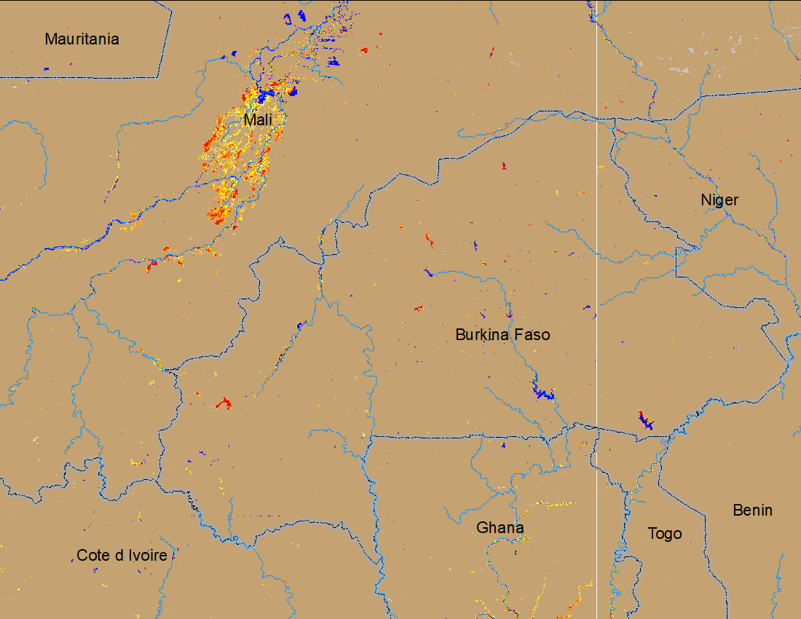
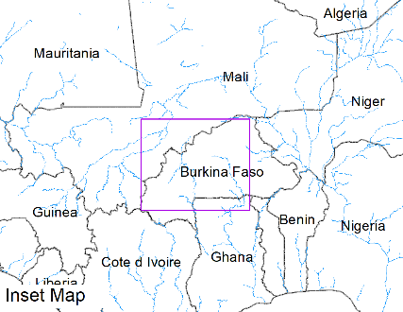
Flooding Conditions in Mali
(% of the pixel)
(% of the pixel)
NOAA VIIRS 5-day comp.: 11 – 15 Oct 2023
NOAA VIIRS 5-day comp.: 18 - 22 Oct 2023
Inundation condition are improving across Central Mali, Burkina Faso, and northern Ghana.

Slide 6
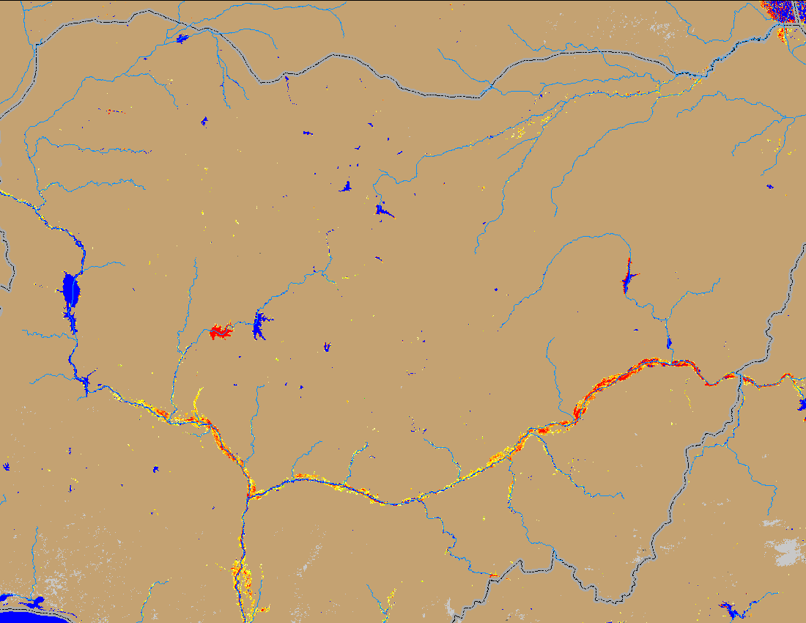
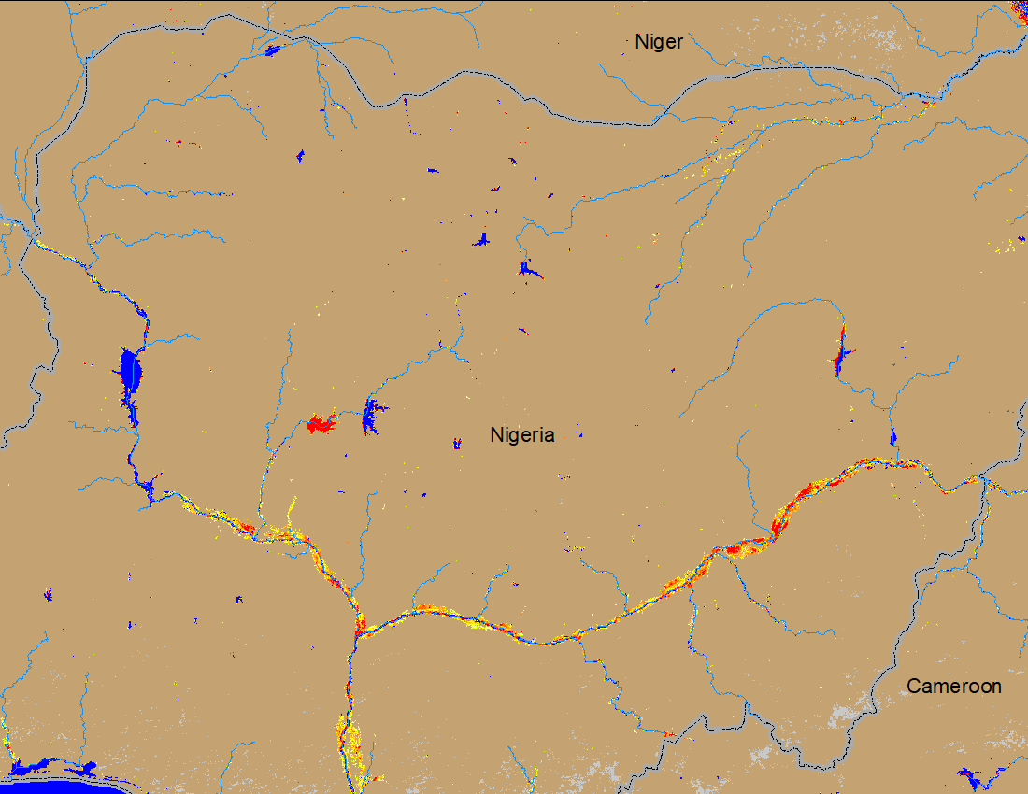
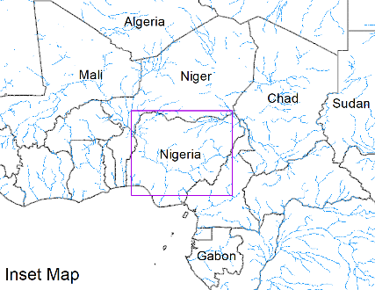
Flooding Conditions in Nigeria
(% of the pixel)
(% of the pixel)
NOAA VIIRS 5-day comp.: 11 – 15 Oct 2023
NOAA VIIRS 5-day comp.: 18 – 22 Oct 2023
Flooding conditions have remained unchanged along Niger and Benue Rivers.

Slide 7
Flooding Conditions in Southern Ghana and Benin
ADAM: Flooding in Benin: Oct 24, 2023
ADAM: Flooding in southern Ghana: Oct 24, 2023

Slide 8
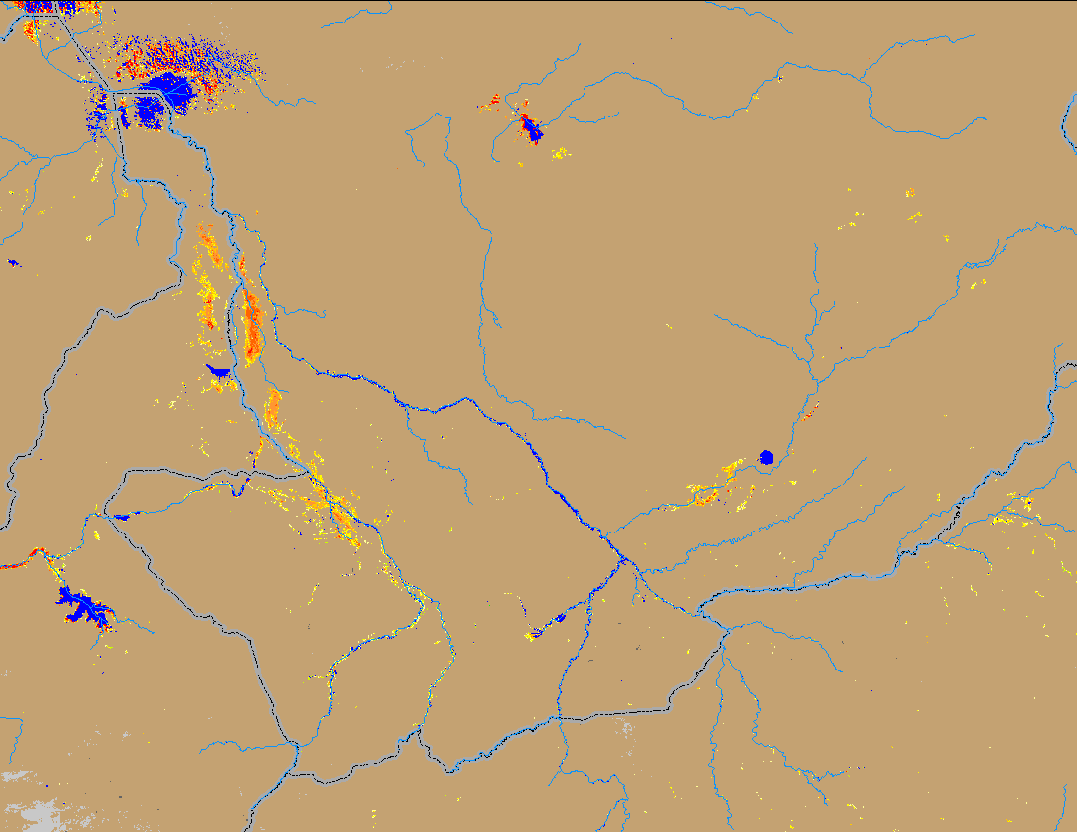
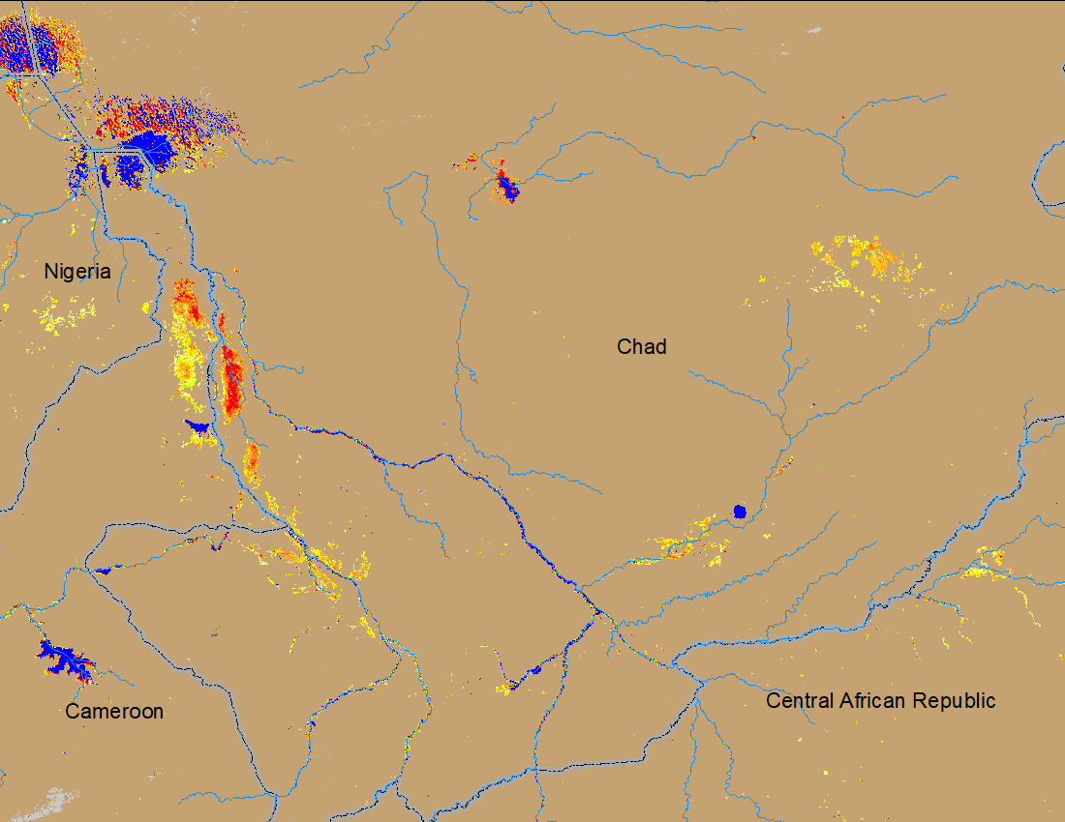
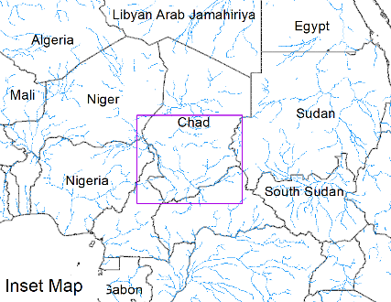
Flooding Conditions in Chad
(% of the pixel)
(% of the pixel)
NOAA VIIRS 5-day comp.: 11 - 15 Oct 2023
NOAA VIIRS 5-day comp.: 18 - 22 Oct 2023
Flooding conditions have deteriorated marginally across southern Chad.

