Slide 1
FEWS NET Enhanced Flood Monitoring – East Africa, West Africa, southern Africa and Yemen
July31, 2023, Hazard Briefing
FEWS NET Science Team:
USGS, NASA, NOAA, UCSB+Regional Scientists

Slide 2
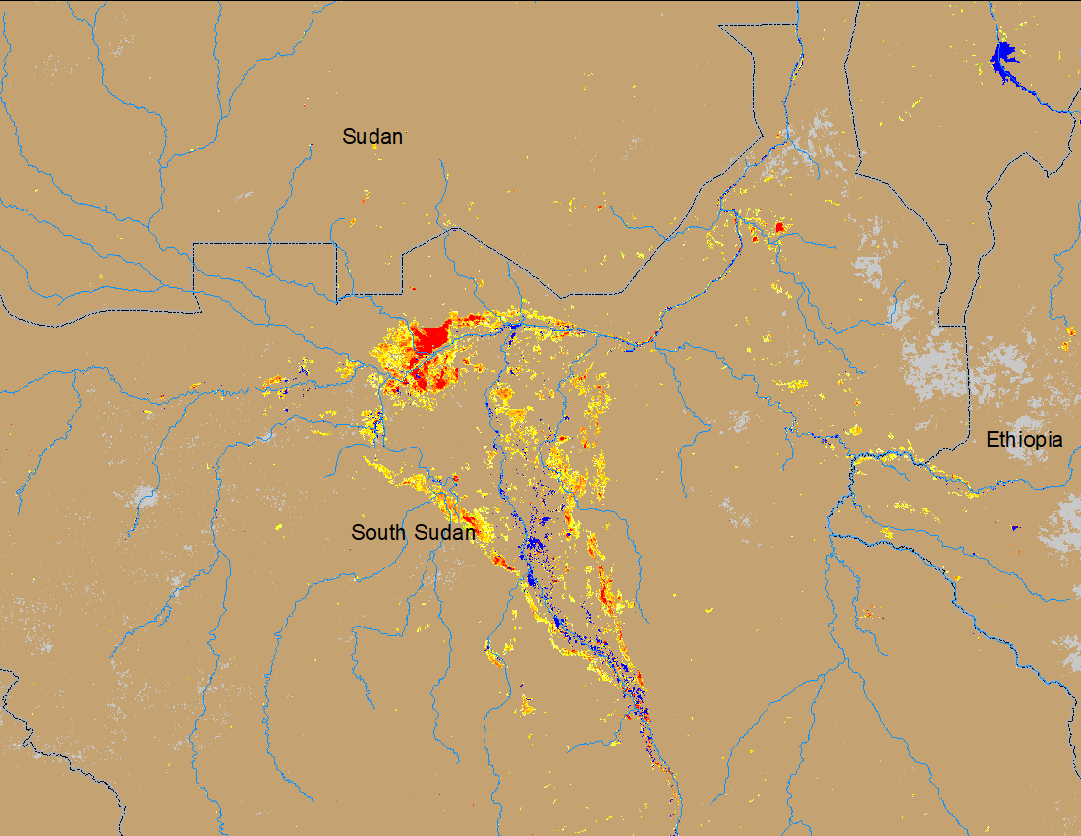
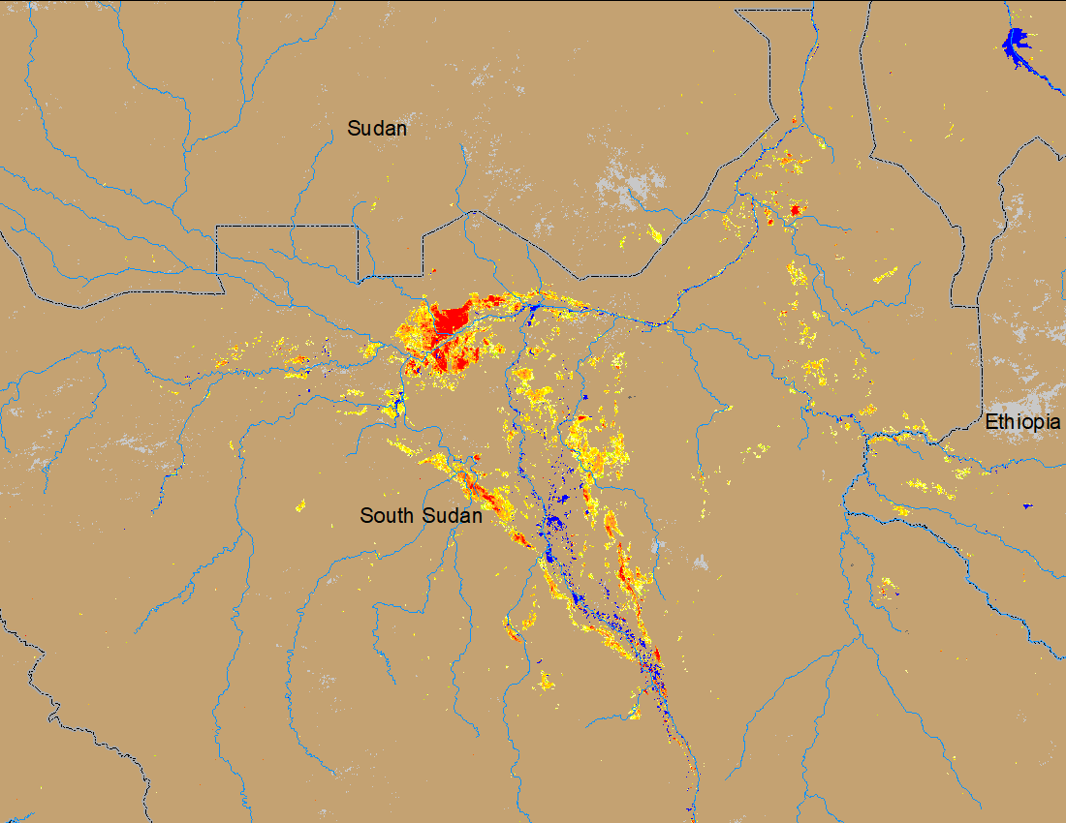
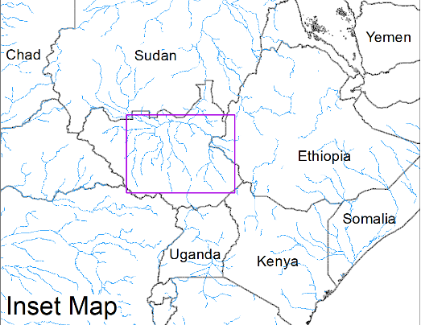
Flooding Conditions in South Sudan
(% of the pixel)
(% of the pixel)
NOAA VIIRS 5-day comp.: 19 – 23 July 2023
NOAA VIIRS 5-day comp.: 26 – 30 July 2023
Flooded area slightly increased in Sobet and Akobo River catchments in South Sudan.

Slide 3
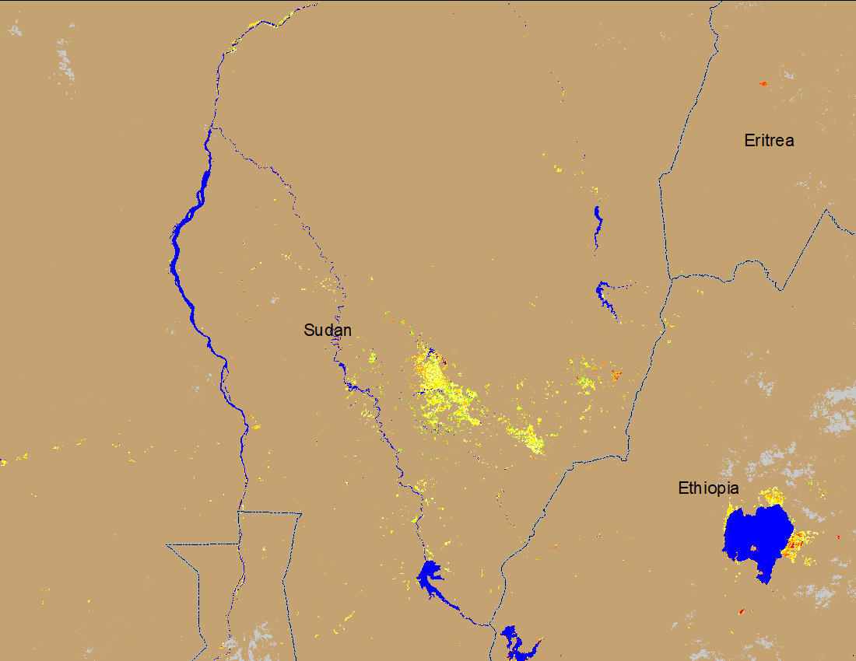
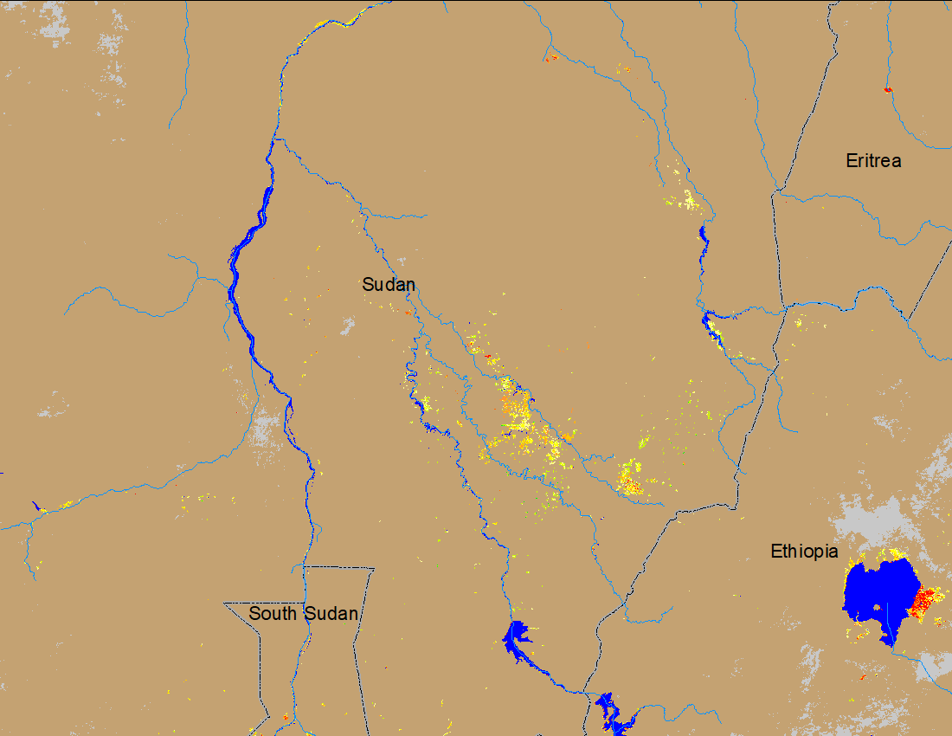
Flooding Conditions in Blue Nile River
(% of the pixel)
NOAA VIIRS 5-day comp.: 19 – 23 July 2023
NOAA VIIRS 5-day comp.: 26 – 30 July 2023
Flooding spreading in the Blue Nile catchment in Sudan.

Slide 4
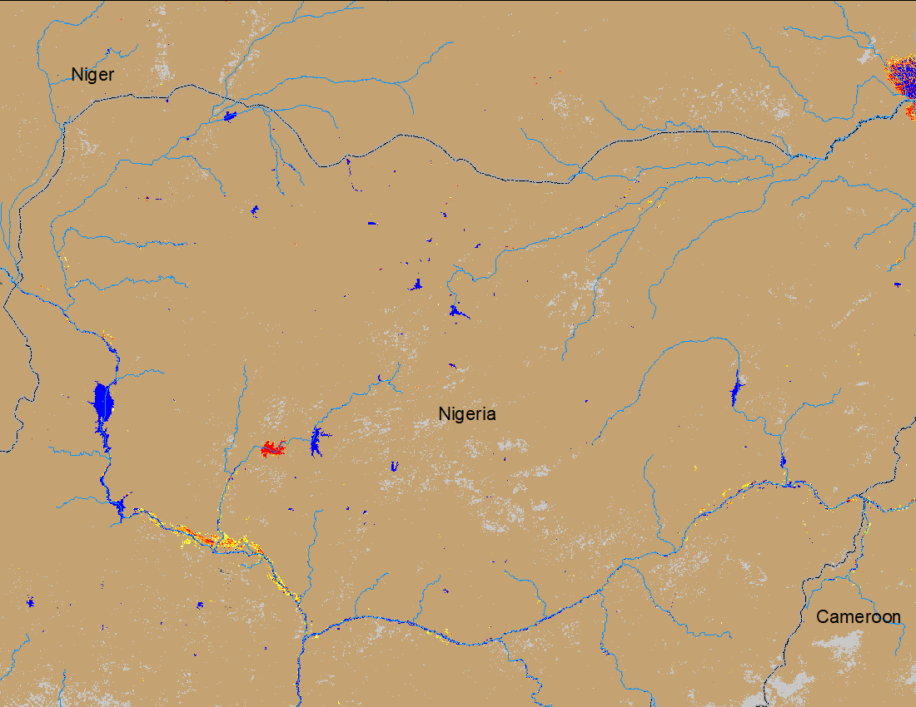
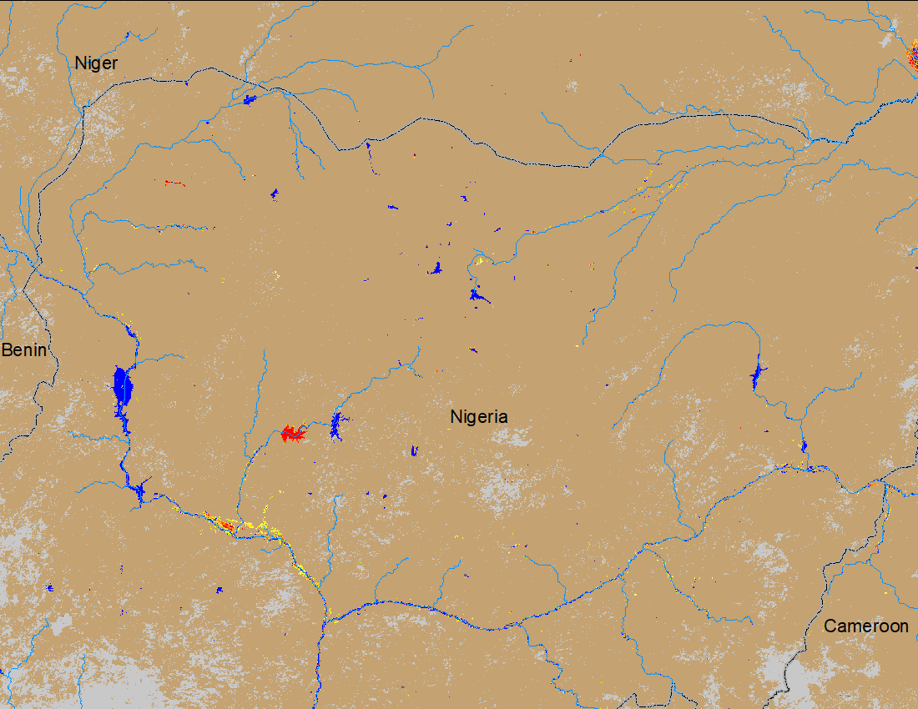
Flooding Conditions in Nigeria
(% of the pixel)
NOAA VIIRS 5-day comp.: 19 – 23 June 2023
NOAA VIIRS 5-day comp.: 26 – 30 July 2023
Flooding conditions have improved along the Niger River in Nigeria.

Slide 5
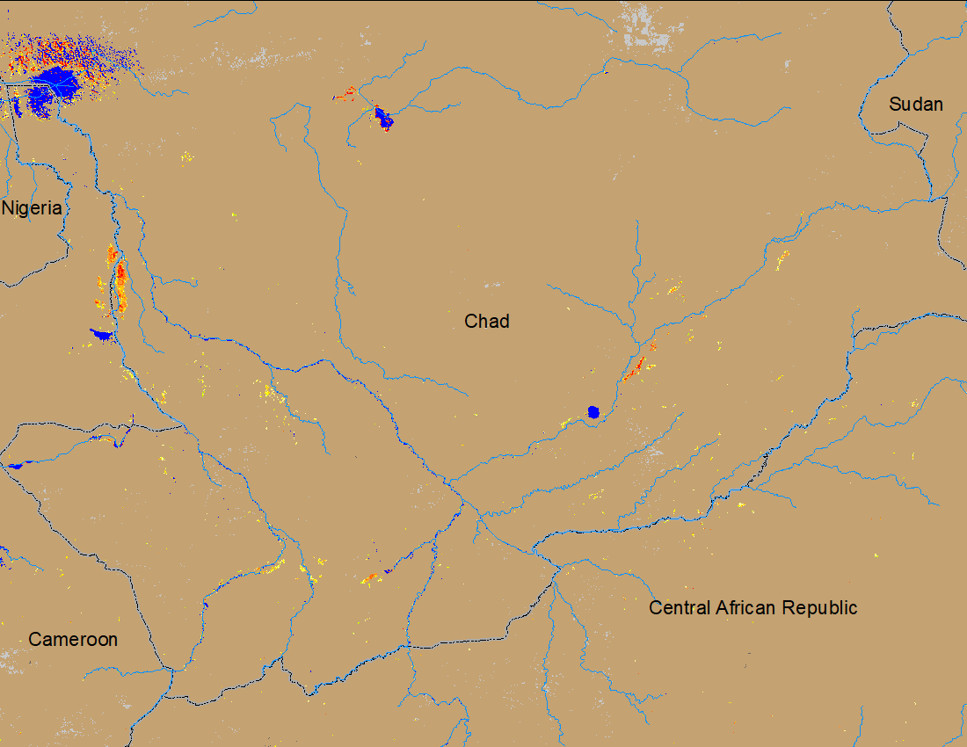
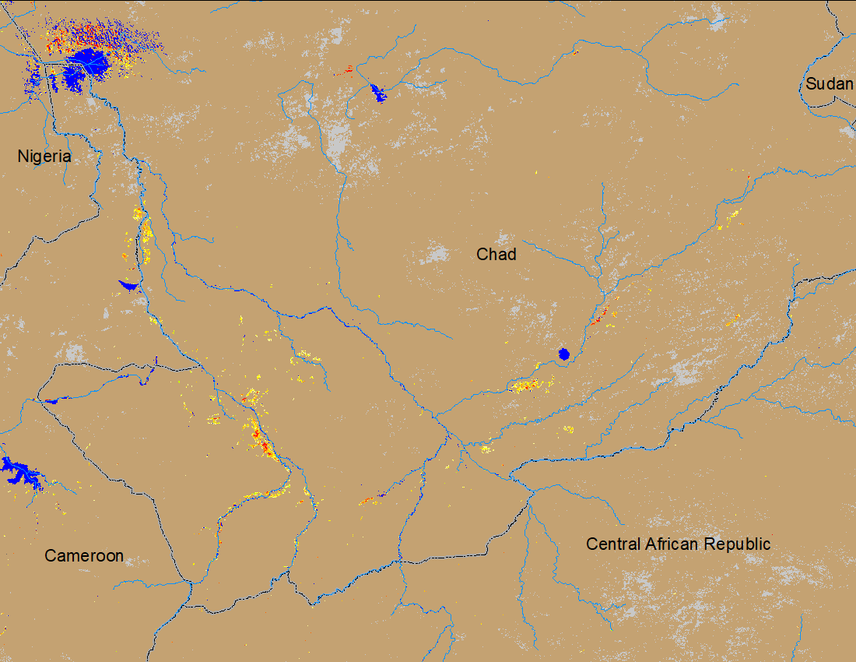
Flooding Conditions in Chad
NOAA VIIRS 5-day comp.: 19 – 23 July 2023
NOAA VIIRS 5-day comp.: 26 – 30 July 2023
Number of Isolated flooded areas are increasing in Chad.

