Slide 1
FEWS NET Enhanced Flood Monitoring – East Africa, West Africa, southern Africa and Yemen
Apr 10, 2023, Hazard Briefing
FEWS NET Science Team:
USGS, NASA, NOAA, UCSB+Regional Scientists

Slide 2
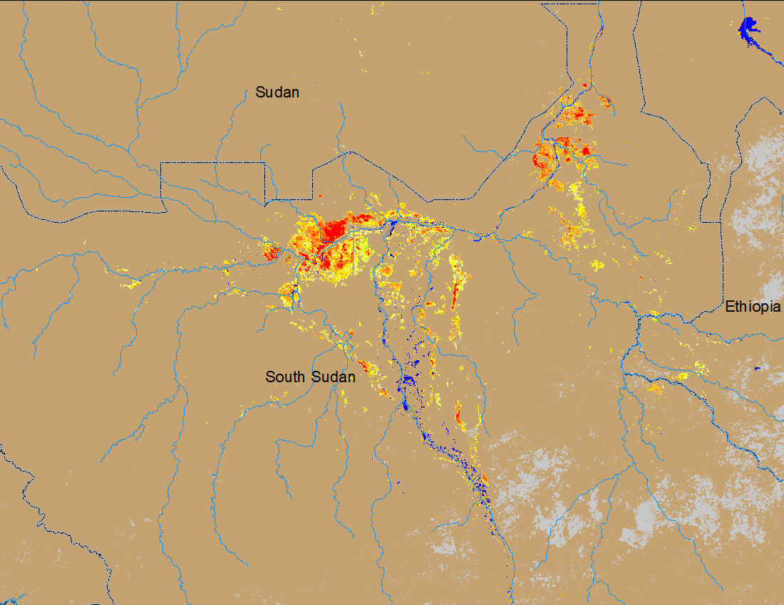
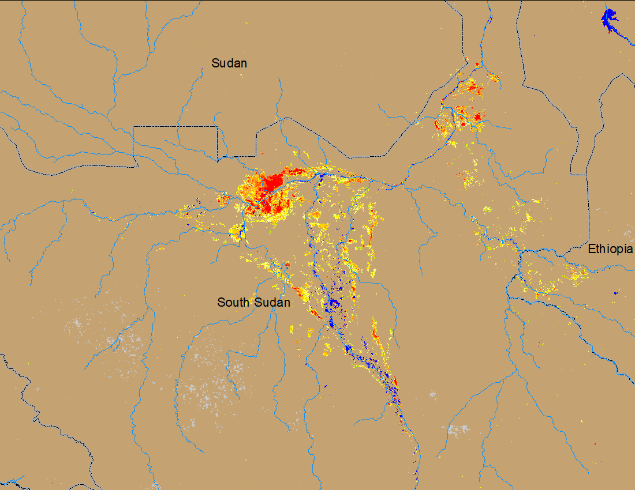
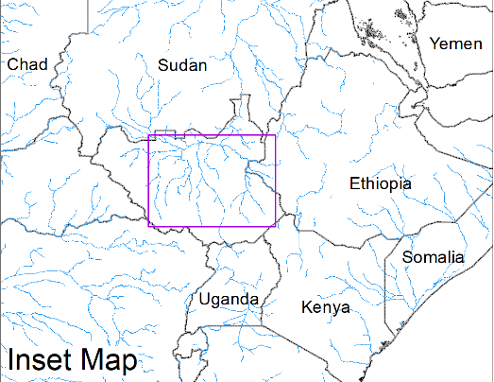
Flooding Conditions in South Sudan
(% of the pixel)
(% of the pixel)
NOAA VIIRS 5-day comp.: 8 – 12 Mar 2023
NOAA VIIRS 5-day comp.: 5 – 9 Apr 2023
Flooding conditions deteriorated in the Akobo and Pibor River catchment but remained unchanged along White Nile.

Slide 3
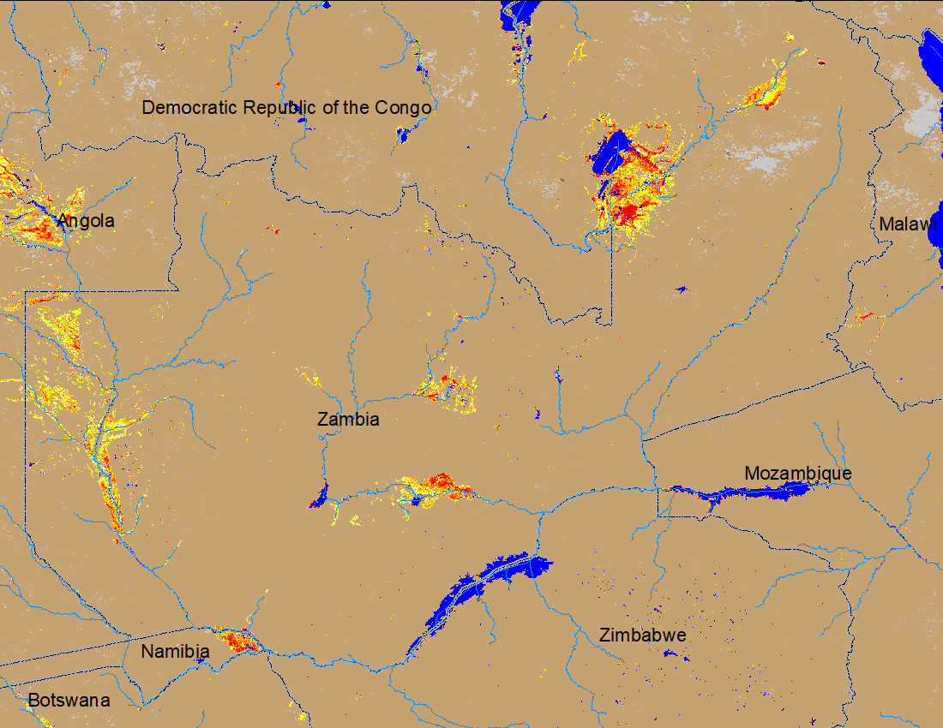
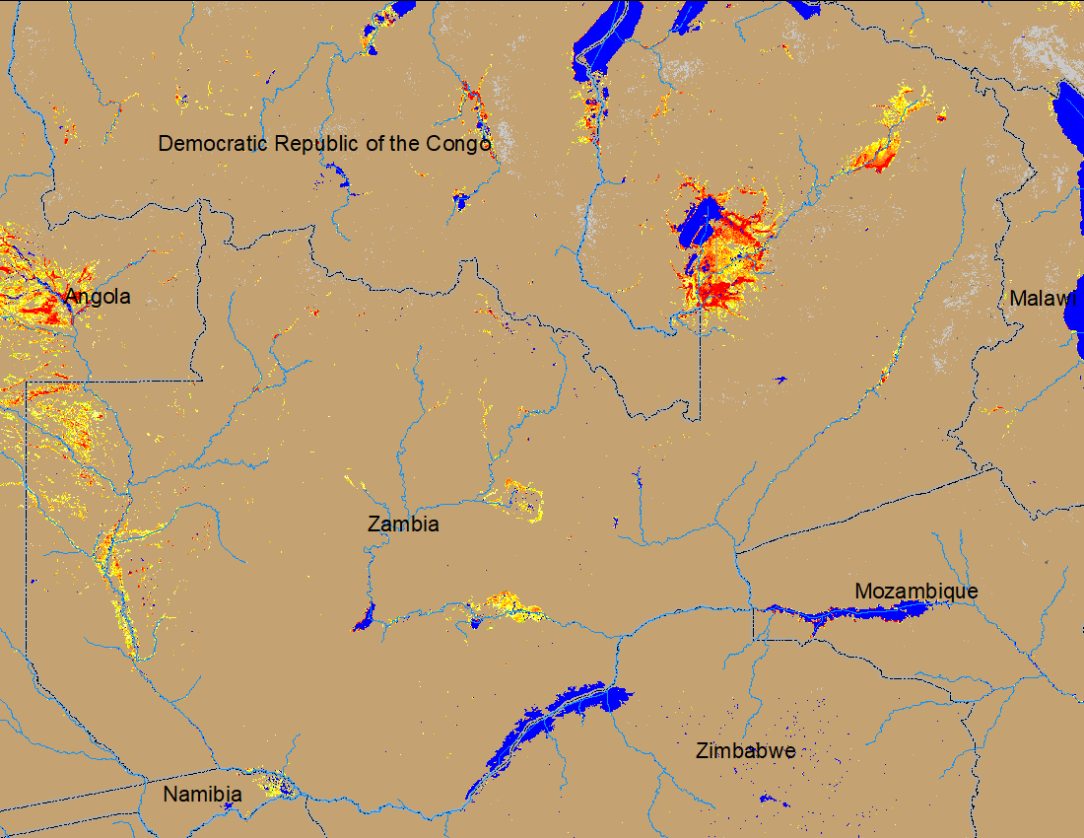
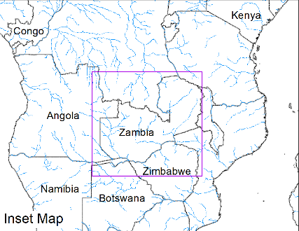
Flooding Conditions in Zambia
(% of the pixel)
(% of the pixel)
NOAA VIIRS 5-day comp.: 8 – 12 Mar 2023
NOAA VIIRS 5-day comp.: 5 – 9 Apr 2023
Flooding conditions worsen in northeastern Zambia.

Slide 4
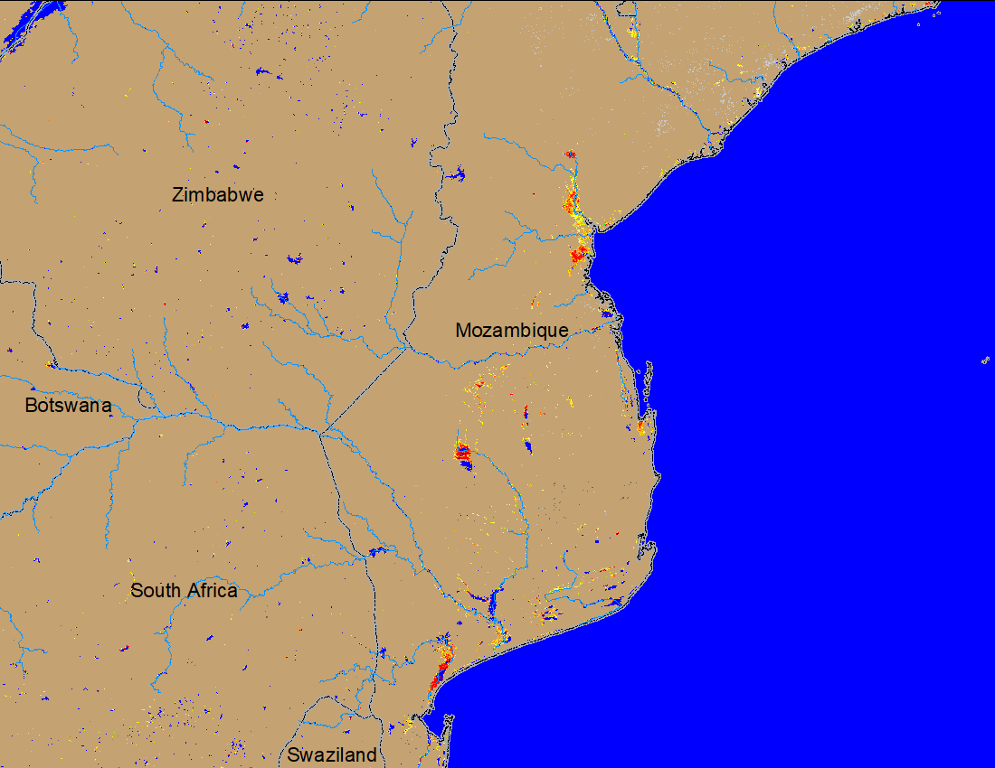
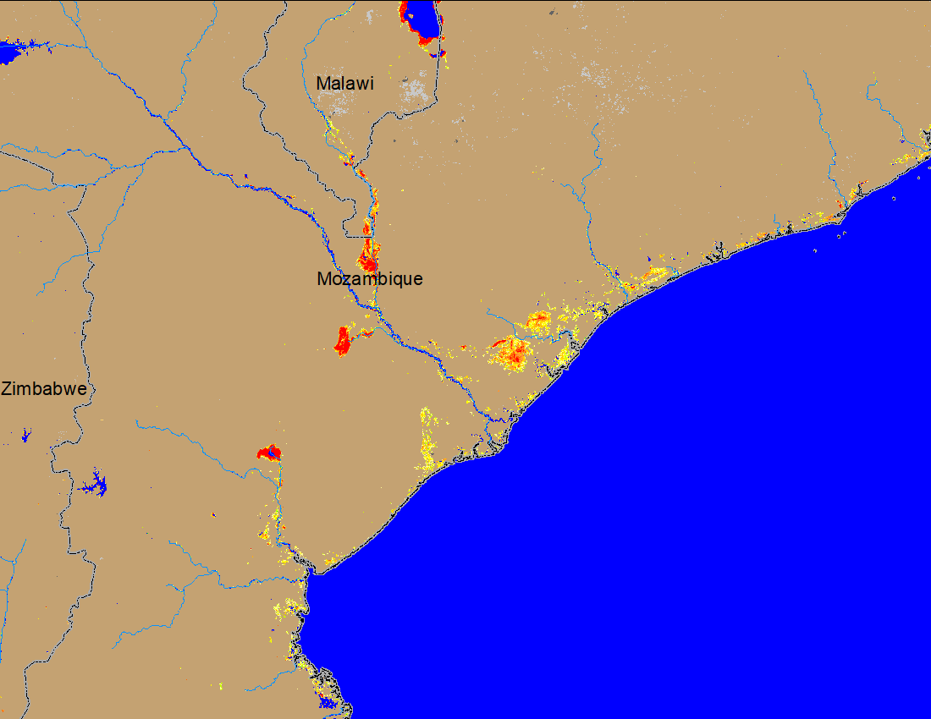
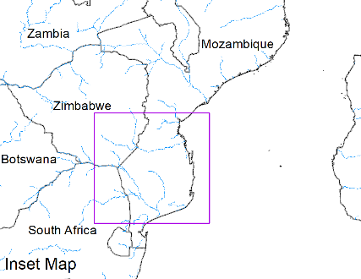
Flooding in Mozambique
(% of the pixel)
(% of the pixel)
NOAA VIIRS 5-day comp.: 8 – 12 Mar 2023
NOAA VIIRS 5-day comp.: 5 – 9 Apr 2023
Flooding still continues along the Shire River in Mozambique before the confluence with Zambezi River.

Slide 5
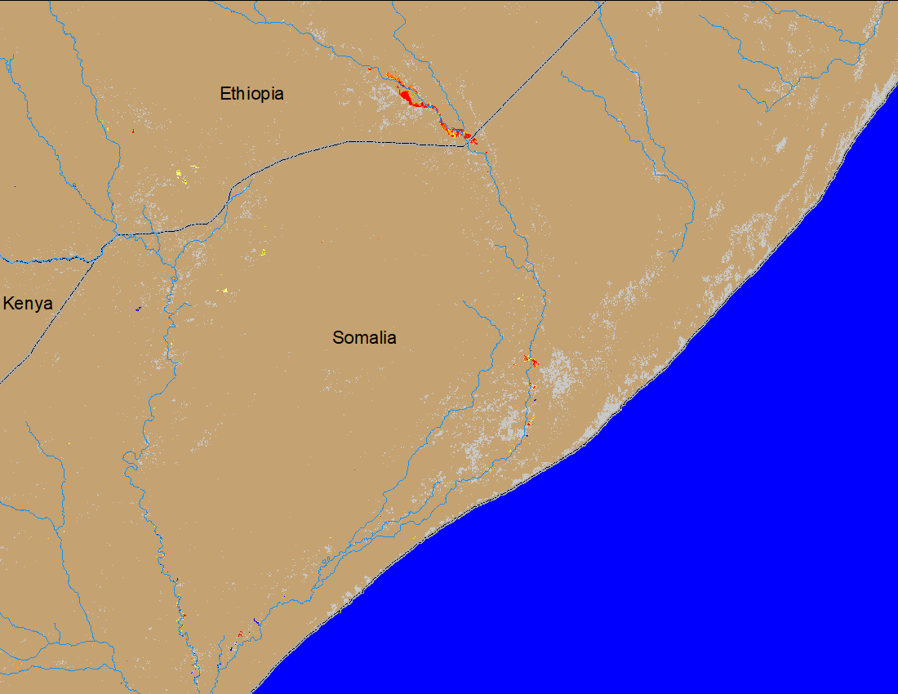
Flooding Conditions in Shebelle River
GEOGloWS streamflow forecast: 11-26 Mar 2023
NOAA VIIRS 5-day comp.: 5 – 9 Apr 2023
Current water level in Shebelle between Ethiopia Somalia boarder is ABOVE the flood danger level with flooding in Ethiopia side.

