Slide 1
FEWS NET Enhanced Flood Monitoring – East Africa, West Africa, southern Africa and Yemen
Dec 03, 2023, Hazard Briefing
FEWS NET Science Team:
USGS, NASA, NOAA, UCSB+Regional Scientists

Slide 2
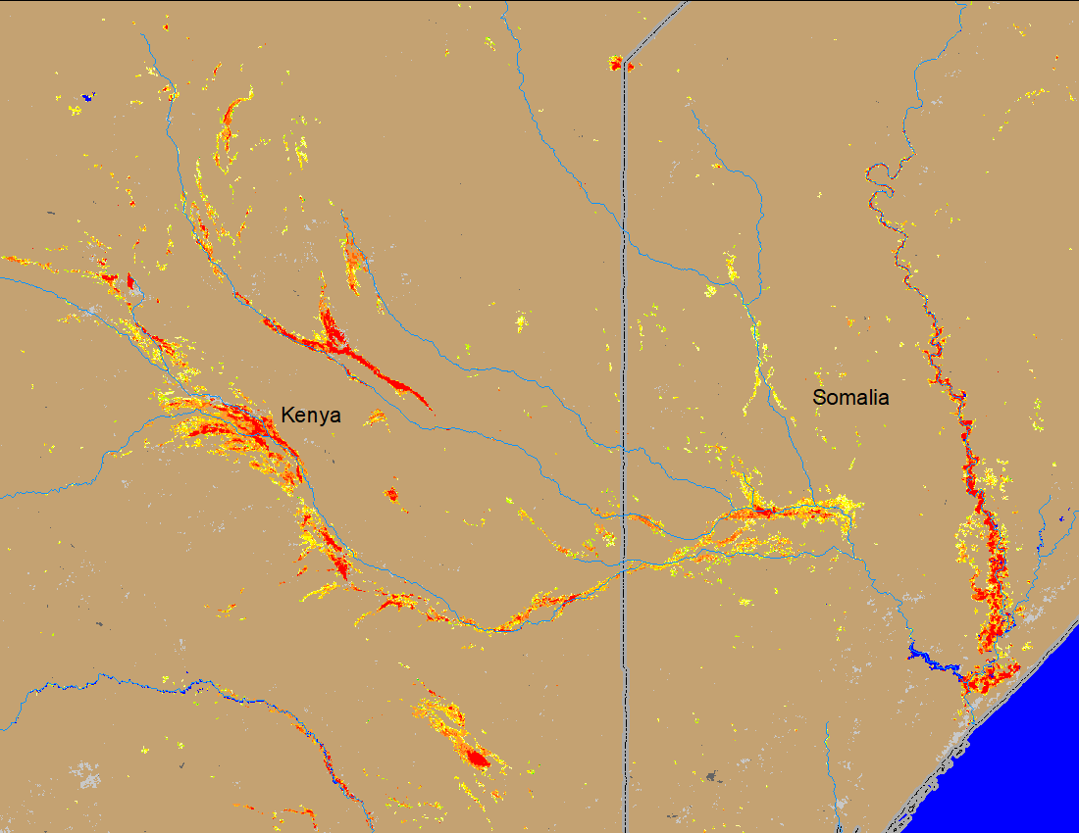
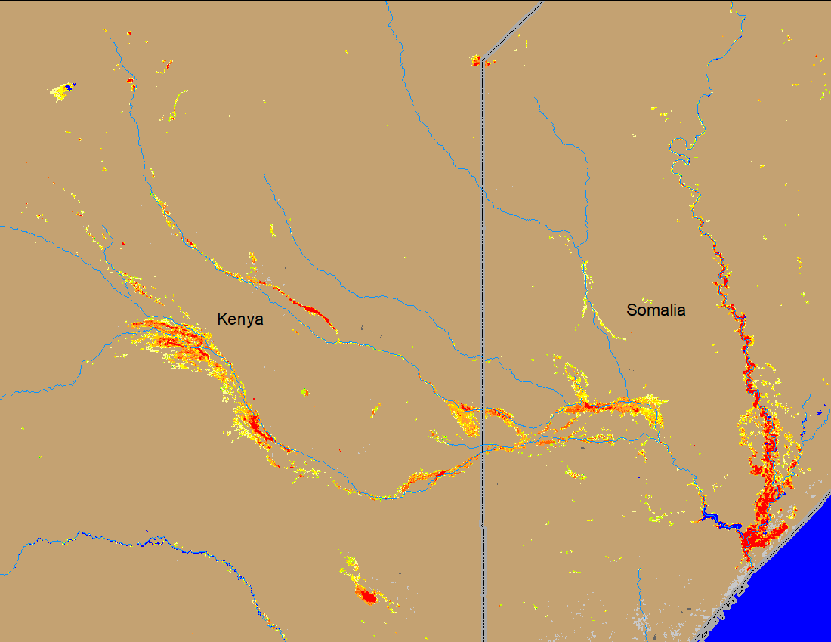
Flooding Conditions in Kenya, and Somalia
(% of the pixel)
(% of the pixel)
Juba
Juba
Lagh Jura
Lagh Jura
Lagh Dera
Lagh Dera
NOAA VIIRS 5-day comp.: 22 – 26 Nov 2023
NOAA VIIRS 5-day comp.: 29 Nov – 03 Dec 2023
Marginal improvements in flooding along the upstream of Lagh Dera and lagh Jura Rivers.
But flooding worsening in the downstream of Juba River.

Slide 3
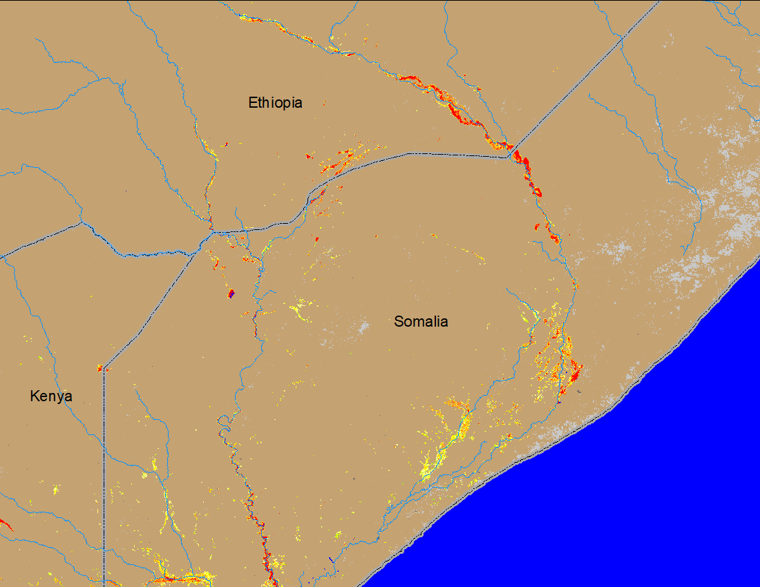
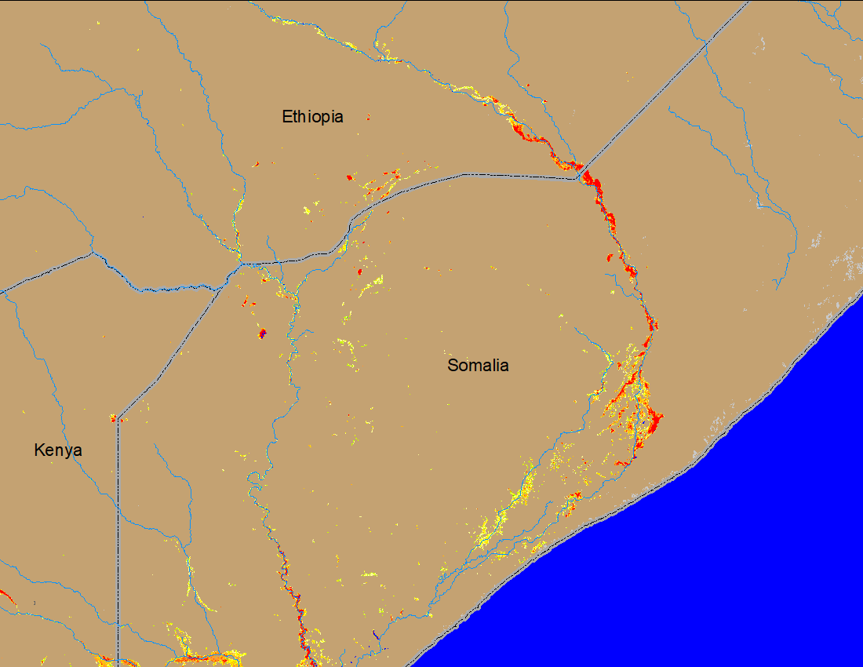
Flooding Conditions in Ethiopia, Kenya, and Somalia
(% of the pixel)
(% of the pixel)
Shabelle
Shabelle
Juba
Juba
NOAA VIIRS 5-day comp.: 22 – 26 Nov 2023
NOAA VIIRS 5-day comp.: 29 Nov – 03 Dec 2023
Flooding conditions along the Shabelle River remained unchanged.

Slide 4
Observed Water Level in Juba and Shabelle
Belet weyne
Dollow
Bulo Burti
Luuq
Bardheere
Jowhar
Bualle
Gage Location: RED – at bankfull
SWALIM Observed Water Level: 04 Dec 2023
Juba River at bankfull only at one station.
Shabelle at bankfull in Belet weyne and Bulo Burti.

Slide 5
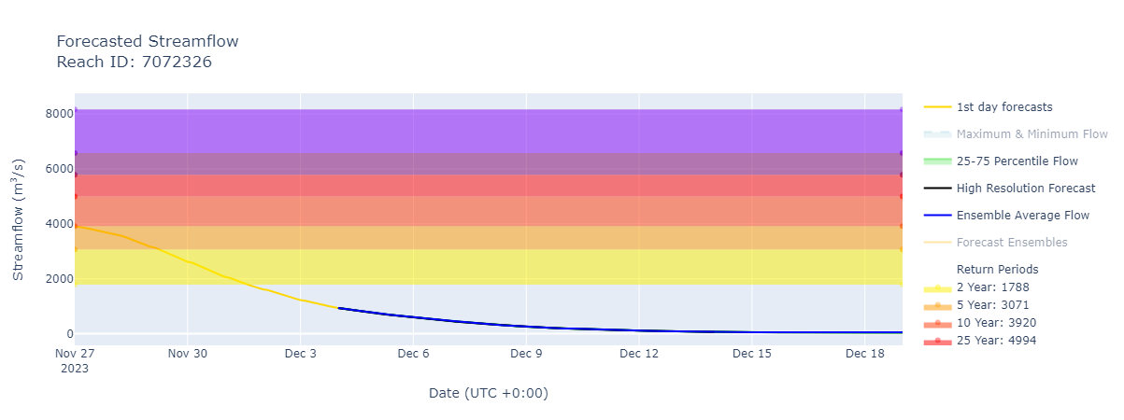
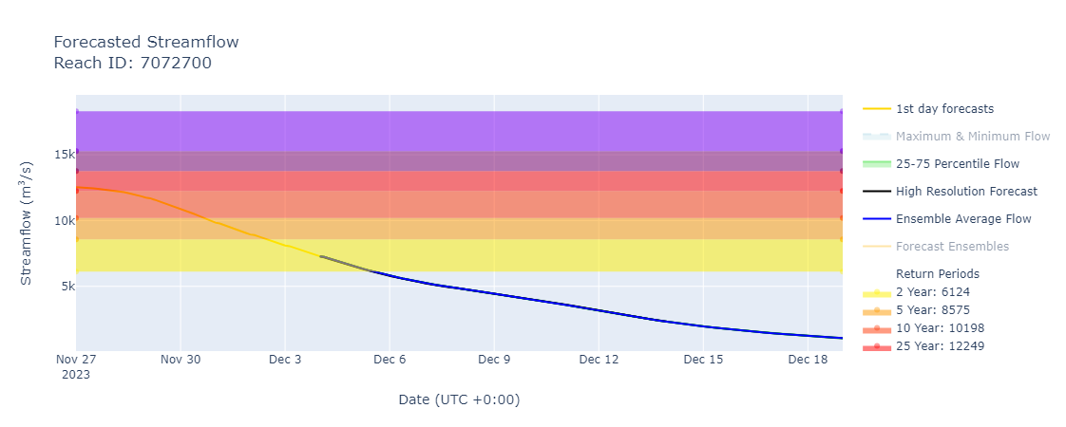
Substantial Decline in Streamflow in Next Two Weeks.
@ point A: combine flow of Lagh Dera and Lagh Jura
@ point B: on Juba River near outlet
A
B
GEOGloWS Forecast.: 04 – 18 Dec 2023
Discharges are expected to decline to normal in Lagh Dera, Lagh Jura and Juba Rivers in the coming days.
GEOGloWS Forecast.: 04 – 18 Dec 2023

