Slide 1
FEWS NET Enhanced Flood Monitoring – East Africa, West Africa, southern Africa and Yemen
August 29, 2022, Hazard Briefing
FEWS NET Science Team:
USGS, NASA, NOAA, UCSB+Regional Scientists

Slide 2
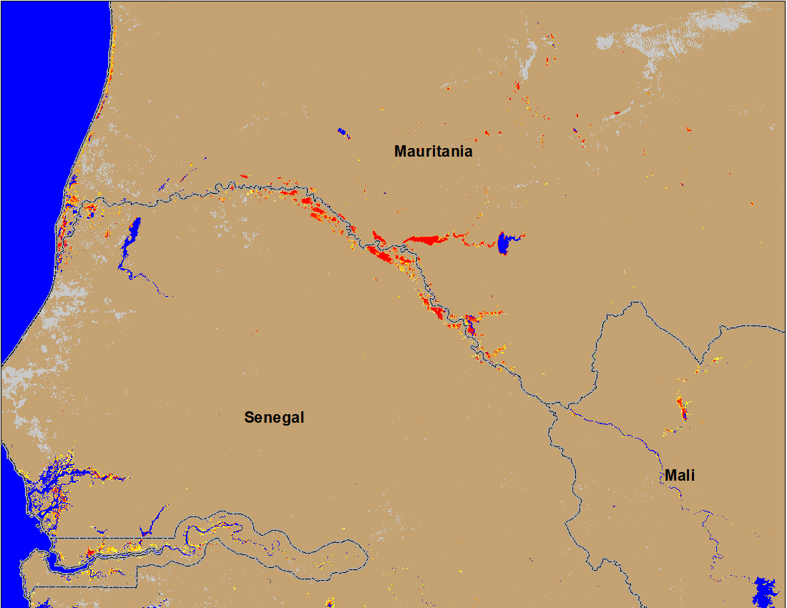
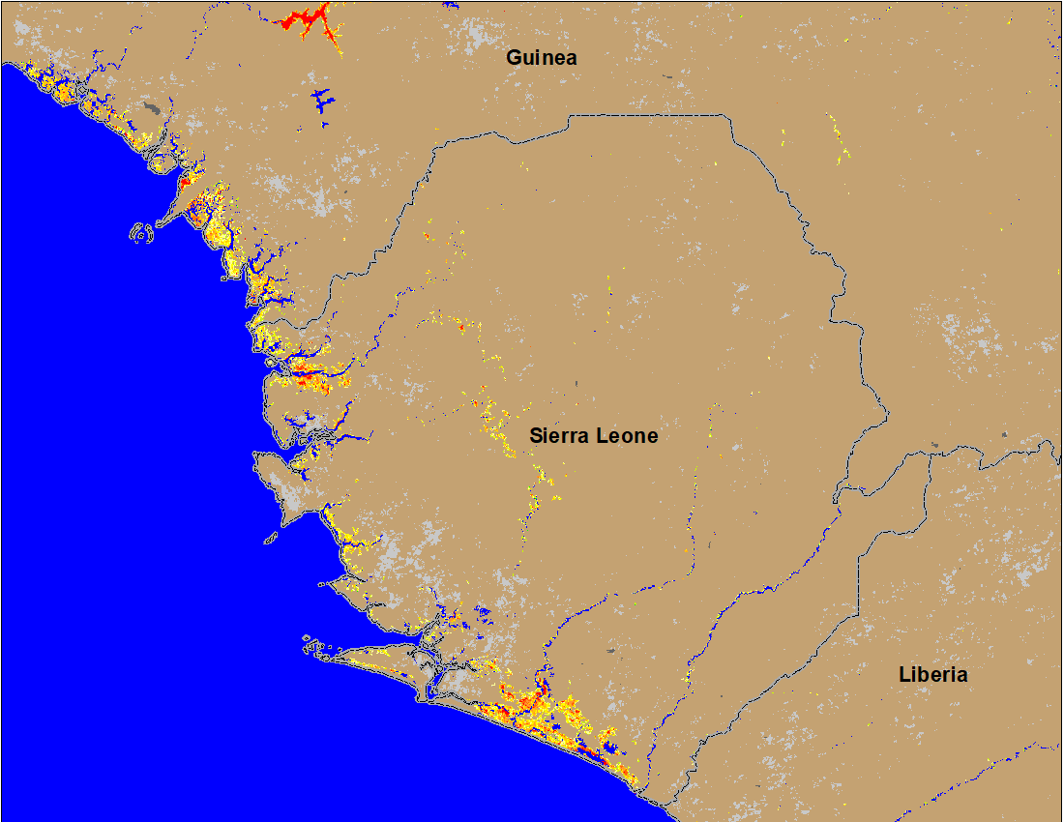

Flooding Conditions in Senegal, Guinea and Sierra Leone
(% of the pixel)
(% of the pixel)
NOAA VIIRS 5-day comp.: 1-5 Sep 2022
NOAA VIIRS 5-day comp.: 1-5 Sep 2022
Flooding in Senegal and along the coastal areas of Guinea and Sierra Leone.

Slide 3
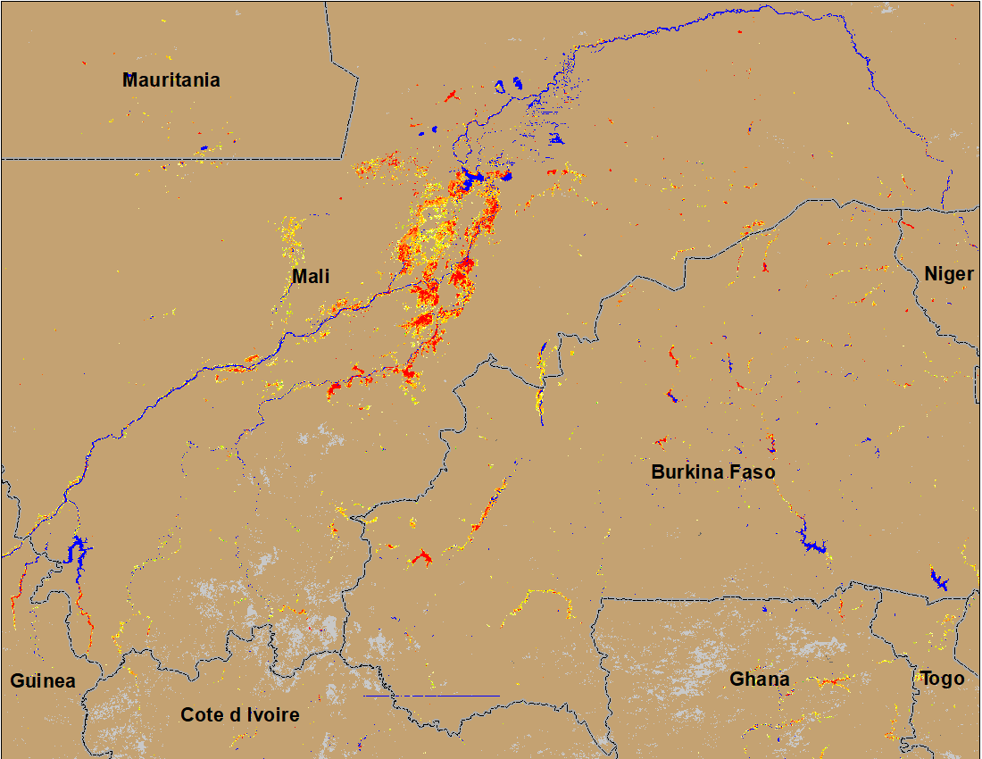
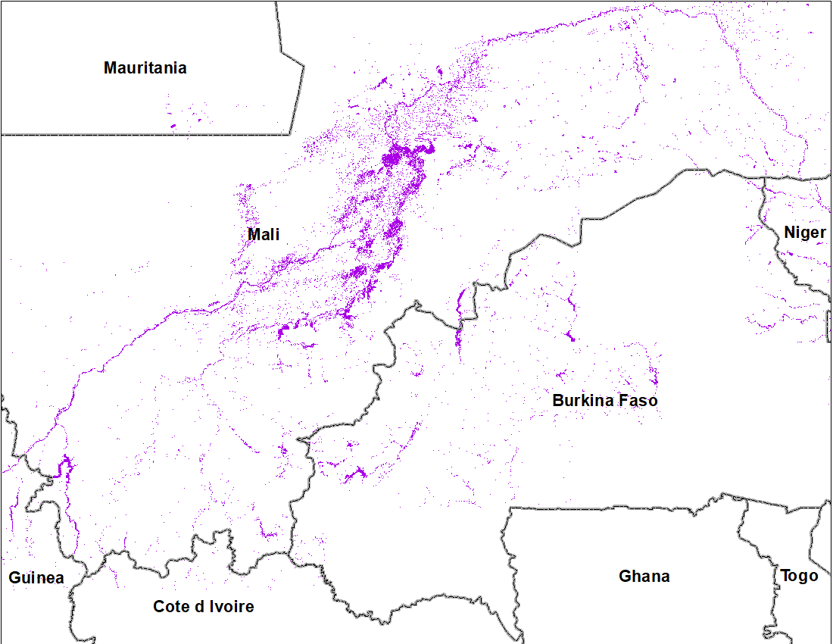
Flooding Conditions in Mali and Burkina Faso
(% of the pixel)
Inundated area
NOAA VIIRS 5-day comp.: 1-5 Sep 2022
Cloud to Street: August 2022
Flooding in central Mali continues, and newly flooding areas in Burkina Faso.

Slide 4
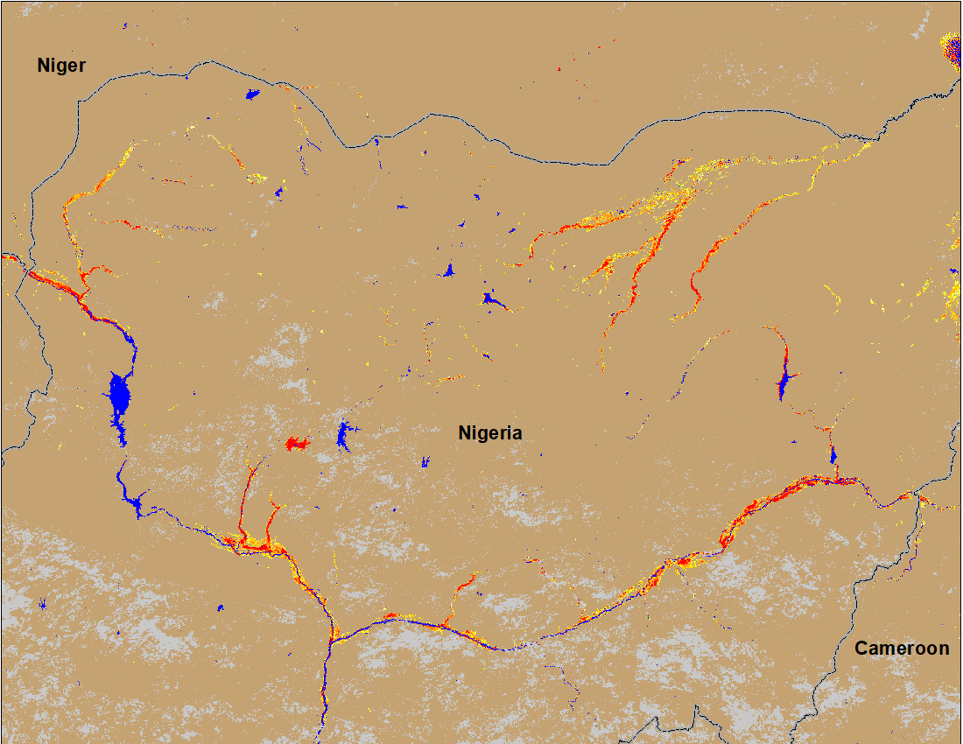
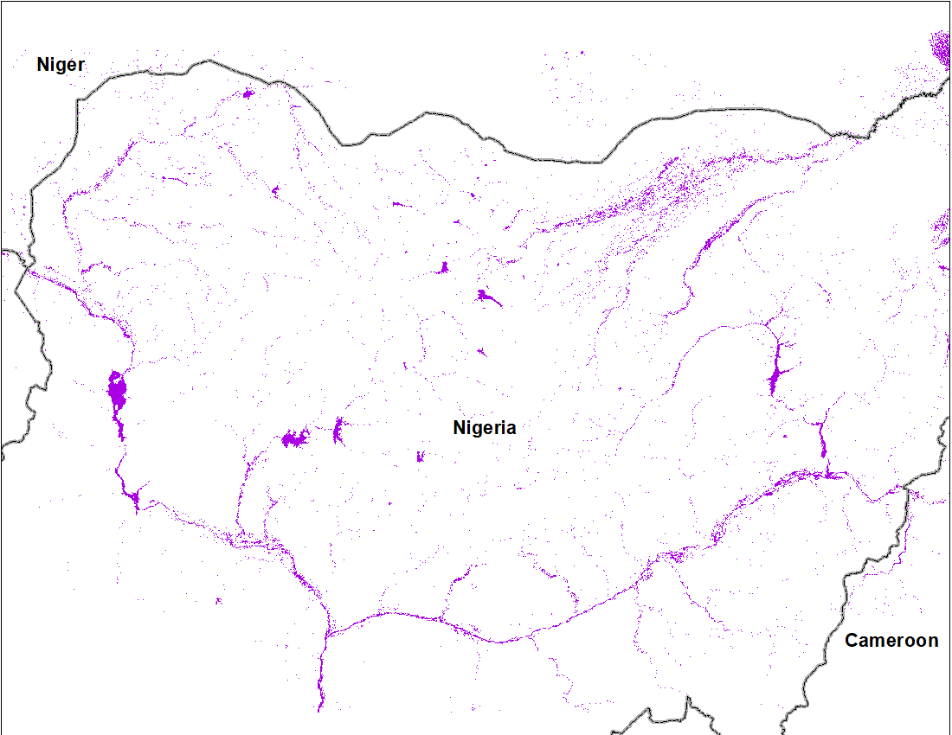
Flooding Conditions in Nigeria
(% of the pixel)
Inundated area
NOAA VIIRS 5-day comp.: 1- Sep 2022
Cloud to Street: August 2022
Newly flooded areas in Sokoto, Komadugu, Niger and Benue Rivers as per the last week’s forecast.

Slide 5
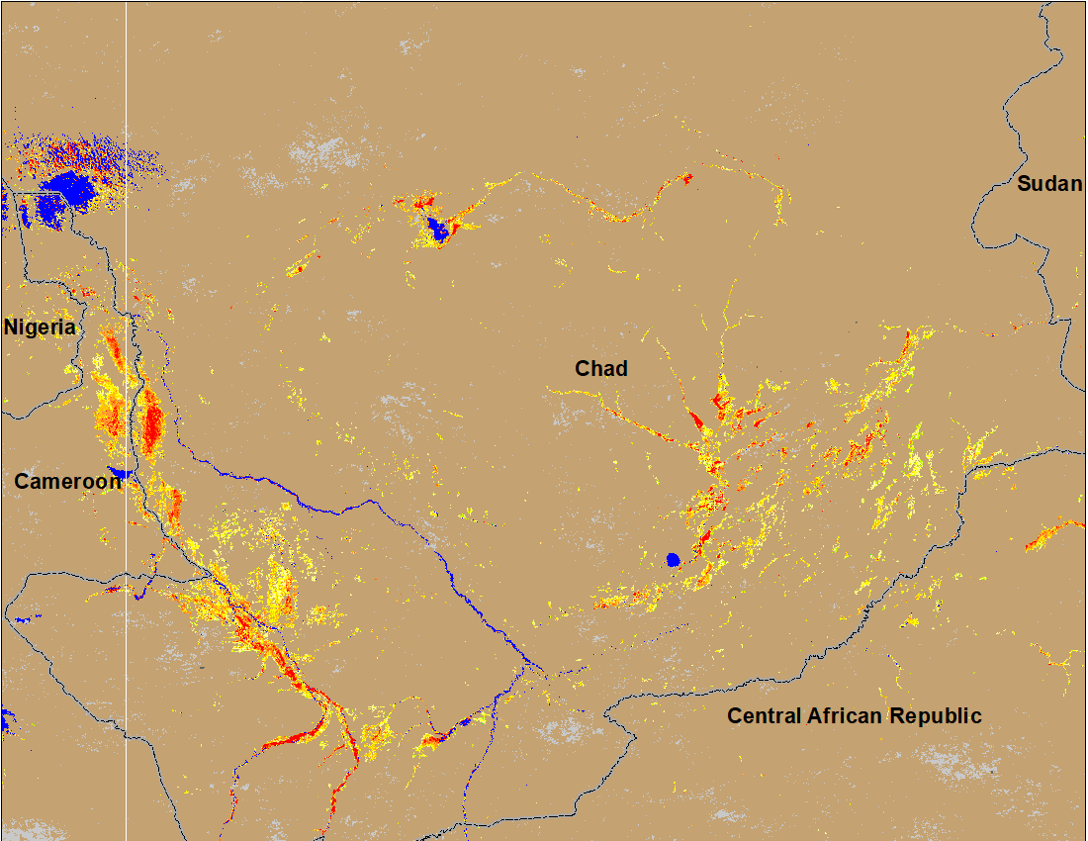
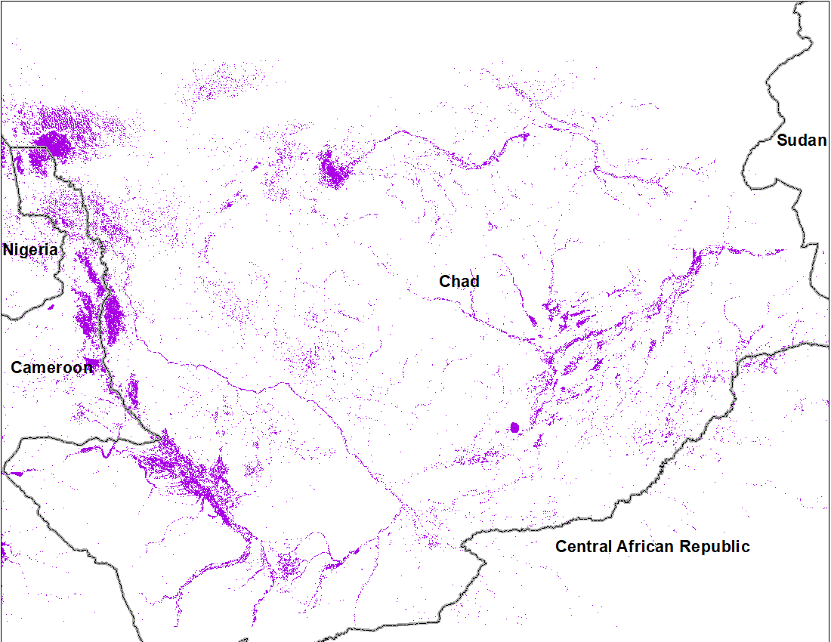
Flooding Conditions in Chad
(% of the pixel)
Inundated area
NOAA VIIRS 5-day comp.: 1- Sep 2022
Cloud to Street: August 2022
Flooding worsen during the last week.

Slide 6
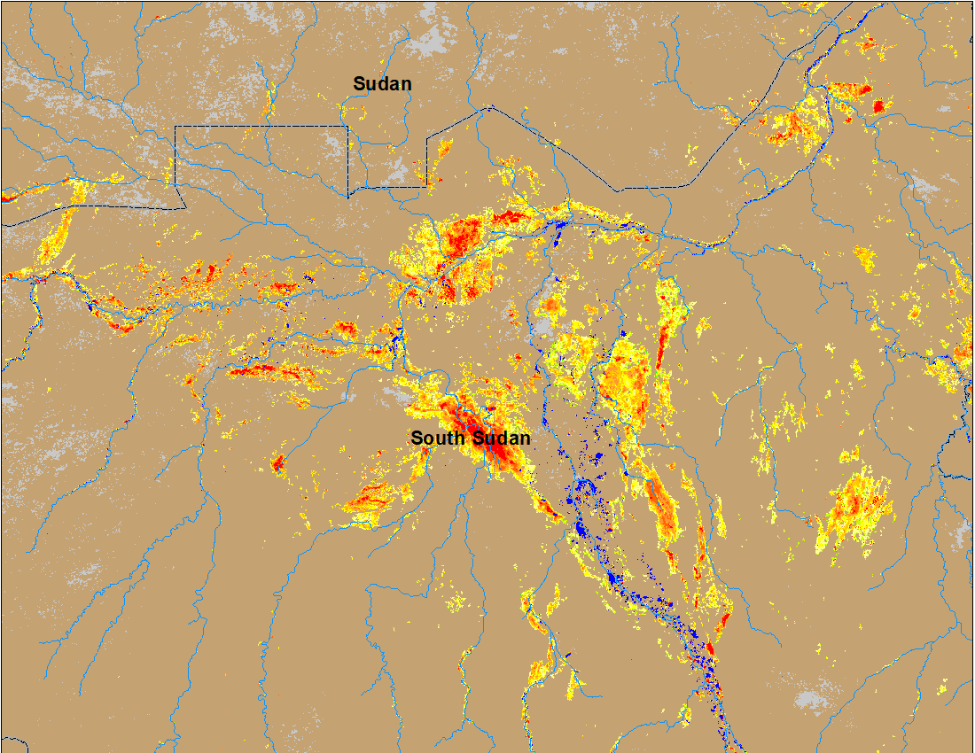
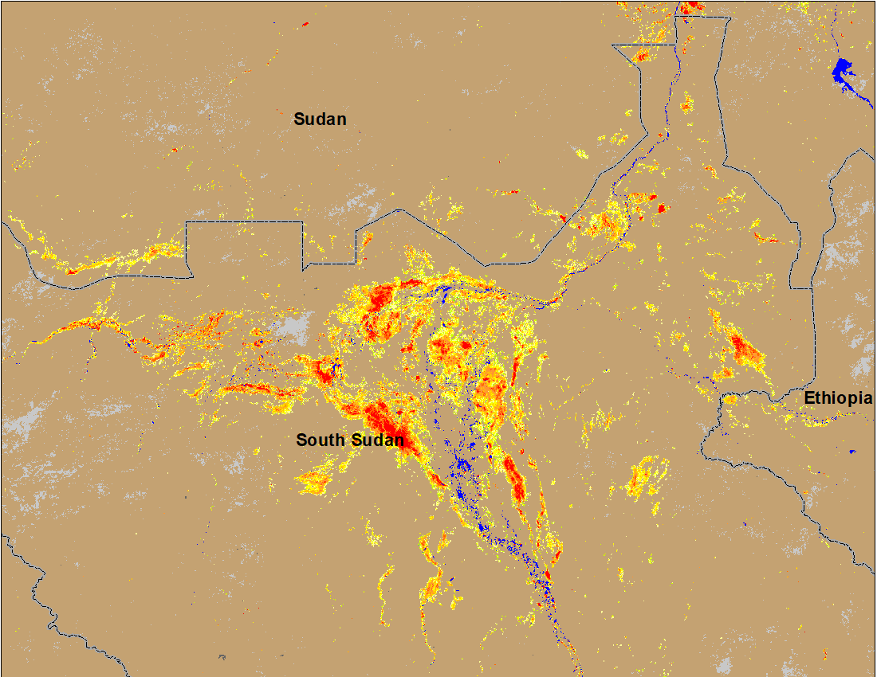
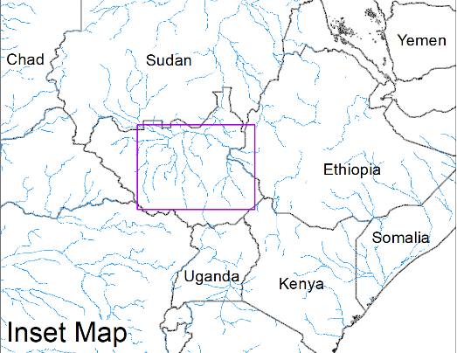
Inundation in the Sudd Wetlands
(% of the pixel)
(% of the pixel)
Northern Sudd Wetlands
Sobet River
Akobo River
Pibor River
ADAM Flood event: 24-28 Aug 2022
NOAA VIIRS 5-day comp.: 1-5 Sep 2022
Flooding conditions worsen in South Sudan and in Sudan with newly inundated areas along Sobet and Akobo Rivers in South Sudan and along the Nile in Southern Darfur and eastern Sudan.

Slide 7
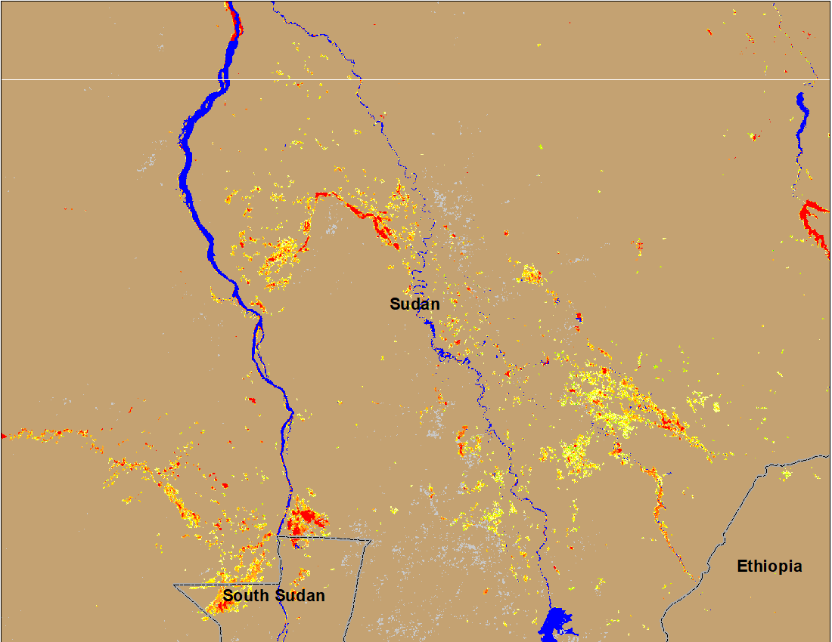
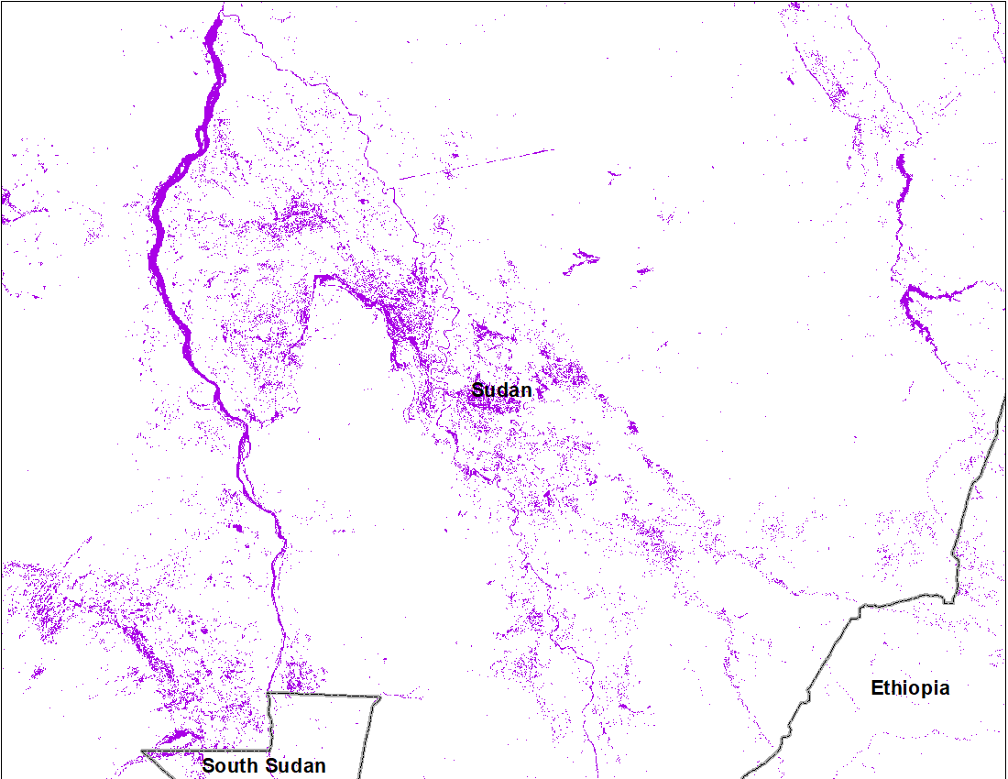
Inundation in Eastern Sudan
(% of the pixel)
Inundated area
NOAA VIIRS 5-day comp.: 1- Sep 2022
Cloud to Street: August 2022
Flooding in the Blue Nile also spreading over new areas.

Slide 8
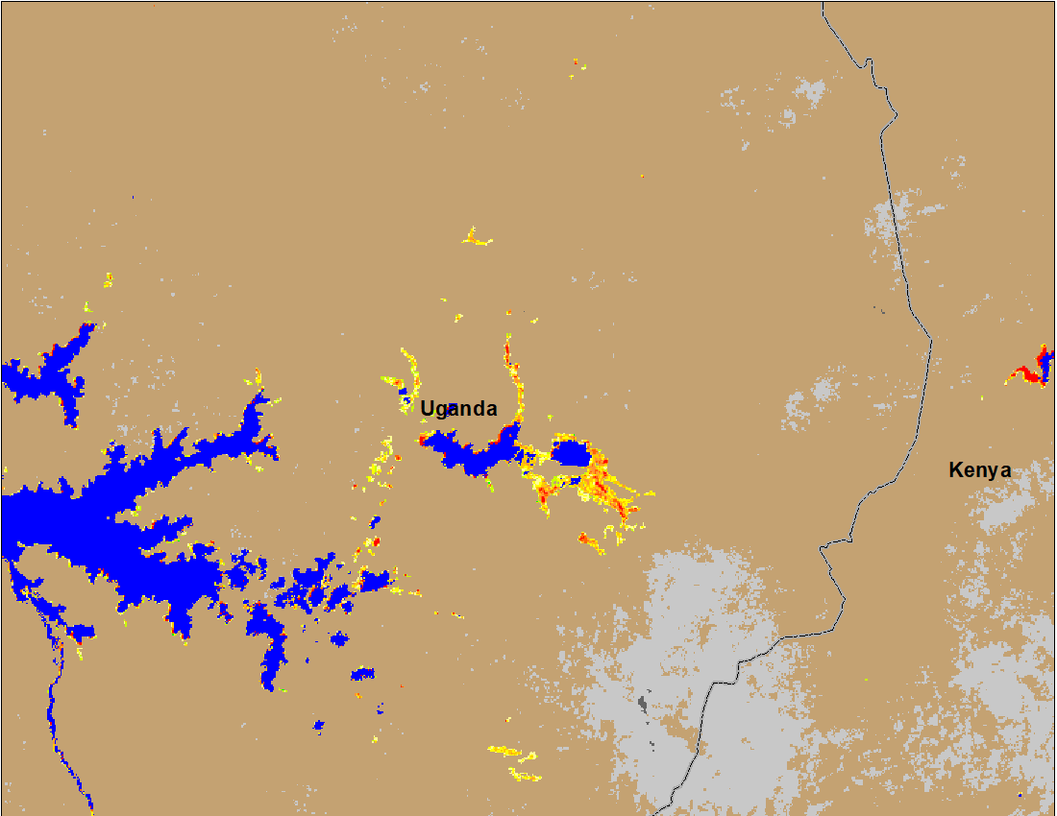
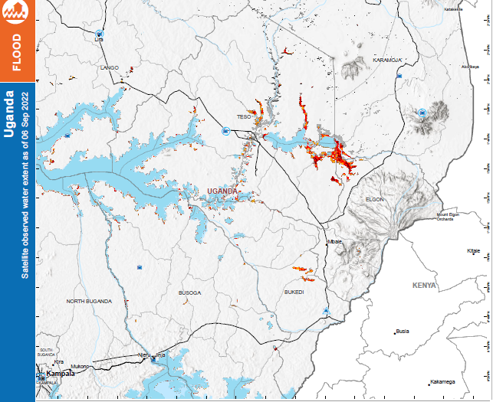
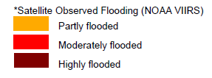
Inundation in Uganda
(% of the pixel)
NOAA VIIRS 5-day comp.: 1- Sep 2022
ADAM Flood Event : 06 Sep 2022
Flooding in Uganda.

Slide 9
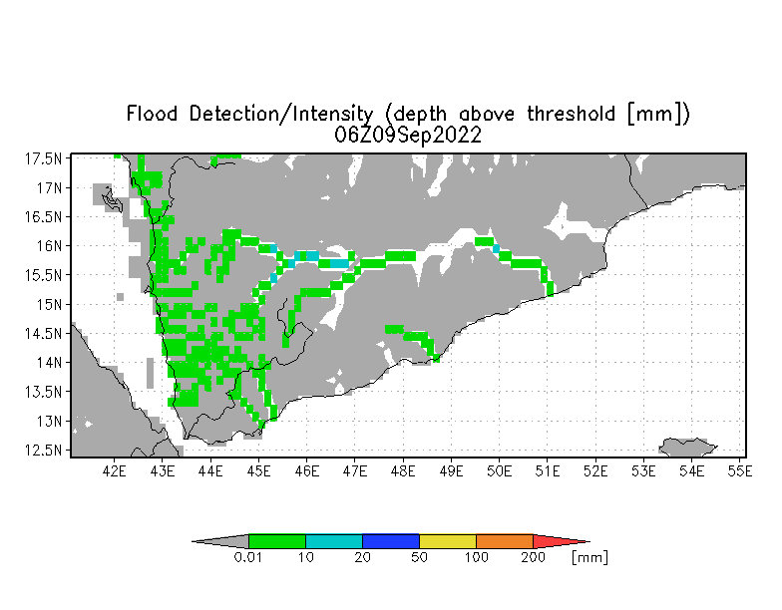
Inundation in Yemen
Flooding is expected along the western and central Wadis in Yemen.
UMD depth above threshold map: Valid for Sep 09, 2022

