Slide 1
FEWS NET Enhanced Flood Monitoring – East Africa, West Africa, southern Africa and Yemen
September 26, 2022, Hazard Briefing
FEWS NET Science Team:
USGS, NASA, NOAA, UCSB+Regional Scientists

Slide 2
Flooding Hazard Areas

Slide 3
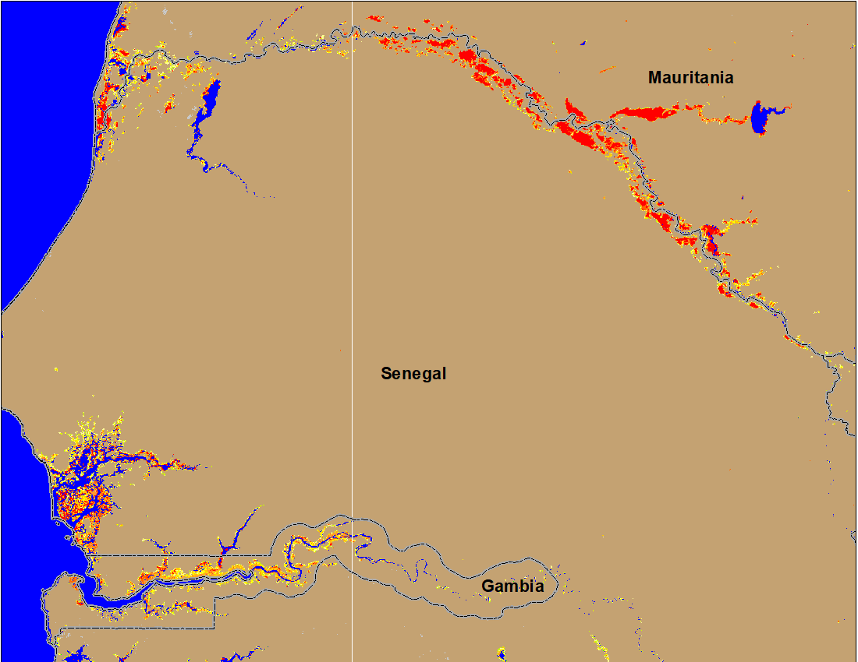
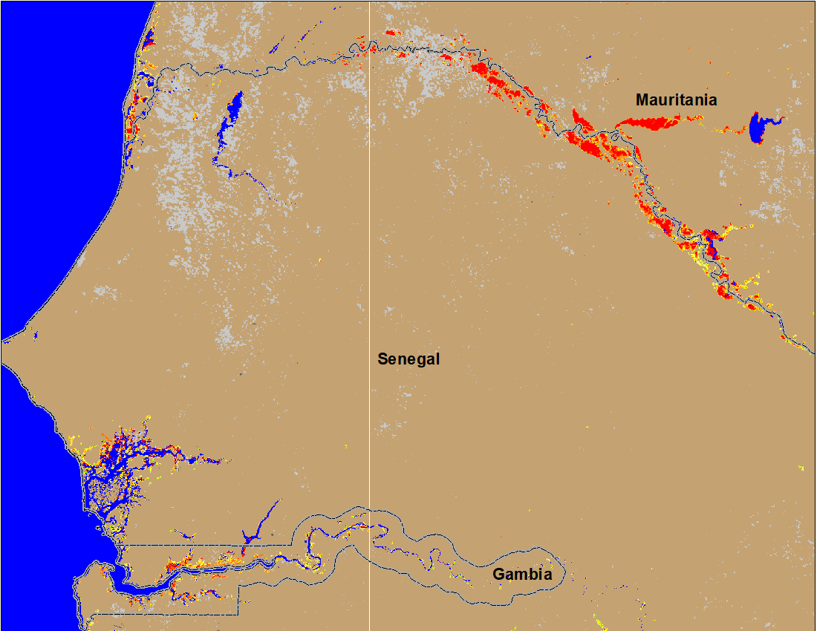
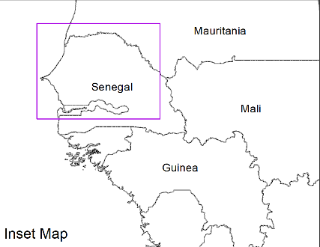
Flooding Conditions in Senegal & Guinea-Bissau
(% of the pixel)
(% of the pixel)
NOAA VIIRS 5-day comp.: 13-17 Sep 2022
NOAA VIIRS 5-day comp.: 21-25 Sep 2022
Flooding progressing downstream along the Senegal River.

Slide 4
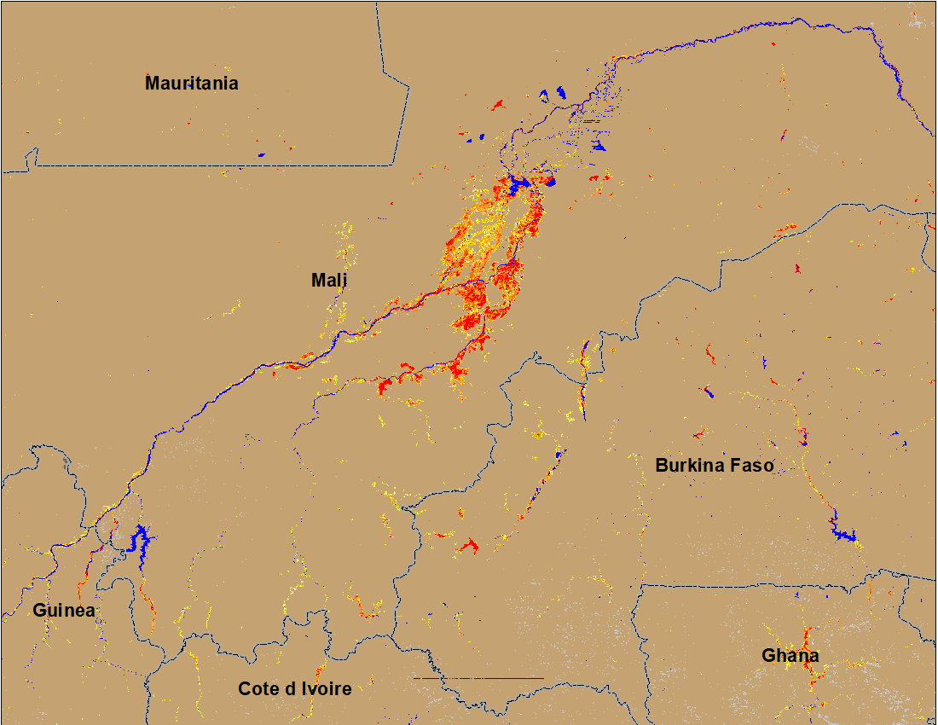
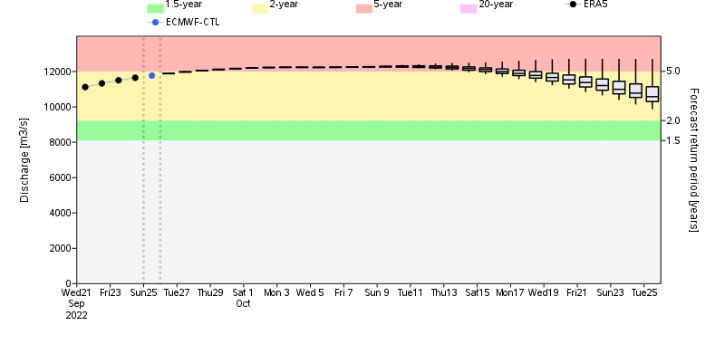
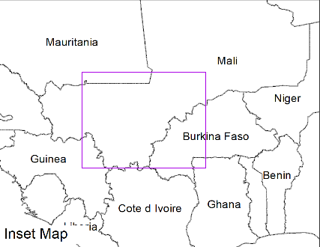
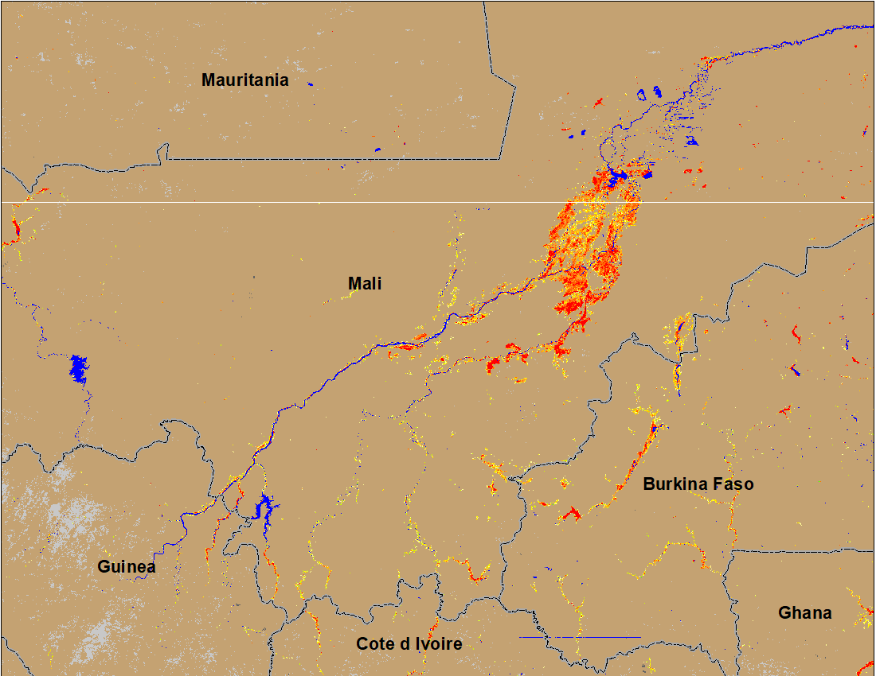
Flooding Conditions in Mali and Burkina Faso
(% of the pixel)
(% of the pixel)
Niger
Niger
NOAA VIIRS 5-day comp.: 13-17 Sep 2022
NOAA VIIRS 5-day comp.: 21-25 Sep 2022
Conditions remained constant in central Mali and deteriorated in Burkina Faso. Niger discharge expected to be continued at 5-yr return period level until mid-October.

Slide 5
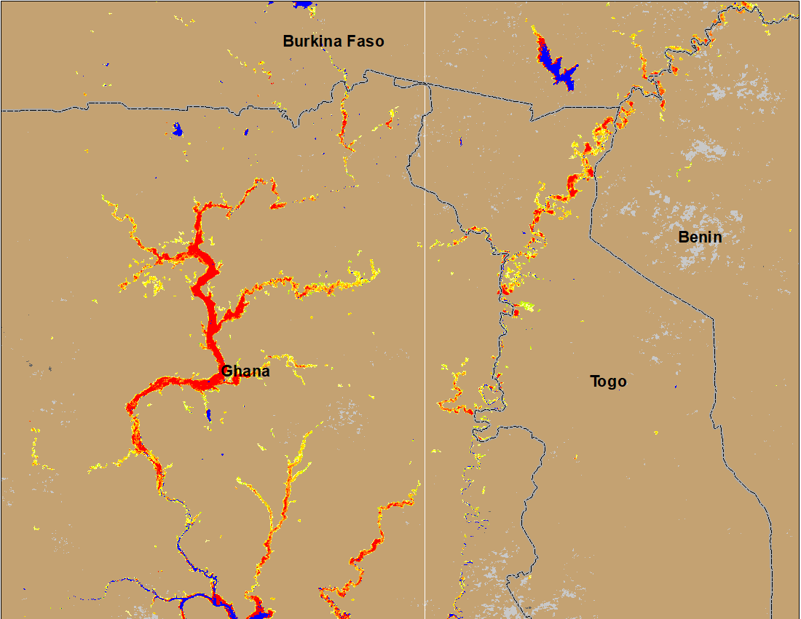
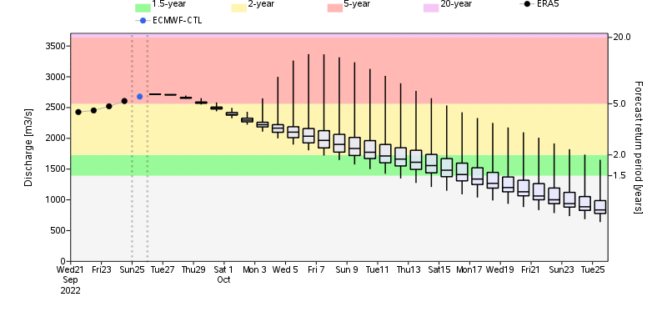
Flooding Conditions in Ghana & Togo
(% of the pixel)
NOAA VIIRS 5-day comp.: 21-25 Sep 2022
ADAM Flood Event: 26 Sep 2022
Flooding worsen in Ghana and Togo. White Volta discharge is at 5-yr return period level but expected to decline at the end of September.

Slide 6
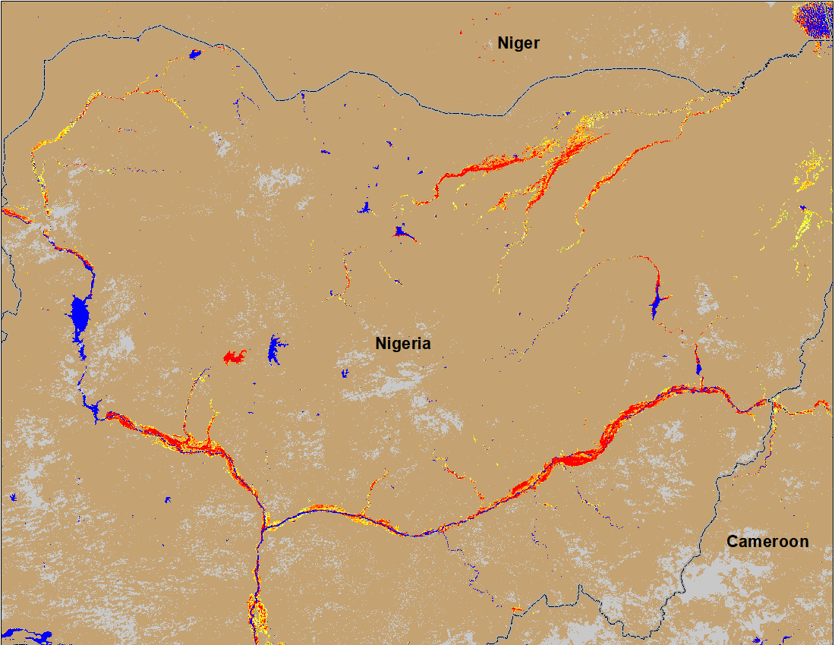
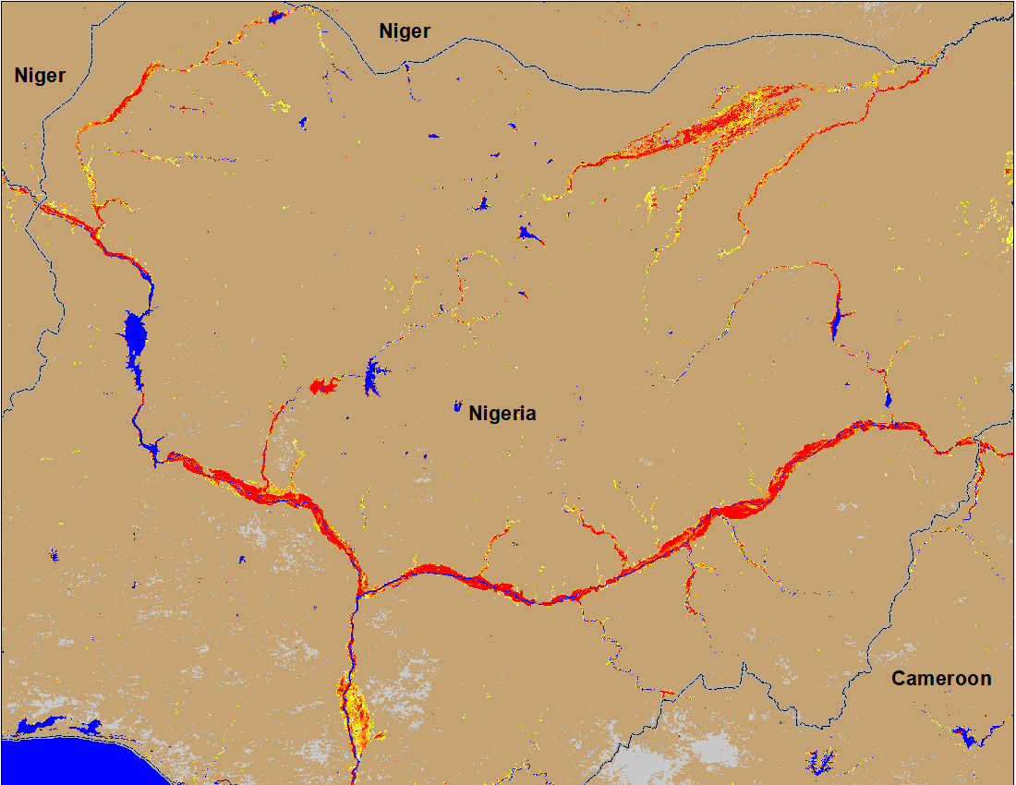
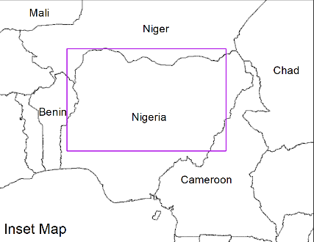
Flooding Conditions in Nigeria
(% of the pixel)
(% of the pixel)
Komadugu
Sokoto
Sokoto
Komadugu
Niger
Niger
Benue
Benue
IC flood map (Sep 1-13, 2022)
NOAA VIIRS 5-day comp.: 13-17 Sep 2022
NOAA VIIRS 5-day comp.: 21-25 Sep 2022
Flooded areas extend along the entire path of Niger and Benue Rivers from the boarder to Niger-Benue confluence.

Slide 7
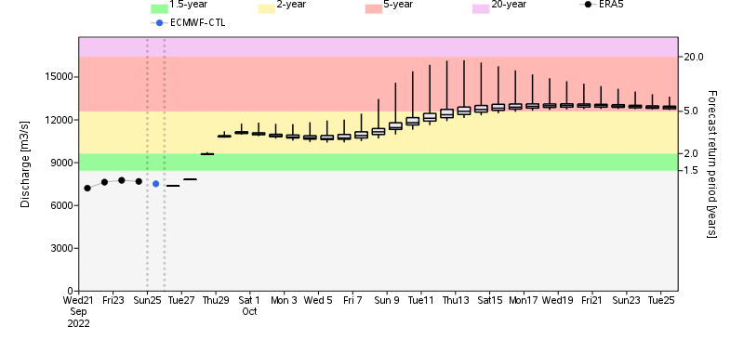
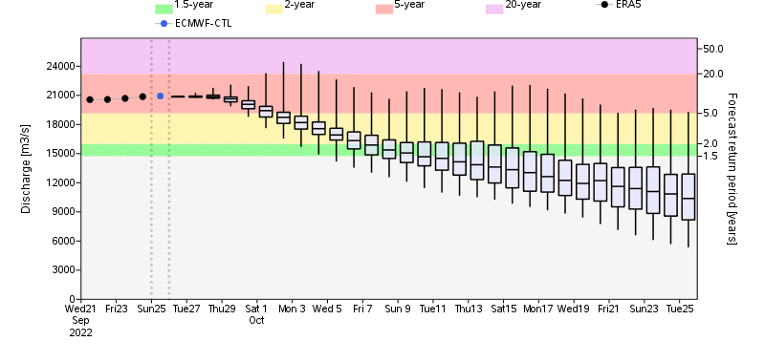
Discharge Forecast for Niger and Benue
GloFAS: Niger discharge at Niger-Nigeria boarder
GloFAS: Benue discharge at upstream of Niger-Benue confluence
Discharge on the Niger River is expected to rise to 5-yr return period level, where as discharge on the Benue River is expected to decline in October.

Slide 8
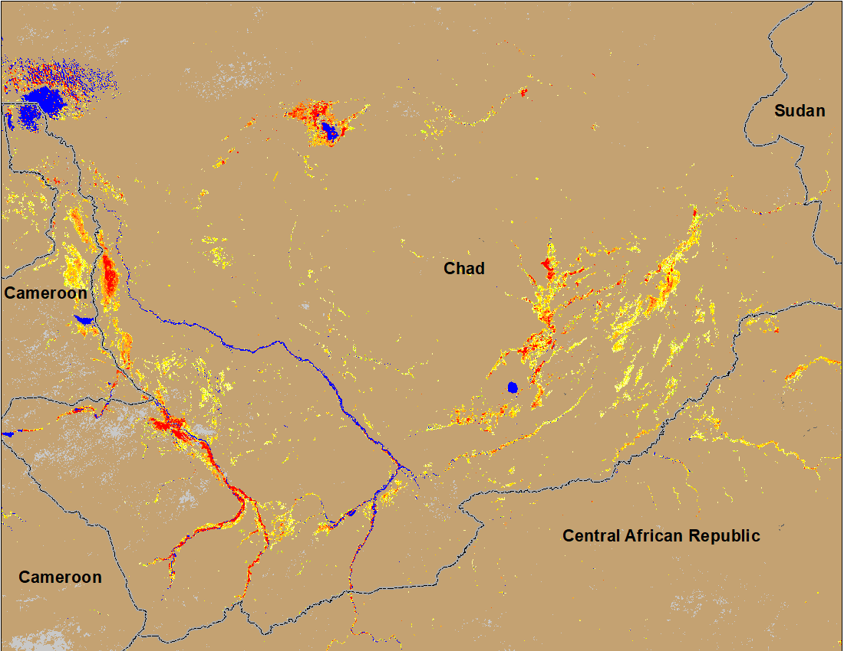
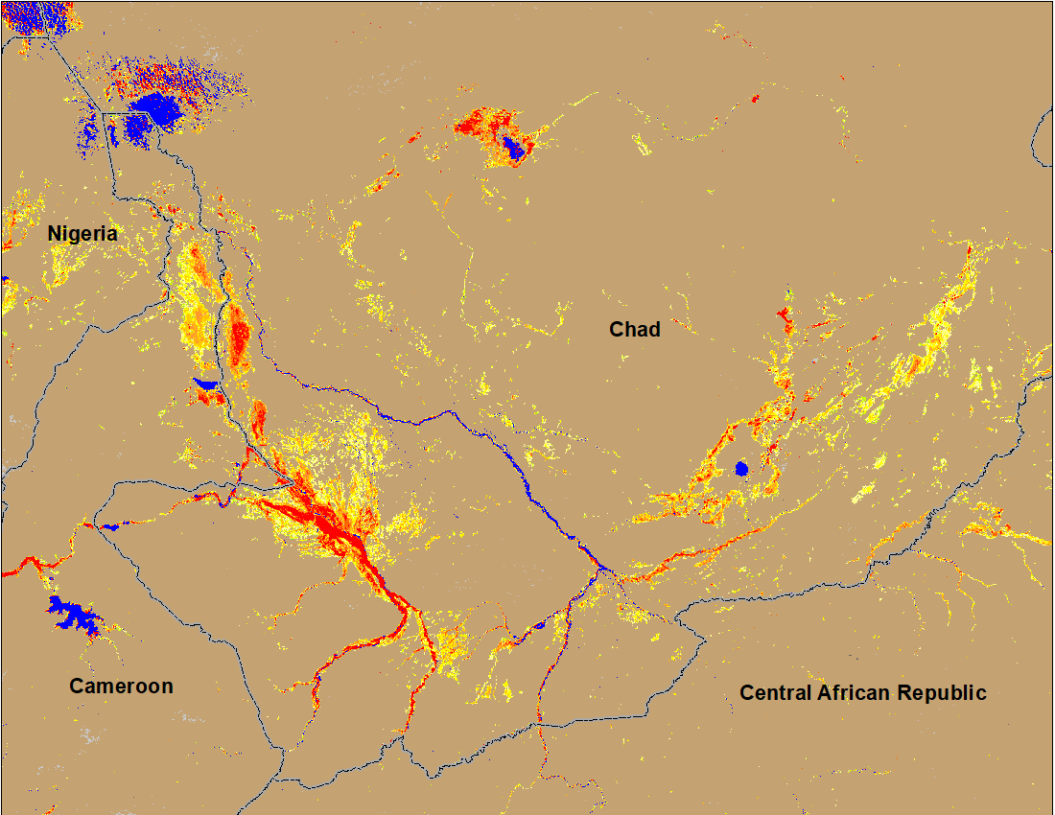
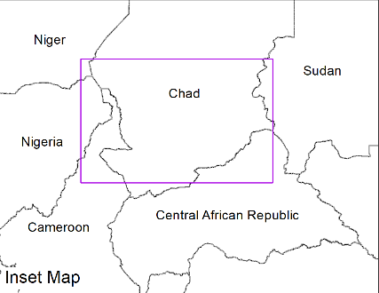
Flooding Conditions in Chad
(% of the pixel)
(% of the pixel)
NOAA VIIRS 5-day comp.: 13-17 Sep 2022
NOAA VIIRS 5-day comp.: 21-25 Sep 2022
Flooding conditions deteriorated with newly flooded areas.

Slide 9
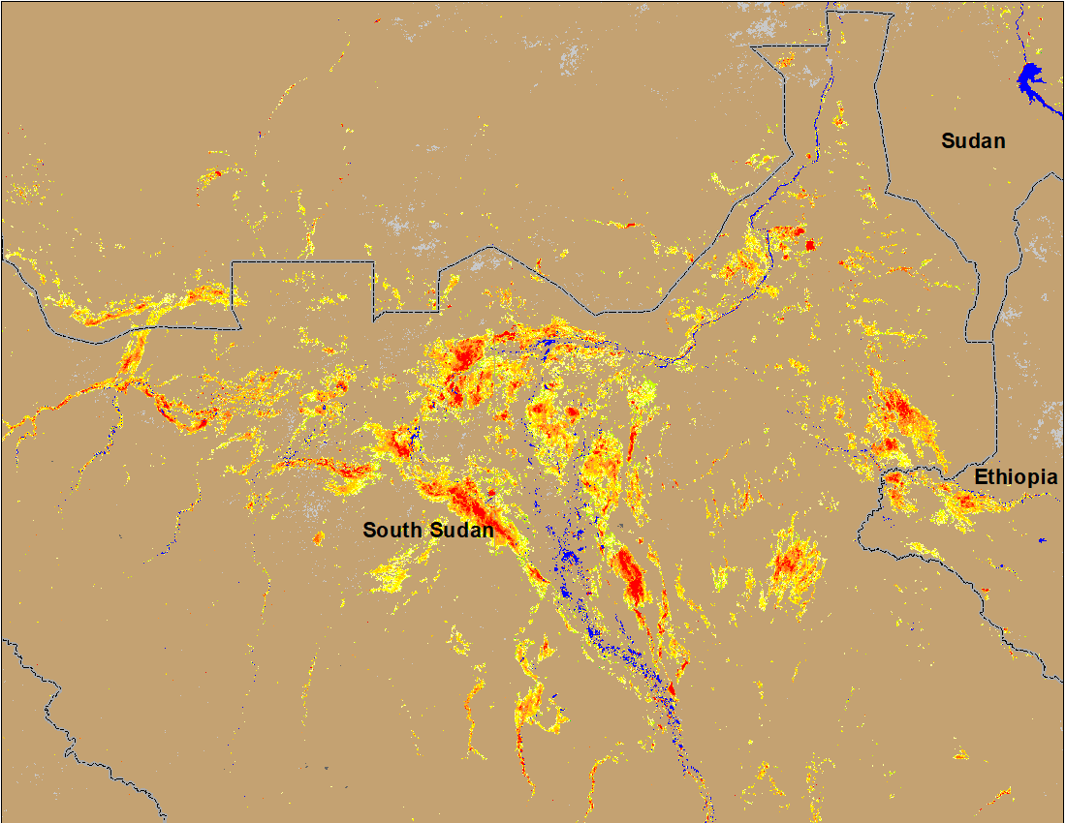
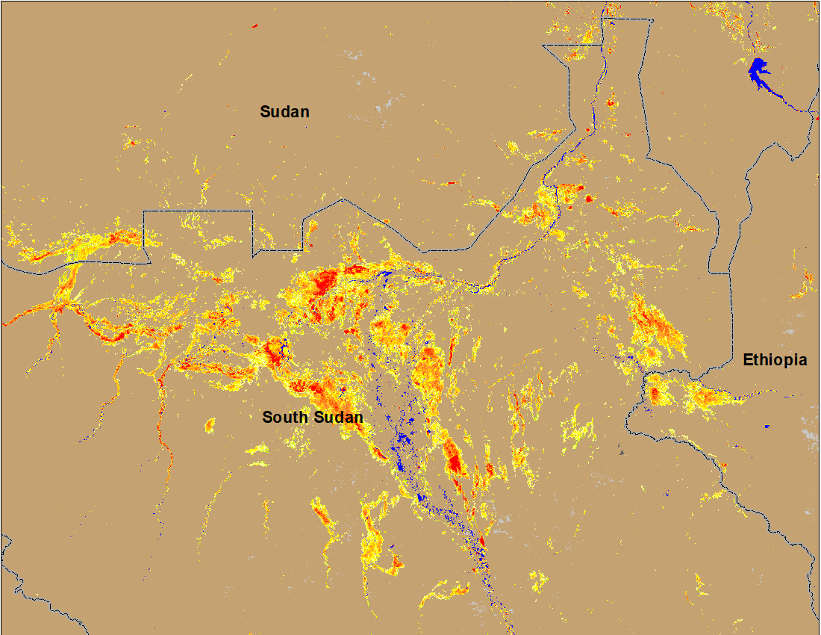
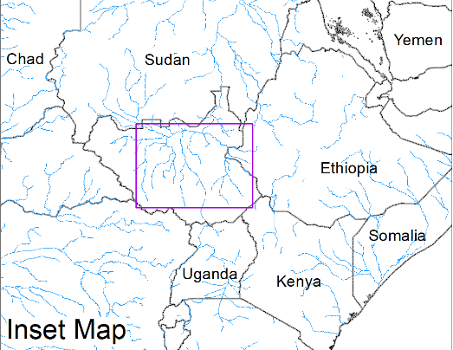
Inundation in the Sudd Wetlands
(% of the pixel)
(% of the pixel)
NOAA VIIRS 5-day comp.: 7-11 Sep 2022
NOAA VIIRS 5-day comp.: 21-25 Sep 2022
Flooding conditions remained unchanged in South Sudan.

Slide 10
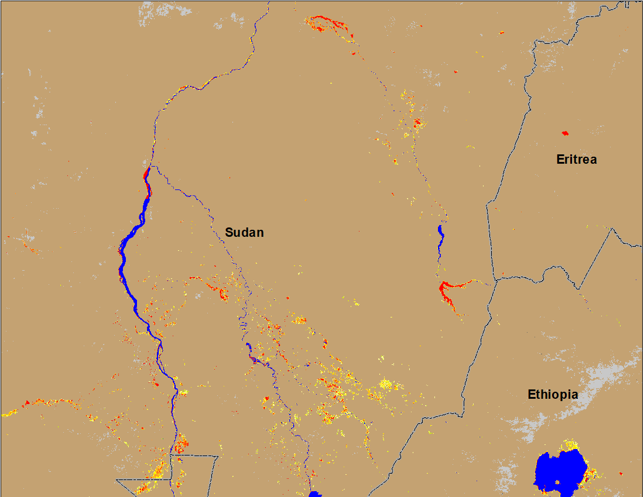
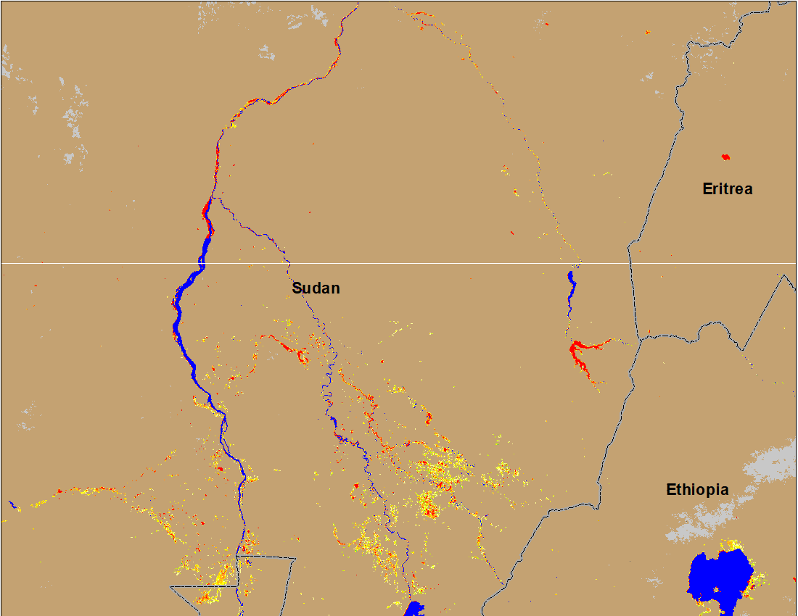
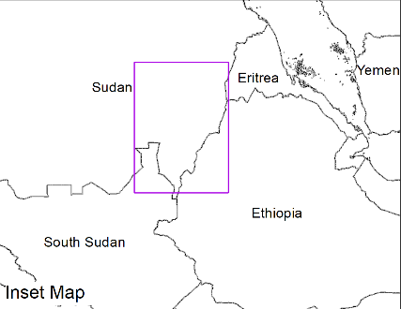
Flooding Conditions in Eastern Sudan
(% of the pixel)
Atbara
Atbara
Blue Nile
Blue Nile
(% of the pixel)
NOAA VIIRS 5-day composite: 13-17 Sep 2022
NOAA VIIRS 5-day composite: 21-25 Sep 2022
Conditions in Atbara have improved, and Blue Nile conditions remained unchanged.

Slide 11
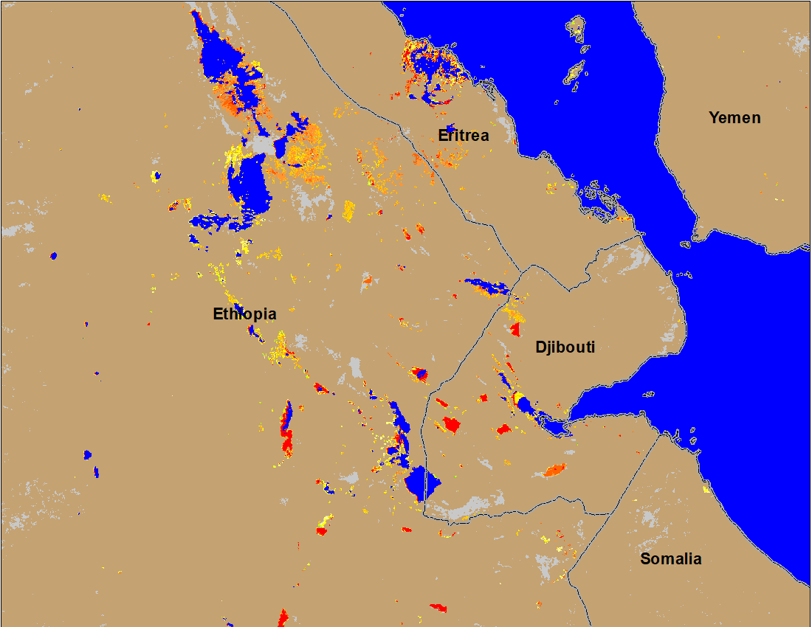
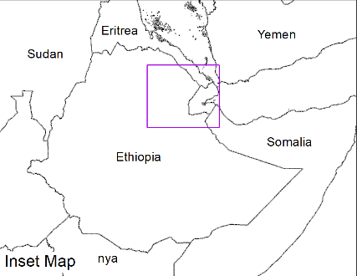
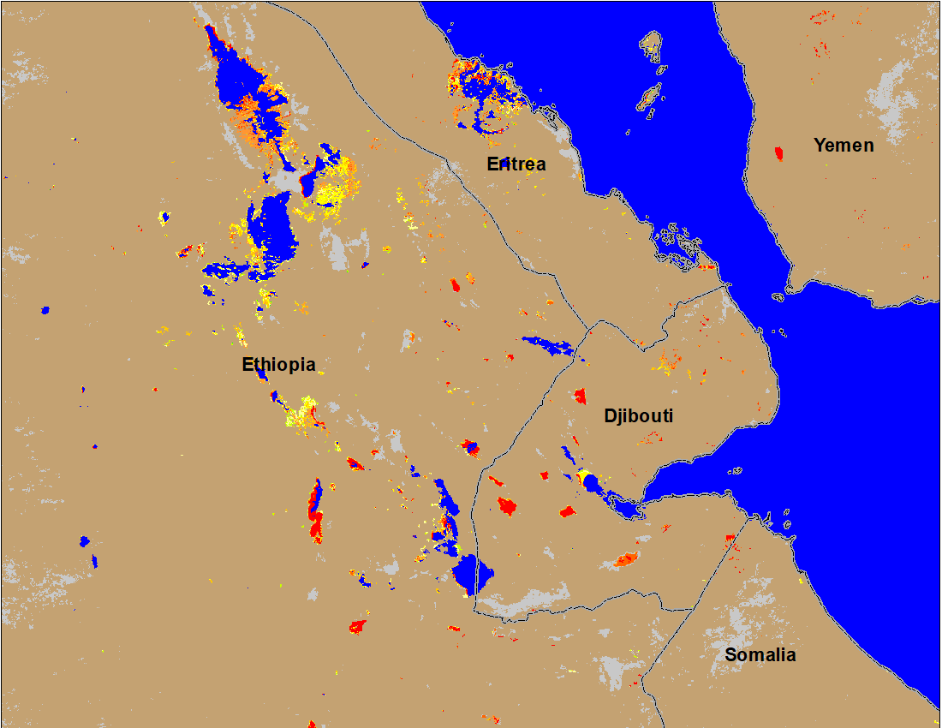
Flooding Conditions in Eastern Sudan & Northeastern Ethiopia
(% of the pixel)
(% of the pixel)
NOAA VIIRS 5-day composite: 13-17 Sep 2022
NOAA VIIRS 5-day composite: 13-17 Sep 2022
Conditions improved in northeastern Ethiopia, Eritrea and Djibouti.

Slide 12
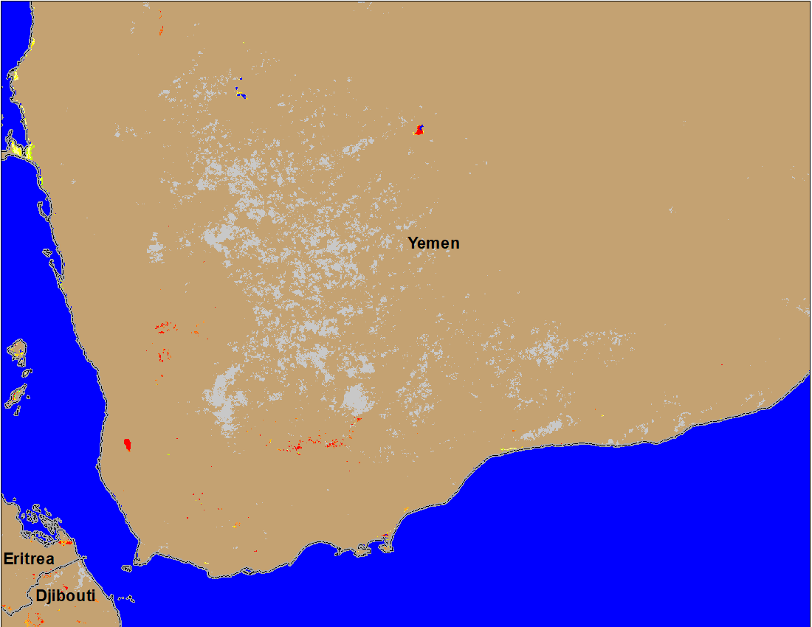
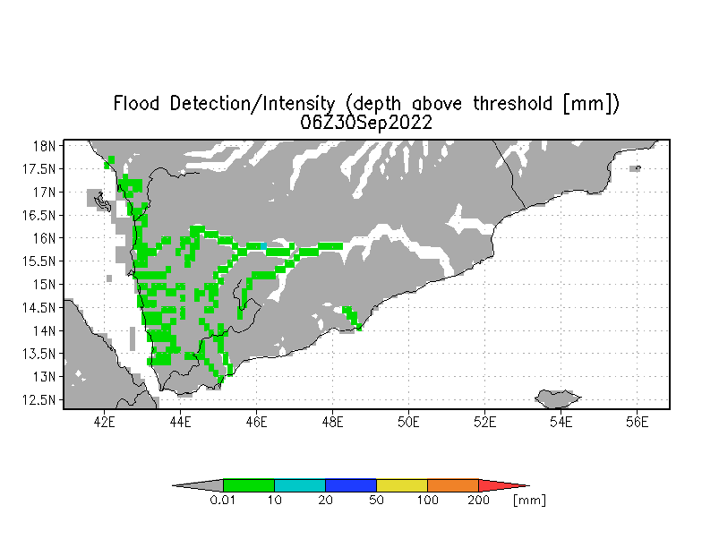
Inundation in Yemen
(% of the pixel)
NOAA VIIRS 5-day composite: 21 - 25 Sep 2022.
UMD Depth above threshold: 30 Sep 2022
More isolated flooding is noticeable in the southwestern Yemen Wadis.

