Slide 1
FEWS NET Enhanced Flood Monitoring – East Africa, West Africa, southern Africa and Yemen
September 19, 2022, Hazard Briefing
FEWS NET Science Team:
USGS, NASA, NOAA, UCSB+Regional Scientists

Slide 2
Flooding Hazard Areas

Slide 3
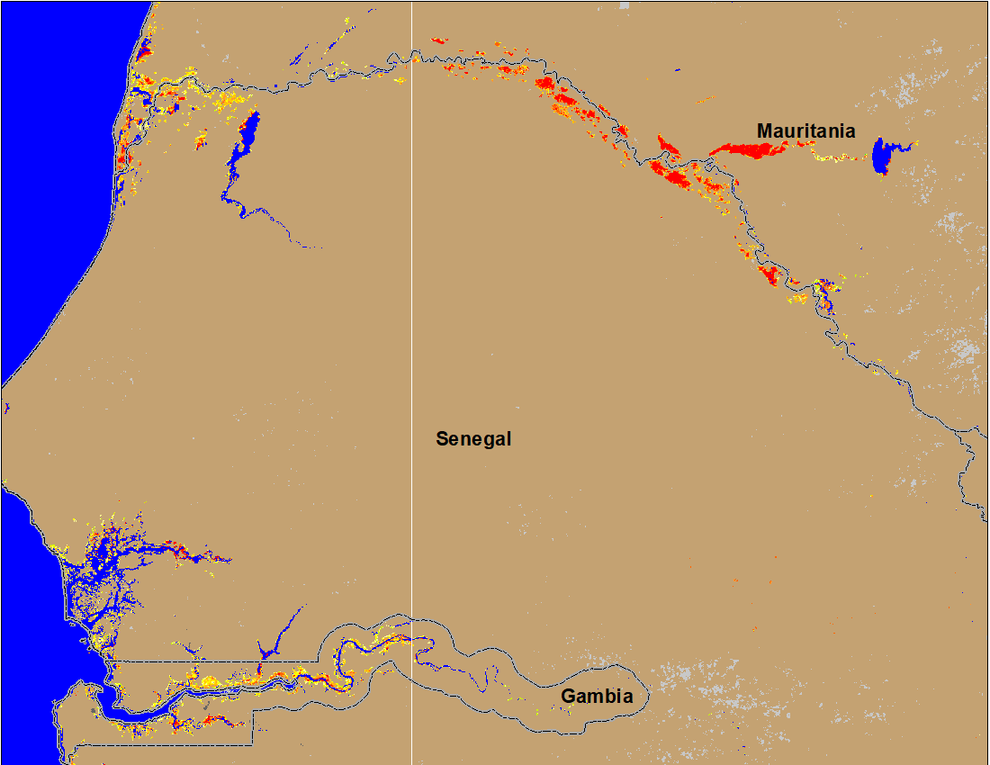
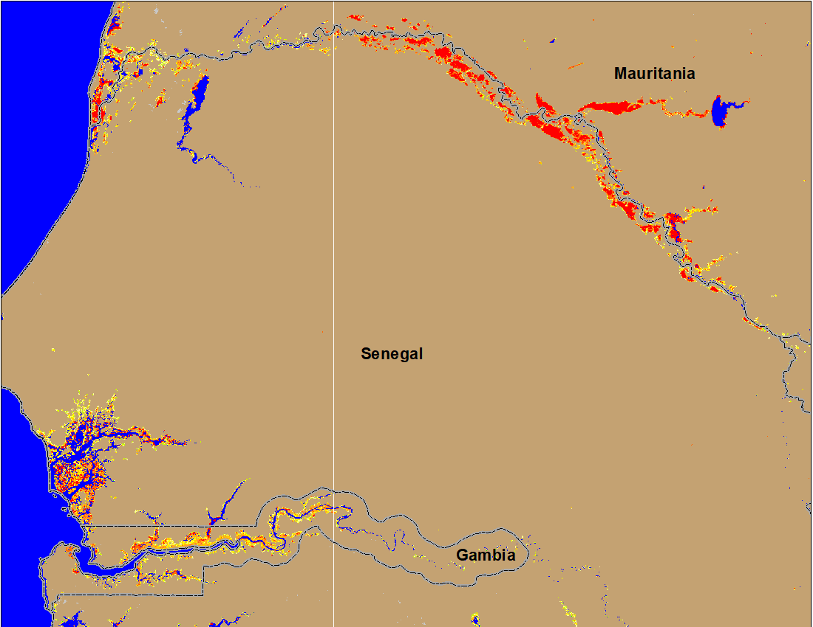
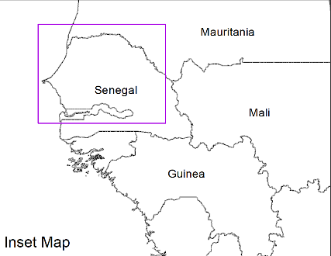
Flooding Conditions in Senegal & Guinea-Bissau
(% of the pixel)
(% of the pixel)
NOAA VIIRS 5-day comp.: 7-11 Sep 2022
NOAA VIIRS 5-day comp.: 13-17 Sep 2022
Senegal River continues to flood new areas along its downstream during last week.

Slide 4
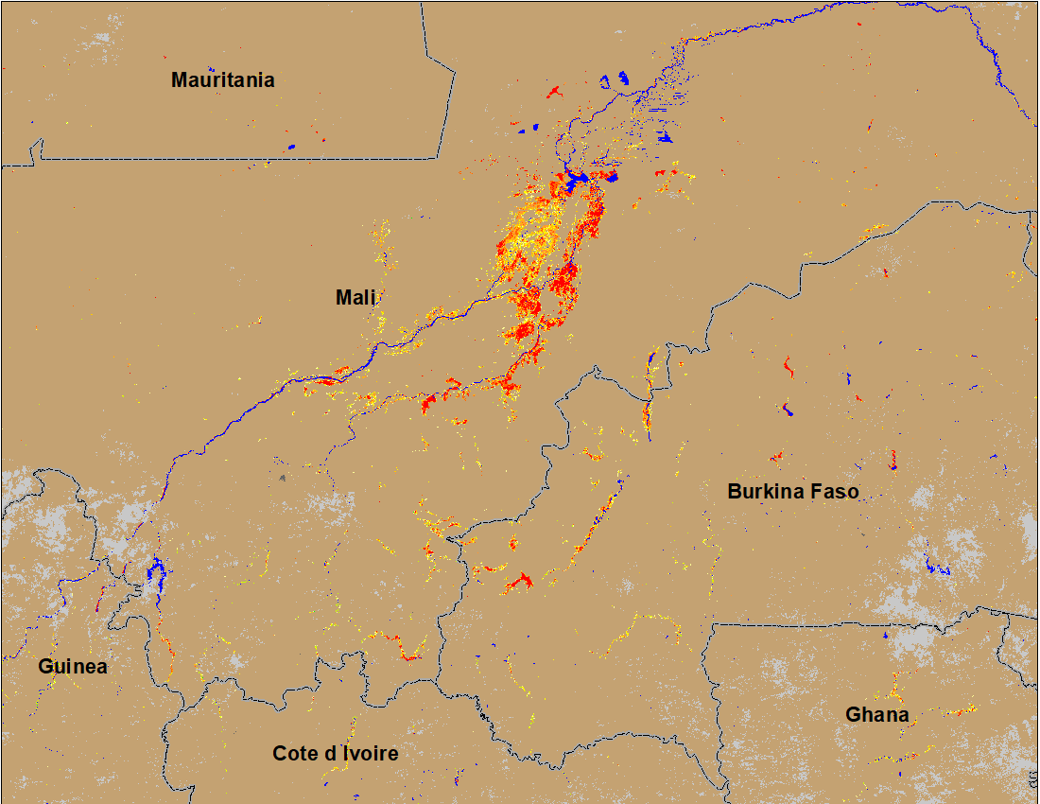
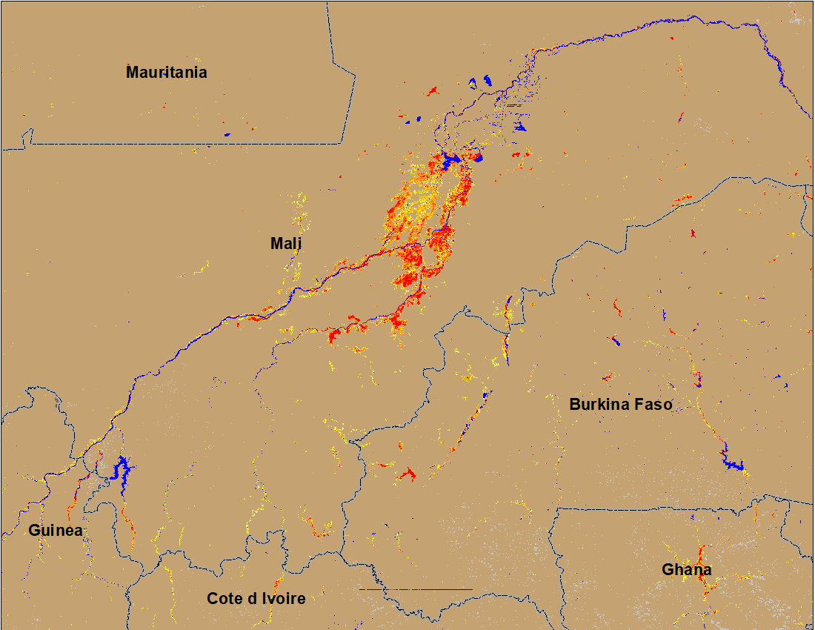
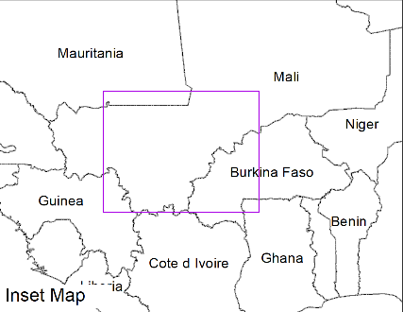
Flooding Conditions in Mali and Burkina Faso
(% of the pixel)
(% of the pixel)
Niger
NOAA VIIRS 5-day comp.: 7-11 Sep 2022
NOAA VIIRS 5-day comp.: 13-17 Sep 2022
Flooding in central Mali and Burkina Faso remained constant.

Slide 5
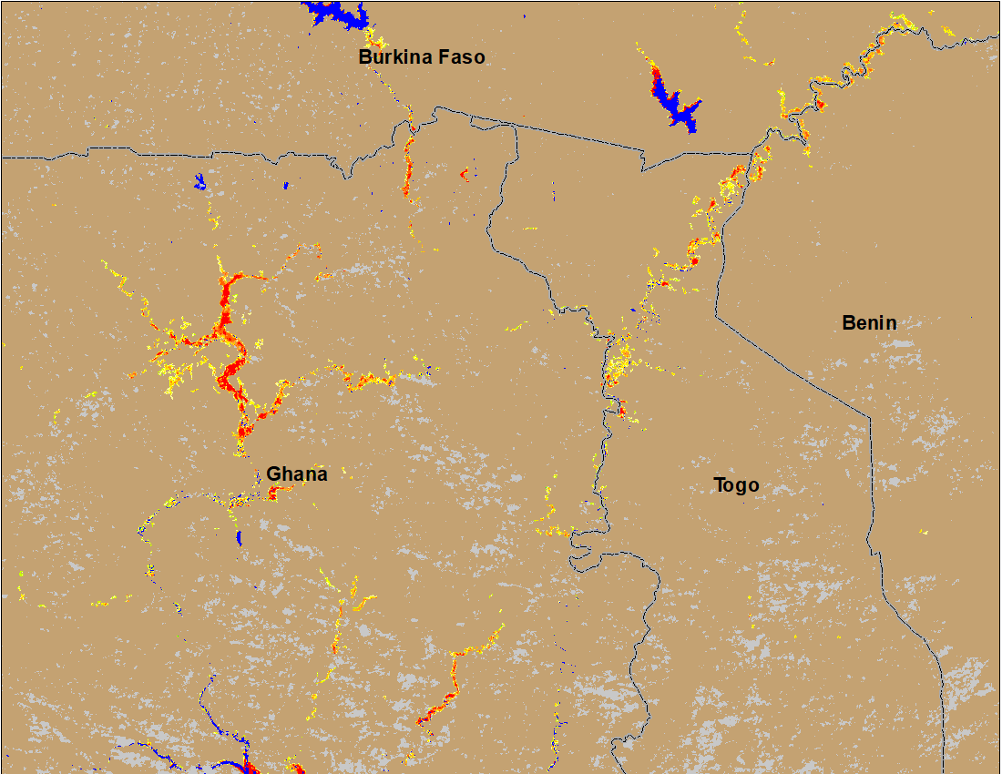
Flooding Conditions in Ghana & Togo
(% of the pixel)
NOAA VIIRS 5-day comp.: 13-17 Sep 2022
Newly flooded areas in Ghana and Togo in the last week.

Slide 6
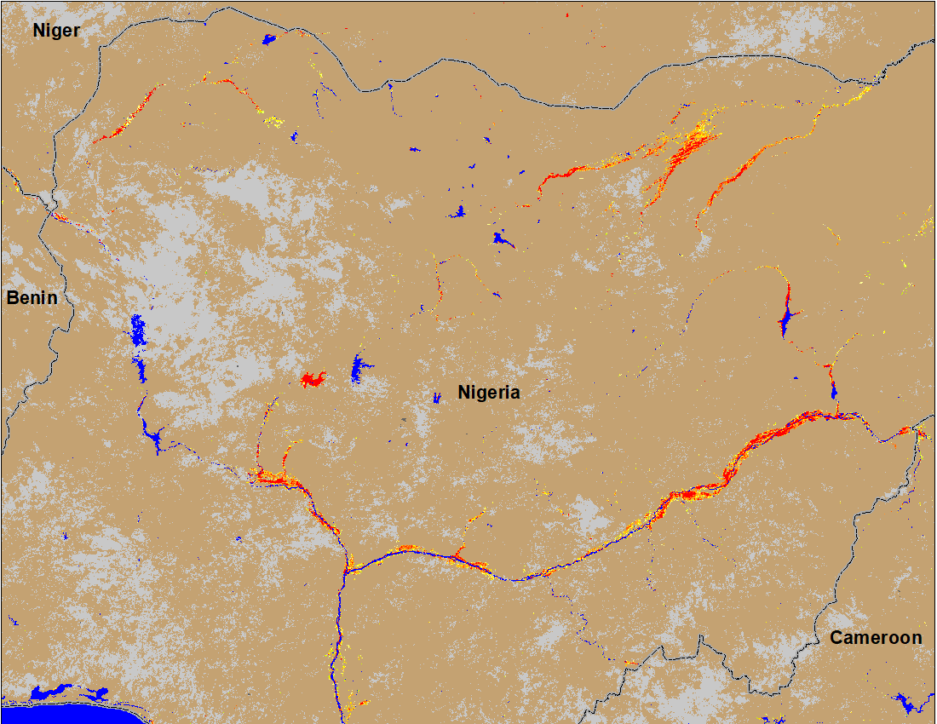
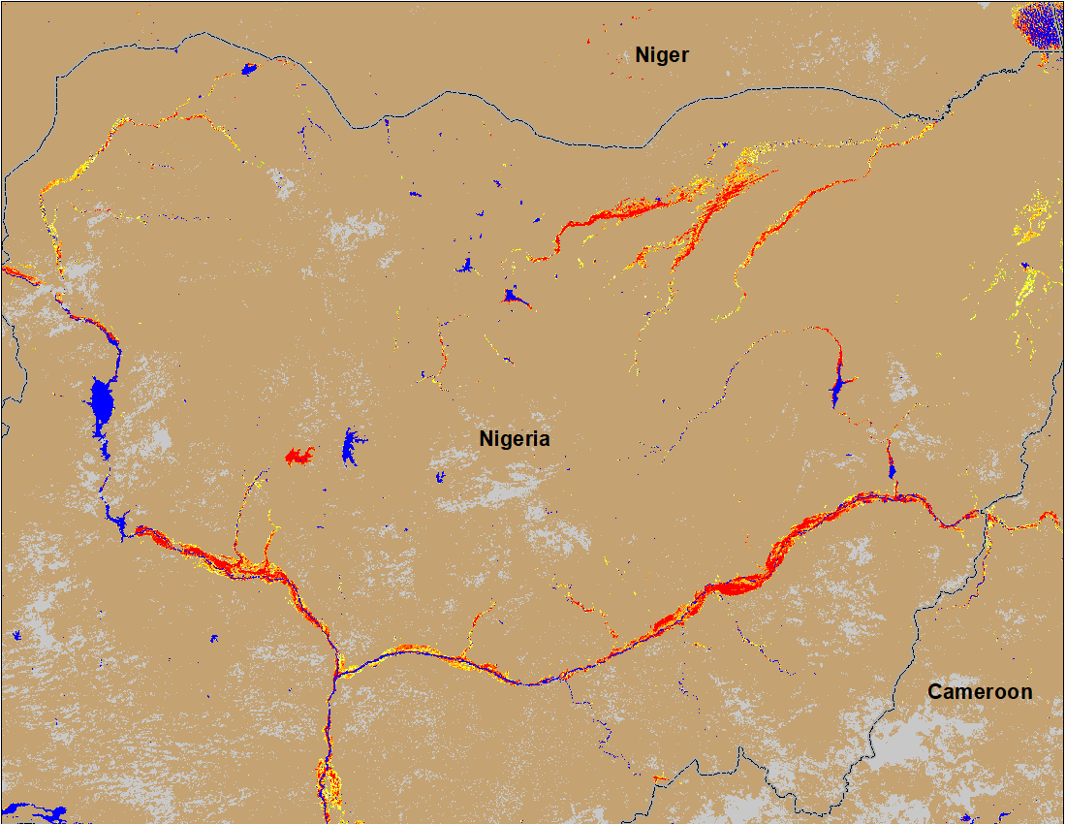
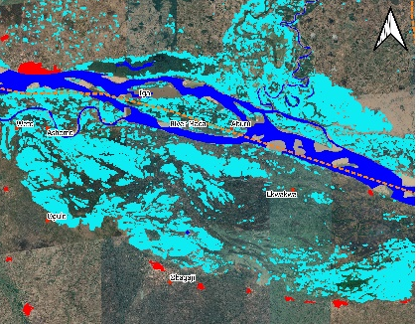
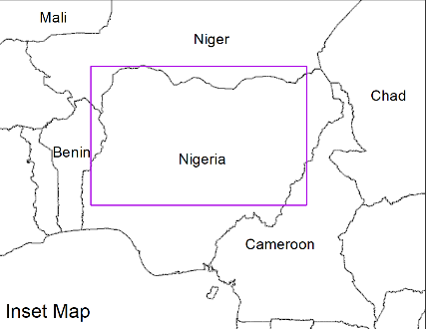
Flooding Conditions in Nigeria
(% of the pixel)
(% of the pixel)
Komadugu
Sokoto
Sokoto
Komadugu
Niger
Niger
Benue
Benue
IC flood map (Sep 1-13, 2022)
NOAA VIIRS 5-day comp.: 7-11 Sep 2022
NOAA VIIRS 5-day comp.: 3-17 Sep 2022
Flooding conditions worsening in the eastern part of Benue River and gradually progressing downstream.

Slide 7
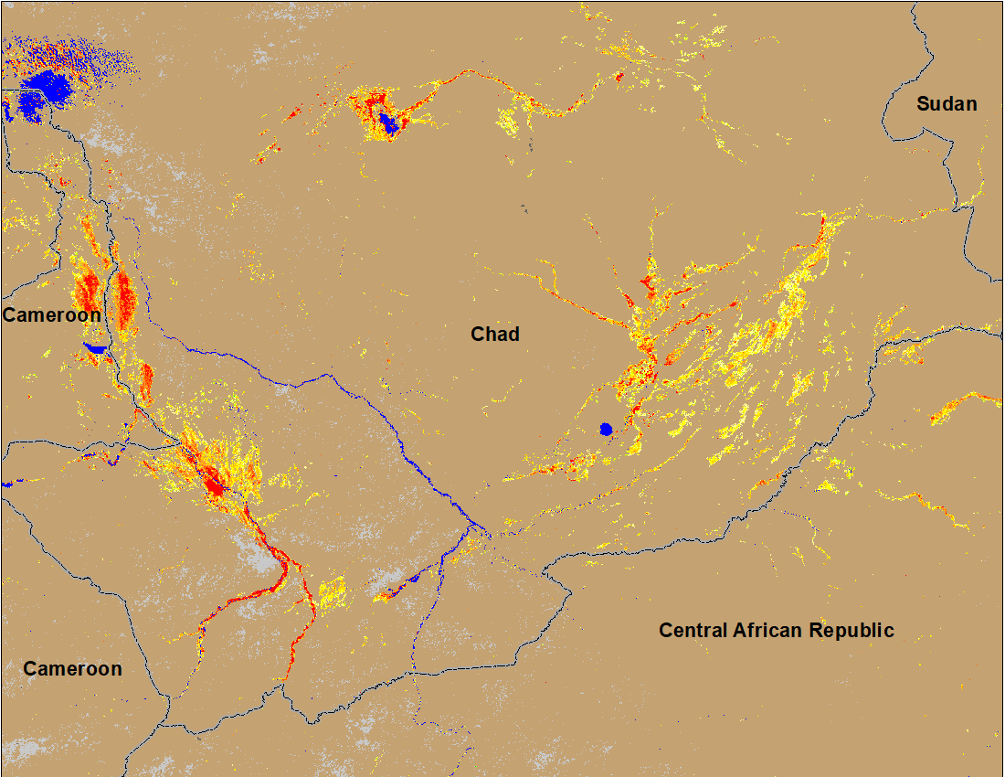
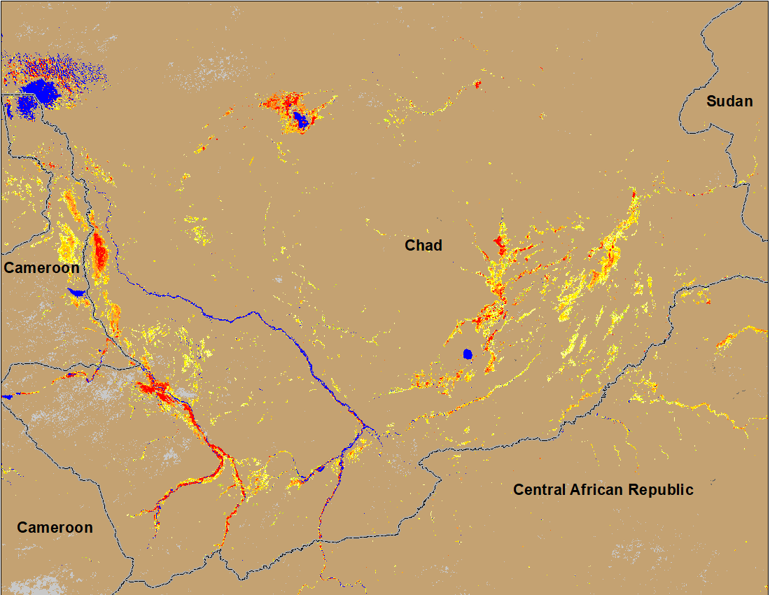
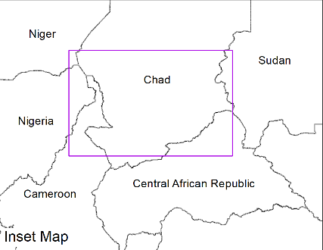
Flooding Conditions in Chad
(% of the pixel)
(% of the pixel)
NOAA VIIRS 5-day comp.: 7-11 Sep 2022
NOAA VIIRS 5-day comp.: 13-17 Sep 2022
Flooding in southern Chad remained unchanged.

Slide 8
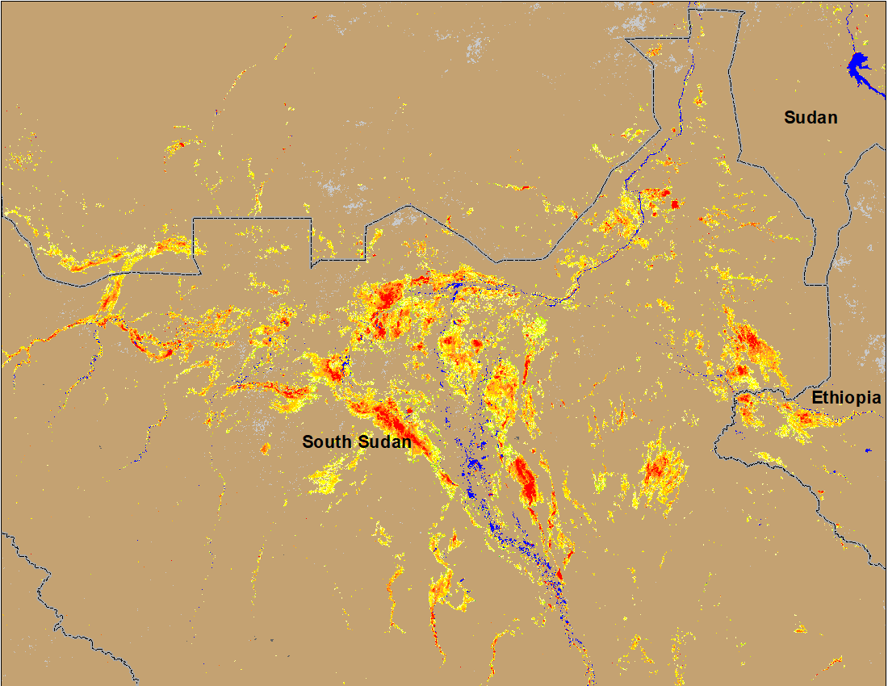
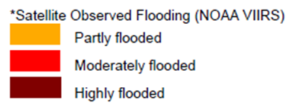
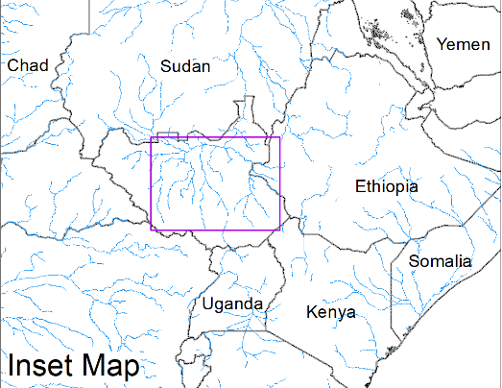
Inundation in the Sudd Wetlands
(% of the pixel)
NOAA VIIRS 5-day comp.: 7-11 Sep 2022
ADAM Flood Event: 19 Sep 2022
Flooding conditions remained unchanged in South Sudan.

Slide 9
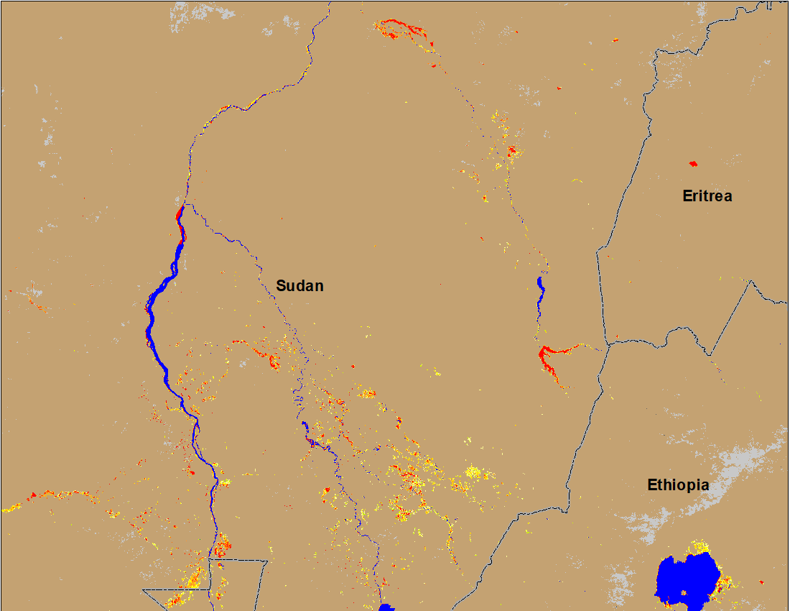
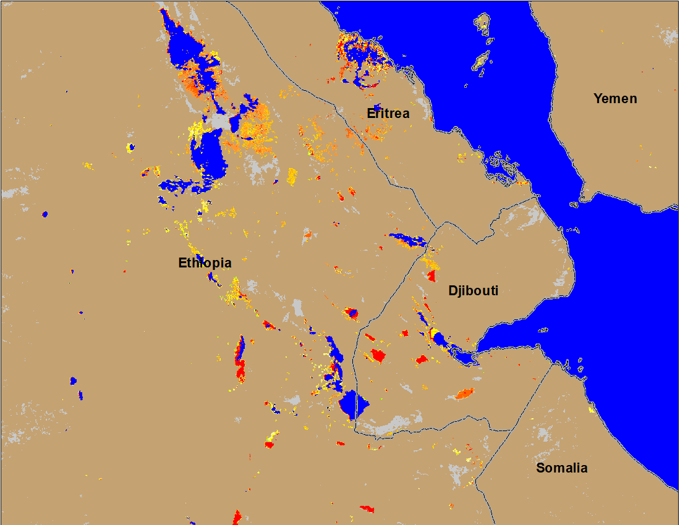
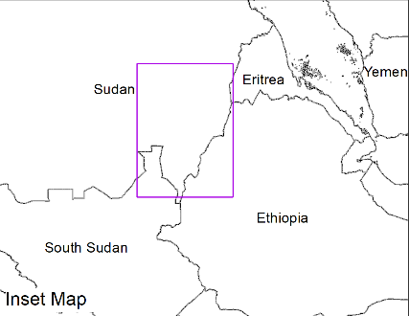
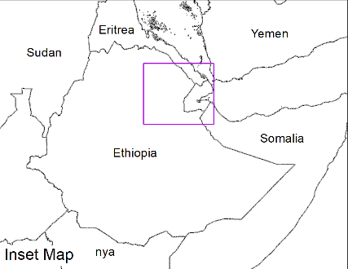
Flooding Conditions in Eastern Sudan & Northeastern Ethiopia
Atbara
Blue Nile
(% of the pixel)
(% of the pixel)
NOAA VIIRS 5-day composite: 13-17 Sep 2022
NOAA VIIRS 5-day composite: 13-17 Sep 2022
Flooding continues in Atbara and Blue Nile and newly flooded areas in northeastern Ethiopia, Eritrea and Djibouti.

Slide 10
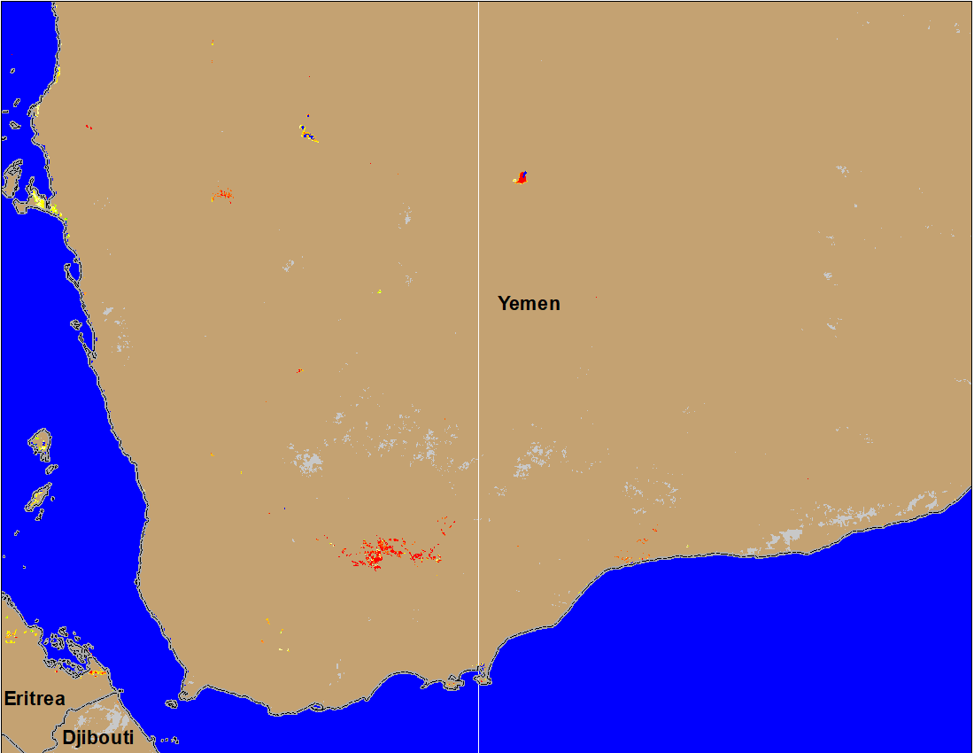
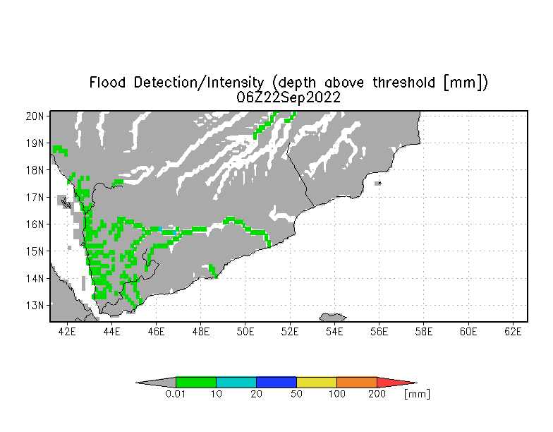
Inundation in Yemen
(% of the pixel)
NOAA VIIRS 5-day composite: 13 - 17 Sep 2022.
UMD Depth above threshold: 22 Sep 2022
Isolated flooding is more likely to continue along the western Yemen Wadis.

