Slide 1
FEWS NET Enhanced Flood Monitoring – East Africa, West Africa, southern Africa and Yemen
September 12, 2022, Hazard Briefing
FEWS NET Science Team:
USGS, NASA, NOAA, UCSB+Regional Scientists

Slide 2
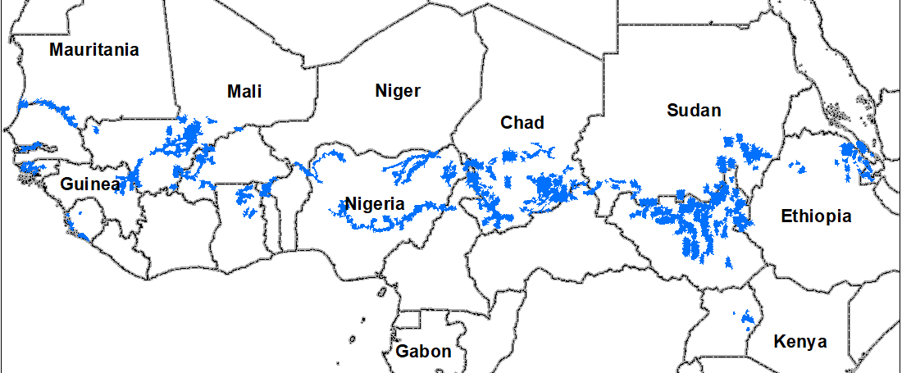
Flooding Hazard Areas

Slide 3
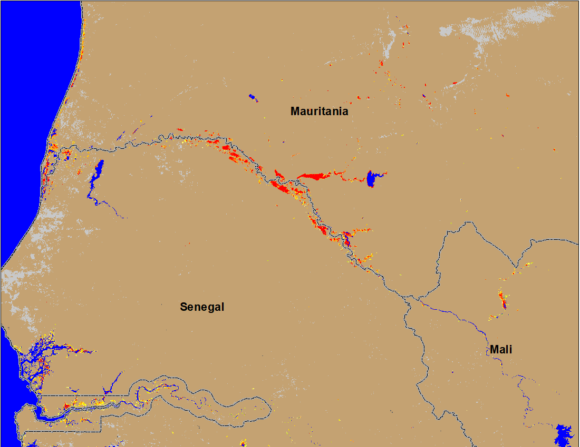
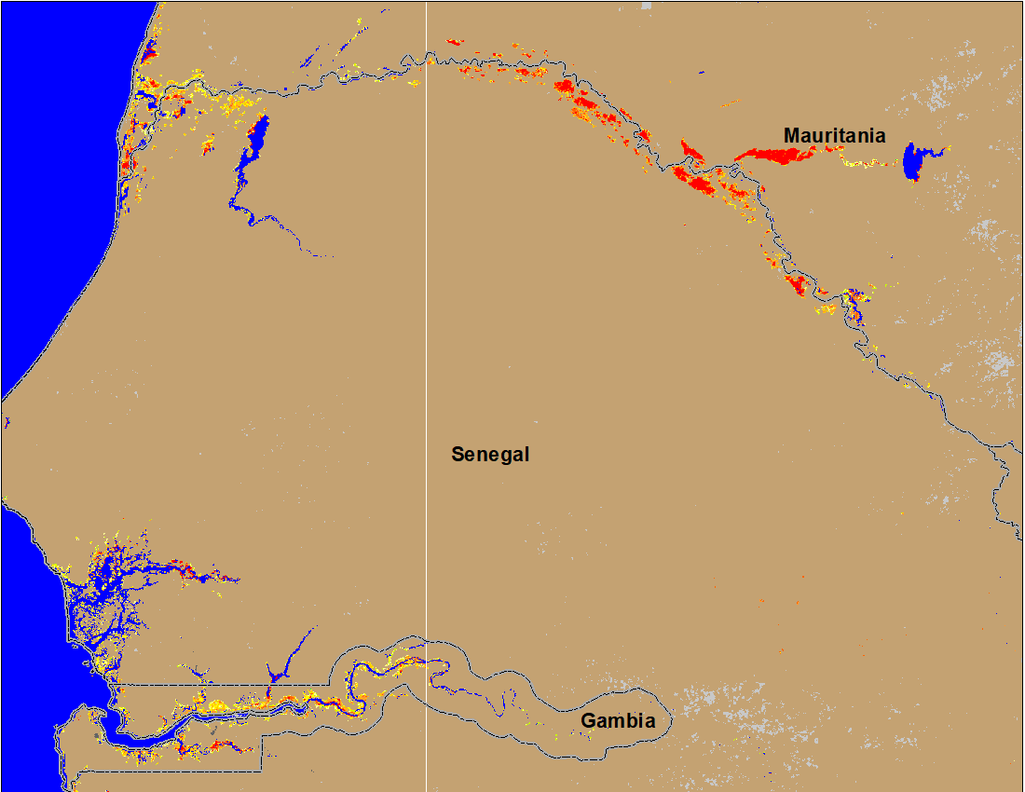
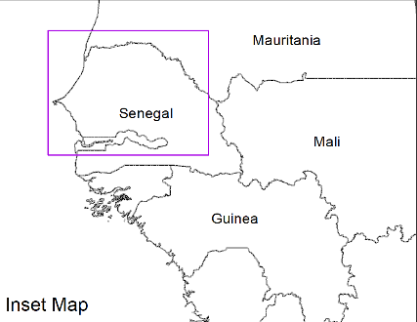
Flooding Conditions in Senegal & Guinea-Bissau
(% of the pixel)
(% of the pixel)
NOAA VIIRS 5-day comp.: 1-5 Sep 2022
NOAA VIIRS 5-day comp.: 7-11 Sep 2022
Flooding expanded to more areas in Senegal and Guinea-Bissau.

Slide 4
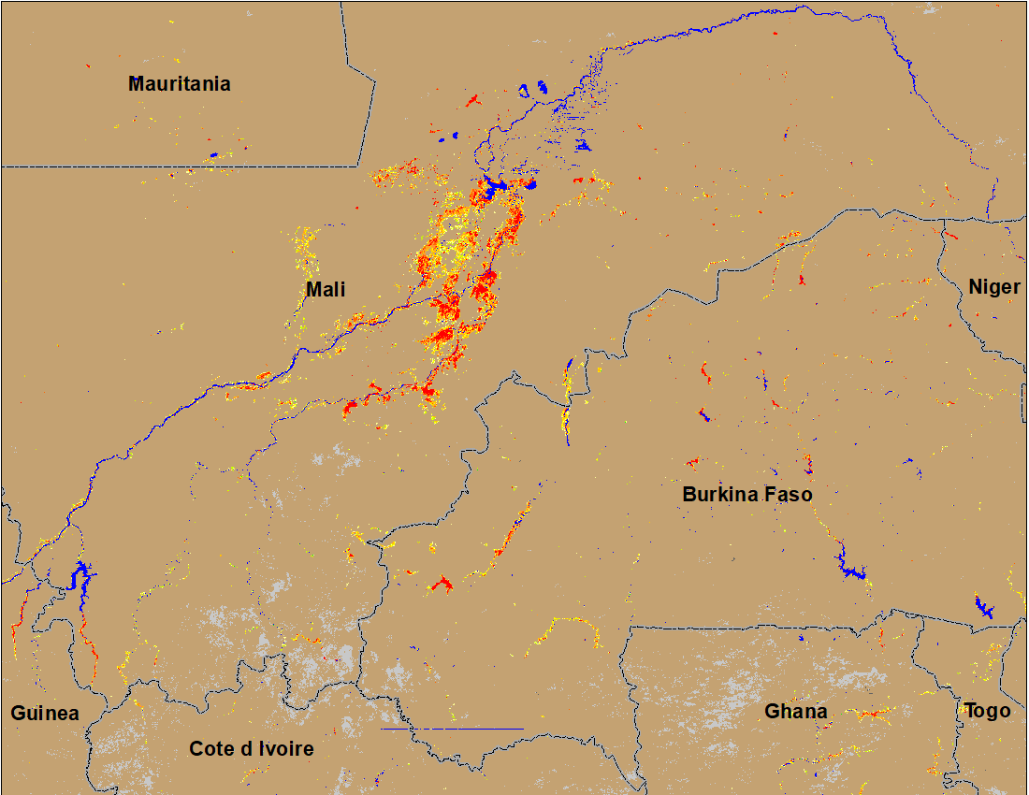
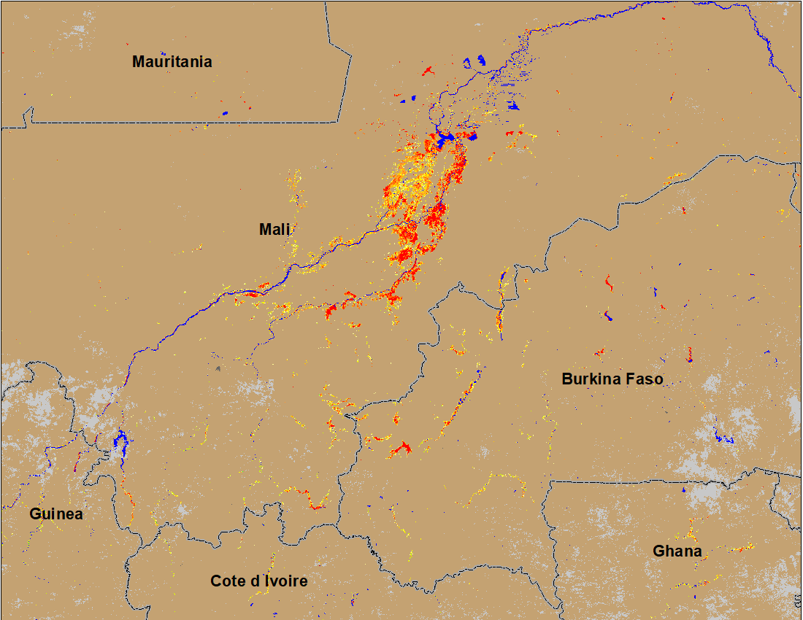
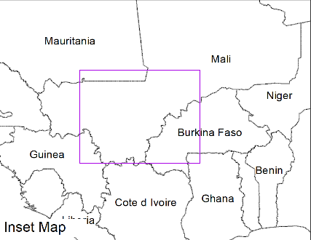
Flooding Conditions in Mali and Burkina Faso
(% of the pixel)
(% of the pixel)
NOAA VIIRS 5-day comp.: 1-5 Sep 2022
NOAA VIIRS 5-day comp.: 7-11 Sep 2022
Flooding conditions worsen in central Mali and Burkina Faso.

Slide 5
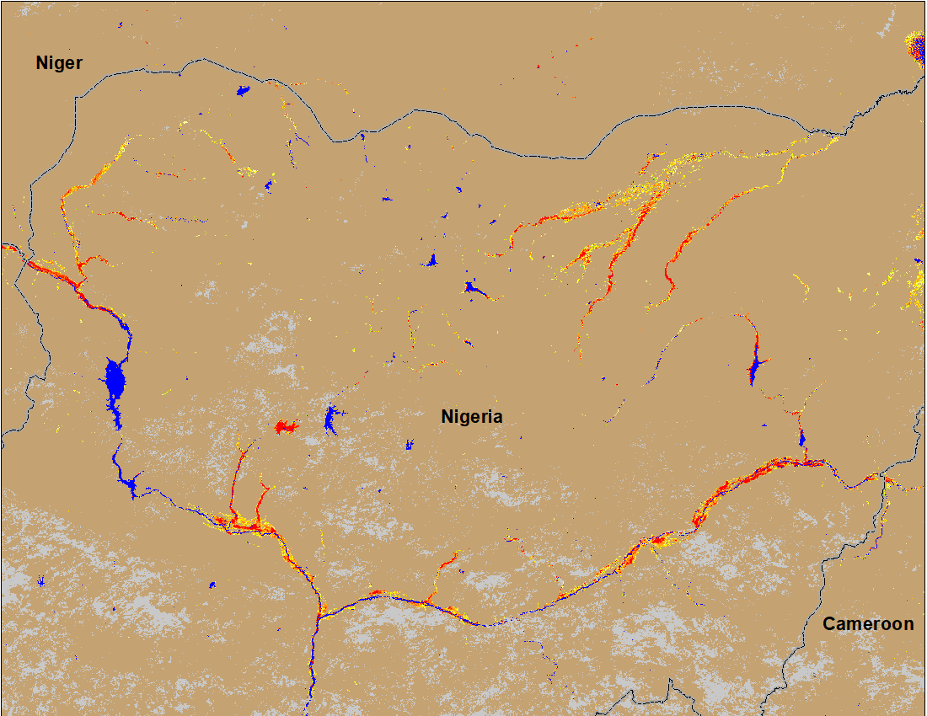
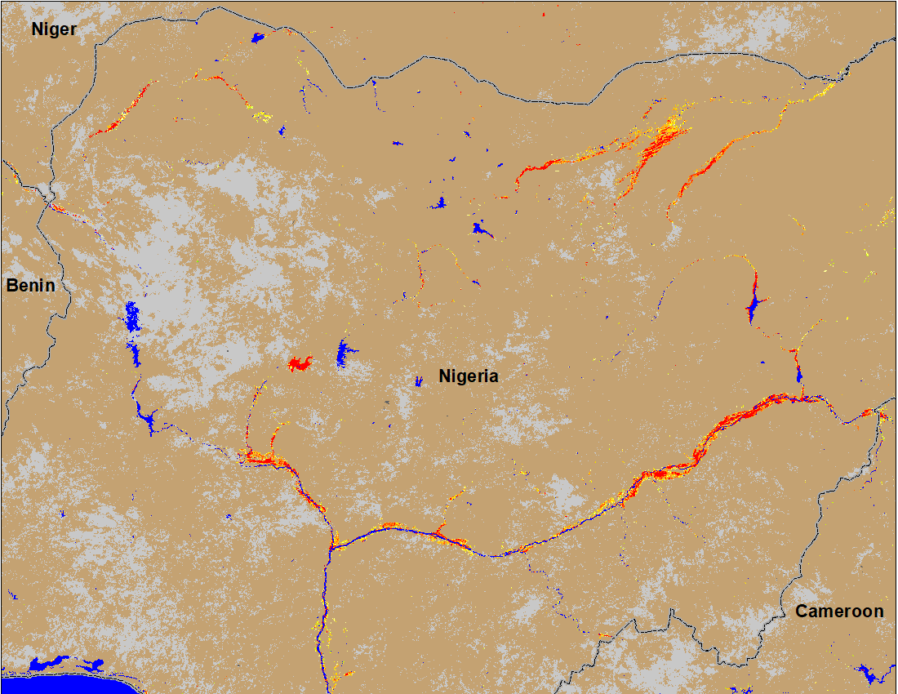
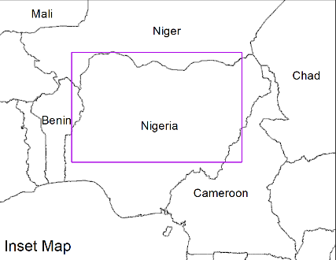
Flooding Conditions in Nigeria
(% of the pixel)
(% of the pixel)
Sokoto
Komadugu
Niger
Benue
NOAA VIIRS 5-day comp.: 1-5 Sep 2022
NOAA VIIRS 5-day comp.: 7-11 Sep 2022
Slight improvement along Sokoto River, but condition along Komadugu, Niger and Benue Rivers continue to worsen.

Slide 6
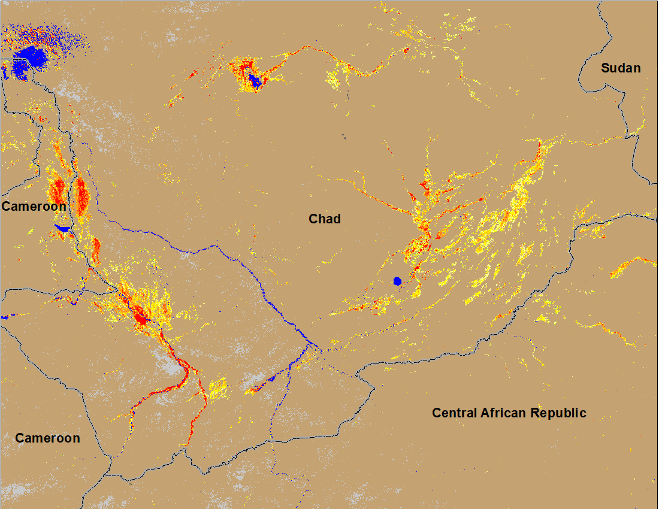
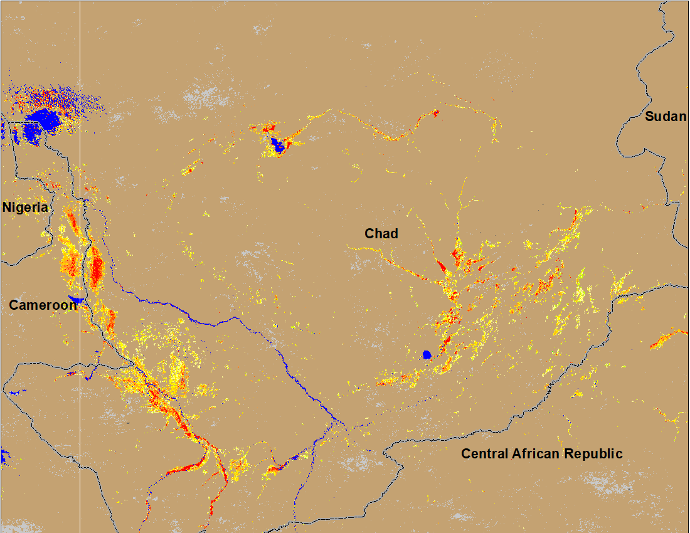
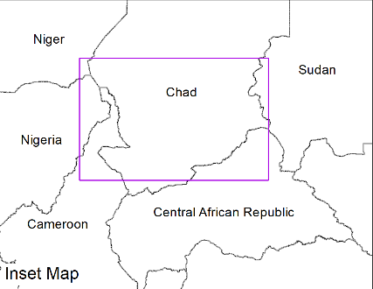
Flooding Conditions in Chad
(% of the pixel)
(% of the pixel)
NOAA VIIRS 5-day comp.: 1-5 Sep 2022
NOAA VIIRS 5-day comp.: 7-11 Sep 2022
Flooding condition worsen, especially in the southeastern Chad.

Slide 7
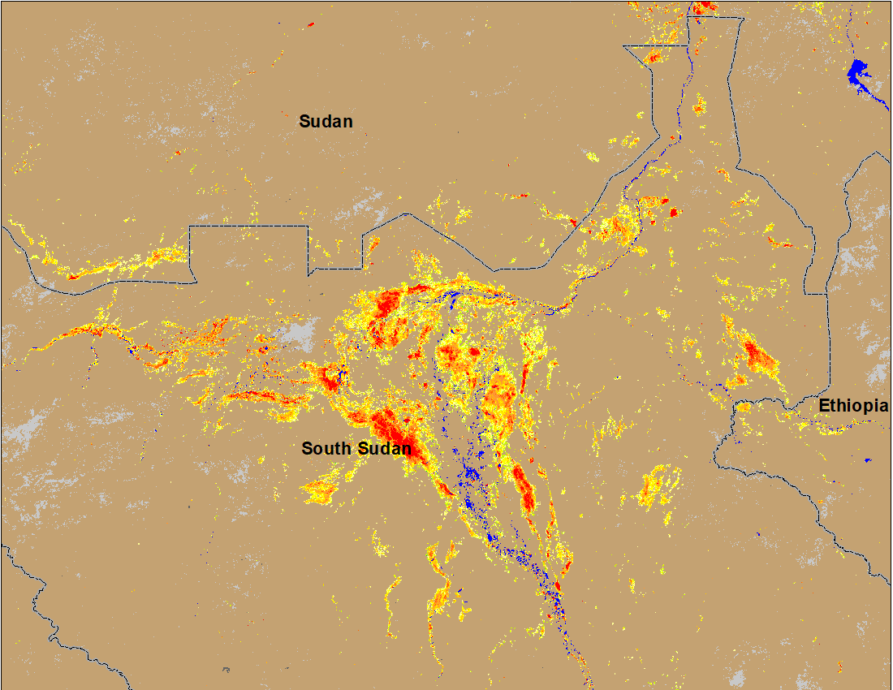
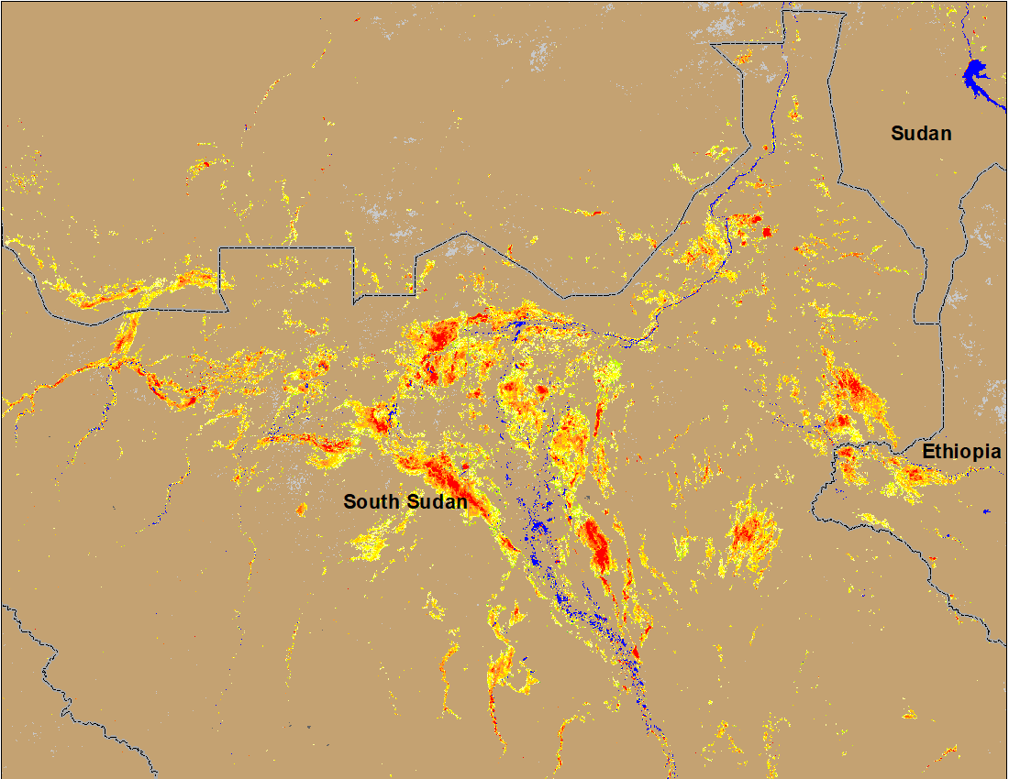
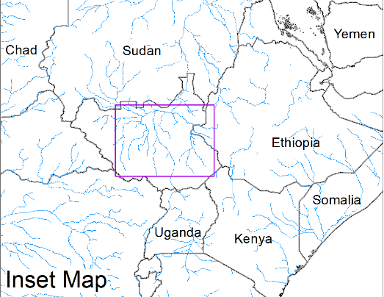
Inundation in the Sudd Wetlands
(% of the pixel)
(% of the pixel)
Northern Sudd Wetlands
Sobet River
Akobo River
Pibor River
NOAA VIIRS 5-day comp.: 1-5 Sep 2022
NOAA VIIRS 5-day comp.: 7-11 Sep 2022
Flooding conditions worsen with newly inundated areas along Sobet and Akobo Rivers in South Sudan and along the Nile in Southern Darfur.

Slide 8
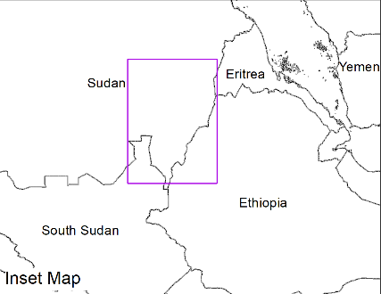
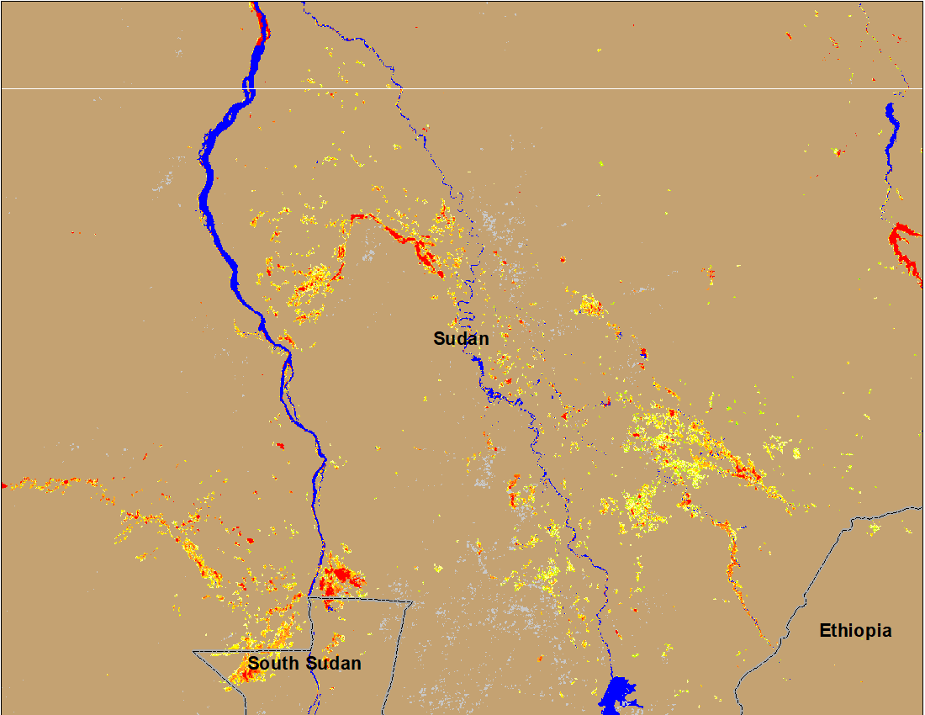
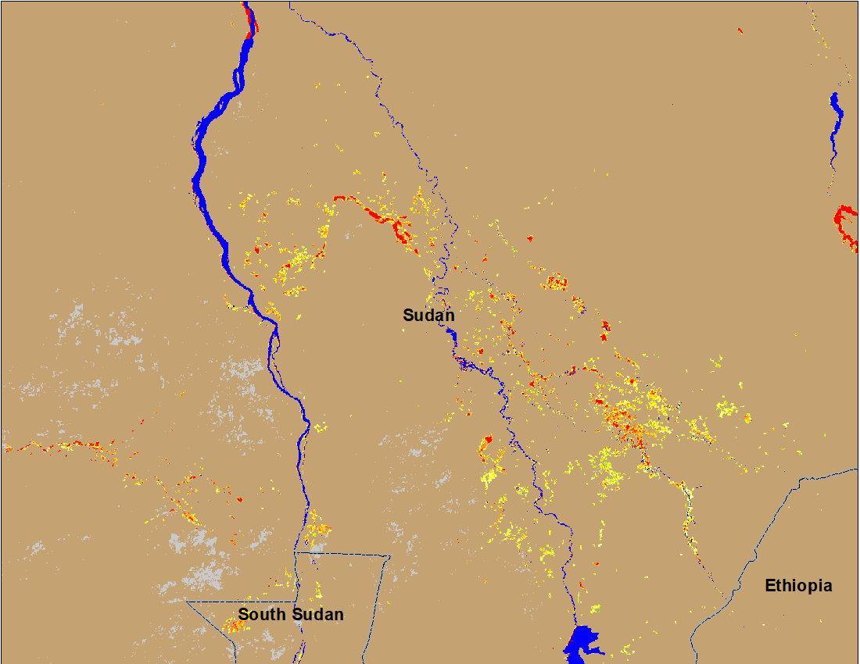
Inundation in Eastern Sudan
(% of the pixel)
(% of the pixel)
Blue Nile
White Nile
NOAA VIIRS 5-day comp.: 1-5 Sep 2022
NOAA VIIRS 5-day comp.: 7-11 Sep 2022
Flooding along the White Nile in Eastern Sudan improved but Blue Nile conditions remained unchanged.

Slide 9
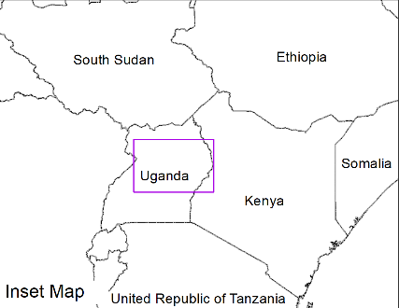
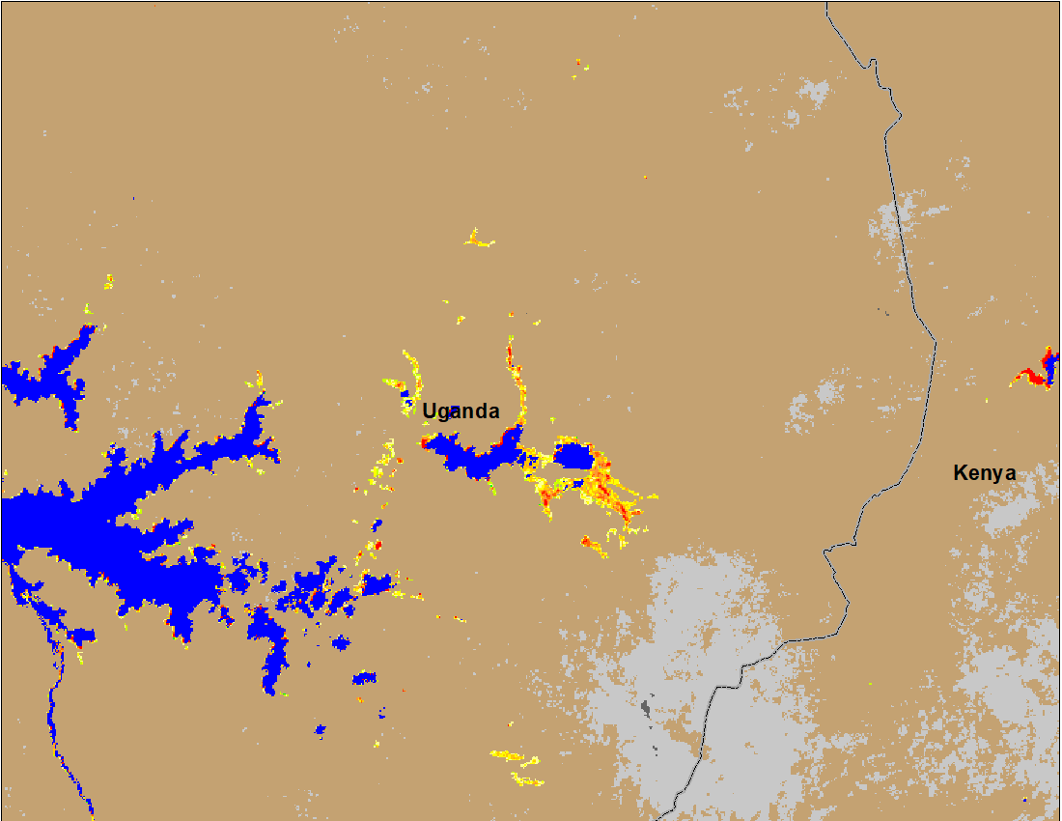
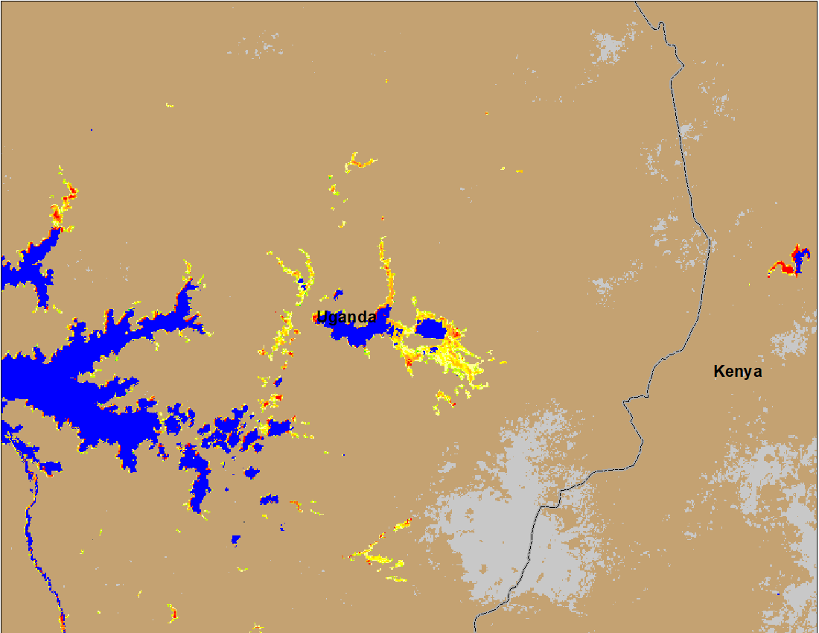
Inundation in Uganda
(% of the pixel)
(% of the pixel)
(% of the pixel)
NOAA VIIRS 5-day comp.: 1-5 Sep 2022
NOAA VIIRS 5-day comp.: 7-11 Sep 2022
Flooding in Uganda remained unchanged.

Slide 10
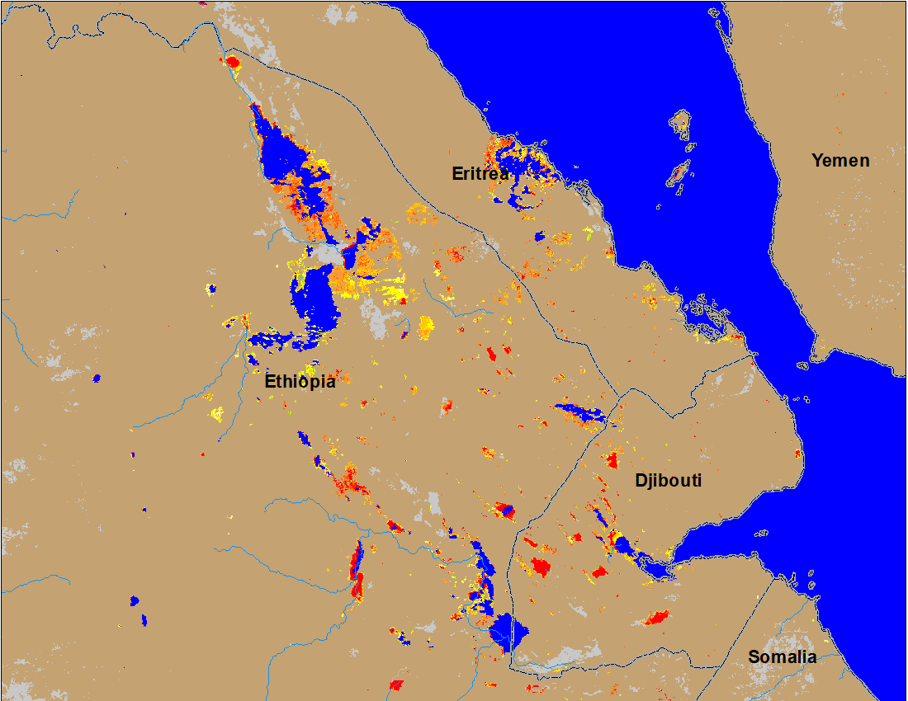
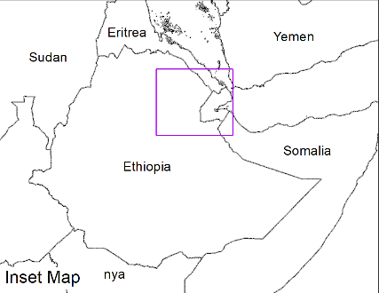
Flooding in Eastern Ethiopia, Eritrea, and Djibouti
(% of the pixel)
NOAA VIIRS 5-day comp.: 7-11 Sep 2022
Some isolated flooding are visible in Eastern Ethiopia, Eritrea and Djibouti.

Slide 11
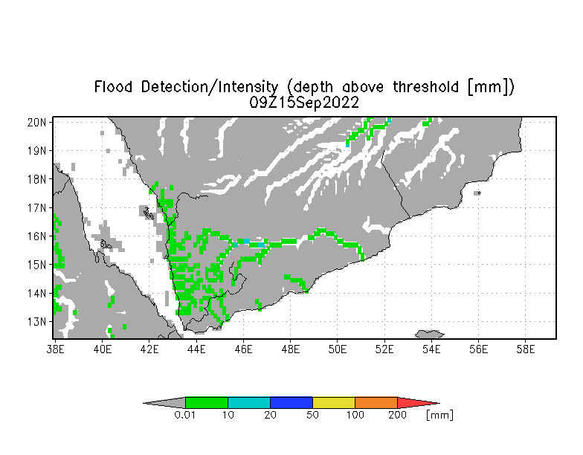
Inundation in Yemen
Flooding is expected along the western and central Wadis in Yemen.
UMD depth above threshold map: Valid for Sep 15, 2022

