Slide 1
FEWS NET Enhanced Flood Monitoring – East Africa, West Africa, southern Africa and Yemen
October 31, 2022, Hazard Briefing
FEWS NET Science Team:
USGS, NASA, NOAA, UCSB+Regional Scientists

Slide 2
Flooding Hazard Areas

Slide 3
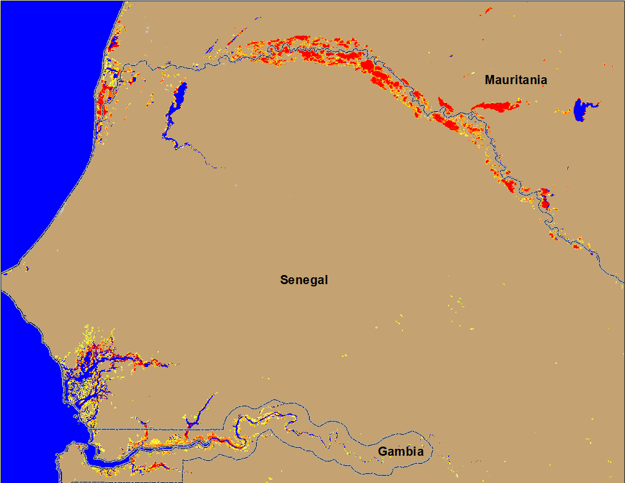
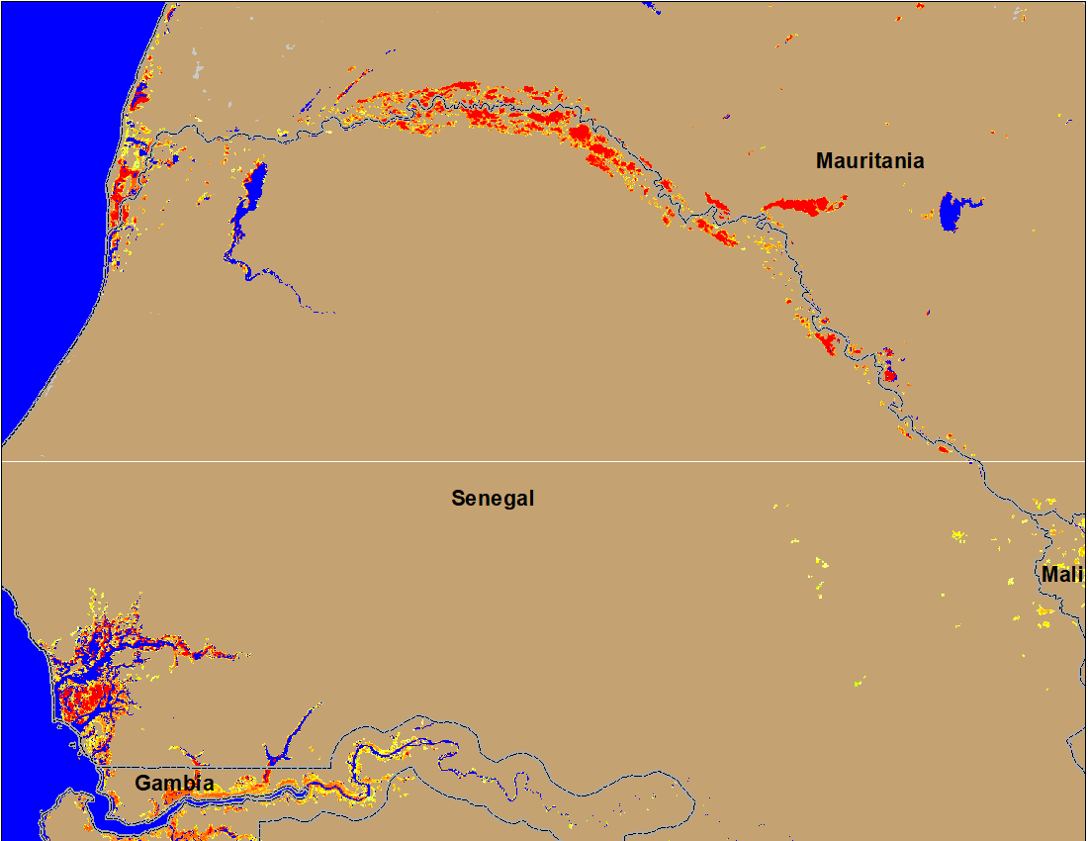
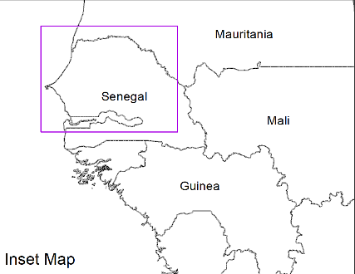
Flooding Conditions in Senegal & Gambia
(% of the pixel)
(% of the pixel)
NOAA VIIRS 5-day comp.: 19 – 23 Oct 2022
NOAA VIIRS 5-day comp.: 26 – 30 Oct 2022
Flooding along Senegal River is improving gradually.

Slide 4
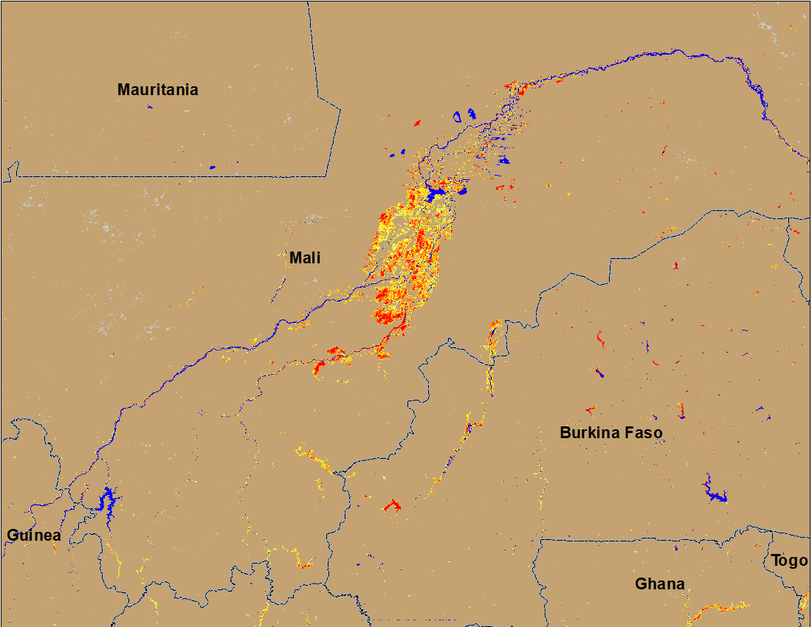
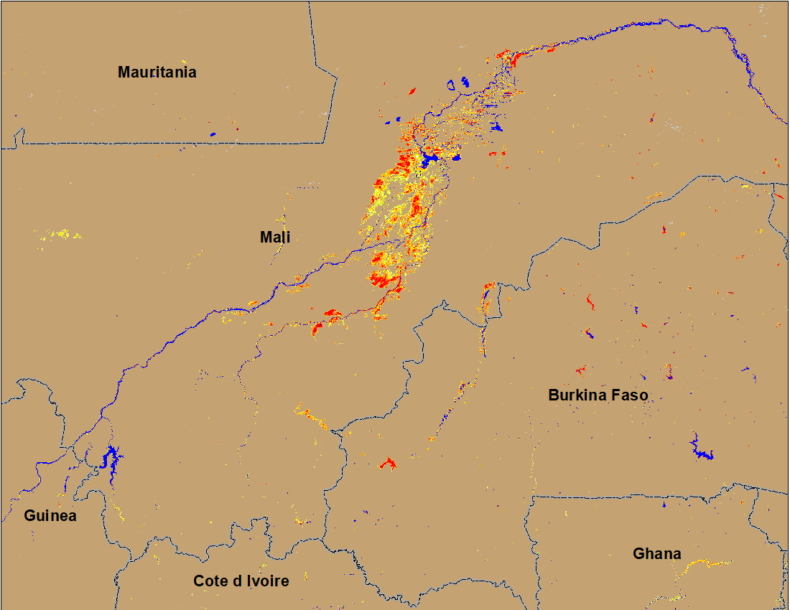
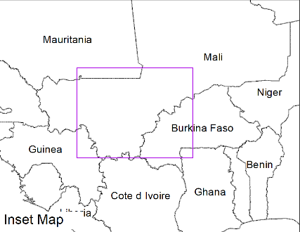
Flooding Conditions in Mali and Burkina Faso
(% of the pixel)
Niger
NOAA VIIRS 5-day comp.: 19 – 23 Oct 2022
NOAA VIIRS 5-day comp.: 26 – 30 Oct 2022
While flooding continues in Central Mali, it improved significantly in Burkina Faso.

Slide 5
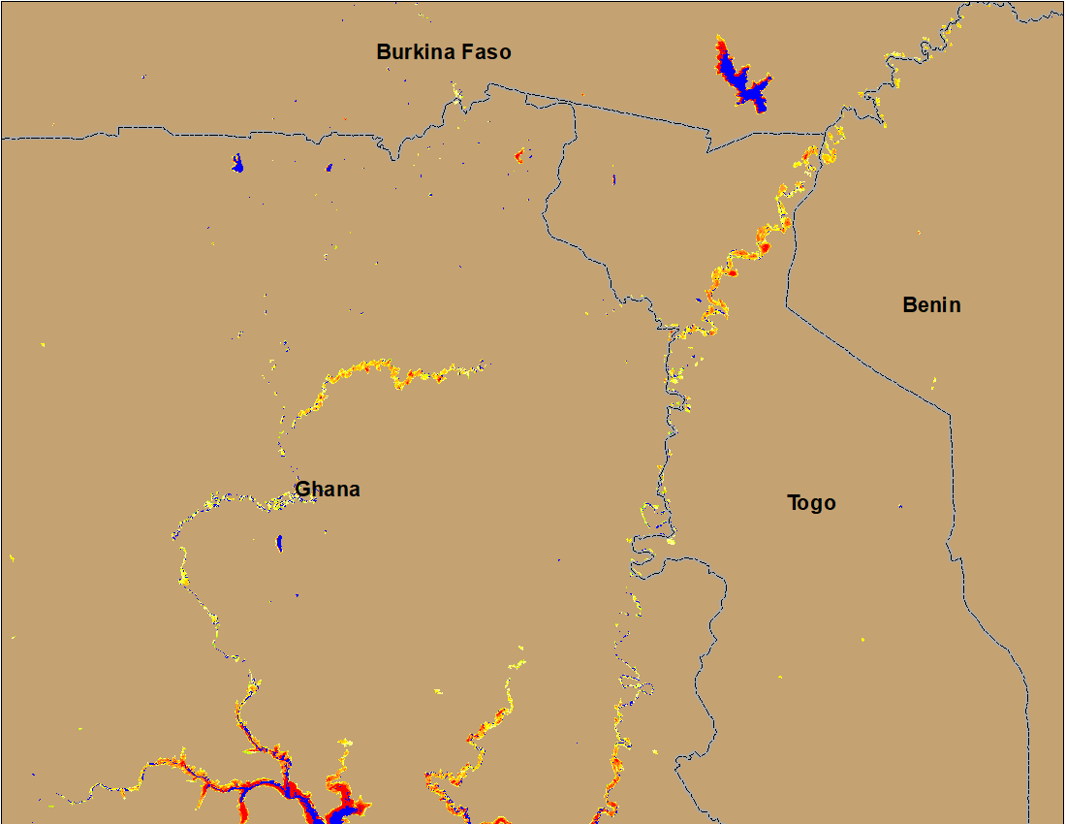
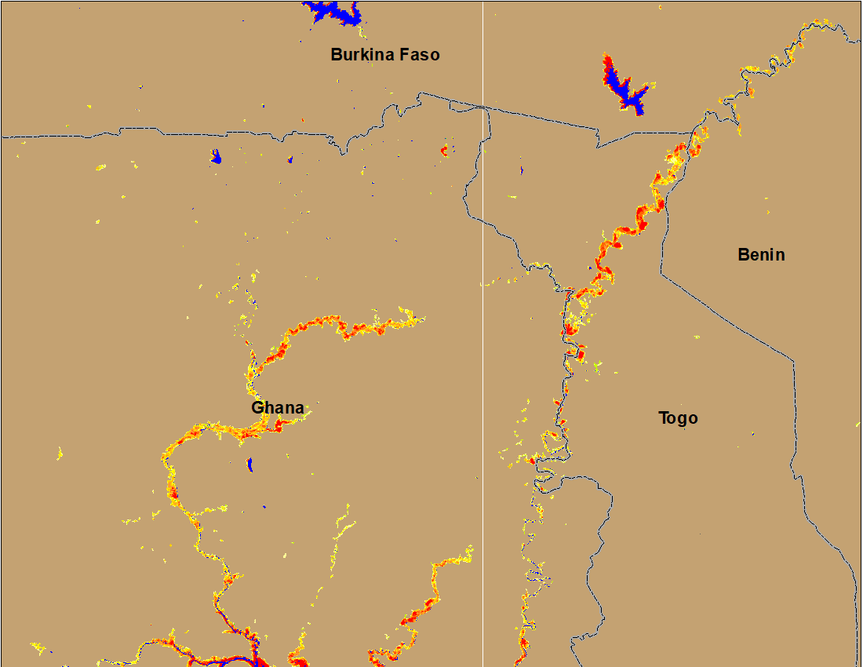
Flooding Conditions in Ghana & Togo
(% of the pixel)
(% of the pixel)
NOAA VIIRS 5-day comp.: 19 – 23 Oct 2022
NOAA VIIRS 5-day comp.: 26 – 30 Oct 2022
Improvements are also noticeable in Volta River in Ghana and in Togo.

Slide 6
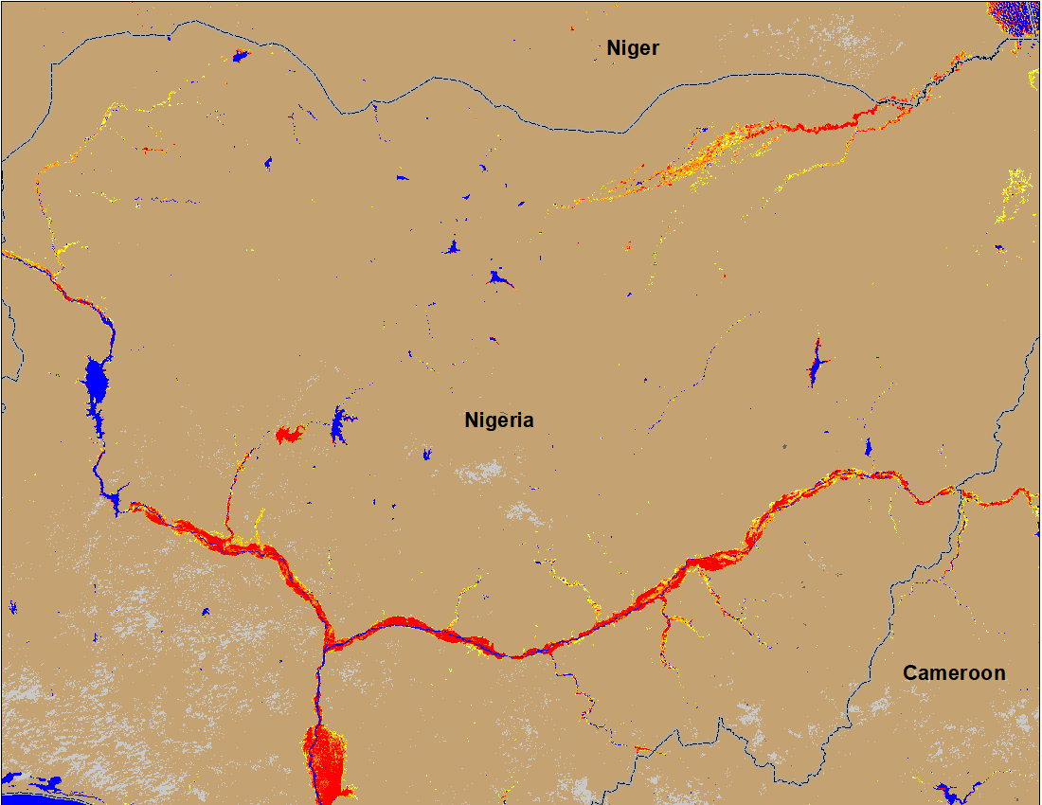
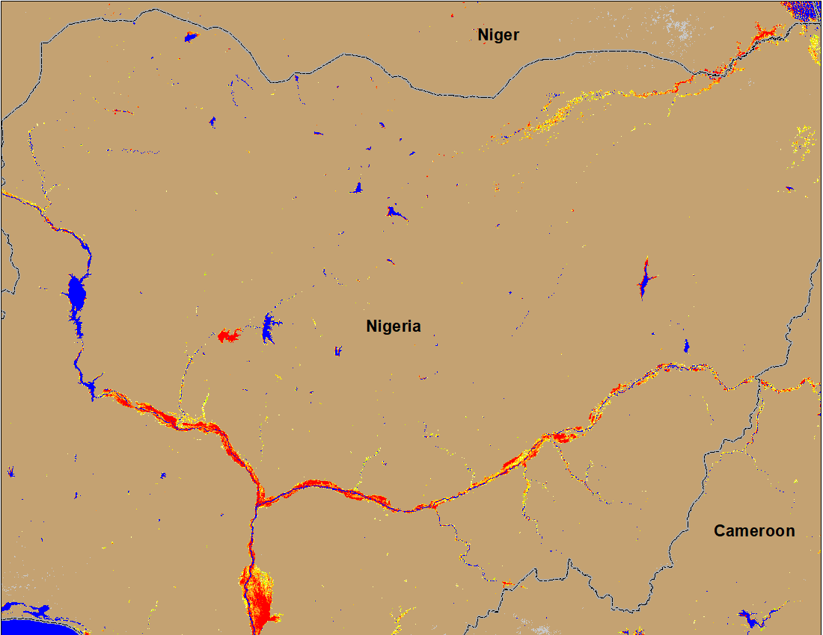
Flooding in Nigeria
Sokoto
Sokoto
Komadugu
Komadugu
Benue
Benue
Niger
Niger
NOAA VIIRS 5-day comp.: 11– 15 Oct 2022
NOAA VIIRS 5-day comp.: 26– 30 Oct 2022
There are noticeable improvements in flooding along Sokoto, Komadugu and upstream of Benue Rivers.

Slide 7
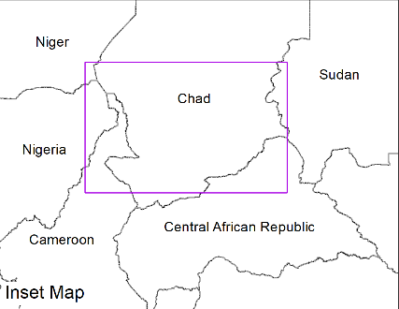
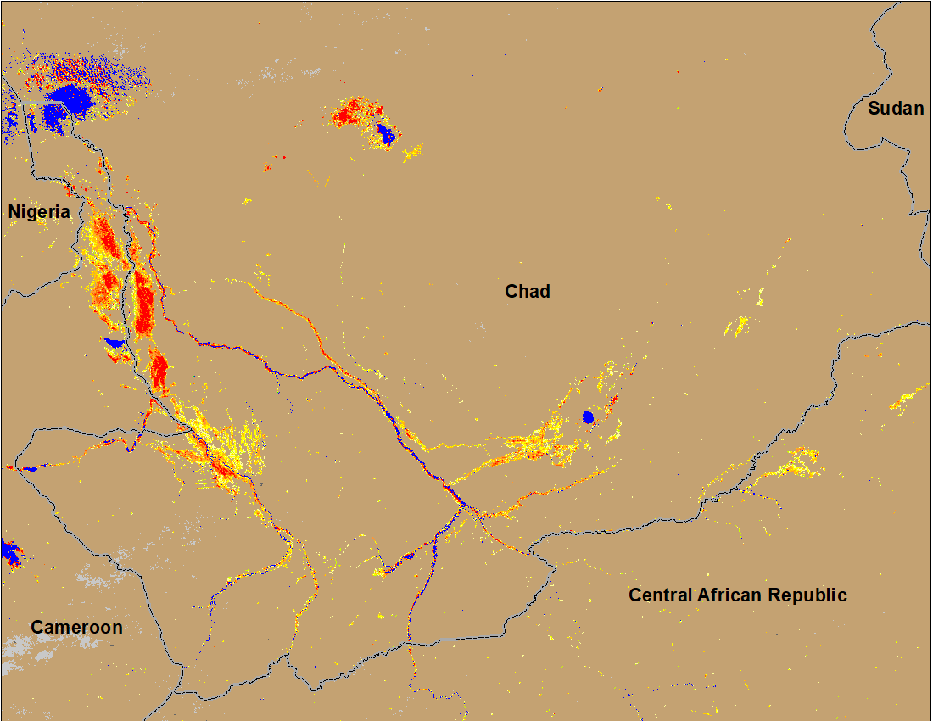
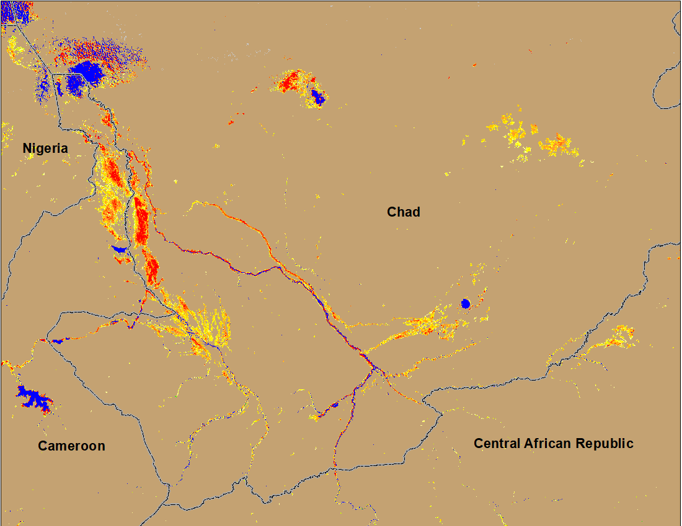
Flooding Conditions in Chad
(% of the pixel)
(% of the pixel)
NOAA VIIRS 5-day comp.: 19 – 23 Oct 2022
NOAA VIIRS 5-day comp.: 26 – 30 Oct 2022
Marginal improvement in the southeastern part of Chand.

Slide 8
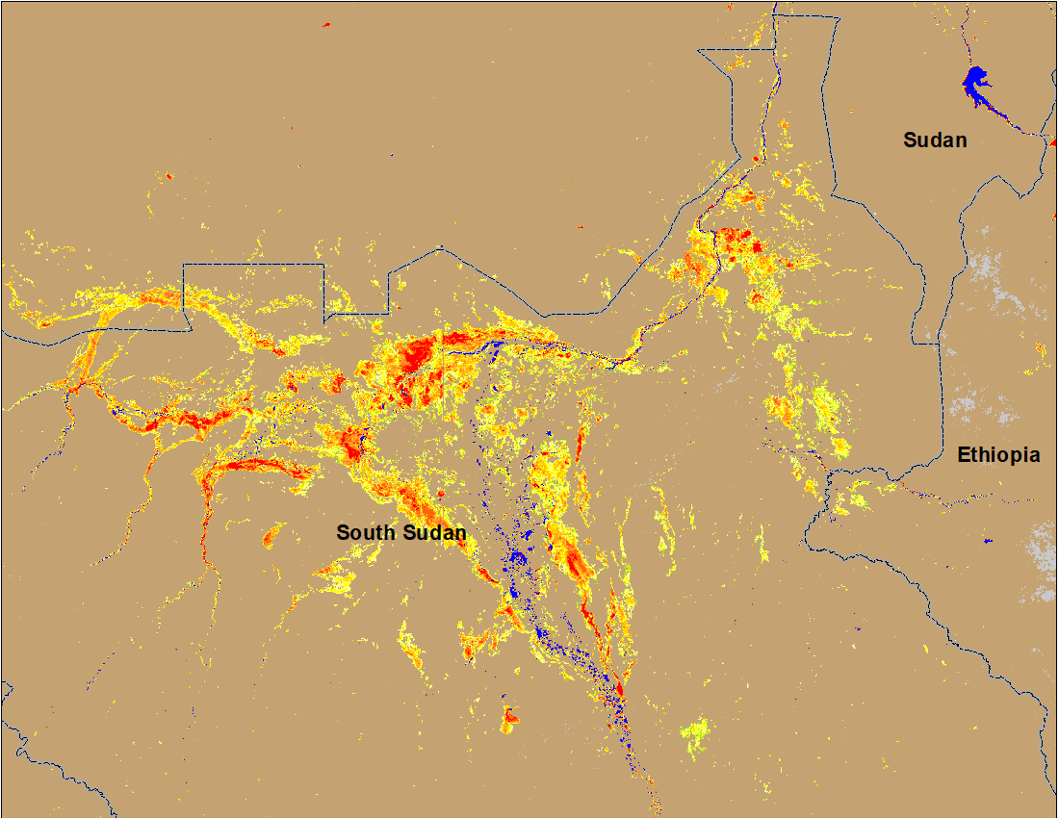
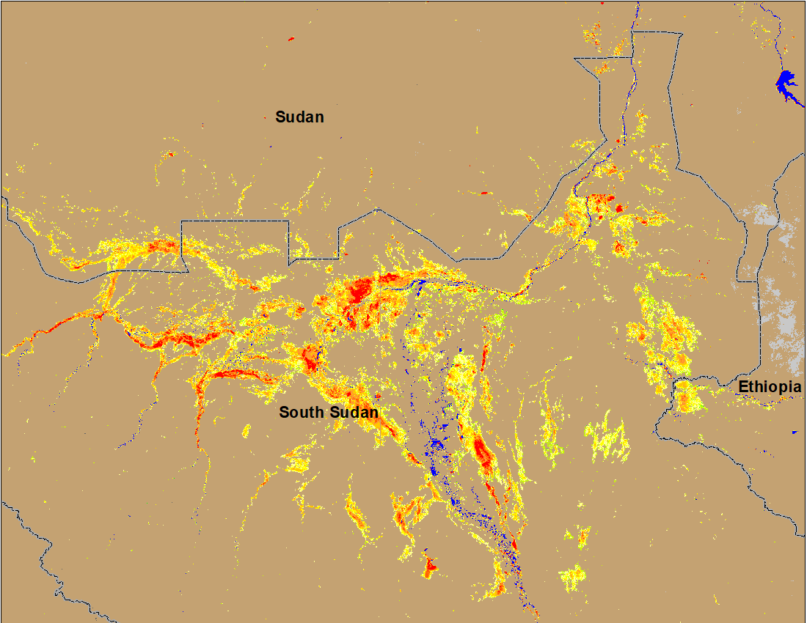
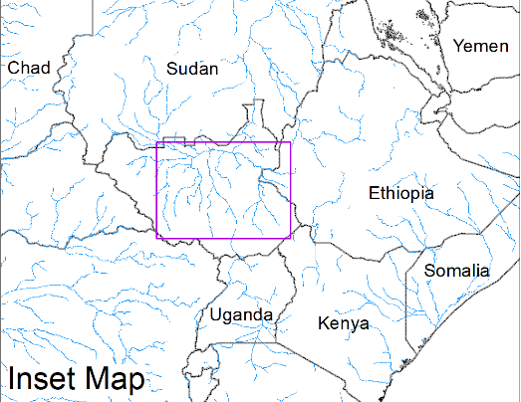
Inundation in the Sudd Wetlands
(% of the pixel)
(% of the pixel)
NOAA VIIRS 5-day comp.: 11 – 15 Oct 2022
NOAA VIIRS 5-day comp.: 26 – 30 Oct 2022
Despite receding discharge in the rivers, the inundation extent remains unchanged.

Slide 9
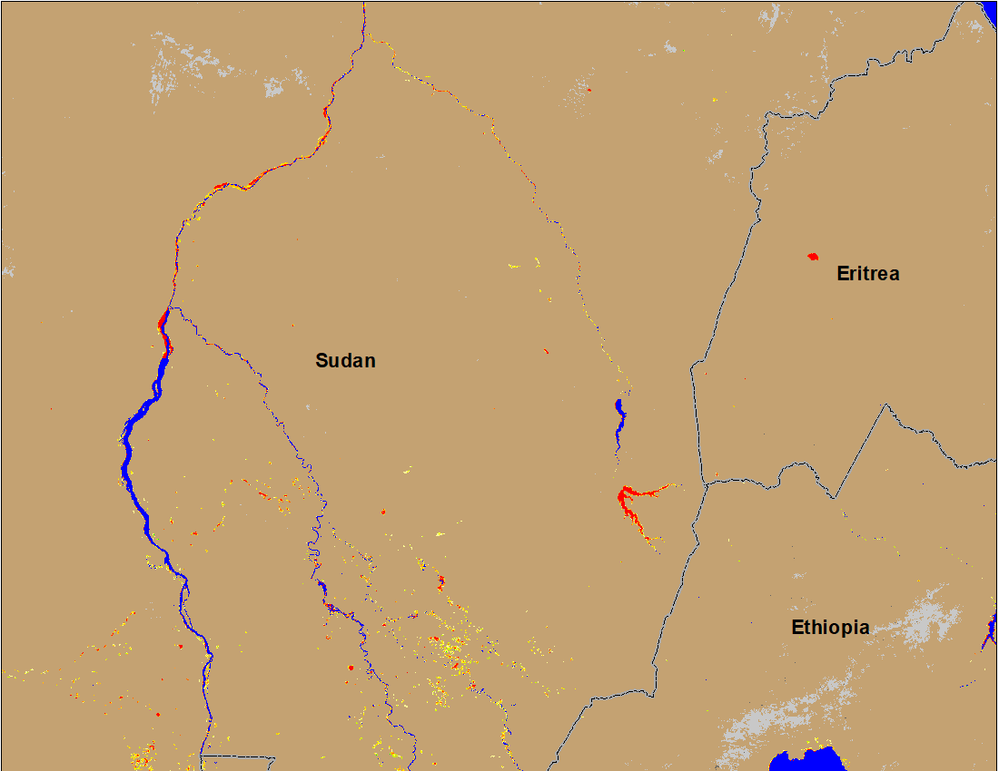
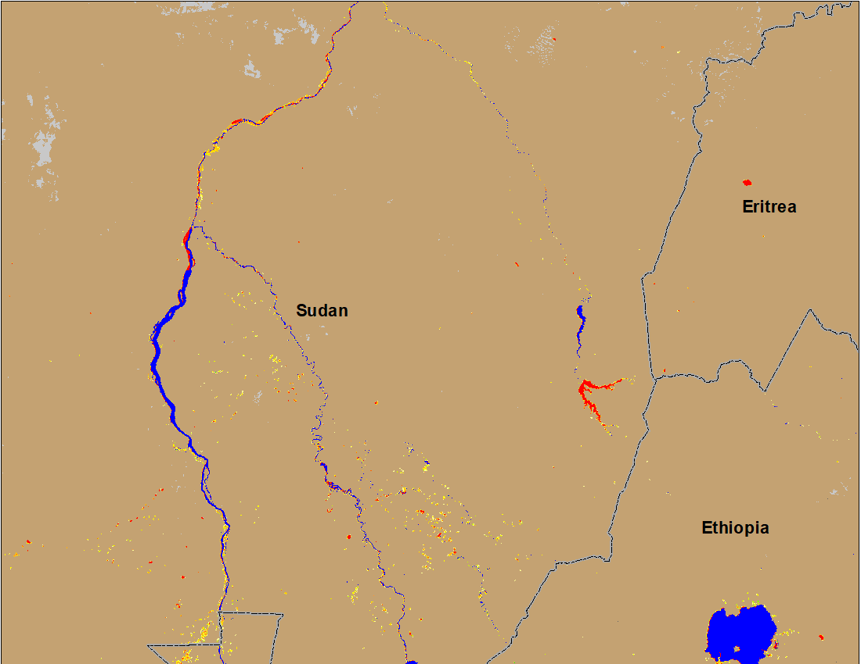
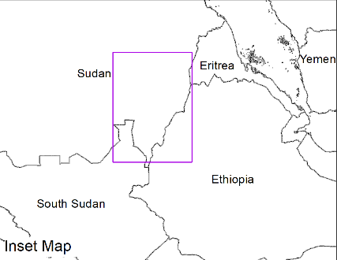
Flooding Conditions in Eastern Sudan
(% of the pixel)
(% of the pixel)
Atbara
Atbara
Blue Nile
Blue Nile
NOAA VIIRS 5-day composite: 11 – 15 Oct 2022
NOAA VIIRS 5-day composite: 26 – 30 Oct 2022
No more flooding along Atbara and Blue Nile is almost flood free.

Slide 10
Inundation in Yemen
No flooding is detected by VIIRS flood product.
No flooding hazards for Yemen.

