Slide 1
FEWS NET Enhanced Flood Monitoring – East Africa, West Africa, southern Africa and Yemen
October 24, 2022, Hazard Briefing
FEWS NET Science Team:
USGS, NASA, NOAA, UCSB+Regional Scientists

Slide 2
Flooding Hazard Areas

Slide 3
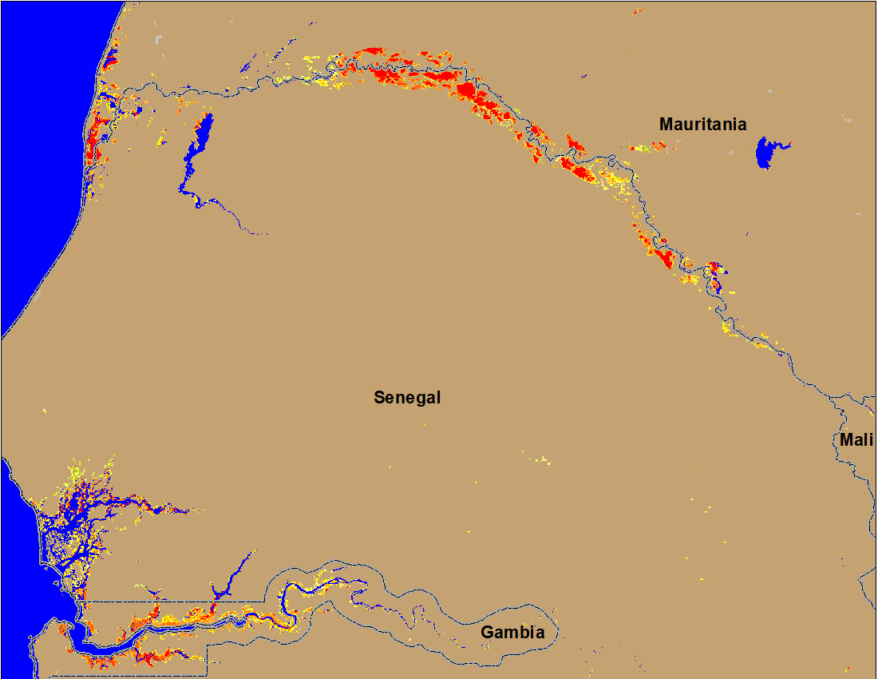
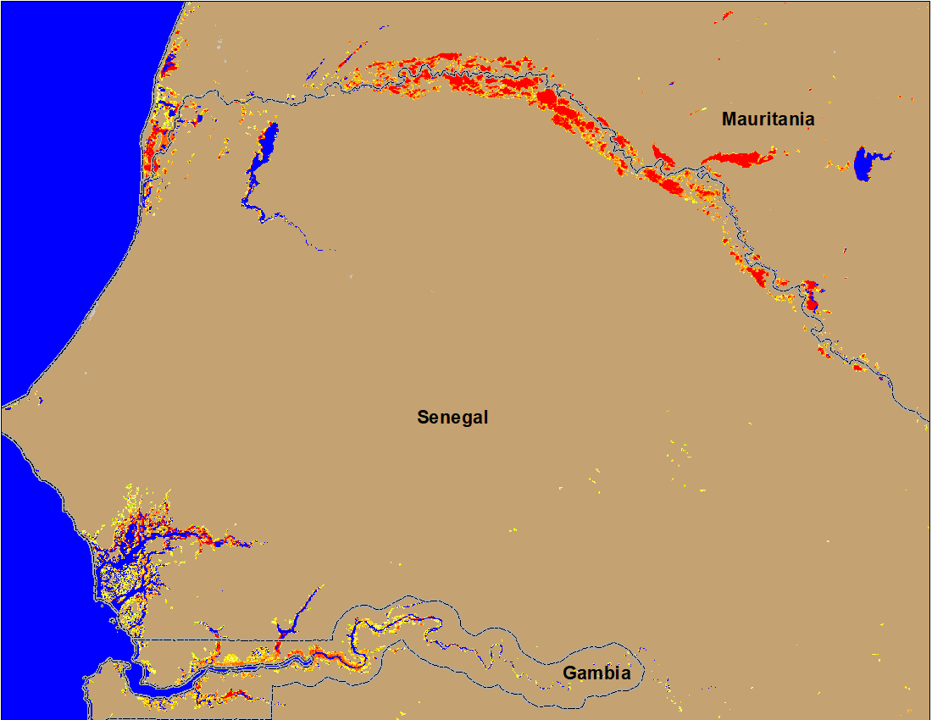
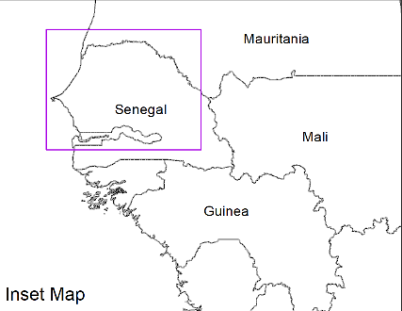
Flooding Conditions in Senegal & Gambia
(% of the pixel)
(% of the pixel)
NOAA VIIRS 5-day comp.: 11 – 15 Oct 2022
NOAA VIIRS 5-day comp.: 19 – 23 Oct 2022
Downstream flooding improved marginally along the Senegal River but no improvement in Gambia.

Slide 4
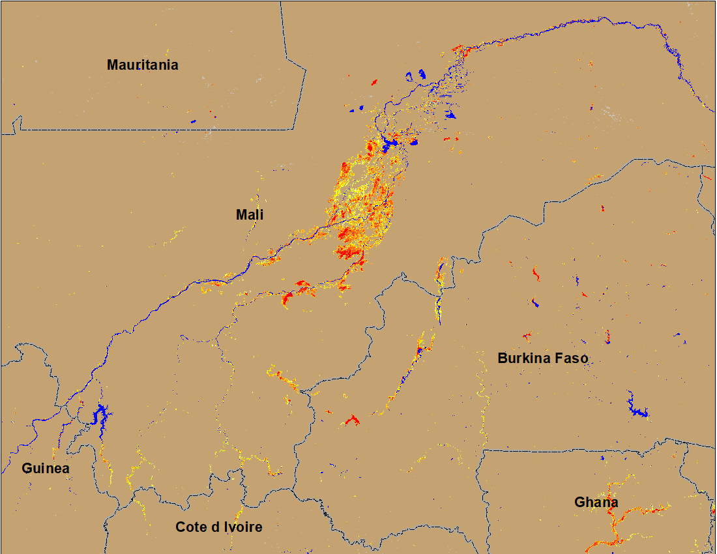
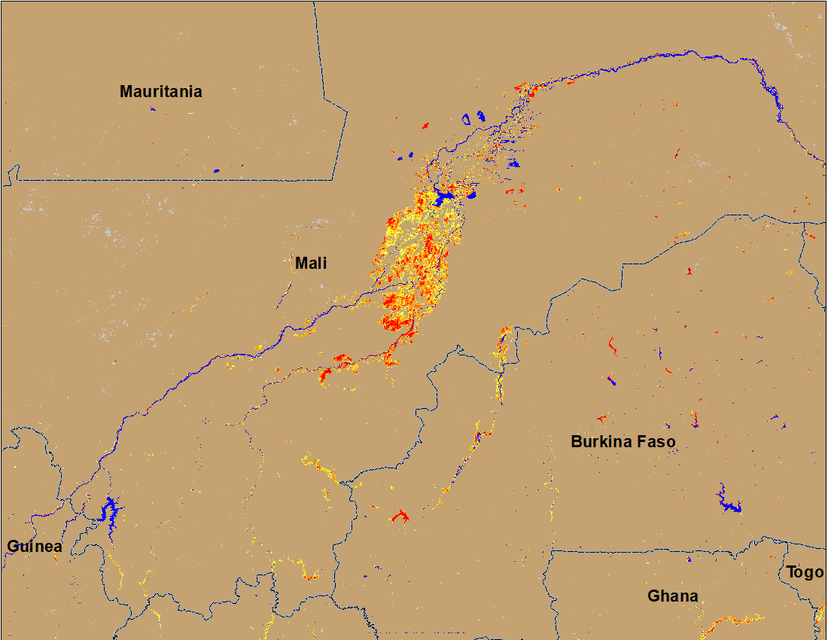
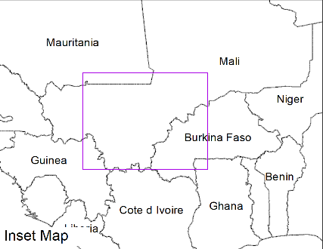
Flooding Conditions in Mali and Burkina Faso
(% of the pixel)
Niger
NOAA VIIRS 5-day comp.: 11 – 15 Oct 2022
NOAA VIIRS 5-day comp.: 19 – 23 Oct 2022
Flooding conditions remained unchanged in central Mali and Burkina Faso.

Slide 5
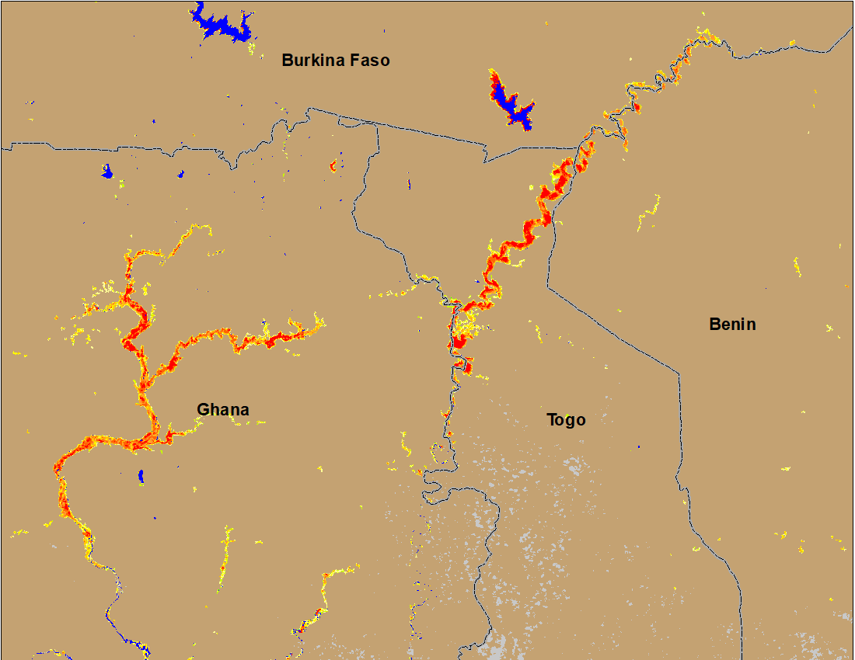
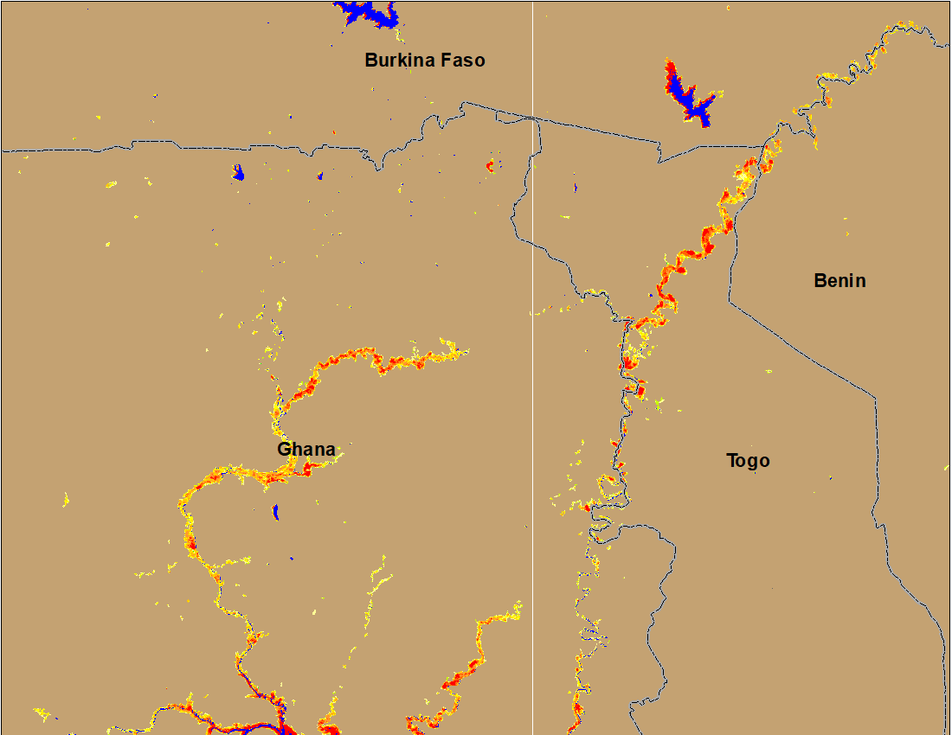
Flooding Conditions in Ghana & Togo
(% of the pixel)
(% of the pixel)
NOAA VIIRS 5-day comp.: 11 – 15 Oct 2022
NOAA VIIRS 5-day comp.: 19 – 23 Oct 2022
Flood water started to subside in Volta River in Ghana and in Togo.

Slide 6
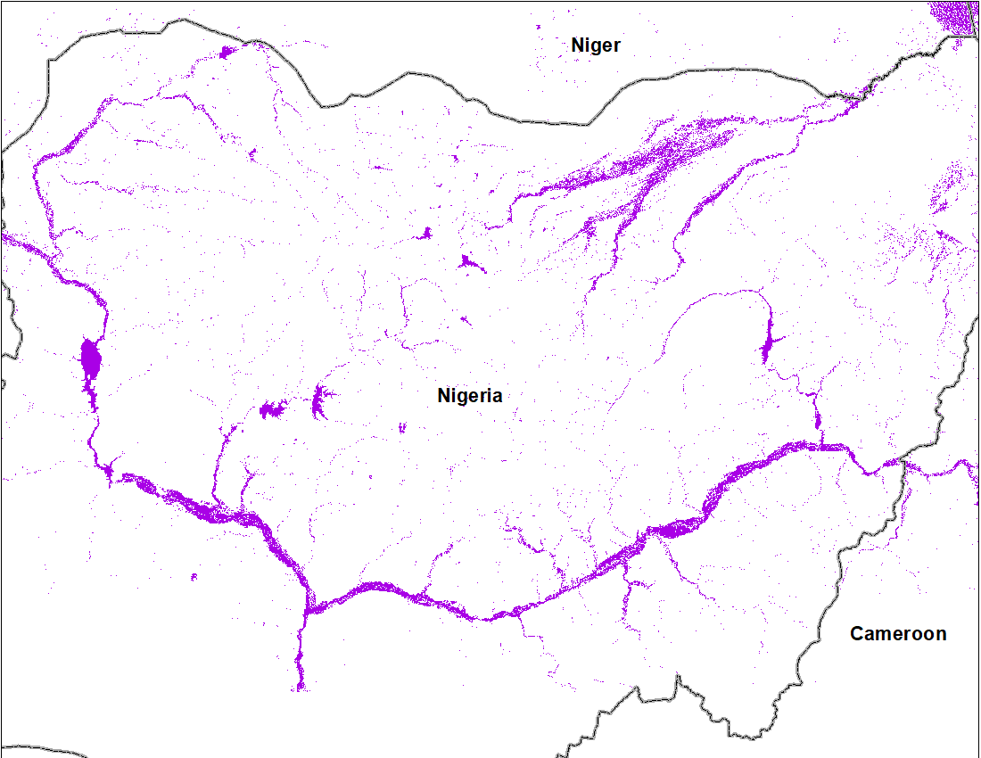
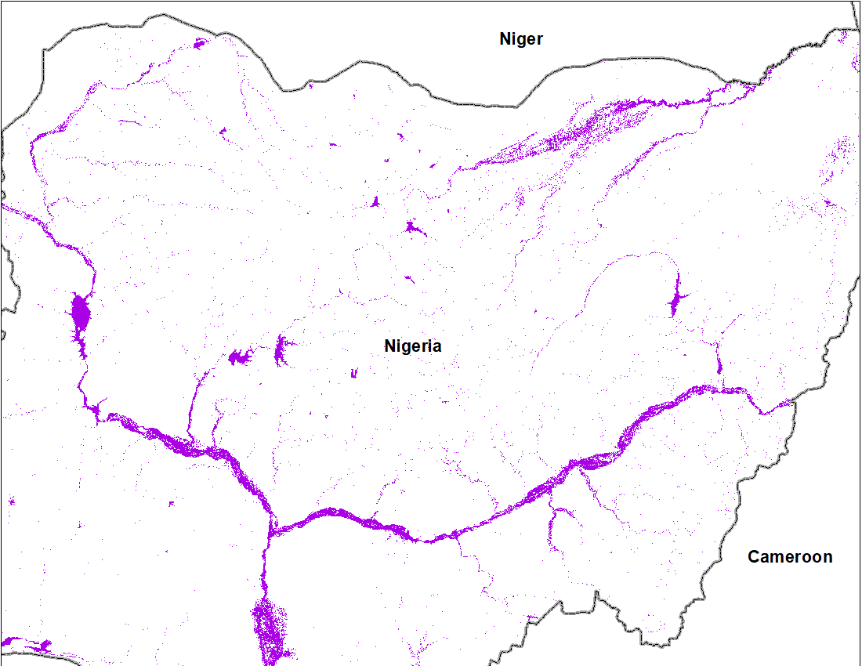
Flooding in Nigeria
Flooded area
18,528 km²
Cloud to Street flood map for September 2022
Cloud to Street flood map 1-19 Oct 2022
Flood water may have started to subside in some areas, but the entire stretch of Niger and Benue Rivers continued to have their banks flooded.

Slide 7
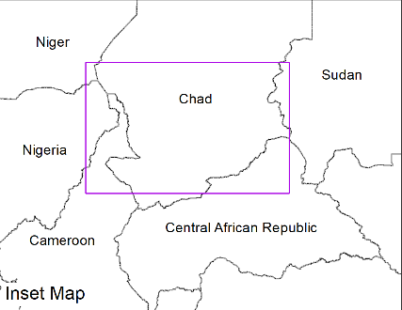
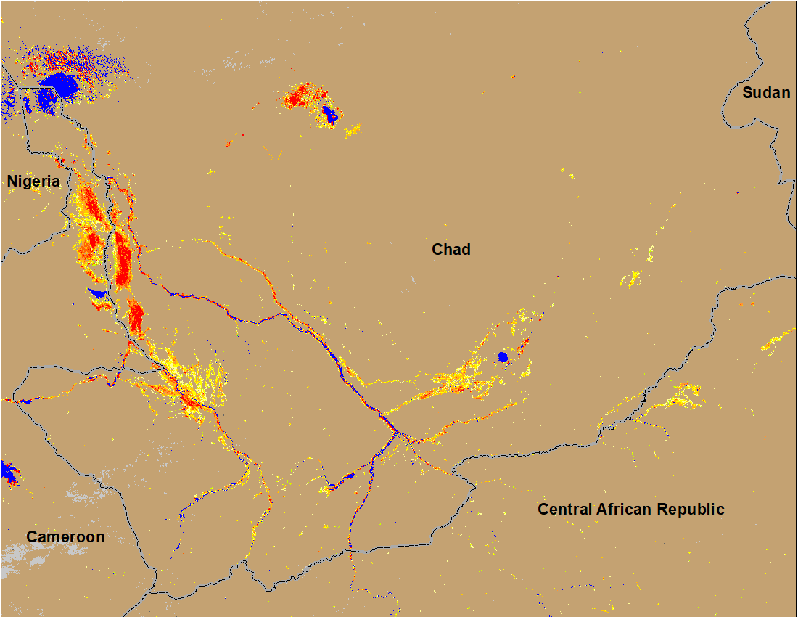
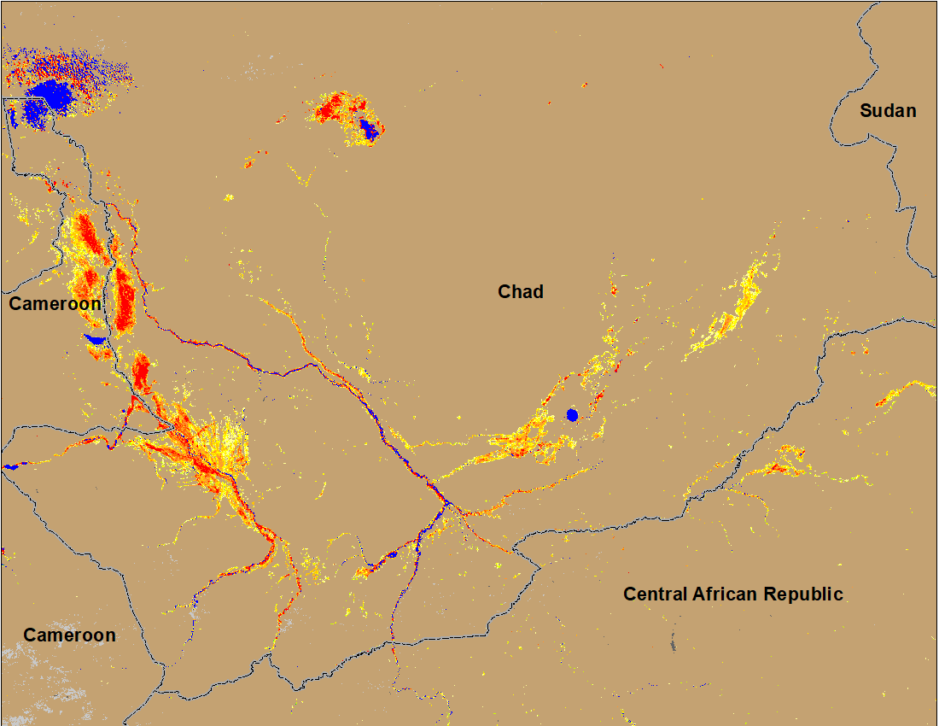
Flooding Conditions in Chad
(% of the pixel)
(% of the pixel)
NOAA VIIRS 5-day comp.: 11 – 15 Oct 2022
NOAA VIIRS 5-day comp.: 19 – 23 Oct 2022
Marginal improvement in the southeastern part of Chand.

Slide 8
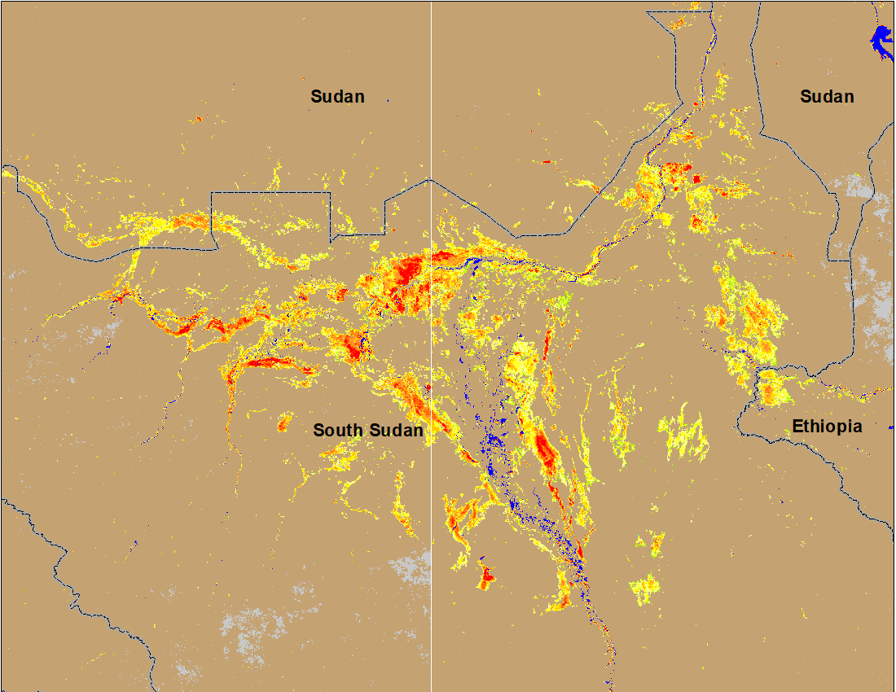
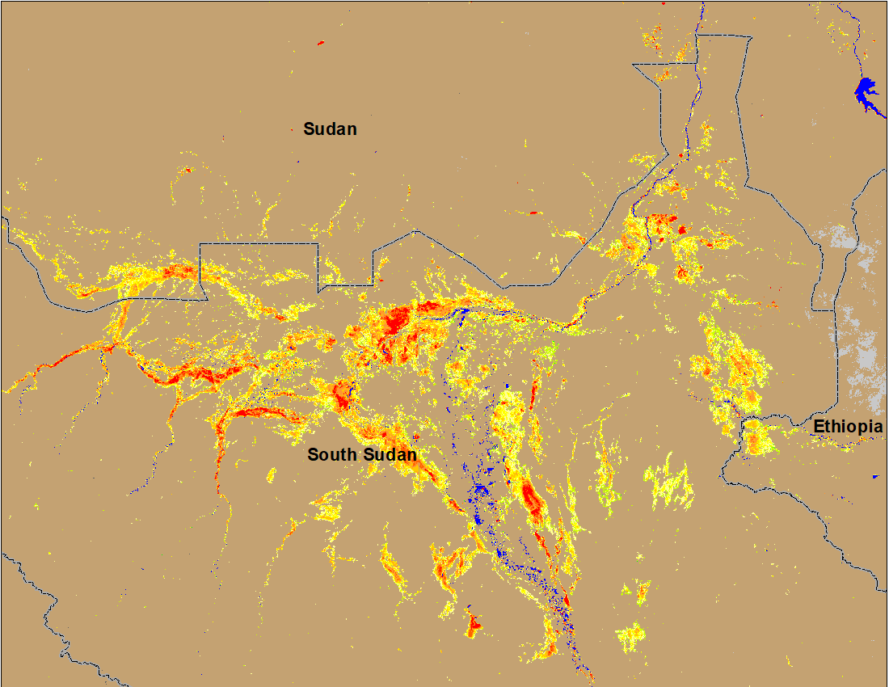
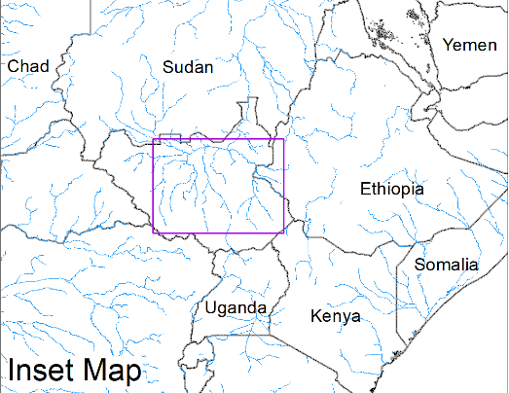
Inundation in the Sudd Wetlands
(% of the pixel)
(% of the pixel)
NOAA VIIRS 5-day comp.: 11 – 15 Oct 2022
NOAA VIIRS 5-day comp.: 19 – 23 Oct 2022
No noticeable change in flooding in South Sudan.

Slide 9
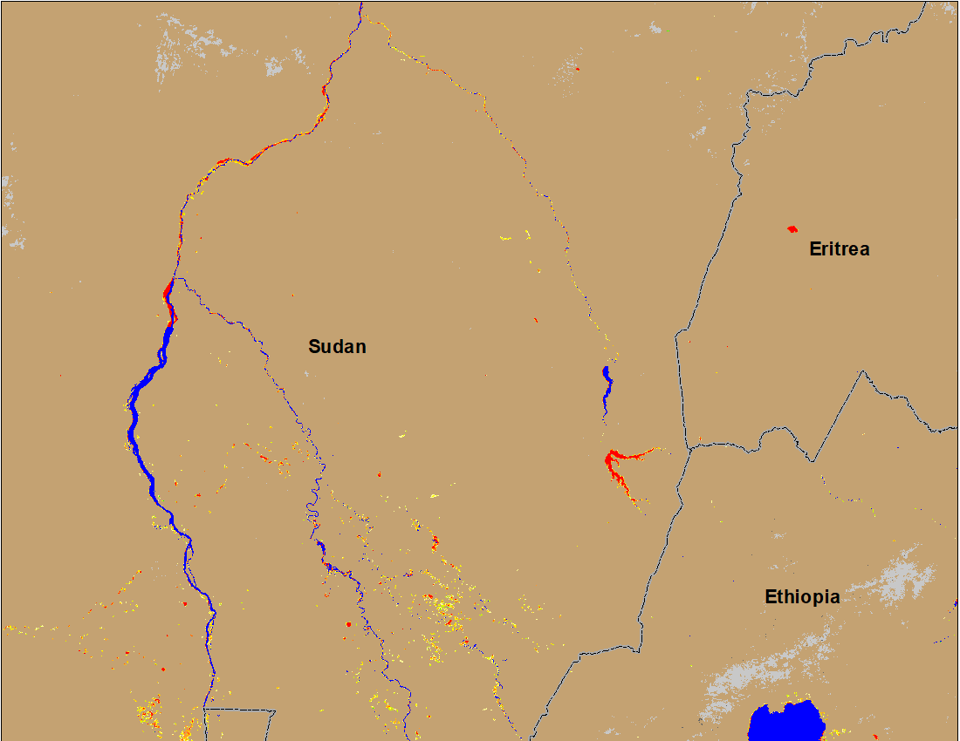
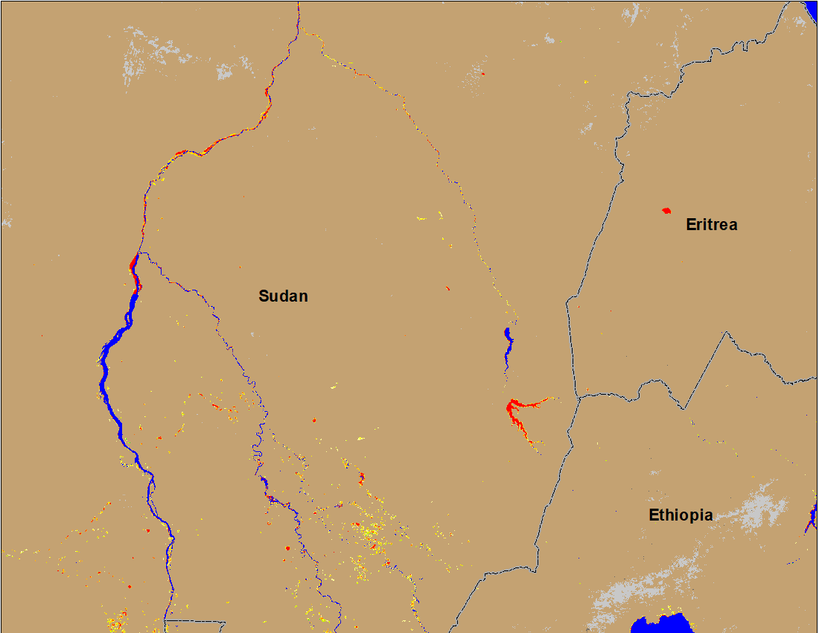
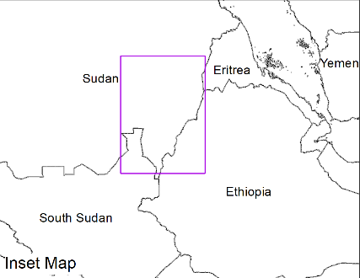
Flooding Conditions in Eastern Sudan
(% of the pixel)
(% of the pixel)
Atbara
Atbara
Blue Nile
Blue Nile
NOAA VIIRS 5-day composite: 6 – 10 Oct 2022
NOAA VIIRS 5-day composite: 11 – 15 Oct 2022
No more flooding along Atbara and significant improvements along Blue Nile in Sudan.

Slide 10
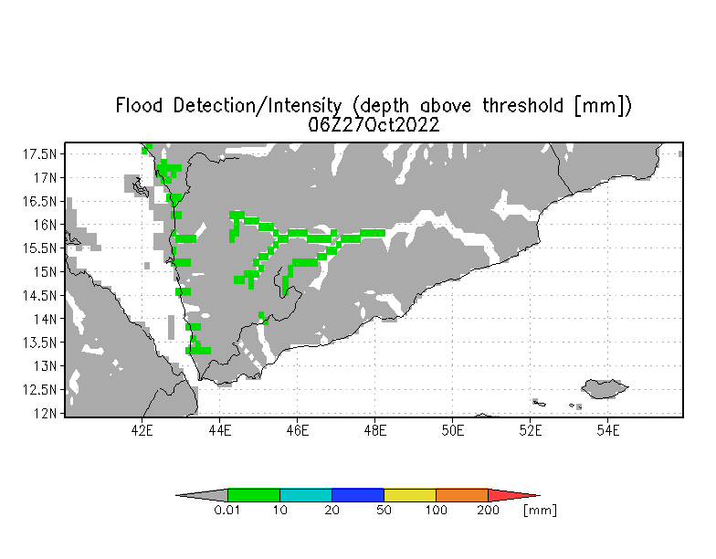
Inundation in Yemen
UMD Depth above threshold forecast for: 27 Oct 2022
Very little and isolated flooding is detected by VIIRS flood product but forecast still shows above threshold flood water depth along some western Wadis in Yemen.

