Slide 1
FEWS NET Enhanced Flood Monitoring – East Africa, West Africa, southern Africa and Yemen
October 11, 2022, Hazard Briefing
FEWS NET Science Team:
USGS, NASA, NOAA, UCSB+Regional Scientists

Slide 2
Flooding Hazard Areas

Slide 3
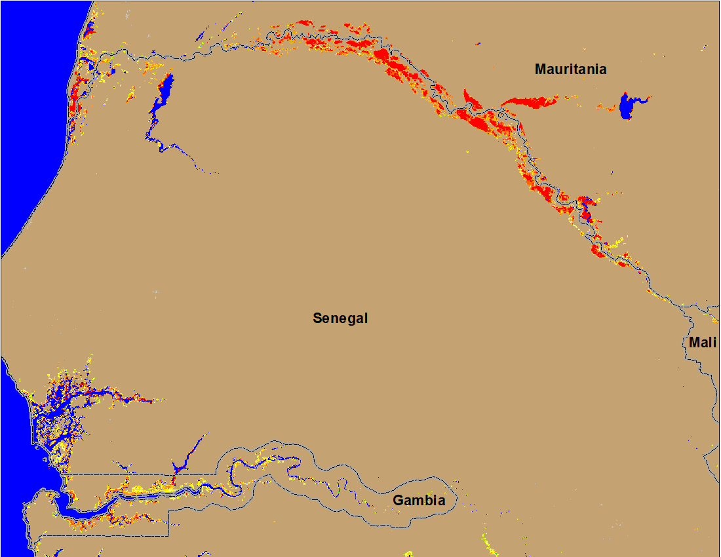
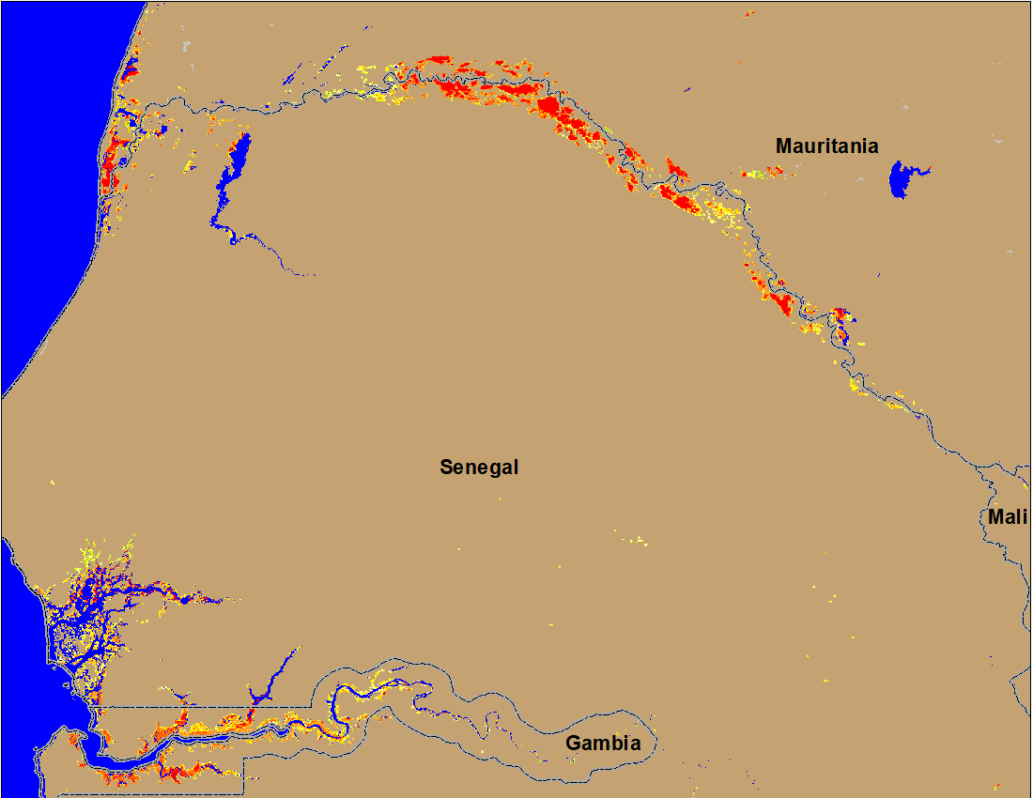
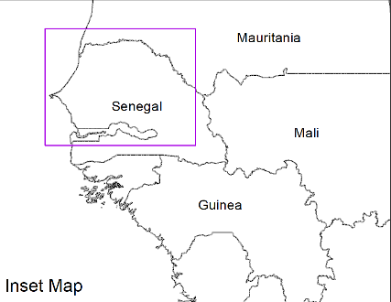
Flooding Conditions in Senegal & Gambia
(% of the pixel)
(% of the pixel)
NOAA VIIRS 5-day comp.: 6 – 10 Oct 2022
NOAA VIIRS 5-day comp.: 11 – 15 Oct 2022
Downstream flooding improved marginally along the Senegal River but deteriorated in Gambia.

Slide 4
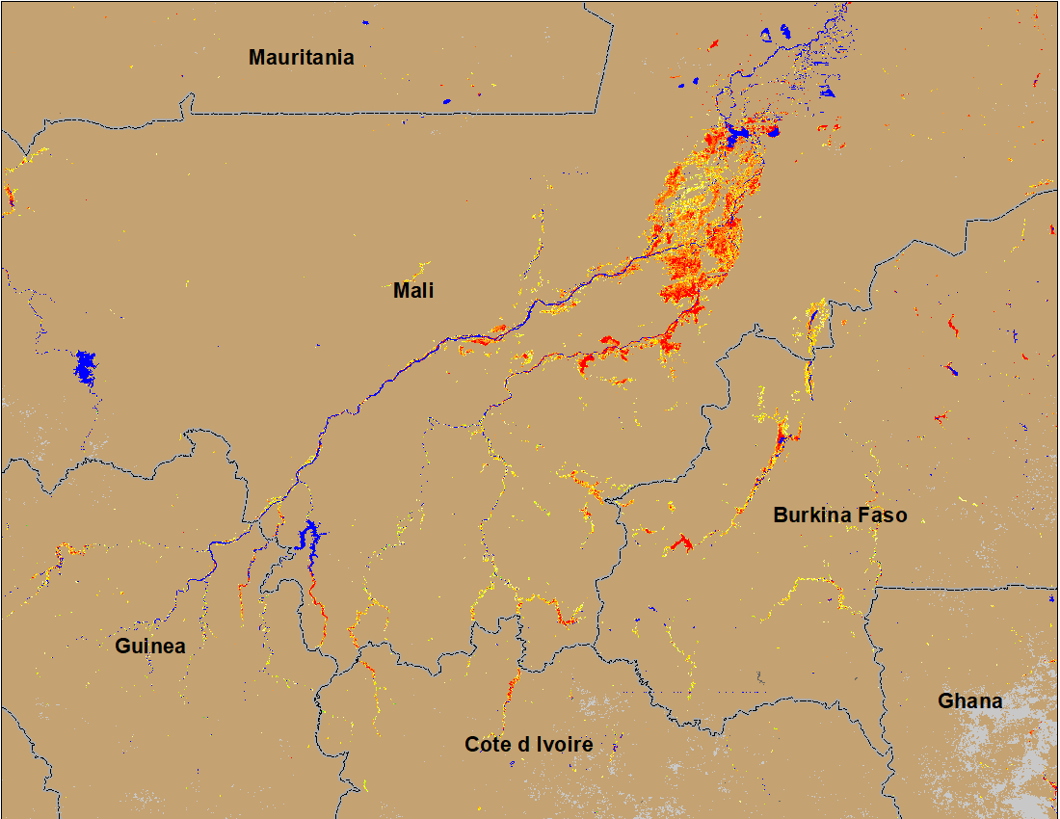
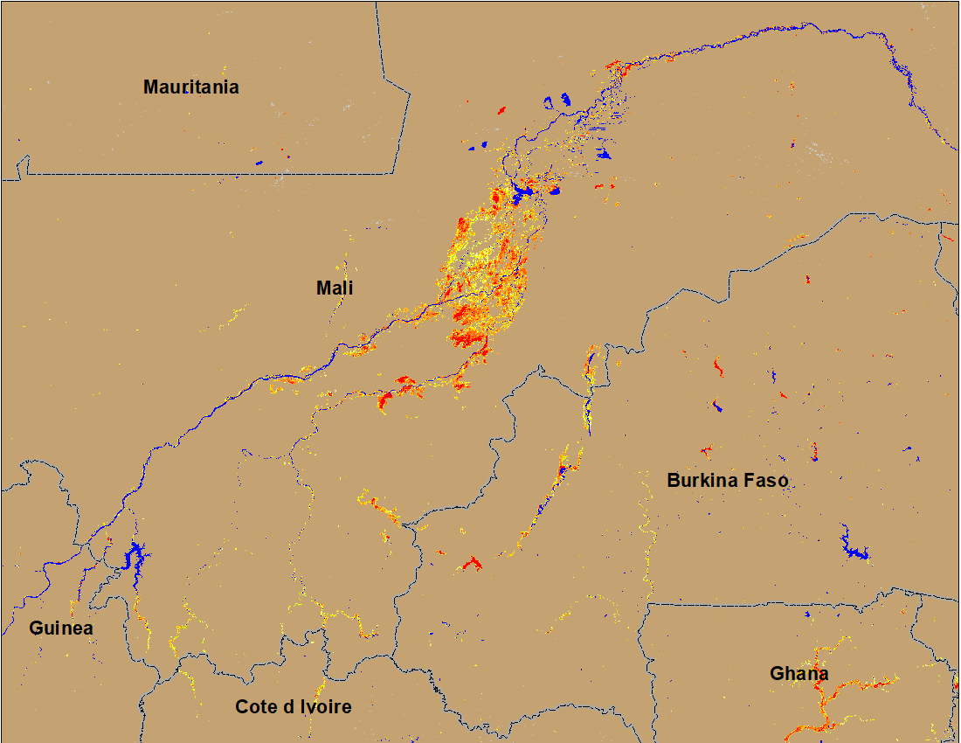
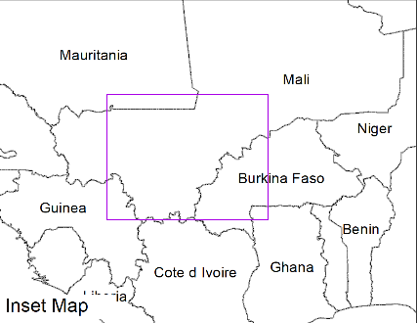
Flooding Conditions in Mali and Burkina Faso
(% of the pixel)
Niger
NOAA VIIRS 5-day comp.: 6 – 10 Oct 2022
NOAA VIIRS 5-day comp.: 11 – 15 Oct 2022
Flooding conditions improved in central Mali and Burkina Faso in October.

Slide 5
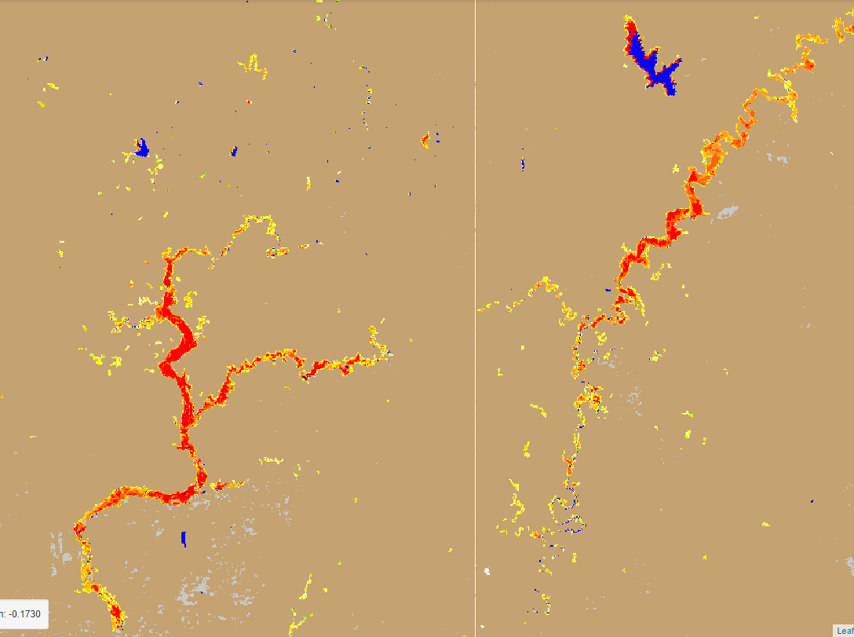
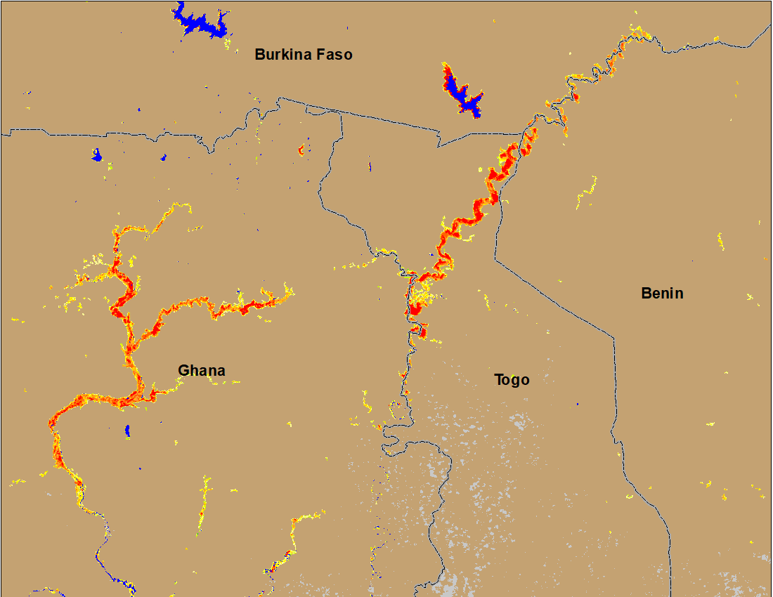
Flooding Conditions in Ghana & Togo
(% of the pixel)
(% of the pixel)
NOAA VIIRS 5-day comp.: 6 – 10 Oct 2022
NOAA VIIRS 5-day comp.: 11 – 15 Oct 2022
More areas were inundated in Ghana and Togo in October.

Slide 6
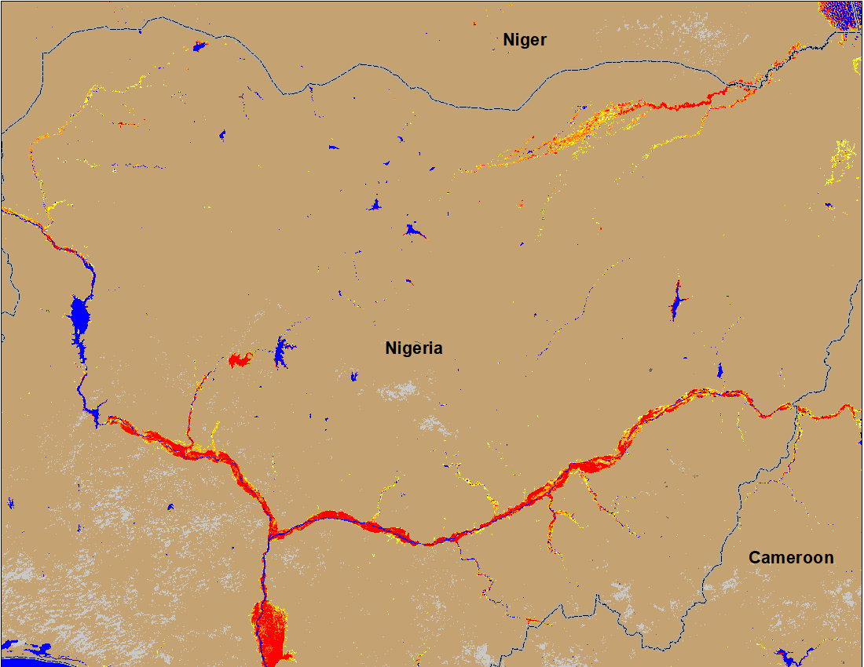
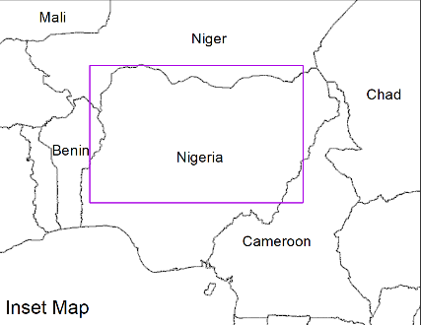
Flooding Conditions in Nigeria
(% of the pixel)
Sokoto
Komadugu
Sokoto
Komadugu
Niger
Niger
Benue
Benue
(% of the pixel)
NOAA VIIRS 5-day comp.: 6 – 10 Oct 2022
NOAA VIIRS 5-day comp.: 11– 15 Oct 2022
The entire path of both Niger and Benue Rivers experienced flooding in the current season.

Slide 7
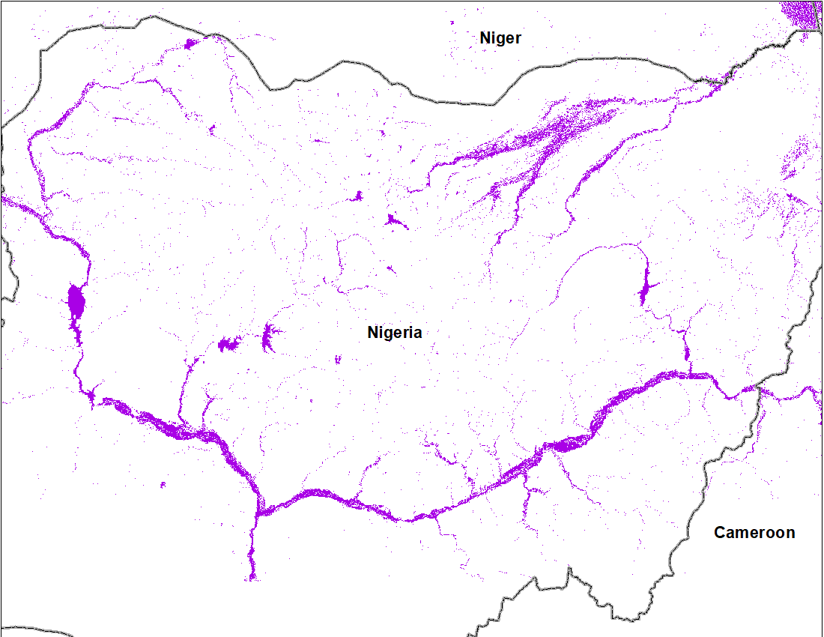
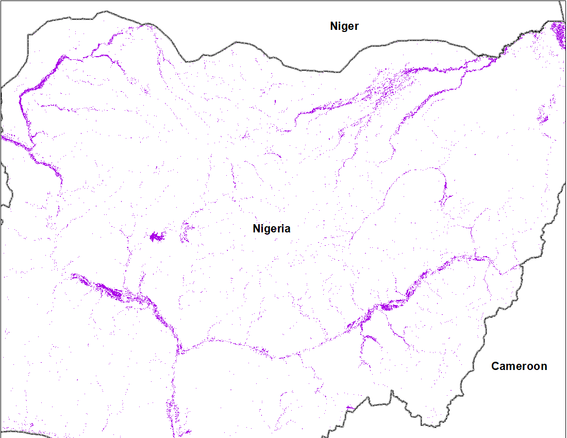
Flooding in Nigeria Compared to 2021 (last season)
2022
2021
Flooded area
18,528 km²
Flooded area
15,294 km²
Cloud to Street flood map for September 2022
Cloud to Street flood map for 2021
Current season flooding is worse than last season (2021)

Slide 8
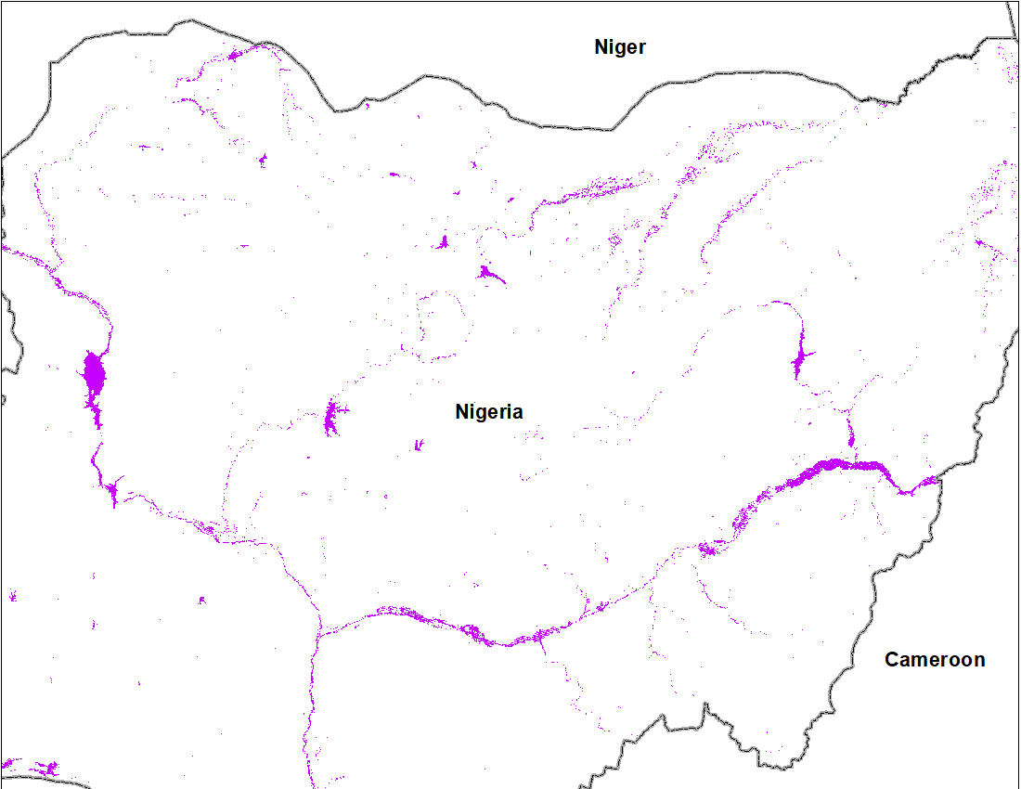
Flooding in Nigeria Compared to 2012
2022
2012
Flooded area
18,528 km²
Flooded area
11,148 km²
Cloud to Street flood map for September 2022 (10 m res.)
Cloud to Street flood map for 2012 (based on 30 m Landsat)
2012 was one of the worst flooding during the past decade.
2022 inundated areas are more than 2012, however 2012 inundation map was computed from 30 m Landsat and likely to have less inundated areas mapped.

Slide 9
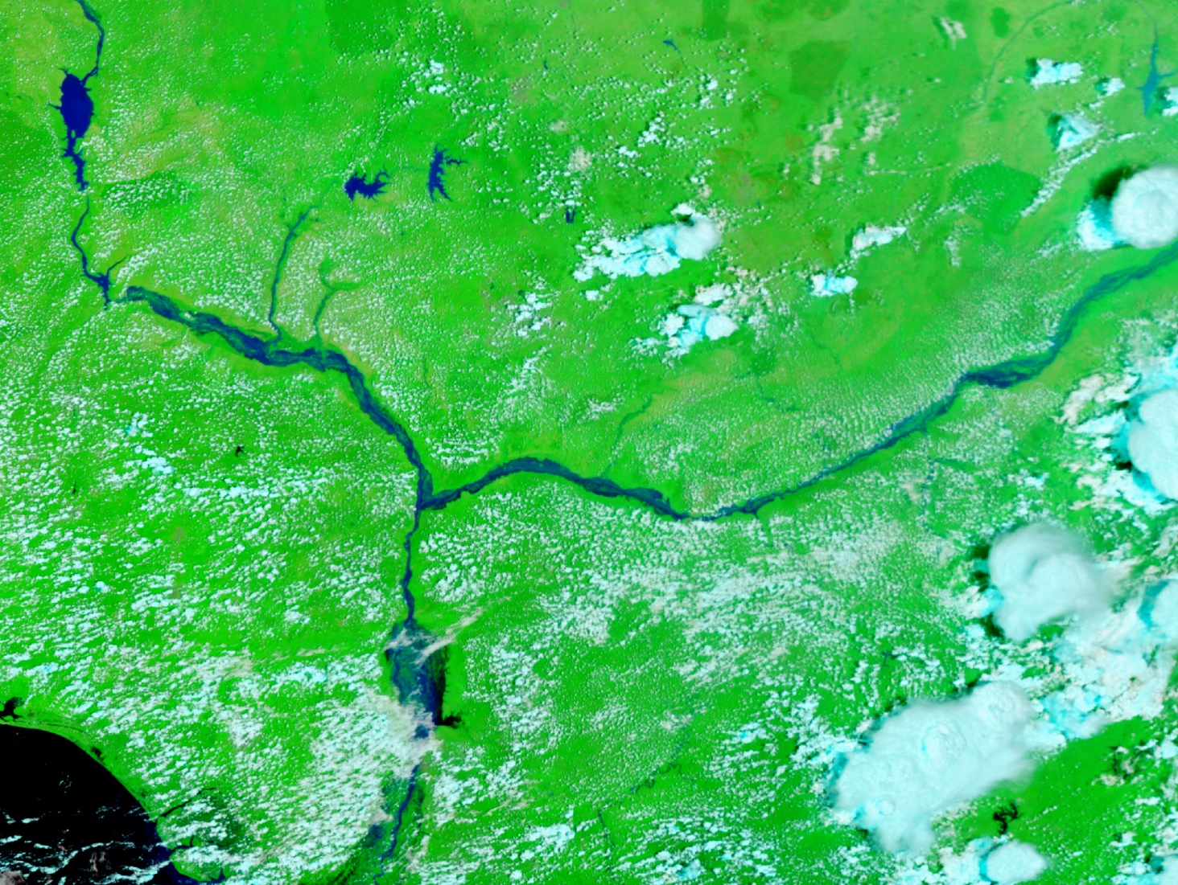
Flooding in Nigeria Compared to 2012
Oct 13, 2012
Oct 11, 2022
MODIS
VIIRS
2022 flooding extent is more likely to exceed the flooding extent of 2012.

Slide 10
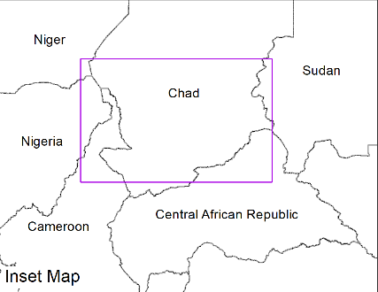
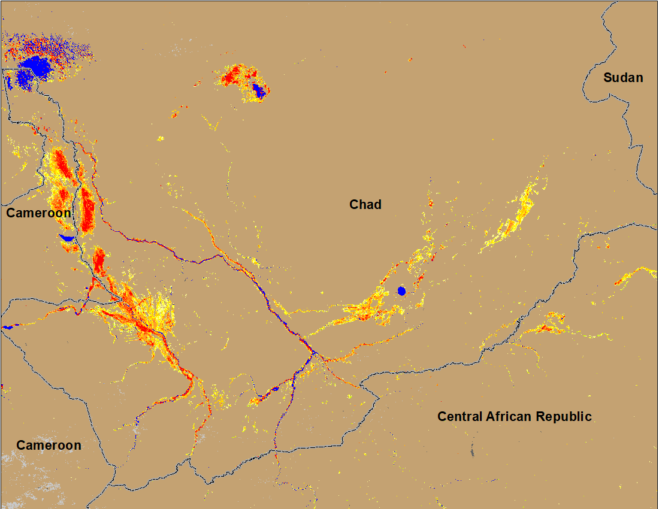
Flooding Conditions in Chad
(% of the pixel)
(% of the pixel)
NOAA VIIRS 5-day comp.: 6 – 10 Oct 2022
NOAA VIIRS 5-day comp.: 11 – 15 Oct 2022
Flooding in southern Chad continuing to deteriorate in October.

Slide 11
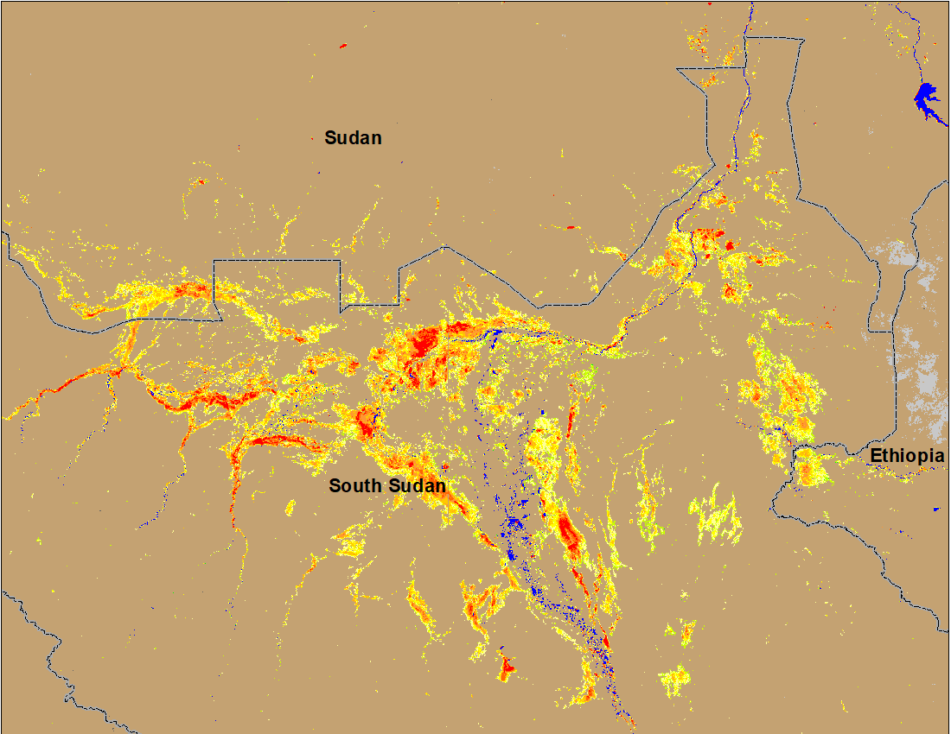
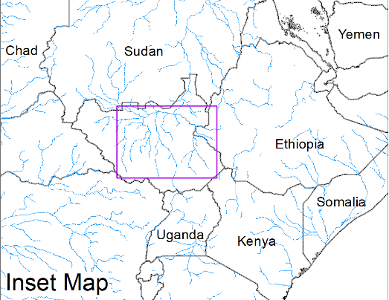
Inundation in the Sudd Wetlands
(% of the pixel)
(% of the pixel)
NOAA VIIRS 5-day comp.: 6 – 10 Oct 2022
NOAA VIIRS 5-day comp.: 11 – 15 Oct 2022
Despite significant decrease in recent river discharge, extent of inundation have NOT decreased.

Slide 12
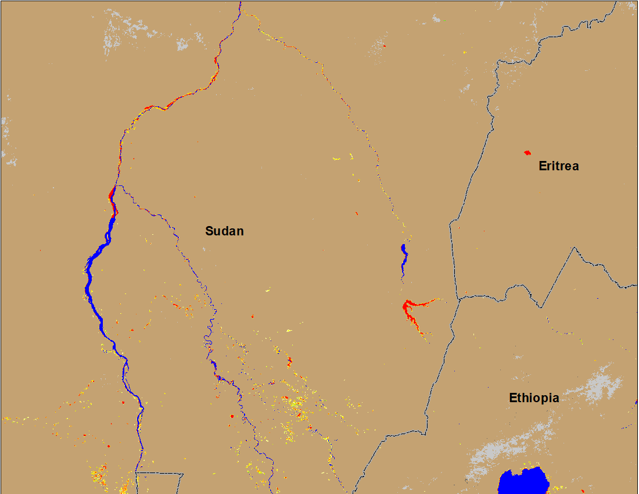
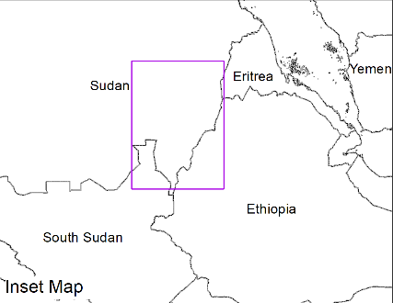
Flooding Conditions in Eastern Sudan
(% of the pixel)
(% of the pixel)
Atbara
Atbara
Blue Nile
Blue Nile
NOAA VIIRS 5-day composite: 6 – 10 Oct 2022
NOAA VIIRS 5-day composite: 11 – 15 Oct 2022
No more flooding along Atbara and significant improvements along Blue Nile in Sudan in October.

Slide 13
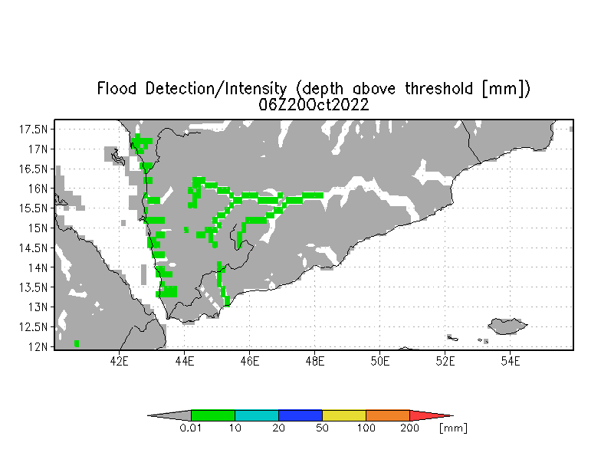
Inundation in Yemen
UMD Depth above threshold forecast for: 20 Oct 2022
Very little and isolated flooding is detected by VIIRS flood product but forecast still shows above threshold flood water depth along some western Wadis in Yemen.

