Slide 1
FEWS NET Enhanced Flood Monitoring – East Africa, West Africa, southern Africa and Yemen
October 11, 2022, Hazard Briefing
FEWS NET Science Team:
USGS, NASA, NOAA, UCSB+Regional Scientists

Slide 2
Flooding Hazard Areas

Slide 3
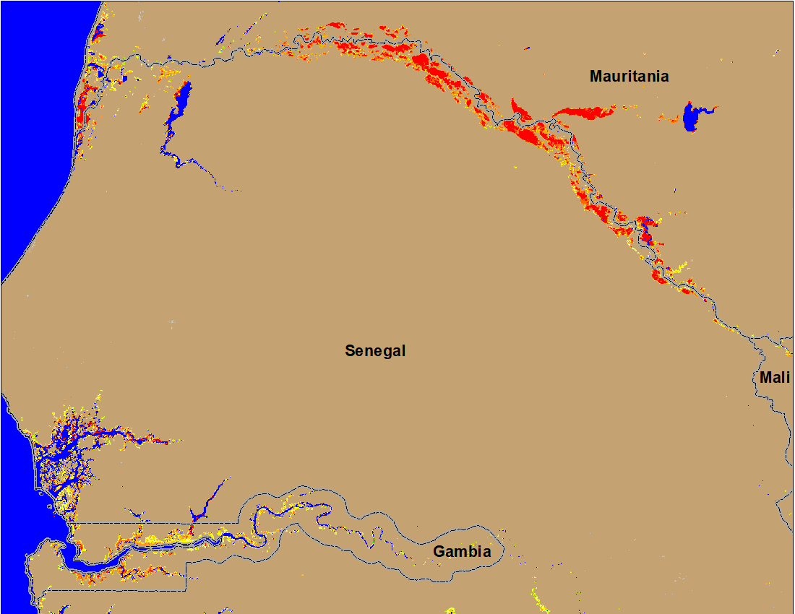
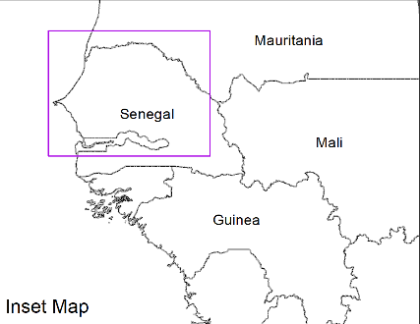
Flooding Conditions in Senegal & Gambia
(% of the pixel)
(% of the pixel)
NOAA VIIRS 5-day comp.: 28 Sep – 2 Oct 2022
NOAA VIIRS 5-day comp.: 6 – 10 Oct 2022
Downstream flooding improved marginally along the Senegal River but deteriorated in Gambia.

Slide 4
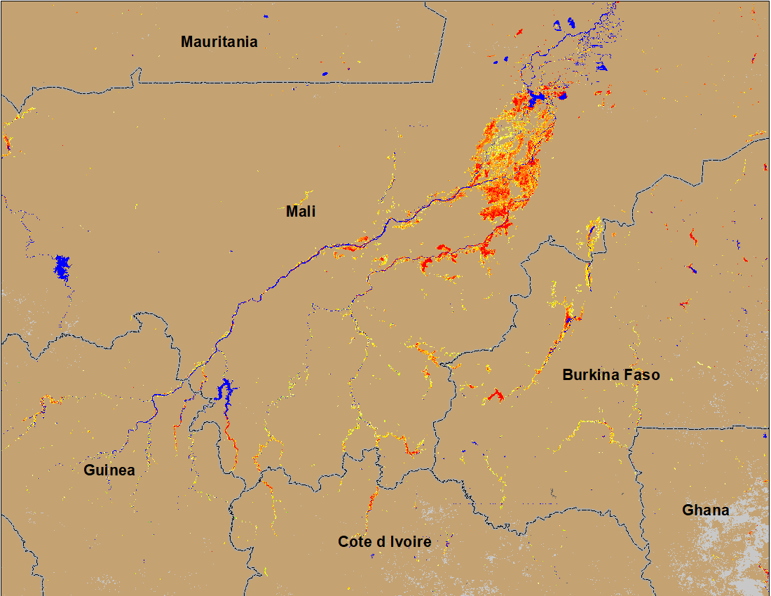
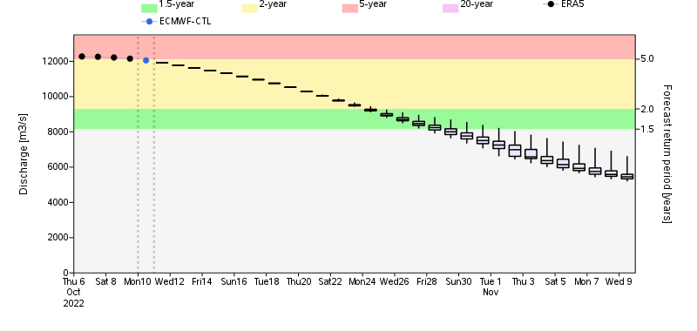
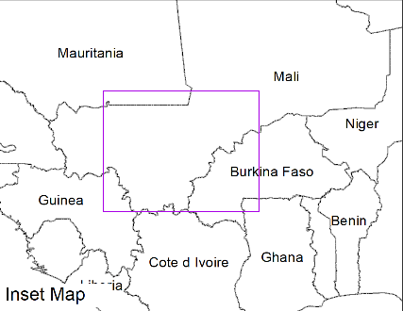
Flooding Conditions in Mali and Burkina Faso
(% of the pixel)
Niger
NOAA VIIRS 5-day comp.: 28 Sep – 2 Oct 2022
NOAA VIIRS 5-day comp.: 6 – 10 Oct 2022
Conditions remained constant in central Mali and Burkina Faso, however Niger discharge expected to be decline to 2-yr return period in October.

Slide 5
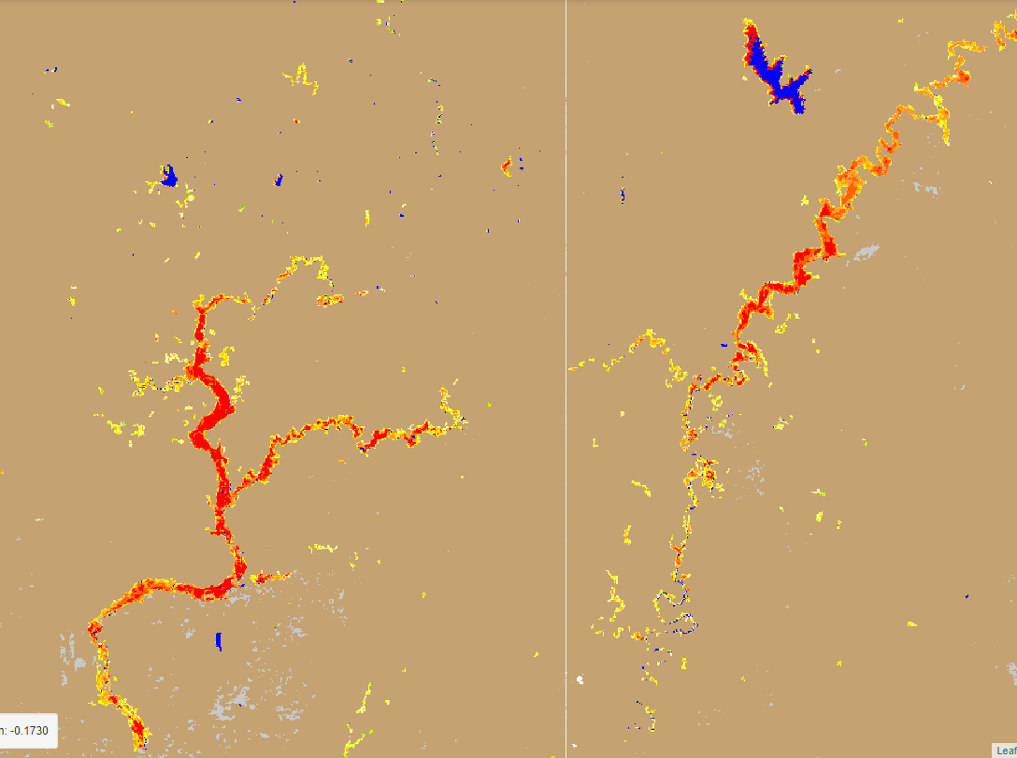
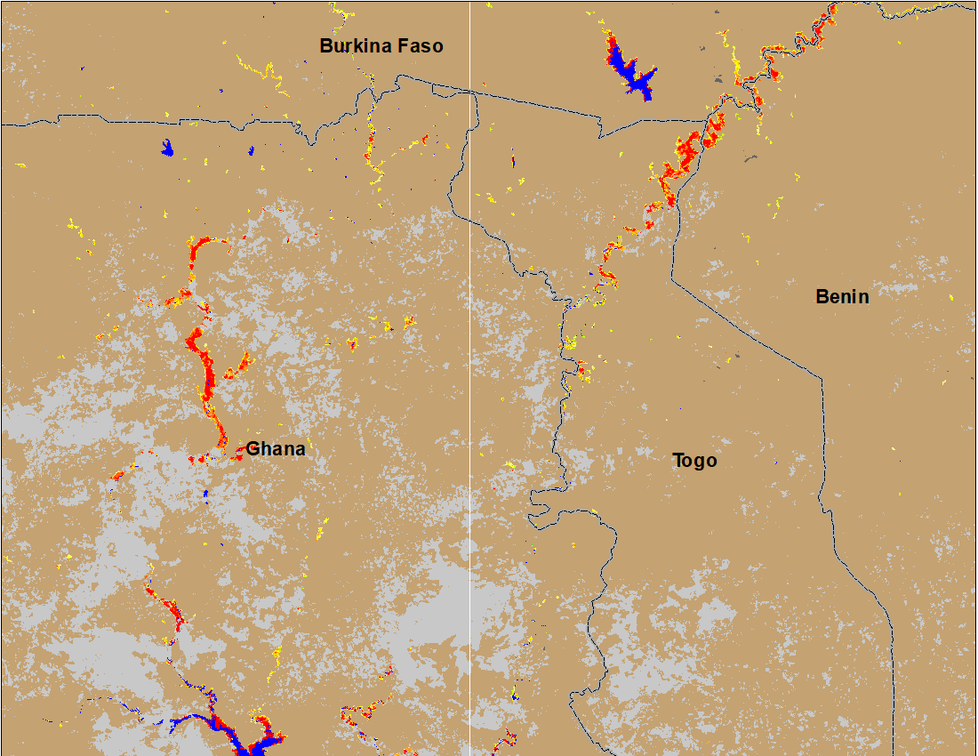
Flooding Conditions in Ghana & Togo
(% of the pixel)
(% of the pixel)
NOAA VIIRS 5-day comp.: 28 Sep – 2 Oct 2022
NOAA VIIRS 5-day comp.: 6 – 10 Oct 2022
Flooding conditions remained unchanged along White Volta in Ghana and Togo.

Slide 6
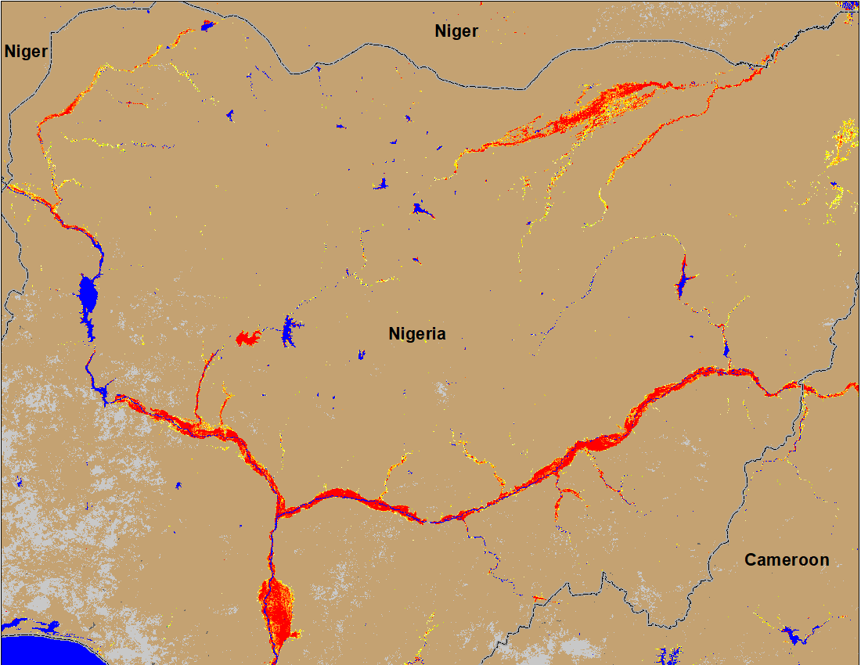
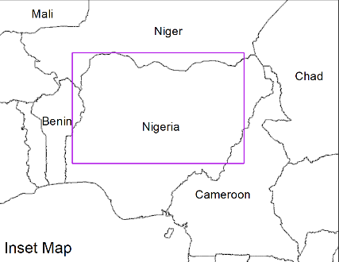
Flooding Conditions in Nigeria
(% of the pixel)
Sokoto
Komadugu
Sokoto
Komadugu
Niger
Niger
Benue
Benue
(% of the pixel)
IC flood map (Sep 1-13, 2022)
NOAA VIIRS 5-day comp.: 21-25 Sep 2022
NOAA VIIRS 5-day comp.: 28 Sep – 2 Oct 2022
The entire path of Niger and Benue Rivers are still flooded but conditions have improved along the Sokoto and Komadugu Rivers.

Slide 7
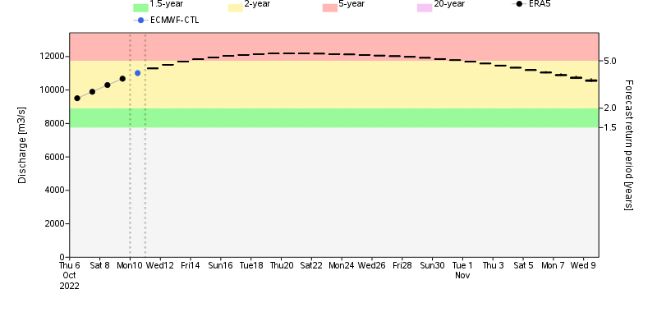
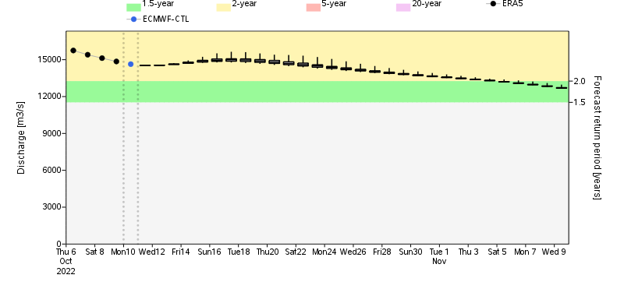
Discharge Forecast for Niger River
GloFAS: Niger discharge at Niamey Niger
GloFAS: Niger discharge at Niger-Nigeria boarder
Discharge on the Niger River in Niamey Niger is expected to rise to 5-yr return period level but expected to be at 2-yr return period level downstream in Nigeria.

Slide 8
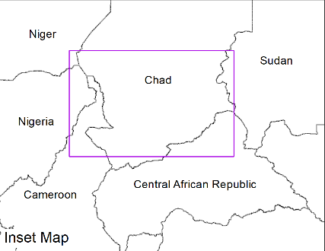
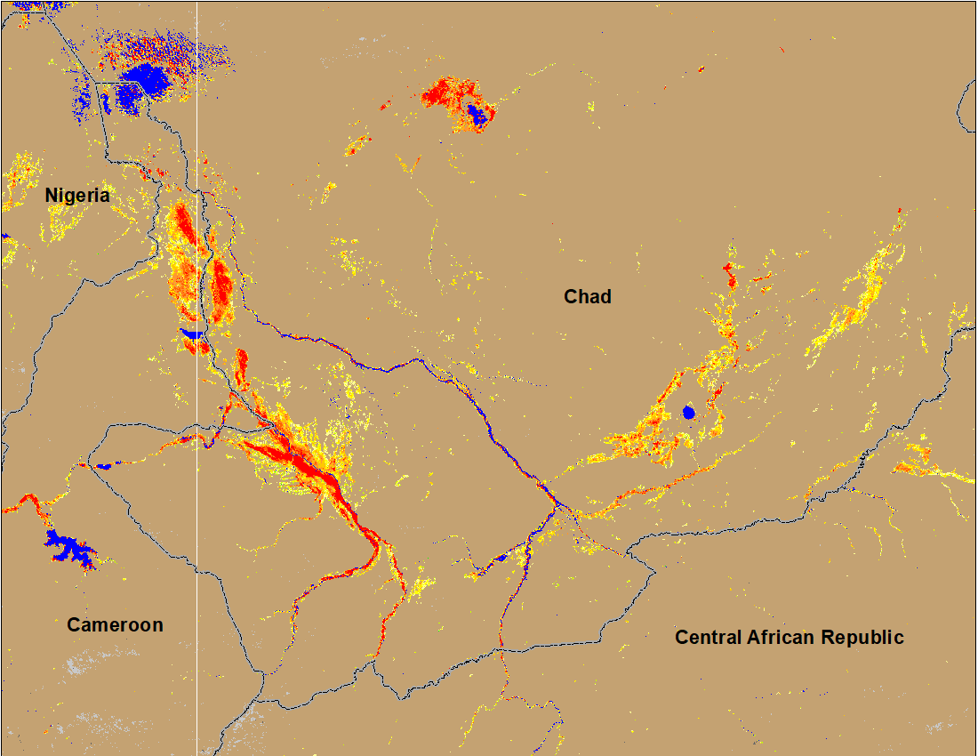
Flooding Conditions in Chad
(% of the pixel)
(% of the pixel)
NOAA VIIRS 5-day comp.: 28 Sep – 2 Oct 2022
NOAA VIIRS 5-day comp.: 6 – 10 Oct 2022
Flooding conditions remained constant in Chad and Central African Republic.

Slide 9
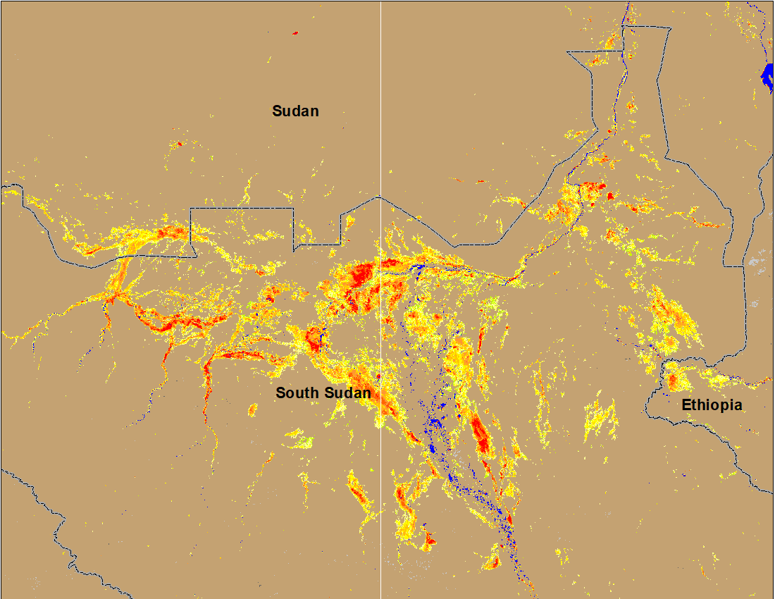
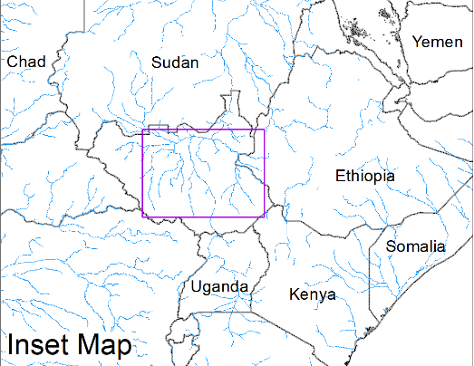
Inundation in the Sudd Wetlands
(% of the pixel)
(% of the pixel)
NOAA VIIRS 5-day comp.: 28 Sep – 2 Oct 2022
NOAA VIIRS 5-day comp.: 6 – 10 Oct 2022
Flooding conditions remained unchanged in South Sudan.

Slide 10
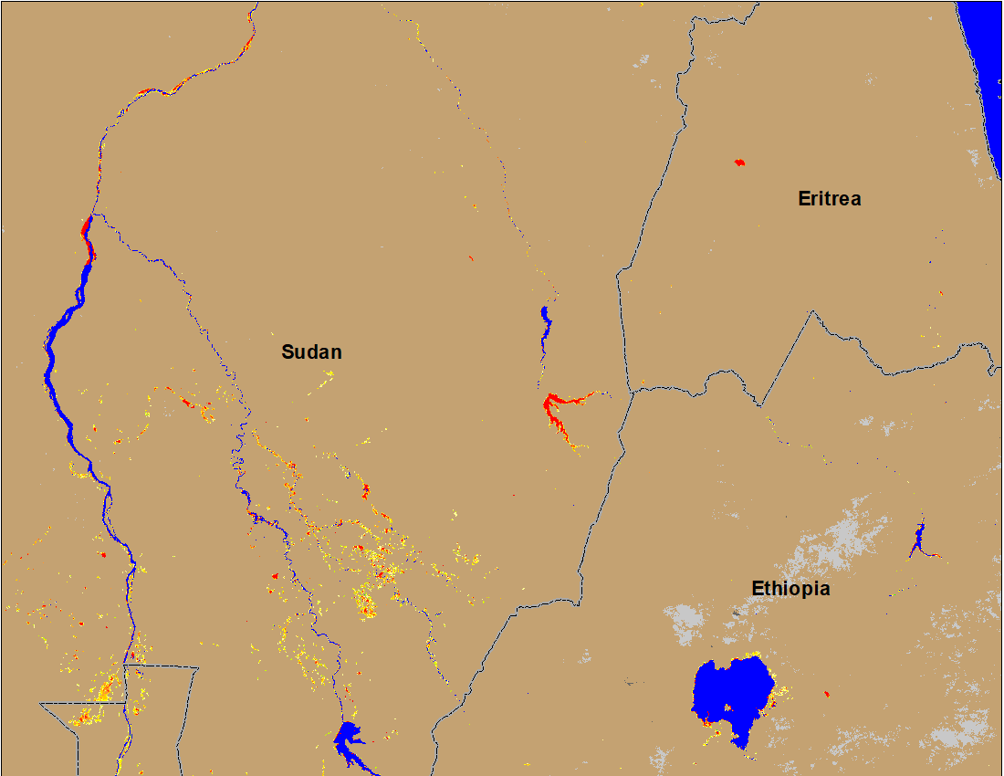
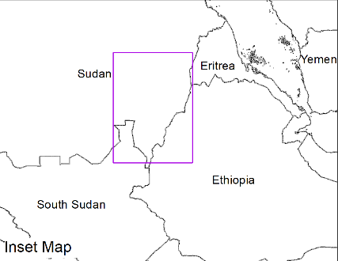
Flooding Conditions in Eastern Sudan
(% of the pixel)
Atbara
Atbara
Blue Nile
Blue Nile
(% of the pixel)
NOAA VIIRS 5-day composite: 28 Sep – 2 Oct 2022
NOAA VIIRS 5-day composite: 6 – 10 Oct 2022
Conditions along Blue Nile and Atbara are improving gradually.

Slide 11
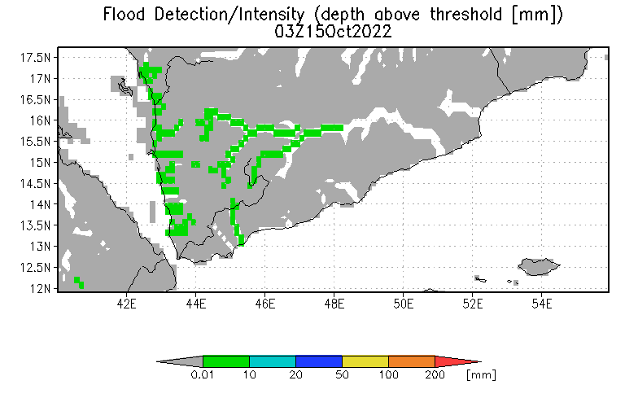
Inundation in Yemen
UMD Depth above threshold forecast for: 15 Oct 2022
Very little and isolated flooding is detected by VIIRS flood product but forecast still shows above threshold flood water depth along the western Wadis in Yemen.

