Slide 1
FEWS NET Enhanced Flood Monitoring – East Africa, West Africa, southern Africa and Yemen
May 09, 2022, Hazard Briefing
FEWS NET Science Team:
USGS, NASA, NOAA, UCSB+Regional Scientists

Slide 2
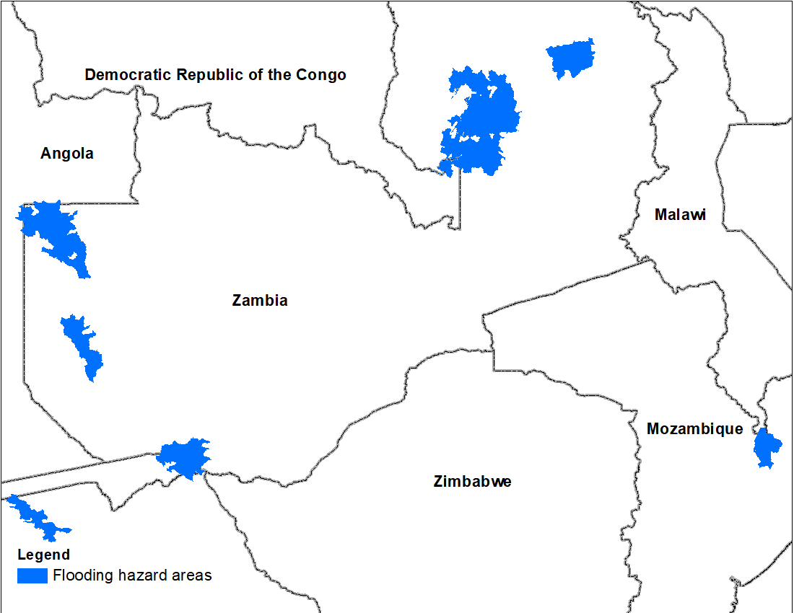
Flooding Polygons

Slide 3
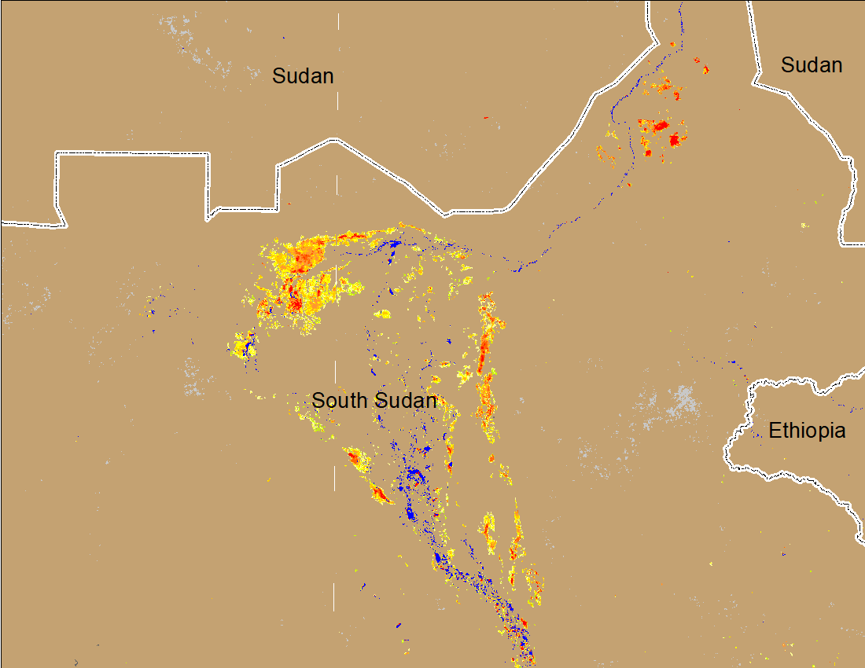
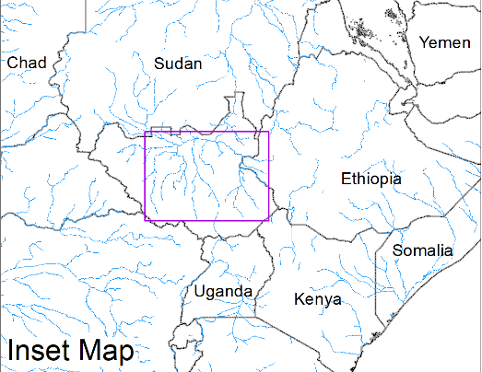
Inundation in the Sudd Wetlands
(% of the pixel)
(% of the pixel)
Northern Sudd Wetlands
Northern Sudd Wetlands
Sobet River
Sobet River
Akobo River
Akobo River
Pibor River
Pibor River
NOAA VIIRS 5-day composite: 20-24 Apr 2022
NOAA VIIRS 5-day composite: 4-8 May 2022
No noticeable change in the inundated areas during the last two weeks in Sudd Wetlands.

Slide 4
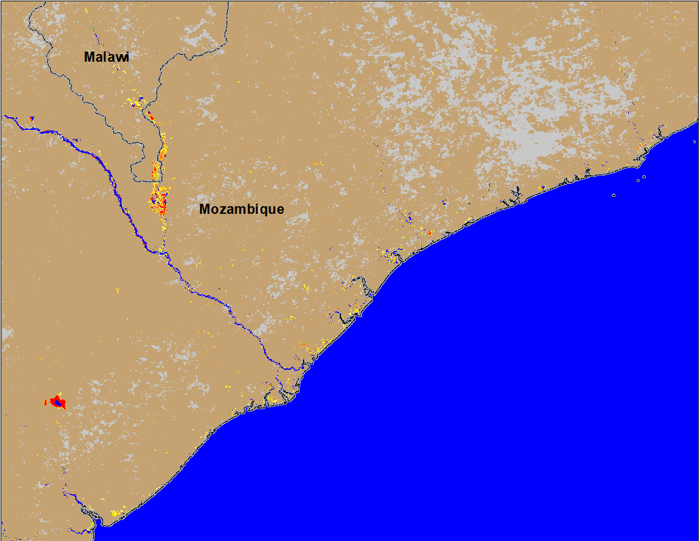
Flooding in Malawi and Mozambique
(% of the pixel)
(% of the pixel)
NOAA VIIRS 5-Day composite: 20-24 Apr 2022
NOAA VIIRS 5-Day composite: 4-8 May 2022
There are still some flooded areas along the Shire River in Southern Malawi and Mozambique.

Slide 5
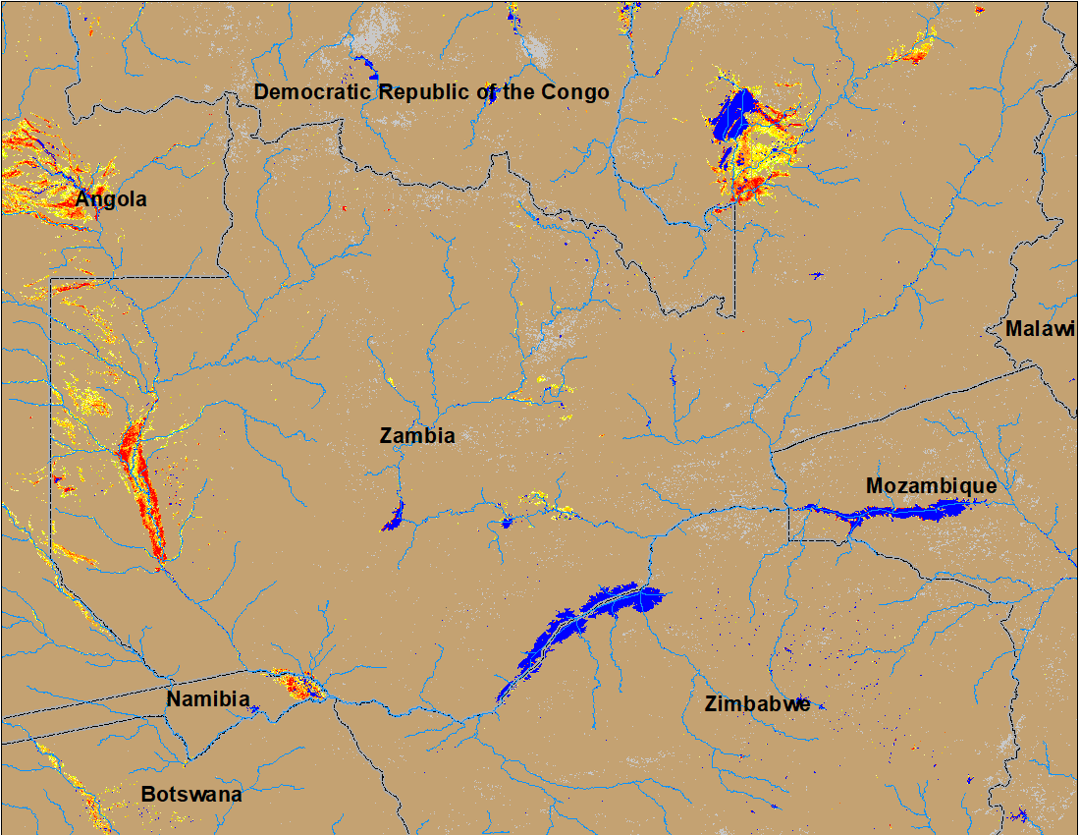
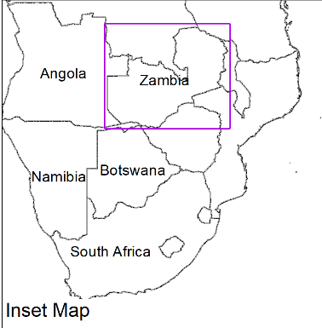
Flooding in Zambia
(% of the pixel)
(% of the pixel)
NOAA VIIRS 5-Day composite: 20-24 Apr 2022
NOAA VIIRS 5-Day composite: 4-8 May 2022
Flooding conditions improved substantially in Zambia, but remained unchanged in Namibia, and Botswana.

