Slide 1
FEWS NET Enhanced Flood Monitoring – East Africa, West Africa, southern Africa and Yemen
May 23, 2022, Hazard Briefing
FEWS NET Science Team:
USGS, NASA, NOAA, UCSB+Regional Scientists

Slide 2
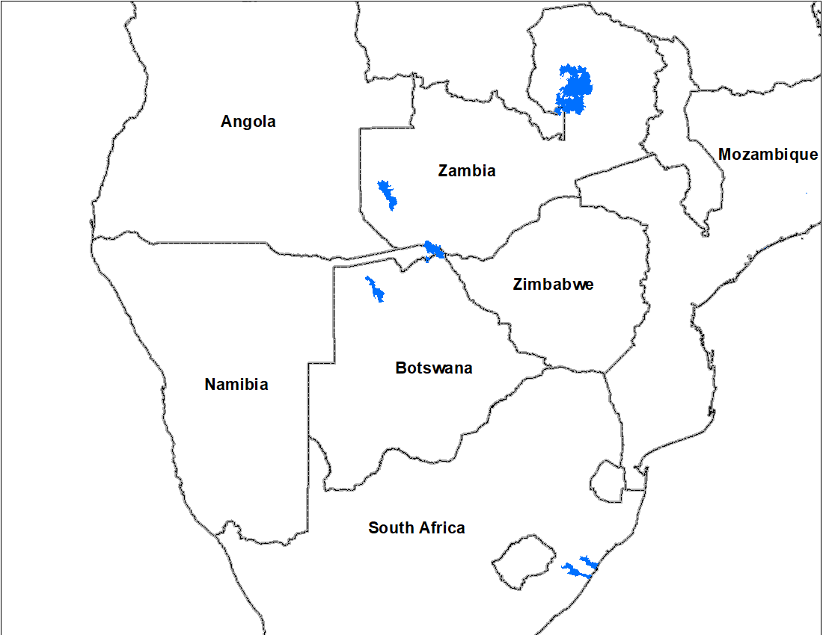
Flooding Polygons

Slide 3
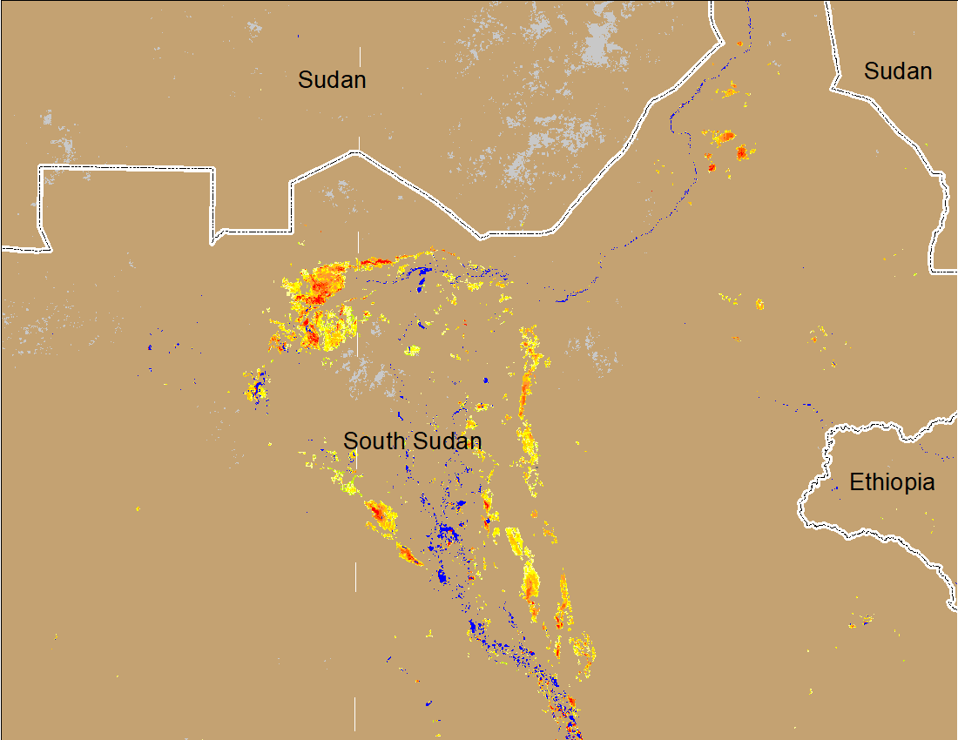
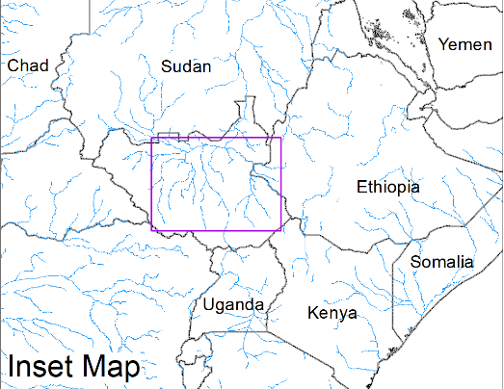
Inundation in the Sudd Wetlands
(% of the pixel)
(% of the pixel)
Northern Sudd Wetlands
Northern Sudd Wetlands
Sobet River
Sobet River
Akobo River
Akobo River
Pibor River
Pibor River
NOAA VIIRS 5-day composite: 4-8 May 2022
NOAA VIIRS 5-day composite: 18-22 May 2022
No noticeable change in the inundated areas during the last two weeks in Sudd Wetlands.

Slide 4
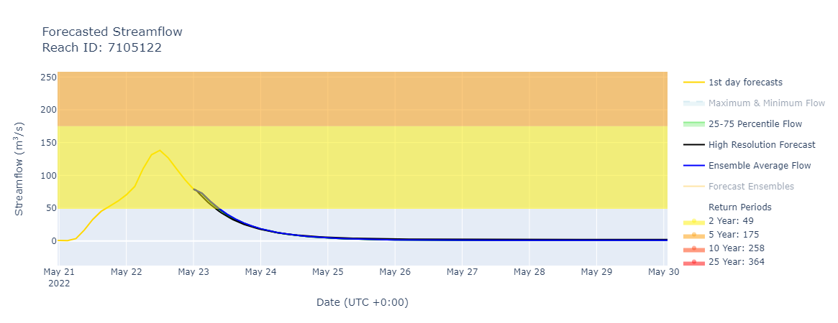
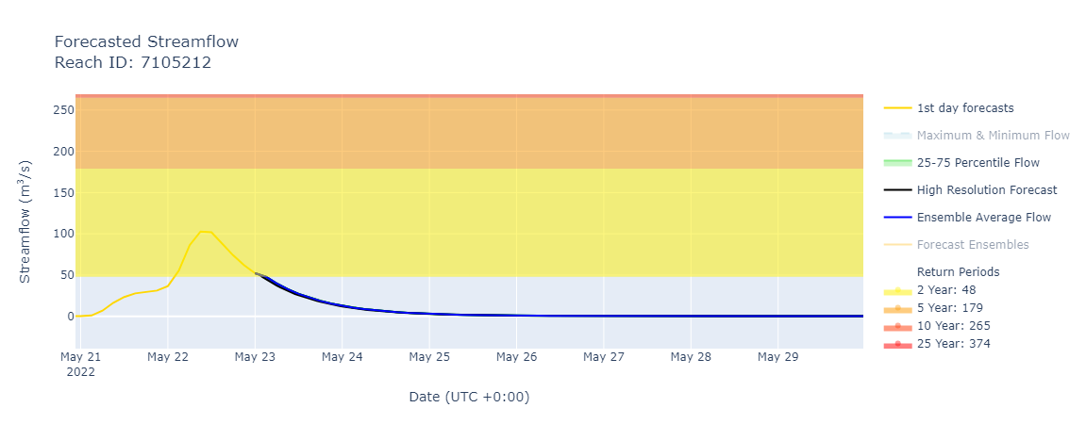
Risk of Flooding in KwaZulu Natal
Due to heavy rain during the last 24 to 36 hours, discharge surged in some rivers in the Durban region which is expected to decline in the following day.

Slide 5
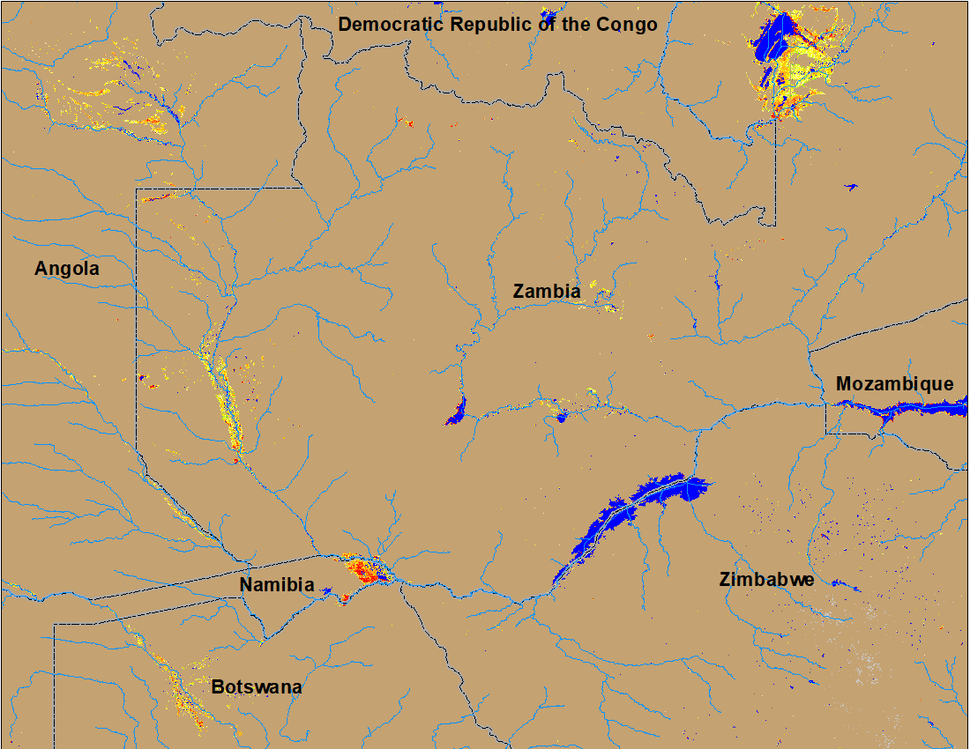
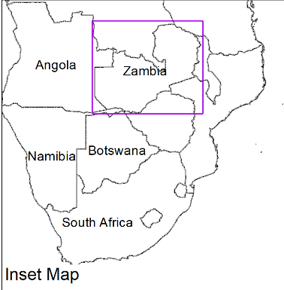
Flooding in Zambia
(% of the pixel)
(% of the pixel)
NOAA VIIRS 5-Day composite: 4-8 May 2022
NOAA VIIRS 5-Day composite: 18-22 May 2022
Flooding conditions improved substantially in Zambia, Namibia, and Botswana but not completely recovered yet.

