Slide 1
FEWS NET Enhanced Flood Monitoring – East Africa, West Africa, southern Africa and Yemen
March 28, 2022, Hazard Briefing
FEWS NET Science Team:
USGS, NASA, NOAA, UCSB+Regional Scientists

Slide 2
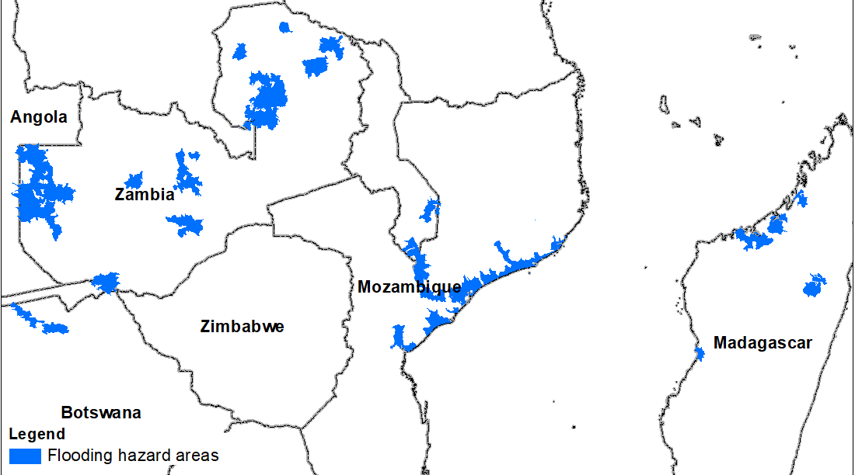
Flooding Polygons

Slide 3
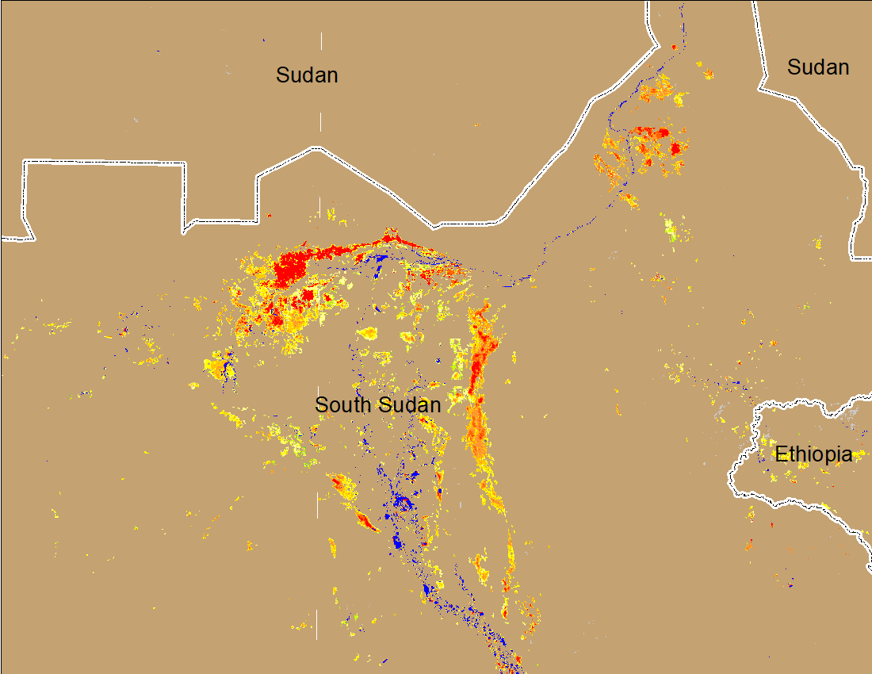
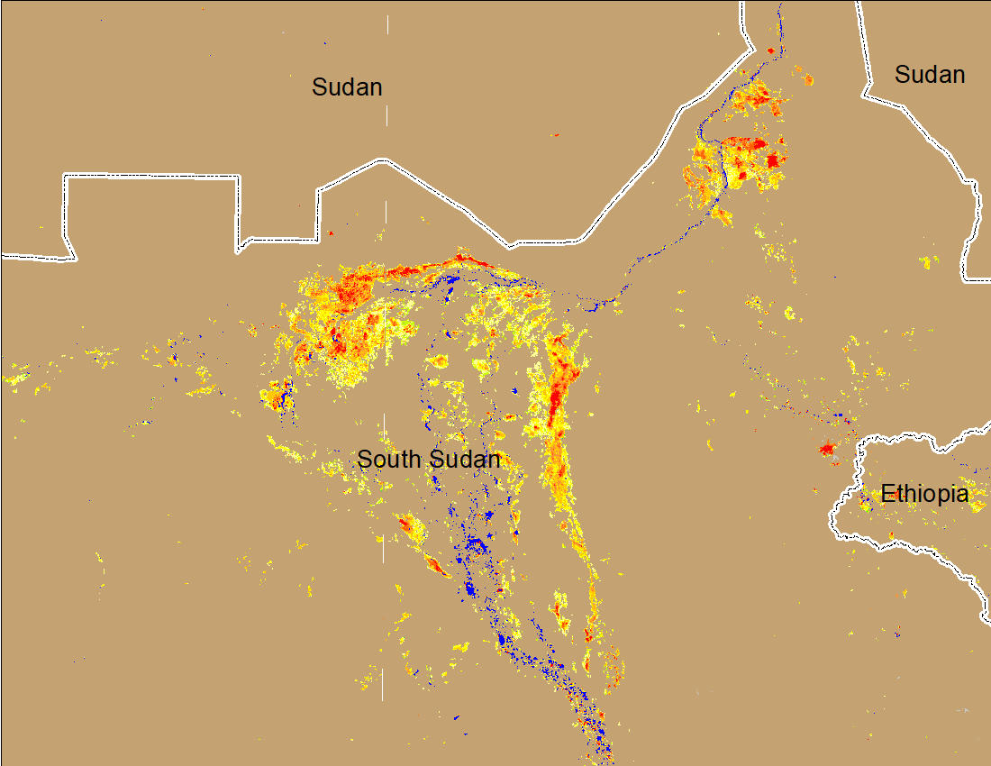
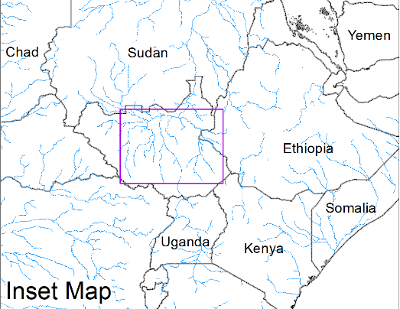
Inundation in the Sudd Wetlands
(% of the pixel)
(% of the pixel)
Northern Sudd Wetlands
Northern Sudd Wetlands
Sobet River
Sobet River
Akobo River
Akobo River
Pibor River
Pibor River
NOAA VIIRS 5-day composite: 16-20 Mar 2022
NOAA VIIRS 5-day composite: 23-27 Mar 2022
Inundation conditions improved compared to last week.

Slide 4
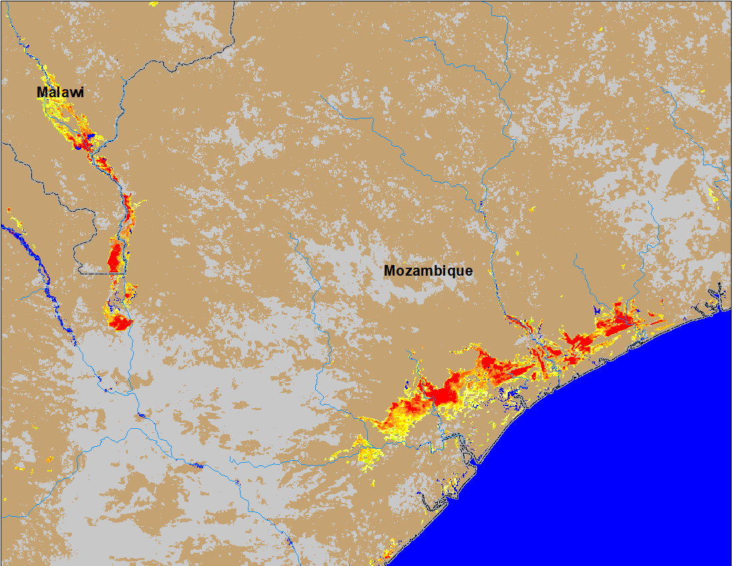
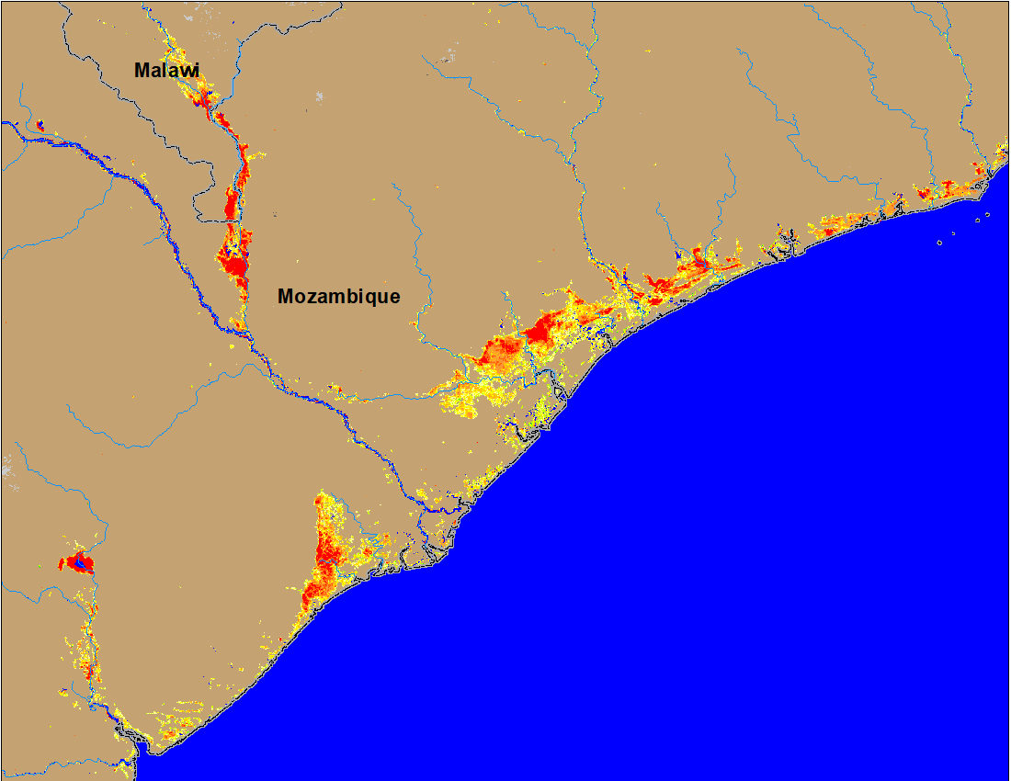
Flooding in Malawi and Mozambique
(% of the pixel)
(% of the pixel)
Before TC Gombe
After TC Gombe
NOAA VIIRS 5-Day composite: 16-20 Mar 2022
NOAA VIIRS 5-Day composite: 23-27 Mar 2022
Flooding continues in southern Malawi and coastal Mozambique with no significant improvement.

Slide 5
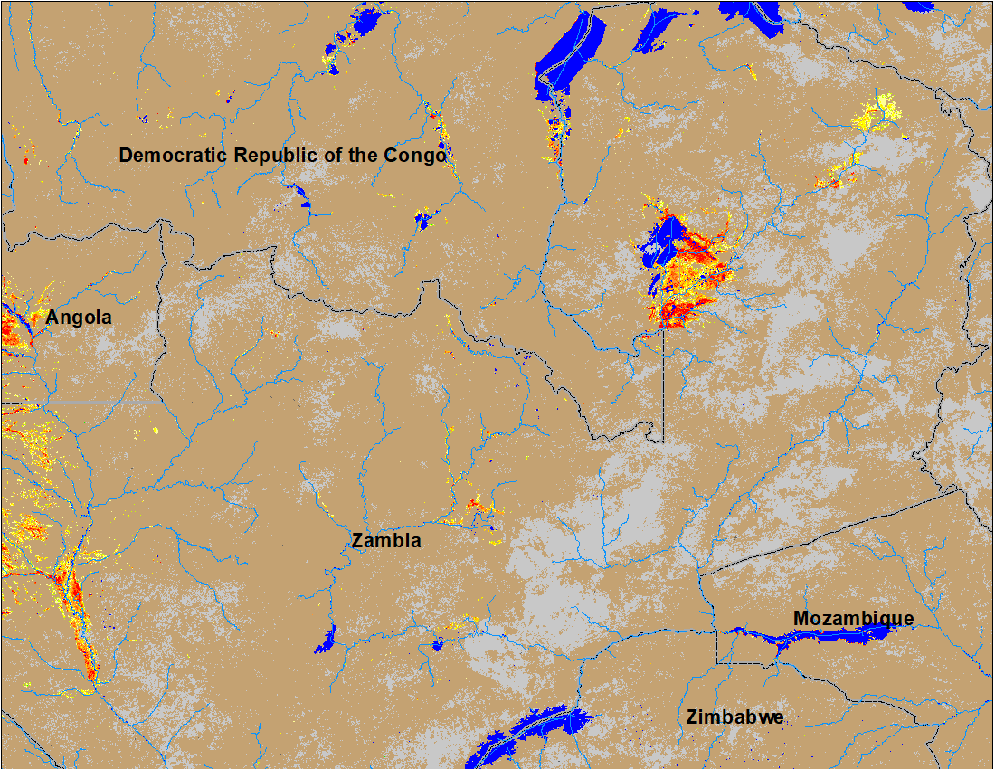
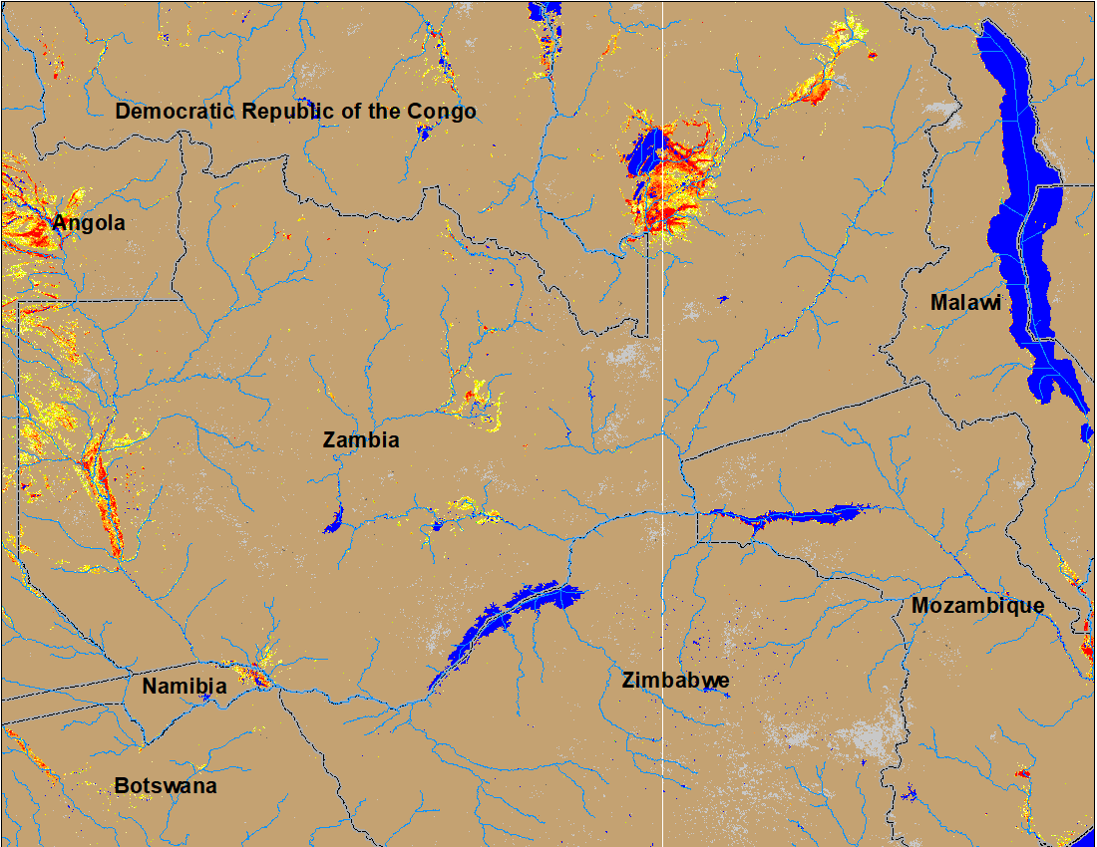
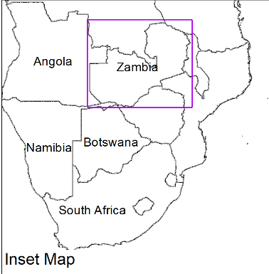
Flooding in Zambia Continues
(% of the pixel)
(% of the pixel)
NOAA VIIRS 5-Day composite: 16-20 March 2022
NOAA VIIRS 5-Day composite: 23-27 Mar 2022
Newly inundated areas in Botswana and Namibia.

Slide 6
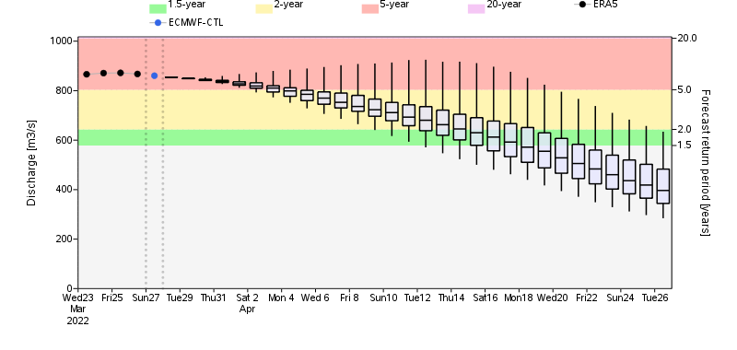
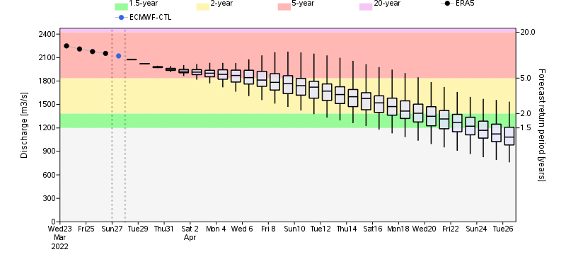
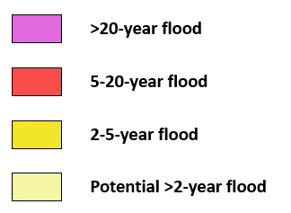
Flooding Likely to Continue in Zambia
Luanga River in Zambia
Luanga River
Luangwa River
GloFAS streamflow forecast suggest, Luanga and Luangwa Rivers (both are tributaries of Zambezi River) are expected to produce discharge at 2 to 5-yr return period level in next two weeks.
Luangwa River in Zambia

Slide 7
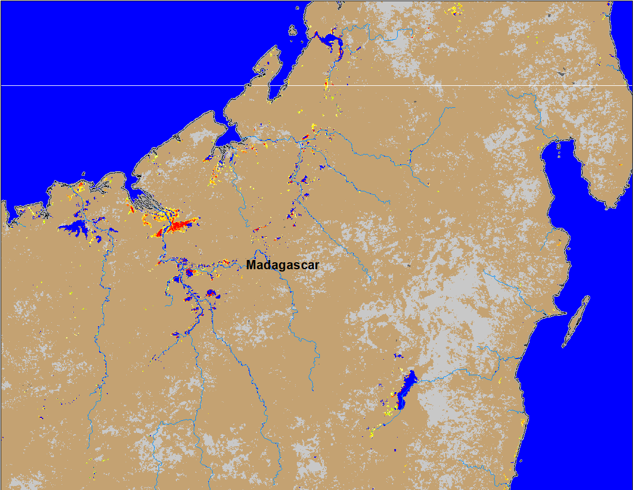
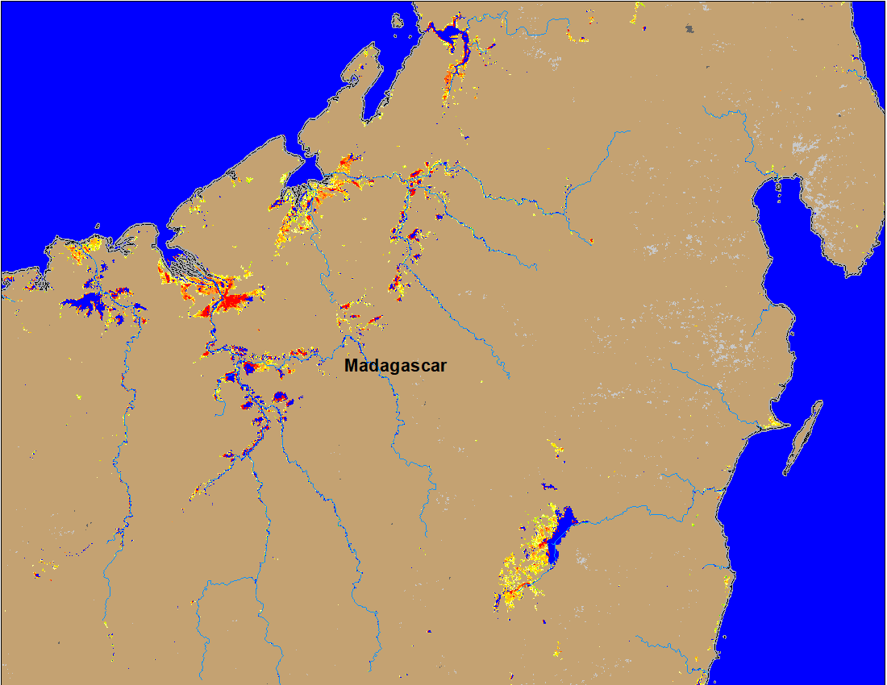
Flooding in Madagascar
(% of the pixel)
(% of the pixel)
NOAA VIIRS 5-day composite: 16-20 Mar 2022
NOAA VIIRS 5-day composite: 23-27 Mar 2022
Deteriorated flooding conditions in northern Madagascar.

