Slide 1
FEWS NET Enhanced Flood Monitoring – East Africa, West Africa, southern Africa and Yemen
March 21, 2022, Hazard Briefing
FEWS NET Science Team:
USGS, NASA, NOAA, UCSB+Regional Scientists

Slide 2
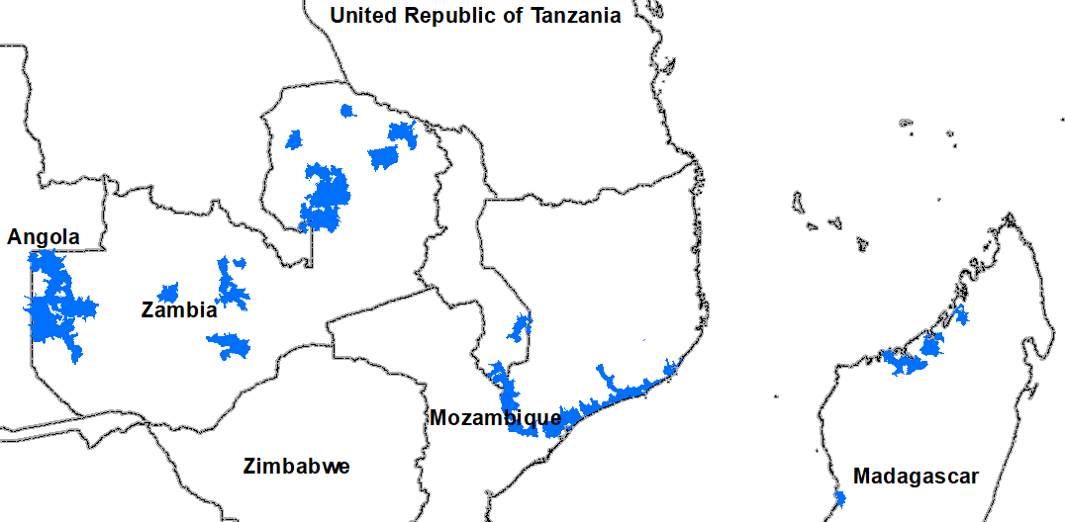
Flooding Polygons

Slide 3
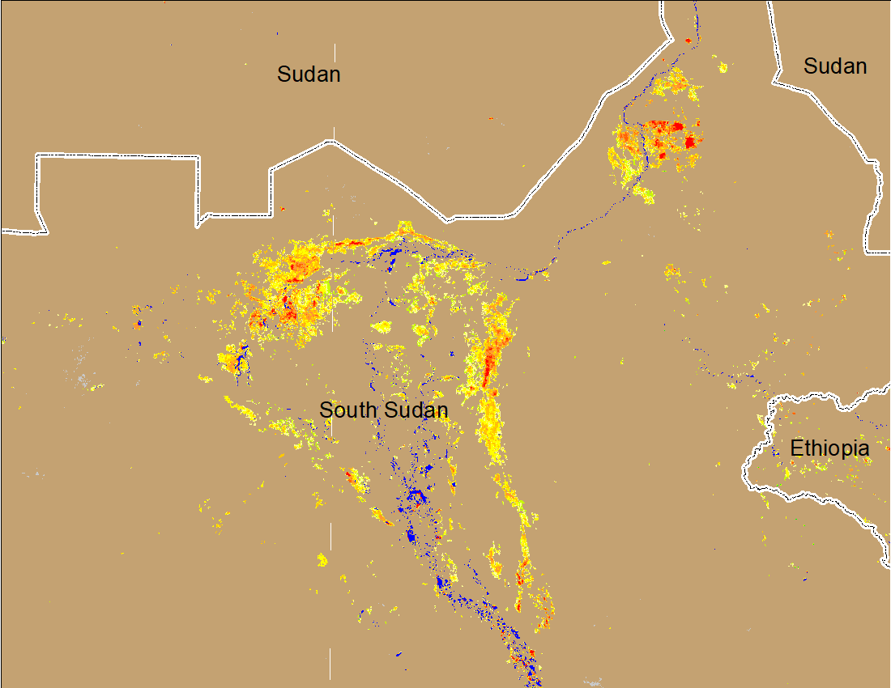
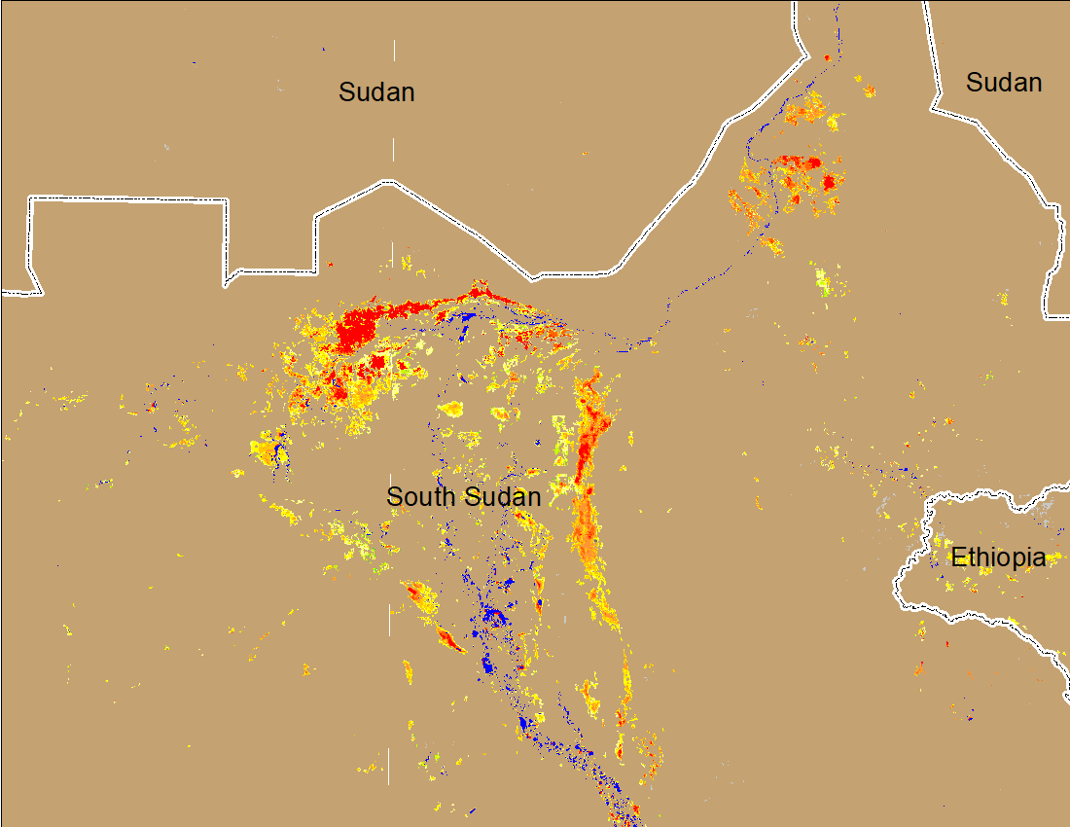
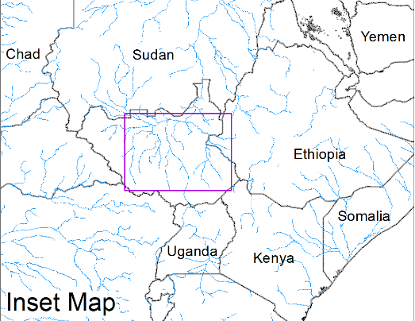
Inundation in the Sudd Wetlands
(% of the pixel)
(% of the pixel)
Northern Sudd Wetlands
Northern Sudd Wetlands
Sobet River
Sobet River
Akobo River
Akobo River
Pibor River
Pibor River
NOAA VIIRS 5-day composite: 9-13 Mar 2022
NOAA VIIRS 5-day composite: 16-20 Mar 2022
Inundation conditions deteriorated compared to last week.

Slide 4
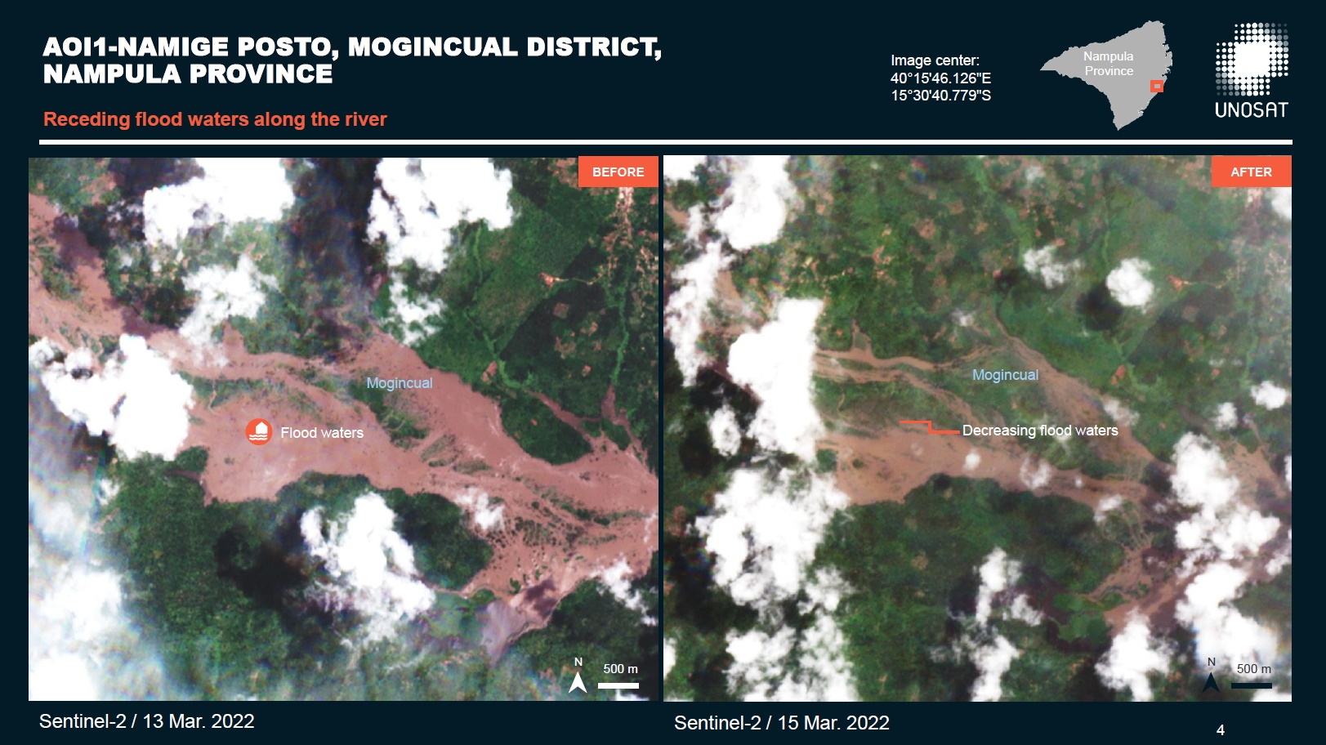
Improvement in Inundation Caused by Gombe
International Charter (using Sentinel-2 data)
Fortunately flood water receding quickly (Mogincual River in Nampula Province)

Slide 5
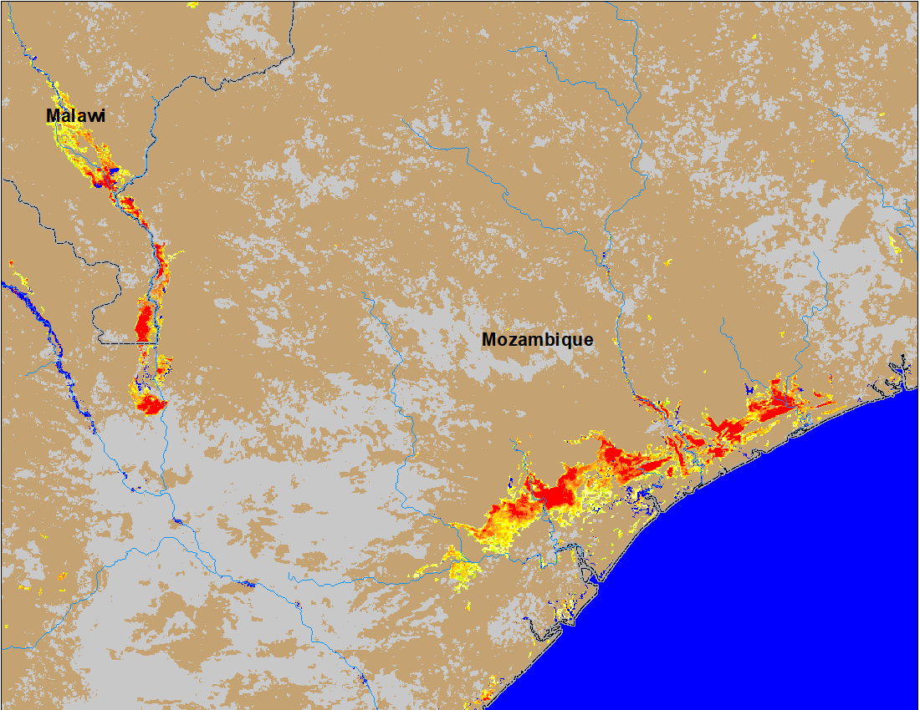
Flooding in Malawi and Mozambique due to Gombe
(% of the pixel)
(% of the pixel)
Before TC Gombe
After TC Gombe
NOAA VIIRS 5-Day composite: 2-6 Mar 2022
NOAA VIIRS 5-Day composite: 16-20 Mar 2022
Flooding due to Gombe were mostly in the impacted areas from previous cyclones.

Slide 6
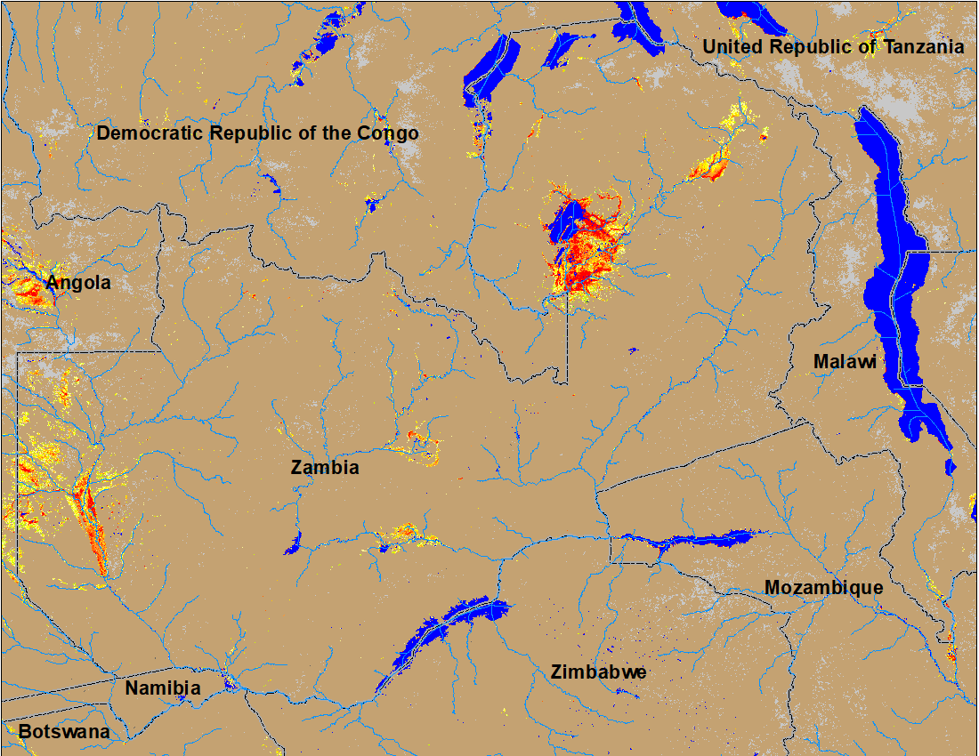
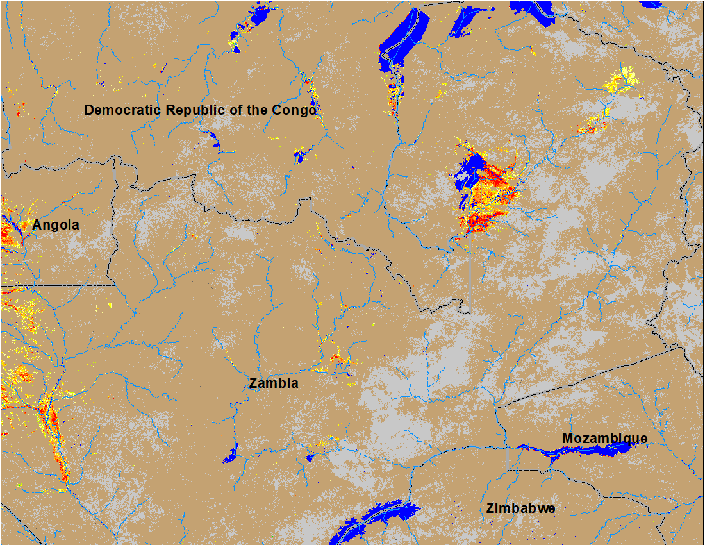
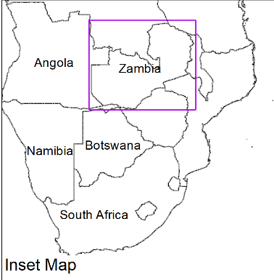
Flooding in Zambia Continues
(% of the pixel)
(% of the pixel)
NOAA VIIRS 5-Day composite: 9-13 March 2022
NOAA VIIRS 5-Day composite: 16-20 Mar 2022
Very little improvement in inundation conditions in Zambia.

Slide 7
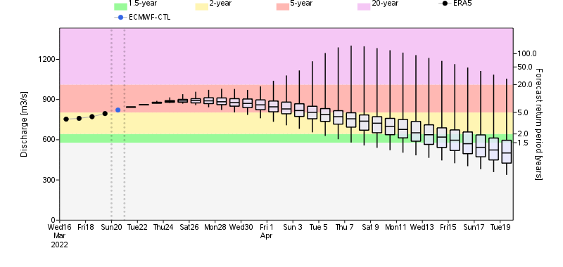
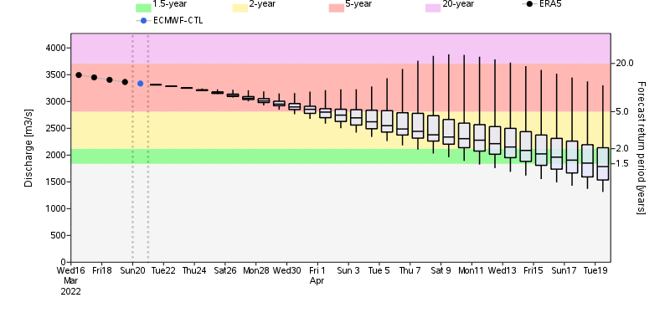
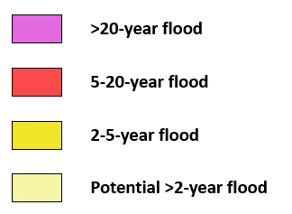
Flooding to Continue in Zambia
Luanga River
Luangwa River
Luanga River in Zambia
GloFAS streamflow forecast suggest, Luanga and Luangwa Rivers (both are tributaries of Zambezi River) are expected to produce discharge at 5-yr return period level in next two weeks.
Rio Luangwa River in Mozambique

Slide 8
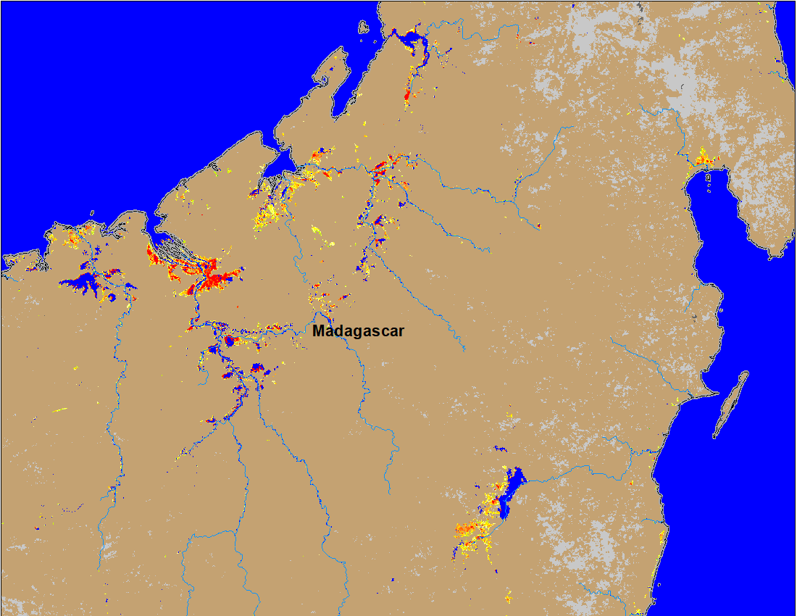
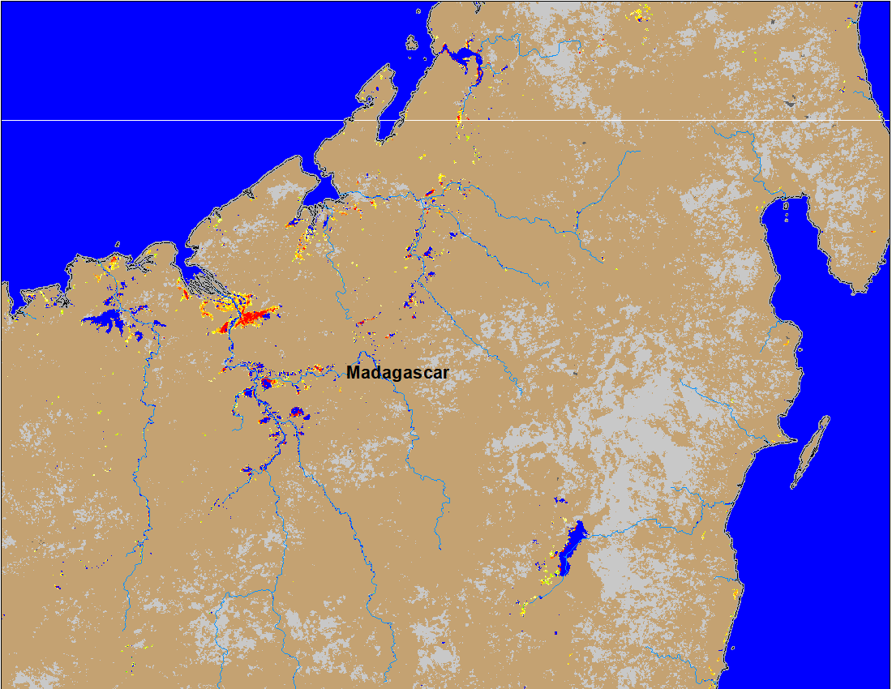
Flooding in Madagascar
(% of the pixel)
(% of the pixel)
NOAA VIIRS 5-day composite: 9-13 Mar 2022
NOAA VIIRS 5-day composite: 16-20 Mar 2022
Flooding conditions improved substantially in northern Madagascar.

