Slide 1
FEWS NET Enhanced Flood Monitoring – East Africa, West Africa, southern Africa and Yemen
March 14, 2022, Hazard Briefing
FEWS NET Science Team:
USGS, NASA, NOAA, UCSB+Regional Scientists

Slide 2
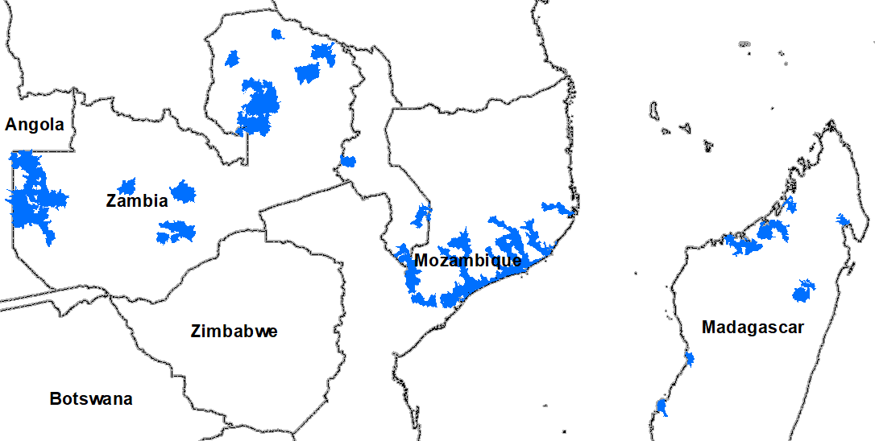
Flooding Polygons

Slide 3
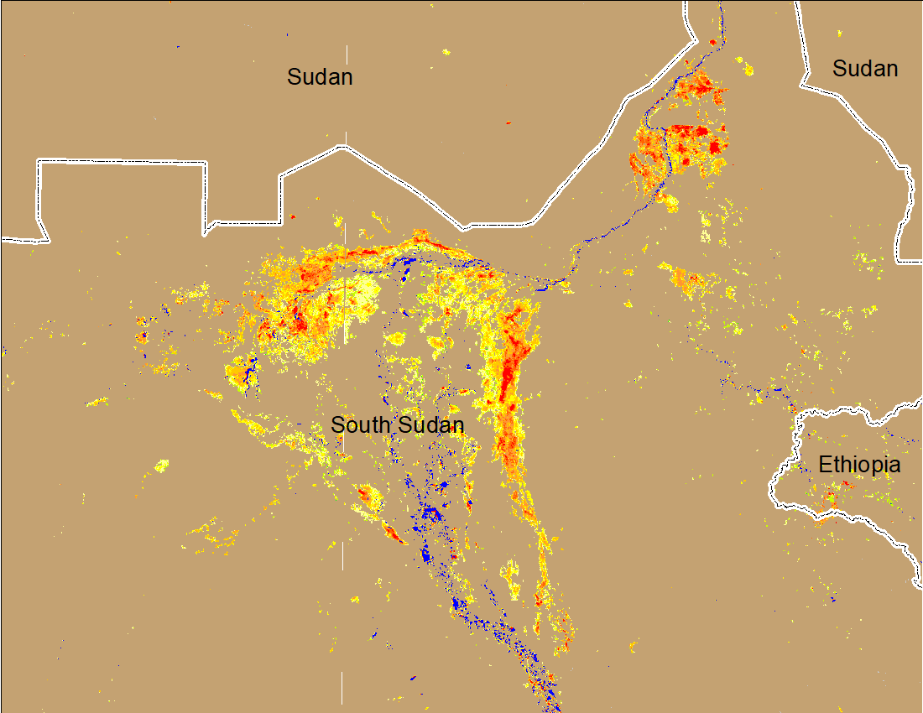
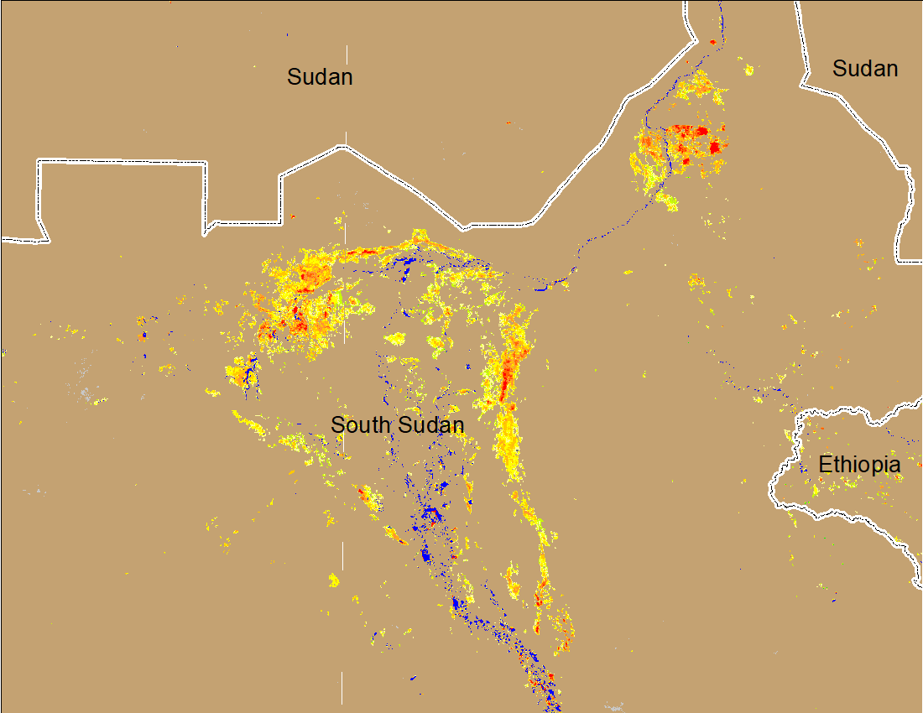
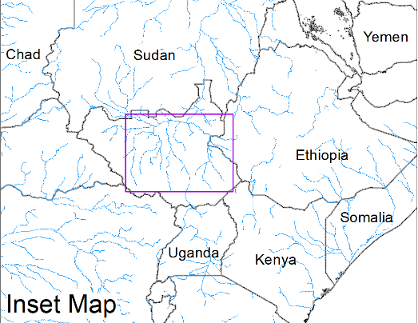
Inundation in the Sudd Wetlands
(% of the pixel)
(% of the pixel)
Northern Sudd Wetlands
Northern Sudd Wetlands
Sobet River
Sobet River
Akobo River
Akobo River
Pibor River
Pibor River
NOAA VIIRS 5-day composite: 2-6 Mar 2022
NOAA VIIRS 5-day composite: 9-13 Mar 2022
Inundation conditions have improved compared to last week.

Slide 4
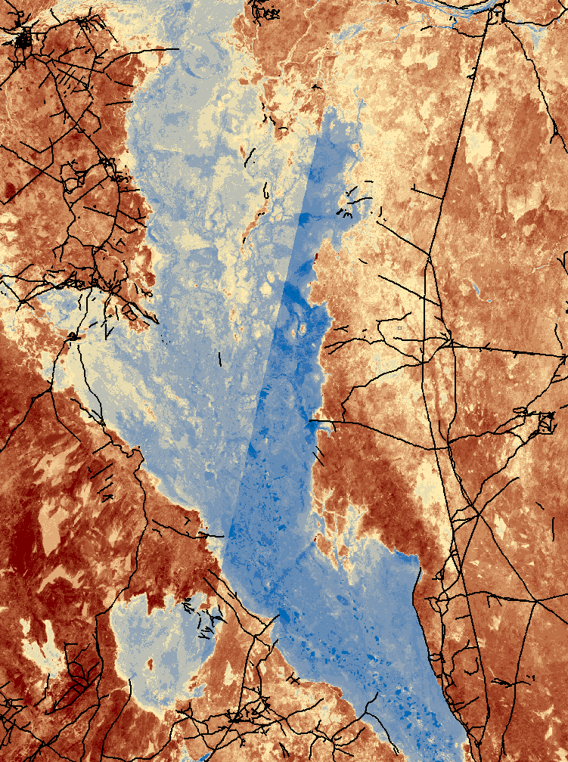
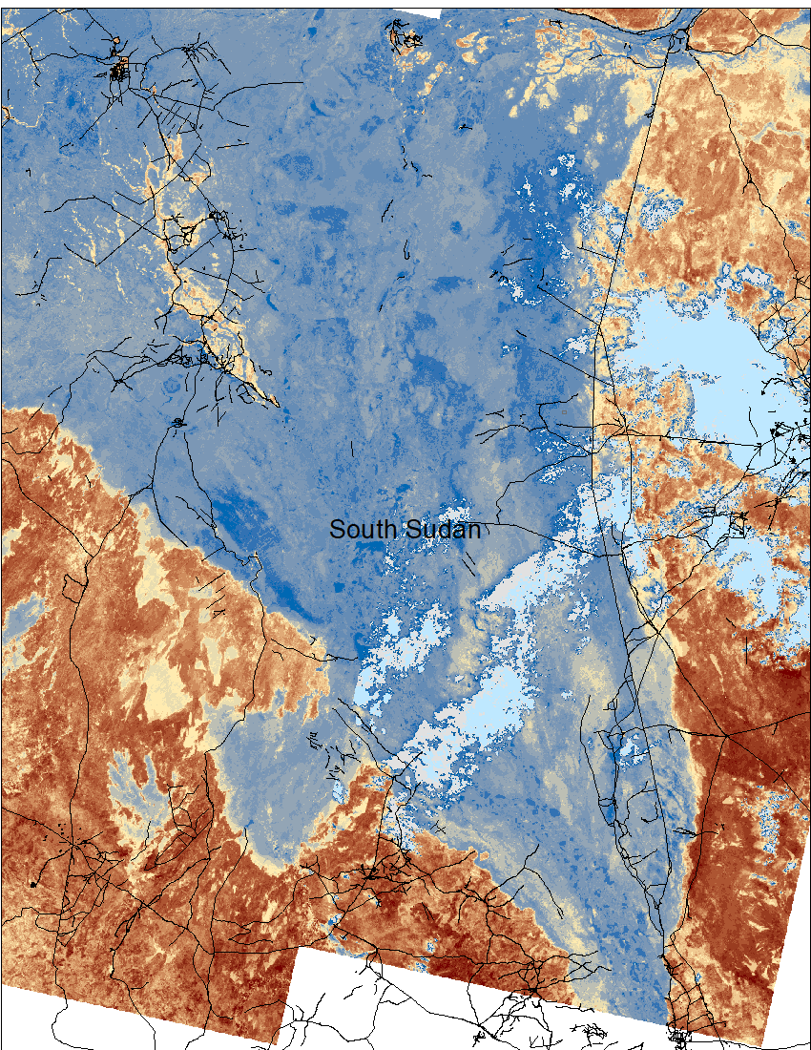
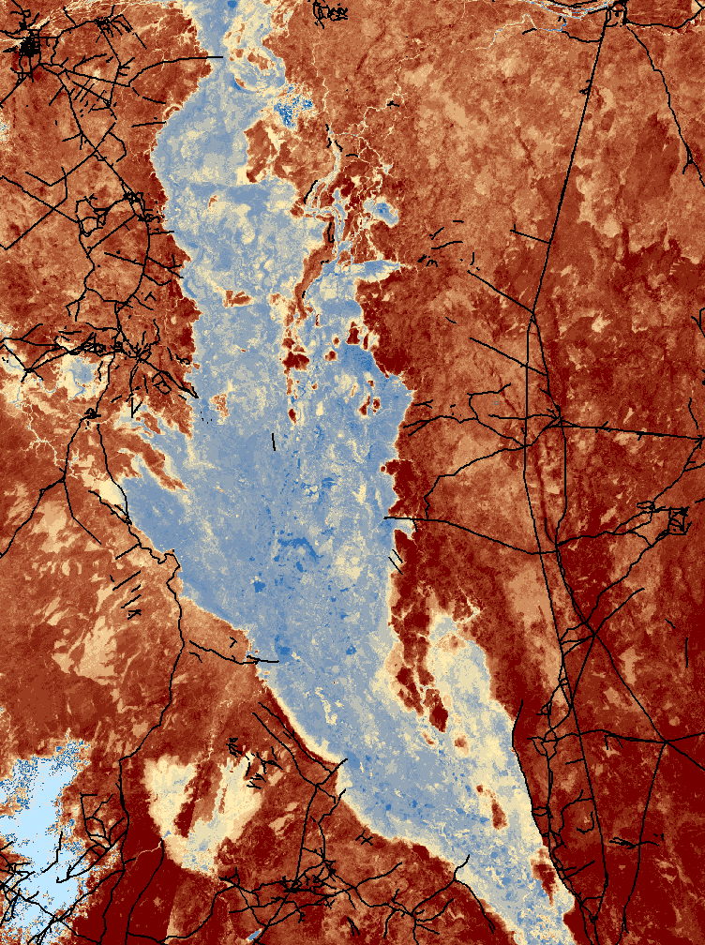
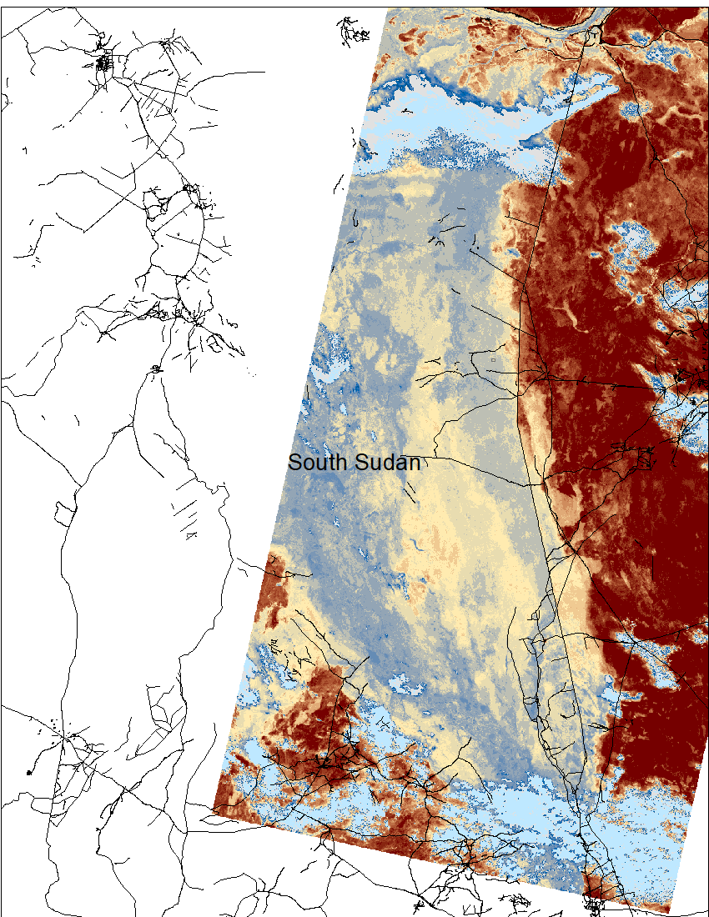
Land Surface Temperature Over Sudd Wetlands
Typical February extent
2022 February
Typical March extent
2022 March
Wet soil conditions over extended areas than normal during the dry period will increase the likelihood of flooding during the upcoming rainy season.

Slide 5
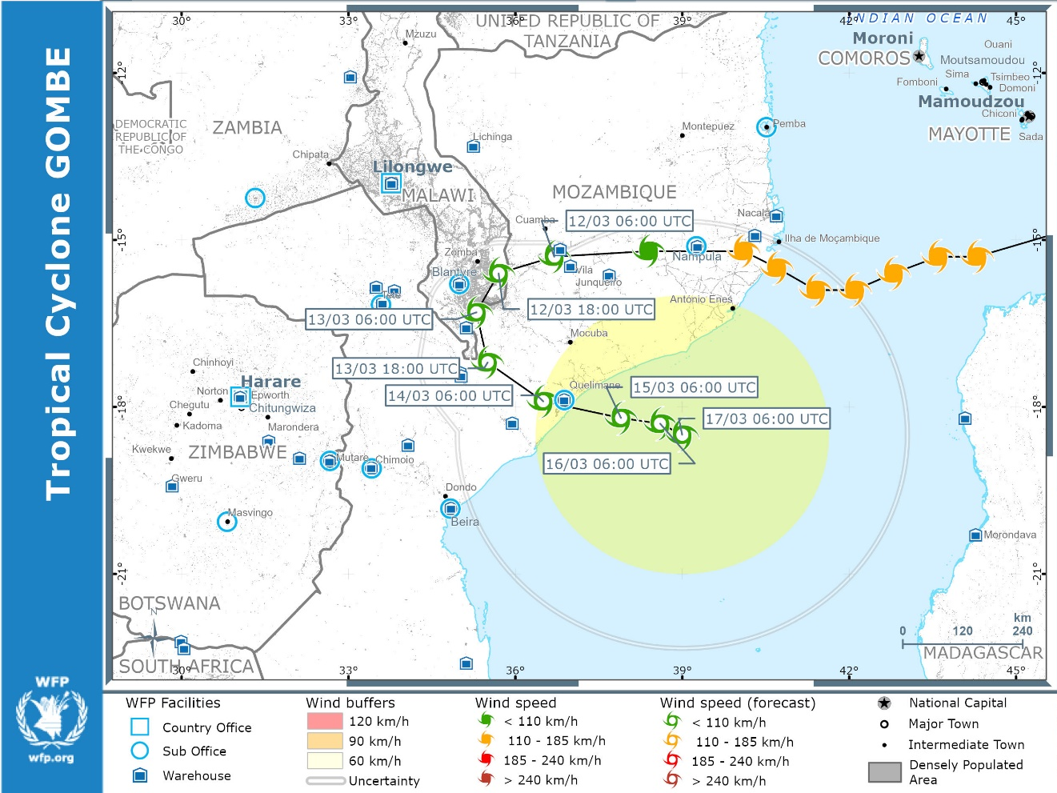
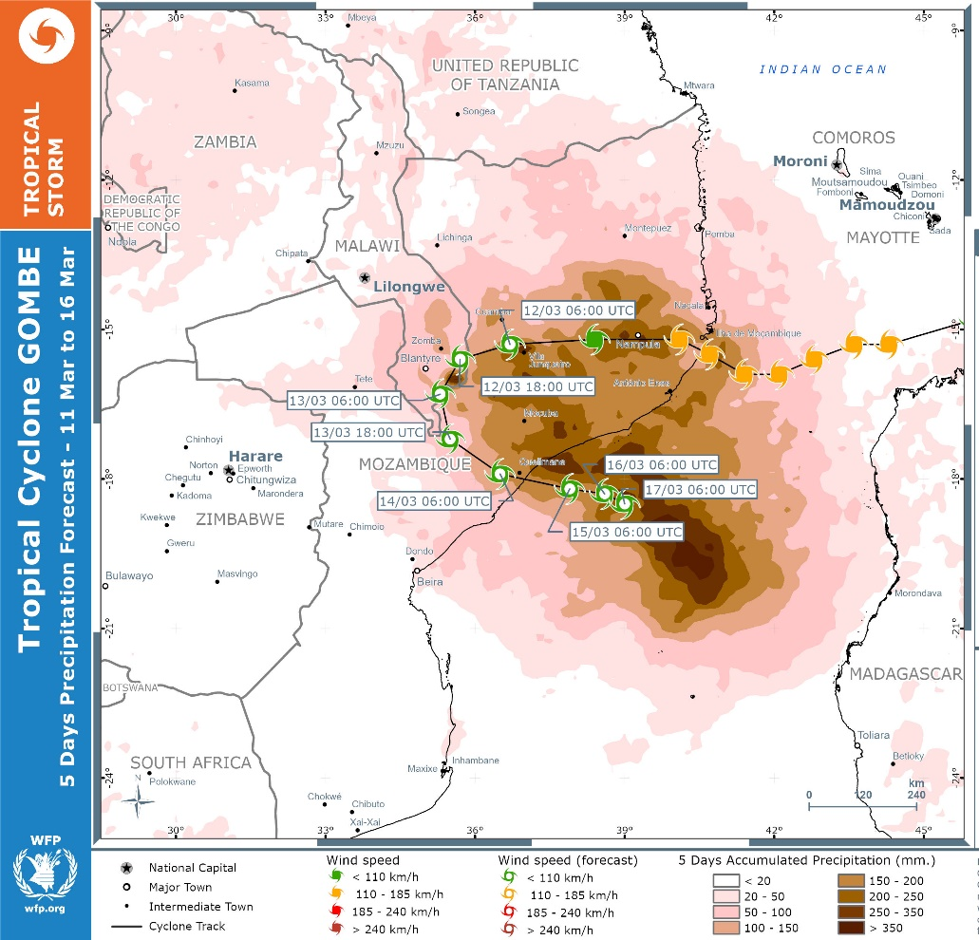
Tropical Cyclone Gombe
Category 3 TC Gombe made landfall on March 11 in central Mozambique and dumped over 200 mm or rainfall in 24 hrs.

Slide 6
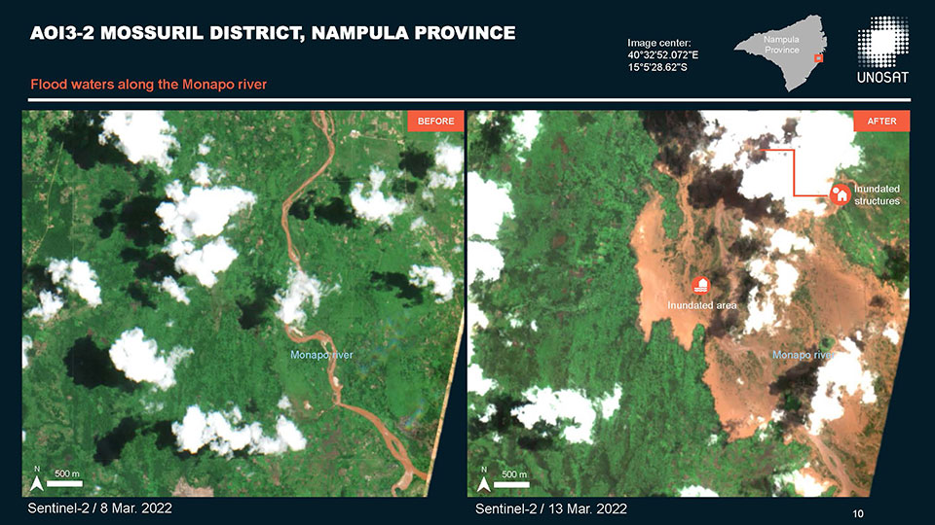
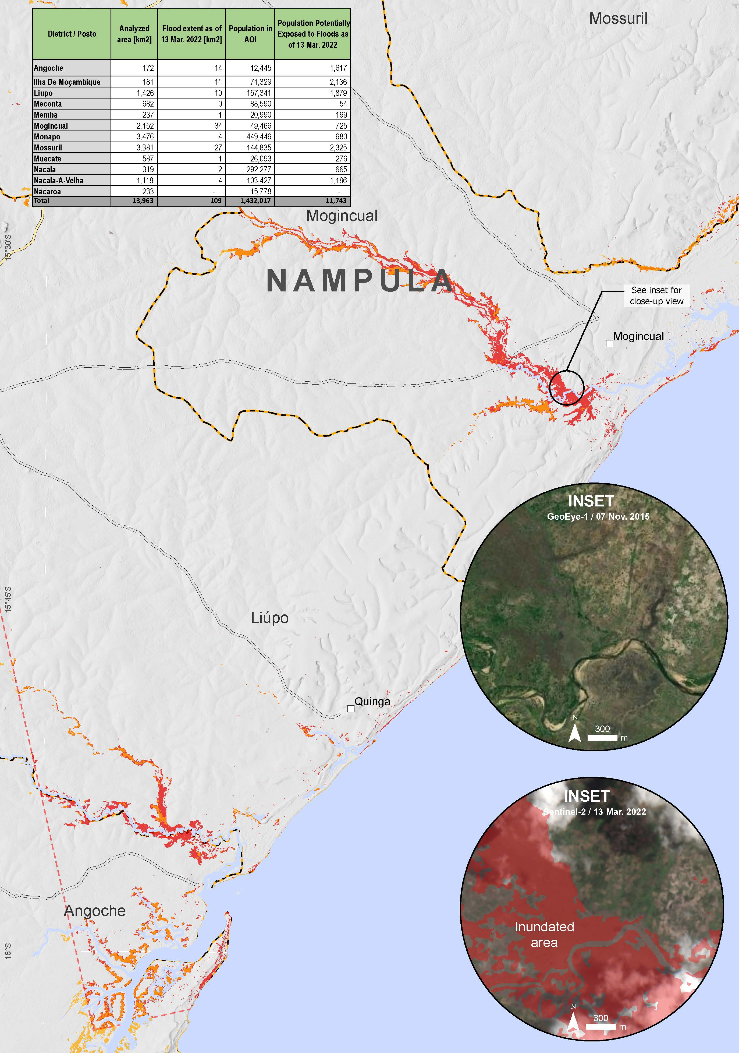
Inundation Caused by Gombe
Flooding along Monapo River in Nampula province.
TC Gombe is still active, and a full-scale inundation map has not been produced yet.
International Charter: Sentinel 2 data

Slide 7
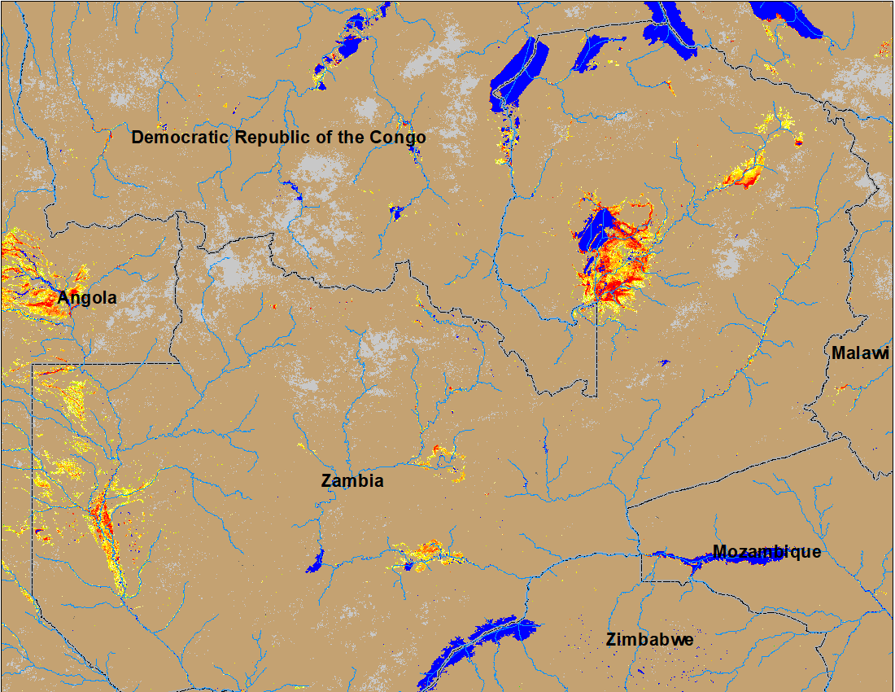
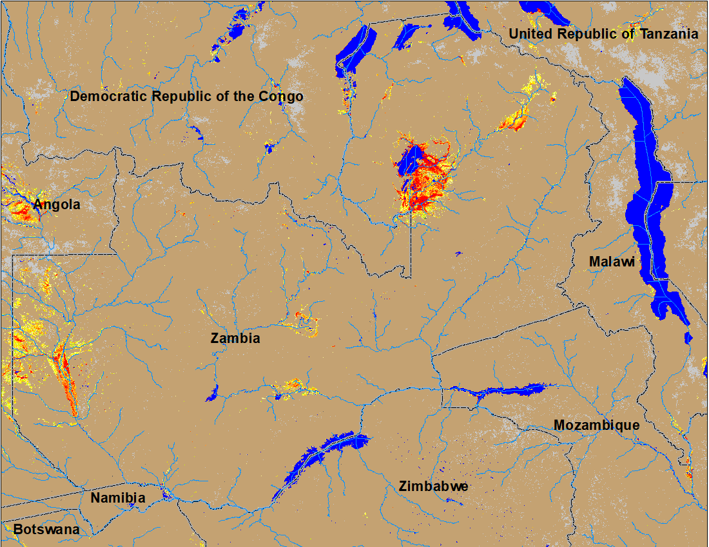
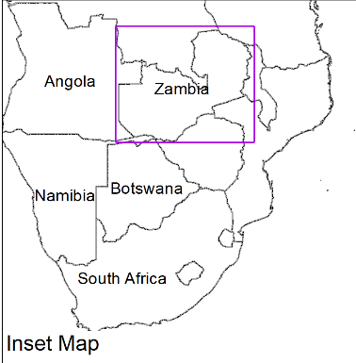
Flooding in Zambia
(% of the pixel)
(% of the pixel)
NOAA VIIRS 5-Day composite: 2-6 March 2022
NOAA VIIRS 5-Day composite: 9-13 Mar 2022
Flooding intensifies in the northern Zambia

Slide 8
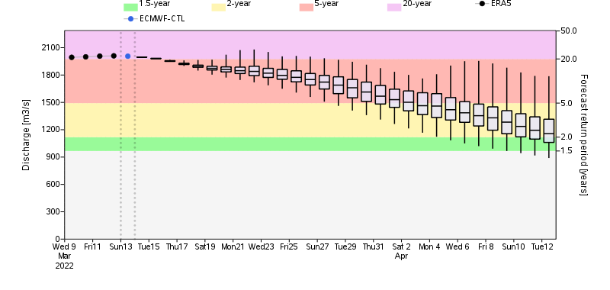
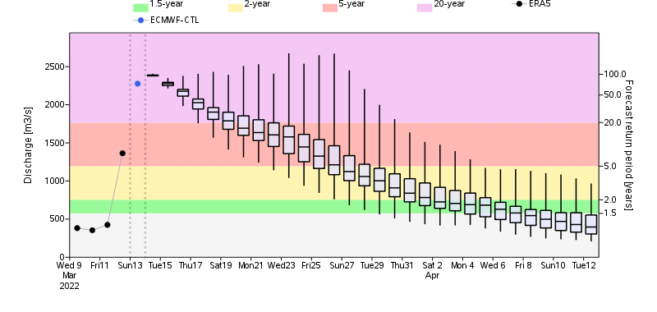
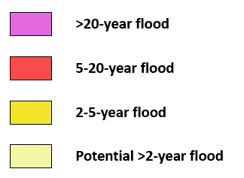
GloFAS Streamflow Forecast
Luapua River
Luangwa River
Luangwa River in Zambia
Flooding to intensify in Northern Zambia and central Mozambique in next two weeks due to 2 to 20-yr return period level discharge forecast in the rivers.
Rio Ligonha River in Mozambique

Slide 9
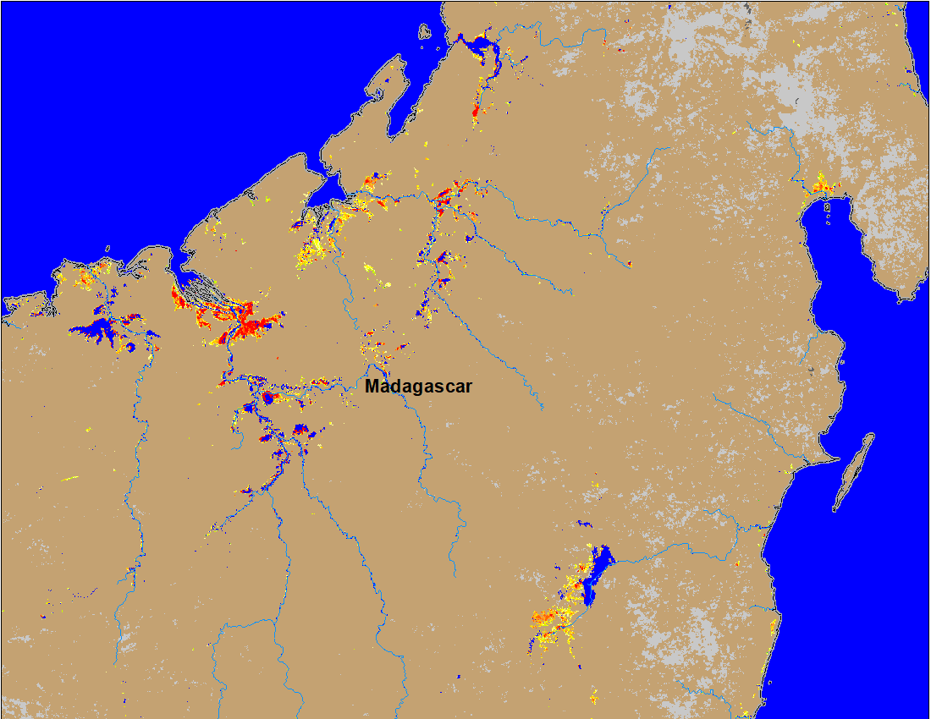
Flooding in Madagascar
Some of the flood receded areas in the northern Madagascar were flooded again due to TC Gombe.
(% of the pixel)
NOAA VIIRS 5-day composite: 9-13 Mar 2022

