Slide 1
FEWS NET Enhanced Flood Monitoring – East Africa, West Africa, southern Africa and Yemen
March 07, 2022, Hazard Briefing
FEWS NET Science Team:
USGS, NASA, NOAA, UCSB+Regional Scientists

Slide 2
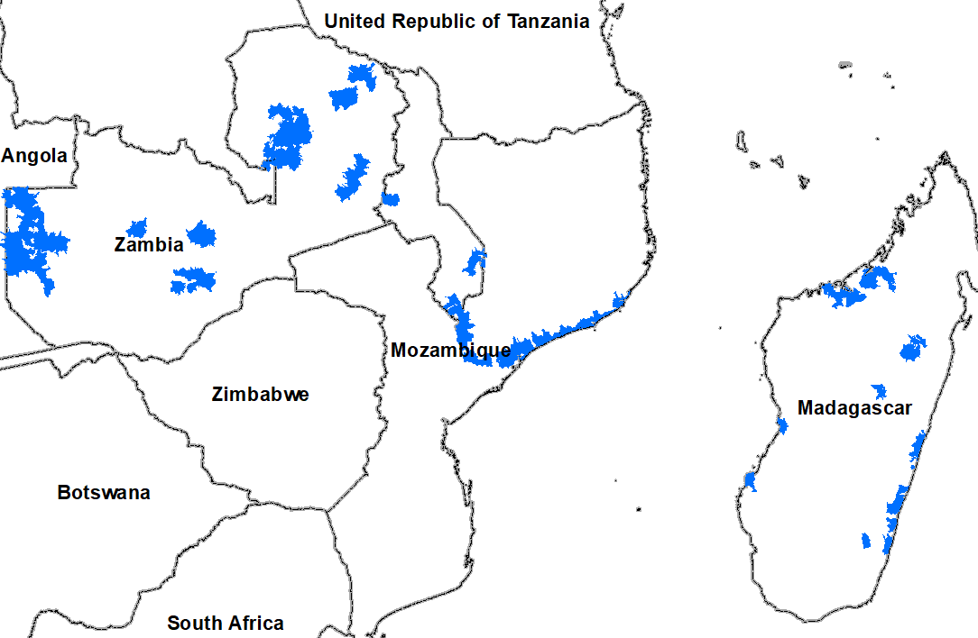
Flooding Polygons

Slide 3
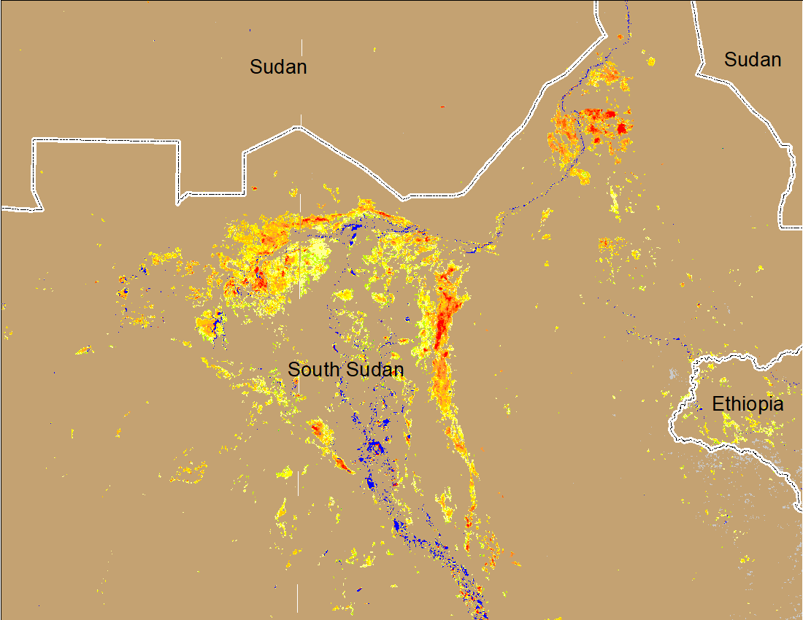
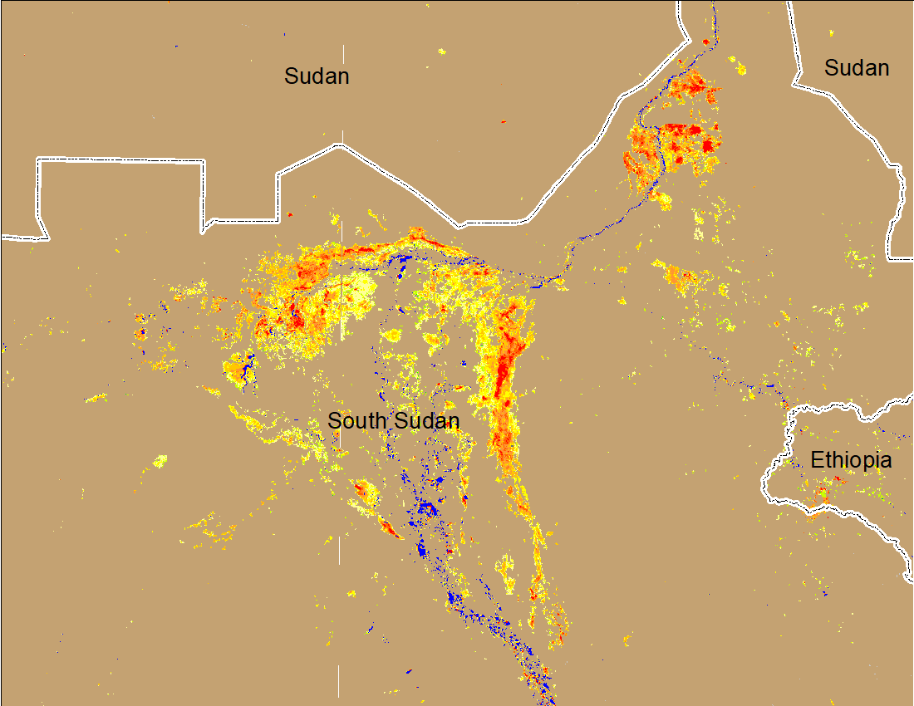
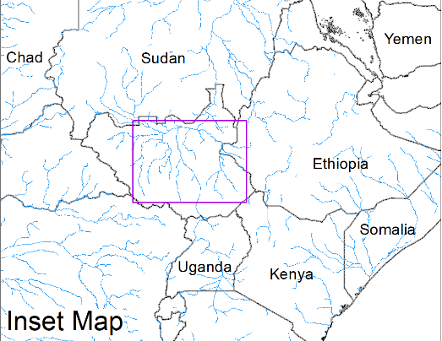
Inundation in the Sudd Wetlands
(% of the pixel)
(% of the pixel)
Northern Sudd Wetlands
Northern Sudd Wetlands
Sobet River
Sobet River
Akobo River
Akobo River
Pibor River
Pibor River
NOAA VIIRS 5-day composite: 23-27 Feb 2022
NOAA VIIRS 5-day composite: 2-6 Mar 2022
Inundation conditions remain very much the same compared to last week.

Slide 4
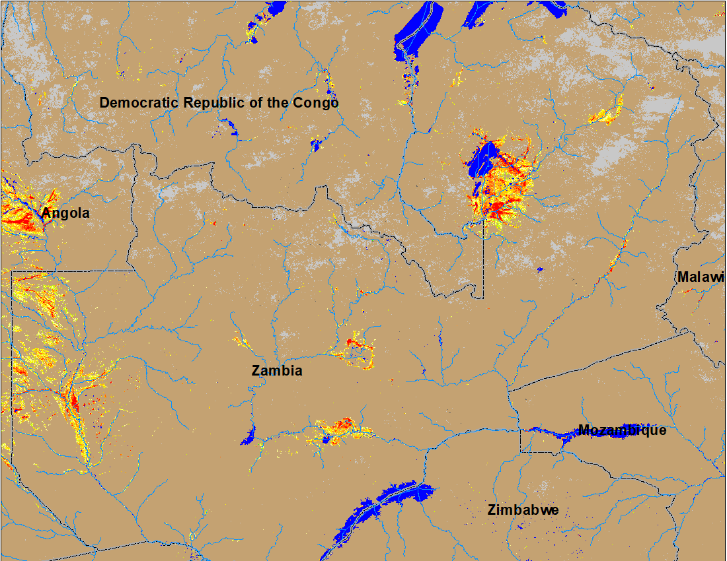
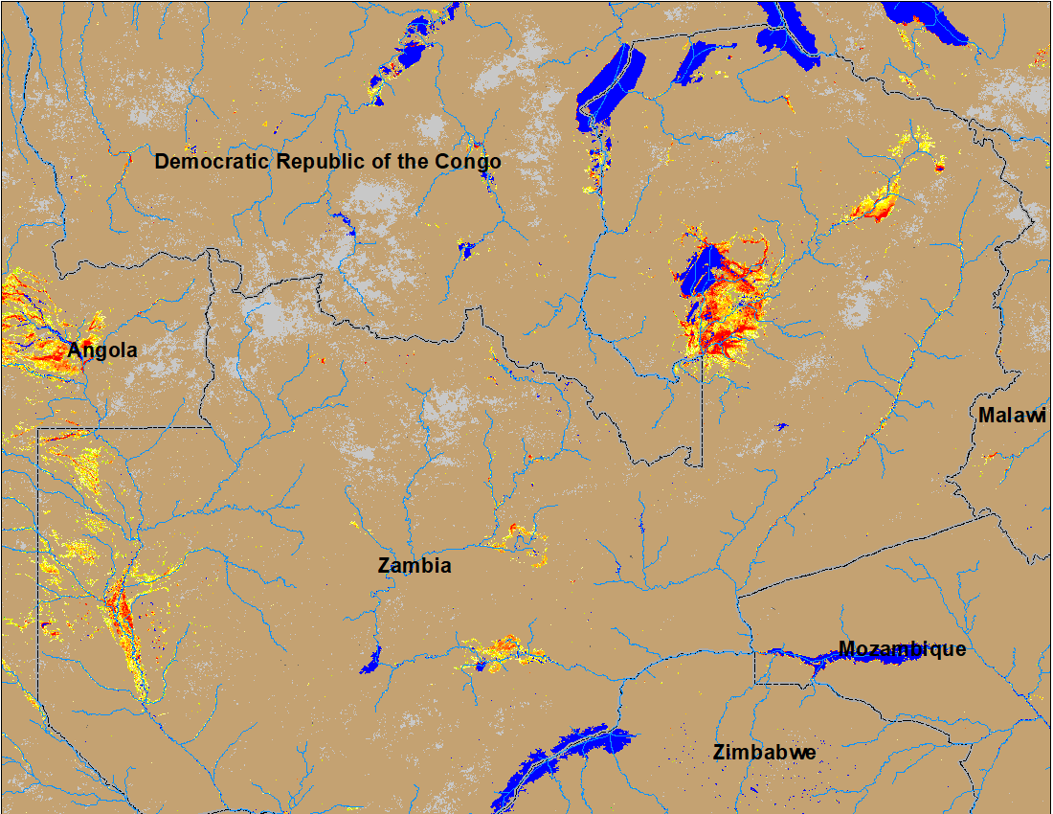
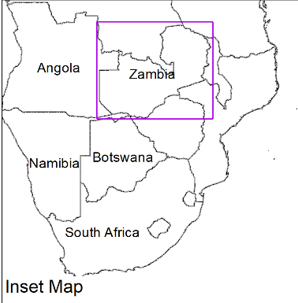
Flooding in Zambia
(% of the pixel)
(% of the pixel)
NOAA VIIRS 5-Day composite: 23-27 Feb 2022
NOAA VIIRS 5-Day composite: 2-6 Mar 2022
Flooding intensifies in the northern Zambia

Slide 5
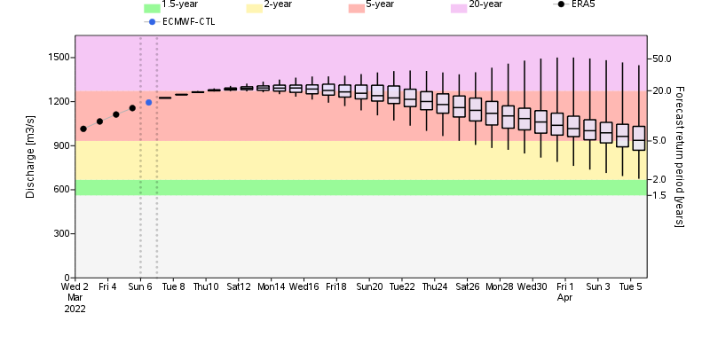
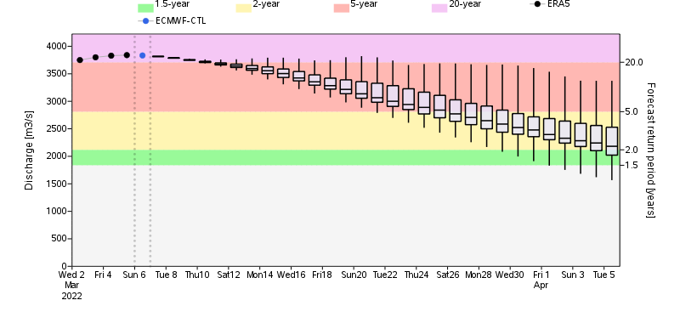
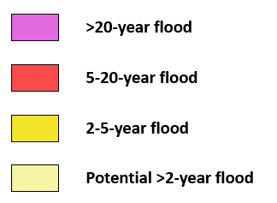
GloFAS Monthly Streamflow Forecast
Chambesh River
Chambesh River in Zambia
Luangwa River
Discharges in many rivers in northern Zambia are expected to be between 2 and 20-yr return period levels by mid-March.
Luangwa River (a tributary of Zambezi) in Zambia

Slide 6
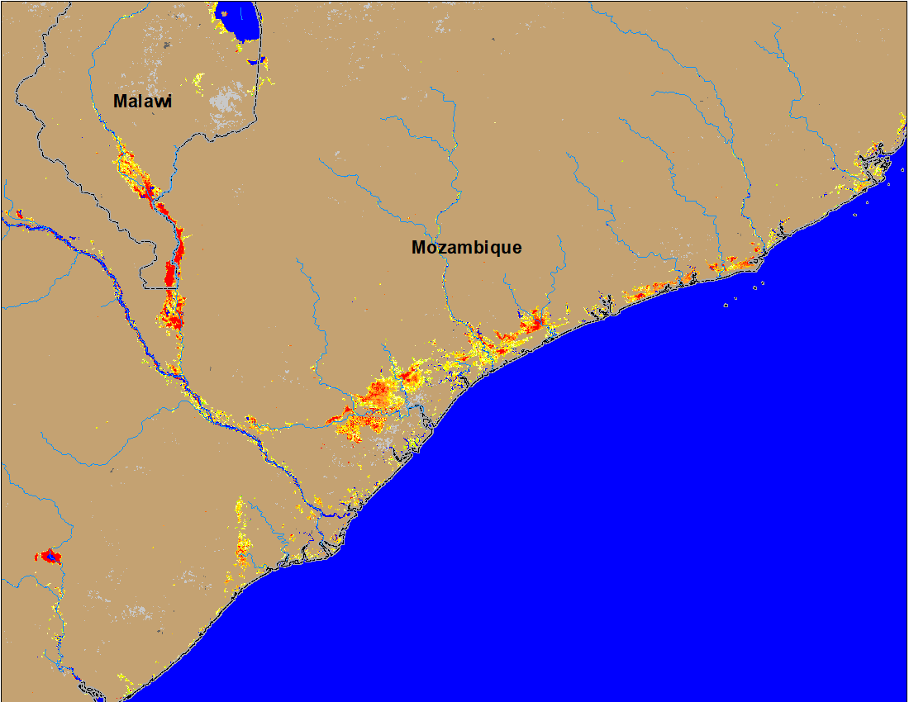
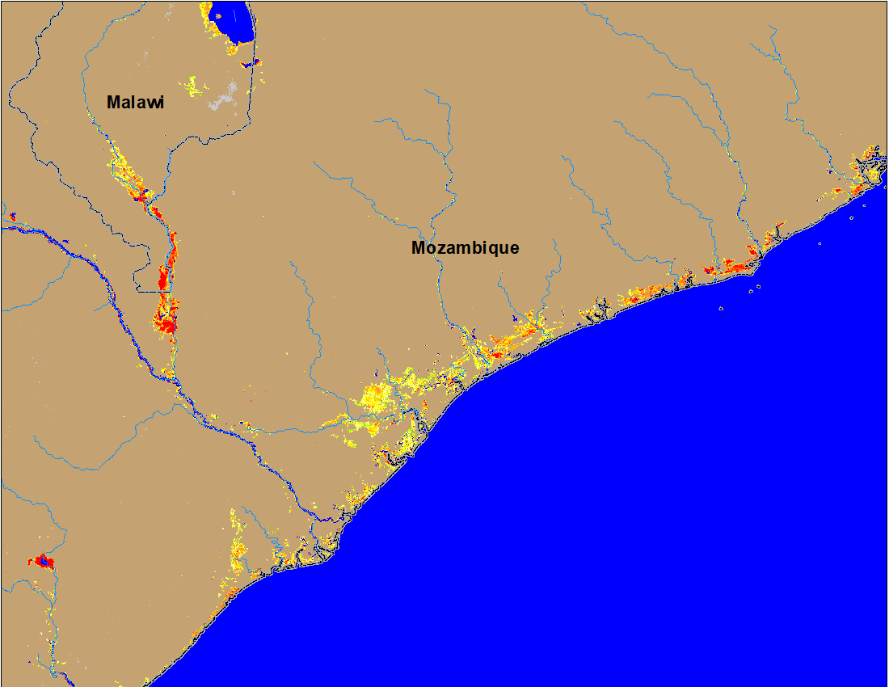
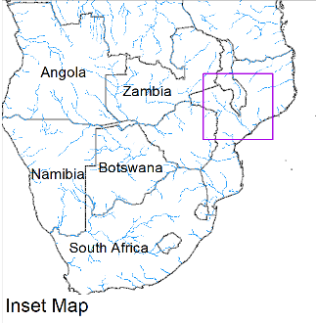
Flooding in Mozambique and Malawi
(% of the pixel)
(% of the pixel)
NOAA VIIRS 5-Day composite: 23-27 Feb 2022
NOAA VIIRS 5-Day composite: 2-6 Mar 2022
Flooding remains unchanged along the Shire River in the Southern Malawi and into Mozambique.
Flooding conditions improved along the coastal areas of Mozambique.

Slide 7
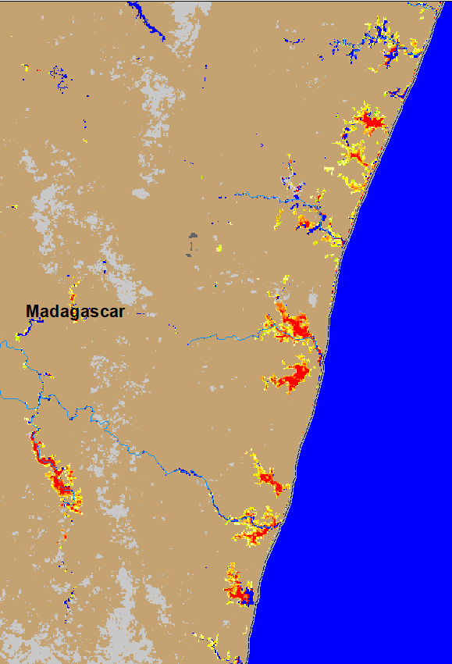
Flooding in Madagascar
(% of the pixel)
(% of the pixel)
NOAA VIIRS 5-day composite: 23-27 Feb 2022
NOAA VIIRS 5-day composite: 2-6 Mar 2022
Flooding conditions improved especially along the southeastern coastal areas of Madagascar.

Slide 8
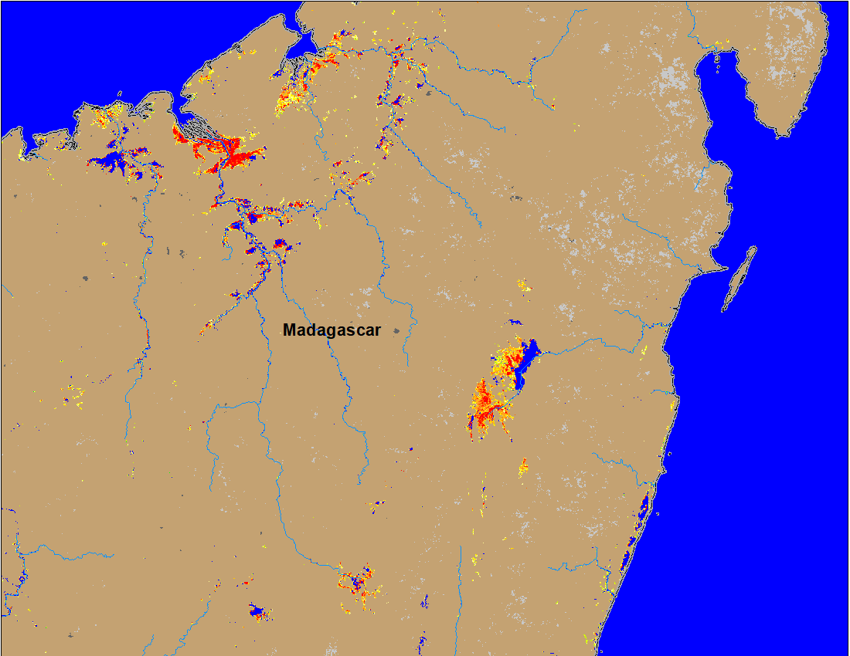
Flooding in Madagascar
Some of the flood receded areas in the northern Madagascar were flooded again during last week.
(% of the pixel)
NOAA VIIRS 5-day composite: 2-6 Mar 2022

Slide 9
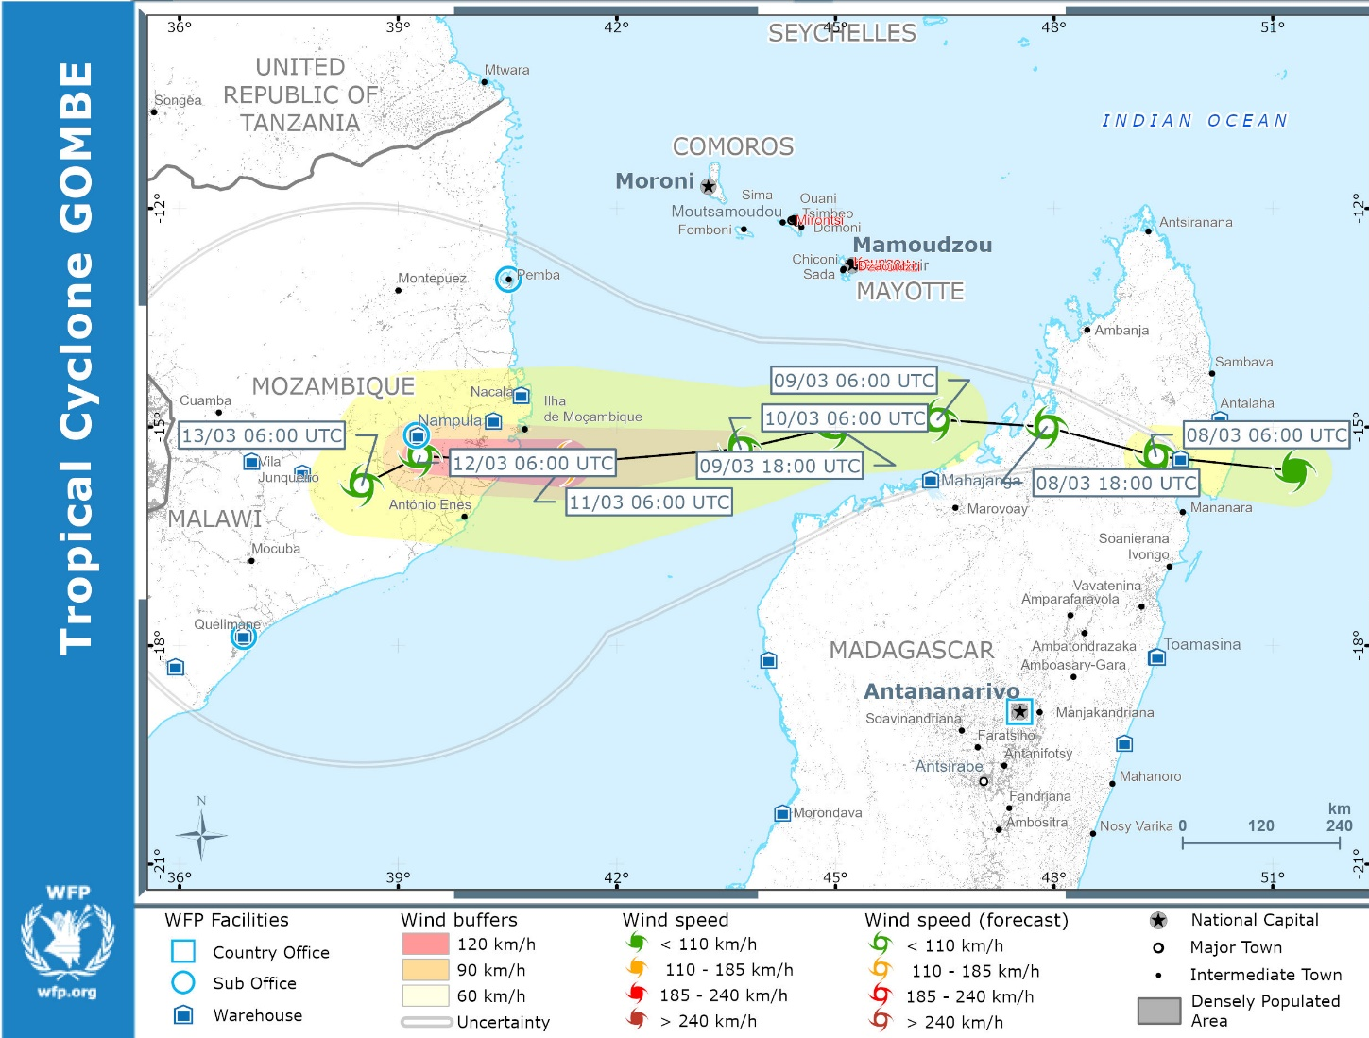
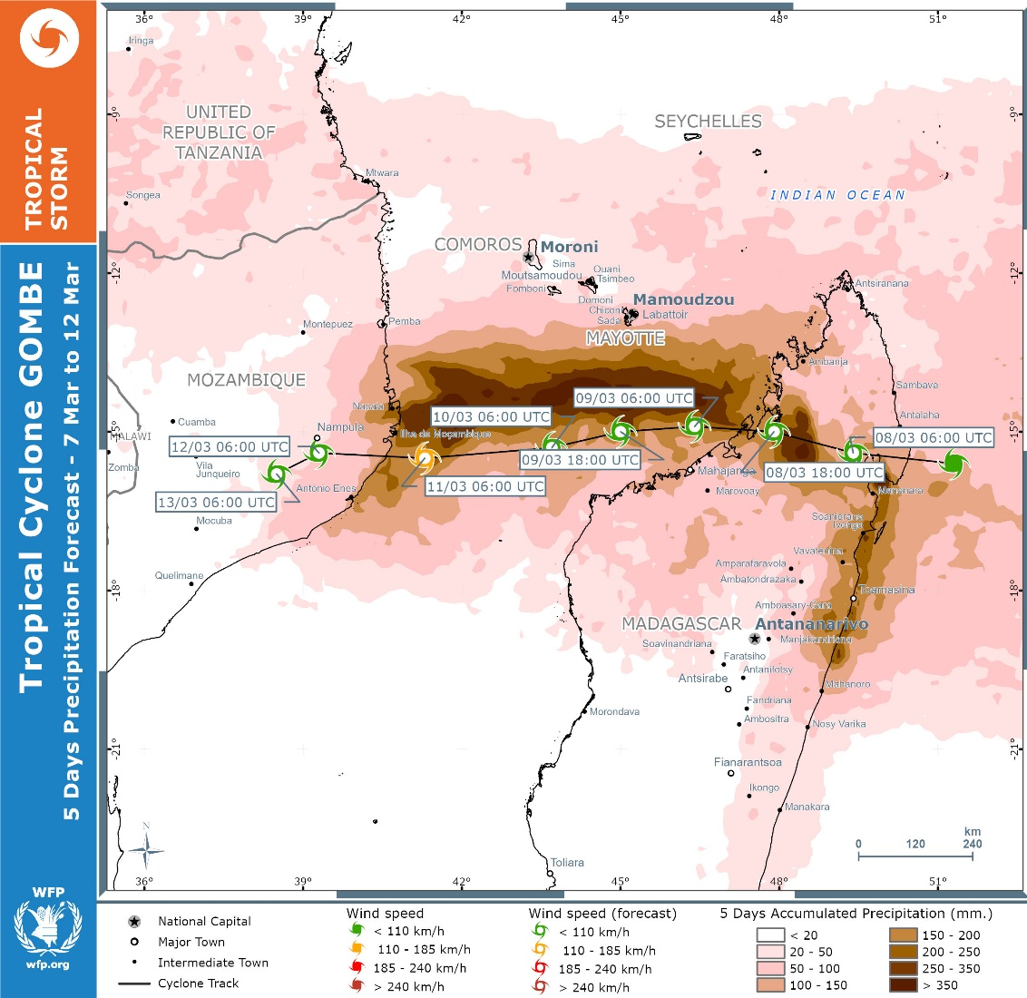
Tropical Cyclone Gombe

