Slide 1
FEWS NET Enhanced Flood Monitoring – East Africa, West Africa, southern Africa and Yemen
June 27, 2022, Hazard Briefing
FEWS NET Science Team:
USGS, NASA, NOAA, UCSB+Regional Scientists

Slide 2
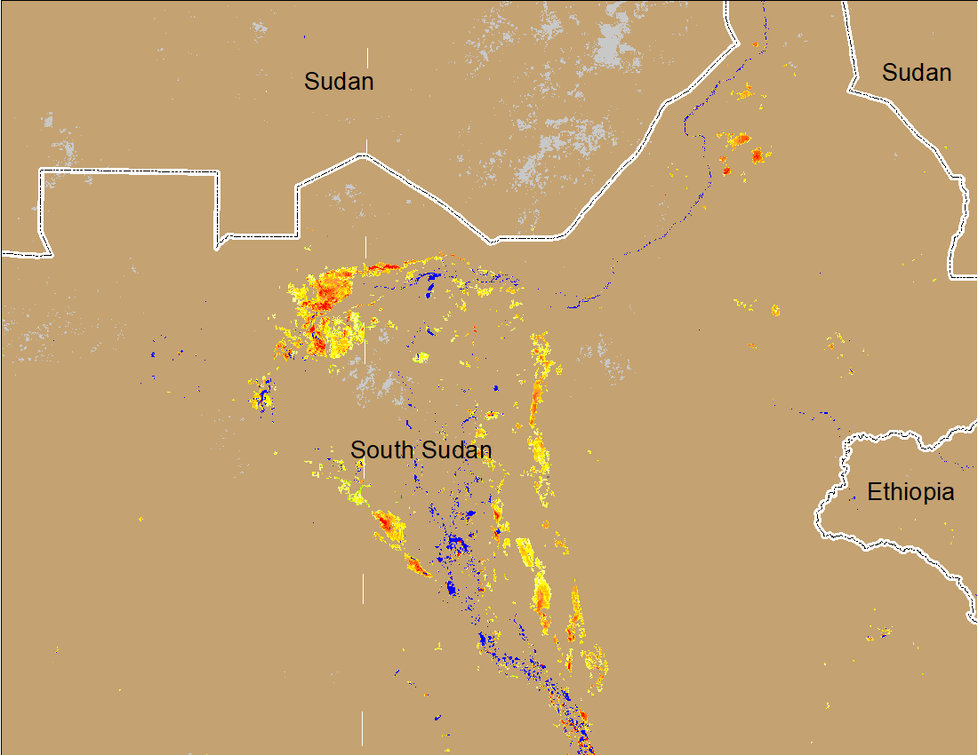
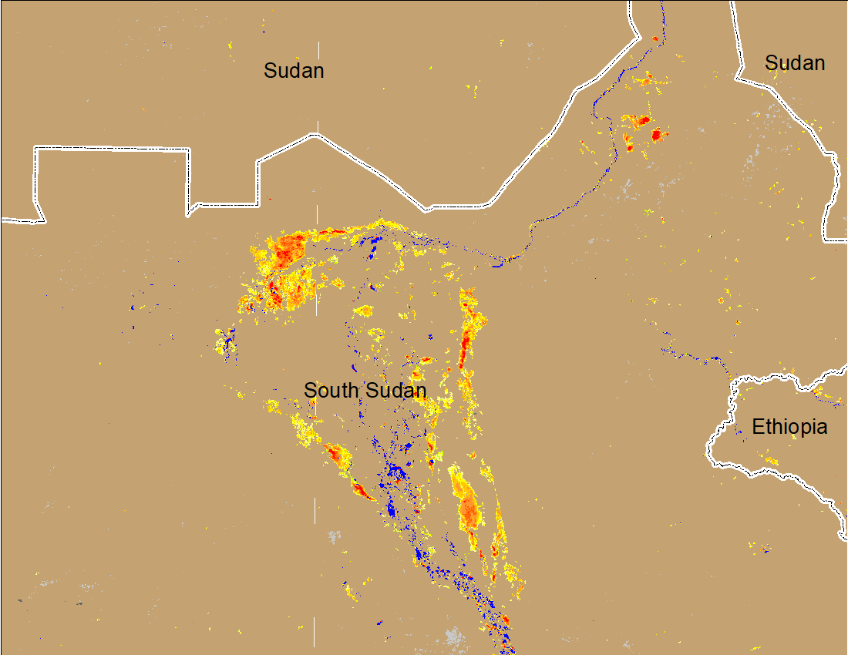
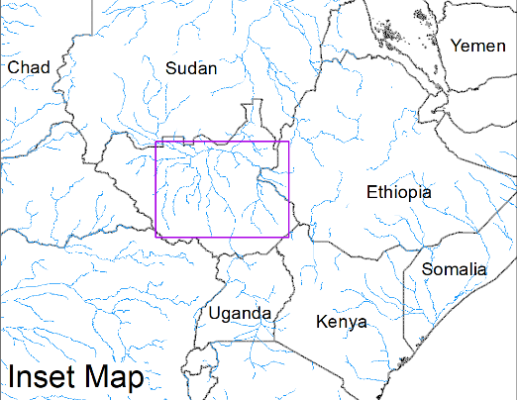
Inundation in the Sudd Wetlands
(% of the pixel)
(% of the pixel)
Northern Sudd Wetlands
Northern Sudd Wetlands
Sobet River
Sobet River
Akobo River
Akobo River
Pibor River
Pibor River
NOAA VIIRS 5-day composite: 18-22 May 2022
NOAA VIIRS 5-day composite: 22-26 June 2022
Despite a poor start to the rainfall season, the inundation started to increase in Sudd Wetlands.

