Slide 1
FEWS NET Enhanced Flood Monitoring – East Africa, West Africa, southern Africa and Yemen
July 23, 2022, Hazard Briefing
FEWS NET Science Team:
USGS, NASA, NOAA, UCSB+Regional Scientists

Slide 2
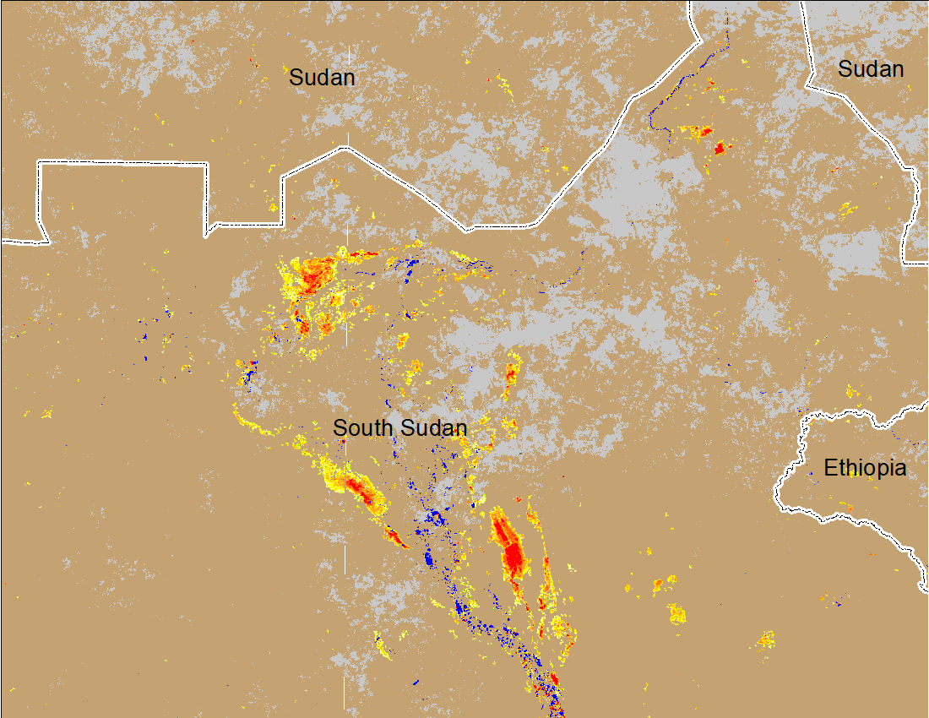
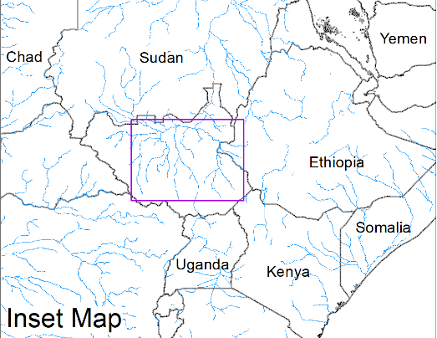
Inundation in the Sudd Wetlands
(% of the pixel)
(% of the pixel)
Northern Sudd Wetlands
Northern Sudd Wetlands
Sobet River
Sobet River
Akobo River
Akobo River
Pibor River
Pibor River
NOAA VIIRS 5-day composite: 12-16 July 2022
NOAA VIIRS: 23 July 2022
First noticeable increase in Inundation in this season in Sudd Wetlands

Slide 3
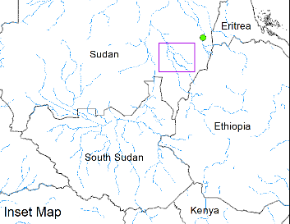
Inundation in the Blue Nile in Sudan
(% of the pixel)
ADAM Flood Event: 20 July 2022
NOAA VIIRS: 23 July 2022
More areas got inundated along the Blue Nine in Sudan during the last one week.

Slide 4
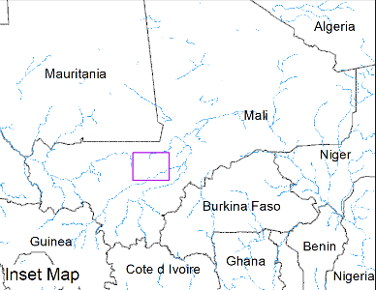
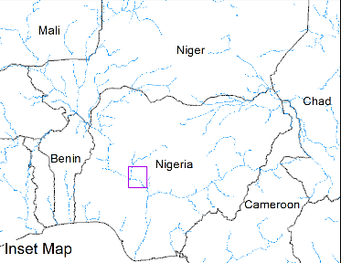
Flooding Along Niger River
(% of the pixel)
(% of the pixel)
In Mali
In Nigeria
NOAA VIIRS: 23 July 2022
NOAA VIIRS: 23 July 2022
Inundation in Mali and Nigeria along Niger River occurred during the last one week.

Slide 5
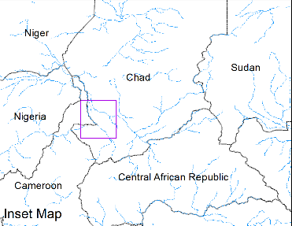
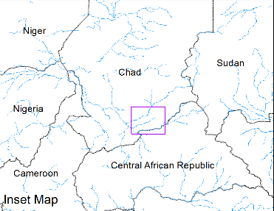
Flooding in Chad
(% of the pixel)
(% of the pixel)
NOAA VIIRS: 23 July 2022
NOAA VIIRS: 23 July 2022
First noticeable flooding in the season in Chad.

