Slide 1
FEWS NET Enhanced Flood Monitoring – East Africa, West Africa, southern Africa and Yemen
July 19, 2022, Hazard Briefing
FEWS NET Science Team:
USGS, NASA, NOAA, UCSB+Regional Scientists

Slide 2
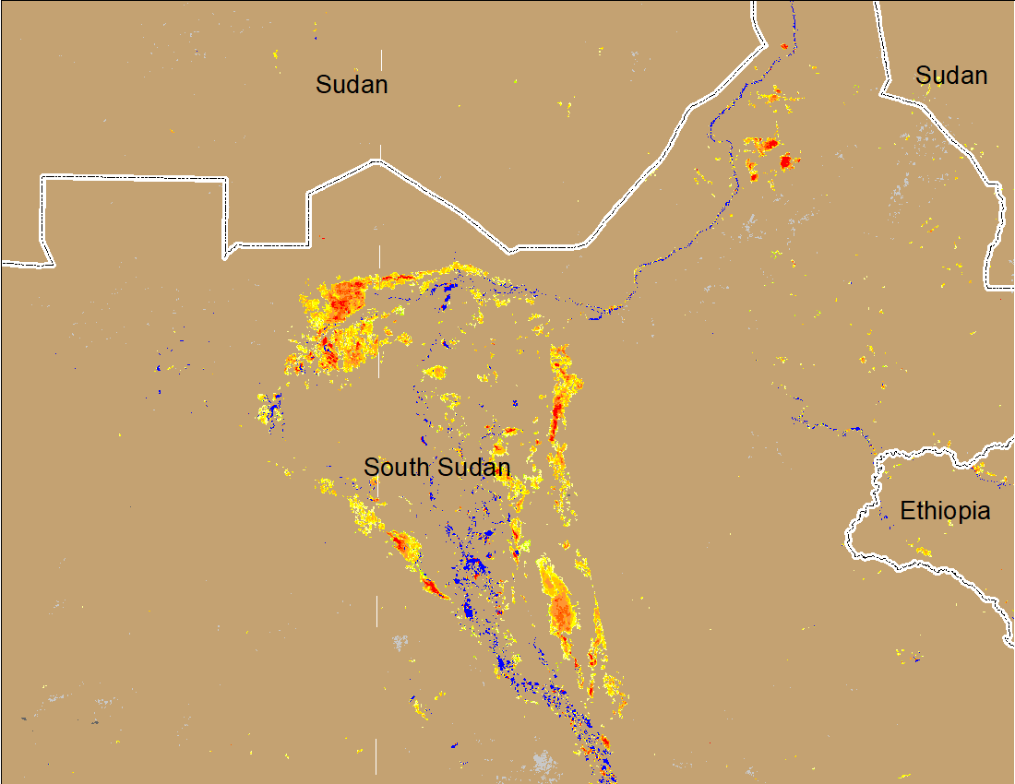
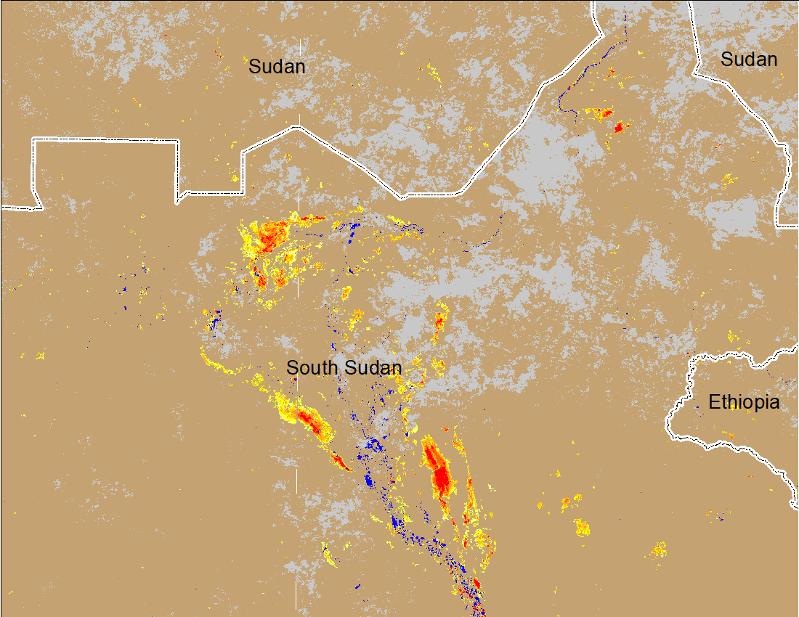
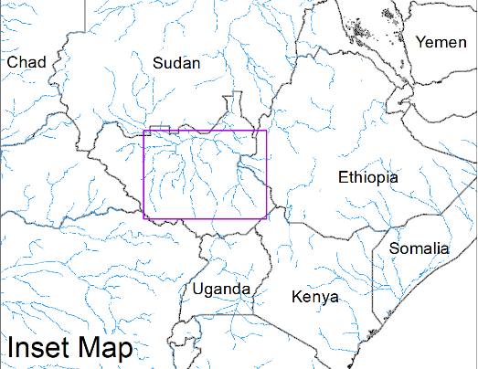

Inundation in the Sudd Wetlands
(% of the pixel)
(% of the pixel)
Northern Sudd Wetlands
Northern Sudd Wetlands
Sobet River
Sobet River
Akobo River
Akobo River
Pibor River
Pibor River
NOAA VIIRS 5-day composite: 22-26 June 2022
NOAA VIIRS 5-day composite: 12-16 July 2022
The last 30-day deficit rainfall helped in reducing inundation especially in northern Sudd Wetlands.

Slide 3
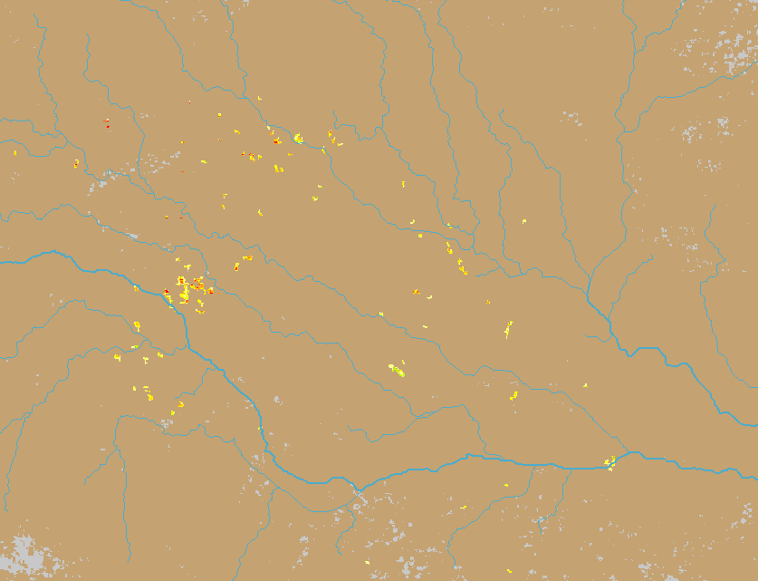
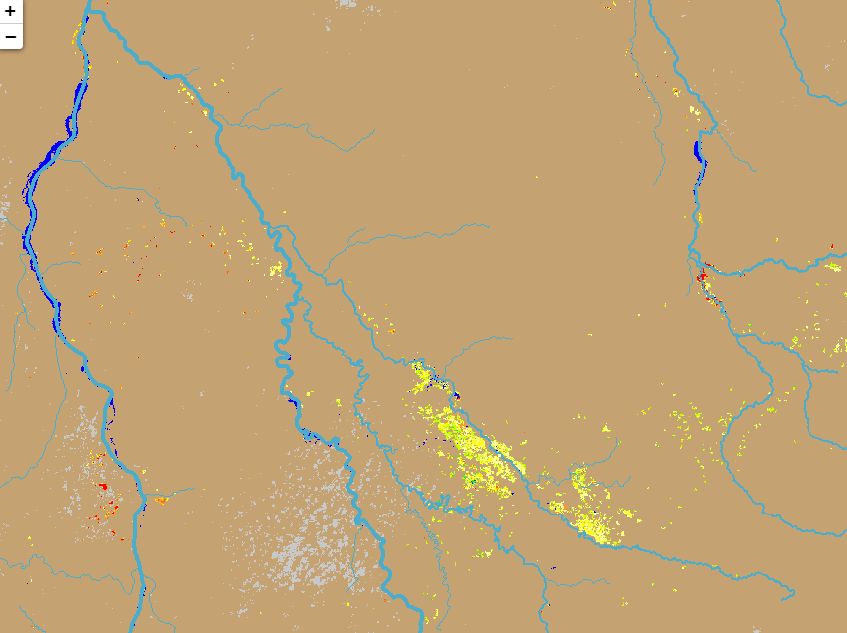
Flooding in Sudan
Darfur Region
(% of the pixel)
Tributaries of Blue Nile
(% of the pixel)
NOAA VIIRS: 18 July 2022
NOAA VIIRS: 18 July 2022
Newly inundated areas in the upper reaches of White Nile in the Darfur region, and along the tributaries of Blue Nile in Sudan.

