Slide 1
FEWS NET Enhanced Flood Monitoring – East Africa, West Africa, southern Africa and Yemen
January 31, 2022, Hazard Briefing
FEWS NET Science Team:
USGS, NASA, NOAA, UCSB+Regional Scientists

Slide 2
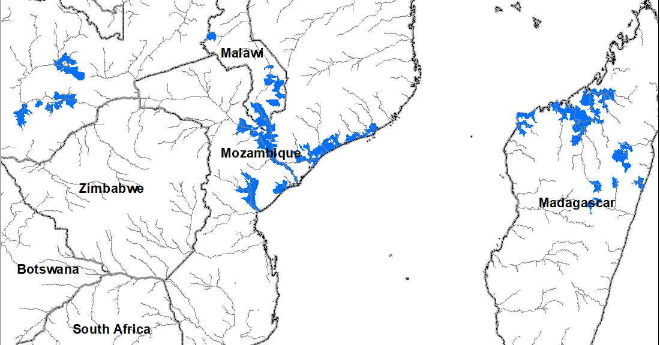
Flooding Polygons

Slide 3
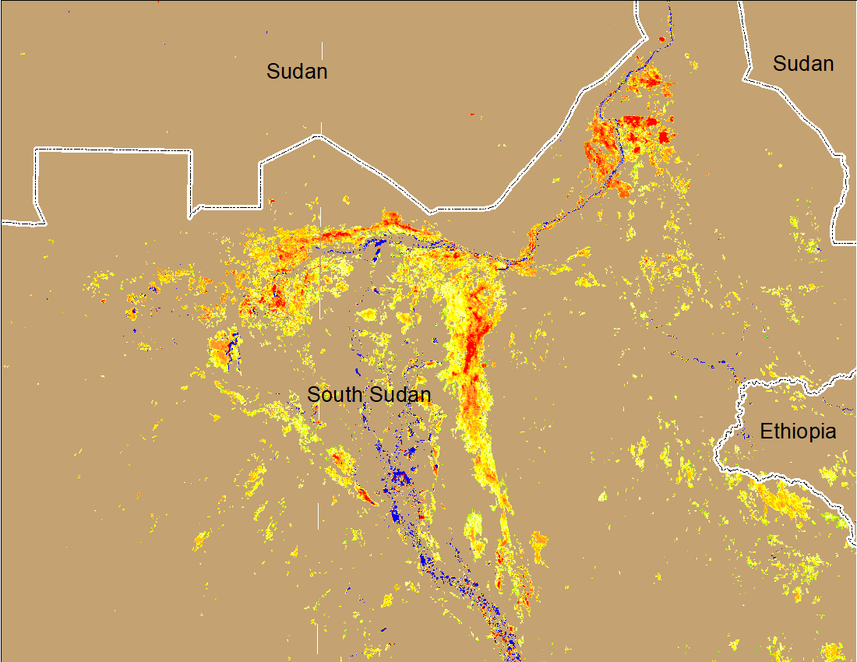
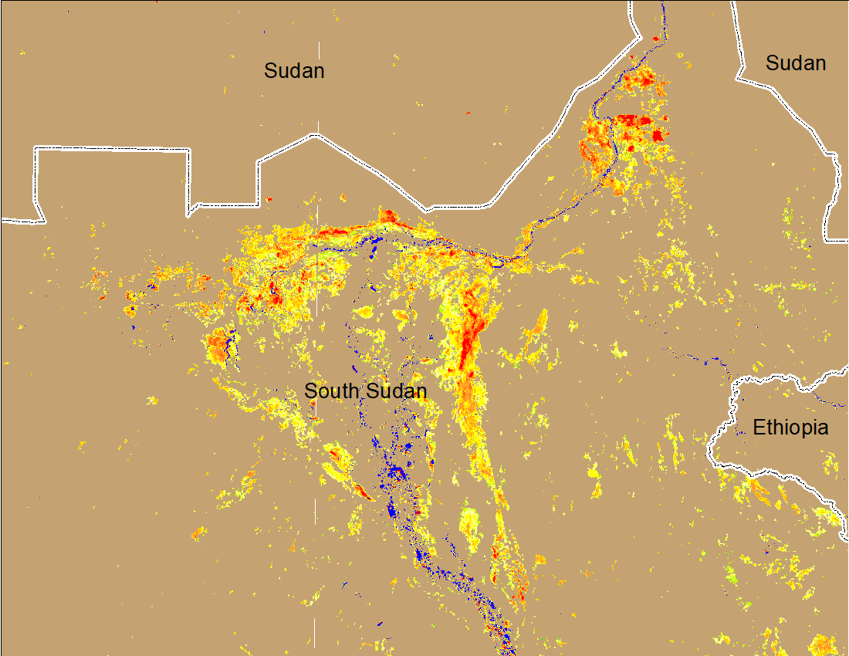
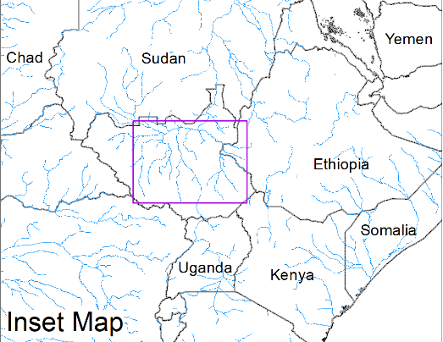
Inundation in the Sudd Wetlands
(% of the pixel)
(% of the pixel)
Northern Sudd Wetlands
Northern Sudd Wetlands
Sobet River
Sobet River
Akobo River
Akobo River
Pibor River
Pibor River
NOAA VIIRS 5-day composite: 19-23 Jan 2022
NOAA VIIRS 5-day composite: 26-30 Jan 2022
Inundation conditions remain unchanged

Slide 4
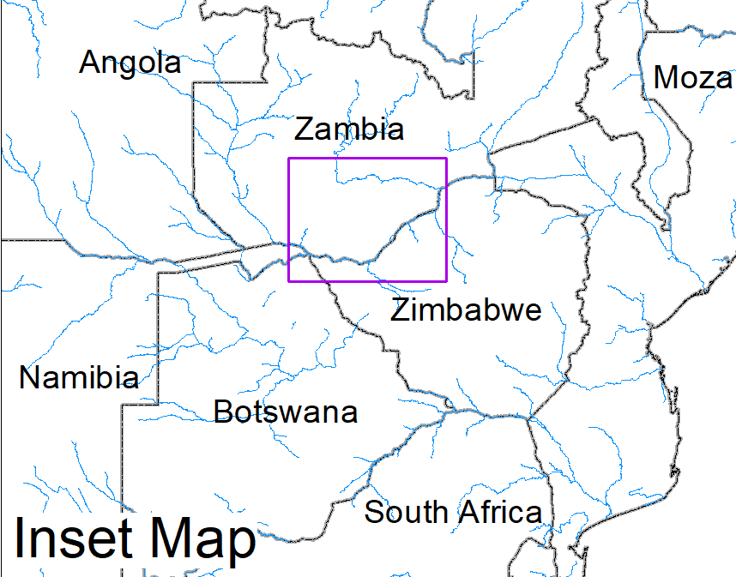
Flooding in Zambia
(% of the pixel)
(% of the pixel)
NOAA VIIRS 5-Day composite: 19-23 Jan 2022
NOAA VIIRS 5-Day composite: 26-30 Jan 2022
Flooding remains mostly unchanged

Slide 5
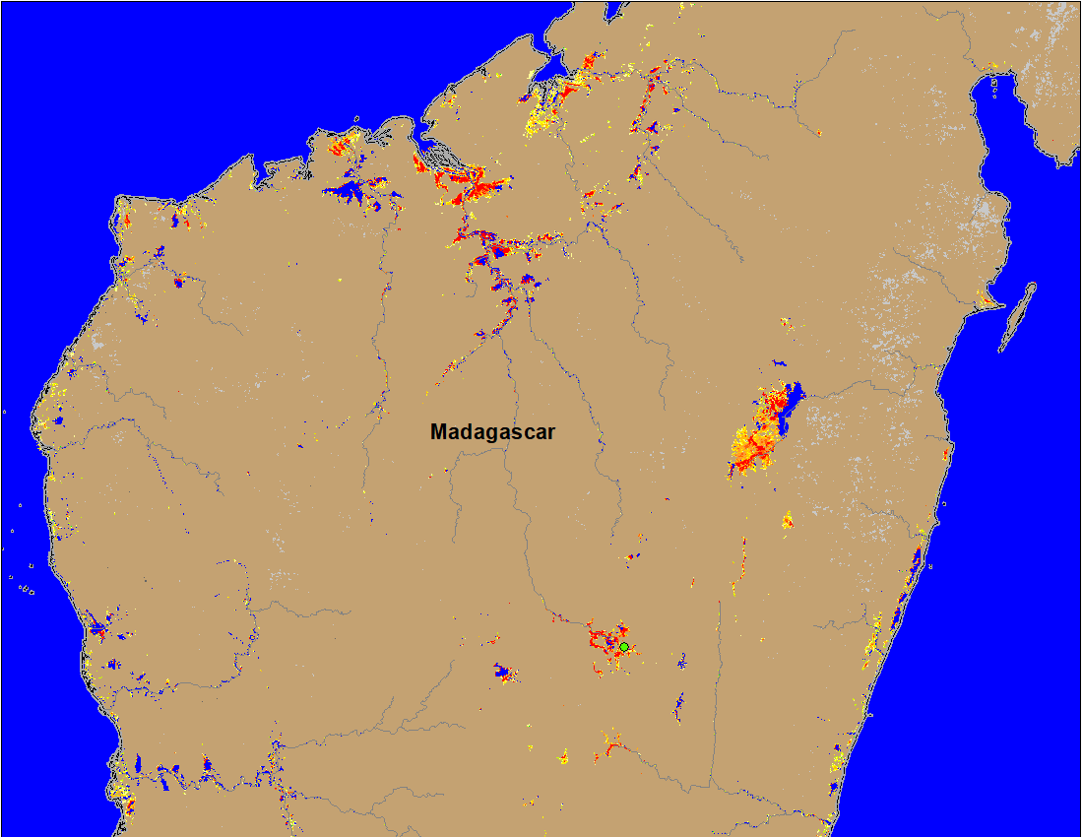
Flooding in Madagascar
(% of the pixel)
NOAA VIIRS 5-Day composite: 26-30 Jan 2022

Slide 6
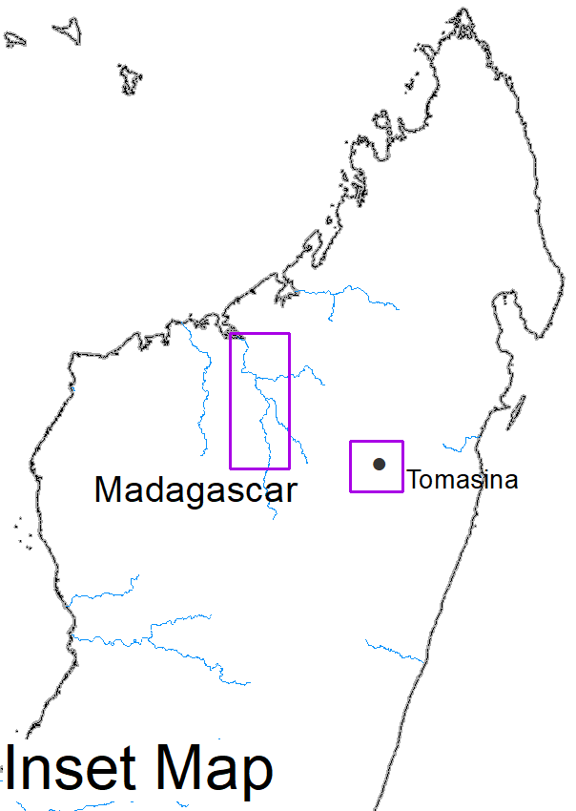
Flooding in Madagascar (Jan 25-29, 2022)
Flooded areas
Flooded areas
Source: International Charter (RADARSAT)
(RADARSAT)

Slide 7
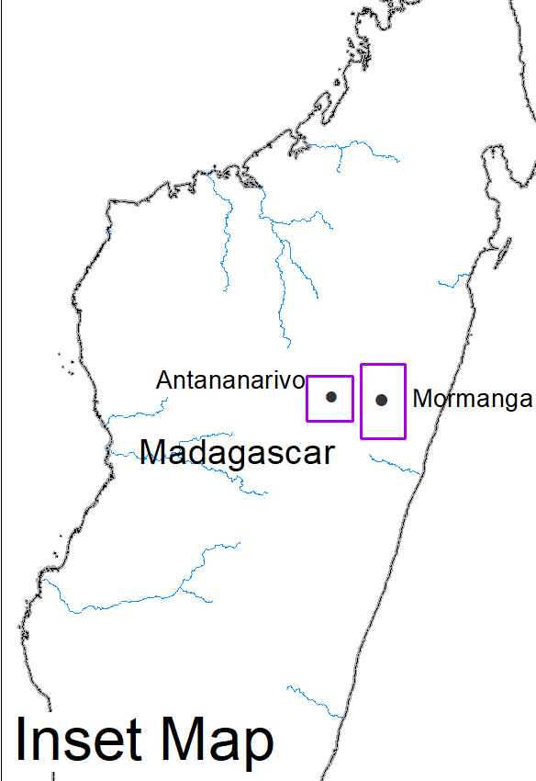
Flooding in Madagascar (Jan 25-29, 2022)
Flooded areas
Flooded areas
Source: International Charter (SAOCOM)
(Pleiades-1A/B CNES)

Slide 8
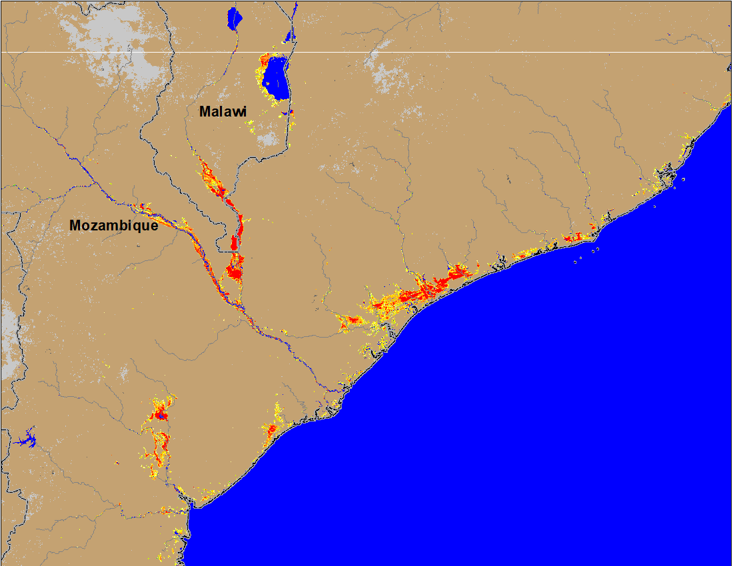
Flooding in Mozambique
(% of the pixel)
FloodScan (AMSR-E): 28 Jan 2022 (90m res. downscaled from 22km res.)
NOAA VIIRS 5-Day composite: 26-30 Jan 2022 (375m res.)

Slide 9
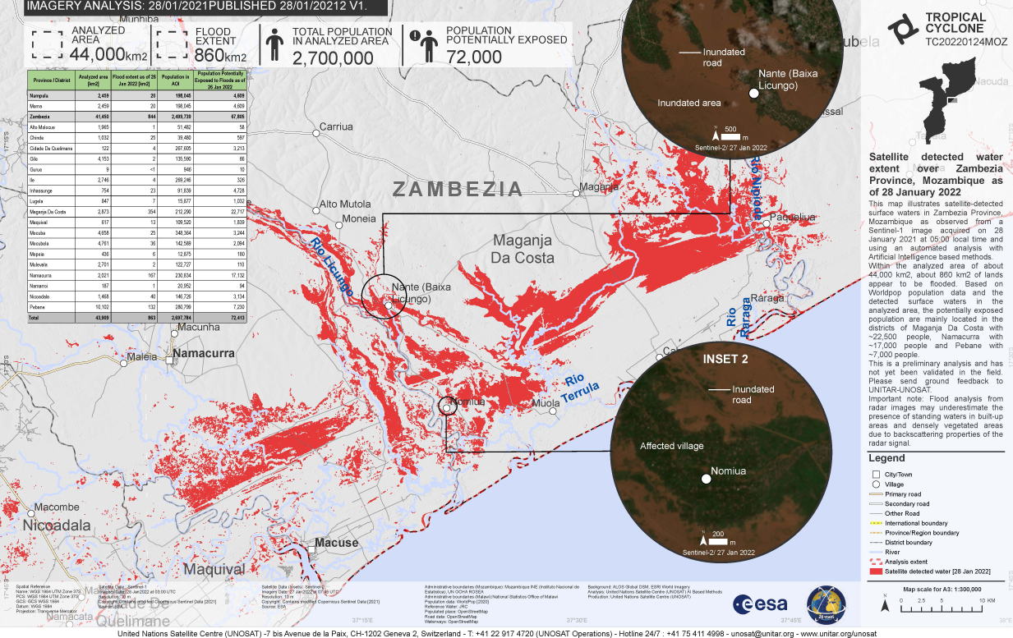
Flooding in Mozambique
(% of the pixel)
NOAA VIIRS 5-Day composite: 26-30 Jan 2022 (375m res.)
Source: International Charter (Sentinel-1), Jan 28, 2022

Slide 10
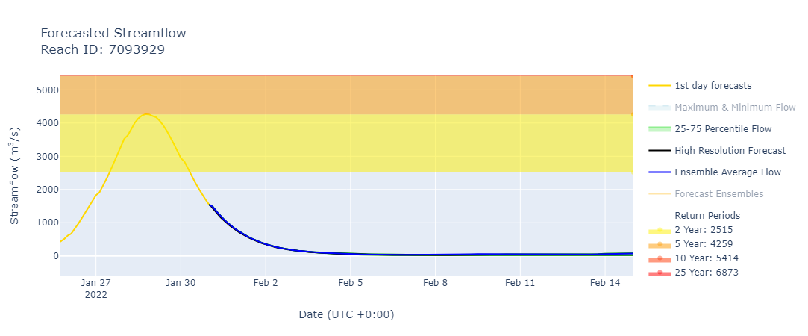
Streamflow Forecast in Mozambique
GEOGloWS streamflow forecast for the next 15 days
Streamflow in Mozambique is expected to rise in the aftermath of Tropical Cyclone Ana

Slide 11
Flooding in Malawi
(% of the pixel)
Flooded areas
NOAA VIIRS 5-Day composite: 26-30 Jan 2022 (375m res.)
International Charter: TERRASAR-X, Jan 31, 2022

