Slide 1
FEWS NET Enhanced Flood Monitoring – East Africa, West Africa, southern Africa and Yemen
January 3, 2022, Hazard Briefing
FEWS NET Science Team:
USGS, NASA, NOAA, UCSB+Regional Scientists

Slide 2
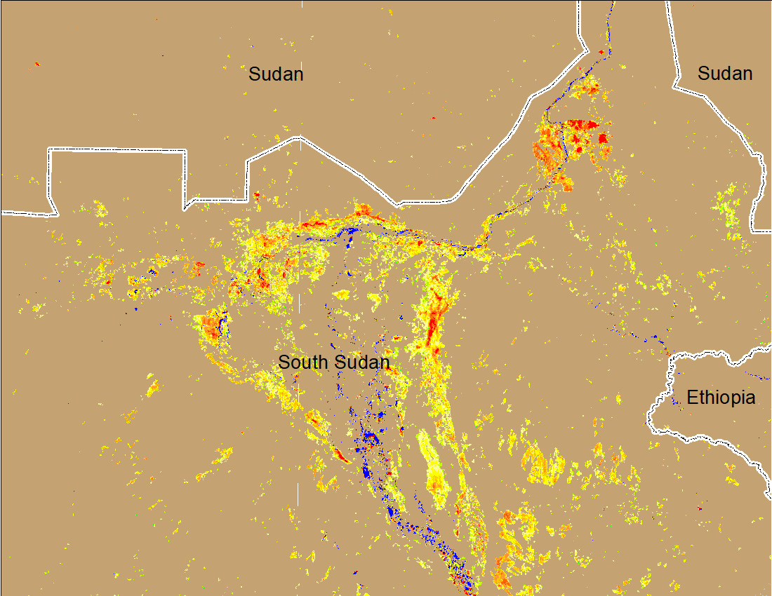
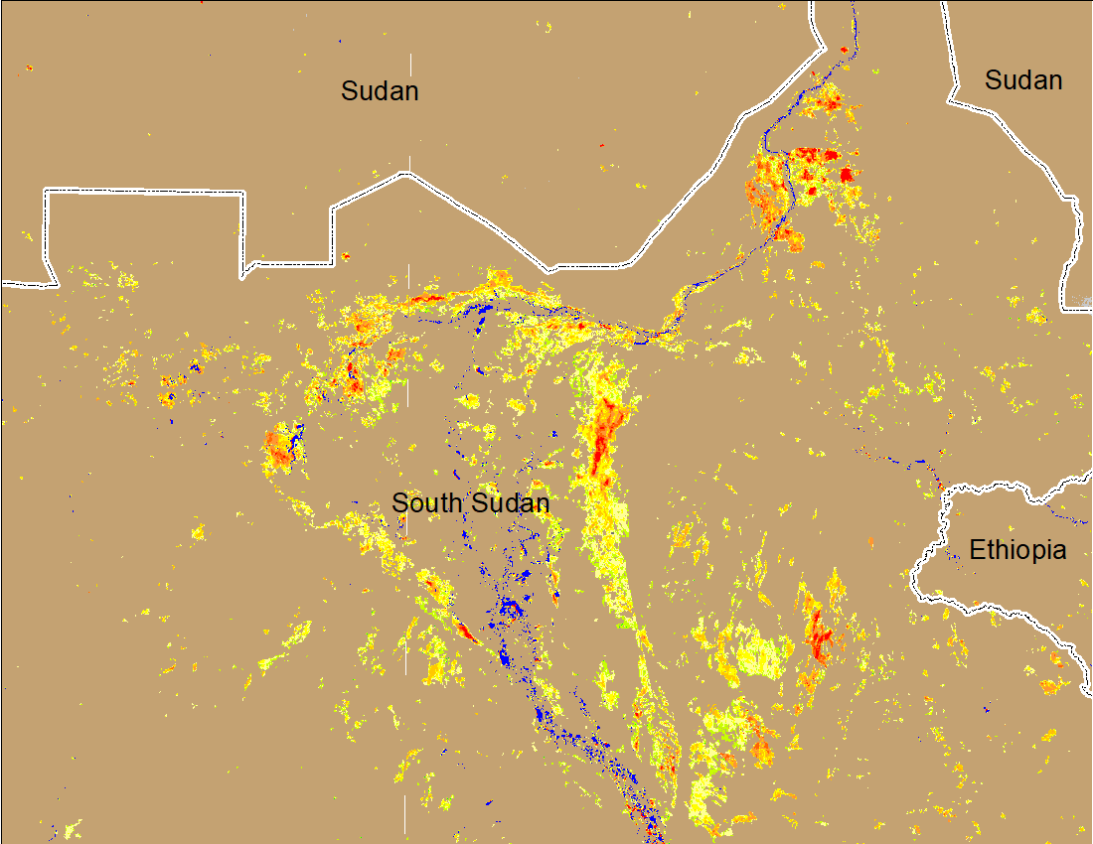
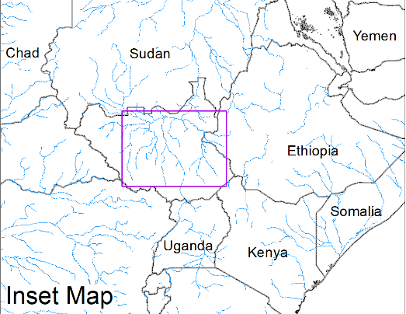
Worsening Conditions Continue in the Sudd Wetlands
(% of the pixel)
(% of the pixel)
Northern Sudd Wetlands
Northern Sudd Wetlands
Sobet River
Sobet River
Akobo River
Akobo River
Pibor River
Pibor River
NOAA VIIRS 5-day composite: 22-26 Dec 2021
NOAA VIIRS 5-day composite: 29 Dec 2021 -2 Jan 2022
Increase in inundated areas, especially in the Pibor River catchment.

Slide 3
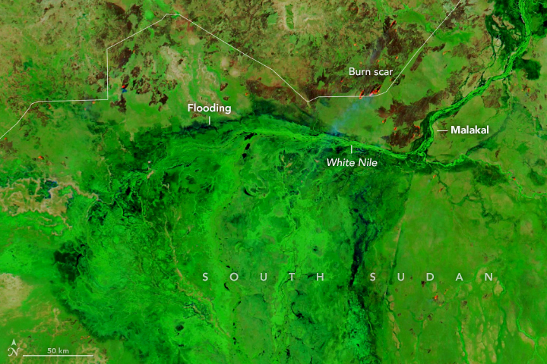
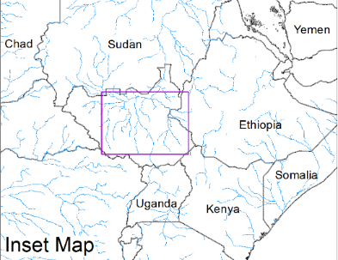
Worsening Conditions Continue in the Sudd Wetlands
(% of the pixel)
(% of the pixel)
Northern Sudd Wetlands
Northern Sudd Wetlands
Sobet River
Sobet River
Akobo River
Akobo River
Pibor River
Pibor River
MODIS false color (NIR-R, red-G, green-B) composite: 4 Dec 2021
NOAA VIIRS 5-day composite: 29 Dec 2021 -2 Jan 2022
After almost one month, inundation over the same areas still exist.

